Slide 1
Python 강의자료04
공학정보처리 ENG1108
김 은 진

Slide 2
Functions
Control flow with functions
Function definition
Function parameters
Local variables and global variables
Lambda form
DocStrings
Modules
Packages

Slide 3
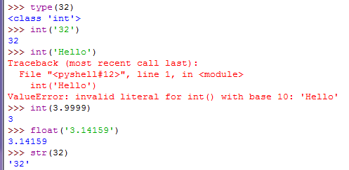
Functions
Reusable pieces of programs
give a name to a block of statements
Calling a function
Run that block using the name anywhere in the program, any number of times
function name
argument
Function result(return value)
type(), int(), float(), str() are built-in functions

Slide 4
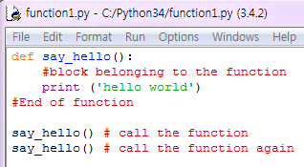


Functions – flow of control
function definition
function is not executed until the function is called
①-1
②-1
①-2
②-2
①
②

Slide 5
Function definition
input to the function
separated by comma
Parameters
The names given in the function definition
Arguments
The values supplied in the function call
function name
def identifier(parameters … ) : statement1
statement2
statement3
……
Block:
Statements must be indented

Slide 6
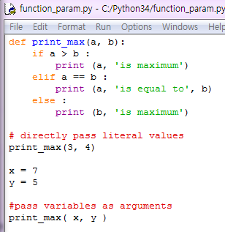

Function parameters
a
b
3
7
4
5
Value of x assigned to a
Value of y assigned to b
x
y
7
5

Slide 7
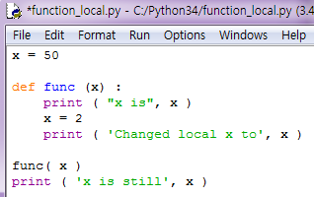

Local variables
Variables declared inside a function definition
local to the function
Scope
All variables have the scope of the block they are declared
local to func
50
x
x in func
50
50
2

Slide 8
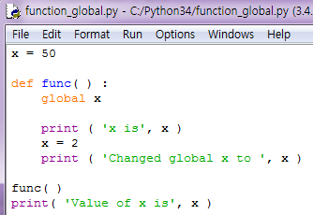

global statement
assign a value to a variable defined outside a function
make it clear that the variable is defined in an outermost block

Slide 9
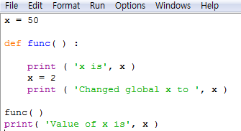
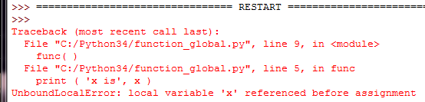
global statement
without global statement

Slide 10
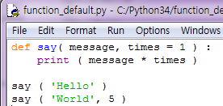

Default argument values
Make some parameters optional
Use default values ( = )
Only parameters at the end of parameter list
invalid example: def func ( a = 1, b)

Slide 11
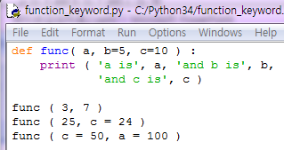

Keyword arguments
give values of only some parameters by naming them
Use name instead of the position
Not worry about the order of the arguments

Slide 12
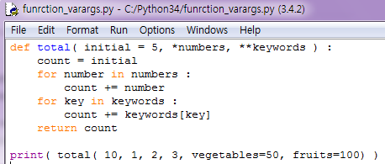

VarArgs arguments
A tuple parameter
takes (1, 2, 3)
variable number of arguments
any number of parameters
use *
** keywords give all keyword arguments except for those corresponding to a formal parameter as a dictionary
Notes:
다음 장에서 tuple, dictionary 배운 후에 설명 이해할 수 있음

Slide 13
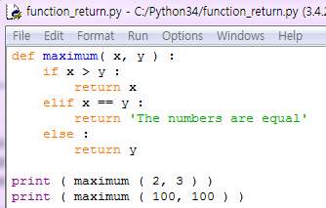

return statement
break out of the function with a value

Slide 14


return statement
return is equal to return None
None represents nothing.
a = None means a has no value
Function without return statements
return None at the end of function

Slide 15
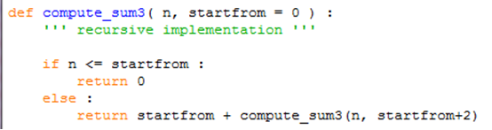
Recursive function
A function refers(calls) itself.
compute_sum3( 7, 0 )
12
return 0 + compute_sume( 7, 2 )
12
return 2 + compute_sume( 7, 4 )
10
return 4 + compute_sume( 7, 6 )
6
return 6 + compute_sume( 7, 8 )
0
if 7 <= 8 : return 0

Slide 16
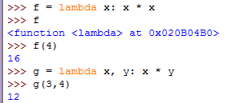

Lambda Forms
To create new function objects
Takes a parameter followed by a single expression (the body of function)
The value of this expression is returned
key parameter of function sort() determines how the list is sorted.
We use a lambda expression to create a new function.

Slide 17
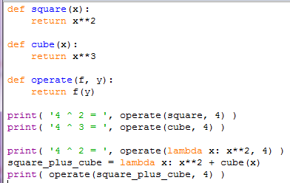

Functions as parameters

Slide 18
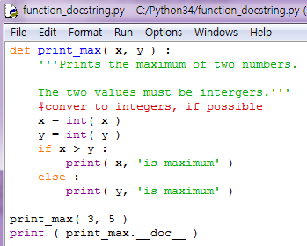
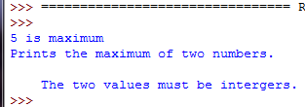
DocStrings
Documentation String
helps to document the program better
makes it easier to understand
String on the first logical line (function, module, class)
First line starts with a capital letter,
ends with a dot.
Second line is blank
From third line,
detailed explanation
Access the docstring using __doc__ attribute

Slide 19
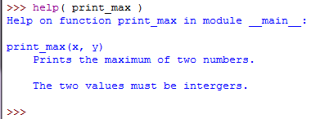
DocStrings
help() fetch the __doc__ attribute of the function and displays it

Slide 20
Modules
To reuse a number of functions in other programs
Methods of writing modules
Write file with.py that contains functions and variables
Write and compile the modules in the language in which the Python interpreter itself written.
Import the module like using Python standard library

Slide 21

How to use standard library modules
Access to the library functions, variables and constants by importing modules
import library_name
Find & use math module:
one of the standard library modules
related to floating point math

Slide 22
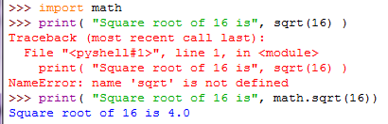

The from … import statement
To directly import the sqrt function into your program
from math import sqrt
import math statement avoids name clashes and be more readable

Slide 23
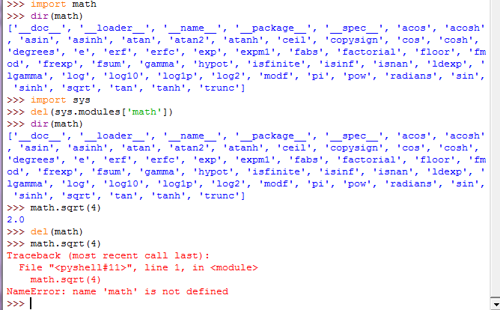
Delete a module
Delete the references to the module ‘math’

Slide 24
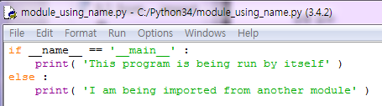

A module’s name
Use the name attribute( __name__ ) of the module to figure out whether the module is being run standalone or being imported.
The module is being run standalone by the user

Slide 25
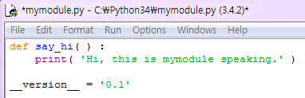

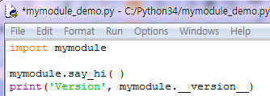
Making your own modules
Every Python program( .py) is also a module.
. (dotted notation)
to access members of the module

Slide 26
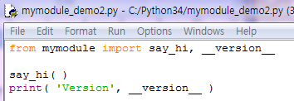

Making your own modules
To prefer the import statement even though it might make your program a little longer
Explicit is better than implicit
from mymodule import *
Import all public names(say_hi), but not import names stated with __ (__version__)

Slide 27
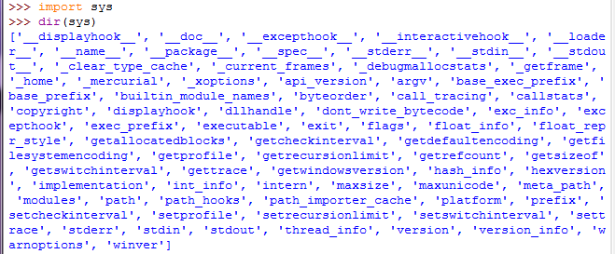
dir function
built-in dir function list the identifiers that an object defines.
Functions, classes, variables defined in that module

Slide 28
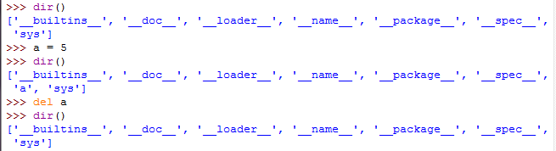
dir function
dir( ) returns the list of the names defined in the current module.

Slide 29
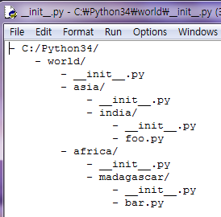
Packages
variables in function,
functions and global variables in module
modules in package
Package
Folder of modules with a special __init__.py file that indicates to Python that this folder contains Python modules
just a convenience to hierarchically organize modules

Slide 30
Page 12의 keyword arguments 설명은 dictionary 배운 후에 다시 할 것
Page 16의 예제 중 dictionary 포함 된 것 나중에 다시 설명

