Slide 1
Python 강의자료05
공학정보처리 ENG1108
김 은 진

Slide 2
Using files
Input
Output formatting
pickle

Slide 3
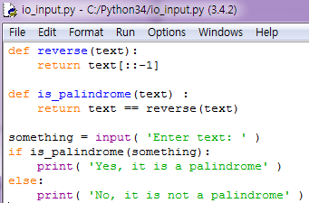
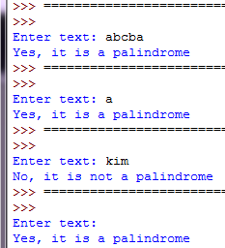
Input from user
Programs take input from the user and print some result back.
Reversing a string
1. takes a string as argument and displays it to the user.
2. waits for the user to type something and press the return key.
3. the user entere and presse the return key
4. then return that text the user has entered as string

Slide 4
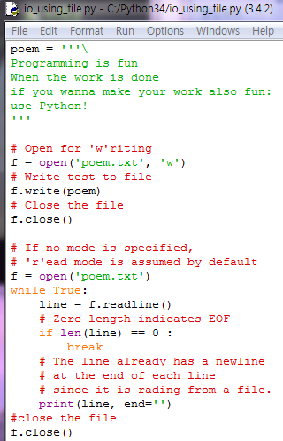

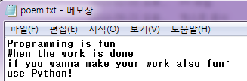
Files
Using files in Python program
Create an object of the file class
Using open method
Use read , readline or write methods
Use close method
2
1
3
4
2
Read one line
1
3
Zero length indicates EOF
4

Slide 5
open method
open(‘filename’, ‘mode’)
mode | explanation
‘r’ | Read (default value)
‘w’ | Write
‘a’ | Append
‘t’ | Text file (default value)
‘b’ | Binary file

Slide 6
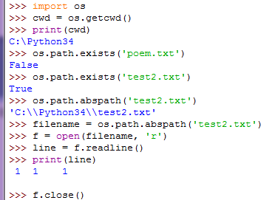
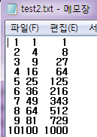
filename
Get current working directory

Slide 7
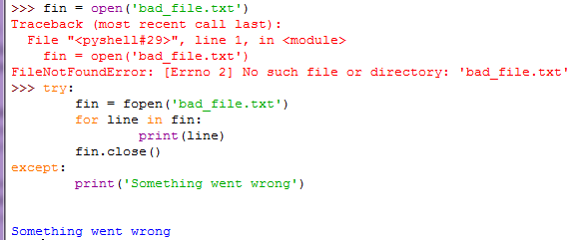
Catching exceptions
If you try to open a file that doesn’t exist, you get an IOError:
To avoid these errors, you could use functions like os.path.exists and os.path.isfile,
It is better to go ahead and try which is exactly what the try statement does.

Slide 8
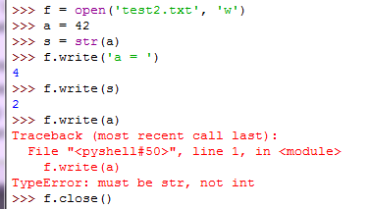
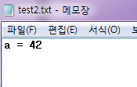
write method
write() method writes the contents of string to file
write() method returns the number of byte written

Slide 9
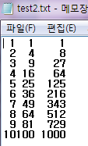

Output formatting
Using rjust(), ljust(), center(), zfill() method of str class
String concatenation +
Right-justifies a string in a field of a given width by padding with spaces on the left
Pads a numeric string on the left with zeros

Slide 10
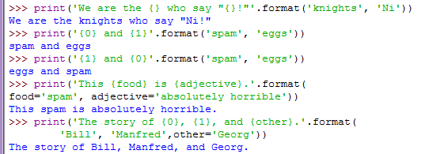
Output formatting
Using str.format() method
The brackets are replaced with the objects passed into the str.format()

Slide 11
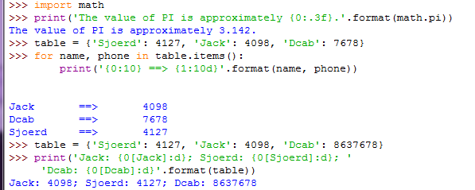
Output formatting
Using str.format() method
Floating point number : three spaces after decimal
: integer ➔ a minimum number of characters wide
Integer number in 10 spaces right justified

Slide 12

Old string formatting
% totalwidth . width_after_’.’ f
for floating point number
The % operator interprets the left argument much like a sprintf()-style format string to be applied to the right argument, and returns the string resulting from this formatting operation.
string
Decimal number
Flag before width

