Slide 1
Python 강의자료06
공학정보처리 ENG1108
김 은 진

Slide 2
list
tuple
dict (Dictionaries)
set
str (Strings)
Sequences

Slide 3
Data structures
Used to store a collection of related data
Which can hold some data together
List, tuple, dictionary and set

Slide 4
List
A data structure that holds an ordered collection of items
a sequence of items in a list
To create list of items using [ ]
Items are seperated by , (comma)
An item can be any type including a list
A list is a mutable data type
We can add and remove items
A list is a sequence

Slide 5
Quick introduction to Objects and Classes
A list is an example of usage of objects and classes
i = 5
create object (instance) i of class(type) int
A class can have methods
Functions defined for use with respect to that class only.
append method for the list class (dotted notation)
Ex) mylist.append( ‘an item’ )
A class can have fields
Variables defined for use with respected to that class only.
Ex) mylist.field
help(list) shows all the methods and fields defined by the list object

Slide 6
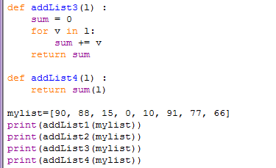
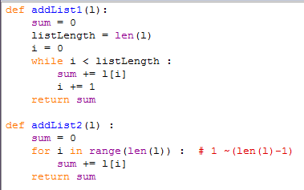

Index of list
You can get items by specifying the index of the item
Indexing stats with 0
Index must be integer

Slide 7
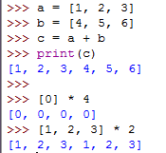
List operations
+ *

Slide 8
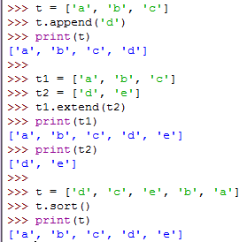
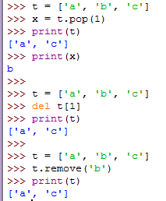
List methods
Index number
append(), extend(), sort(), pop(), remove()
Indexed item
Item value

Slide 9
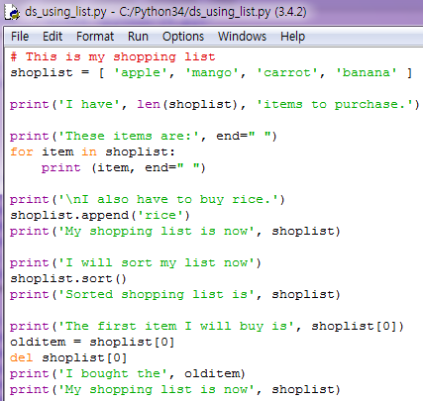
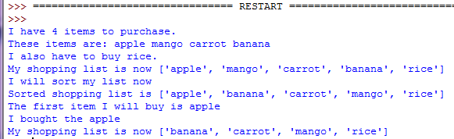
List example
Create a list shoplist
Print on a same line
Lists are mutable

Slide 10
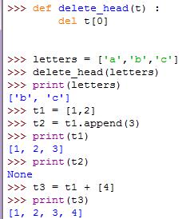
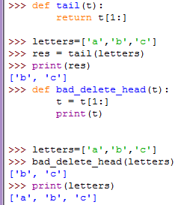
List arguments
When you pass a list to a function, the function gets a reference to the list.
tail ( ) returns a new list
If the function modifies a list parameter, the caller sees the change.
Parameter t
append( ) method modifies the list
+ does not modify the list, but create a new list
A new local variable t

Slide 11
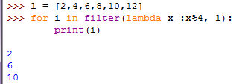
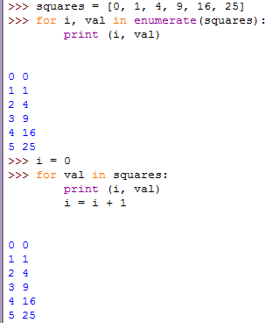
Using built-in function on lists

Slide 12
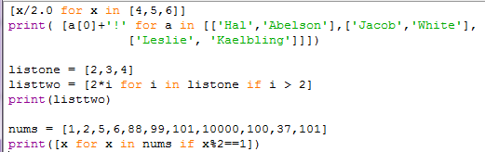

List comprehension
To derive a new list from an existing list, doing iterative operations on the list.
[expr for var in list filtering]

Slide 13

Nested list comprehension

Slide 14
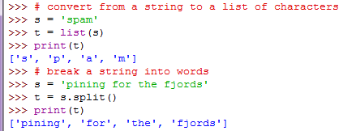
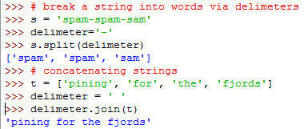
Lists and Strings
A list of characters is not the same as a string

Slide 15
Tuple
To hold together multiple objects
Similar to lists, but without extensive functionality of list class
Tuples are immutable, not modifiable.
Like strings
To create a tuple of items using ( )
Items are seperated by , (comma)
( ) is optional
Tuples are used in cases where
A statement or a usre-defined function can assume that the collection of values which will not change.
A tuple is a sequence
help(tuple) shows all the methods defined by the list object

Slide 16
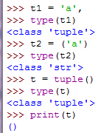
Tuple with 0 or 1 item
An empty tuple
A tuple with 0 item
Ex) myempty = ( )
A tuple with a single item
Using a comma following the only item, Python differentiate between a tuple and a pair of parentheses surrounding the object in an expression
Ex) singleton = ( 2, )

Slide 17
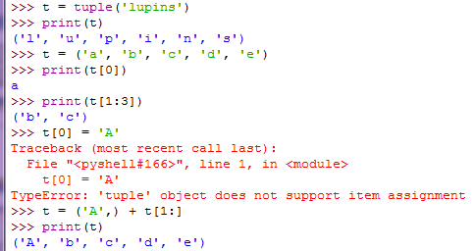
Elements of tuple
[ ] Indexing an element
Connot modify the tuple

Slide 18
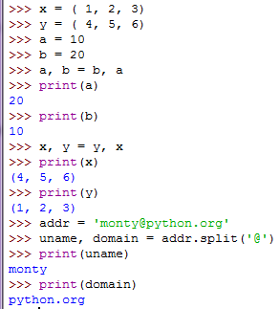
Tuple assignment
Tuple of variables
Tuple of expressions
Swap the values of two variables
Items of tuple can be tuples
return value of split() is a list of strings

Slide 19

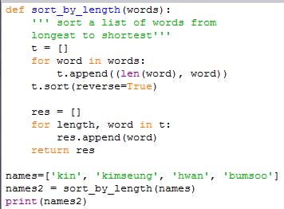

Comparing tuples
Relational operators work with tuples and other sequences.
Comparing the first element from each sequence. If they are equal, it goes on to the next element, and so on, until it finds elements that differ.
t =[ (3, ‘kin’), (7, ‘kimseung’), (4, ‘hwan’), (6, ‘bumsoo’) ]
t =[ (7, ‘kimseung’), (6, ‘bumsoo’) , (4, ‘hwan’), (3, ‘kin’) ]
res =[ ‘kimseung’, ‘bumsoo’, ‘hwan’, ‘kin’ ]

Slide 20
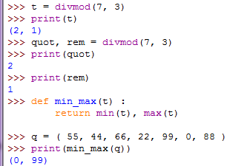
Tuples as return values
divmod() returns a tuple of quotient and remainder
Tuple of variables
Return a tuple

Slide 21
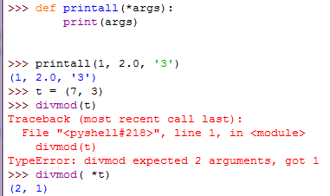
Variable-length argument tuples
A parameter name that begins with * gathers arguments into a tuple.
printall() takes any number of arguments.
divmod() cannot take a tuple as parameter.
* scatters a tuple into many values.

Slide 22
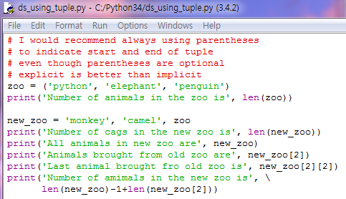
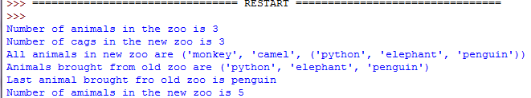
Tuple example
Create a tuple zoo
Create a tuple new_zoo
without ()
a tuple within a tuple
Indexing operator[]
[][] Indexing a item of tuple in tuple

Slide 23
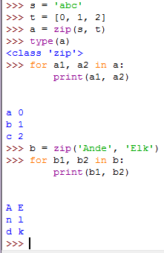
Iterator of tuples
zip(), a built-in function, takes two or more sequences and “zips” them into an iterator of tuples where each tuple contains one element from each sequence.
If the sequences are not the same length, the result has the length of the shorter one
(‘A’, ‘E’)
(‘n’,’l’)
(‘d’,’k’)

Slide 24
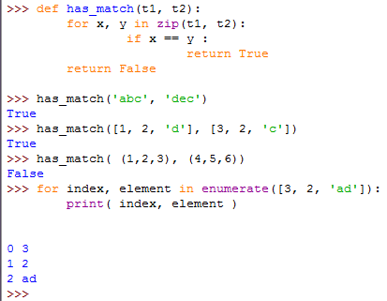
Iterator of tuples
enumerate() traverse the elements of a sequence and their indices
has-match() takes two sequences, and returns True if there is an index i such that t1[i] == t2[i]

Slide 25
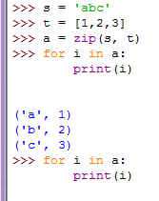
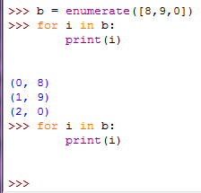
Iterator of tuples

Slide 26
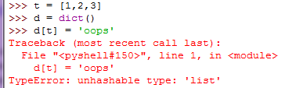
Dictionary
A Dictionary associates keys(name) with values(details)
Like an address-book where you can find the address or contact details of a person by only his/her name
Keys
must be unique
must be immutable objects(like strings)
must be simple objects
Values
can either immutable or mutable objects
Pairs of keys and values are specified by using the notation
d = { key1: value1, key2: value2 }
Key-value pairs(items) are not ordered in any manner.
A dictionary is an objects of the dict class.
help(dict)

Slide 27
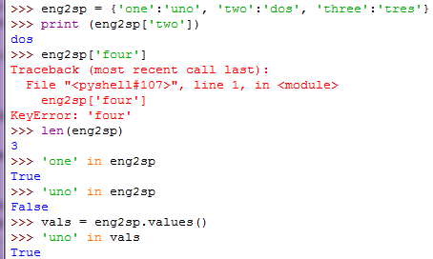
Dictionary
The method values() of dictionaries returns values as a list
The method keys() of dictionaries returns keys as a list

Slide 28
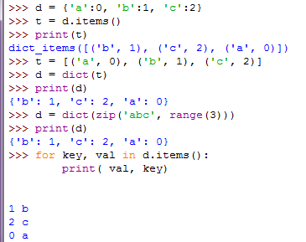
Dictionaries and tuples
The method items() of dictionaries returns a list of tuples
dict() initializes a dictionary with a list of tuples.
dict() initializes a dictionary with zip.

Slide 29
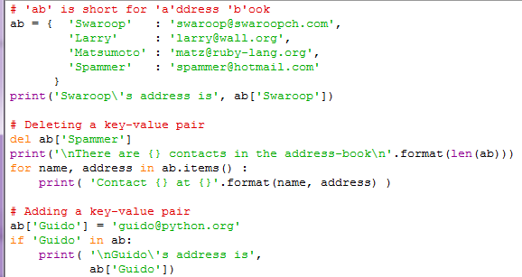
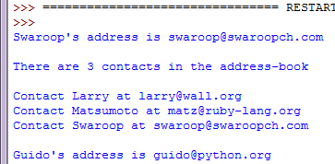
Dictionary example
Create a dictionary ab
Using a key as an index
items() returns a list of tuples, pairs of items-the key followed by the value.
key → name
value → address
Adding new pair by
not using append() method but using = with new key

Slide 30
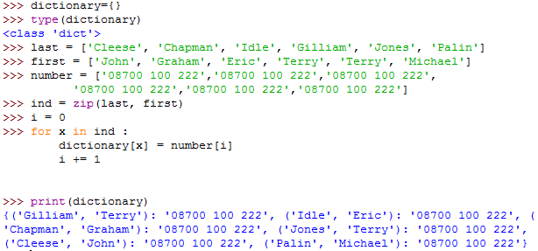
Using index of dictionary by tuple
Making an empty dictionary
Dictoinary = dict()
Making tuples for indexing

Slide 31
Keyword arguments and Dictionary
Keyword arguments in functions are the key-value pairs in the parameter list of the function definition.
If you access variables with in the function, it is a key access of a dictionary(the symbol table)

Slide 32
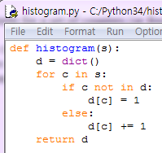

Dictionary as a set of counters
If you want to count how many times each letter appears, You could create a dictionary with characters as keys and counters as the corresponding values. The first time you see a character, you would add an item to the dictionary. After that you would increment the value of an existing item.

Slide 33

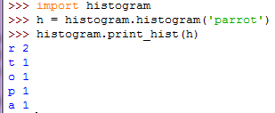
Looping and dictionaries
Add function print_hist() to the module histogram.py
h is dictionary
c is key
h[c] is value
→ lookup

Slide 34


Reverse lookup
Add function reverse_lookup() to the module histogram.py

Slide 35
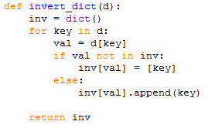
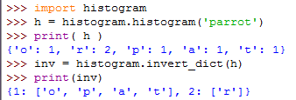
Dictionaries and lists
If you want to create a dictionary that maps from frequencies to letters. Since there might be several letters with the same frequency, each value in the inverted dictionary should be a list of letters.
Add function invert_dict() to the module histogram.py

Slide 36
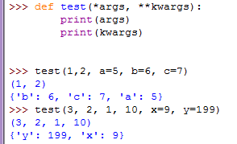
Dictionary as argument
Use ** to get argument names and their values as a dictionary

Slide 37
Sequence
Lists, tuples and strings are examples of sequences
Membership test
in and not in expressions
Indexing operations
to fetch a particular item in the sequence
Slicing operation
to retrieve a slice of the sequence(a part of the sequence)

Slide 38
Operations for sequences
a[i] | returns i-th element of a
a[i:j] | a[i:j] returns elements i up to j - 1
len(a) | returns number of elements in sequence
min(a) | returns smallest value in sequence
max(a) | returns largest value in sequence
x in a | returns True if x is element in a
a + b | concatenates a and b
n * a | creates n copies of sequence a

Slide 39
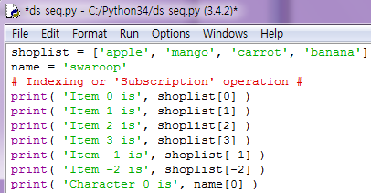
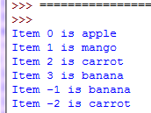
Sequence - example
Create a list shoplist
Create a sting name
Start from 0
Last item

Slide 40
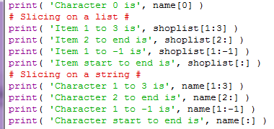
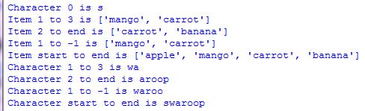
Sequence – example (cont.)
Slicing operation with :
start : end
stop slicing before end
Whole sequence

Slide 41
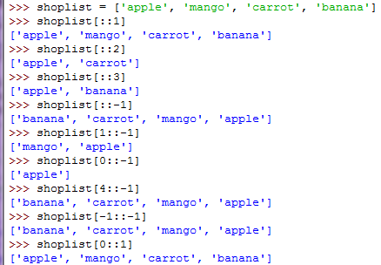
Sequence – example2
3rd argument for the slice is the step for the slicing
Default value is 1

Slide 42
Indexing & slicing
0 1 2 3 4 ← use for indexing
-5 -4 -3 -2 -1 ← use for indexing
from the end
H
e
l
l
o
0 1 2 3 4 5 ← use for slicing
-5 -4 -3 -2 -1 ← use for slicing
from the end

Slide 43
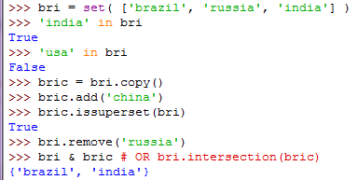
Set
Unordered collections of simple objects
Existence of an object in a collection is more important that the order or how many times it occurs
Using sets
Test for membership(Whether it is a subset of another set)
Find the intersection between 2 sets

Slide 44
References
Binding the name to the object
When you assign an object to a variable, the variable only refers to the object.
The variable name points to that part of the computer’s memory where the object is stored

Slide 45
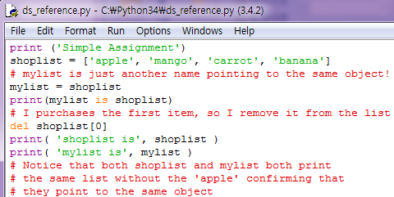

References - example
mylist and shoplist “refer” to the same object

Slide 46
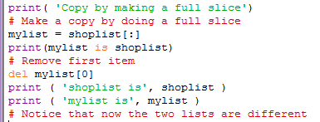

References – example(cont.)

Slide 47
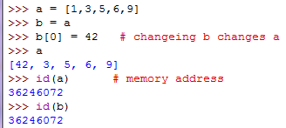
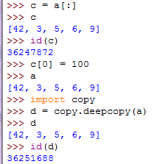
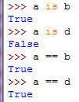
Copying obejcts
a
[1, 3, 5, 6, 9]
[42, 3, 5, 6, 9]
b
c
[42, 3, 5, 6, 9]
[100, 3, 5, 6, 9]
d
[42, 3, 5, 6, 9]

Slide 48
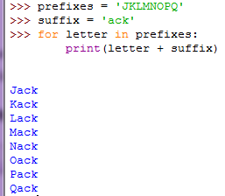

More about strings
The strings are all objects of the class str.
help(str) shows all the methods of str.
The stings are immutable.

Slide 49
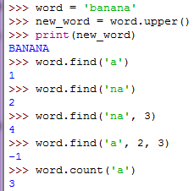

More about strings
find(string, start_point, stop_point)

Slide 50


More about strings
-1 means that it is unsuccessful in finding the substring
join() joins the items of a sequence with the string acting as a delimeter between each item

Slide 51


More about strings
capitalize() does not modify the string k, but create a new string

Slide 52

More about strings
Parsing a string

