Slide 1
Python 강의자료07
공학정보처리 ENG1108
김 은 진

Slide 2
Object-oriented programming
Class and objects
Method
Special methods
Operator overloading
Class variables and objects variables
Polymorphism
Inheritance

Slide 3
Object Oriented Programming
Procedure-oriented programming
Design a program with functions(blocks of statements)
Object-oriented programming
Design a program with objects
Object combines data and functionality
Writing large programs
Class & Objects
A class creates a new type(using keyword class)
Objects are instances of the class
Fields: variables belong to an object or a class
Instance variables: belong to each object
Class variables: belong to the class
Methods: function belong to a class
( attributes of the class are fields and methods)

Slide 4
self
Class methods must have an extra first name (self) added to the beginning of the parameter list
When you call the method, Python give a value to the parameter. You do not give a value for self.
class
object
class MyClass :
method( self, par1, par2 )
myobject = MyClass( );
myobject.method(arg1, arg2);
Python converts the function call automatically
method has to be defined with one more parameter (self)
MyClass.method(myobject, arg1, arg2);
Add value(obejct name) to self parameter

Slide 5
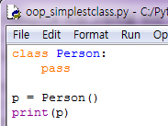

Classes
p is an object of Person class in main module
Memory address where object is stored
Define class Person
pass statement does nothing
Instantiation: create an object

Slide 6
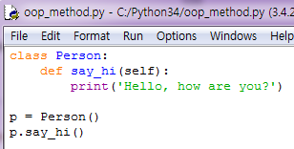

Methods
functions with an extra self parameter

Slide 7

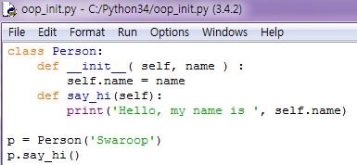
__init__ method
__int__ method is run as soon as an object of a class is instantiated.
Useful to do any initialization
p.name
‘Swaroop’
calls Person.__init__(p, ‘Swaroop’)
calls Person.say(p)

Slide 8
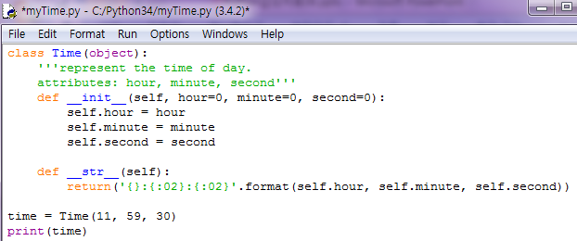

__str__ method
__str__ is a special method, like __init__, that is supposed to return a string representation of an object.
calls Time.__str__(time)

Slide 9
Special methods
To mimic certain behaviors of built-in types.
__init__(self, …)
Called just before the newly created object is returned for usage
__del(self)__
Called just before the object is destroyed
Unpredictable timing, so avoid using this
__str__(self)
Called when we use print or when str() is used
__lt__(self, other)
Called when the less than operator(<) is used
There are special methods for all the operators(+, >, etc)
__getitem__(self, key)
Called when x[key] indexing operation is used
__len__(self)
Called when the built-in len() function is used for the sequence object.

Slide 10
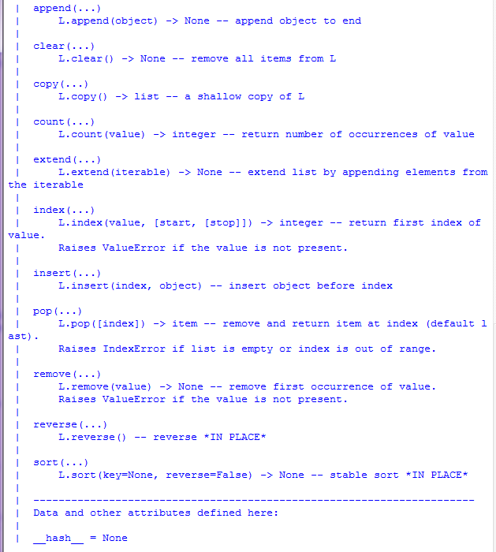
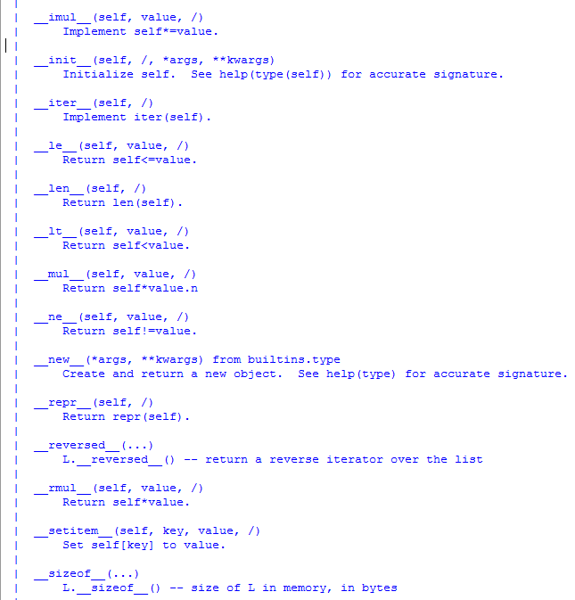
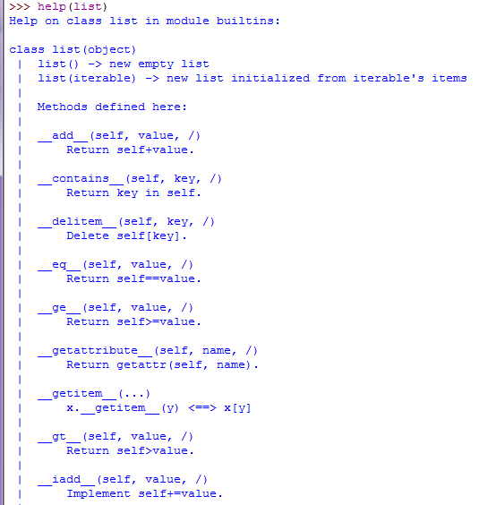
Special methods - ex

Slide 11
Class variables and Object variable
Name spaces
names are valid with the context of the classes and objects only.
Two types of fields
Class variables are shared
Can be accessed by all instances of that class.
Object variables are owned by each object of the class.
Each object has its own copy of the field

Slide 12
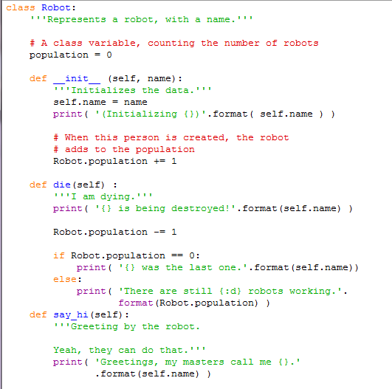
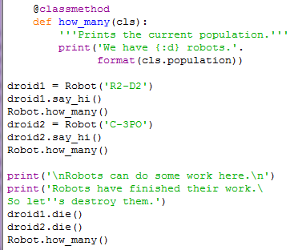
Class & object- programming
Robot.doc
All class members are public
Member name with prefix __ makes it private
Class variable
object variable
@classmethod decorator makes how_many() belong to the class not to the object
Robot.die.doc
Can be replaced by self.__class__.population
(object refers to it’s class via __class__)

Slide 13
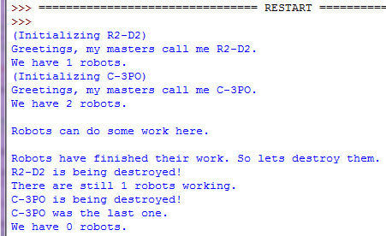
Class & object- control flow
Robot.population
droid1.name
droid2.name
0
1
‘R2-D2’
‘C-3PO’

Slide 14

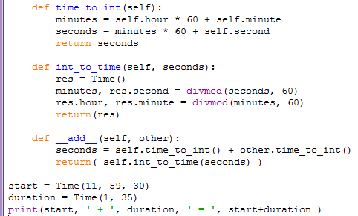
Operator overloading
Specify the behavior of operators for defining special methods
invokes __add__(start, duration)
1

Slide 15
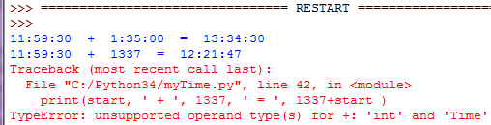
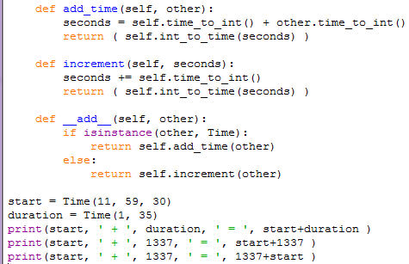
Type-based dispatch
Dispatches the computation to different methods based on the type of the arguements
Returns True, if the value is an instance of the class
Addition is not commutative
first operand must be a Time object

Slide 16

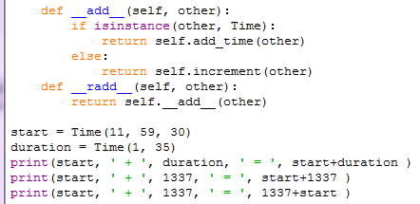
Type-based dispatch
Right-side add:
invoked when a Time object
appears on the right side of +

Slide 17

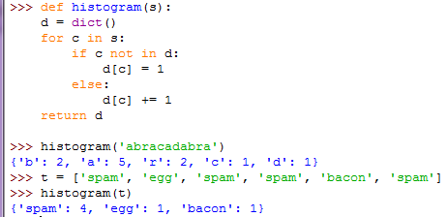
Polymorphism
Functions can work with several types.
Built-in function sum is polymorphic, works as long as the elements of the sequence support addition.
function histogram is polymorphic, works for lists, tuples, and dictionaries, as long as the elements are hashable.

Slide 18
Inheritance
Makes it easy to reuse of code
inheritance can make programs difficult to read
Implementing a type and subtype relationship between classes
Type
Base class
superclass
class SchoolMember:
name, age, address
Common characteristics
We can refer to Teacher or Student object as a SchoolMember object ➔ polymorphism
If we change any functionality in SchoolMember, this is automatically reflected n the subtypes
Inherit from SchoolMember
class Teacher(SchoolMember):
salary, courses
class Student(SchoolMember):
marks, fees
specific characteristics for each class
subType
derived class
subclass
Notes:
교수와 학생에게 새로 출입증 발급해야 하는 경우는 SchoolMember의 특성만 변경하면 됨
모든 SchoolMember의 인원 수를 알고 싶다면 Teacher와 Student의 object를 SchoolMember의 object로 간주하여 사용할 수 있어 유용함 ➔ polymorphism

Slide 19
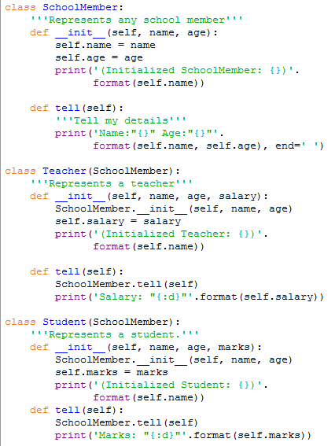
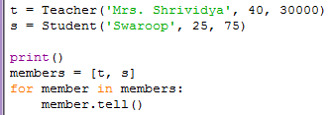
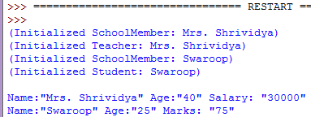
Superclass and subclass - programming
You should explicitly call __init__ method of the base class using self ➔ it initializes SchoolMember part of the Teacher object
Treat instances of Teacher as just instance of SchoolMember

Slide 20
Superclass and subclass - Control/Data flow
t
t.name
t.age
t.salary
‘Mrs. Shrividya’
40
30000

