Slide 1
Python 강의자료08
공학정보처리 ENG1108
김 은 진

Slide 2
Numpy

Slide 3
More Python libraries
Dedicated Python libraries
Provide numerical tools for frequently occurring tasks
Convenient to use
More efficient in terms of CPU time and memory requirements
Such as
numpy provides a data type specialized for number crunching of verctors and matrices(array), and linear algebra tools
matplotlib(pylab) provides plotting and visualization capabilities
scipy provides a multitude of numerical algorithms
Download site
Anaconda
https://www.continuum.io/downloads (아나콘다)
open data science platform
including numpy, pylab, matplotlib, scipy and …
http://www.scipy.org/Download

Slide 4
NumPy package
NumPy(Numerical Python) provides
A new data structure called arrays which allow
n-dimensional array of homogeneous data
Efficient vector and matrix operations
A number of linear algebra operations

Slide 5
Arrays
Very similar to a list
An array keep only elements of the same type
More efficient to store
Vectors and matrices are all called “arrays” in NumPy

Slide 6



Vectors
1d-arrays
Conversion of a list(or tuple) into an array using numpy.array:
Creation of a vector using “ArrayRANGE”
Creation of vector with zeros
Creation using linspace
9 numbers from 0 to 2

Slide 7
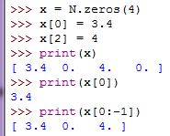
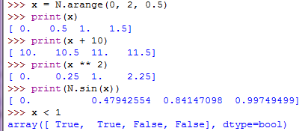
Vectors
Individual values of vector
Calculations on every elements in the vector

Slide 8
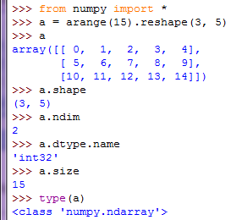


Matrices
2d-array
Converting a list of lists(or tuples) into an array
Using zeros, ones to create a matrix
3 rows and 5 columns
Number of dimensions of the array
An object describing the type of the elements in the array
Total number of elements of the array

Slide 9
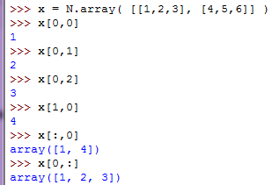
Matrices
Accessing individual elements

Slide 10
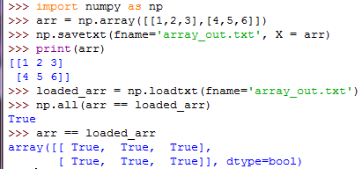
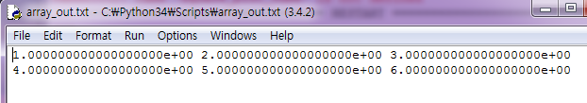
Array IO
c

Slide 11
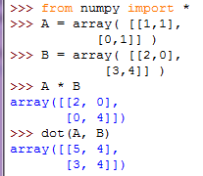
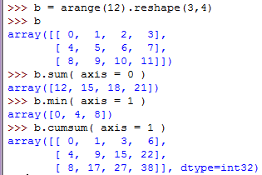
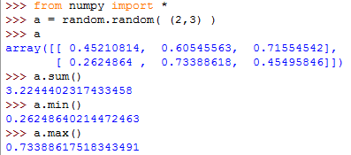
Calculations on matrices
Sum of each column
Elementwise product
min of each row
Matrix product
Cumulative sum

Slide 12
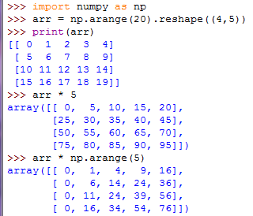
Array broadcasting
To operate on arrays of different shapes makes us to write more efficient and readable code with fewer for loops.

Slide 13
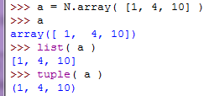
Convert from array to list or tuple

Slide 14
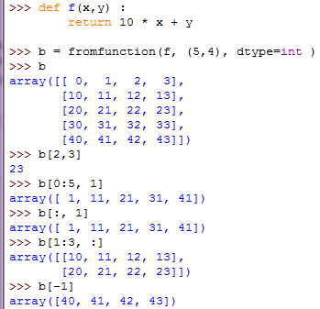
Indexing and Slicing
One-dimensional arrays can be indexed, sliced and iterated over, much like lists.
Multidimensional arrays can have one index per axis. These indices are given in a tuple separated by commas.
Each row in the second column
Each column in the second and third row
b[ -1, : ] , last row

Slide 15
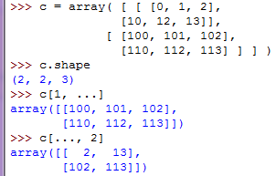
Indexing and Slicing
dots(…) represent as many colons as needed to produce a complete indexing tuple. For example, if x is a rank 5 array (i.e., it has 5 axes)
x[1,2,...] is equivalent to x[1,2,:,:,:],
x[...,3] to x[:,:,:,:,3]
x[4,...,5,:] to x[4,:,:,5,:].
3D array
Same as c[1,:,:] or c[1]
Same as c[:,:,2]

Slide 16
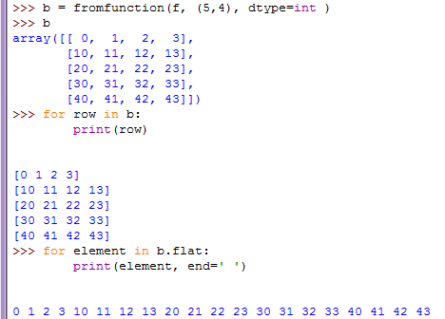
Iterating

Slide 17
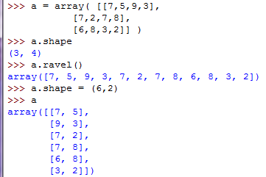
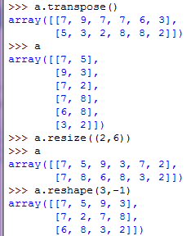
Changing the shape of an array
Flatten the array in row-major
Resize modifies the array itself
If a dimension is given as -1 in a reshaping operation, the other dimensions are automatically calculated

Slide 18
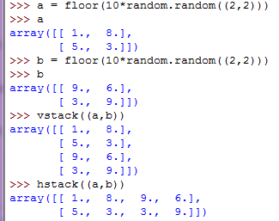
Stacking together different arrays

Slide 19
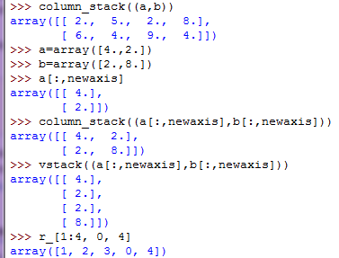
Stacking together different arrays
stacks 1D arrays as columns into a 2D array, same as hstack
Allows to have a 2D columns vector
r_[] creates an array by stacking numbers along x axis. c_[] creates along y axis.

Slide 20
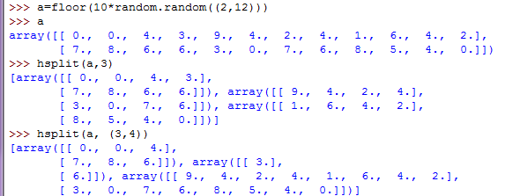
Splitting one array into several smaller ones
hsplit splits an array along x axis.
vsplit splits an array along y axis
array_split specifies along which axis to split
Splits a into 3 arrays
Splits a after the 3rd and the 4th column

Slide 21
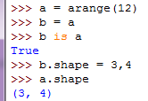
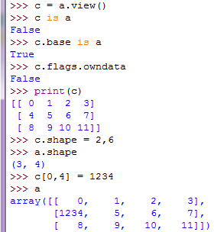
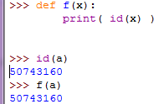
Copies and Views
No new object is creates
c is a view of the data owned by a
Two names for the same array
a’s shape doesn’t change
a’s data changes

Slide 22
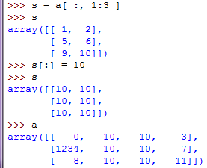
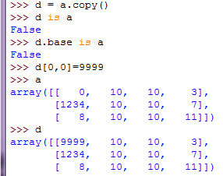
Copies and Views
Spaces added for s
Deep copy: a new array object with new data is created
d doesn’t share anything with a
s[:] is a view of s

Slide 23
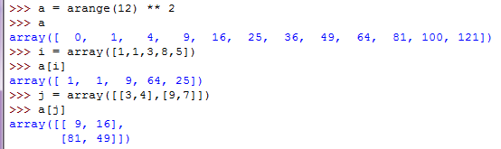
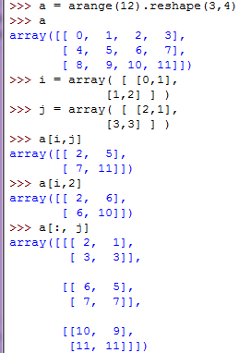
Indexing with arrays of Indices
An array of indices
The elements of a at the position i
Indices for the first dim of a
Indices for the second dim of a
A bidimensional array of indices
i and j must have equal shape
The same shape as j

Slide 24
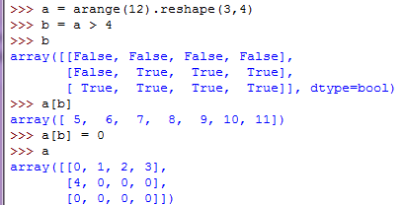
Indexing with boolean arrays
b is a boolean with a’s shape
1d array with the selected elements
All elements of ‘a’ higher than 4 become 0

Slide 25
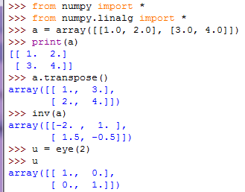
Standard linear algebra operations
Linear algebra package

Slide 26
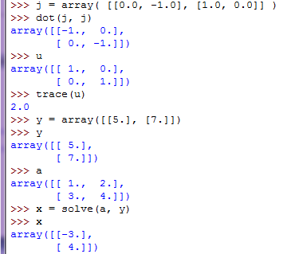
Standard linear algebra operations
Matrix product
Sum along diagonals
Solve ax = y

Slide 27
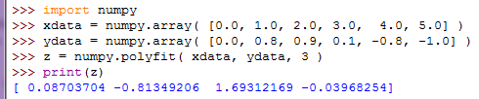
Standard linear algebra operations
Curve fitting of polynomials
To minimize the least square deviation of the fit from the data
Fit for cubic (order = 3) polynomial
An array of coefficients of x^3, x^2, x, 0

