Slide 1
Python 강의자료9
공학정보처리 ENG1108
김 은 진

Slide 2
matplotlib
pylab

Slide 3
Visualizing Data
The purpose of scientific computation is insight not numbers
Matplotlib/Pylab allows us to generate high quality graphs of the type y = f(x) and a bit more
Visual Python quickly generates animations of time dependent processes taking place in 3d space.
Matplotlib is an object oriented plotting library
Gives detailed control over how plots are created
Pylab is an interface to the same set of functions that imitates the Matlab plotting interface
More convenient to use for easy plots
Notes:
To understand the meaning of the(many) numbers we compute, we often need postprocessing, statistical analysis and graphical visualization of our data.

Slide 4
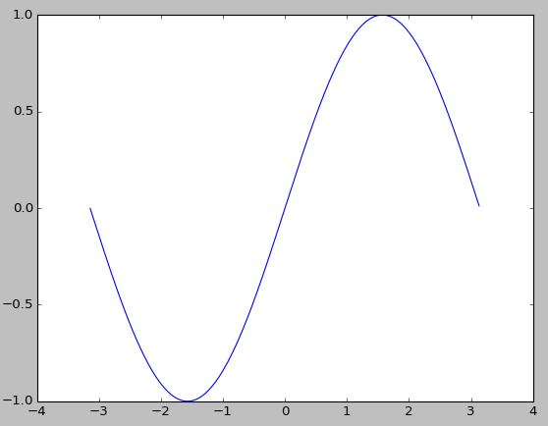
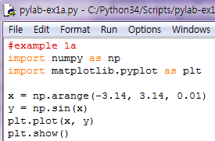
Using pyplot
pyplot has plotting functions
create x-data
compute y-data
create plot
Show plot (makes window pop up)

Slide 5
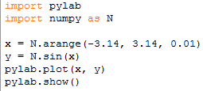
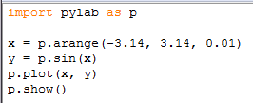
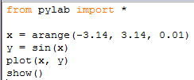
How to import matplotlib, pylab, pyplot, numpy, …
numpy.arrange & numpy.sin have been imported into the pylab
pylab provides over 800 objects.
This could conflict with other objects.
You never use this in programs but at command prompt.

Slide 6
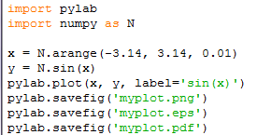
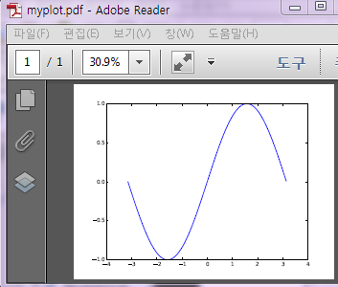
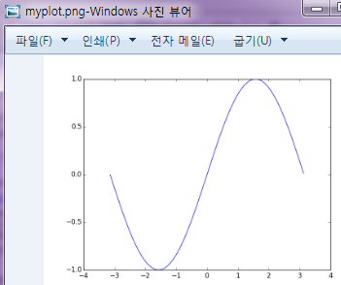
Saving the figure to a file
In non-interactive mode, no plots will be displayed until show() is issued.
In interactive mode, plots will be immediately displayer.
pylab.ion( ) switch the interactive mode on, and off using pylab.ioff( )

Slide 7
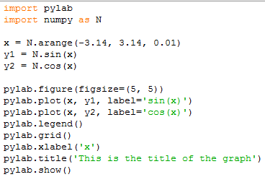
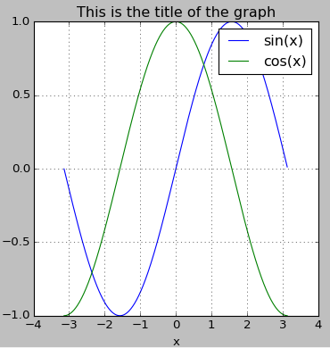
Fine tuning your plot
figure size is 5 inch by 5 inch

Slide 8
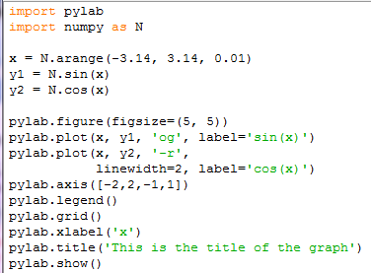
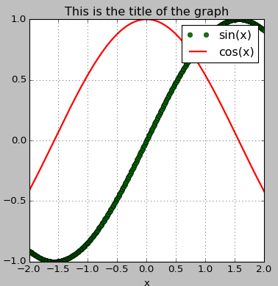
Fine tuning your plot
plot circle(‘o’) in green(‘g’)
plot a line(‘-’) in red(‘r’)
help(pylab.plot) shows the full list of options

Slide 9
Line specifier
Line style | Specifier
Solid(default) | -
dashed | --
Dotted | :
Dash-dot | -.
Marker type | Specfier
plus sign | +
circle | o
asterisk | *
point | .
cross | x
triangle (pointed up) | ^
triangle (pointed down) | v
square | s
diamond | d
five-pointed star | p
six-pointed star | h
triangle (pointed left) | <
triangle (pointed right) | >
Line Color | Specifier
red | r
green | g
blue | b
cyan | c
magenta | m
yellow | y
black | k
white | w

Slide 10
property name & property value
Property Name | Description | Possible Property Values
LineWidth (linewidth) | the width of the line | A number in units of points (default 0.5)
MarkerSize (markersize) | the size of the marker | A number in units of points
MarkerEdgeColor (markeredgecolor) | the color of the marker or the color of the edge line for filled markers | Color Specifiers typed as a string
MarkerFaceColor (markerfacecolor) | the color of the filling for filled markers | color specifiers typed as a string
LineStyle (linestyle) | line style specifier | from the table on previous page
LineColor (linecolor) | line color specifier | from the table on previous page
Marker (marker) | marker type specifier | from the table on previous page

Slide 11
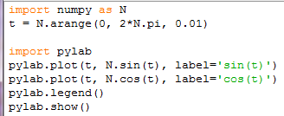
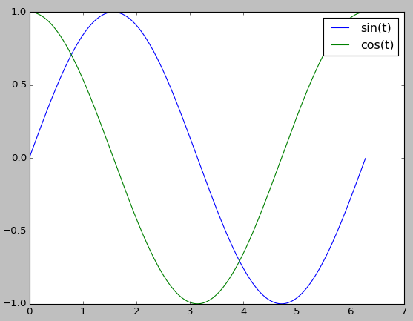
Two (or more) curves in one graph
calling the plot() repeatedly

Slide 12
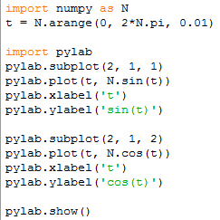
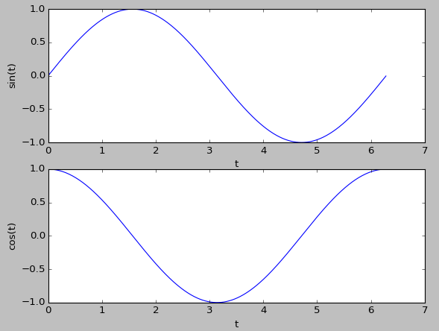
Two (or more) graphs in one figure window
subplot(numRows, numCols, plotNum)

Slide 13
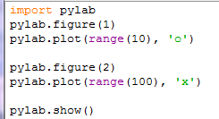
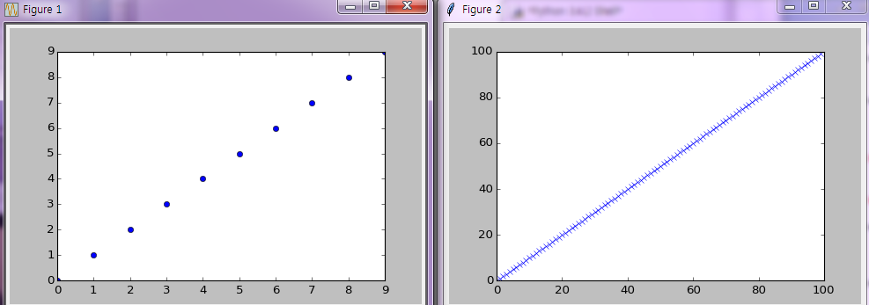
Two (or more ) figure windows
pylab.close() closes one, some or all figure windows.

Slide 14
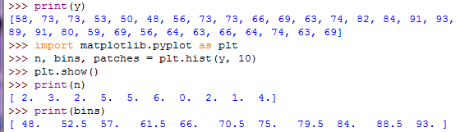
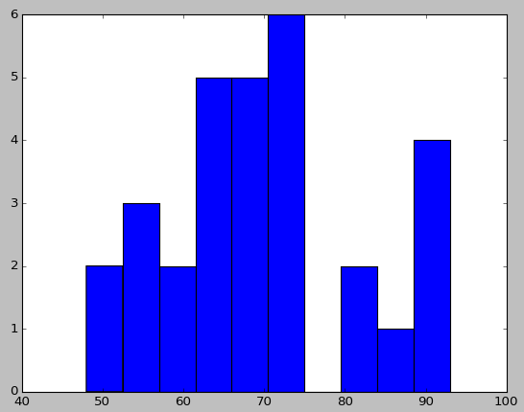
histograms
Count of elements
x position value

Slide 15
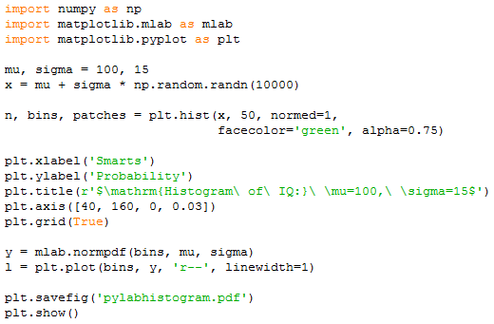
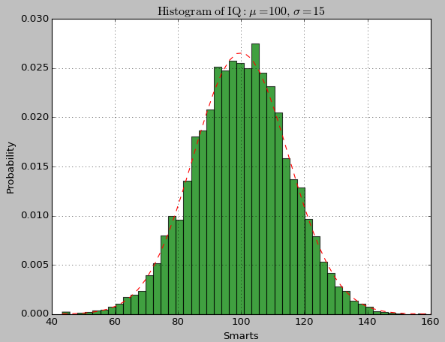
Histograms
numerical functions written for compatibility with MATLAB commands with the same names
50: 51 edges of x are returned
If normed is true, the first element of the return tuple is the normalized counts.
can use Latex strings for labels and titles
calculates the best fit line value

Slide 16
modifiers within the string
modifier | Effect
\bf | bold font
\it | italic style
\rm | normal font
\fontname{fontname} | font name
\fontsize{fontsize} | font size
_{string} | subscript
^{string} | superscript
characters in the string | Greek Letter
\alpha | α
\beta | β
\gamma | γ
\theta | θ
\pi | π
\sigma | σ
\Phi | Φ
\Delta | Δ
\Gamma | Γ
\Lambda | Λ
\Omega | Ω
\Sigma | Σ

Slide 17
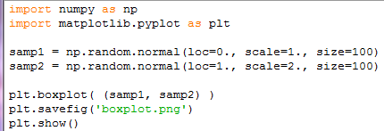
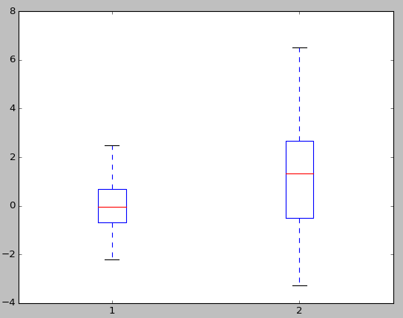
Box Plot

Slide 18
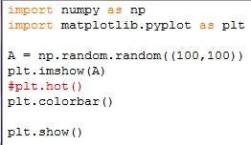
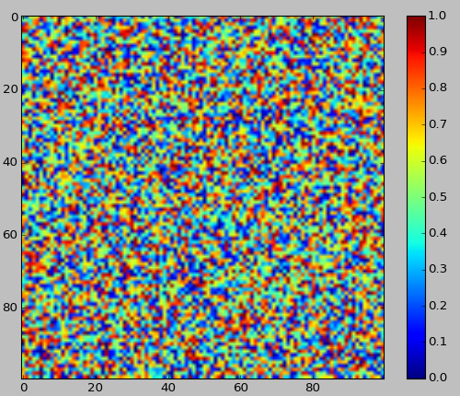
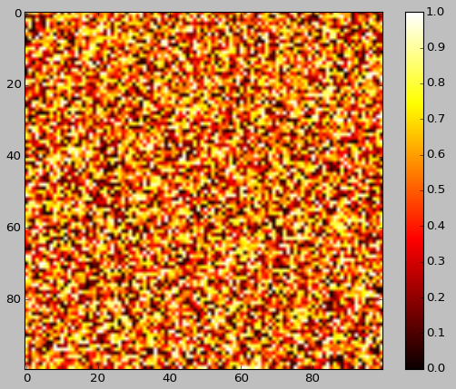
Image Plot

Slide 19
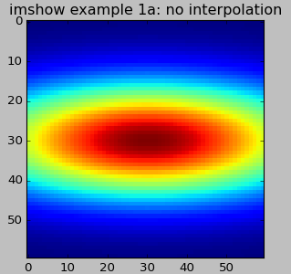
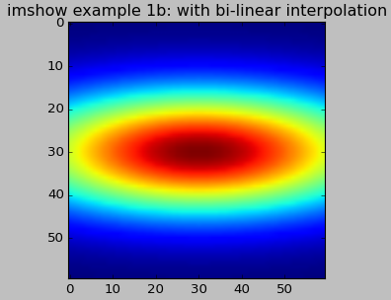
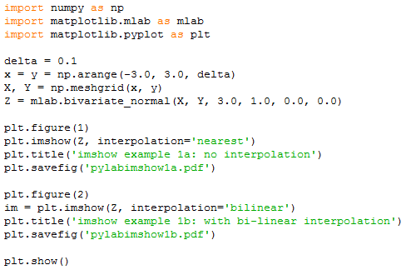
Visualizing matrix data
Without interpolation
With interpolation
To create a bitmap-plot of the entries of a matrix
Bivariate Gaussan distribution for equal X and Y (X, Y, sigmax, sigmay, mux, muy)
Display an image on the axes

Slide 20
3D plotting
3-dim plots used for plotting functions z=f (x,y)
Wireframe and surface plots are created in 3 steps
to create a grid in the x-y plane for domain
to calculate the value for z at each point of the grid
to create the plot
Notes:
x,y 좌표 set 구한 후, 각 점들에 대한 Z 함수로 z 값 구한 후 그리기➔ plot_wireframe, plot_surface

Slide 21
Creating a grid in the x-y plane
The grid is a set of points in the x-y plane in the domain of the function
[Ex]
the distance between the grid point is one unit
(-1,4) (0,4) (1,4) (2,4) (3,4)
(-1,3) (0,3) (1,3) (2,3) (3,3)
(-1,2) (0,2) (1,2) (2,2) (3,2)
(-1,1) (0,1) (1,1) (2,1) (3,1)

Slide 22
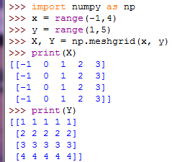
Creating a grid in the x-y plane
numpy.meshgrid creates X and Y matrices.
[usage]
[X,Y] = numpy.meshgrid(x,y)
X : matrix of x coordinates of the grid points
Y: matrix of y coordinates of the grid points
x: vector that divides the domain of x
y: vector that divides the domain of y
[Ex]

Slide 23
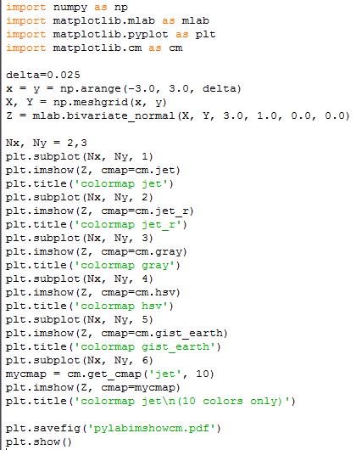
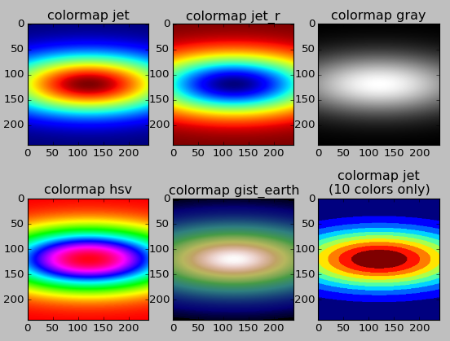
using different colormaps
To use different colormaps
Default color map
Reverse colors in jet
Make isolines by reducing number of colors to 10

Slide 24
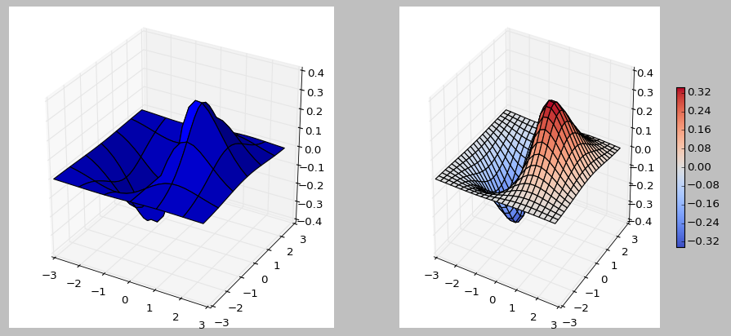
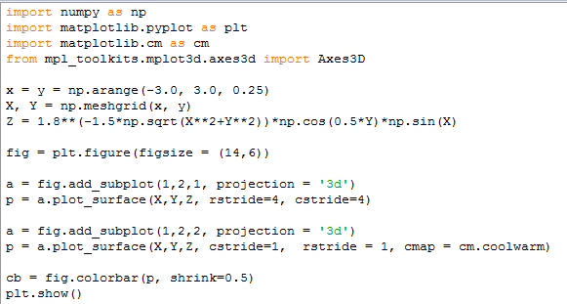
3D plotting
a is a 3D-aware axis instance because of projection =‘3d’

Slide 25
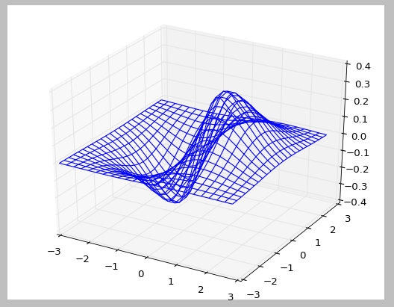
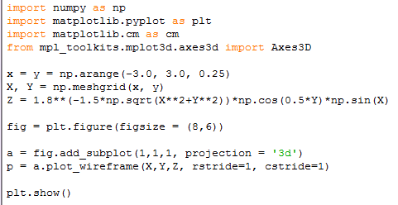
3D plotting

Slide 26
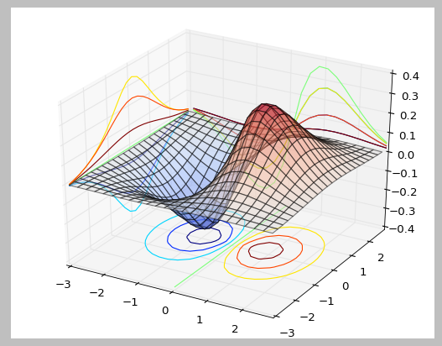
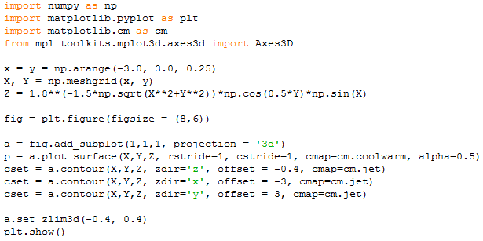
3D plotting

Slide 27
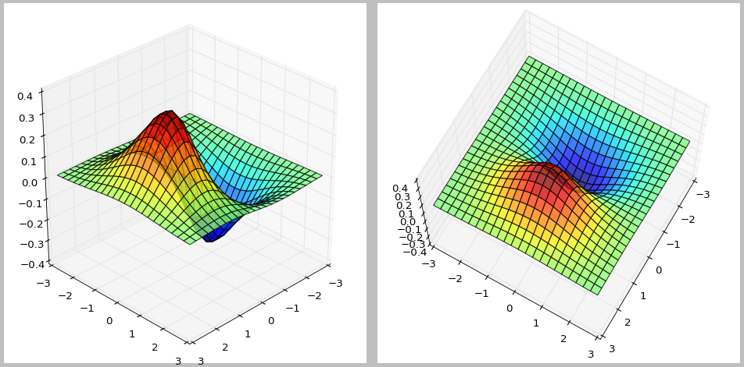
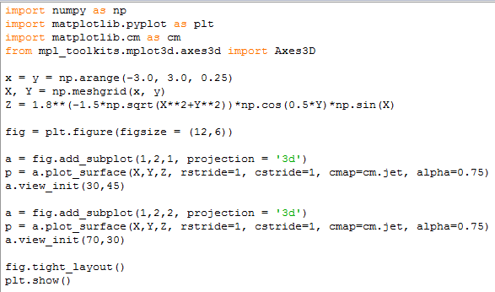
Change view angle
z
y
Elevation
Azimuth
x
view_init(el, az)
az: azimuth (in degrees) angle in the x-y plane measured relative to the negative y axis/ default = 37.5
el: elevation (in degrees) from the x-y plane / default = 30

