Slide 1
Python 강의자료10
공학정보처리 ENG1108
김 은 진

Slide 2
scipy

Slide 3
Numerical methods using Python(scipy)
scipy(Scientific Python)
Provides a multitude of numerical algorithms
Statistics : scipy.ststs
Optimization: scipy.optimize
Sparse matrices: scipy.sparse
Signal processing: scipy.signal
Execute much faster than pure Python code
Is built on numpy

Slide 4
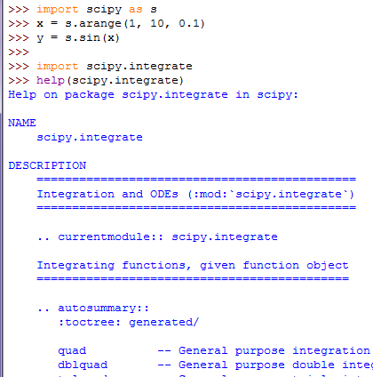
Using scipy
All functionality from numpy seems to be available in scipy
Algorithm to integrate a function

Slide 5
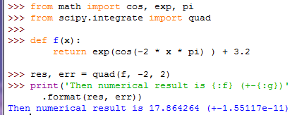
Numerical integration
scipy.integrate module
quad returns the computed result and the estimation of the numerical error of that result

Slide 6
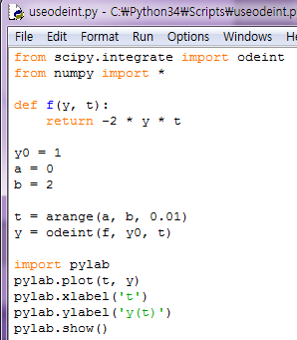
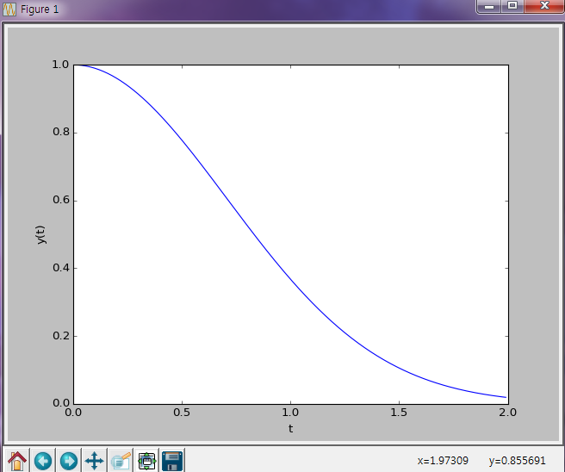
Solving ordinary differential equations
scipy.odeint module solves an ordinary differential equation
Notes:
상미분방정식: 함수의 독립변수가 하나만인 경우의 미분 방정식
편미분방정식: 함수의 독립변수가 여러 개인 경우

Slide 7
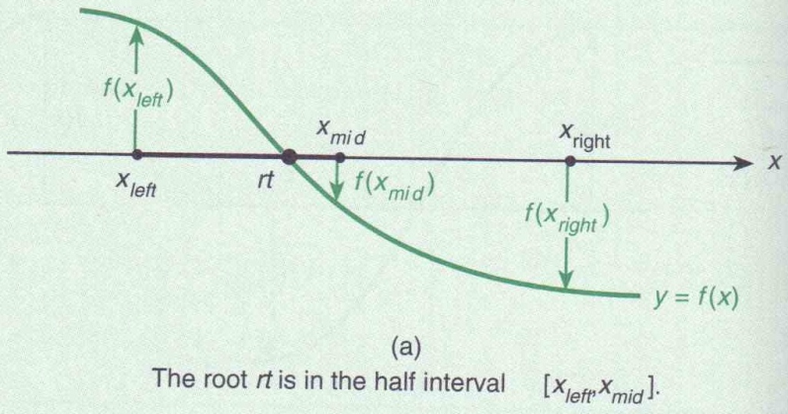
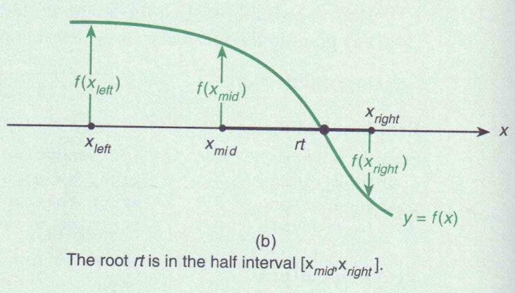
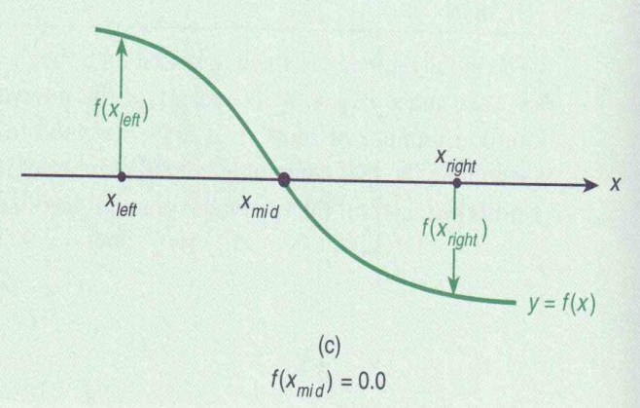
Root finding using the bisection method
To find a x such that f(x) = 0 using scipy.optimize module
Bisection method is robust, slow but conceptually very simple

Slide 8
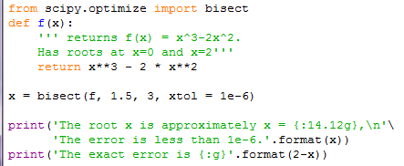

Root finding using the bisection method
using scipy.optimize module
f: function
1.5: lower limit of x
3: upper limit of x
xtol: the maximum error of the method

Slide 9
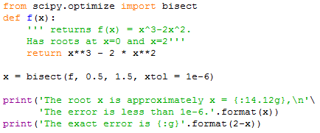
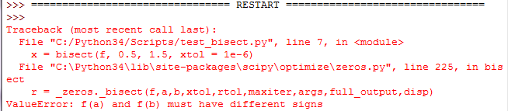
Root finding using the bisection method
using scipy.optimize module

Slide 10
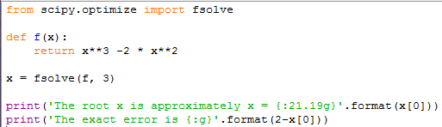

Root finding using the fsolve function
Finding root of multidimensional functions
fsolve() needs only one starting point close to the suspected location of the root
f: function
3: starting point
fsolve returns value of type numpy.ndarray

Slide 11
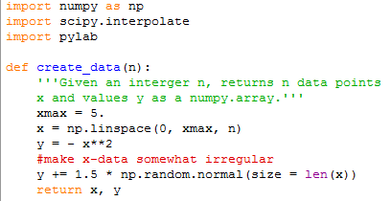
interpolation
Given a set of N points (x_{i}, y_{i}) with i = 1, 2, …, N, we need a function f(x) which returns y_{i} =f(x_{i}) and provides interpolation of the data for all x.
y₀ = scipy.interpolate.interp1d(x, y, kind=‘nearest’)
returns a function y₀ which interpolate the x-y data for any given x when called as y₀(x)

Slide 12
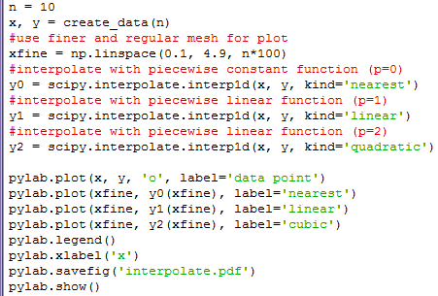
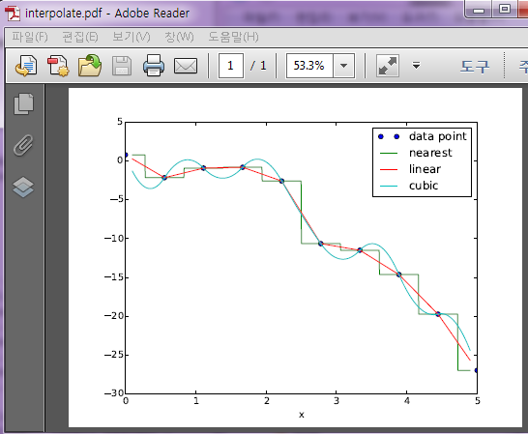
interpolation
Notes:
각 구간(xi ~ xi+1) 에서의 추정방법
Nearest: 상수 함수
Linear: 선형함수
Quadratic: 2차함수

Slide 13
Curve fitting
numpy.polyfit fits polynomial functions through a data set
scipy.optimize.curve_fit fits a given function to a given data set.
Given a set of data with points x1, x2, …, xN and corresponding function values yi and a dependence of yi on xi such that yi=f(xi, p).
Determine the parameter vector p=(p1, p2, …, pk) so that r, the sum of the residuals, is as small as possible:
Curve fitting is of particular use if the data is noisy
Notes:
다항식 추정하기

Slide 14
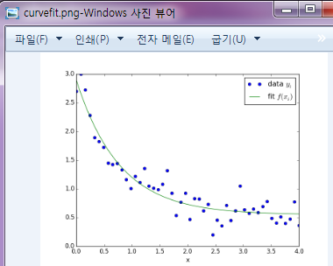
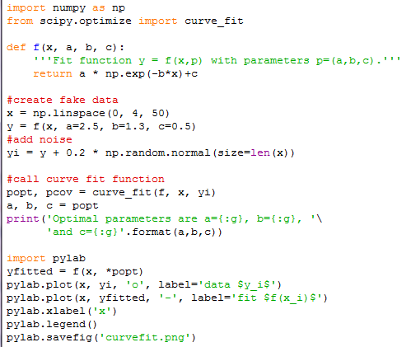
Curve fiting
popt: a tuple of the OPTimal Parameters
(in the sense that these minimize equation)
pcov: covariance matix for all parameters
the diagonals are the variance of the
parameter estimations
initial guess of a, b,c is assumed as 1

Slide 15
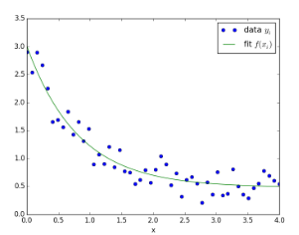
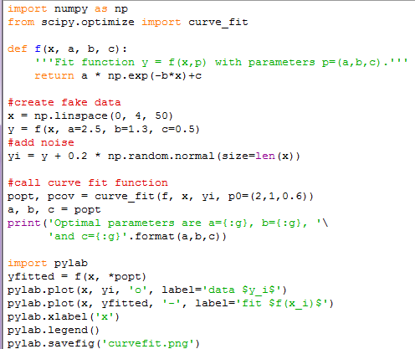

Curve fiting
initial guess of a, b,c is assigned 2,1,0.6
➔ The fitting usually works well

Slide 16
Fourier transforms
Create a signal as a superposition of a 50Hz and 70Hz sine wave with a slight phase shift.
Fourier transform the signal and plot the absolute value of the discrete Fourier transform coefficients against frequency
Expect to see peaks at 50Hz and 70Hz

Slide 17
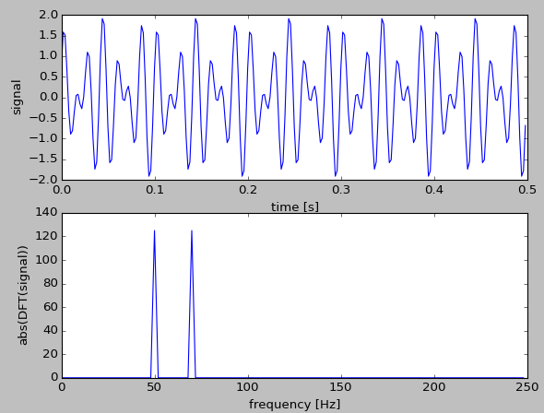
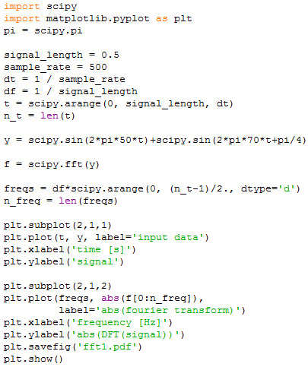
Fourier transforms
seconds
Sampling rate [Hz]
Time between two samples
Freq. between points in freq. domain
Time vector
Create signal
Compute fourier transform
Work out meaningful freq. in fourier transform
‘d’ = double precision float
Plot input data y against time
Plot freq. spectrum

Slide 18
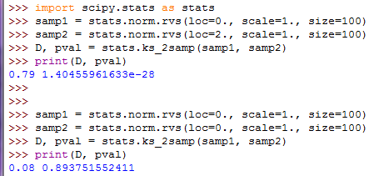
KS-test
do two data samples come from the same distribution?
Generate two data samples from different distributions
Kolmogorov-Smirnov test compares two samples.
Notes:
Stats.norm.rvs: normalized 분포로 random number 발생
Ks_2samp의 결과 값중 D 값이 작거나 pval 값이 크면 두개의 sample이 같을 확률이 높은 것임

Slide 19
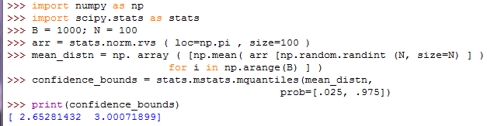
bootstrapped confidence interval
Compute distribution of mean estimate
97.5% confidence
Notes:
mean_distn: arr 값들을 random하게 100개 꺼내 평균값 구하는 작업을 1000번 반복하므로 1000개의 원소를 갖게 됨
Prob: quantile 값들
quantile = random variable의 누적분포함수의 역함수의 정규 구간 값

Slide 20
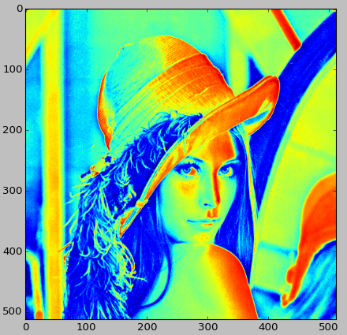
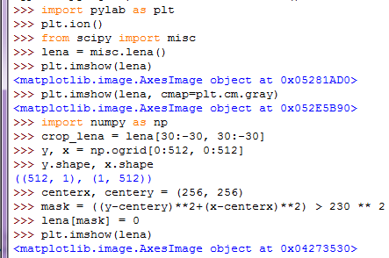
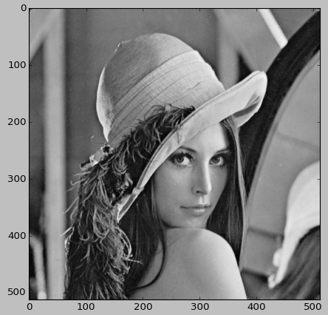
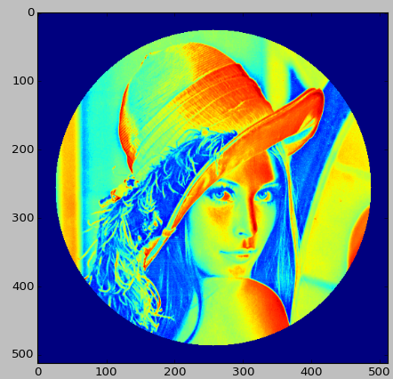
Picture manipulation

Slide 21
Optimization
To find the maximum or minimum of a particular function f(x) where f is a scalar function, but x could be a vector
Ex] minimization of entities such as cost, risk and error
Ex] maximization of productivity, efficiency and profit
Using scipy.optimize.fmin
Takes as arguments a function f to minimize and an initial value x0 from which to start the search for the minimum
Returns the value of x for which f(x) is locally minimized

