Slide 1
Python 강의자료11
공학정보처리 ENG1108
김 은 진

Slide 2
Programming examples
Many ways to compute a series
Making simple codes

Slide 3
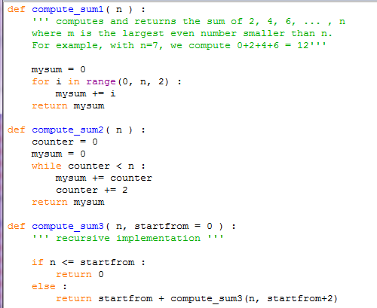
Many ways to compute a series
compute_sum3( 7, 0 )
12
return 0 + compute_sume( 7, 2 )
12
return 2 + compute_sume( 7, 4 )
10
return 4 + compute_sume( 7, 6 )
6
return 6 + compute_sume( 7, 8 )
0
if 7 <= 8 : return 0

Slide 4
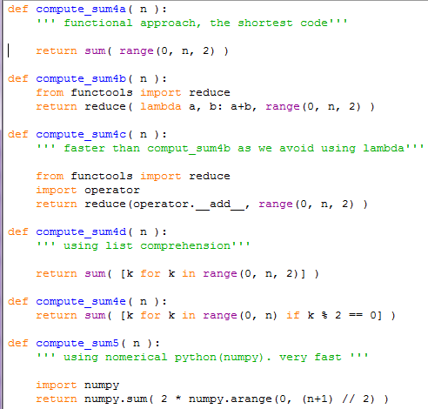
Many ways to compute a series

Slide 5
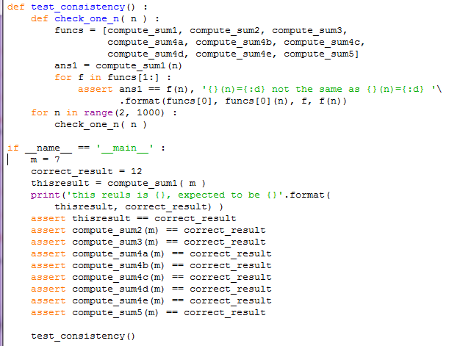

Many ways to compute a series

Slide 6
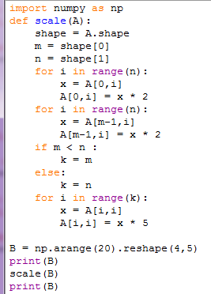
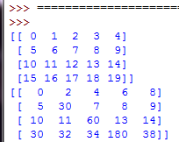
Simple codes
The pythonic way is the simple, correct, most beautiful way of doing things.
scale function

Slide 7
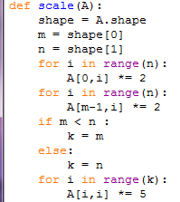
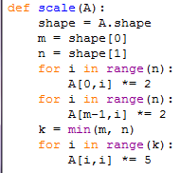
Simple codes
Using *=
Using built-in function

Slide 8
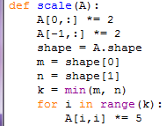
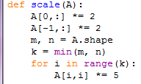
Simple codes
Using data structure indexing
Avoiding too many variable

Slide 9


Simple codes
Avoiding too many variable
Avoiding too many variable

Slide 10

Simple codes
Avoiding too many variable
Using indexing

Slide 11

Simple codes
Using module method

