Slide 1
Python 실습자료02 - answer
공학정보처리 ENG1108
김 은 진

Slide 2
Basic Types
For each of the expressions below, select the appropriate type.
NoneType
int
float
bool
3.14
-34
True
None
3.0

Slide 3
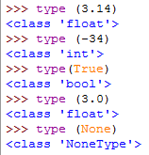
Basic Types - answer

Slide 4
Numeric Expressions
For each of the expressions below, write its value.
6 + 12 – 3
2.2 * 3.0
- - 4
10 / 3
10.0 / 3.0
(2 + 3) * 4
2 + 3 * 4
2 ** 3 + 1
2.1 ** 2.0

Slide 5
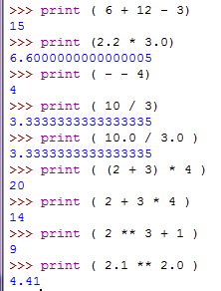
Numeric Expressions - answer

Slide 6
Relations and Boolean Expressions
For each of the expressions below, specify its value.
3 > 4
4.0 > 3.999
4 > 4
4 >= 4
2 + 2 == 4
True or False
False or False
not False
3.0 – 1.0 != 5.0 – 3.0
3 > 4 or ( 2 < 3 and 9 > 10 )
4 > 5 or 3 < 4 and 9 > 8
not (4 > 3 and 100 > 6)

Slide 7
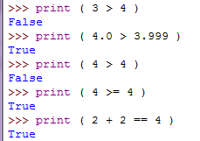
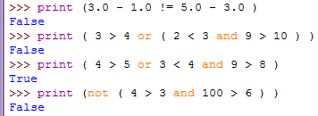

Relations and Boolean Expressions - answer

Slide 8
Mixed-type Expressions
For each of the expressions below, specify its type and value.
3 + 5.0
5 / 2
5 / 2 == 5 / 2.0
5 / 2.0
round(2.6)
int(2.6)
2.0 + 5.0
5 * 2 == 5.0 * 2.0

Slide 9
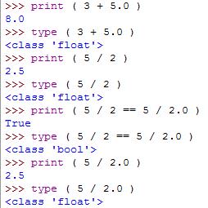
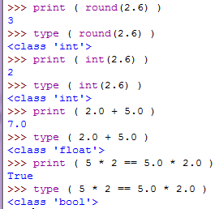
Mixed-type Expressions - answer

Slide 10
Variable Binding
Provide the type and value of the expressions being evaluated.
a = 3
a + 2.0
a = a + 1.0
a
b
a == 5.0
a
b = 10
c = b > 9
c

Slide 11
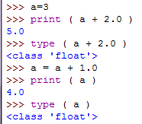
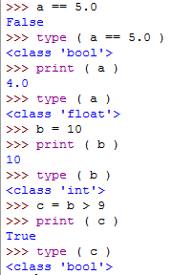
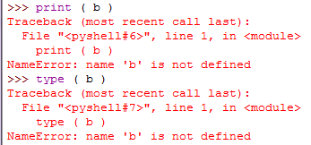
Variable Binding - answer

Slide 12
Calculating
If you run a 10 kilometer race in 43 minutes 30 seconds, what is your average time per mile? What is your average speed in miles per hour? (Hint: there are 1.61 kilometers in a mile).
The volume of a sphere with radius r is . What is the volume of a sphere with radius 5? Hints: Be sure to execute the statement pi = 3.1415926535897931 first and 392.6 is wrong!
Suppose the cover price of a book is $24.95, but bookstores get a 40% discount. Shipping costs $3 for the first copy and 75 cents for each additional copy. What is the total wholesale cost for 60 copies?

Slide 13



Calculating - answer
(1)
(2)
(3)

Slide 14
temperature
Write a program(script) which prompts the user for a Celsius temperature, convert the temperature to Fahrenheit and print out the converted temperature.

Slide 15

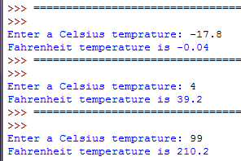
Temperature - answer
Write a program(script) which prompts the user for a Celsius temperature, convert the temperature to Fahrenheit and print out the converted temperature.

Slide 16
circle
Write a program that prompts the user for a radius and displays the area and perimeter of a circle using the following formulas:
perimeter = 2 * radius * p
area = radius * radius * p

Slide 17
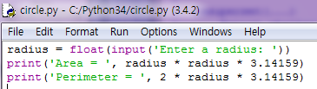

Circle - answer

Slide 18

Sum of digits
Write a program that reads an integer between 0 and 1000 and adds all the digits in the integer. For example, if an integer is 932, the sum of all its digits is 14. (Hint: Use the % operator to extract digits, and use the // operator to remove the extracted digit. For instance, 932 % 10 = 2 and 932 // 10 = 93.)
Here is a sample run:

Slide 19
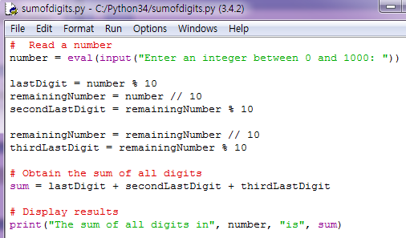
Sum of digits - answer

Slide 20

calculate energy
Write a program that calculates the energy needed to heat water from an initial temperature to a final temperature. Your program should prompt the user to enter the amount of water in kilograms and the initial and final temperatures of the water. The formula to compute the energy is
Q = M * (finalTemperature – initialTemperature) * 4184
where M is the weight of water in kilograms, temperatures are in degrees Celsius, and energy Q is measured in joules. Here is a sample run:

Slide 21
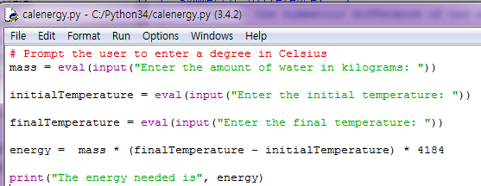
calculate energy - answer

Slide 22

area of a triangle
Write a program that prompts the user to enter the three points (x1, y1), (x2, y2), and (x3, y3) of a triangle and displays its area. The formula for computing the area of a triangle is
Here is a sample run:

Slide 23
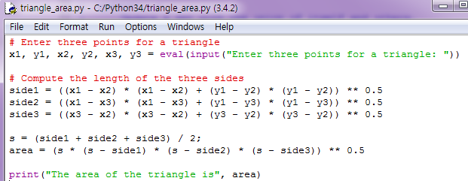
area of a triangle - answer

Slide 24

calculate interest
If you know the balance and the annual percentage interest rate, you can compute the interest on the next monthly payment using the following formula:
interest = balance * (annualInterestRate / 1200)
Write a program that reads the balance and the annual percentage interest rate and displays the interest for the next month.
Here is a sample run:

Slide 25
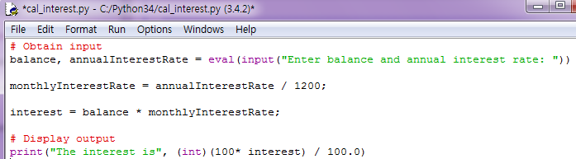
calculate interest - answer

Slide 26

runway length
Given an airplane’s acceleration a and take-off speed v, you can compute the minimum runway length needed for an airplane to take off using the following formula:
Write a program that prompts the user to enter v in meters/second (m/s) and the acceleration a in meters/second squared and displays the minimum runway length. Here is a sample run:

Slide 27
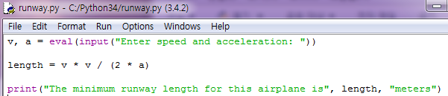
runway length - answer

