Slide 1
Python 실습자료03 - answer
공학정보처리 ENG1108
김 은 진

Slide 2
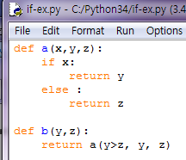
if statements
Provide the type and value of the expressions being evaluated. If evaluating an expression would cause an error, select noneType and write error message. If the result is a function, write that function.
Result type is one of (noneType, num, int, float, boolean)
Assume the following definitions have been made:

Slide 3
if statements
a(False, 2, 3)
b(3,2)
a(3>2, a, b)
b(a,b)

Slide 4

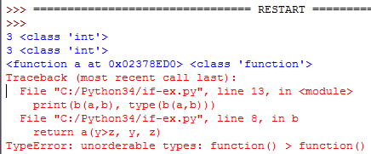
if statements-answer

Slide 5
if statements ex1
Make a script compare.py that enter two numbers x, y from user input and print “Greater” if x is greater than y, “Equal” if x equals y and “Smaller” if x is less than y. Use elif to write the comparison.

Slide 6
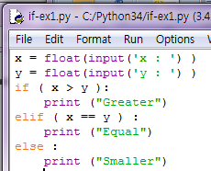
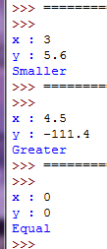
if statements ex1 - answer

Slide 7
if statements ex2
Write a script clip.py that takes numbers lo, x, hi from user input and prints lo if x is less than lo, prints hi if x is greater than hi, and prints x otherwise. You can assume that lo < hi. Use if.

Slide 8
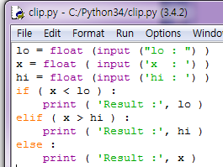
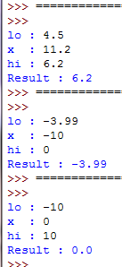
if statements ex2-answer

Slide 9
Fermat’s Last Theorem
Fermat’s Last Theorem says that there are no integers a, b, and c such that
a^{n} + b^{n} = c^{n} for any values of n greater than 2.
Write a script named check_fermat.py that prompts the user to input values for a, b, c and n, converts them to integers and that checks to see if Fermat’s theorem holds. If n is greater than 2 and it turns out to be true that a^{n} + b^{n} = c^{n} , the program should print “Holy smokes, Fermat was wrong!”. Otherwise, the program should print, “No, that doesn’t work.”

Slide 10
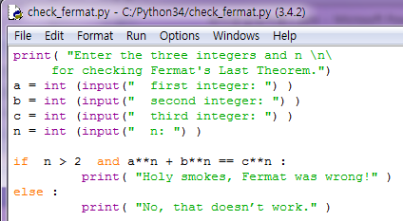
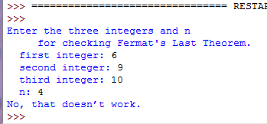
Fermat’s Last Theorem - answer

Slide 11
Triangles
If you are given three sticks, you may or may not be able to arrange them in a triangle. For example, if one of the sticks is 12 inches long and the other two are one inch long, it is clear that you will not be able to get the short sticks to meet in the middle. For any three lengths, there is a simple test to see if it is possible to form a triangle:
“If any of the three lengths is greater than the sum of the other two, then you cannot form a triangle. Otherwise, you can.”
Write a script named is_triangle.py that takes three integers as user input, and that prints either “Yes” or “No,” depending on whether you can or cannot form a triangle from sticks with the given lengths.

Slide 12
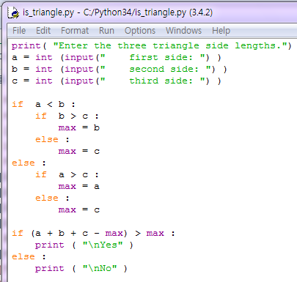
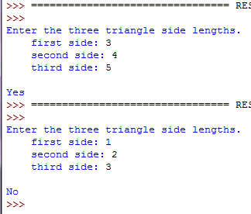
Triangles - answer

Slide 13
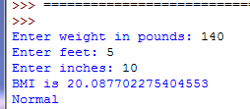
BMI
Write a program to let users enter their weight in pounds and their height in feet and inches. Note that one pound is 0.45359237 kilograms and one inch is 0.0254 meters.
For example, if a person is 5 feet and 10 inches, you will enter 5 for feet and 10 for inches. Here is a sample run:
BMI | Interpretation
Below 18.5 | Underweight
18.5 ~ 24.9 | Normal
25.0 ~ 29.9 | Overweight
Above 30.0 | Obese

Slide 14
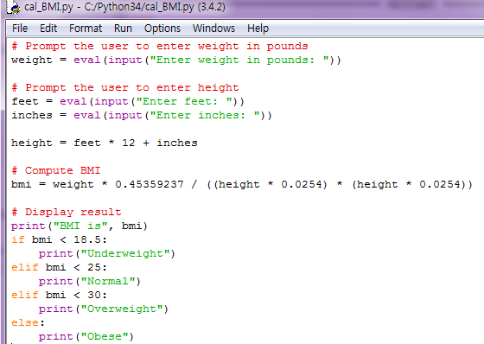
BMI - answer

Slide 15

Order of three numbers
Write a program that prompts the user to enter three integers and displays them in increasing order.

Slide 16
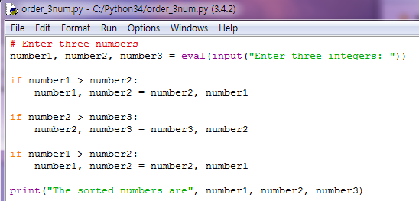
Order of three numbers - answer

Slide 17
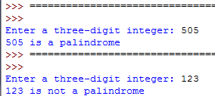
Palindrome number
Write a program that prompts the user to enter a three-digit integer and determines whether it is a palindrome number. A number is a palindrome if it reads the same from right to left and from left to right. Here is a sample run of this program:

Slide 18
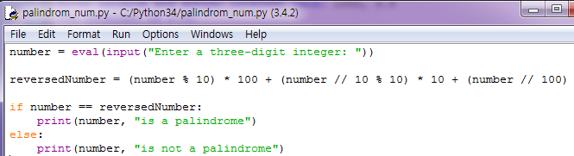
Palindrome number - answer

Slide 19
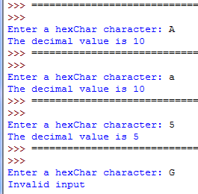
Hex to decimal
Write a program that prompts the user to enter a hex character and displays its corresponding decimal integer. Here are some sample runs:

Slide 20
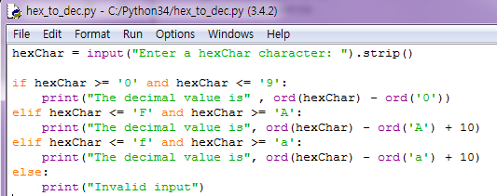
Hex to decimal - answer

Slide 21
while statement ex1
Define a script multIA.py which prints the product of m and n, assuming that n is a positive integer. Don't use *; instead, use a while loop, and +.

Slide 22
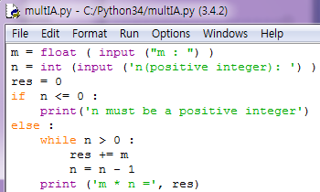
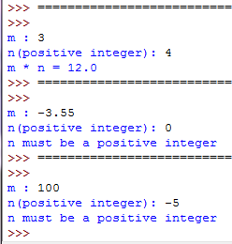
while statement ex1 - answer

Slide 23
for statement ex1
Write a script prime.py, which takes an positive integer n, prints “prime” if n is prime and prints “not prime” otherwise. It's okay if it's slow. Use a for loop.

Slide 24
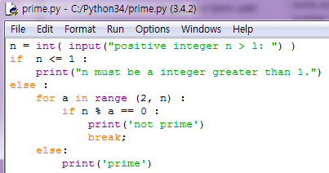
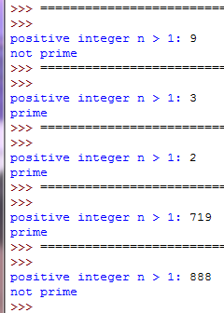
for statement ex1 - answer

Slide 25
Smallest number
Use a while loop to find the smallest integer n such that n2 is greater than 12,000.

Slide 26
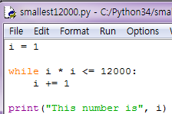

Smallest number - answer

Slide 27
Greatest common divisor
A solution to find the greatest common divisor of two integers n1 and n2 is as follows: First find d to be the minimum of n1 and n2, and then check whether d, d - 1, d - 2, ..., 2, or 1 is a divisor for both n1 and n2 in this order. The first such common divisor is the greatest common divisor for n1 and n2.
Write a program that prints a gcd of two integers.

Slide 28
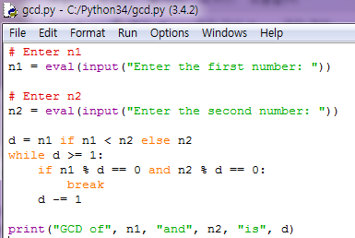

Greatest common divisor - answer

Slide 29
Display patterns
Use nested loops that display the following patterns in four separate programs:
Pattern A Pattern B Pattern C Pattern D
1 1 2 3 4 5 6 1 1 2 3 4 5 6
1 2 1 2 3 4 5 2 1 1 2 3 4 5
1 2 3 1 2 3 4 3 2 1 1 2 3 4
1 2 3 4 1 2 3 4 3 2 1 1 2 3
1 2 3 4 5 1 2 5 4 3 2 1 1 2
1 2 3 4 5 6 1 6 5 4 3 2 1 1

Slide 30
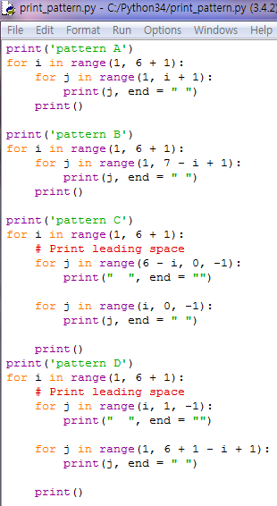
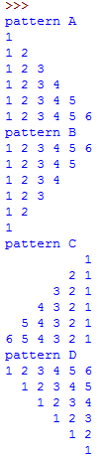
Display patterns - answer

Slide 31
Approximate e
You can approximate e by using the following series:
Write a program that displays the e value for i = 10000, 20000, . . ., and 100000.
(Hint: Since ,
then is
Initialize e and item to be 1 and keep adding a new item to e. The new item is the previous item divided by i for i = 2, 3, 4, . . . .)

Slide 32
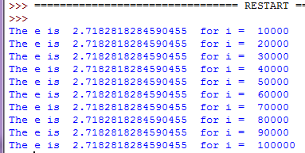
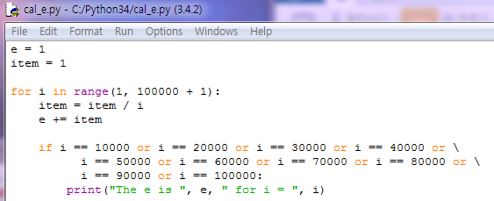

Slide 33
Loop
Write a script p2.py that takes an integer parameter x. If x is greater than 1, prints the largest power of two that is less than x; otherwise, prints 0. Use a loop.

Slide 34
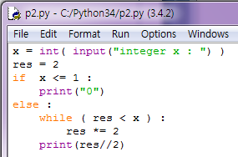
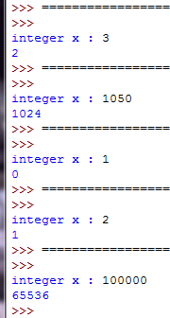
Loop -answer

Slide 35
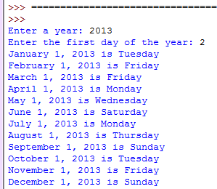
First day of each month
Write a program that prompts the user to enter the year and first day of the year, and displays the first day of each month in the year on the console. For example, if the user entered year 2013, and 2 for Tuesday, January 1, 2013, your program should display the following output:

Slide 36
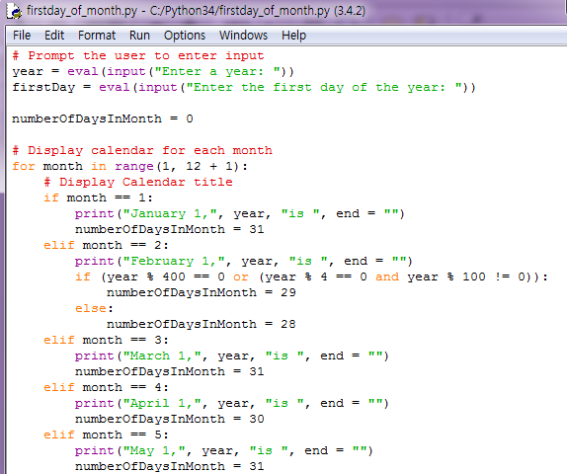
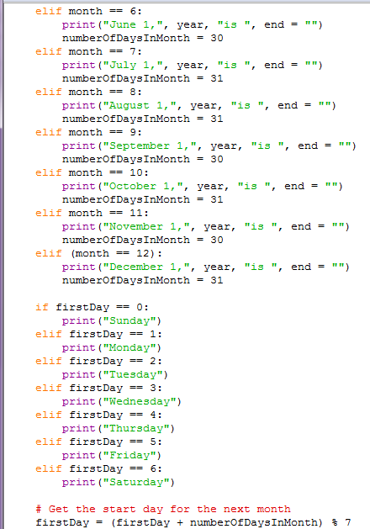
First day of each month - answer

Slide 37
Newton’s method
One way of computing square roots is Newton’s method. Suppose that you want to know the square root of a. If you start with almost any estimate, x, you can compute a better estimate with the following formula:
Repeatedly calculate y with old value of y as x until absolute value of (y – x) is smaller than epsilon.
Write a script named newton.py that takes x and epsilon as user inputs, and that prints the result value.

Slide 38
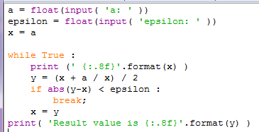
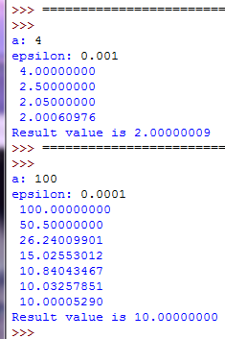
Newton’s method - answer

