Slide 1
Python 실습자료04 - answer
공학정보처리 ENG1108
김 은 진

Slide 2
Function Types
For each of the following functions, specify the type of the output. If it can be either an int or a float, use num, which isn't a real Python type, but which we'll use to indicate that either basic numeric type is legal. In fact, in Python, booleans True and False can be operated on as if they were the integers 1 and 0; but it is ugly and confusing to take advantage of this fact, and we will resolutely pretend that it isn't true.
Result is one of (noneType, num, int, float, boolean)

Slide 3
Function Types
def a(x):
return x + 1
def b(x):
return x + 1.0
def c(x, y):
return x + y(Assume that x and y are ints or floats.)
def d(x,y):
return x > y
def e(x, y, z):
return x >= y and x <= z
def f(x, y):
x + y - 2

Slide 4
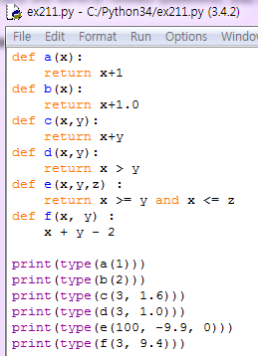
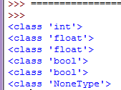
Function Types -answer

Slide 5
Function Types 2
Assume the functions from Function Type have been defined. Provide the type and value of the expressions being evaluated. If evaluating an expression would cause an error, select noneType and write error message. If the value of an expression is a function, write the type and the function name
Result type is one of (noneType, num, int, float, boolean)

Slide 6
Function Types 2
a(6)
a(-5.3)
a(a(a(6)))
c(a(1), b(1))
d(10, 11.1)
e(a(3), b(4), c(3,4))

Slide 7
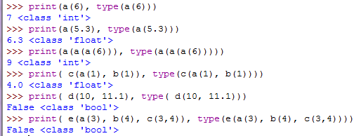
Function Types 2 -answer

Slide 8
Odd Test
Define a function odd(x) that returns True when its integer argument is an odd number and False otherwise. It should have type int -> boolean. Use the % (mod) operator, not if.

Slide 9
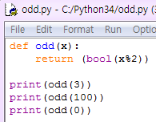

Odd Test - answer

Slide 10
Evaluate a quadratic at a point
Define a function evalQuadratic(a, b, c, x) that returns the value of the quadratic ax² + b x + c. Your function should have type (num, num, num, num) -> num.

Slide 11
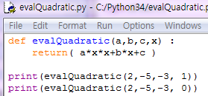

Evaluate a quadratic at a point - answer

Slide 12
Boolean function
A number, a, is a power of b if it is divisible by b and a/b is a power of b. Write a function called is_power that takes parameters a and b and returns True if a is a power of b. otherwise, it returns False.
Note: you will have to think about the base case.

Slide 13
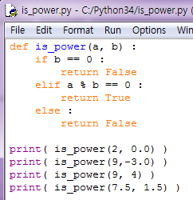

Boolean function-answer

Slide 14
Arithmetic if
Define a function arithmeticIf(v, a, b, c) that returns a if v is greater than 0, b if v is equal to 0, and c if it is less than 0. Your function should have type (num, *, *, *) -> *, where, by * we mean that it could be any type.

Slide 15
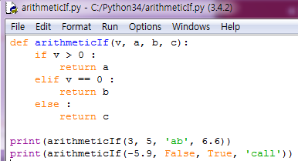

Arithmetic if-answer

Slide 16
Clip clop
Define a function clip(lo, x, hi) that returns lo if x is less than lo, returns hi if x is greater than hi, and returns x otherwise. You can assume that lo < hi. This time, don't use if, but use min and max. Your function should have type (num, num, num) -> num.

Slide 17
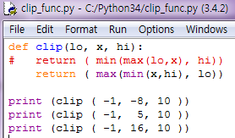

Clip clop - answer

Slide 18
Multiple times
Define a function multIA(m, n), which returns the product of m and n, assuming that n is a positive integer. Don't use *; instead, use a while loop, and +. Your function should have type (num, positiveInt) -> num.

Slide 19
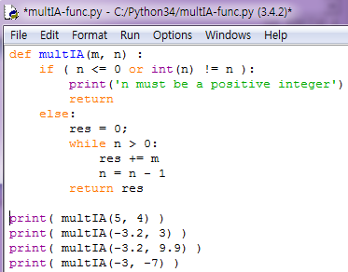
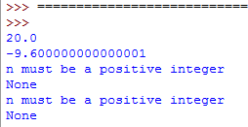
Multiple times - answer

Slide 20
Multiple times2
Define a function multIAgen(m, n), which returns the product of m and n, both arguments are integers, but can be positive or negative. Don't use *, but assume that multIA from the last problem is already defined for you. Your function should have type (int, int) -> int

Slide 21
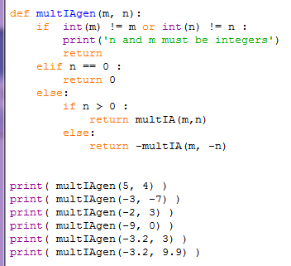
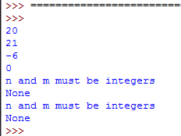
Multiple times2 - answer

Slide 22
A la mod
Define a function mod(m, n), which returns m mod n, where both arguments are positive integers. Don't use %. Your function should have type (positiveInt,positiveInt) -> positiveInt

Slide 23
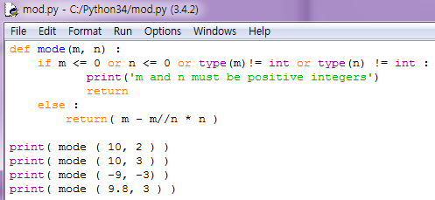
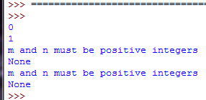
A la mod - answer

Slide 24
Great Common Divisor
The greatest common divisor (GCD) of a and b is the largest number that divides both of them with no remainder. One way to find the GCD of two numbers is Euclid’s algorithm, which is based on the observation that if r is the remainder when a is divided by b, then gcd(a, b) = gcd(b, r). As a base case, we can consider gcd(a, 0) = a.
Write a function called gcd that takes parameters a and b and returns their greatest common divisor.

Slide 25
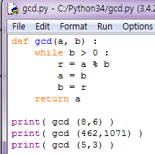

Great Common Divisor -answer

Slide 26
distance
You want to find the distance between two points, given by the coordinates (x₁, y₁) and (x₂, y₂). By the Pythagorean theorem, the distance is:
Define the function distance which calculate and return the distance between two points and write a script that test the function with(2,1)and (5,-3).

Slide 27
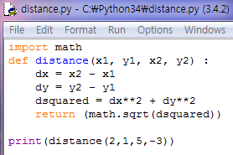

Distance - answer

Slide 28
Distance from point to line
Define a function perpDist(px, py, a, b, c) that returns the unsigned (positive) distance between a point in two-dimensional space with coordinates px, py and a line with equation ax + by + c == 0. Use math.sqrt (of type num -> float). Your function should have type (num, num, num, num, num) -> float. We don't necessarily expect you to remember or rederive this formula; try Google if you need help. You might find the function abs useful.

Slide 29
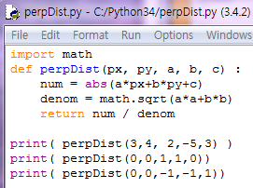

Distance from point to line - answer

Slide 30
eval function
The built-in function eval takes a string and evaluates it using the Python interpreter. For example:
>>> eval('1 + 2 * 3')
7
>>> import math
>>> eval('math.sqrt(5)')
2.2360679774997898
>>> eval('type(math.pi)')
<type 'float'>
Write a function called eval_loop that iteratively prompts the user, takes the resulting input and evaluates it using eval, and prints the result.
It should continue until the user enters 'done', and then return the value of the last expression it evaluated.

Slide 31
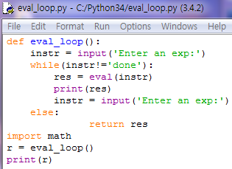
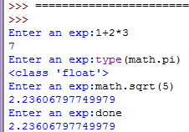
eval function - answer
Function return value

Slide 32
Newton’s method 2
To test the Newton’s method, you could compare it with math.sqrt. Write a function named test_square_root that prints a table like this:
1.0 1 1 0
2.0 1.41421356237 1.41421356237 2.22044604925e-16
3.0 1.73205080757 1.73205080757 0
4.0 2 2 0
5.0 2.2360679775 2.2360679775 0
6.0 2.44948974278 2.44948974278 0
7.0 2.64575131106 2.64575131106 0
8.0 2.82842712475 2.82842712475 4.4408920985e-16
9.0 3 3 0
The first column is a number, a; the second column is the square root of a computed with Newton’s method function; the third column is the square root computed by math.sqrt; the fourth column is the absolute value of the difference between the two estimates.

Slide 33
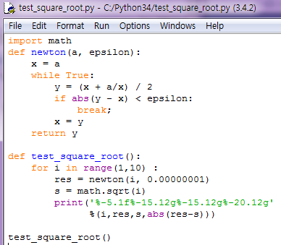
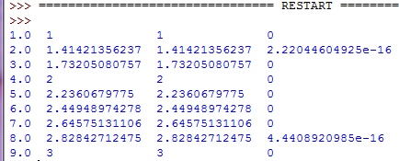
Newton’s method 2 - answer
Format string % values for replacing
Format string
%f : floating-point
%-5.1f: left justified
% 5.1f: right justified
%g: very big or small number in scientific notation

Slide 34
numerical approximation of π
The brilliant mathematician Srinivasa Ramanujan found an infinite series that can be used to generate a numerical approximation of π:
Write a function called estimate_pi that uses this formula to compute and return an estimate of π. It should use a while loop to compute terms of the summation until the last term is smaller than 1e-15 (which is Python notation for 10⁻¹⁵). You can check the result by comparing it to math.pi.

Slide 35

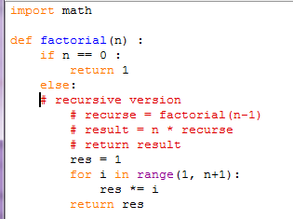
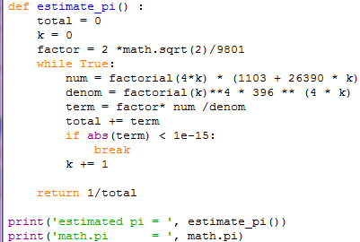
numerical approximation of π - answer

Slide 36
Perfectly square
Define a function perfectSquare(n), which returns True if n is a perfect square and False otherwise. Your function should have type (positiveInt) -> boolean

Slide 37
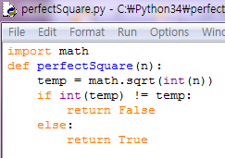
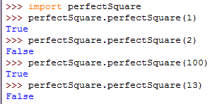
Perfectly square - answer
Module name
Module name.function name

