Slide 1
Python 실습자료05 - answer
공학정보처리 ENG1108
김 은 진

Slide 2
Upper case-file
Write a program to read through a file and print the contents of the file(line by line) all in upper case. Executing the program will look as follows:
python shout.py
Enter a file name: mbox-short.txt
FROM STEPHEN.MARQUARD@UCT.AC.ZA SAT JAN 5 09:14:16 2008
RETURN-PATH: <POSTMASTER@COLLAB.SAKAIPROJECT.ORG>
RECEIVED:FROM MURDER (MAIL.UMICH.EDU [141.211.14.90])
BY FRANKENSTEIN.MAIL.UMICH.EDU (CYRUS V2.3.8) WITH LMTPA;
SAT 05, JAN 2008 09:14:16 -0500
You can download the file from www.py4inf.com/code/mbox-short.txt

Slide 3
Upper case-file - answer
# Main
file = None
fileName = enterFileName()
try:
file = open(fileName, 'r') # Open file
except:
print("File cannot be opened: " + str(fileName))
exit()
if file != None:
try:
for line in file: # Read file content
print(line.rstrip().upper()) # Print content
except:
print("Error on reading file content!")
try:
file.close() # Close file
except:
print("File could not be closed!")
exit()
# main.py
# Functions
def enterFileName():
"""
The user has to enter a filename.
Returns fileName
"""
fileName = None
while fileName == None:
# Enter filename
try:
fileName = input("Enter the filename: ")
except:
print("Invalid input!")
continue
return fileName

Slide 4
Spam confidence -file
Write a program to prompt for a file name, and then read through the file and look for lines of the form:
X-DSPAM-Confidence: 0.8475
When you encounter a line that starts with ‘X-DSPAM-Confidence:’ pull apart the line to extract the floating point number on the line. Count these lines and the compare the total of the spam confidence values from these lines. When you reach the end of the file, print out the average spam confidence.
Enter a file name: mbox.txt
Average spam confidence: 0.894128046745
Enter a file name: mbox-short.txt
Average spam confidence: 0.750718518519
Test your file on the mbox.txt and mbox-short.txt files.

Slide 5
Spam confidence –file - answer
# main.py
''' Functions '''
def enterFileName():
"""
The user has to enter a filename.
Returns fileName
"""
fileName = None
while fileName == None:
# Enter filename
try:
fileName = input("Enter the filename: ")
except:
print("Invalid input!")
continue
return fileName
# End of enterFileName()
''' Main '''
file = None
totalSpam = 0
spamCounter = 0
spamAverage = 0
fileName = enterFileName()
try:
file = open(fileName, 'r') # Open file
except:
print("File cannot be opened: " + str(fileName))
exit()
if file != None:
try:
for line in file: # Read file content
if line.startswith("X-DSPAM-Confidence:"):
try:
totalSpam += float(line[20:-1])
spamCounter += 1
except:
continue
except:
print("Error on reading file content!")
spamAverage = totalSpam / spamCounter
print("Average spam confidence: " + str(spamAverage))
try:
file.close() # Close file
except:
print("File could not be closed!")
exit()

Slide 6
Easter Egg -file
Sometimes when programmers get bored or want to have a bit of fun, they add a harmless Easter Egg to their program (en.wikipedia.org /wiki /Easter_egg_(media)). Modify the program that prompts the user for the file name so that ir prints a funny message when the user types in the exact file name ‘ma ma boo boo’. The program should behave normally for all other files which exist and don’t exist. Here is a sample execution of the program:
Enter a file name: mbox.txt
There were 1797 subject lines in mbox.txt
Enter a file name: missing.tyxt
File cannot be opened: missing.tyxt
Enter a file name: na na boo boo
NA NA BOO BOO TO YOU – You have been punk’d!
We are not encouraging you to put Easter Eggs in your programs – this is just an exercise.

Slide 7
Easter Egg –file -answer
''' Main '''
file = None
subjectCounter = 0
fileName = enterFileName()
try:
file = open(fileName, 'r') # Open file
except:
if fileName == "na na boo boo":
print("NA NA BOO BOO TO YOU - You have been punk'd!")
else:
print("File cannot be opened: " + str(fileName))
exit()
if file != None:
try:
for line in file: # Read file content
if line.startswith("Subject: "):
subjectCounter += 1
except:
print("Error on reading file content!")
print("There were " + str(subjectCounter)
+ " subject lines in " + str(fileName))
try:
file.close() # Close file
except:
print("File could not be closed!")
exit()
# main.py
''' Functions '''
def enterFileName():
"""
The user has to enter a filename.
Returns fileName
"""
fileName = None
while fileName == None:
# Enter filename
try:
fileName = input("Enter the filename: ")
except:
print("Invalid input!")
continue
return fileName
# End of enterFileName()

Slide 8
CopyFile
Write a program
Prompts the user to enter a source file and target file
Determines whether the files exit
If the file doesn’t exit, the program reads each lines from the source file and write the line on the target file.
Tracks the number of lines and characters .
Enter a source file: input.txt
Enter a target file: output.txt
output.txt already exits
Enter a source file: input.txt
Enter a target file: output2.txt
3 lines and 73 characters copied

Slide 9
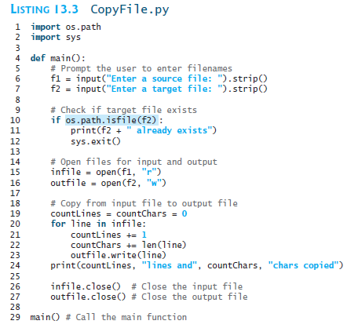
CopyFile -answer

