Slide 1
Python 실습자료06 - answer
공학정보처리 ENG1108
김 은 진

Slide 2
Types and values
For each of the expressions below, specify its type and value. If it generates an error, write type noneType and write the word error for the value. Assume we've made the following assignments:
Type is one of (noneType, int, float, boolean, function, string, list, tuple)
>>> a = 'hi'
>>> x = [ 1, 2, [3, 'John', 4], 'Hi‘ ]

Slide 3
Types and values
1. a
2. a[0]
3. a[1]
4. a[2]
5. x[0]
6. x[2]
7. x[-1]
8. x[2][2]
9. x[2][-1]
10. x[-1][2]
11. x[0:1]
12. x[0:-1]
13. len(x)
14. (a, b, c, d) = x
15. range(3)
16. range(3,10)
17. range(3,10,3)
18. range(10,3)
19. range(10,3,-1)
20. range(len(x))

Slide 4
Types and values
21. 'hi' == 'Hi'
22. 2 in x
23. 3 in x
24. 'John' in x
25. 'Hi' in x
26. sum(range(4))
27. [x for x in range(3)]
28. [x*2 for x in range(3)]
29. sum([x*2 for x in range(3)])
30. [-x for x in [8, 2, 1]]
31. def fizz(x):
return x + 1
[fizz(fizz(x)) for x in [8, 2, 1]]
32. [x for x in rang(10) if x % 2 == 0]

Slide 5
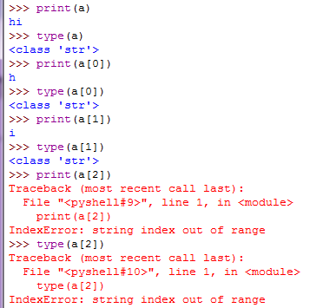
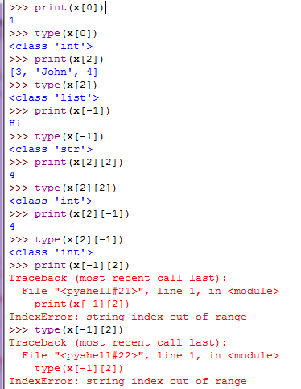
Types and values -answer

Slide 6
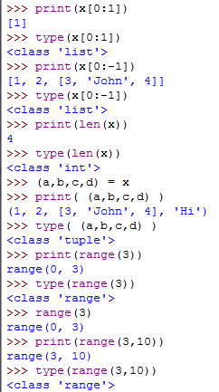
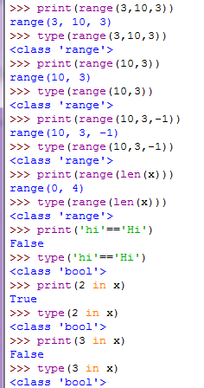
Types and values -answer

Slide 7
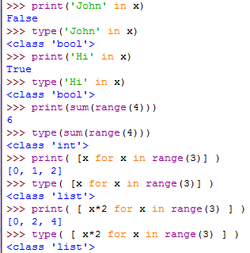
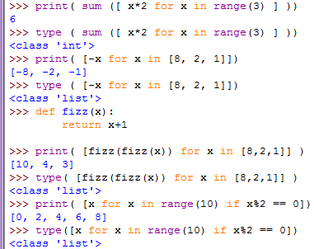
Types and values -answer

Slide 8
ranger
Write an expression that is a single call to range, such as range(2, 3) to generate each of the following lists.
1. [0, 1, 2, 3, 4]
2. [44, 45, 46]
3. [-3, -2, -1, 0, 1]
4. [1, 3, 5, 7]
5. [5, 4, 3, 2]

Slide 9
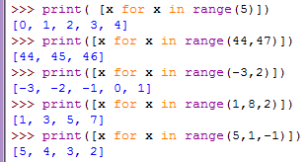
ranger - answer

Slide 10
every other(list)
Write a function that takes a list as input and returns a new list with alternating elements of the original list, starting with the first. So, you'd get
>>> everyOther([1, 2, 3, 4, 5])
[1, 3, 5]
>>> everyOther(['this', 'is', 'a', 'sentence'])
['this', 'a']
You can do this using the things you already know; or you can go read the Python Tutorial documentation about fancier uses of range.

Slide 11
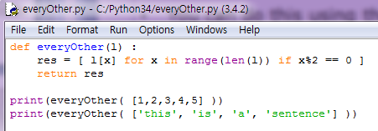

every other

Slide 12
Cat6(list)
In Python you can use + to concatenate two lists. Write a function, called cat6(l) that takes a list as an argument and returns a list with the integer 6 concatenated to the end; the output will be a list with one more element that the input.

Slide 13
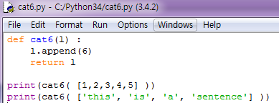

Cat6 – answer

Slide 14
home on the range (list)
Write a function, called myRange, that takes a single positive integer n as an argument and returns a list with elements starting with 0 and going up through n - 1. Don't use range! Use a while loop.

Slide 15
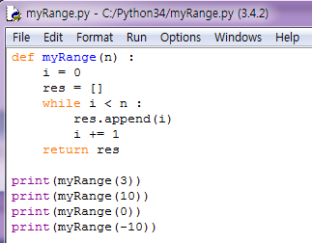
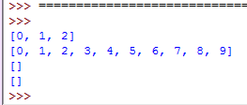
home on the range - answer

Slide 16
Cumulative sum(list)
Write a function that takes a list of numbers and returns the cumulative sum.

Slide 17
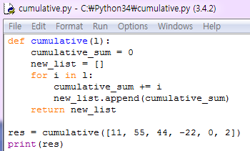

Cumulative sum(list) - answer

Slide 18
middle(list)
Write a function called middle that takes a list and returns a new list that contains all but the first and last elements..

Slide 19
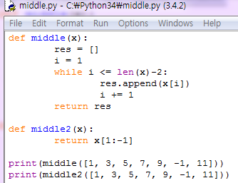

middle(list)- answer

Slide 20
chop(list)
Write a function called chop that takes a list and modifies it, removing the first and last elements, and returns None

Slide 21
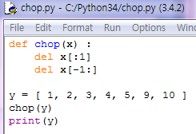

chop(list)- answer

Slide 22
The mean of a list of numbers(list)
The mean (or average) of a list of n numbers is the sum of the numbers divided by n. For example, the mean of 2, 7, 3, 9, and 13 is (2+7+3+9+13)/5, or 6.8. Write a function mean that takes as input a list of numbers (of any length) and returns the mean. It should have type list(num) -> float. One thing to watch out for is an empty list as input. It's not clear that any numeric answer makes sense here. You should just return None You can implement this as an extremely short procedure if you use the Python built-in procedures sum, which returns the sum of the elements of a list, and len, which returns the length of a list. If your function says that the mean of 1 and 2 is 1, rather than 1.5, then you've been tricked by Python's division (/) operation. Be careful.

Slide 23
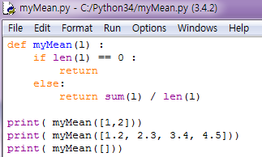

The mean of a list of numbers - answer

Slide 24
Standard deviation(list)
Implement a function stddev that takes a list of numbers as argument and returns the standard deviation. If the list has fewer than 2 elements, then the standard deviation should be 0.0. (Actually, if we want to be correct, the standard deviation of a list of 0 or 1 elements isn't defined, but returning 0.0 is okay for now.)
The standard deviation of a list of n numbers is the square root of the following quantity: 1/(n-1) times the sum of (xi - m)², where xi ranges over the elements of the list and m is the mean of the list. It is a measure of how much variation there is from the mean.

Slide 25
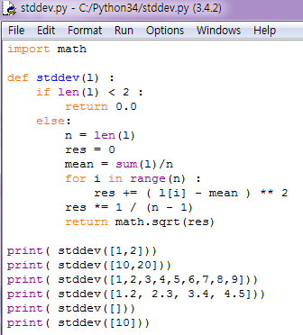
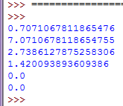
Standard deviation - answer

Slide 26
Standard deviation2(list)
You should try to write the procedure so that it uses list comprehension rather than an explicit loop. You should also use your mean function from the previous problem.
To compute the square root of a number, you can simply raise the number to the power of 0.5 using Python's exponentiation operator **. Alternatively, you can use the Python sqrt function, but you'll need to import it from the math package. In order to do that include
from math import sqrt

Slide 27
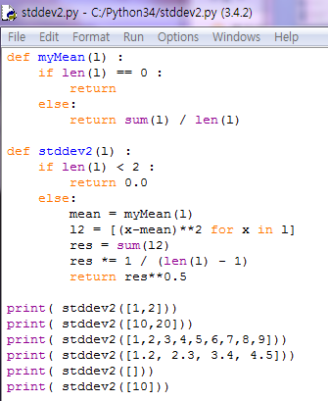
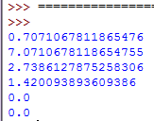
Standard deviation2

Slide 28
Slice of Pi (list)
Define a function piSeries(n), which computes a series approximation to pi with n terms, using the formula:
Your function should have type positiveInt -> float. Be careful about integer division. Use a list comprehension.

Slide 29
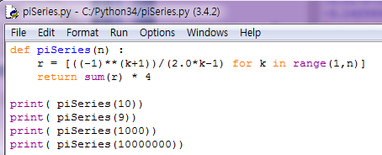

Slice of Pi - answer

Slide 30
Poly(list)
Define a function evalPolynomial(coeffs, x), which returns the value of
where coeffs is a list of coefficients, from highest to lowest order: . A straightforward way to evaluate polynomials is to explicitly add up the terms . Do this with list comprehension and sum.
The type of this function should be (list(num), num) -> num.

Slide 31
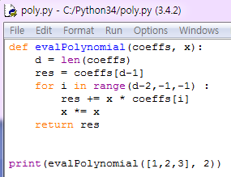

Poly(list) - answer

Slide 32
is_sorted (list)
Write a function called is_sorted that takes a list as a parameter and returns True if the list is sorted in ascending order and False otherwise. You can assume (as a precondition) that the elements of the list can be compared with the relational operators <, >, etc.
For example, is_sorted([1,2,2]) should return True and is_sorted(['b','a']) should return False.

Slide 33
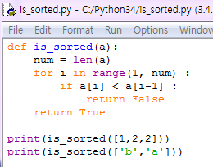

is_sorted (list) - answer

Slide 34
Birthday Paradox (list)
The (so-called) Birthday Paradox:
Write a function called has_duplicates that takes a list and returns True if there is any element that appears more than once. It should not modify the original list.
If there are 23 students in your class, what are the chances that two of you have the same birthday? You can estimate this probability by generating random samples of 23 birthdays and checking for matches. Hint: you can generate random birthdays with the randint function in the random module.

Slide 35
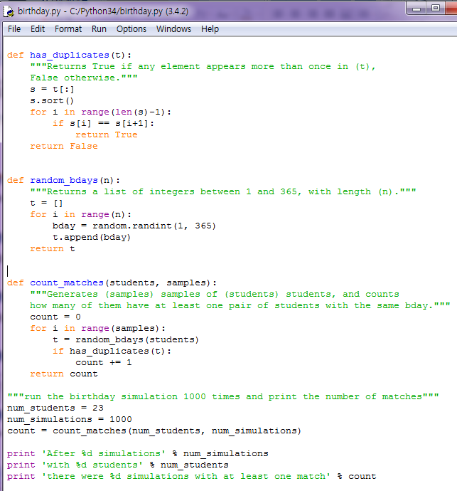
Birthday Paradox (list) - answer

Slide 36
Words (list)
Write a function that reads the file words.txt and builds a list with one element per word. Write two versions of this function, one using the append method and the other using the idiom t = t + [x]. Which one takes longer to run? Why?.

Slide 37
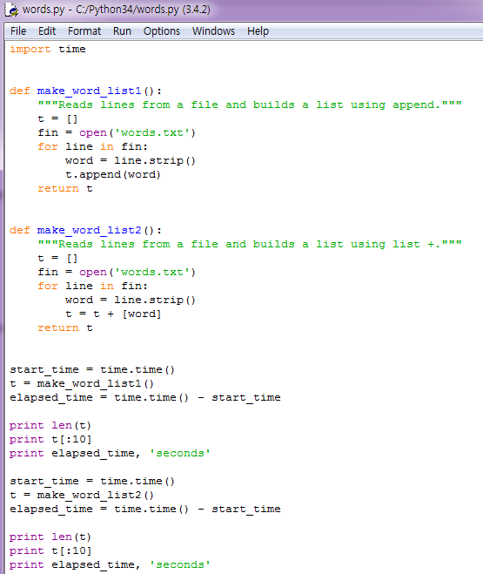
Words (list) - answer

Slide 38
nested sum(list ,recursive)
Write a function called nested_sum that takes a nested list of integers and add up the elements from all of the nested lists.

Slide 39
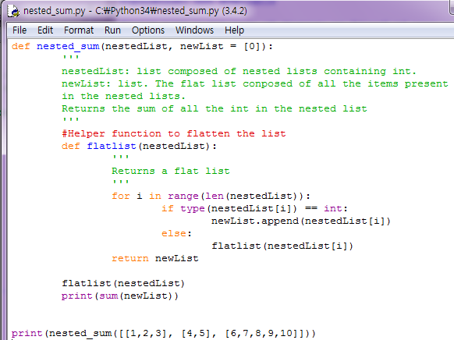

nested sum(list) - answer

Slide 40
Capitalized_nested(list, recursive)
Write a function named "capitalize_nested" that takes a nested list of strings and returns a new nested list with all strings capitalized.

Slide 41
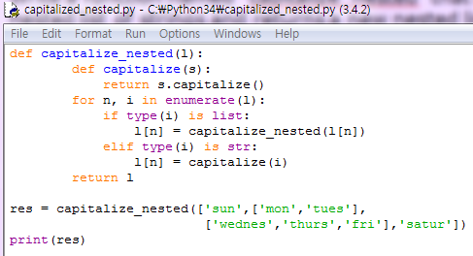
Capitalized_nested(list)

