Slide 1
Python 실습자료07 - answer
공학정보처리 ENG1108
김 은 진

Slide 2
From point A to point B (tuple)
Define a function pointDist(p1, p2) that returns the distance between a point in two-dimensional space with coordinates p1 = (x1, y1) and another point with coordinates p2 = (x2, y2). Use math.sqrt (of type num -> float). Your function should have type ((num, num), (num, num)) -> float.

Slide 3
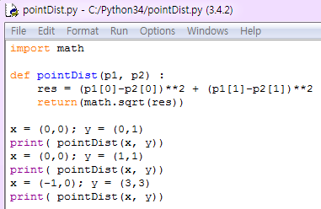

From point A to point B - answer

Slide 4
Distance from point to line (tuple)
Define a function perpDist2(p, l) that returns the unsigned (positive) distance between a point in two-dimensional space with coordinates p = (px, py) and a line with equation ax + by + c == 0, where l = (a, b, c). Use math.sqrt (of type num -> float). Your function should have type ((num, num), (num, num, num)) -> float. We don't necessarily expect you to remember or rederive this formula; try Google if you need help. You might find the function abs useful.

Slide 5
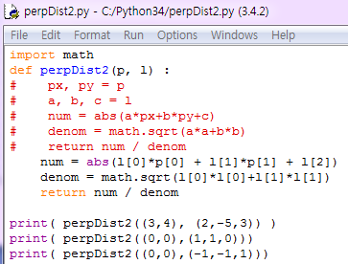

Distance from point to line - answer

Slide 6
Multiple times(tuple)
Define a function multIA2(m, n), which returns the product of m and n, assuming that n is a positive integer. Don't use *; instead, use a for loop, and +. Even though we first asked you to do this with while, generally speaking, any iteration over a fixed set of values is clearer and easier to write as a for loop. Your function should have type (num,positiveInt) -> num

Slide 7
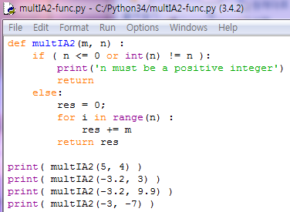
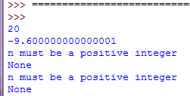
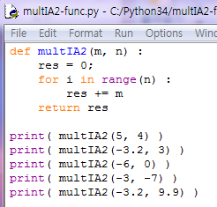
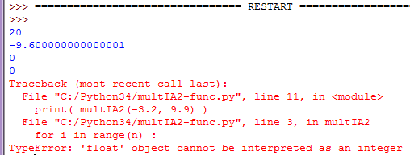
Multiple times - answer

Slide 8
Small (tuple)
Many of the built-in functions use variable-length argument tuples. For example, max and min can take any number of arguments:
>>> max(1,2,3)
3
But sum does not.
>>> sum(1,2,3)
TypeError: sum expected at most 2 arguments, got 3
Write a function called sumall that takes any number of arguments and returns their sum

Slide 9
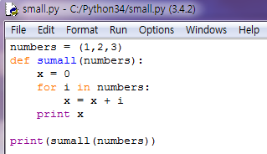
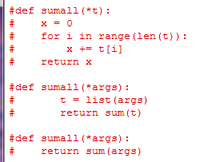
Small (tuple) - answer

Slide 10
Sort_by_length2 (tuple)
In this example, ties are broken by comparing words, so words with the same length appear in reverse alphabetical order. For other applications you might want to break ties at random. Modify this example so that words with the same length appear in random order. Hint: see the random function in the random module.

Slide 11
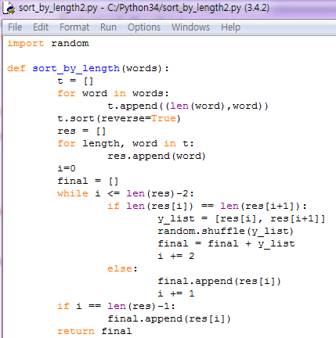
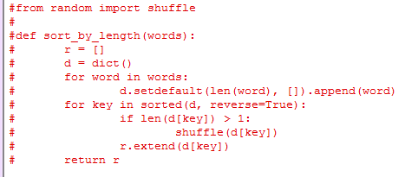
Sort_by_length2 (tuple)- answer

Slide 12
Most_frequent (tuple, dict)
Write a function called most_frequent that takes a string and prints the letters in decreasing order of frequency. Find text samples from several different languages and see how letter frequency varies between languages. Compare your results with the tables at wikipedia.org/wiki/Letter_frequencies.

Slide 13
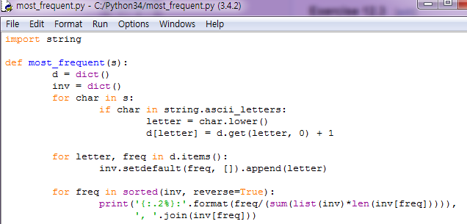
Most_frequent (tuple, dict)-answer

Slide 14
Car Talk Puzzler(tuple, dict)
What is the longest English word, that remains a valid English word, as you remove its letters one at a time? Now, letters can be removed from either end, or the middle, but you can’t rearrange any of the letters. Every time you drop a letter, you wind up with another English word. If you do that, you’re eventually going to wind up with one letter and that too is going to be an English word—one that’s found in the dictionary. I want to know what’s the longest word and how many letters does it have?
I’m going to give you a little modest example: Sprite. Ok? You start off with sprite, you take a letter off, one from the interior of the word, take the r away, and we’re left with the word spite, then we take the e off the end, we’re left with spit, we take the s off, we’re left with pit, it, and I.
Write a program to find all words that can be reduced in this way, and then find the longest one.

Slide 15
Car Talk Puzzler(tuple, dict) – cont.
This exercise is a little more challenging than most, so here are some suggestions:
You might want to write a function that takes a word and computes a list of all the words that can be formed by removing one letter. These are the “children” of the word.
Recursively, a word is reducible if any of its children are reducible. As a base case, you can consider the empty string reducible.
The wordlist I provided, words.txt, doesn’t contain single letter words. So you might want to add “I”, “a”, and the empty string.
To improve the performance of your program, you might want to memorize the words that are known to be reducible.

Slide 16
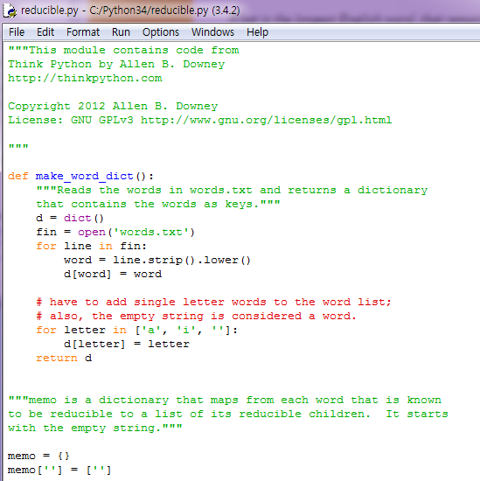
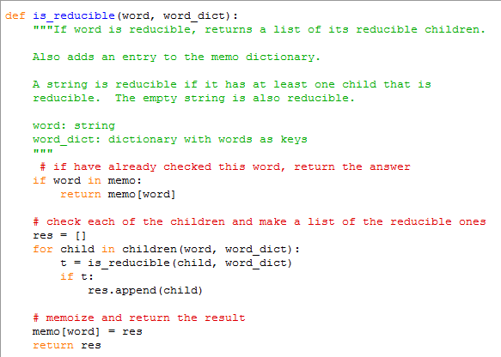
Car Talk Puzzler(tuple, dict) - answer

Slide 17
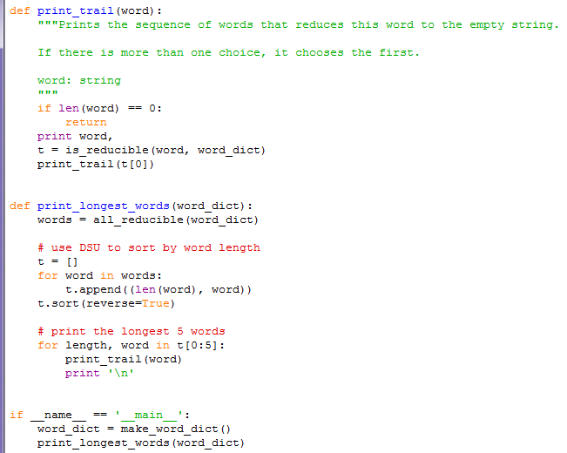
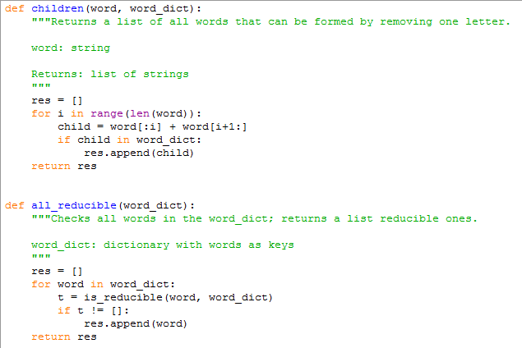
Car Talk Puzzler(tuple, dict) - answer

