Slide 1
Python 실습자료08 - answer
공학정보처리 ENG1108
김 은 진

Slide 2
Dictionaries
Suppose we evaluate the following expressions:
x={}
x['a']='apple‘
x['b']='banana‘
x['c']='chili dog'
Suppose we next evaluate more expressions, producing the following sequence of interactions. Write the result of each expression at that point. If an expression below would generate an error, write error message.

Slide 3
Dictionaries
>>> x
{'a':'apple','c':'chili dog','b':'banana'}
>>> x['c']
>>> x['banana']
>>>x['a']=37
>>>x['a']
>>> x.has_key('a')

Slide 4
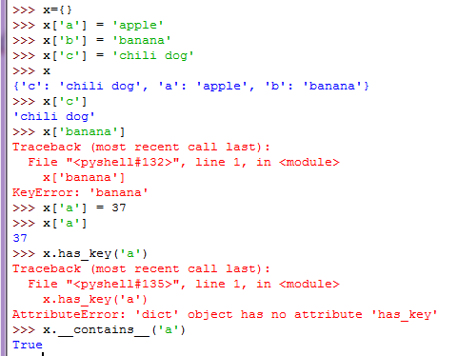
Dictionaries - answer

Slide 5
is_anagram (dic)
Two words are anagrams if you can rearrange the letters from one to spell the other. Write a function called is_anagram that takes two strings and returns True if they are anagrams.

Slide 6
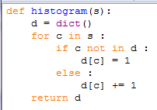

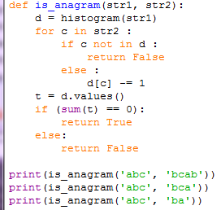
is_anagram (dic) - answer

Slide 7
Words from file(dictionary)
Write a function that reads the words in words.txt and stores them as keys in a dictionary. It doesn’t matter what the values are. Then you can use the in operator as a fast way to check whether a string is in the dictionary.

Slide 8
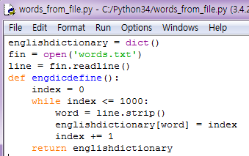
Words from file(dictionary)- answer

Slide 9
Sorting by keys or values (dictionary)
Dictionaries have a method called keys that returns the keys of the dictionary, in no particular order, as a list. Modify print_hist to print the keys and their values in alphabetical order

Slide 10
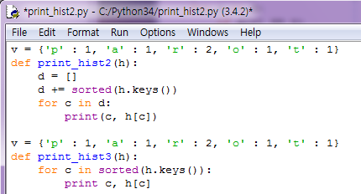
Sorting by keys or values (dictionary) - answer

Slide 11
Reverse_loopup2 (dictionary)
Modify reverse_lookup so that it builds and returns a list of all keys that map to v, or an empty list if there are none.

Slide 12
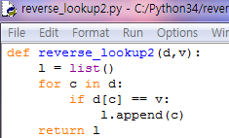
Reverse_loopup2 (dictionary)- answer

Slide 13
Search string(dictionary)
Write a function that reads the words in words.txt and stores them as keys in a dictionary. It doesn’t matter what the values are. Then you can use the in operator as a fast way to check whether a string is in the dictionary.

Slide 14
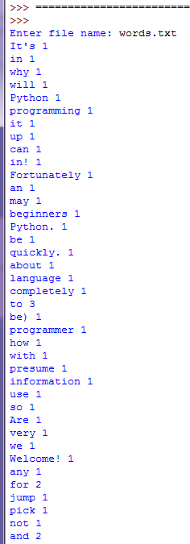
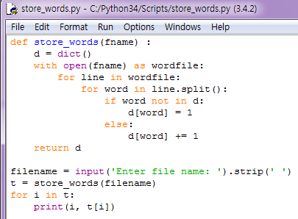
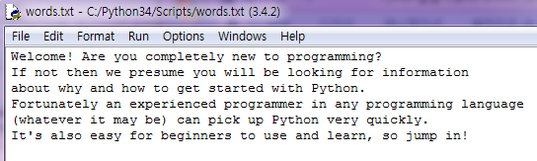
Search string(dictionary) - answer

Slide 15
String slice(string)
A string slice can take a third index that specifies the “step size;” that is, the number of spaces between successive characters. A step size of 2 means every other character; 3 means every third, etc.
>>> fruit = 'banana'
>>> fruit[0:5:2]
'bnn'
A step size of -1 goes through the word backwards, so the slice [::-1] generates a reversed string.
Use this idiom to write a one-line version of is_palindrome

Slide 16
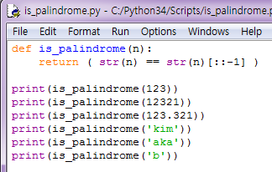
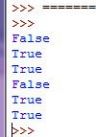
Sting slice(string) - answer

Slide 17
is_anagram (strings)?
Two words are anagrams if you can rearrange the letters from one to spell the other. Write a function called is_anagram that takes two strings and returns True if they are anagrams.

Slide 18
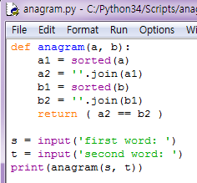
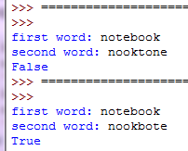
is_anagram (strings)? - answer

Slide 19
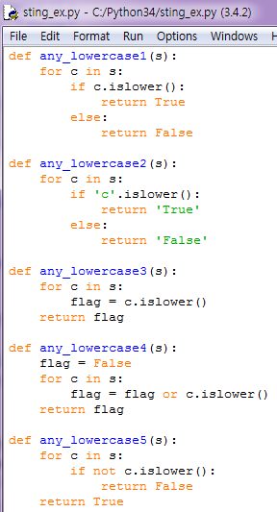
function(string)
The following functions are all intended to check whether a string contains any lowercase letters, but at least some of them are wrong. For each function, describe what the function actually does (assuming that the parameter is a string).

Slide 20
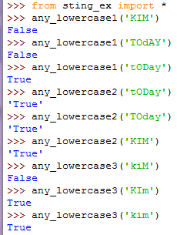
function(string) - answer
any_lowercase1()
첫 글자가 소문자인지 확인
any_lowercase2()
'c'.islower() : 소문자 ‘c’가 소문자인지 확인하므로 항상 ‘True’
any_lowercase3()
각 문자에 대해 islower()를 반복하므로 최종결과는 마지막 문자에 대한 islower() 결과임

Slide 21


function(string) - answer
any_lowercase4()
flag = flag or c.islower()
정답(한 자라도 소문자가 있으면 True)
any_lowercase5()
모든 글자가 소문자일때 True

Slide 22
rotate_word(string)
ROT13 is a weak form of encryption that involves “rotating” each letter in a word by 13 places. To rotate a letter means to shift it through the alphabet, wrapping around to the beginning if necessary, so ’A’ shifted by 3 is ’D’ and ’Z’ shifted by 1 is ’A’.
Write a function called rotate_word that takes a string and an integer as parameters, and that returns a new string that contains the letters from the original string “rotated” by the given amount.
For example, “cheer” rotated by 7 is “jolly” and “melon” rotated by -10 is “cubed”.
You might want to use the built-in functions ord, which converts a character to a numeric code, and chr, which converts numeric codes to characters.
Potentially offensive jokes on the Internet are sometimes encoded in ROT13. If you are not easily offended, find and decode some of them.

Slide 23
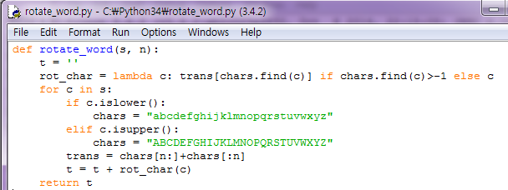
rotate_word(string) - answer

