Slide 1
Python 실습자료09 - answer
공학정보처리 ENG1108
김 은 진

Slide 2
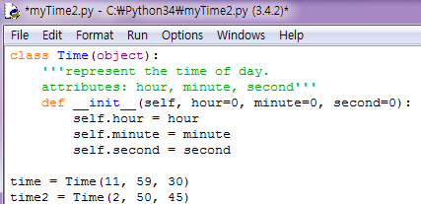
Classes – Time (1)
We will define a class called Time that records the time of day. The class definition looks like this. And we can create a new Time object and __init__ method assigns attributes for hour, minutes, and seconds:

Slide 3
Classes – Time (2)
Write a method called print_time that takes a Time object and prints it in the form hour:minute:second. Hint: the format sequence %.2d prints an integer using at least two digits, including a leading zero if necessary.
Write a boolean method called is_after that takes a Time object, t2, and returns True if self follows t2 chronologically and False otherwise. Don’t use an if statement.

Slide 4
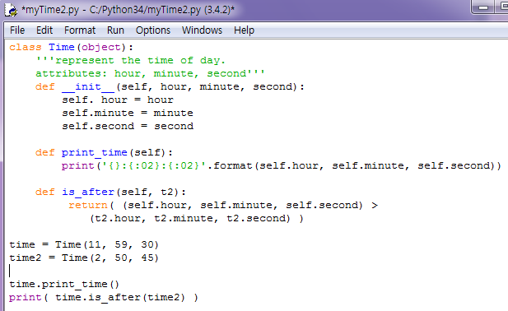

Classes – Time (2) - answer
1.2.

Slide 5
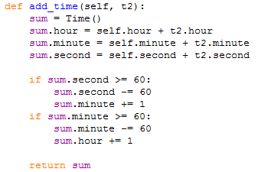
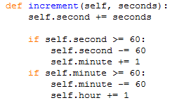
Classes – Time (3)
We’ll write two functions that add time values. Here is add_time:
Increment, which adds an given number of seconds to a Time object. Is this function correct?

Slide 6
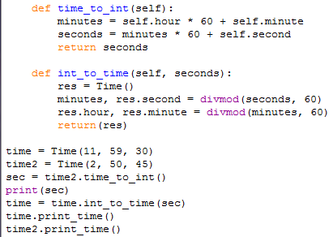

Classes – Time (4)
Write a correct version of increment that doesn’t contain any loops.
Here is a function that converts Times to integers. And here is the function that converts integers to Time. You might have to think a bit, and run some test, to convince yourself that these functions are correct. This is an example of a consistency check.

Slide 7
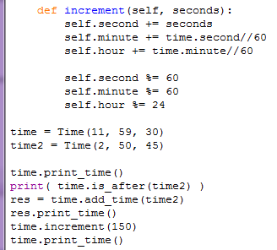

Classes – Time (4) - answer
3.

Slide 8
Classes – Time (5)
Rewrite add_time using time_to_int and int_to_time
Rewrite increment using time_to_int and int_to_time.
Write a method called mul_time that takes a number and returns a new Time object that contains the product of the original Time and the number. Then use mul_time to write a method that represents the finishing time in a race, and a number that represents the distance, and returns a Time object that represents the average pace(time per mile).

Slide 9
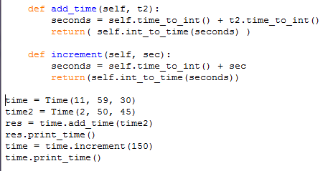

Classes – Time (5) – answer1
4. 5.

Slide 10
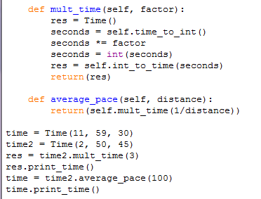

Classes – Time (5) – answer2
6.

Slide 11
Class-Time(6)
Write a __lt__ method and __eq__ method for Time objects. Hint: you can use tuple comparison, but you also might consider using integer subtraction

Slide 12
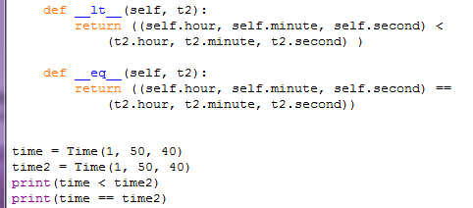
Class-Time(6) - answer

Slide 13
Classes – Date
Write a class definition for a Date object that has attributes day, month, and year. Write a method called increment_date that takes an integer n, and returns a new Date object that represents the day n days after date. Does your function deal with leap years correctly?

Slide 14
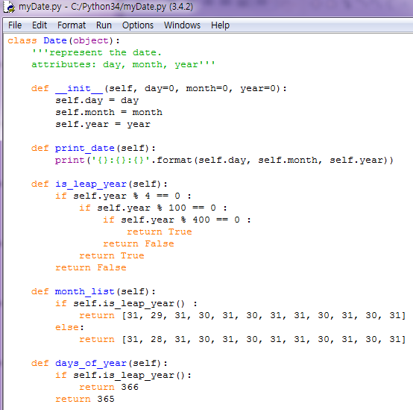
Classes – Date – answer1

Slide 15
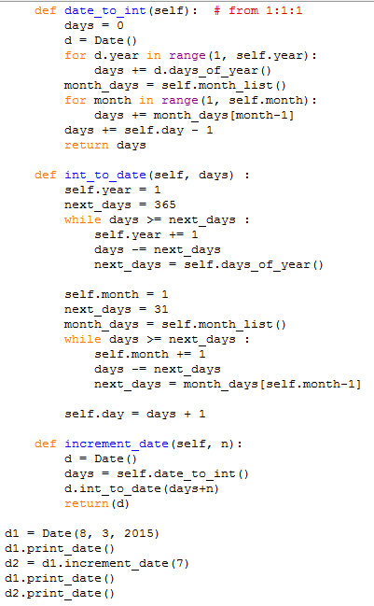

Classes – Date – answer2

Slide 16
Using datetime
Use the datetime module to write a function current_weekday that gets the current date and prints the day of the week.

Slide 17
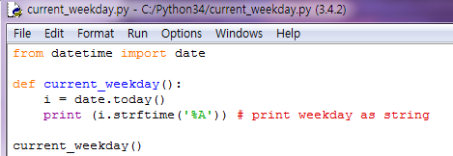

Using datetime - answer

Slide 18
Next Birthday
Write a function that takes a birthday as input and prints the user’s age and the number of days, hour, minutes and seconds until their next birthday?

Slide 19

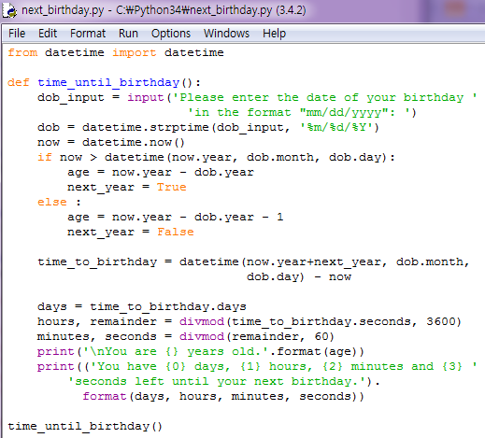
Next Birthday - answer

Slide 20
Class - Point
Write an init method for the 'Point' class that takes 'x' and 'y' as optional parameters and assigns them to the corresponding attributes.
Write a ‘__str__' method for the 'Point' class. Create a Point object and print it.
Write an ‘__add__' method for the Point class.
Write an 'add' method for Points that works with either a Point object or a tuple:
If the second operand is a Point, the method should return a new Point whose 'x' coordinate is the sum of the 'x' coordinates of the operands, and likewise for the 'y' coordinates.
If the second operand is a tuple, the method should add the first element of the tuple to the 'x' coordinate and the second element to the 'y' coordinate, and return a new Point with the result.

Slide 21
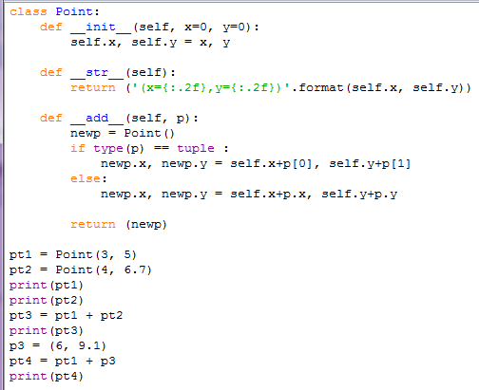

Class – Point - answer

Slide 22
Cautionary tail
This exercise is a cautionary tale about one of the most common, and difficult to find, errors in Python.
Write a definition for a class named 'Kangaroo' with the following methods:
An __init__ method that initializes an attribute named pouch_contents to an empty list.
A method named put_in_pouch that takes an object of any type and adds it to pouch_contents.
A __str__ method that returns a string representation of the Kangaroo object and the contents of the pouch.
Test your code by creating two '''Kangaroo''' objects, assigning them to variables named '''kanga''' and '''roo''', and then adding '''roo''' to the contents of '''kanga'''’s pouch.‘

Slide 23
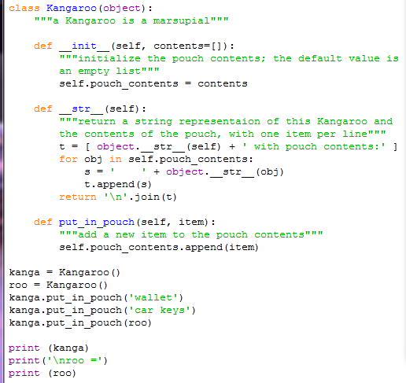
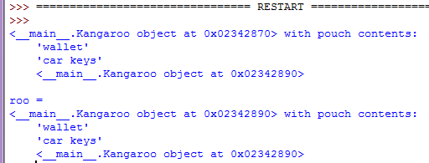
Cautionary tail – wrong answer
Wrong answer와 다음 페이지의 정답을 비교하십시오.
# The problem is the default value for contents.
# Default values get evaluated ONCE, when the function
# is defined; they don't get evaluated again when the
# function is called.
# In this case that means that when __init__ is defined,
# [] gets evaluated and contents gets a reference to
# an empty list.
# After that, every Kangaroo that gets the default
# value get a reference to THE SAME list. If any
# Kangaroo modifies this shared list, they all see
# the change.

Slide 24
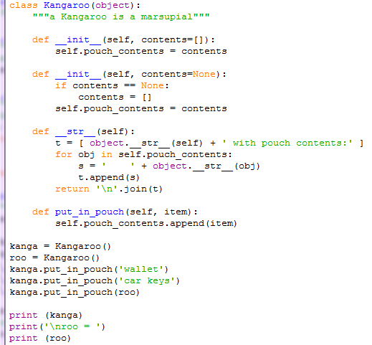
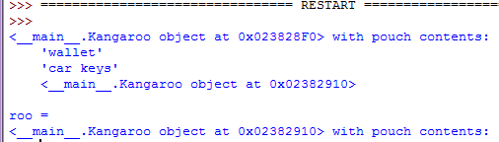
Cautionary tail - answer
# In this version, the default value is None. When
# __init__ runs, it checks the value of contents and,
# if necessary, creates a new empty list. That way,
# every Kangaroo that gets the default value get a
# reference to a different list.
# As a general rule, you should avoid using a mutable
# object as a default value, unless you really know
# what you are doing.

Slide 25

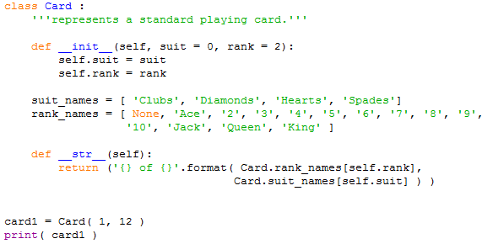
Card game – inheritance (1)
There are fifty-two cards in a deck, each of which belongs to one of four suits and one of thirteen ranks. The suits are Spades, Hearts, Diamonds, and Clubs (in descending order in bridge). The ranks are Ace, 2, 3, 4, 5, 6, 7, 8, 9, 10, Jack, Queen, and King. Depending on the game that you are playing, an Ace may be higher than King or lower than 2.
We define the class Card like this
Class attributes
instance attributes

Slide 26
Card game – inheritance(2)
For user-defined types, override the behavior of the conditional operators(<, >, == etc) by providing a method names __lt__ and __eq__

Slide 27
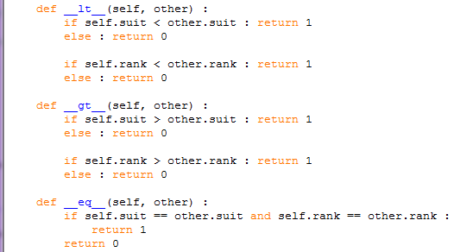
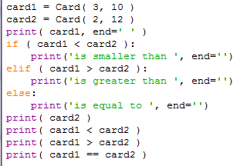

Card game– inheritance(2) - answer
For user-defined types, override the behavior of the conditional operators(<, >, == etc) by providing a method names __lt__, __gt__, and __eq__
Single statement block can be specified on the same line of a conditional statement or looping statement.

Slide 28
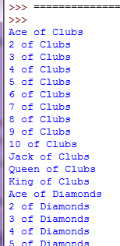
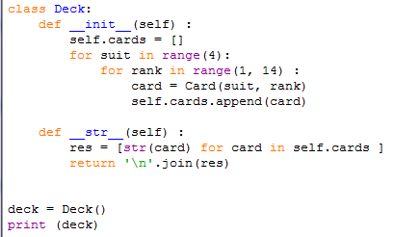
Card game– inheritance(3)
Now that we have Cards, the next step is to define Decks. Since a deck is made up of cards, it is natural for each Deck to contain a list of cards as an attribute. The following is a class definition for Deck. The init method creates the attribute cards and generates the standard set of fifty-two cards

Slide 29
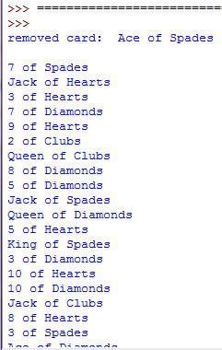
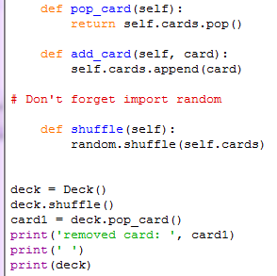
Card game– inheritance(4)
To deal cards, we make some methods
pop removes a card from the deck and returns it
append adds a card to the deck
shuffle does shuffle the deck

Slide 30
Card game– inheritance(5)
Write a Deck method named 'sort' that uses the list method 'sort' to sort the cards in a 'Deck'. 'sort' uses the __lt__ method we defined to determine sort order.

Slide 31

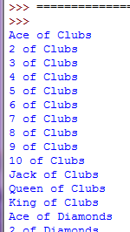

Card game– inheritance(5) - answer

Slide 32
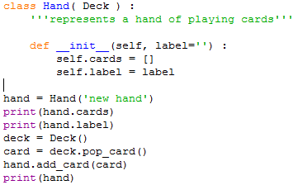

Card game– inheritance(6)
Let’s make a class to represent a “hand” , that is, the set of cards held by one player. A hand is similar to a deck: both are made up of a set of cards, and both require operations like adding and removing cards. A hand is also different from a deck; there are operations we want for hands that don’t make sense for a deck. For example, in poker we might compare two hands to see which one wins. In bridge, we might compute a score for a hand in order to make a bid. This relationship between classes—similar, but different—lends itself to inheritance.
inherits from Deck class
can use pop_card, add_card,
__str__ method of Deck
- __init__ method for Hand

Slide 33
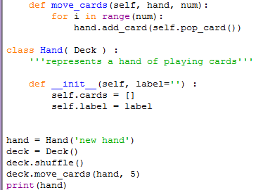
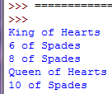
Card game– inheritance(7)
This method move_cards takes two arguments, a Hand object and the number of cards to deal. It modifies both self and hand, and returns None. In some games, cards are moved from one hand to another, or from a hand back to the deck. You can use move_cards for any of these operations: self can be either a Deck or a Hand, and hand, despite the name, can also be a Deck. Therefore you must define move_cards in Deck class(superclass) not in Hand class.

Slide 34
Card game– inheritance(8)
Write a Deck method called deal_hands that takes two parameters, the number of hands and the number of cards per hand, and that creates new Hand objects, deals the appropriate number of cards per hand, and returns a list of Hand objects.

Slide 35
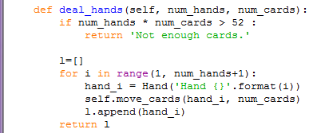
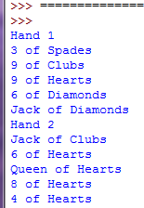
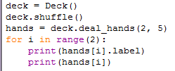
Card game– inheritance(8) - answer

Slide 36
palindrome
Checking whether a text is a palindrome should also ignore punctuation, spaces and case. For example, "Rise to vote, sir." is also a palindrome but our current program doesn’t say it is.
Use a tuple (you can find a list of all punctuation marks here [http://grammar.ccc.commnet.edu/grammar/marks/marks.htm]) to hold all the forbidden characters, then use the membership test to determine whether a character should be removed or not, i.e. forbidden = ( ! , ? , . , …).

Slide 37
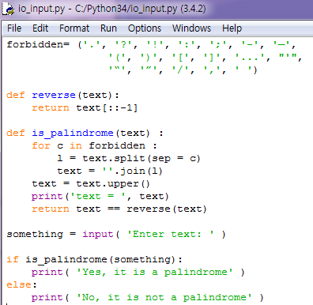

Palindrome - answer

Slide 38
Cartesian points
(a) Write a class called CartPoint that contains x, y, and z points as member variables. The constructor for the class should take an (x; y; z) tuple.
(b) Add a magnitude( ) function to CartPoint that computes the magnitude of the point (px2 + y2 + z2).
(c) Create a subclass of CartPoint called CartPointTime that represents an (x; y; z; t) vector, t representing time. The constructor for the class should take an (x; y; z; t) tuple.
(d) Add a magnitude_and_time() to CartPointTime function that returns a (magnitude; time) tuple.

Slide 39
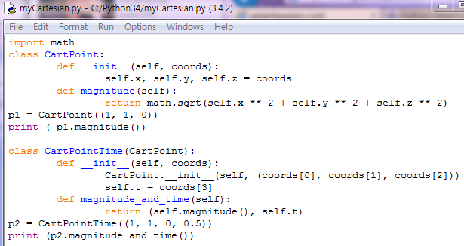

Cartesian points - answer

