Slide 1
Python 실습자료10 - answer
공학정보처리 ENG1108
김 은 진

Slide 2
Array Mathematics
import numpy as np
a = np.array([1,2,3])
b = np.array([5,2,6])
a + b
a – b
a * b
b / a
a % b
b ** a

Slide 3
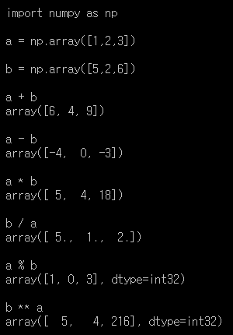
Array Mathematics - answer

Slide 4

Calculating matrix
Subtract the mean of each row of a matrix $A=\left( \begin{matrix}2 & 3 \\ 4 & 5 \\ 8 & 9\end{matrix}\right)$
Normalize matrix $X=\left(\begin{matrix}9 & 2 & 3 \\ 5 & 11 & 3 \\ 4 & 8 & 6\end{matrix} \right)$

Slide 5
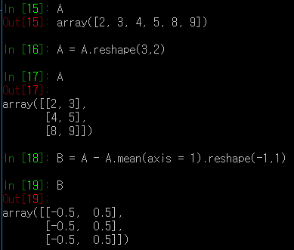
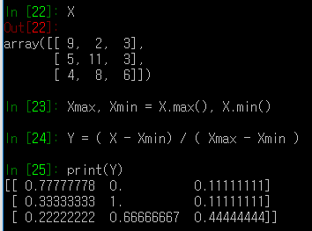

Calculating matrix - answer
Subtract the mean of each row of a matrix $A=\left( \begin{matrix}2 & 3 \\ 4 & 5 \\ 8 & 9\end{matrix}\right)$
Normalize matrix $X=\left(\begin{matrix}9 & 2 & 3 \\ 5 & 11 & 3 \\ 4 & 8 & 6\end{matrix} \right)$

Slide 6
Simple Exercises
Create a 1D array A with values ranging from 0 to 8
Create a new array B which consists of the odd indices of A
Convert an array A to a 3x3 array C
Create a 8x8 array D and fill it with a checkerboard pattern (a black square is 1, and a white one is 0)

Slide 7
Simple Exercises - answer
Create a 1D array A with values ranging from 0 to 8
import numpy as np
A = np.arange(9)
Create a new array B which consists of the odd indices of A
B = A[1::2]
Convert an array A to a 3x3 array C
C = A.reshape(3,3)
Create a 8x8 array D and fill it with a checkerboard pattern (a black square is 1, and a white one is 0)
D = np.zeros((8,8))
D[1::2,::2] = 1
D[::2,1::2] = 1

Slide 8
Vector calculation
First defined two vectors, called x and y. x should be initialized to the vector (1 5 -2 6 8 10) and y should be (-1 0 1 1 2 3). Compute and store in a value a the dot product between these two vectors. Store in a vector z1 a copy of x but where every value less than zero has been replaced with zero (do this using slices). Store in z2 all of the elements of x that correspond to positions of y that are strictly greater than zero (again, use slices). Finally, store in z3 the sum all values in y that correspond to even elements of x (again, use slices and use modulus to get evenness: this is % in python).

Slide 9
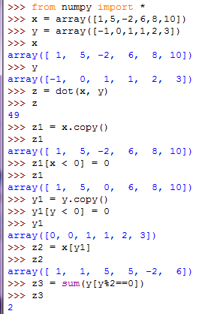
Vector calculation - answer

Slide 10
Solve linear equations
Solve the system of linear equations
1) 3x + 6y – 5z = 12
2) x – 3y + 2z = -2
3) 5x – y + 4z = 10
Convert the form into the linear algebra matrix AX = B
Solve X = A⁻¹B
Use numpy.linalg library
3 | 6 | -5 |  | x |  | 12
1 | -3 | 2 |  | y | = | -2
5 | -1 | 4 |  | z |  | 10

Slide 11
Solve linear equations - answer
Solve the system of linear equations
import numpy as np
A = np.array([[3, 6, -5], [1, -3, 2], [5, -1, 4]])
B = np.array([12, -2, 10])
X = A⁻¹B
X = np.linalg.inv(A).dot(B)
or
X = np.linalg.solve(A, B)
print(X) → [1.75 1.75 0.75]
(x = 1.75, y = 1.75, z = 0.75)
3 | 6 | -5 |  | x |  | 12
1 | -3 | 2 |  | y | = | -2
5 | -1 | 4 |  | z |  | 10

Slide 12

Array and Matrix
Let $x$ = arange(12). Use reshape to produce 2 by 6 array, $y$, and 3 by 4 array, $z$. Construct the following 6 by 12 array, $w$, using hstack and vstack.

Slide 13
Array and Matrix - answer
import numpy as np
x = np.arange(12)
y = x.reshape(2, 6)
z = x.reshape(3, 4)
y2 = np.hstack((y, y))
z3 = np.hstack((z, z, z))
w = np.vstack((x, y2, z3))
print(x)
print(y)
print(z)
print(w)
>>>
[ 0 1 2 3 4 5 6 7 8 9 10 11]
[[ 0 1 2 3 4 5]
[ 6 7 8 9 10 11]]
[[ 0 1 2 3]
[ 4 5 6 7]
[ 8 9 10 11]]
[[ 0 1 2 3 4 5 6 7 8 9 10 11]
[ 0 1 2 3 4 5 0 1 2 3 4 5]
[ 6 7 8 9 10 11 6 7 8 9 10 11]
[ 0 1 2 3 0 1 2 3 0 1 2 3]
[ 4 5 6 7 4 5 6 7 4 5 6 7]
[ 8 9 10 11 8 9 10 11 8 9 10 11]]

Slide 14
Basic operations
In the following table we have expression values for 5 genes at 4 time points. These are completely made up data. Although, some of the questions can be easily answered by looking at the data, microarray data generally come in much larger tables and if you can figure it out here the same code will work for an entire gene chip.
Gene name | 4h | 12h | 24h | 48h
A2M | 0.12 | 0.08 | 0.06 | 0.02
FOS | 0.01 | 0.07 | 0.11 | 0.09
BRCA2 | 0.03 | 0.04 | 0.04 | 0.02
CPOX | 0.05 | 0.09 | 0.11 | 0.14
1. Create a single array for the data (4x4).
2. Find the mean value per gene.
3. Find the mean value per time point.
4. Which gene has the maximum mean value?
5. Sort the gene names by descending order of the mean value.

Slide 15
Basic operations - answer
# 1.
a = np.array([[0.12, 0.08, 0.06, 0.02],
[0.01, 0.07, 0.11, 0.09],
[0.03, 0.04, 0.04, 0.02],
[0.05, 0.09, 0.11, 0.14]])
print(a)
# 2.
print(a.mean(axis = 1))
# 3.
print(a.mean(axis = 0))
# 4.
G_name = ['A2M', 'FOS', 'BRCA2', 'CPOX']
v_max = (a.mean(axis = 1)).max()
count = 0
for v in a.mean(axis = 1):
if v == v_max:
print(G_name[count])
count+=1
# 5.
b = a.mean(axis = 1)
s = np.sort(b)[::-1] # reverse sort
G_name = ['A2M', 'FOS', 'BRCA2', 'CPOX']
G_name_sorted = [];
flag = np.zeros(s.size) # to avoid double count
for v in s:
count = 0
for w in b:
if w == v and flag[count] == 0:
G_name_sorted.append(G_name[count])
flag[count] = 1
count+=1
print(G_name_sorted)
>>>
[[ 0.12 0.08 0.06 0.02]
[ 0.01 0.07 0.11 0.09]
[ 0.03 0.04 0.04 0.02]
[ 0.05 0.09 0.11 0.14]]
[ 0.07 0.07 0.0325 0.0975]
[ 0.0525 0.07 0.08 0.0675]
CPOX
['CPOX', 'A2M', 'FOS', 'BRCA2']

