Slide 1
Python 실습자료11 - answer
공학정보처리 ENG1108
김 은 진

Slide 2
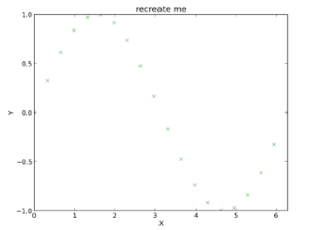
Sin plotting
Create following image

Slide 3
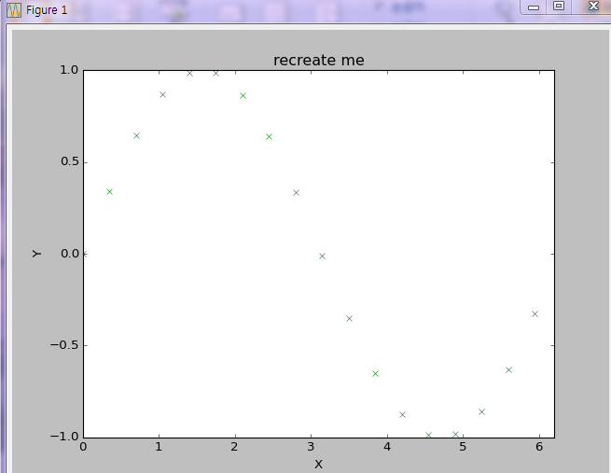
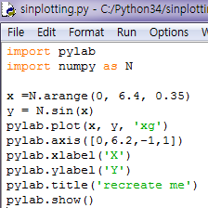
Sin-plotting - answer

Slide 4
plotting
Produce a plot of the functions f(x) =e^{-x/10} sin(πx) and g(x) = xe^{-x/3} over the interval [0,; 10]. Include labels for the x- and y-axes, and a legend explaining which line is which plot. Save the plot as a .pdf file.

Slide 5
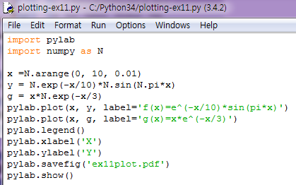
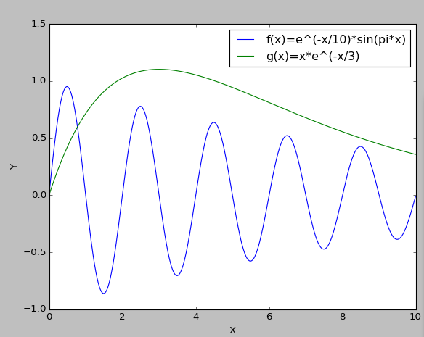
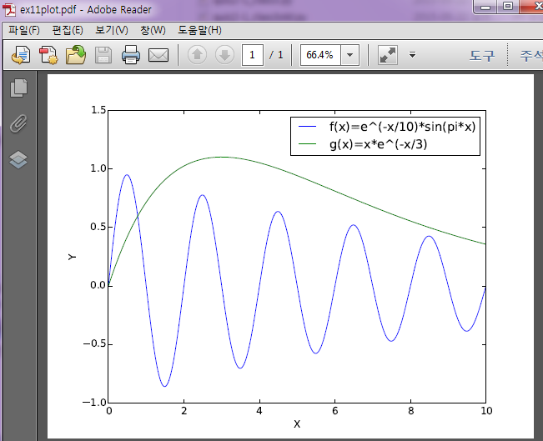
plotting-answer

Slide 6
limacon
The shape of a limacon can be defined parametrically as
r = r0 + cosθ
x = r cosθ
y = r sinθ
When r0 = 1, this curve is called a cardioid. Use this definition to plot the shape of a limacon for r0 = 0.8, r0 = 1.0, and r0 = 1.2. Be sure to use enough points that the curve is closed and appears smooth (except for the cusp in the cardioid). Use a legend to identify which curve is which.
Save the plot as a .pdf file.

Slide 7
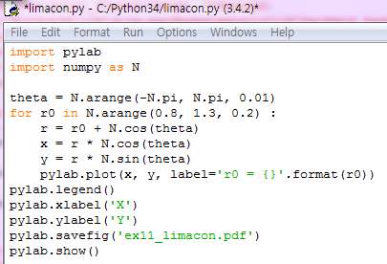
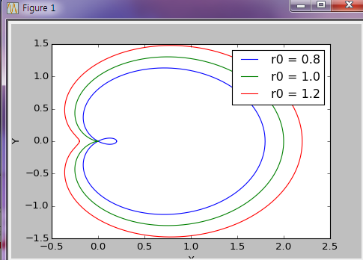
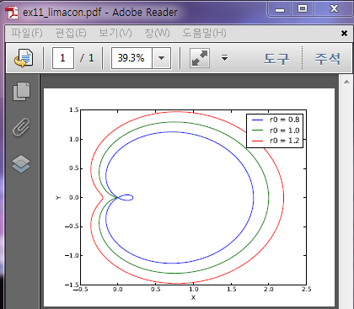
Limacon-answer

Slide 8
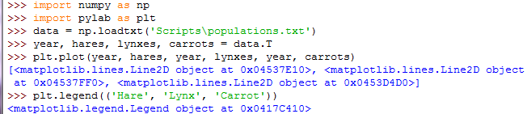
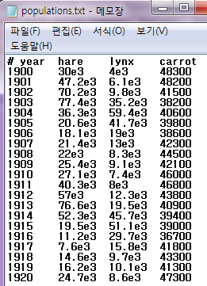
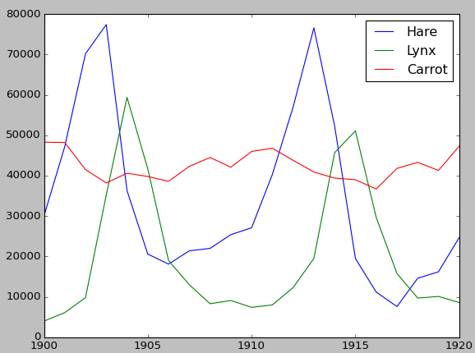
Data statistics(1)
The data in populations.txt describes the populations of hares and lynxes (and carrots) in northern Canada during 20 years

Slide 9
Data statistics(2)
Computes and print, based on the data in populations.txt.
The mean and std of the populations of each species for the years in the period.
Which year each species had the largest population.
Which species has the largest population for each year. (Hint: argsort & fancy indexing of np.array(['H', 'L', 'C']))
Which years any of the populations is above 50000. (Hint: comparisons and np.any)
The top 2 years for each species when they had the lowest populations. (Hint: argsort, fancy indexing)
Compare (plot) the change in hare population (see help(np.gradient)) and the number of lynxes. Check correlation (see help(np.corrcoef)).
... all without for-loops.

Slide 10
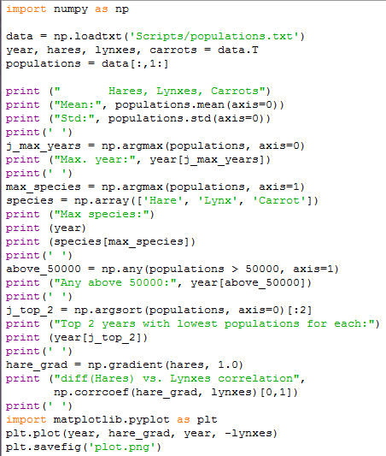
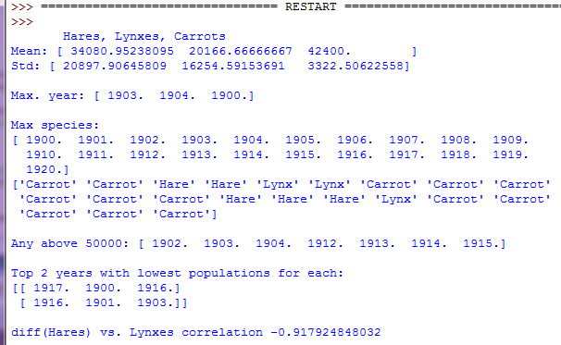
Data statistics - answer

Slide 11
Integral approximations
Write a function f(a, b, c) that returns a^{b}-c . Form a 24x12x6 array containing its values in parameter ranges [0,1] x [0,1] x [0,1].
Approximate the 3-d integral
over this volume with the mean. The exact result is: what is your relative error?
(Hints: use elementwise operations and broadcasting. You can make np.ogrid give a number of points in given range with np.ogrid[0:1:20j].)

Slide 12
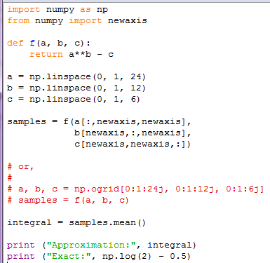

Integral approximations - answer

Slide 13


Mandelbrot fractal
Write a script that computes the Mandelbrot fractal. The Mandelbrot iteration:
Point (x, y) belongs to the Mandelbrot set if |c| <some_threshold.
Do this computation by:
Construct a grid of c = x + 1j*y values in range [-2, 1] x [-1.5, 1.5]
Do the iteration
Form the 2-d boolean mask indicating which points are in the set
Save the result to an image with:

Slide 14
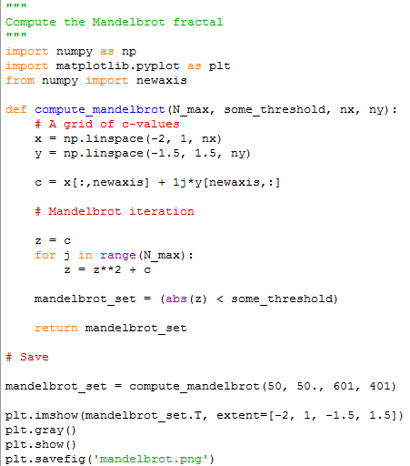
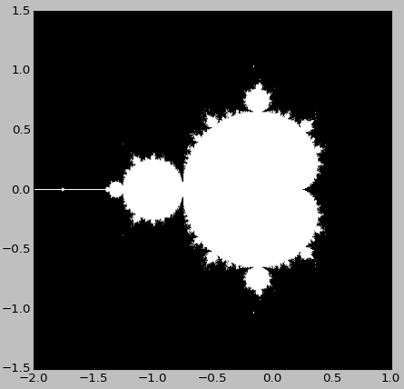
Mandelbrot fractal - answer

