Slide 1
Python 실습자료12 - answer
공학정보처리 ENG1108
김 은 진

Slide 2
scipy.linalg(1)
The scipy.linalg module offers a number of interesting routines, some of which overlap with the numpy.linalg module.
Use Scipy's linear algebra tools to compute the value of x, y, and z:
2x + 3y - z = 5
3x - 2y + 4z = 6
-x + 2y -z = 12

Slide 3
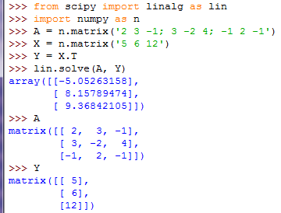
scipy.linalg(1) - answer

Slide 4
scipy.linalg(2)
Find the inverse of the following matrix:
[[ 2 3 -1][ 3 -2 4] [-1 2 -1]]
Find the product of this inverse with the vector
[5 6 12]
How many nonzero eigenvalues does the following matrix have?
M = np.array([[ 1, 4, 2], [ 4, 16, 8], [ 2, 8, 4]])

Slide 5
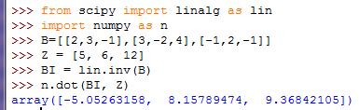
scipy.linalg(2) - answer

Slide 6
scipy.interpolate
Define an array x which contains 10 points from 0 to 2π
Compute an array y which is the sine of the points in x
Define an array x_new which contains 1000 points from 0 to 2π
Use functions in scipy.interpolate to interpolate x and y onto x_new, using cubic interpolation. Call the results y_new.
Use the following commands to plot the results:
plt.plot(x, y, '.k')
plt.plot(x_new, y_new, '-k')

Slide 7
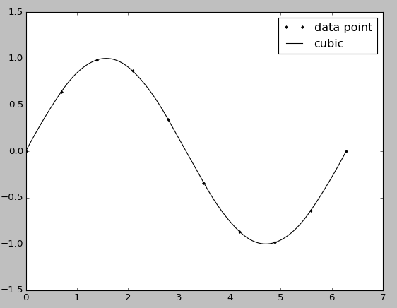
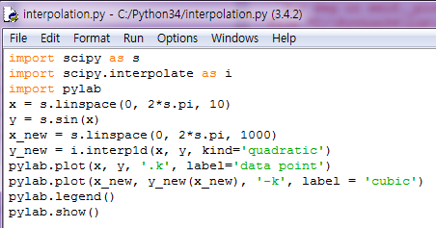
scipy.interpolate - answer

Slide 8

scipy.integrate(1)
Numerical integrations is central to many cosmological calculations. Here we'll calculate the angular diameter distance as a function of z. For simplicity here, we'll assume a flat universe Ω_{k} =0 with contributions only from Ω_{M} and Ω_{Λ}.
The equations below refer to Hogg’s 1999 paper.
Write a function E(z, OmegaM) which computes E(z), as defined by equation 14 of the Hogg paper. The function should take two arguments, z and OmegaM, in that order. Assume Ω_{M} + Ω_{Λ} = 1, Ω_{k} =0, and use the default value Ω_{M} = 0.3.
You should be able to call the function like this:
>>> E(1.0)
1.7606816861659007
Also define a function invE(z, OmegaM) which computes the inverse of E, above.

Slide 9
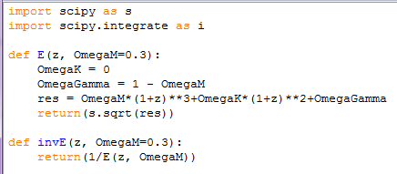
scipy.integrate(1) - answer
Computing E(z)

Slide 10

scipy.integrate(2)
Using the tools in scipy.integrate, write a function D_C(z) that computes the comoving distance to z in megaparsecs (eqn. 15 of Hogg). Use D_{H} = 3000 Mpc.
You should be able to call the function like this:
>>> D_C(1)
2314.281199283433

Slide 11

scipy.integrate(2) - answer
Comoving Distance

Slide 12

scipy.integrate(3)
write a function D_A which computes the angular diameter distance as a function of z (Eqn. 18 in Hogg). Note that because we're assuming a flat cosmology, D_{M} = D_{C}.

Slide 13

scipy.integrate(3) - answer
Angular Diameter Distance

Slide 14
scipy.integrate(4)
Plot the angular diameter distance as a function of z, with z ranging from 0 to 4.
Note: your function most likely expects a scalar argument for z, so passing an array will not work!
The angular diameter distance is essentially a plot of the ratio of the object's physical size to its apparent (angular) size. You should see a turnover in the plot around z=1

Slide 15
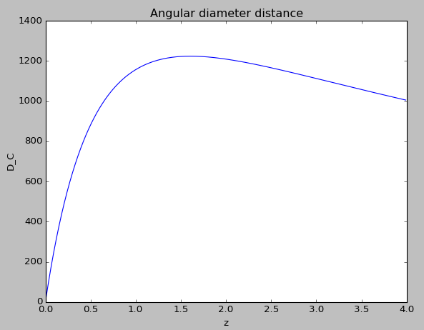
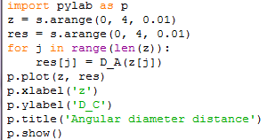
scipy.integrate(4) - answer
Plot the angular diameter distance

Slide 16
scipy.optimize(1)
The optimize submodule contains functions used for function minimization and optimization. There are lots of options in there for multi-dimensional function optimization.
Algebraically determine the value of x which minimizes this function:
f(x) = x^2 + 2x - 4
Numerically compute the value of x which minimizes this function, using a suitable routine from scipy.optimize

Slide 17
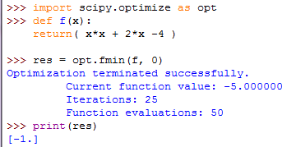
scipy.optimize - answer

Slide 18
scipy.optimize(2)
Using the same routine, find the value of z for which D_A(z), above, is maximized. You can reuse your function from the previous problem.

Slide 19

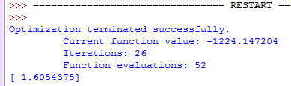
scipy.optimize(2) - answer

