Slide 1
Relational Foundation Models (KumoRFM)
Data AI Lab
Taewook Ham
Notes:
Today I’ll talk about Relational Foundation Models, or RFMs especialy KumoRFM which is suggest by Kumoai.

Slide 2
Contents
Introduction to Relational Database
Relational Deep Learning
Relational Graph Transformer
Relational Foundation Model
Benchmark for RDL
Toy example
Notes:
I’ll talk in this order.
I’ll start from basic introduction of reldb, then move through relational deep learning, graph transformers, and finally RFMs
Also I’ll briefly cover benchmarks and toy examples, and then conclude with my perspective.
So I want to think about whether this field is truly necessary and it can be included in our next steps.

Slide 3
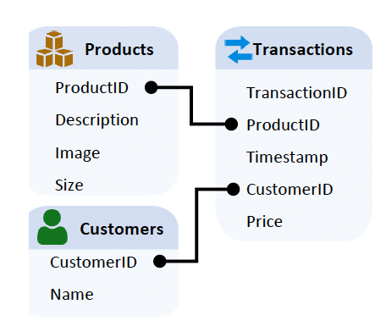
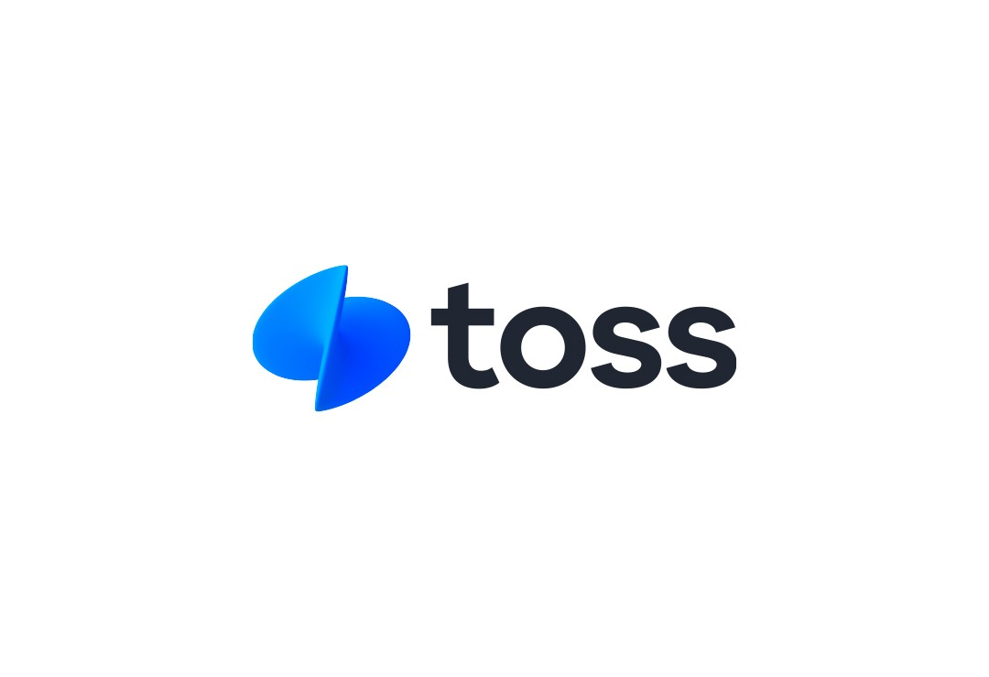


Relational Data(base)
Most real-world enterprise data lives in relational database, not in graphs or text.
E-commerce (users, products, transactions)
Finance (accounts, transactions, merchants)
Healthcare (patients, doctors, treatments)
Histroy in Multiple Table
Notes:
I guess you guys already took a database course of EE or CS and remember the fundamental notions about database.
Most real-world enterprise data does not live in text or graph format -it lives in relational databases.
Think of e-commerce, finance, and healthcare.
As shown in the right most image, they have multiple table system.

Slide 4
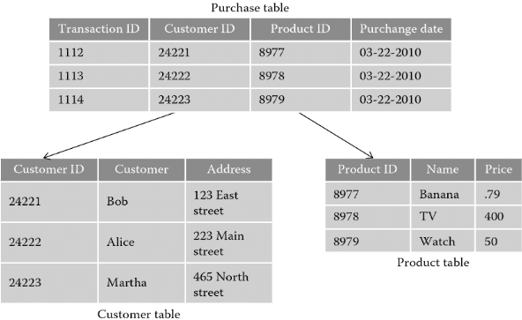
Basic Terminologies
Tables
A row can be treated as entity.
A column is an attribute of a relational table.
Keys
Primary key
Foreign key
Relations
Arrows as Primary-Foreign Key
Timestamps
Recorded when an entity or event occurred.
Notes:
Let me remind the terminology.
For example, this is the database of e-commerce system.
Each of this is called table.(Customer table, product table, transaction table)
Each row in table is treated as an entity. Each column includes attribute.
PK: A primary key uniquely identifies each record in a table.
FK: A foreign key references a primary key in another table, defining a relationship between records.
The relation is shown in a arrow connecting the primary-foreign key relations
The transaction table is history of the event occurred. so, most of database includes timestamp in the table.
In relational deep learning, timestamp is important part of understanding the sampling strategy.

Slide 5


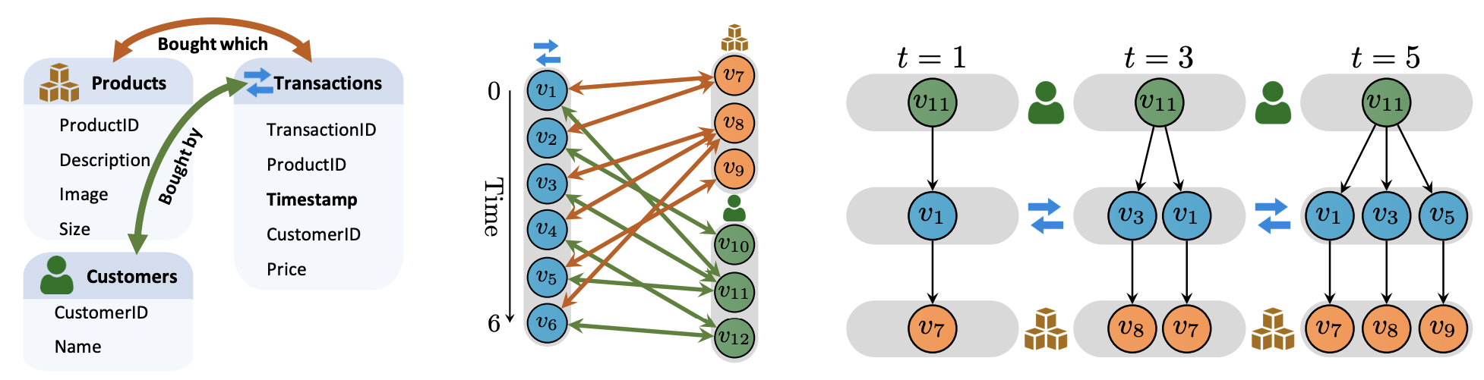
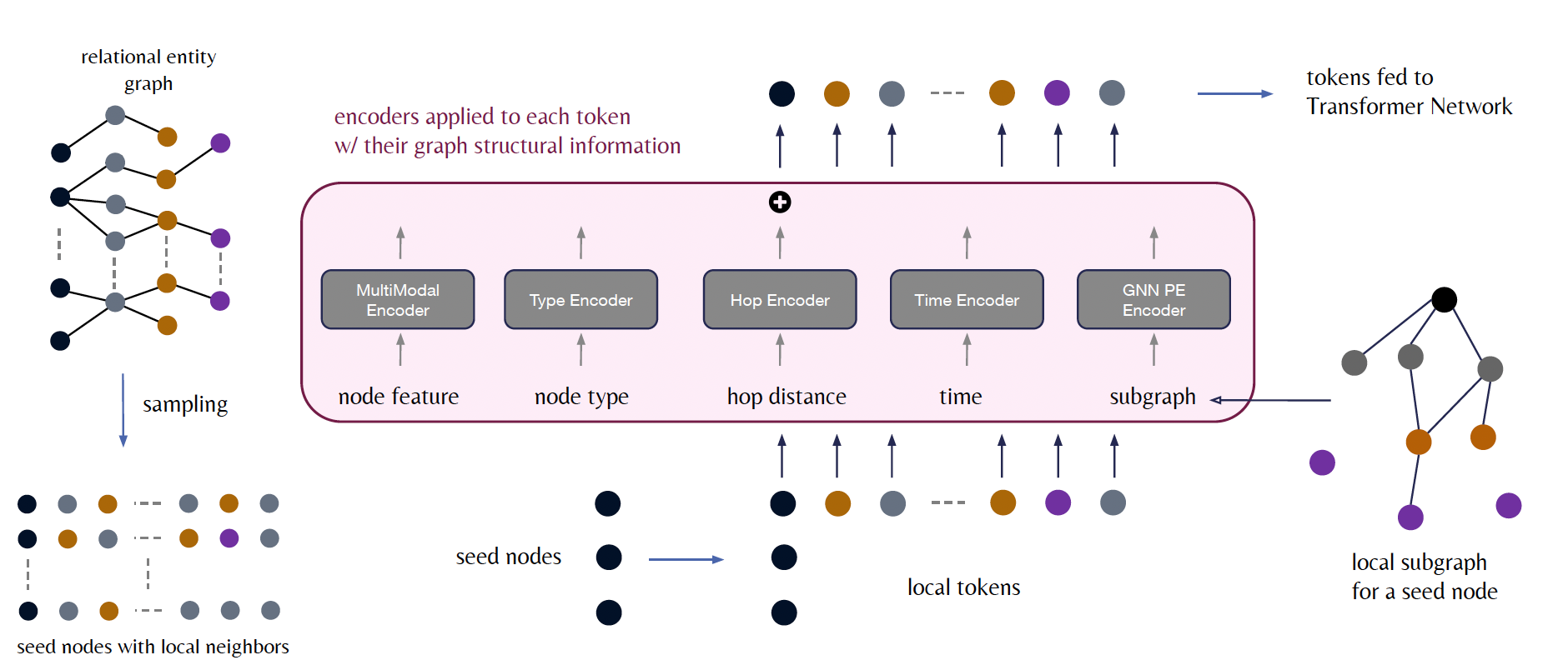
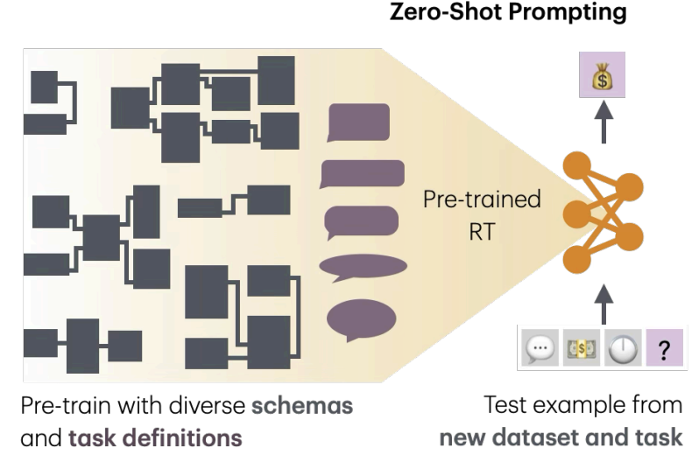
Recent History of Relation Deep Learning
Relational Graph Transformer
(2025(ICLR 2026))
Relational Deep Learning (2023(ICML 2024))
Relational Transformer
(2025(ICLR 2026))
RELBench 2024(NeurIPS2024)
KumoRFM
(2025(From Kumo))
KumoRFM-2
(2026)
Notes:
This is Recent history of rdl.
Kumo serves as a pioneer in this field, suggesting RELBench and Relational Deep Learning framework in 2024.
And last year KumoRFM was founded based on Relational Graph Transformers.
This field is so young.

Slide 6
Contents
Introduction to Relational Database
Relational Deep Learning
Relational Graph Transformer
Relational Foundation Model
Benchmark for RDL
Toy example
Notes:
What follows describes the common structure within the Relational Deep Learning framework.

Slide 7
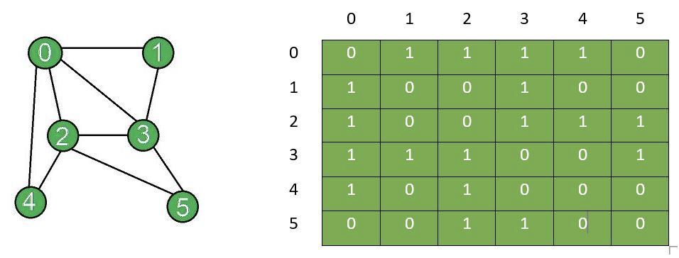

Graphs
Data structure that represents connections and relationships.
A graph consists of nodes (e.g., users) and edges (e.g., friendship).
A graph is represented as a sparse adjacency matrix.
$a_{ij}=1$ if nodes $i$ and $j$ are connected; $a_{ij}=0$ otherwise.

Slide 8
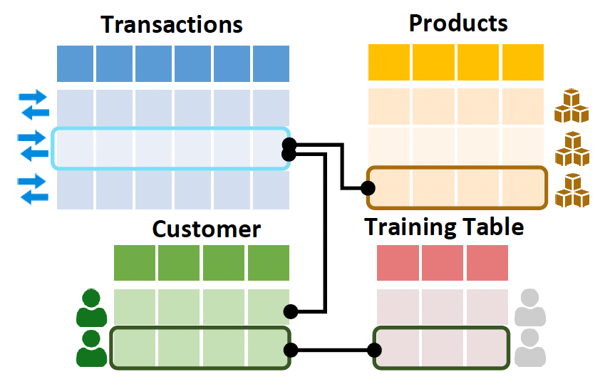
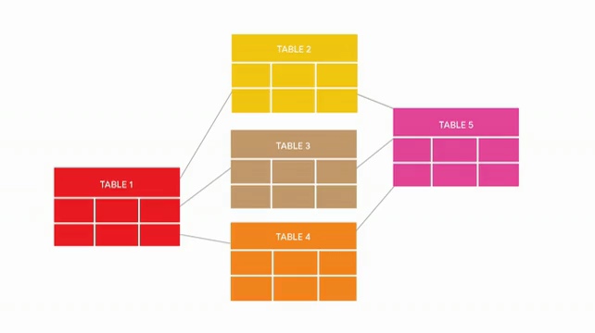
Relational Entity Graph
The key is to represent relational database as temporal, heterogeneous graphs.
Schema graph defines how tables are related (table-level structure).
Relational entity graph instantiates this schema at the entity (row) level.
Each row becomes a node; PK-FK links become edges.
Schema Graph
Relational Entity Graph
Notes:
And the core abstraction is Relational Entity Graph.
We start from the schema graph, where each table is treated as a whole big node and edges define how tables are connected through primary–foreign key relationships.
Then we want to convert it to the graph.
Each row in each table becomes a node, and each primary–foreign key relation becomes an edge between nodes.
I’ll show how this conversion works in practice.
One thing to note is that there is a subtle mistake in the video: rows within the same table are not necessarily connected to each other—in most cases, they are not.
This representation, relational entity graph allows us to reinterpret relational databases as large-scale, and heterogeneous graphs.

Slide 9
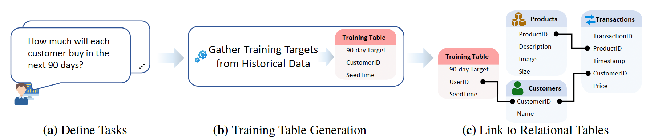

Training Table
Key insight for model training is generating training table $T_{train}$.
A training table contains supervision labels automatically computed based on historical data in the relational database.
Then, $T_{train}$ is linked to the main relational database.
Training Table Generation
Link to Relational Tables
Define Tasks
Notes:
The key insight for model training is the construction of a training table, denoted as T_train.
This training table contains supervision labels that are automatically generated from historical data stored in the relational database.
Rather than manually labeling data, the labels are computed directly from past events and interactions.
For example, at a given time t, the ground-truth label for a task such as “how much will each customer spend in the next 90 days?” can be computed by summing that customer’s spending over the interval [t, t + 90].
By selecting multiple reference time points t, we can generate many training examples per entity, all in a time-consistent manner.
Finally, the training table T_train is linked back to the main relational database through primary–foreign key relationships.

Slide 10


Time-Consistent Computational Graphs
A subgraph is created induced by the set of foreign keys $K_{v}$ and its timestamp $t_{v}$ of a training example in the training table $T_{train}$.
The subgraph acts as a local and time-consistent computation graph to predict ground-truth label $y_{v}$.
$$T_{train}$$
Customers
Transactions
Products
…
Relational Tables
Subgraph Sampling of a Training Example
Notes:
After constructing and linking the training table, we can generate a subgraph for each training instance.
This subgraph serves as a local, time-consistent computational graph used to predict the ground-truth label for that instance.
One more important thing when sampling the subgraph is that we do not want the future value affect to the past value.
To ensure temporal correctness, information flow within the subgraph can go forward in time. it is only allowed to attend to events that occurred before time t_v.
Up to this point, this defines the core preprocessing pipeline that constructs trainable, time-consistent subgraphs as inputs to the model.

Slide 11
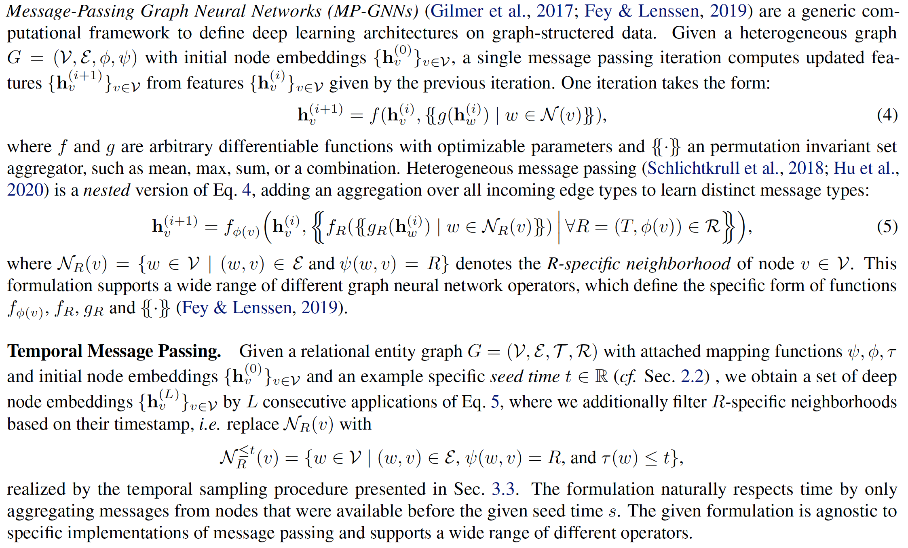

Temporal, Heterogeneous Message Passing
Information flow between nodes can only go forward in time, ensured by a temporal neighbor sampler.
Node embeddings are constructed by encoding modality-specific column features and fusing them into a unified row-level representation.
$$T_{train}$$
Customers
Transactions
Products
…
Notes:
After constructing and linking the training table, we can generate a subgraph for each training instance.
This subgraph serves as a local, time-consistent computational graph used to predict the ground-truth label for that instance.
One more important thing when sampling the subgraph is that we do not want the future value affect to the past value.
To ensure temporal correctness, information flow within the subgraph can go forward in time. it is only allowed to attend to events that occurred before time t_v.
Up to this point, this defines the core preprocessing pipeline that constructs trainable, time-consistent subgraphs as inputs to the model.

Slide 12
Contents
Introduction to Relational Database
Relational Deep Learning
Relational Graph Transformer
Relational Foundation Model
Benchmark for RDL
Toy example

Slide 13
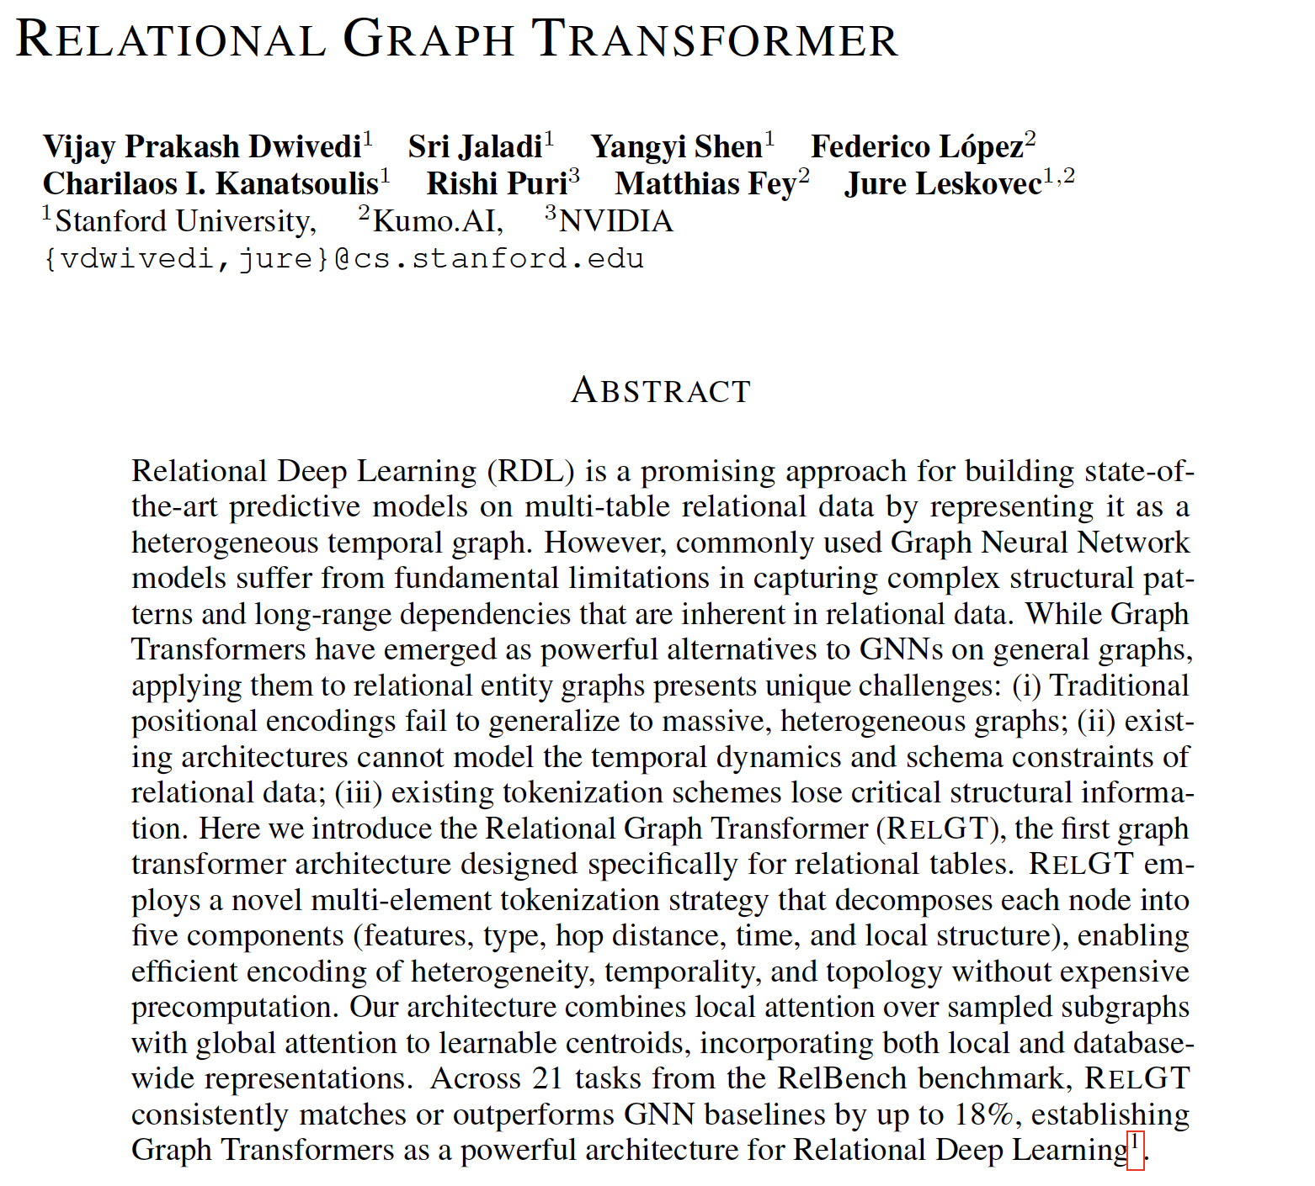
Relational Graph Transformer (RELGT)
RELGT is a Transformer architecture specifically designed to model large-scale, heterogeneous, and temporal relational graphs.
Each node is tokenized into a structured representation that encodes its attributes, type, temporal context, and structural role.
Tokenziation Process of RELGT
Notes:
RELGT is a Transformer architecture specifically designed for large-scale, heterogeneous, and temporal relational graphs.
Instead of representing each node with a single embedding, RELGT tokenizes each node into a structured representation that captures its attributes, node type, temporal context, and structural role.
This tokenization allows Transformer attention to operate effectively on relational graphs while preserving the key properties of database-derived structures.

Slide 14

Encoders for Entity Embeddings
Node Feature Encoder
Node Type Encoder
Hop Encoder
Time Encoder
Subgraph PE Encoder
Notes:
Each token element has its own encoder:
When tokenizing each node, 5 main information is encoded as learnable embeddings:
- feature encoder encodes attributes: ages, country, product explanation
- type encoder for heterogeneity: the source table where this node is come from
- hop encoder for structure: from given seed node, how far it is located.
- time encoder for temporality: from given seed node, how old it is generated.
- subgraph GNN for local topology: simple GNN is used to embed the local structure information into a node
Finally, they are concatenated and create a structurally rich token without global preprocessing.

Slide 15
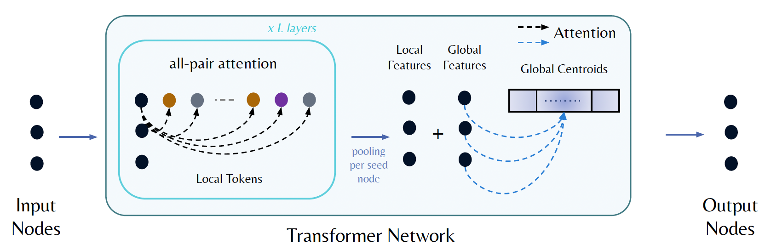

Relational Graph Transformer
RELGT includes local attention and global attention.
The model is trained end-to-end using suitable task specific loss functions.
Notes:
RELGT uses a hybrid attention design with both local and global modules.
Locally, this is full self-attention: every node in the subgraph attends to its K sampled neighbors.
For example, in e-commerce data, products that never directly connect can still interact through shared customers or transactions.
Globally, The global attention enables each seed node to attend to a set of B
global tokens. it represents centroids of all nodes in the training graph.
These centroids are updated during training using an Exponential Moving Average (EMA) K-Means algorithm applied to seed node features in each mini-batch.
By combining local structural and global context, RELGT can capture long-range dependencies, heterogeneity, and temporal relation.

Slide 16
Contents
Introduction to Relational Database
Relational Deep Learning
Relational Graph Transformer
Relational Foundation Model
Benchmark for RDL
Toy example

Slide 17
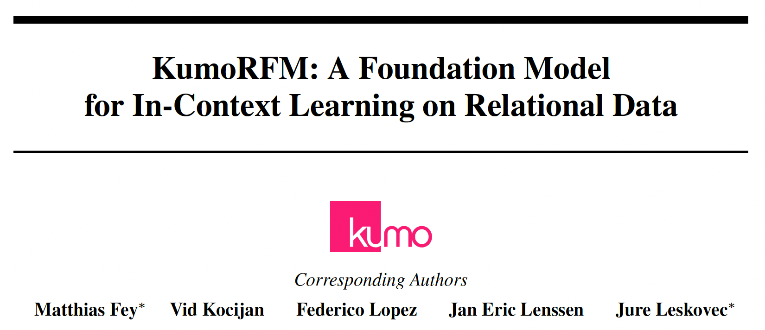
Relational Foundation Model (KumoRFM)
KumoRFM: relational foundation model making predictions over any relational database and any predictive task without requiring any data- or task-specific training.
KumoRFM is pre-trained based on RELGT built on the principles of RDL.
Notes:
Up to this point, this has been the buildup for introducing KumoRFM.
I spent time explaining these components in detail because KumoRFM is designed on top of the RDL framework, and it is pretrained based on RELGT as a core architecture.
Kumorfm is a relational foundation model suggested by kumo group, and it does not need any data or task-specific training.
From now on, I will explain the core components of KumoRFM.

Slide 18
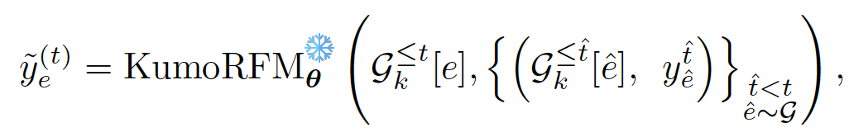
Relational Foundation Model (KumoRFM)
KumoRFM is built upon a large-scale pretrained Relational Graph Transformer.
KumoRFM performs in-context learning on query-generated relational subgraphs, without retraining the model.
It enables prediction on unseen relational datasets through in-context learning.
Context Subgraphs /labels (Train)
Target Entity Subgraph (Test)
Notes:
K-hop subgraph is sampled up to timestamp t of seed node.
KumoRFM uses in-context learning.

Slide 19
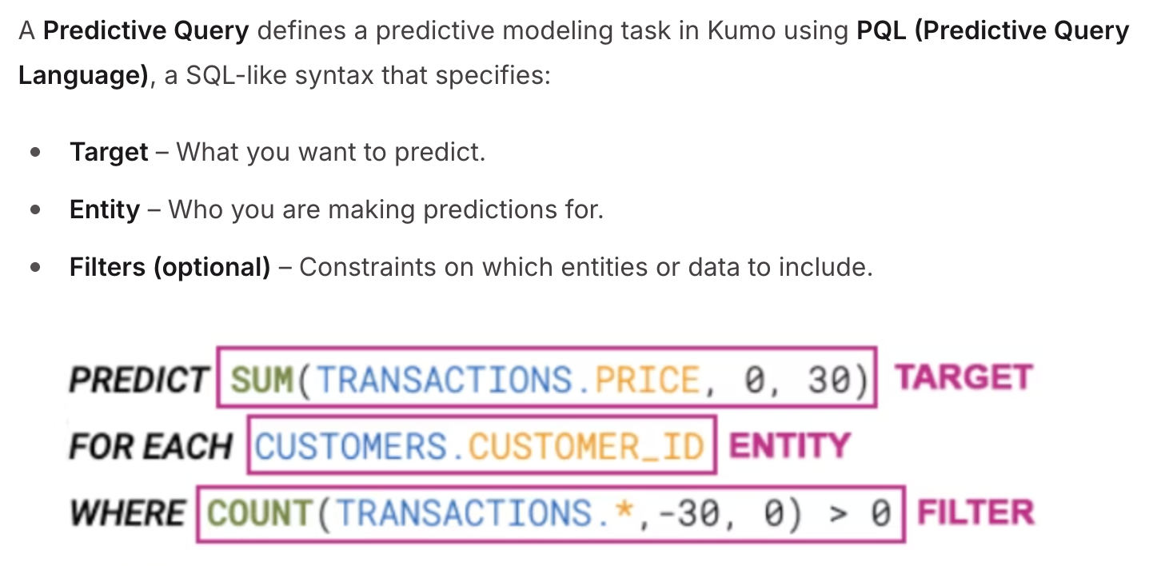
Predictive Query Language (PQL)
A Predictive Query is a declarative syntax used to define a predictive modeling task in Kumo.
Surprisingly, it provides interface that interpret NL into PQL (details not provided).
Notes:
I think most of you already know what SQL is and how to use it.
similar to SQL, KumoRFM uses a special syntax which is called Predictive Query Language(a for prediction task over relational data.
Instead of manually constructing training pipelines, the user defines what to predict, for which entity, and over what future time.
Once we input the querty, the system then automatically translates it into a time-consistent relational learning problem.
it means constructing the input subgraphs, labels, and training data internally.

Slide 20
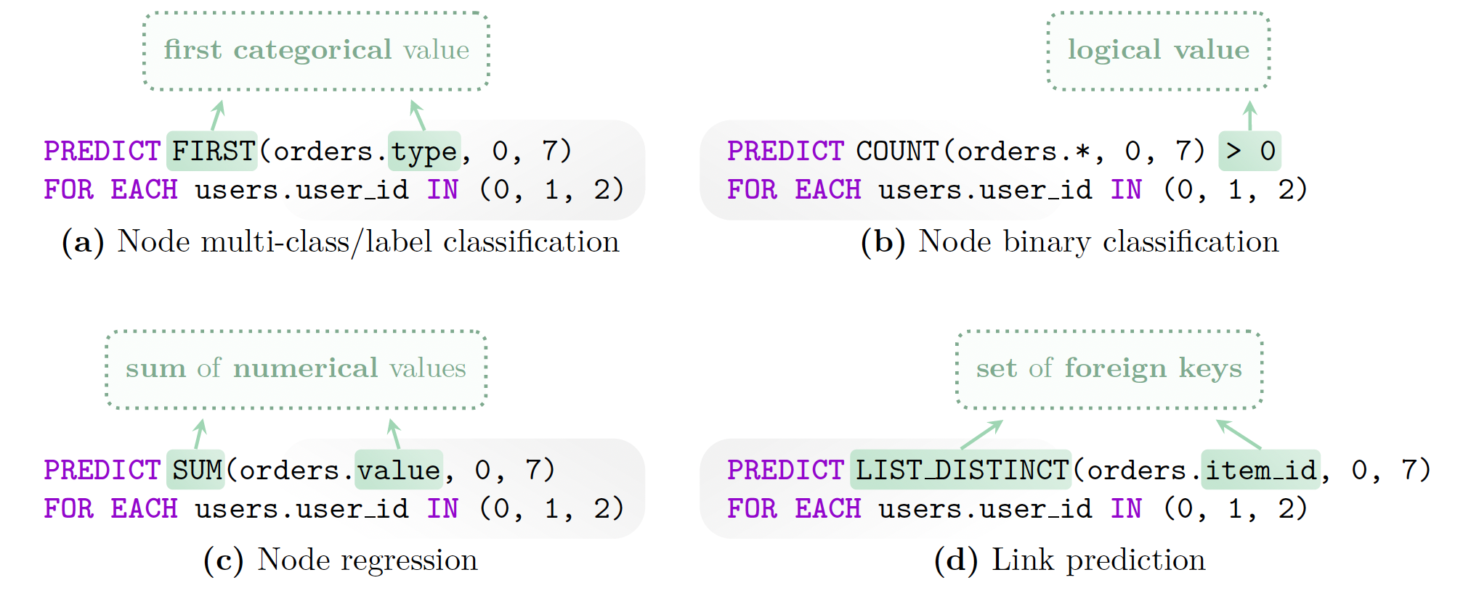
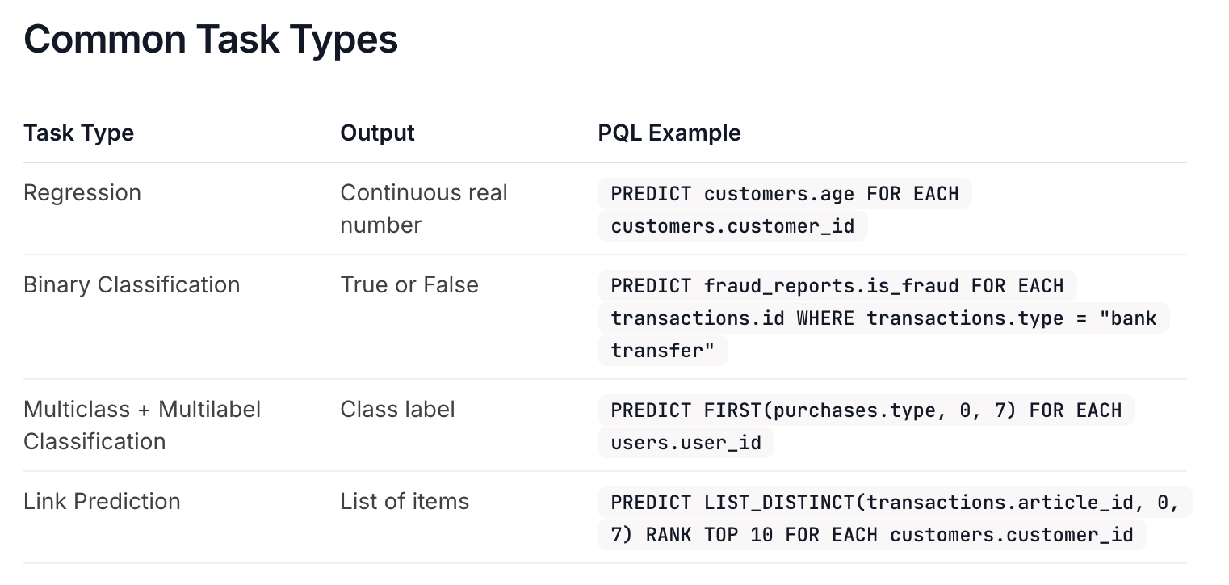
Predictive Query Language (PQL)
Query has PREDICT, FOR, WHERE clause.
PQL supports various predictive tasks (regression, binary classification, multi-class classification, and link prediction).
Notes:
Every query has a predictable label (in PREDICT clause) and entity definition (in FOR clause), defining both the entities for which predictions are made the label for every individual entity.
Additional filters (using WHERE clause) can be applied to both the label and entity clause.
PQL supports aggregations (like SUM, COUNT, AVG, LIST_DISTINCT), binary operations (=, <, CONTAINS, etc.), and logical operations across different time constraint (like hours, days, months).
In KumoRFM, every predictive query basically have PREDICT, and FOR clause.
The PREDICT clause defines the label - what we want to predict for each entity.
The FOR clause defines the entity set - whom the predictions are made for.
like image in previous slide, WHERE conditions filter entities or labels to choose.
Importantly, PQL supports relational aggregations such as SUM, COUNT, and AVG, as well as logical and comparison operators across multiple time constraint, like hours, days, or months.
As a result, it says PQL can express rich query and act as a versatile interface of KumoRFM.
Plus, PQL support various predictive task such as regression ,bc

Slide 21
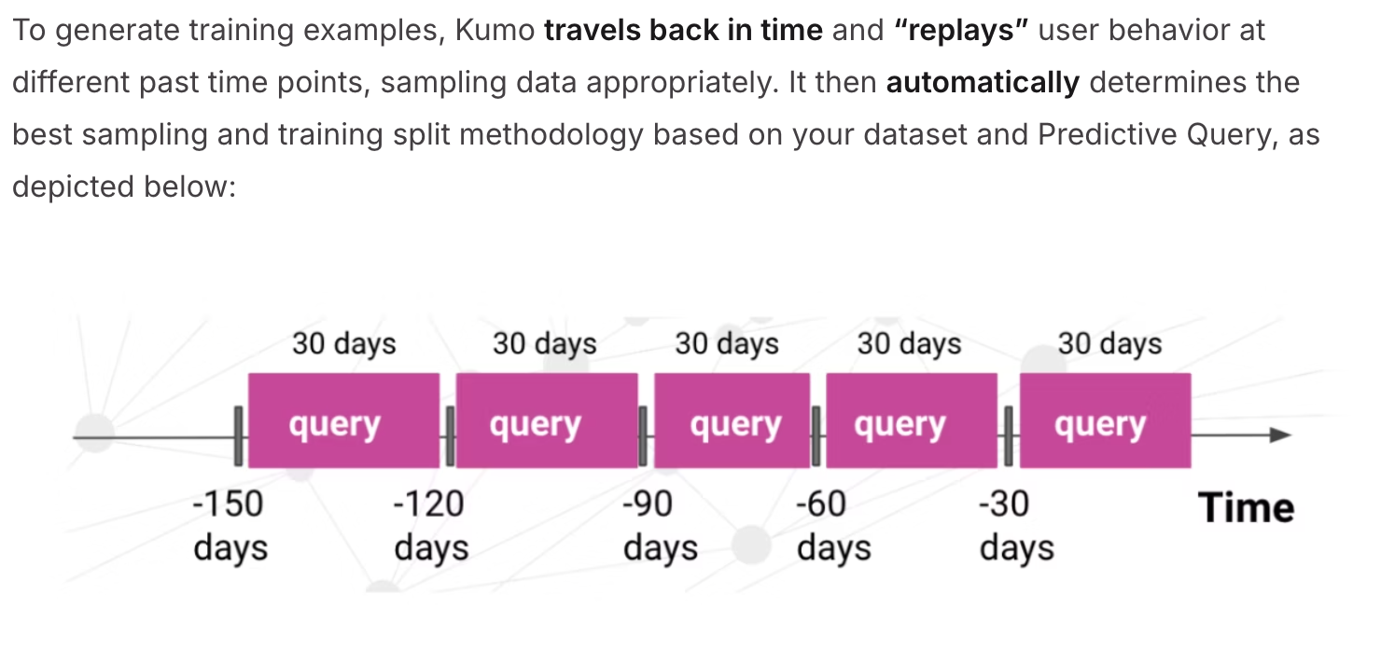
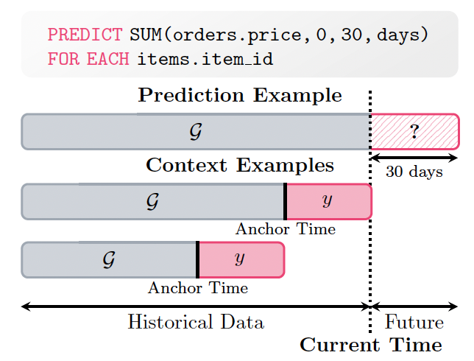

Online Context Generation
$k$-hop subgraph $g_{k}^{≤t}\left[e\right]⊆𝒢$ is sampled around entity $e$ up to timestamp $t$ to be used as input to make a prediction ${\tilde{y}}_{e}^{t}$.
Dynamically update the graph on-the-fly, grouping historical labels into a dynamically constructed training table $\hat{T}$ and attaching it to the entity table.
Notes:
During inference, KumoRFM performs in-context learning dynamically by updating the graph on the fly.
Historical labels are grouped into a dynamically constructed training table, which is attached to the entity table and used as contextual information for prediction.

Slide 22
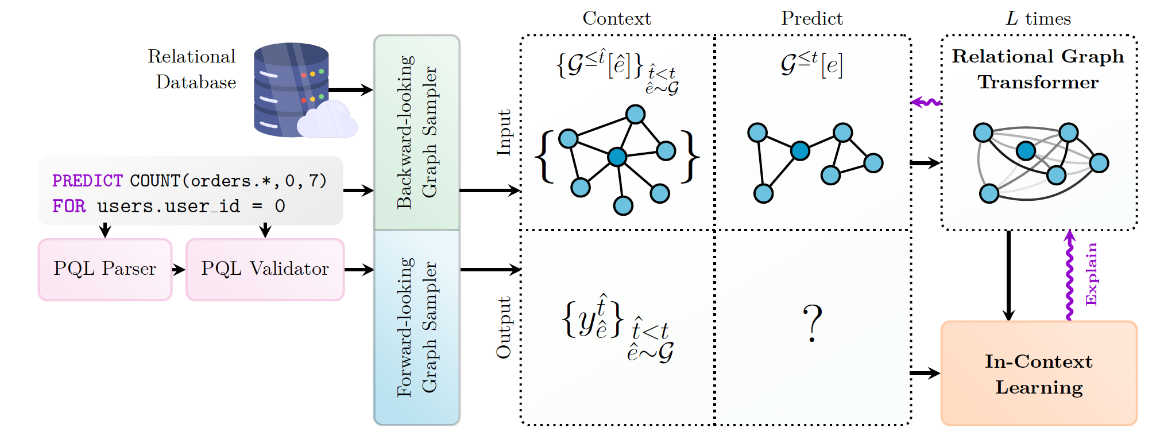
Temporal Sampling Procedures
Backward-looking: to generate the corresponding input subgraphs
Forward-looking: to generate the in-context labels

Slide 23
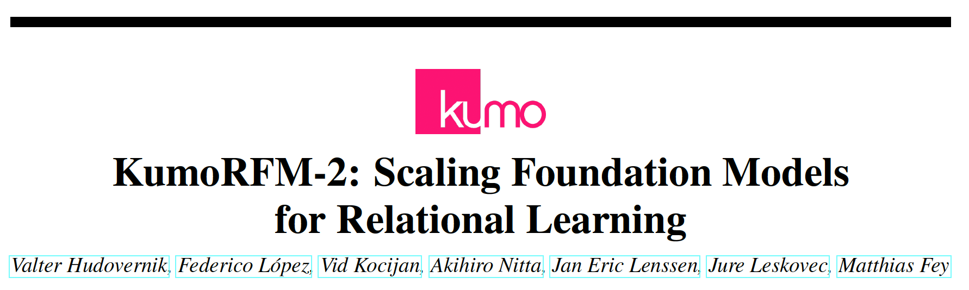
Relational Foundation Model (KumoRFM-v2)
Last April, KumoRFM-v2 was released.
Slight changes were added for task-conditioned relational reasoning.

Slide 24
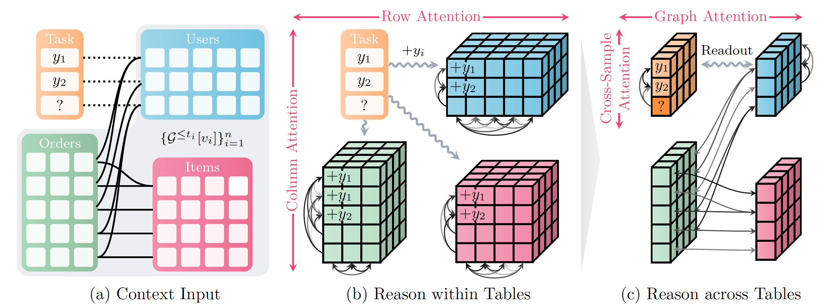
KumoRFM-2 Architecture
KumoRFM-2 first computes representations for all rows in the context via alternating column- and row-wise attention.
The representations are enriched via graph attention over primary-foreign key relationships and cross-sample attention over context examples.

Slide 25
Key Changes
Hierarchical Attention Scheme:
It introduces early task-conditioned hierarchical attention, enabling task-aware relational representations from the row/column feature extraction stage.
Smarter Context and Lagged Targets:
It combines (local) self-history and recent global database patterns to build more informative task-aware contexts.

Slide 26
Benchmark for KumoRFM-2
RelBenchV1
RelBenchV2
SALT
4DBInfer
None of these datasets were used during pre-training, which guarantees no leakage of information!
Notes:
Benchmark

Slide 27
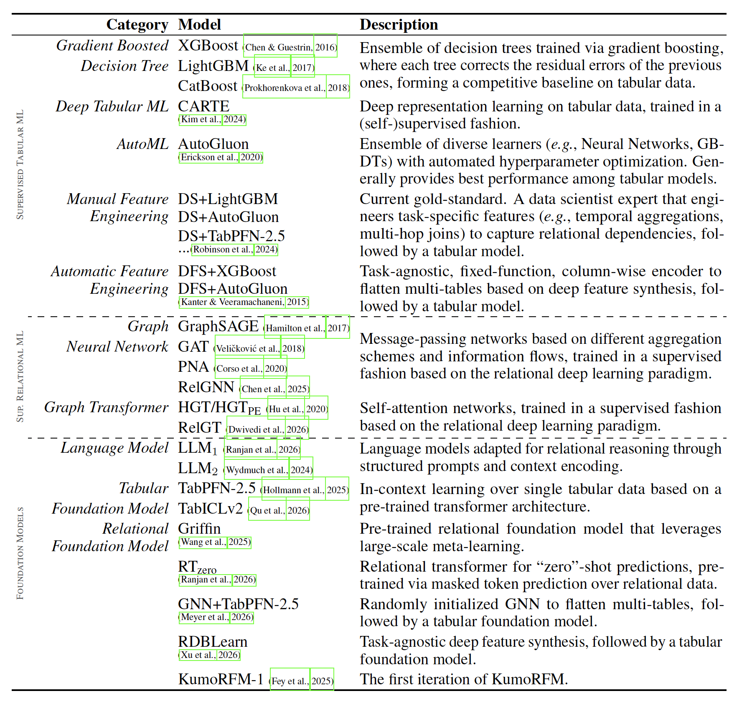
Baselines for KumoRFM-v2
Supervised Tabular ML
Traditional ML
AutoML
Feature Engineering based
Naïve
Global mean/median
Supervised Relational ML
GNNs / GT
Foundation Models
LLMs
Tabular FMs
Relational FMs
Notes:
Benchmark

Slide 28
Contents
Introduction to Relational Database
Relational Deep Learning
Relational Graph Transformer
Relational Foundation Model
Benchmark for RDL
Toy example
Conclusion

Slide 29
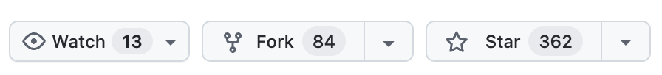
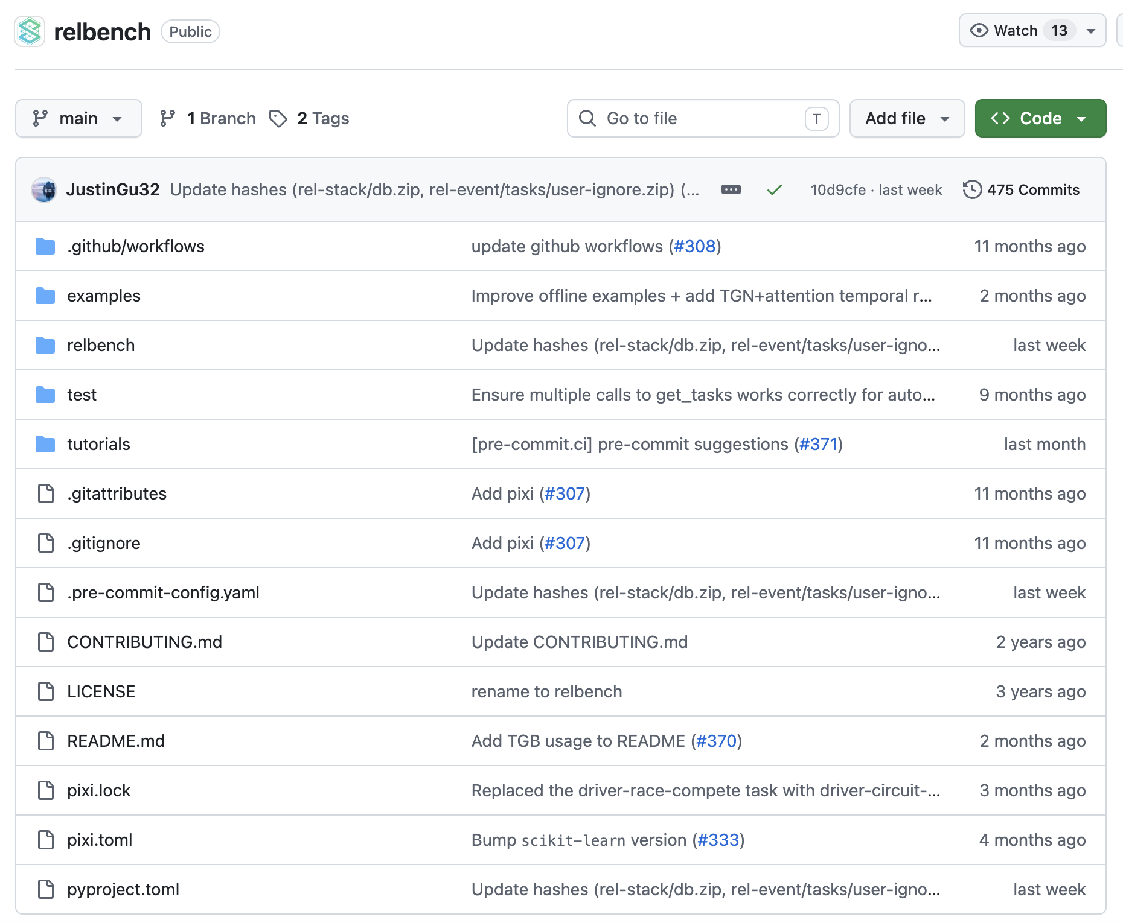
RelBench: Benchmark for Relational Model
RelBench GitHub page as of May 28, 2026.
Notes:
Benchmark

Slide 30
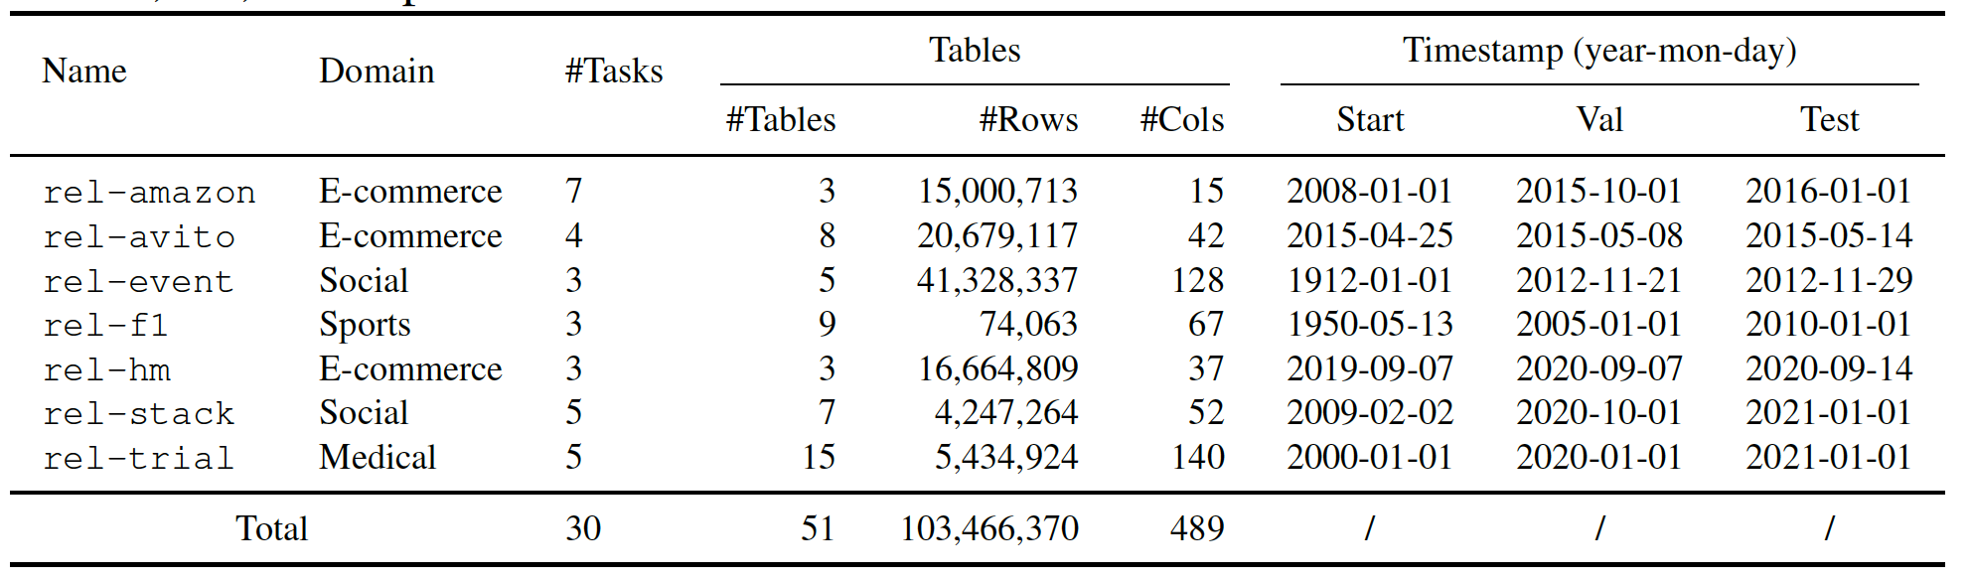
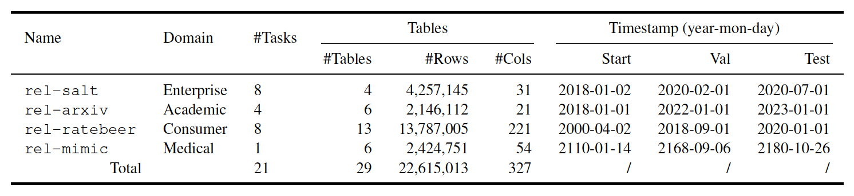
RelBench Datasets
Statistics of RelBench dataset used for KumoRFM.
RelBench is updated continuously!
v1
v2
Notes:
Benchmark

Slide 31
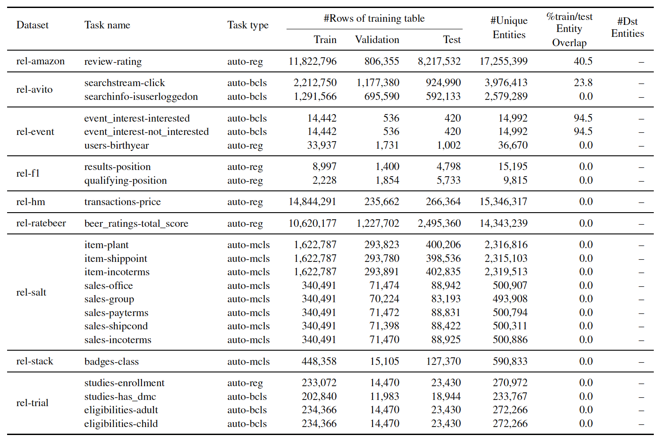
RelBench-v2 Datasets
RelBench-v2 newly introduces 4 datasets and autocomplete tasks.
Model learns to fill in a table's missing cells using the surrounding relational schema and historical context.
Notes:
Benchmark

Slide 32
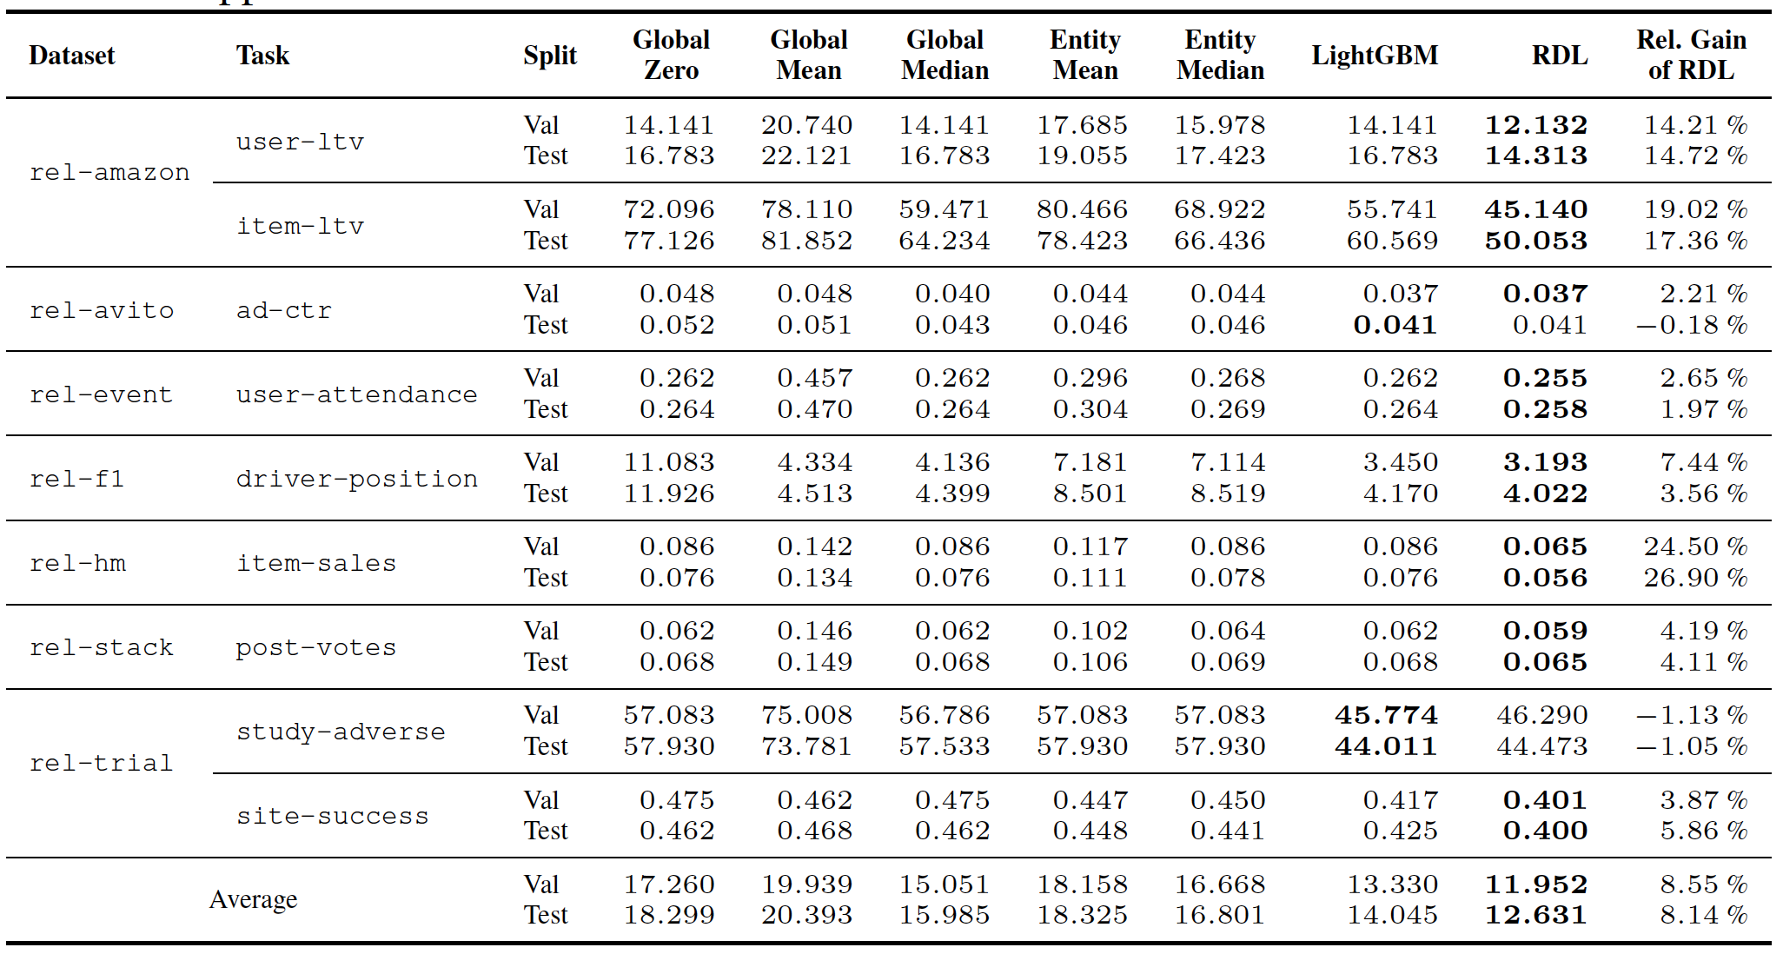
Baselines
Tabular Machine Learning
XGBoost, LightGBM
Naïve method
Global mean/median
GNNs
Homogeneous GNNs
Heterogeneous GNNs(RGCN, HAN,HGT)
RDL
HeteroGraphSAGE
RELGT
LLM
Notes:
Benchmark

Slide 33
Contents
Introduction to Relational Database
Relational Deep Learning
Relational Graph Transformer
Relational Foundation Model
Benchmark for RDL
Toy example

Slide 34
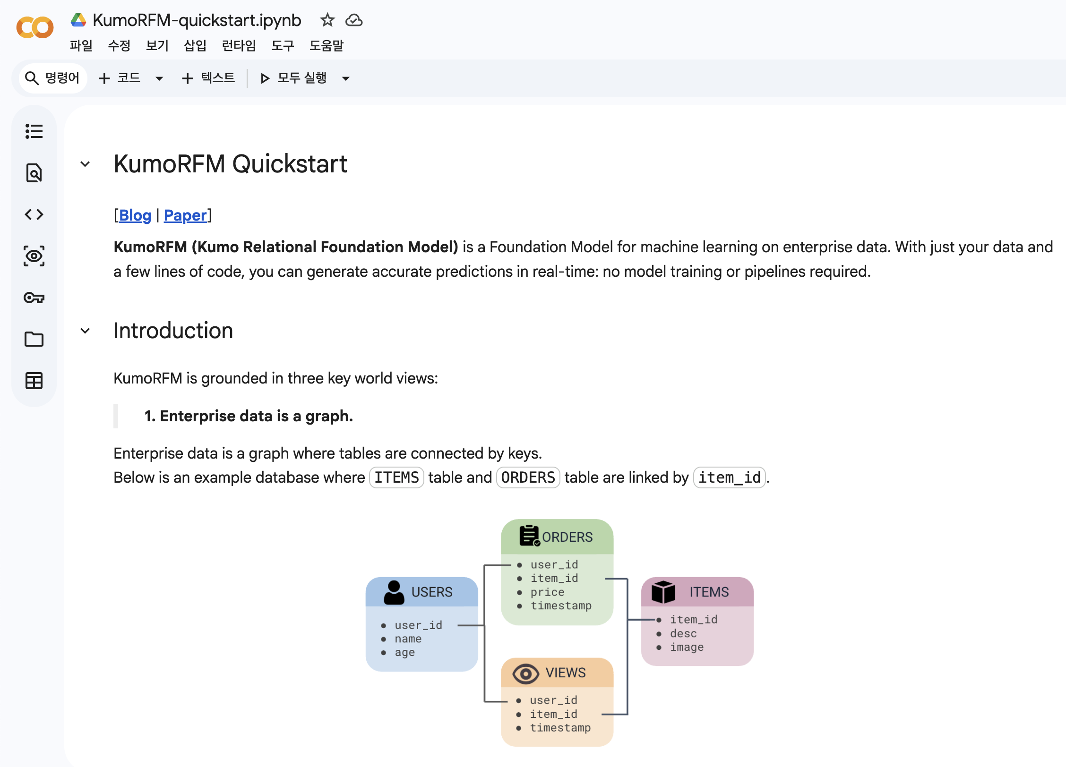
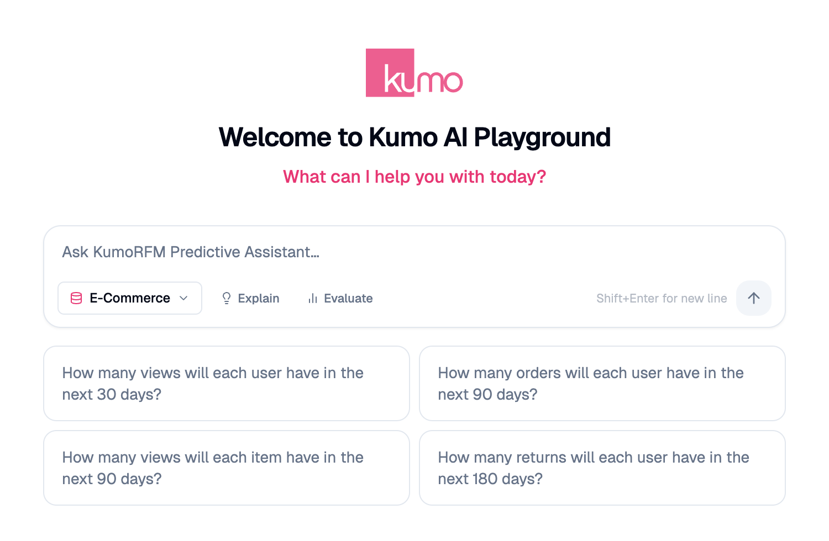
Toy Example to Understand KumoRFM
Let’s play!
Playground in Kumo.ai
QuickStart in Colab

Slide 35
References
Fey, Matthias, et al. "Position: Relational deep learning-graph representation learning on relational databases." Forty-first International Conference on Machine Learning. 2024.
Dwivedi, Vijay Prakash, et al. "Relational Graph Transformer." arXiv preprint arXiv:2505.10960 (2025).
Fey, Matthias, et al. "Kumorfm: A foundation model for in-context learning on relational data." 2025,
Ranjan, Rishabh, et al. "Relational Transformer: Toward Zero-Shot Foundation Models for Relational Data." arXiv preprint arXiv:2510.06377 (2025).
Hudovernik, Valter, et al. "KumoRFM-2: Scaling Foundation Models for Relational Learning." arXiv preprint arXiv:2604.12596 (2026).

Slide 36
References
Robinson, Joshua, et al. "Relbench: A benchmark for deep learning on relational databases." Advances in Neural Information Processing Systems 37 (2024): 21330-21341.
Gu, Justin, et al. "RelBench v2: A Large-Scale Benchmark and Repository for Relational Data." arXiv preprint arXiv:2602.12606 (2026).

Slide 37
References
https://kumo.ai
https://kumorfm.ai
https://relbench.stanford.edu/
https://kumo.ai/company/news/kumo-relational-foundation-model
https://research.google/blog/graph-foundation-models-for-relational-data
https://www.linkedin.com/posts/leskovec_kumoai-trains-foundation-model-for-relational-activity-7365853971019612160-es7y

