Slide 1
Flanner
Cross-platform interactive health care app

Slide 2
OUR TEAM
GEORGE SELIVANOV | DANILA KOCHEGAROV | ALEKSEI FOMINYKH | SAVVA PONOMAREV
manager / programmer | team lead / programmer | programmer | programmer / designer
calories calculator training calculator presentation | team leader habit tracker main screen localization | notes | animations themes menius localization pages launch screen

Slide 3
PROBLEM STATEMENT
Background: need for a utility to keep track of habits, exercises and nutrition records
Solution: an app for daily use to eat and exercise properly
Main goals:
food calorie count
habit tracker
statistics collection
training calorie count
notes
calendar accounting

Slide 4
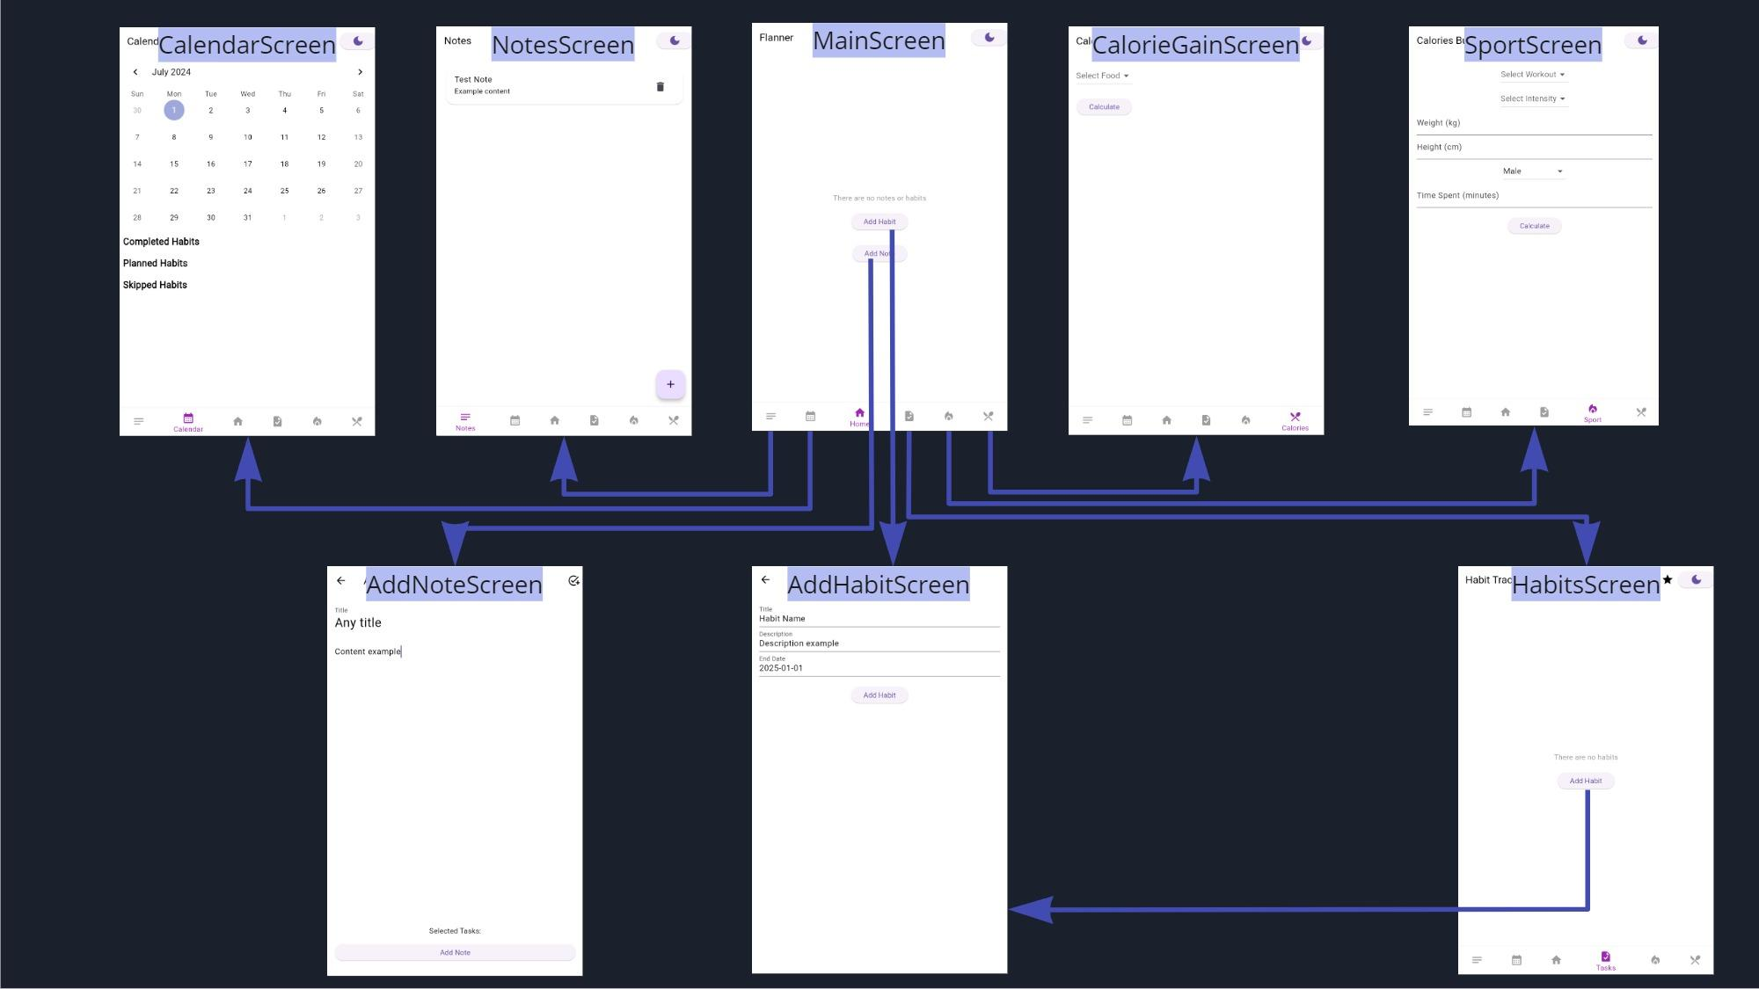
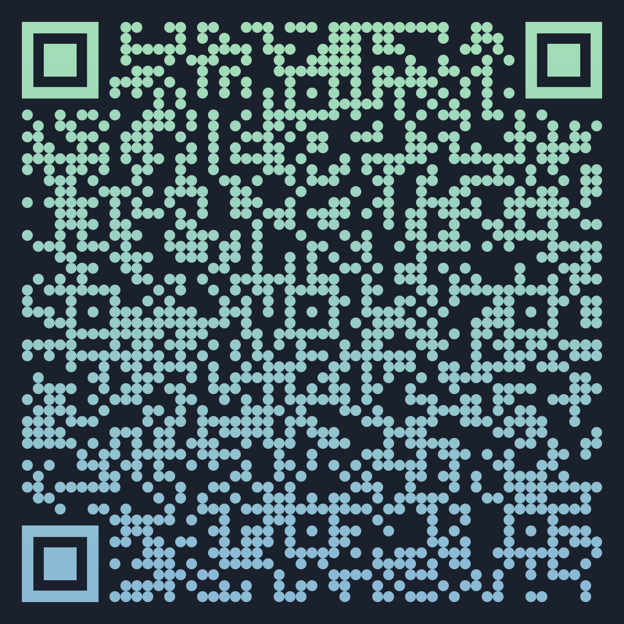
APP ARCHITECTURE
check out the high-quality version on Miro

Slide 5
MAIN CHALLENGES
COMMON
Library version conflict
problem: flutter dependent libraries conflict
solution: used customised pub get
Github branch conflict
problem: some code had merge conflicts with current version
solution: created new branch, rewrite all code
UNCOMMON
Animations
problem: an inappropriate library was used
solution: found and used custom painter library
Localization problems
problem: localization does not work correctly
solution: l18n library was used

Slide 6
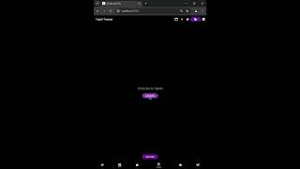
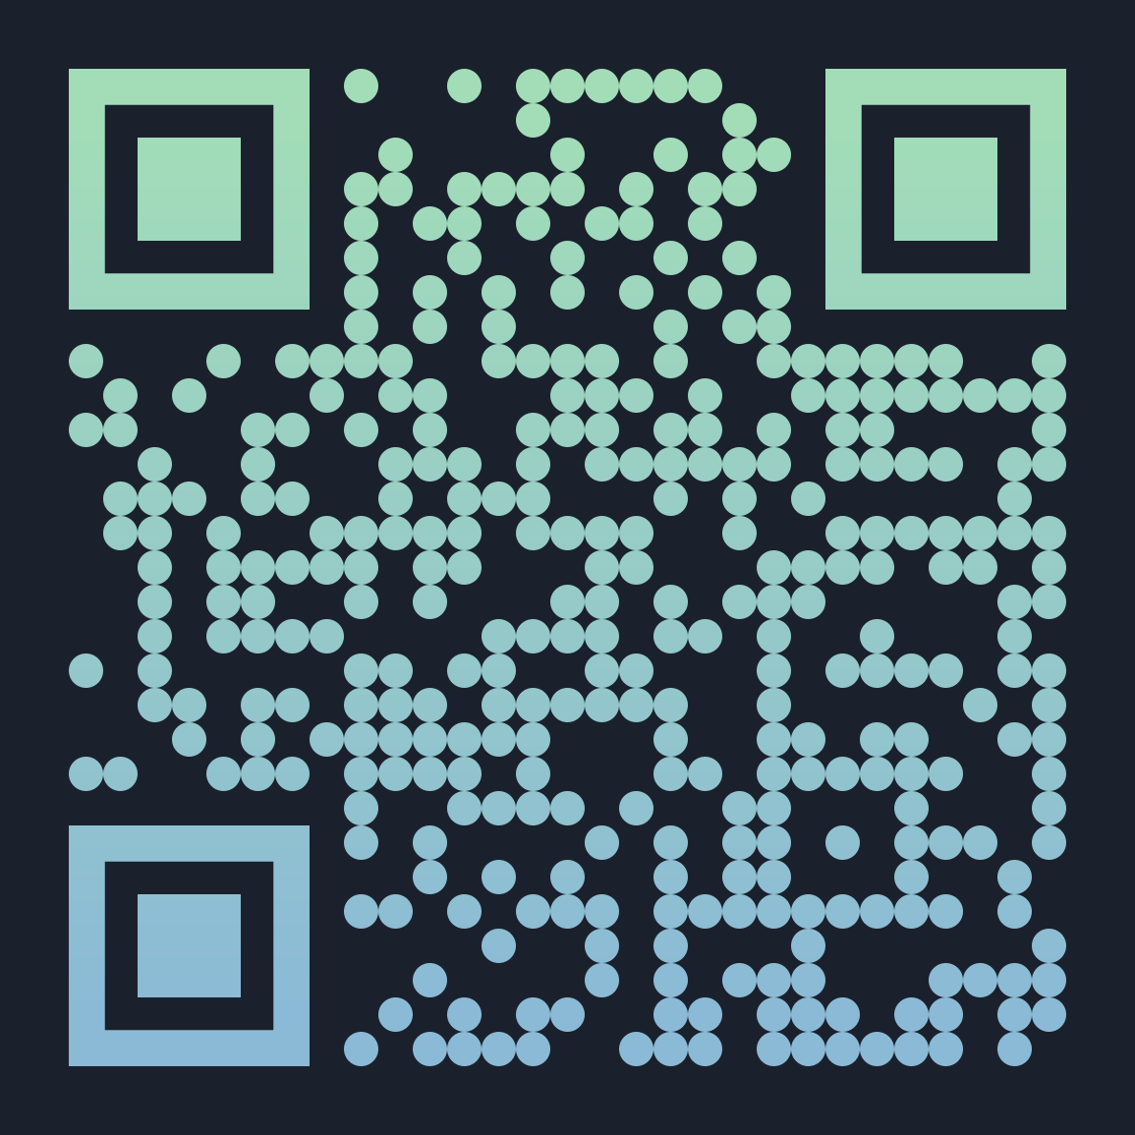
APP DEMONSTRATION
Check our demo YouTube video

Slide 7
Thank you for your attention!
You can track changes to the project and download the current version of our project from github

