Slide 1
Welcome!
While you wait
Have you done these?
Created a Github Account
Downloaded Github Desktop
There’s refreshments!
Sign your name at the table in front to collect them
Links and materials available at:
bit.ly/NTU-ghMats2023

Slide 2
Github Workshop

Slide 3
Outline
What is Version Control & Github
Commits
Branching & Merge Conflicts
Pull Requests & Forking
Setting up a static website (Optional)

Slide 4
1.
What is version control?
Why do we care?

Slide 5


What is version control?
Collaborate
Create anything with other people
Track & revert changes
See changes that have been made or going back in time
Notes:
Version control lets you do 2 very important things

Slide 6
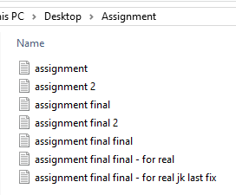
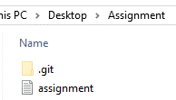
What is version control?

Slide 7
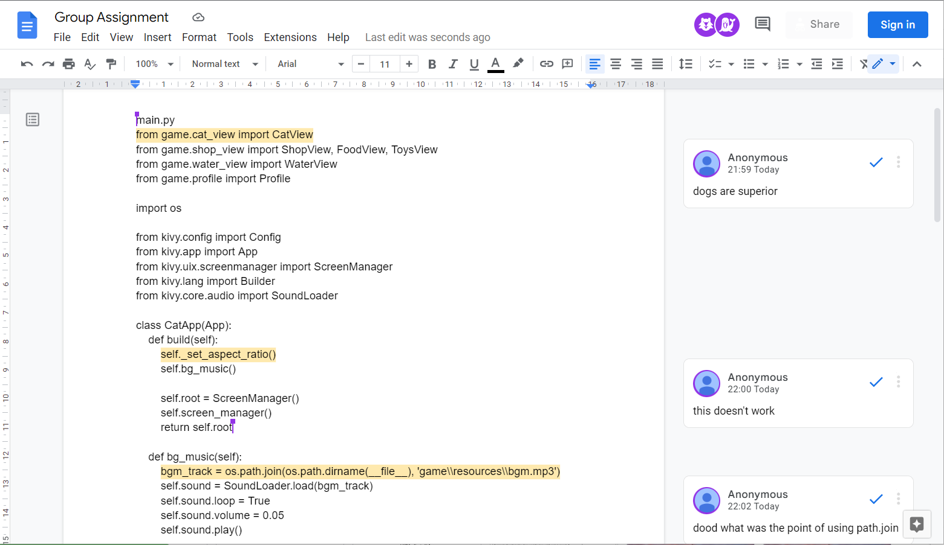
Coding with friends

Slide 8
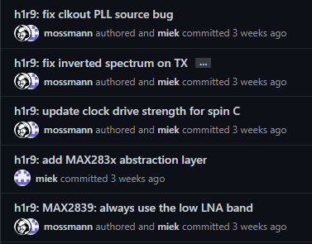
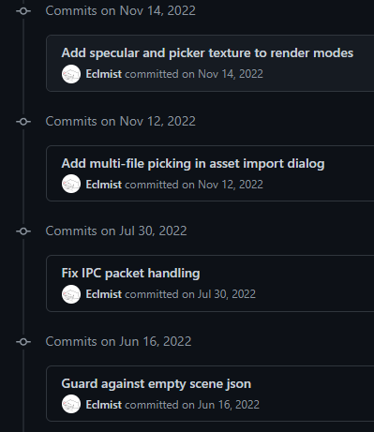
The Ideal
github.com/greatscottgadgets/hackrf
github.com/Eclmist/Matcha-Editor
Descriptive commit messages
Notes:
Good commit messages

Slide 9
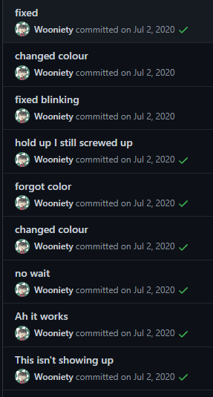
The Ideal
(?)
github.com/i’m-not-linking-this
(?)
Descriptive commit messages
Notes:
Bad.

Slide 10
2.
Github
What is it?

Slide 11



git ≠ Github
≠

Slide 12
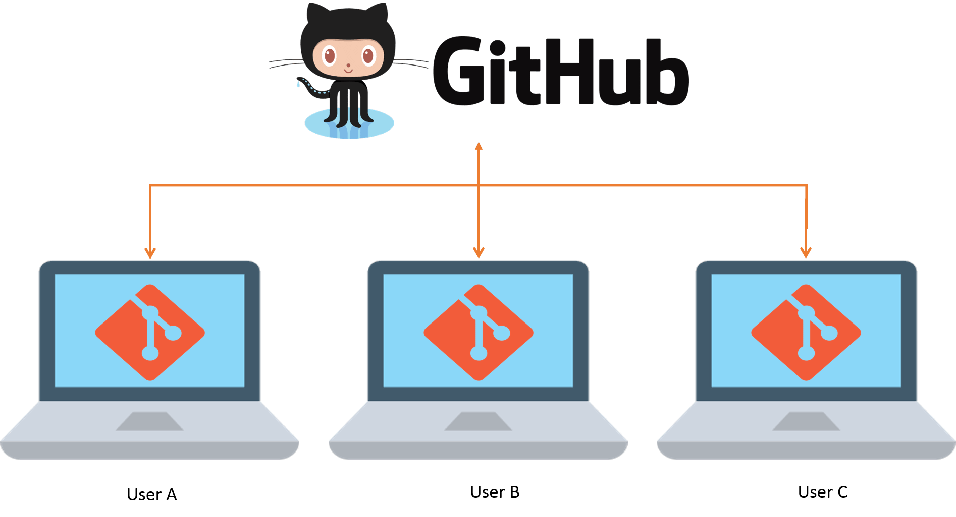
git ≠ Github
Notes:
Git (the orange one) is the tool you can install on your computer and use to version control your projects
Github is the website where you can upload and share these projects with other people

Slide 13
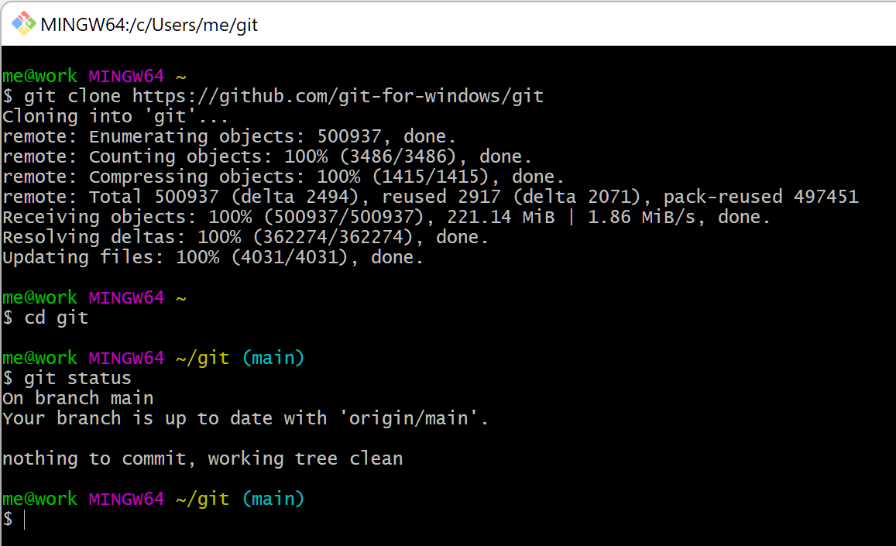
git
git is a Version control system software that you can run on your own computer, or on a server

Slide 14
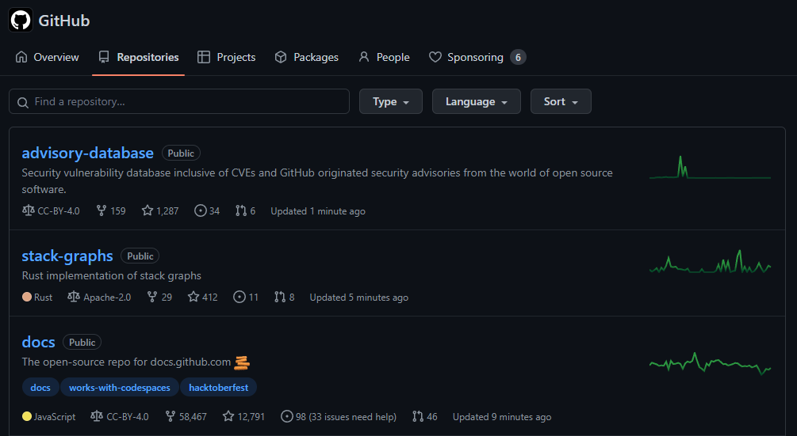
Github
GitHub is a Web-based service for storing, sharing, and collaborating on projects managed with Git

Slide 15
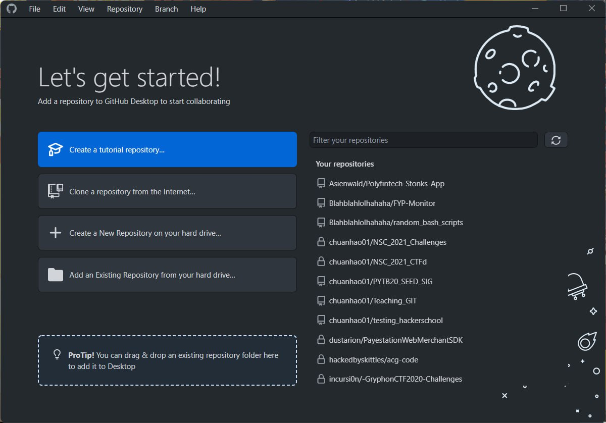

Github Desktop
An application made by Github made to use a GUI instead of the command line or web browser

Slide 16
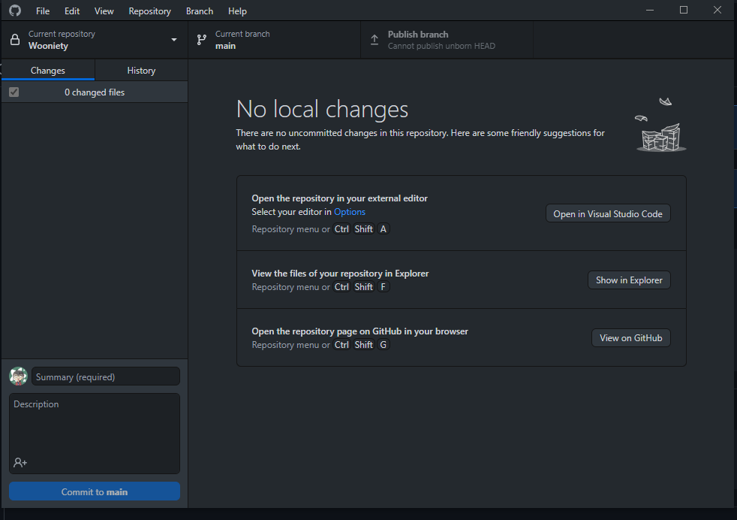
Github Desktop
Notes:
Showing the where the files are

Slide 17
Create a repository
The first project

Slide 18




Github Desktop
Computer
Github
About-Me
About-Me
Notes:
Cloning a repo from Github to your computer

Slide 19
Write an introduction
Introduce yourself on Github!

Slide 20
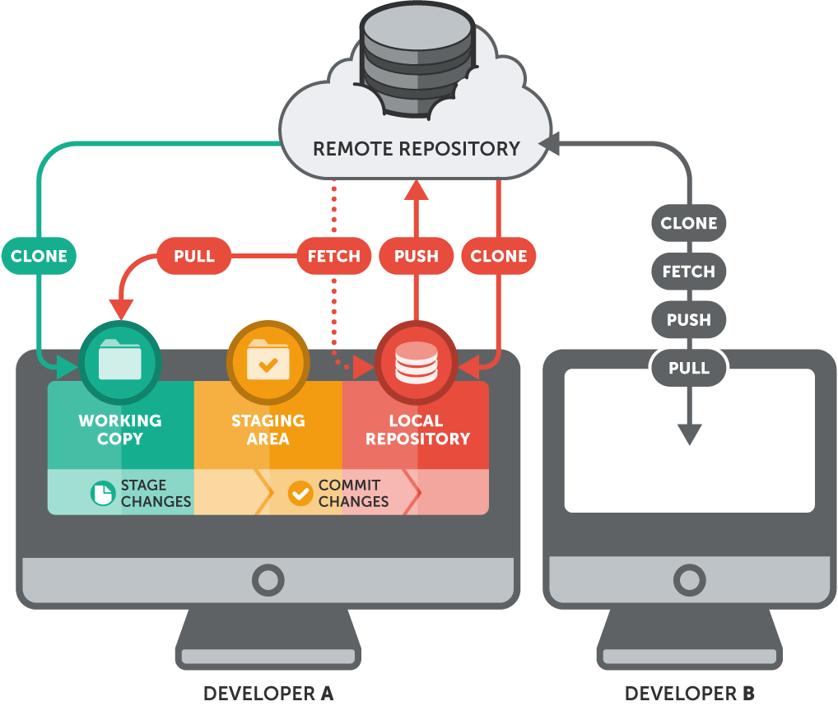
git Flow
Notes:
Stage:
Add
Commit
Push

Slide 21
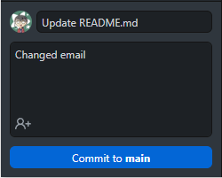
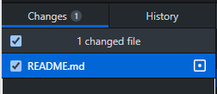

Commiting
About-Me
Computer
README.md
Work Copy
Staging Area
Local Repository
Notes:
Showing the where the files are

Slide 22
Push your changes
Make your changes show on Github

Slide 23


Github Desktop
Computer
Github
About-Me
About-Me
README.md
README.md
Notes:
Pushing changes to Github

Slide 24
3.
A bit more on version control
What is it?

Slide 25
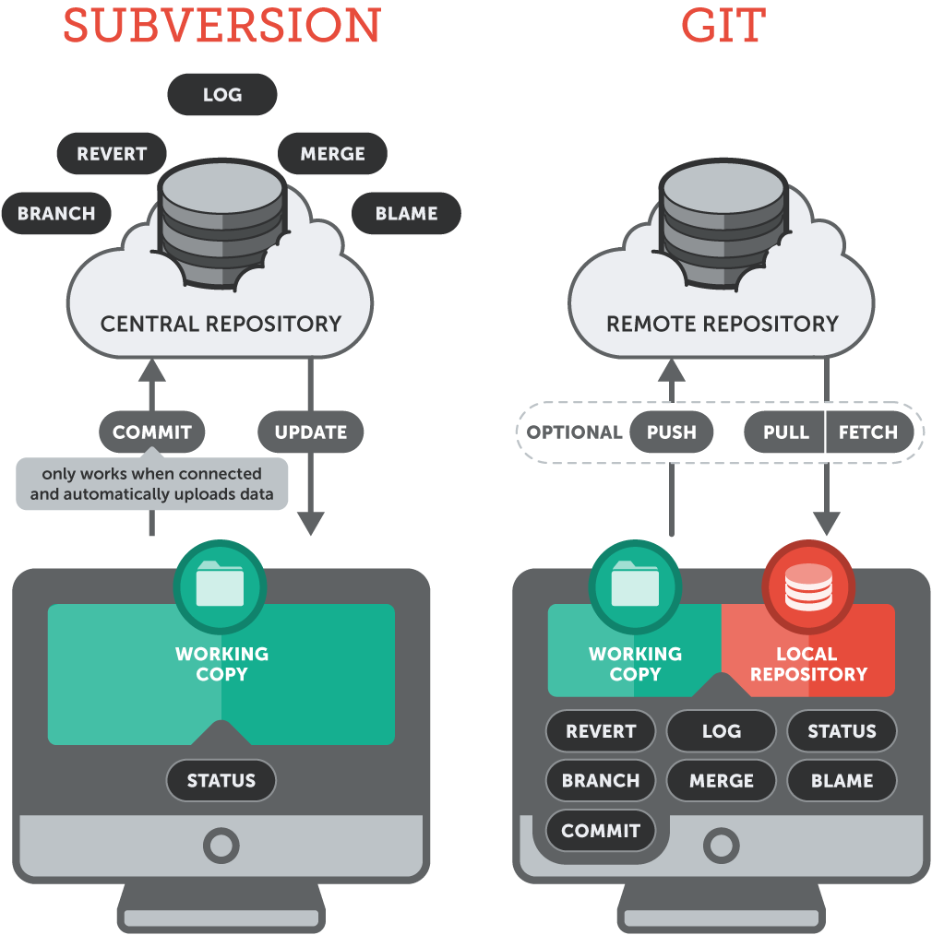
Version Control Types
Notes:
SVN vs. Git

Slide 26

Version Control Types
Centralised Version Control
1 central server
Each person checks out and merges back into the main server
Distributed Version Control
Each person has a local repository
This is then merged with the main server
Notes:
Pt. 2
Centralised Version Control: SVN, Perforce, CVN
Distributed Version Control: git, Mercurial

Slide 27
4.
Collaboration
Branches

Slide 28
Pair up!
Get the username of the person next to you

Slide 29
Pair up!
Get the Github Username of the person next to you
Clone their repository
Notes:
Show how to add collaborators on a repo (vv impt if it’s private or they won’t see)

Slide 30

Our current flow
Person A
main
Add README
Edit
README
Edit
README
Notes:
Literally Animation Hell

Slide 31
Our current flow
Person A
Person B
main
Add README
Edit
README
Edit
README
Add
B.md
Edit
README

Slide 32

Branching
Person A
Person B
docs/B
Add
B.md
main
Add README
Edit
README
Edit
README
Notes:
Now try branching off and making some changes to your file

Slide 33
Coding with friends
Notes:
Plz no

Slide 34
Branching
Person A
Person B
docs/B
Add
B.txt
main
Add README
Edit
README
Edit
README
Merged
dev-B

Slide 35
MERGE CONFLICTS
Notes:
badbadbad

Slide 36
Branching
Person A
Person B
docs/B
Add
B.txt
Edit
README
main
Add README
Edit
README
Edit
README
Edit
README

Slide 37

Branching
Person A
Person B
docs/B
Add
B.txt
Edit
README
main
Add README
Edit
README
Edit
README
Edit
README
Merged
dev-B

Slide 38
Merge Conflicts
Don’t have merge conflicts!
Small features/fixes
Pull & update often
Be mindful of conflict during project planning

Slide 39
What we’ve done

Slide 40
Our Flow
Person A
Person B
2. Added
Commits
dev-B
1. Created a branch
Add
B.txt
Edit
README
main
3. Merged
Add README
Edit
README
Edit
README
Edit
README
Merged
dev-B

Slide 41
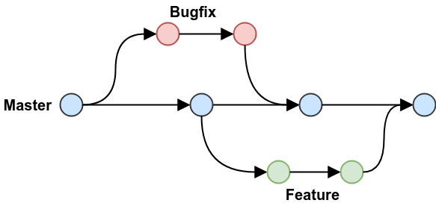
Branching Practices
Notes:
Simple example of some branching practices

Slide 42
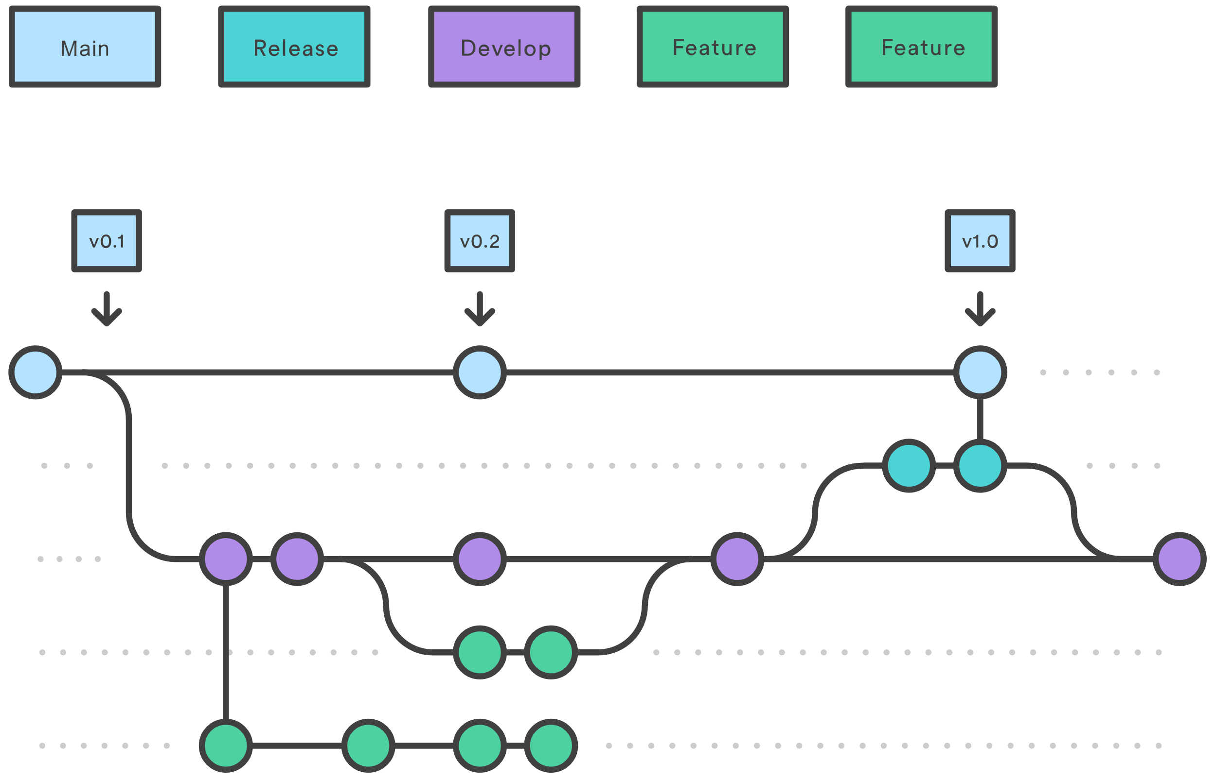
Branching Practices
https://www.atlassian.com/git/tutorials/comparing-workflows/gitflow-workflow
Notes:
A flow more people use (There are more advanced ones but it rlly depends on the ppl you’re with)

Slide 43
Merge Conflicts
Don’t have merge conflicts!
Small features/fixes
Pull & update often
Be mindful of conflict during project planning

Slide 44
5.
Pull Requests
The social part of Github

Slide 45

Pull Requests
Person A
Person B
dev-B
Pull Request
Add
B.txt
Edit
README
main
Add README
Edit
README
Edit
README
Edit
README
Merged
dev-B

Slide 46
Let’s Create a PR

Slide 47
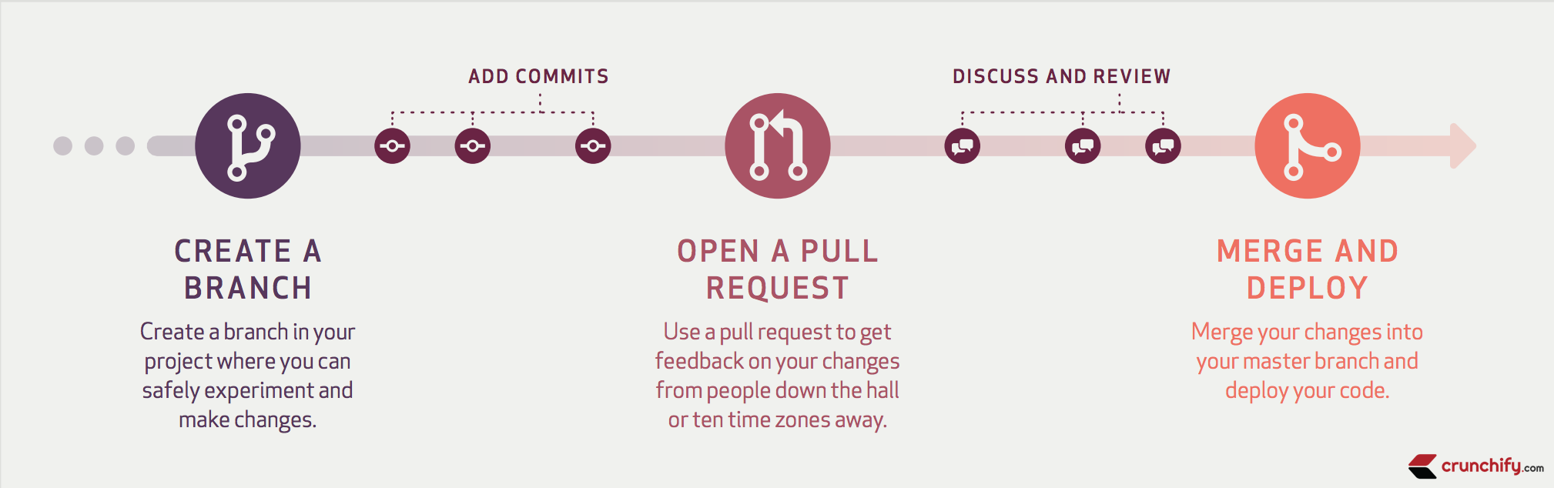
When you might use it
Notes:
General Github Flow

Slide 48
6.
Forking
The social part of Github

Slide 49
Forking
You
User B
Cool Project
Cool Project
Notes:
Forking is copying from another repo on Github (I don’t rlly use it unless I’m working on Open Source stuff)

Slide 50
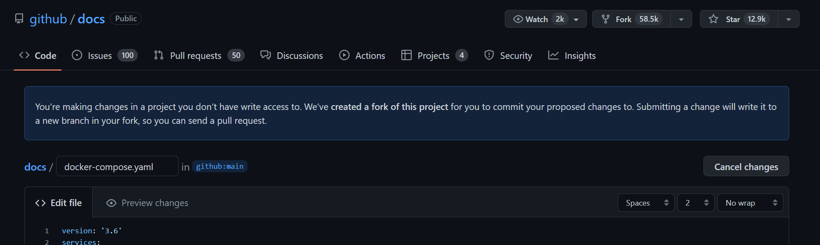
When you might use it
If you want to make changes to a repo you don’t control, you can fork it then make a Pull Request

Slide 51
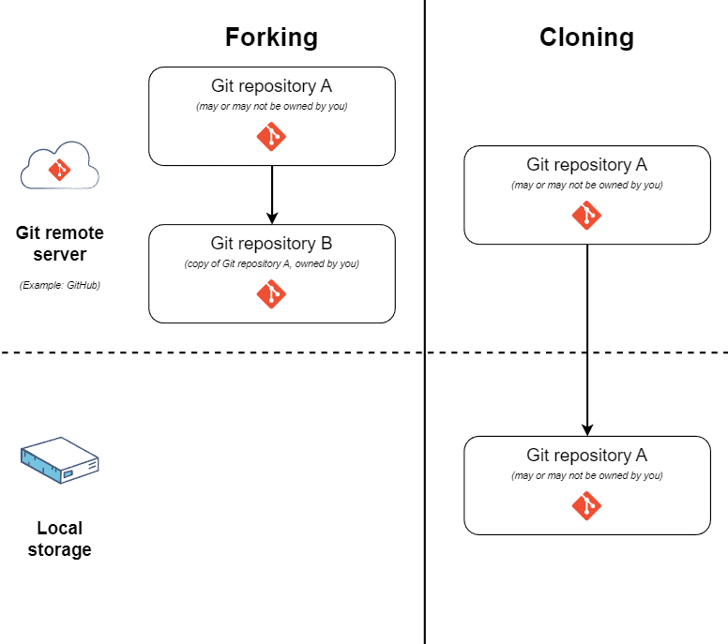
Forking Vs Cloning
educative.io/answers/what-is-the-difference-between-forking-and-cloning-in-git

Slide 52
6.
Github Pages
The social part of Github
Notes:
Just show

Slide 53

Thanks!
Any questions?
Feedback Form bit.ly/3kVsqOS
Notes:
There really shouldn’t be anyone seeing this but if you do you can ask me toss you another USB data blocker (while I still have them) secret{waw_sl1d3s}

