Slide 1

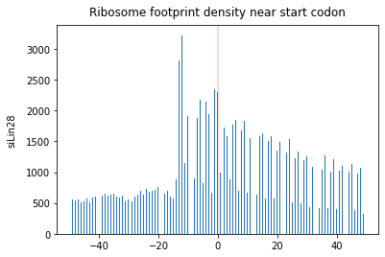
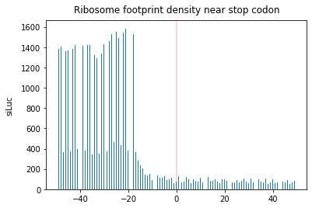
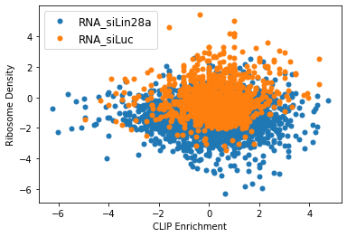
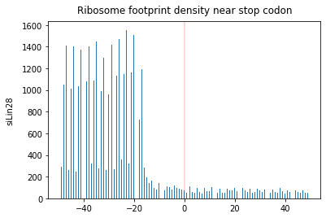
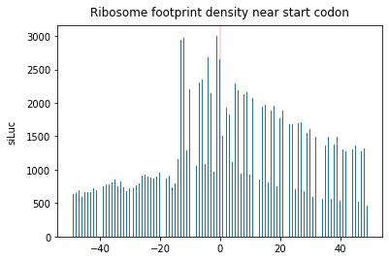
LIN28A Is a Suppressor of ER-Associated Translation in Embryonic Stem Cells
Woosub Kim¹⁾ and Hyesik Jang¹⁾
1 Seuou National University Interdisciplinary Program of Bioinformatics
Introduction
LIN28 is a conserved RNA-binding protein, with homologs found in worms to humans. It was originally identified as a regulator of developmental timing in Caenorhabditis elegans (Moss et al., 1997), and its expression is tightly regulated during animal development (Moss and Tang, 2003). Mammals have two homologues, Lin28a and Lin28b. Lin28a is highly expressed in embryonic stem cells (ESCs) (Yu et al., 2007). Perturbation of Lin28 results in developmental defects and tumorigenesis (Zhu et al., 2010). At the molecular level, LIN28 acts as a repressor of let-7 microRNA biogenesis (Heo et al., 2008; Newman et al., 2008; Rybak et al., 2008; Viswanathan et al., 2008). Studies using ribosome footprinting revealed that
(B)
(C)
(D)
Fig1 Compared to siLuc(control) siLin28a RNA is negatively affected by ribosome density.
Fig2 Ribosome footprint near start and stop codon
A Ribosome footprint near startcodon of siLuc
B Ribosome footprint near startcodon of siLin28a
C Ribosome footprint near stopcodon of siLuc
D Ribosome footprint near stopcodon of siLin28a
(A)
Discussion
LIN28A represses translation, binding to RNA. Because interaction sites typically occur throughout the coding sequence and the 3' UTR at multiple positions, LIN28A may interfere with the step before or during elongation. LIN28A is the first example of an mRNA-binding protein that inhibits ER-related translation. LIN28A-related follow-up studies may provide new insights into ER-related translational control.

