Slide 1
Methemathics for Machine Learning (MA4029)
7.5 HP
X₁
X₂
Neural Network
Multilayer Perceptron (MLP)
Project
X₃
X_{n}
Dennis Mitzeus – 70002183
Halmstad University
2024-05-16

Slide 2
Methemathics for Machine Learning (MA4029)
7.5 HP
Multilayer Perceptron (MLP)
X₁
+b₁
Σ
X₂
+b₂
+b₄
Σ
Σ
ŷ
X₃
+b₃
Σ
X_{n}
Dennis Mitzeus – 70002183
Halmstad University
2024-05-16

Slide 3
Multilayer Perceptron (MLP)
X₁
Dense Layer
+b₁
_{σ}
Some non-linear activation function
Σ
X₂
+b₂
_{σ}
+b₄
Σ
Σ
ŷ
X₃
+b₃
_{σ}
Σ
X_{n}

Slide 4
Multilayer Perceptron (MLP)
X₁
Dense Layer
+b₁
_{σ}
Some non-linear activation function
Σ
X₂
+b₂
_{σ}
+b₄
Σ
Σ
ŷ
X₃
+b₃
_{σ}
Σ
X_{n}

Slide 5



Forward
Input
X ⋅W + B
Output
Backward
Input
$$∇W=\frac{∂E}{∂W}$$
$$∇X=\frac{∂E}{∂X}$$
Output
Gradient
$$∇B=\frac{∂E}{∂B}$$
Gradient

Slide 6



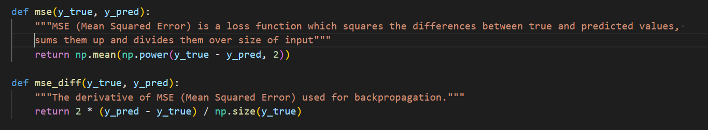
Components

Slide 7
Components

Slide 8


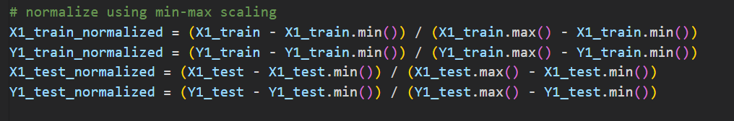
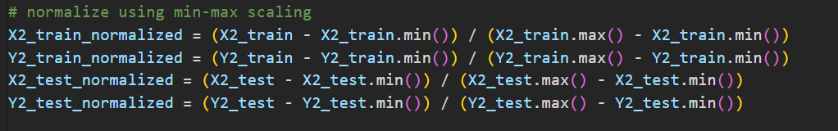
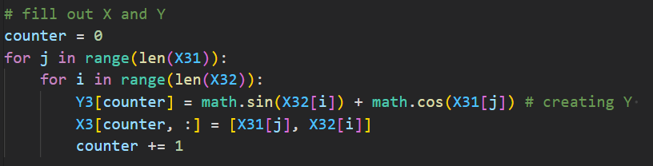
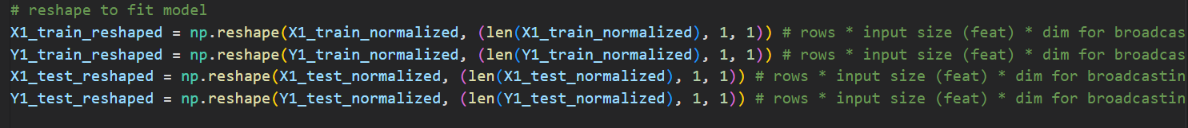
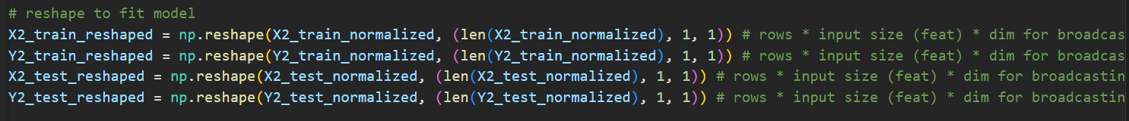
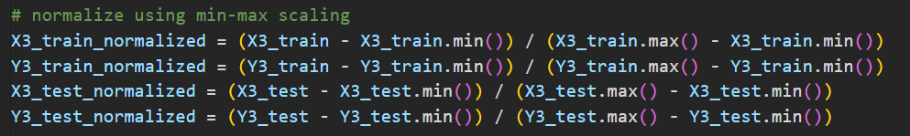
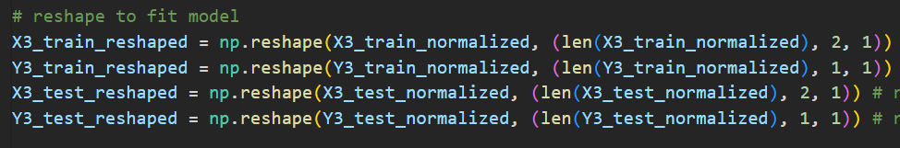
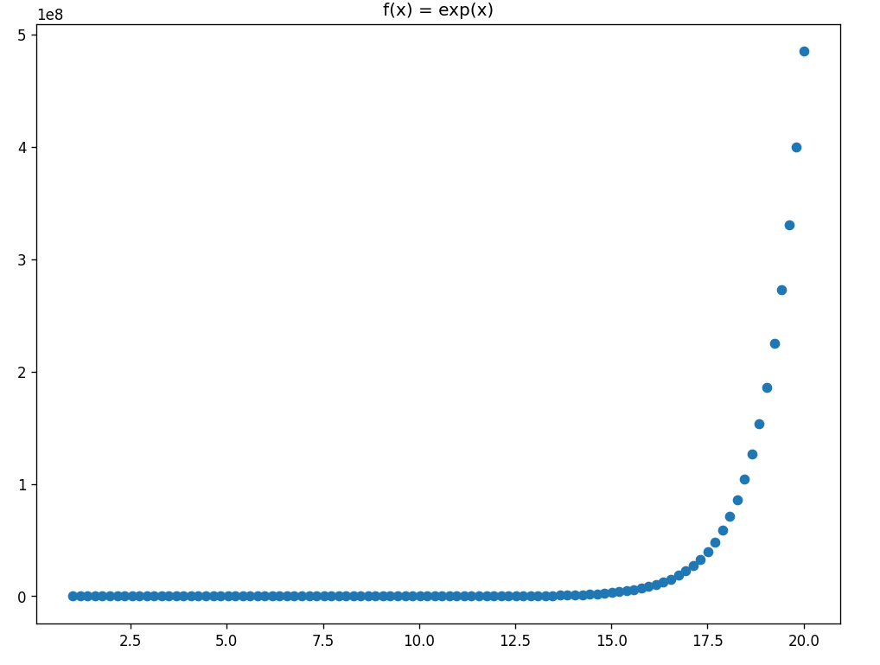
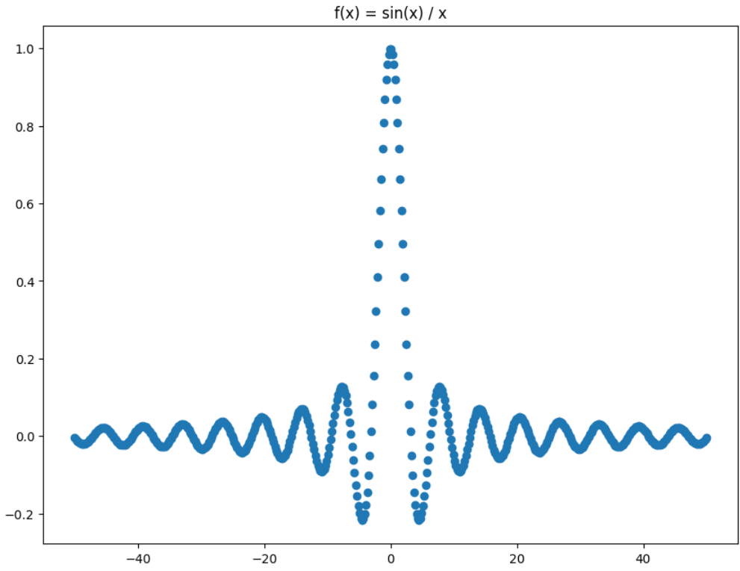
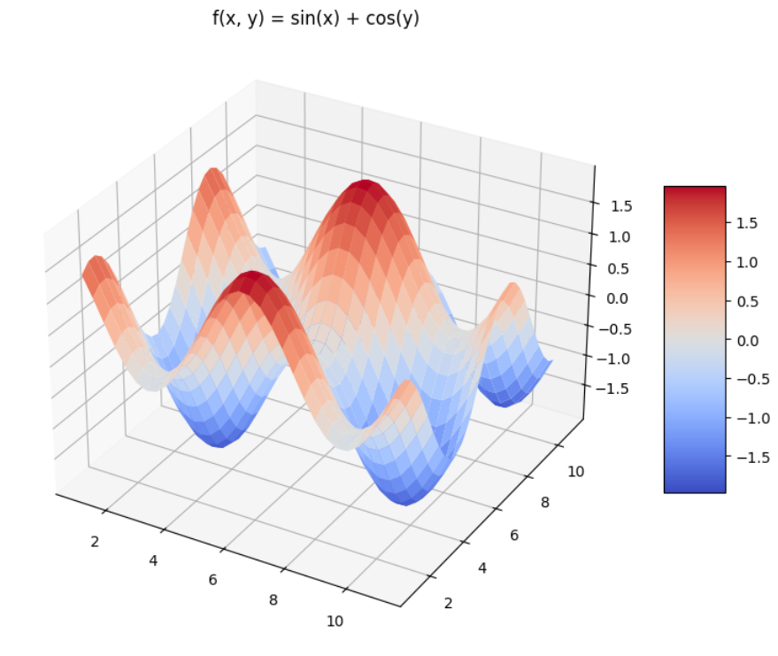



X and Y
Divide into train and test
Normalize Train Data
Min-Max Scaler
Normalize Test Data
Reshape Train Data
2D/3D Matrix
Reshape Test Data
NN.fit(X_train_rs, X_train_rs)
NN.train(…)
NN.test(X_test_rs, X_test_rs)
$$f\left(x\right)=e^{x}$$
$$f\left(x\right)=\frac{sin(x)}{x}$$
$$f\left(x, y\right)=sin\left(x\right)+cos(y)$$

Slide 9
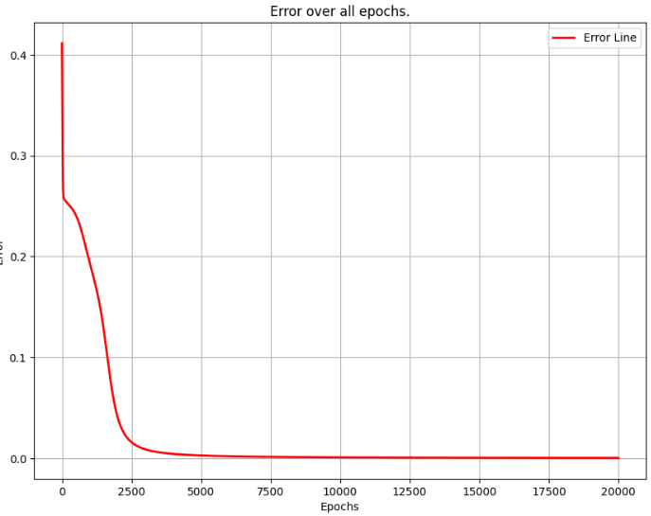
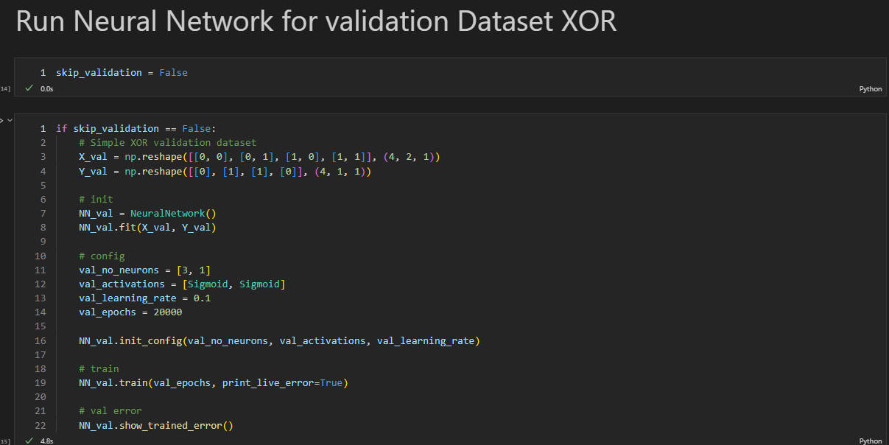
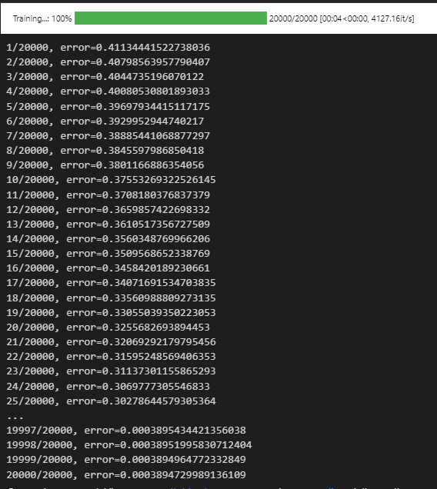



X and Y
Divide into train and test
Normalize Train Data
Min-Max Scaler
Normalize Test Data
Reshape Train Data
2D/3D Matrix
Reshape Test Data
NN.fit(X_train_rs, X_train_rs)
NN.train(…)
NN.test(X_test_rs, X_test_rs)
$$f\left(x\right)=e^{x}$$
$$f\left(x\right)=\frac{sin(x)}{x}$$
$$f\left(x, y\right)=sin\left(x\right)+cos(y)$$
XOR Validation

Slide 10



$$f\left(x\right)=e^{x}$$
$$f\left(x\right)=\frac{sin(x)}{x}$$
$$f\left(x, y\right)=sin\left(x\right)+cos(y)$$
XOR Validation

Slide 11
XOR Validation

Slide 12
XOR Validation

Slide 13
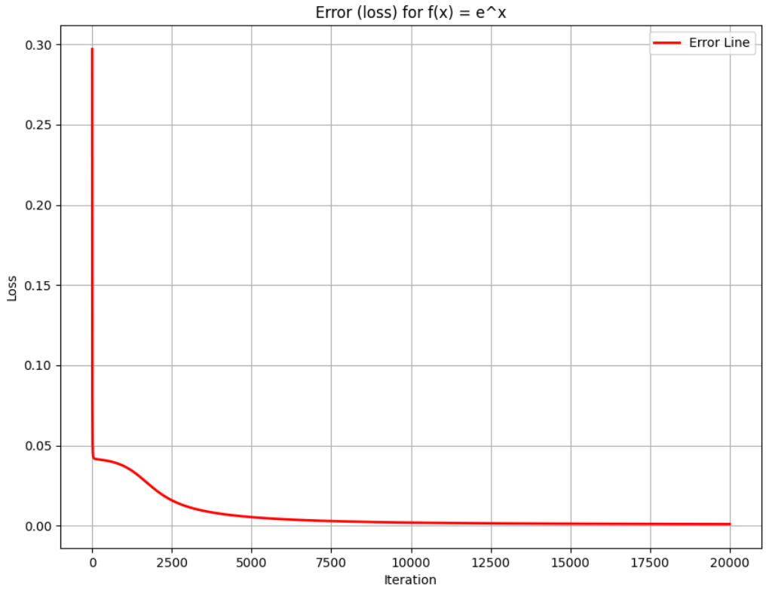
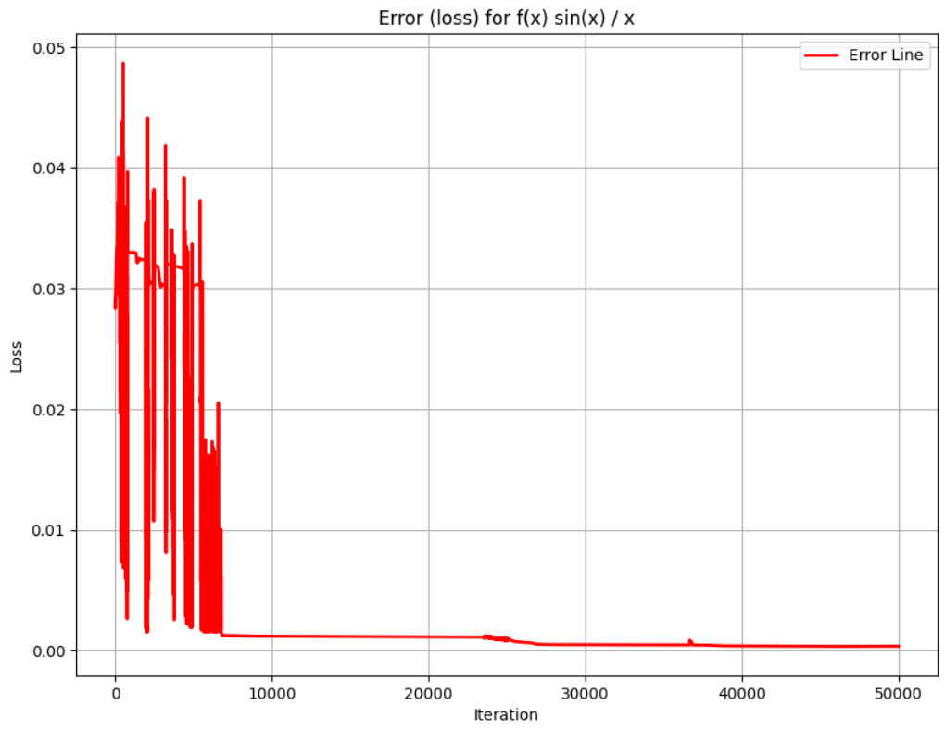
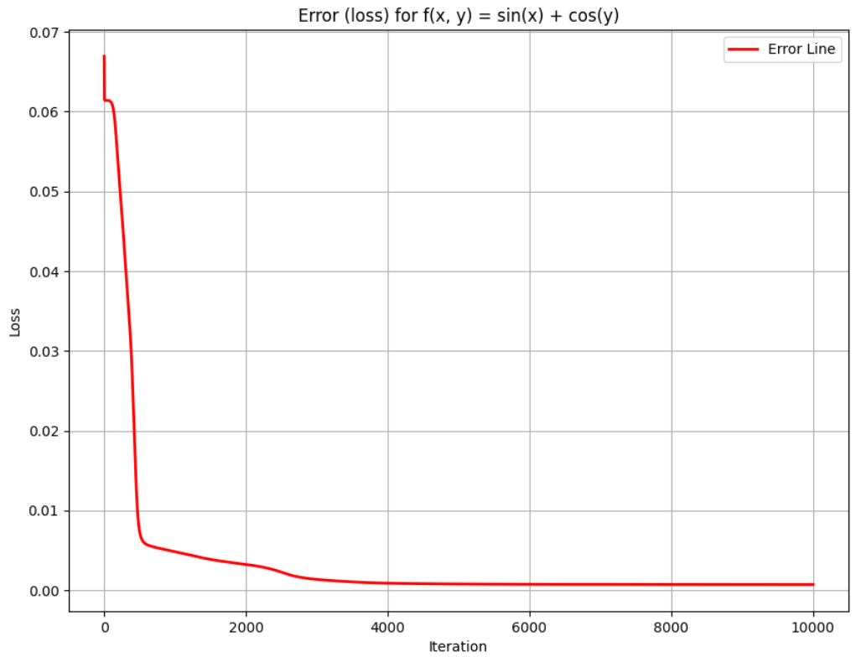



Loss
$$f\left(x\right)=\frac{sin(x)}{x}$$
$$f\left(x\right)=e^{x}$$
$$f\left(x, y\right)=sin\left(x\right)+cos(y)$$

Slide 14
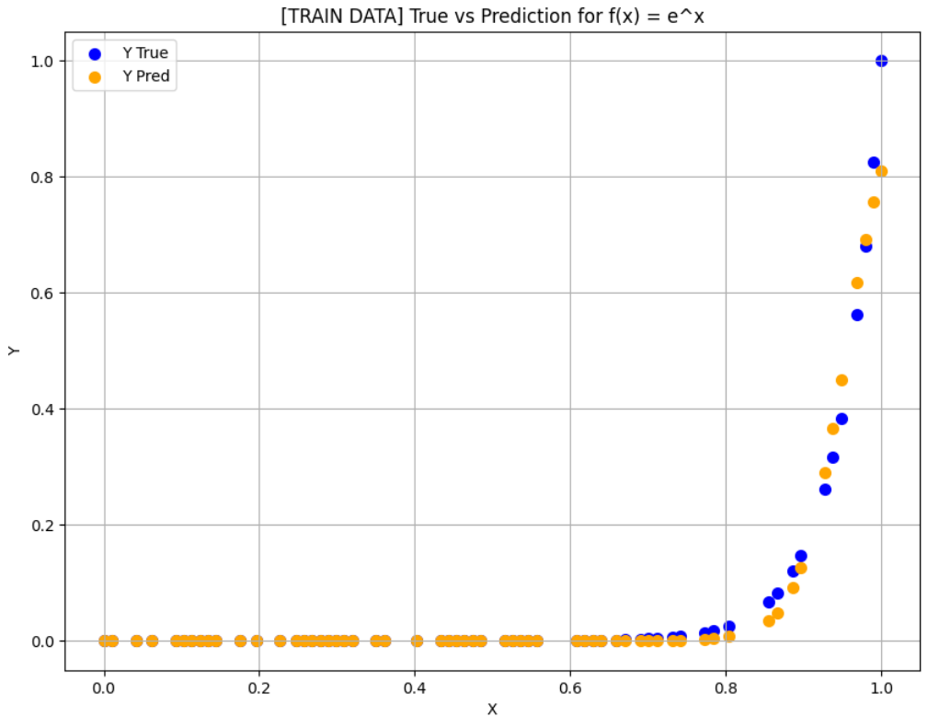
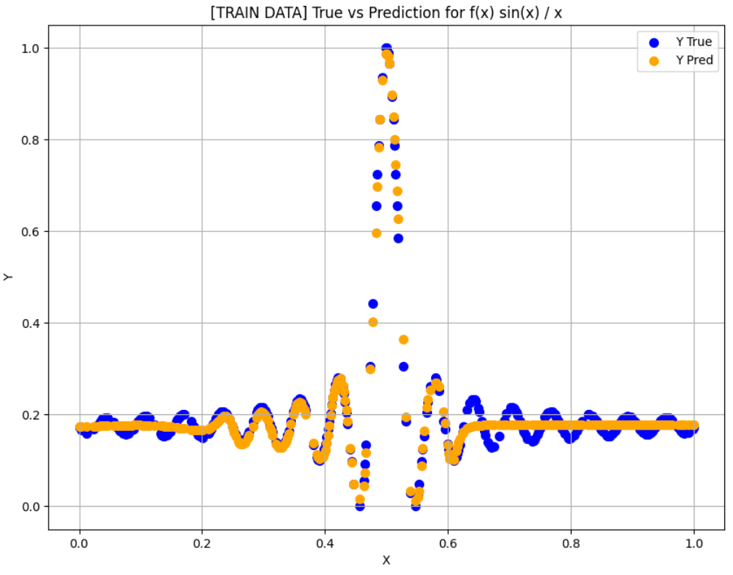
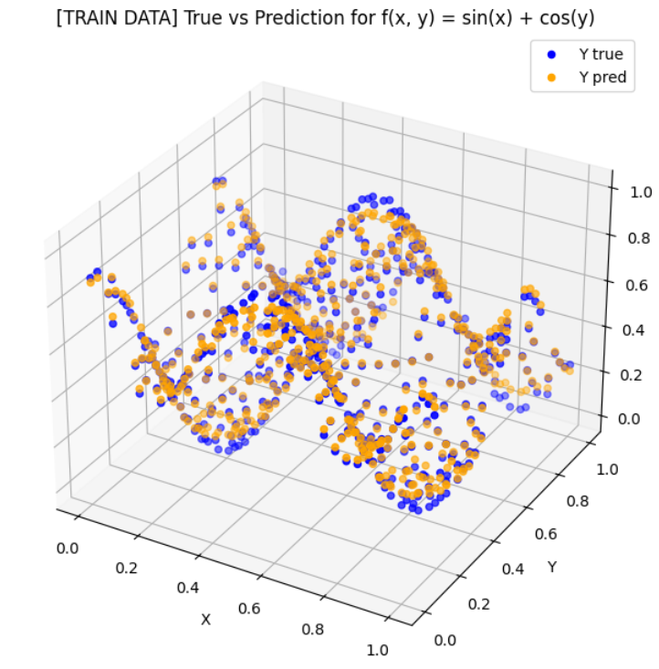
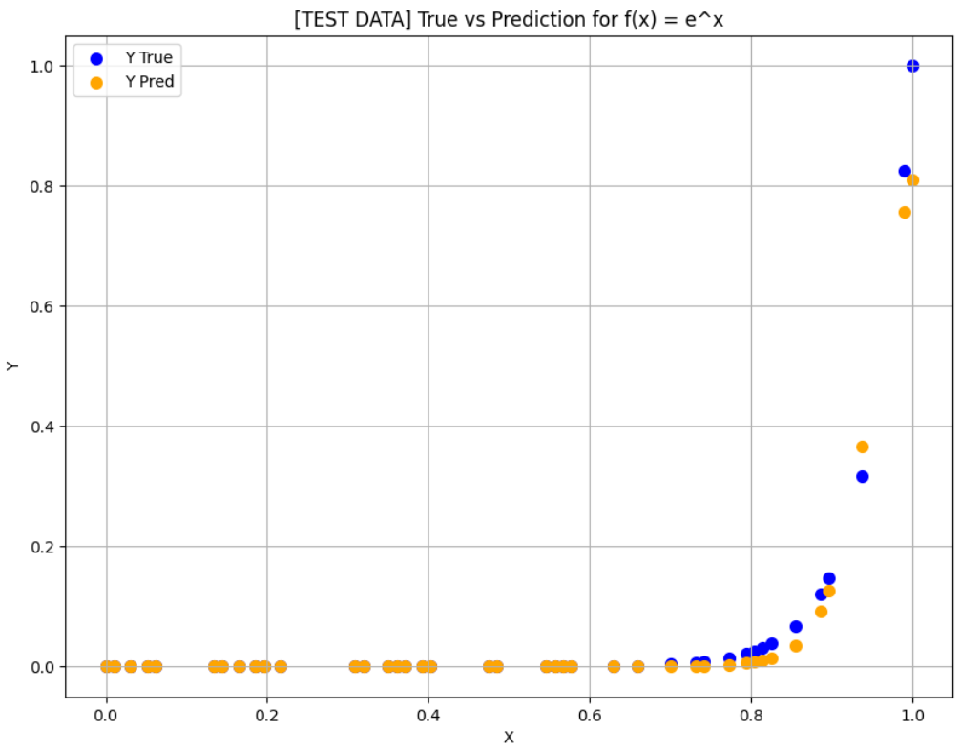
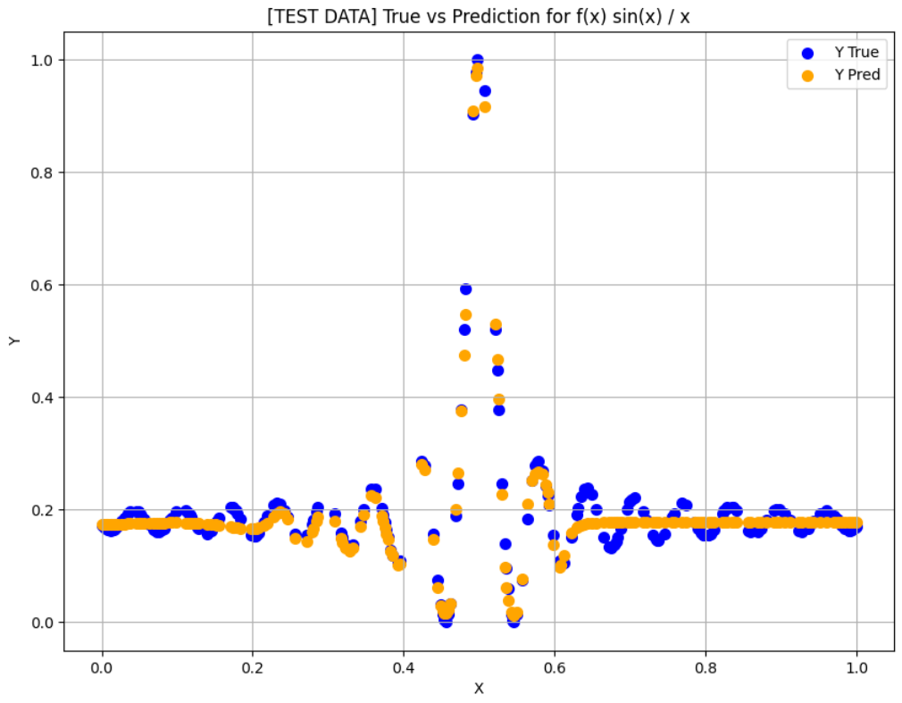
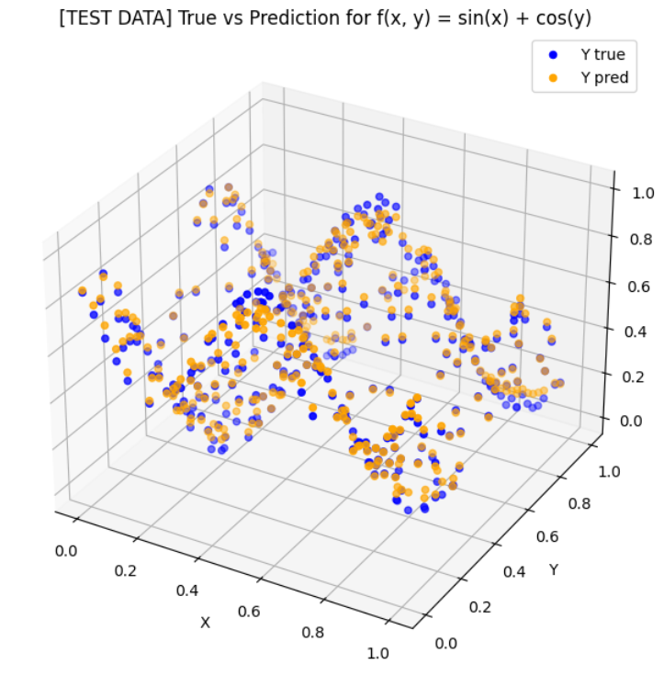
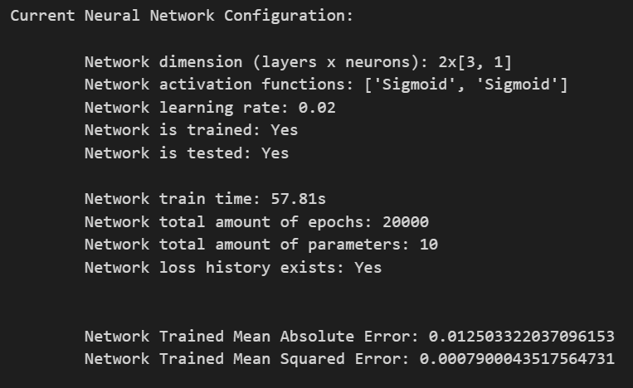
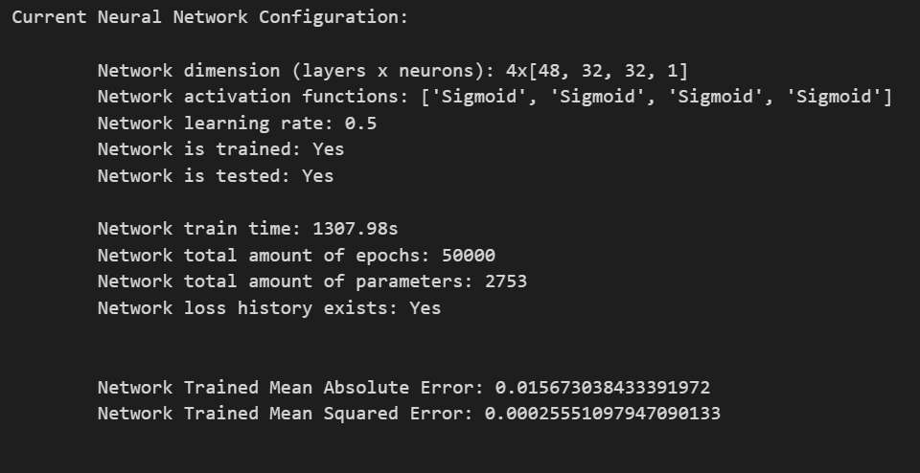
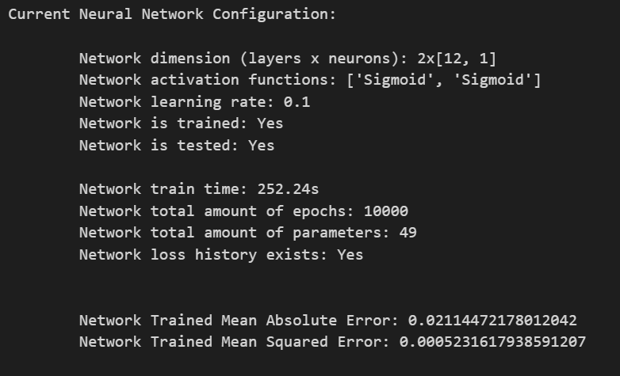
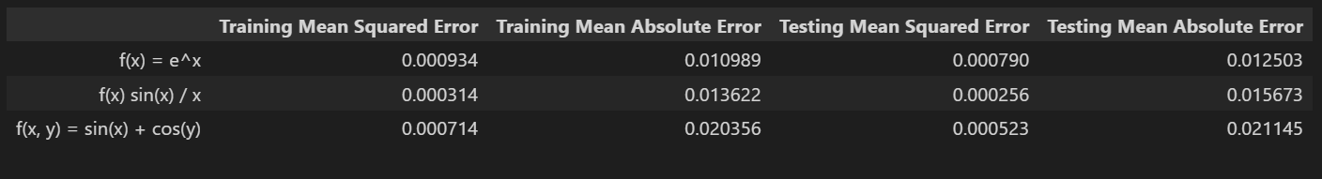



Loss
$$f\left(x\right)=\frac{sin(x)}{x}$$
$$f\left(x\right)=e^{x}$$
$$f\left(x, y\right)=sin\left(x\right)+cos(y)$$

Slide 15
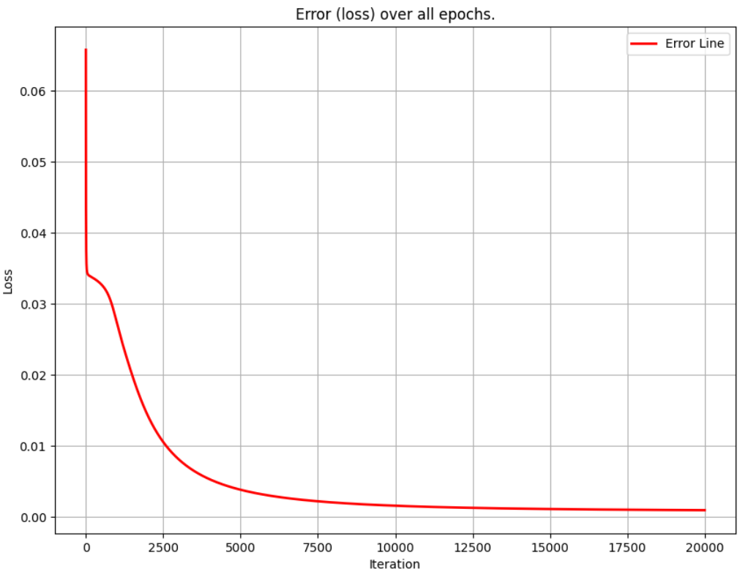
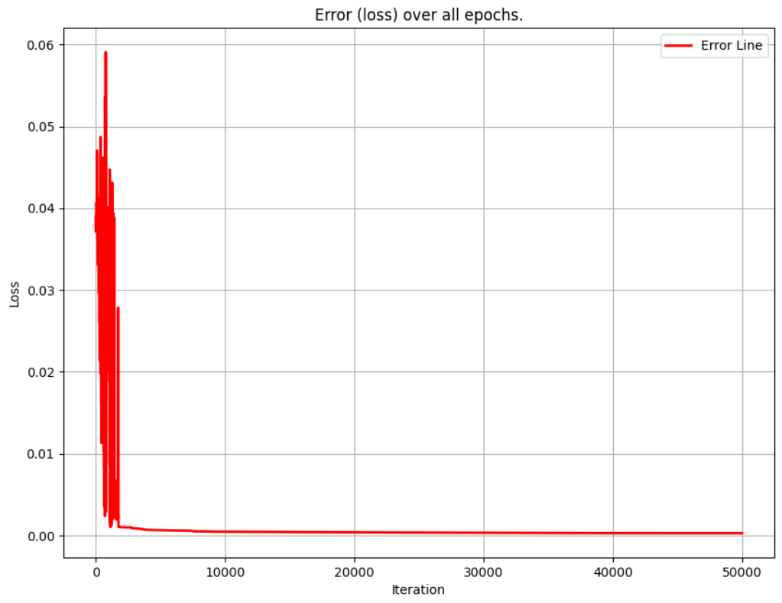
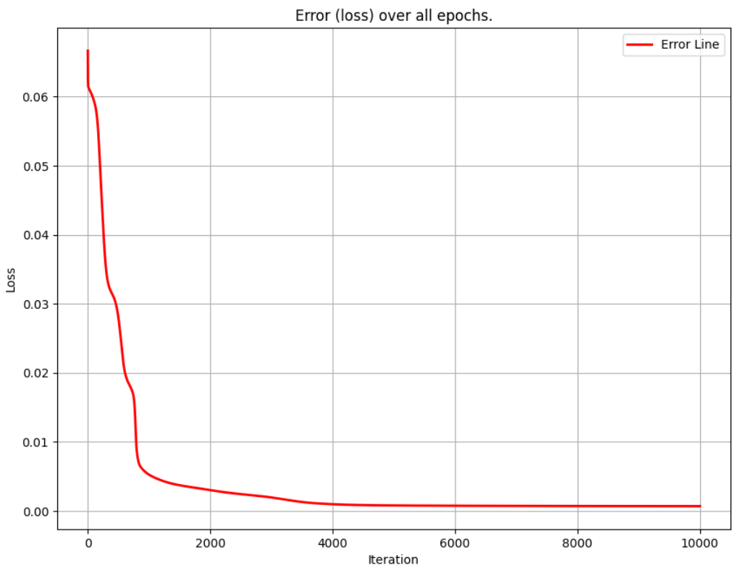



$$f\left(x\right)=e^{x}$$
$$f\left(x\right)=\frac{sin(x)}{x}$$
$$f\left(x, y\right)=sin\left(x\right)+cos(y)$$

Slide 16



Mathematics for Machine Learning Algorithms That Never Works Until You Debugged It For 20 Hours Realizing That You Forgot To Change One Variable And Now It Works But You Don’t Know Why
(MA4029)
7.5 HP
$$f\left(x\right)=e^{x}$$
$$f\left(x\right)=\frac{sin(x)}{x}$$
$$f\left(x, y\right)=sin\left(x\right)+cos(y)$$
Dennis Mitzeus – 70002183
Halmstad University
2024-05-16

Slide 17



$$f\left(x\right)=e^{x}$$
$$f\left(x\right)=\frac{sin(x)}{x}$$
$$f\left(x, y\right)=sin\left(x\right)+cos(y)$$
Mathematics for Machine Learning Algorithms That Never Works Until You Debugged It For 20 Hours Realizing That You Forgot To Change One Variable And Now It Works But You Don’t Know Why
(MA4029)
7.5 HP
Neural Network
Multilayer Perceptron (MLP)
Project
Dennis Mitzeus – 70002183
Halmstad University
2024-05-16

Slide 18
Mathematics for Machine Learning Algorithms That Never Works Until You Debugged It For 20 Hours Realizing That You Forgot To Change One Variable And Now It Works But You Don’t Know Why
(MA4029)
7.5 HP
Neural Network
Multilayer Perceptron (MLP)
Project
Dennis Mitzeus – 70002183
Halmstad University
2024-05-16

