Slide 1
Spleen scRNA-seq Analysis
Harmony Integration & Cell Type Annotation
Date: 2026-01-16

Slide 2
Analysis Overview
Dataset: 461,102 cells × 32,194 genes
Sample type: Spleen tissue (73 samples)
Batch correction: Harmony integration
Clustering: Louvain (31 clusters, resolution 1.0)
PCs used: 40 (optimal from range 30-50)
Cell types identified: 11 major types, 31 refined subtypes

Slide 3
Analysis Workflow
1. Quality Control: Filtered doublets (28,433 cells removed)
2. Normalization: Total count to 10,000 UMIs + log transformation
3. Feature Selection: 3,000 highly variable genes
4. PCA: 50 components computed, 40 selected
5. Harmony Integration: Batch effect correction (11 iterations)
6. UMAP: Dimensionality reduction for visualization
7. Louvain Clustering: 31 clusters identified
8. Cell Type Annotation: Based on marker gene expression

Slide 4
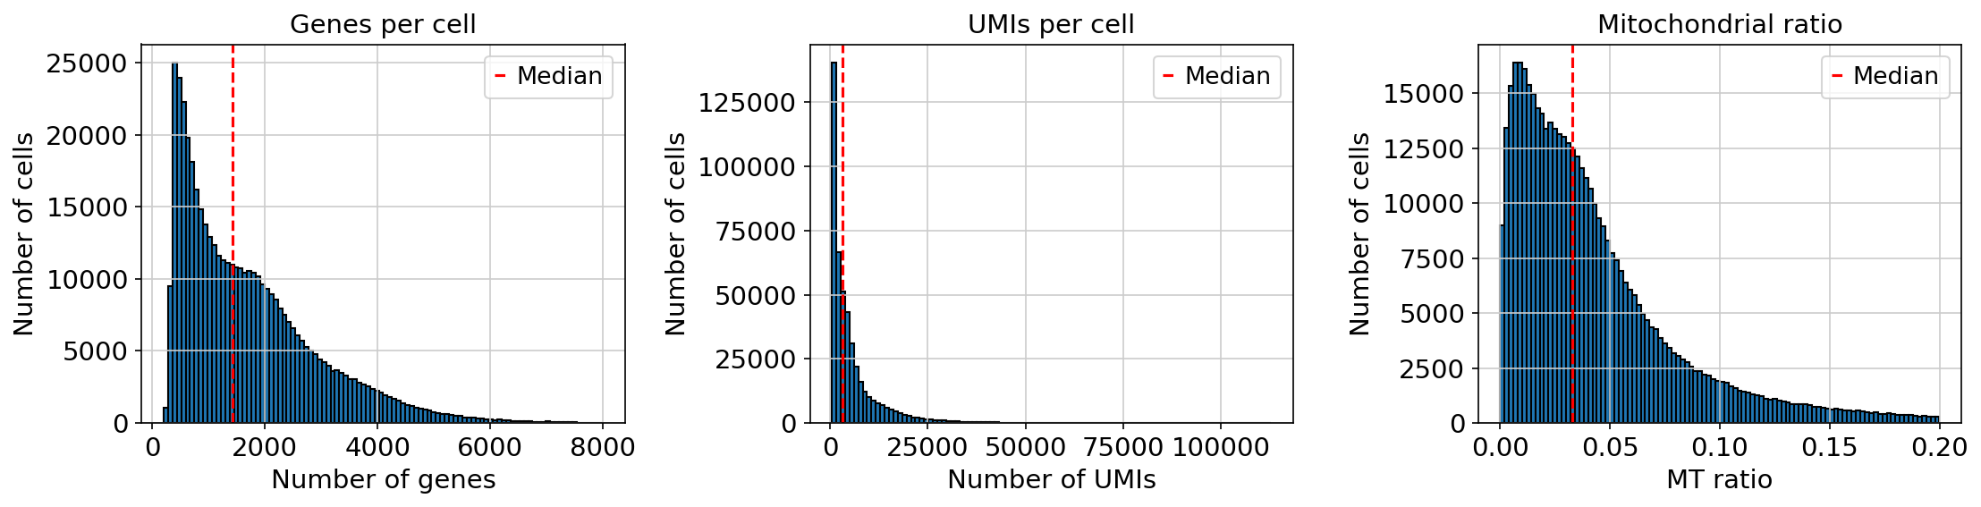
Quality Control Metrics

Slide 5
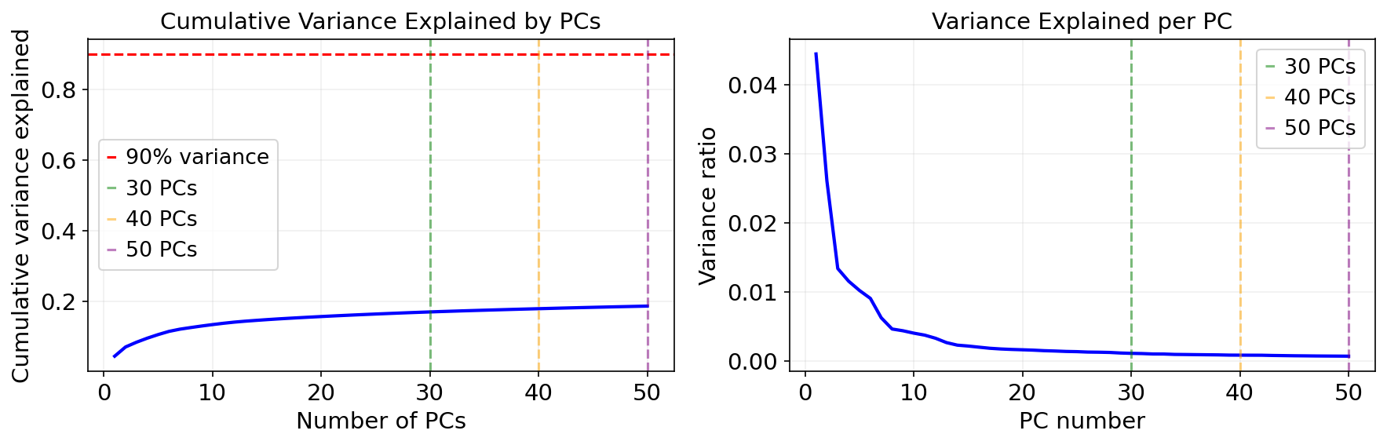
Principal Component Analysis
40 PCs selected (explains 17.9% variance)

Slide 6
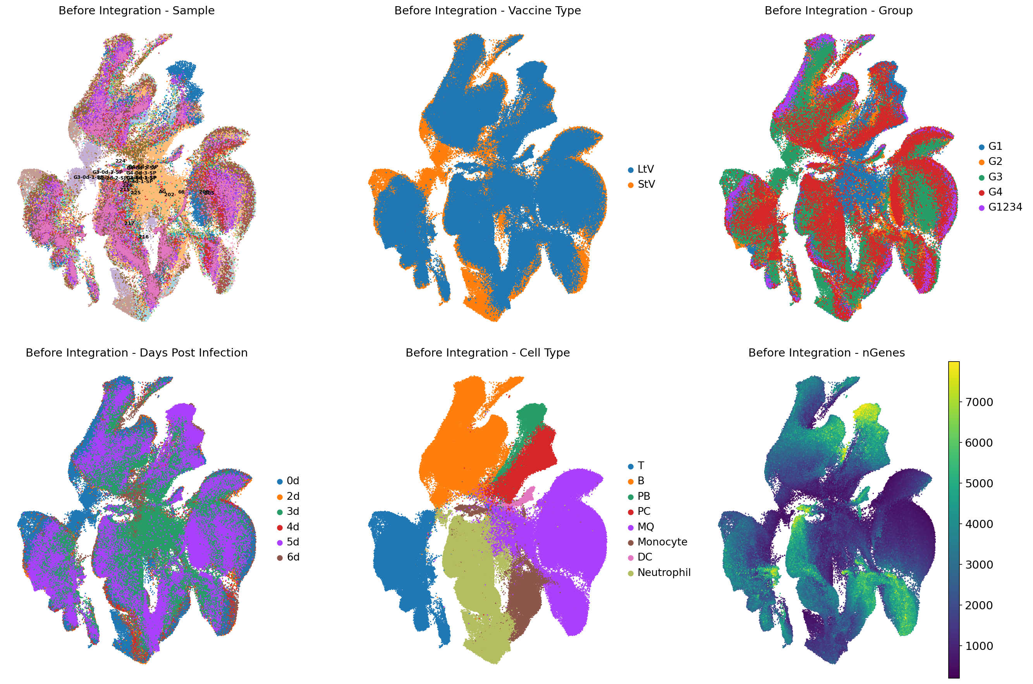
Before Harmony Integration

Slide 7
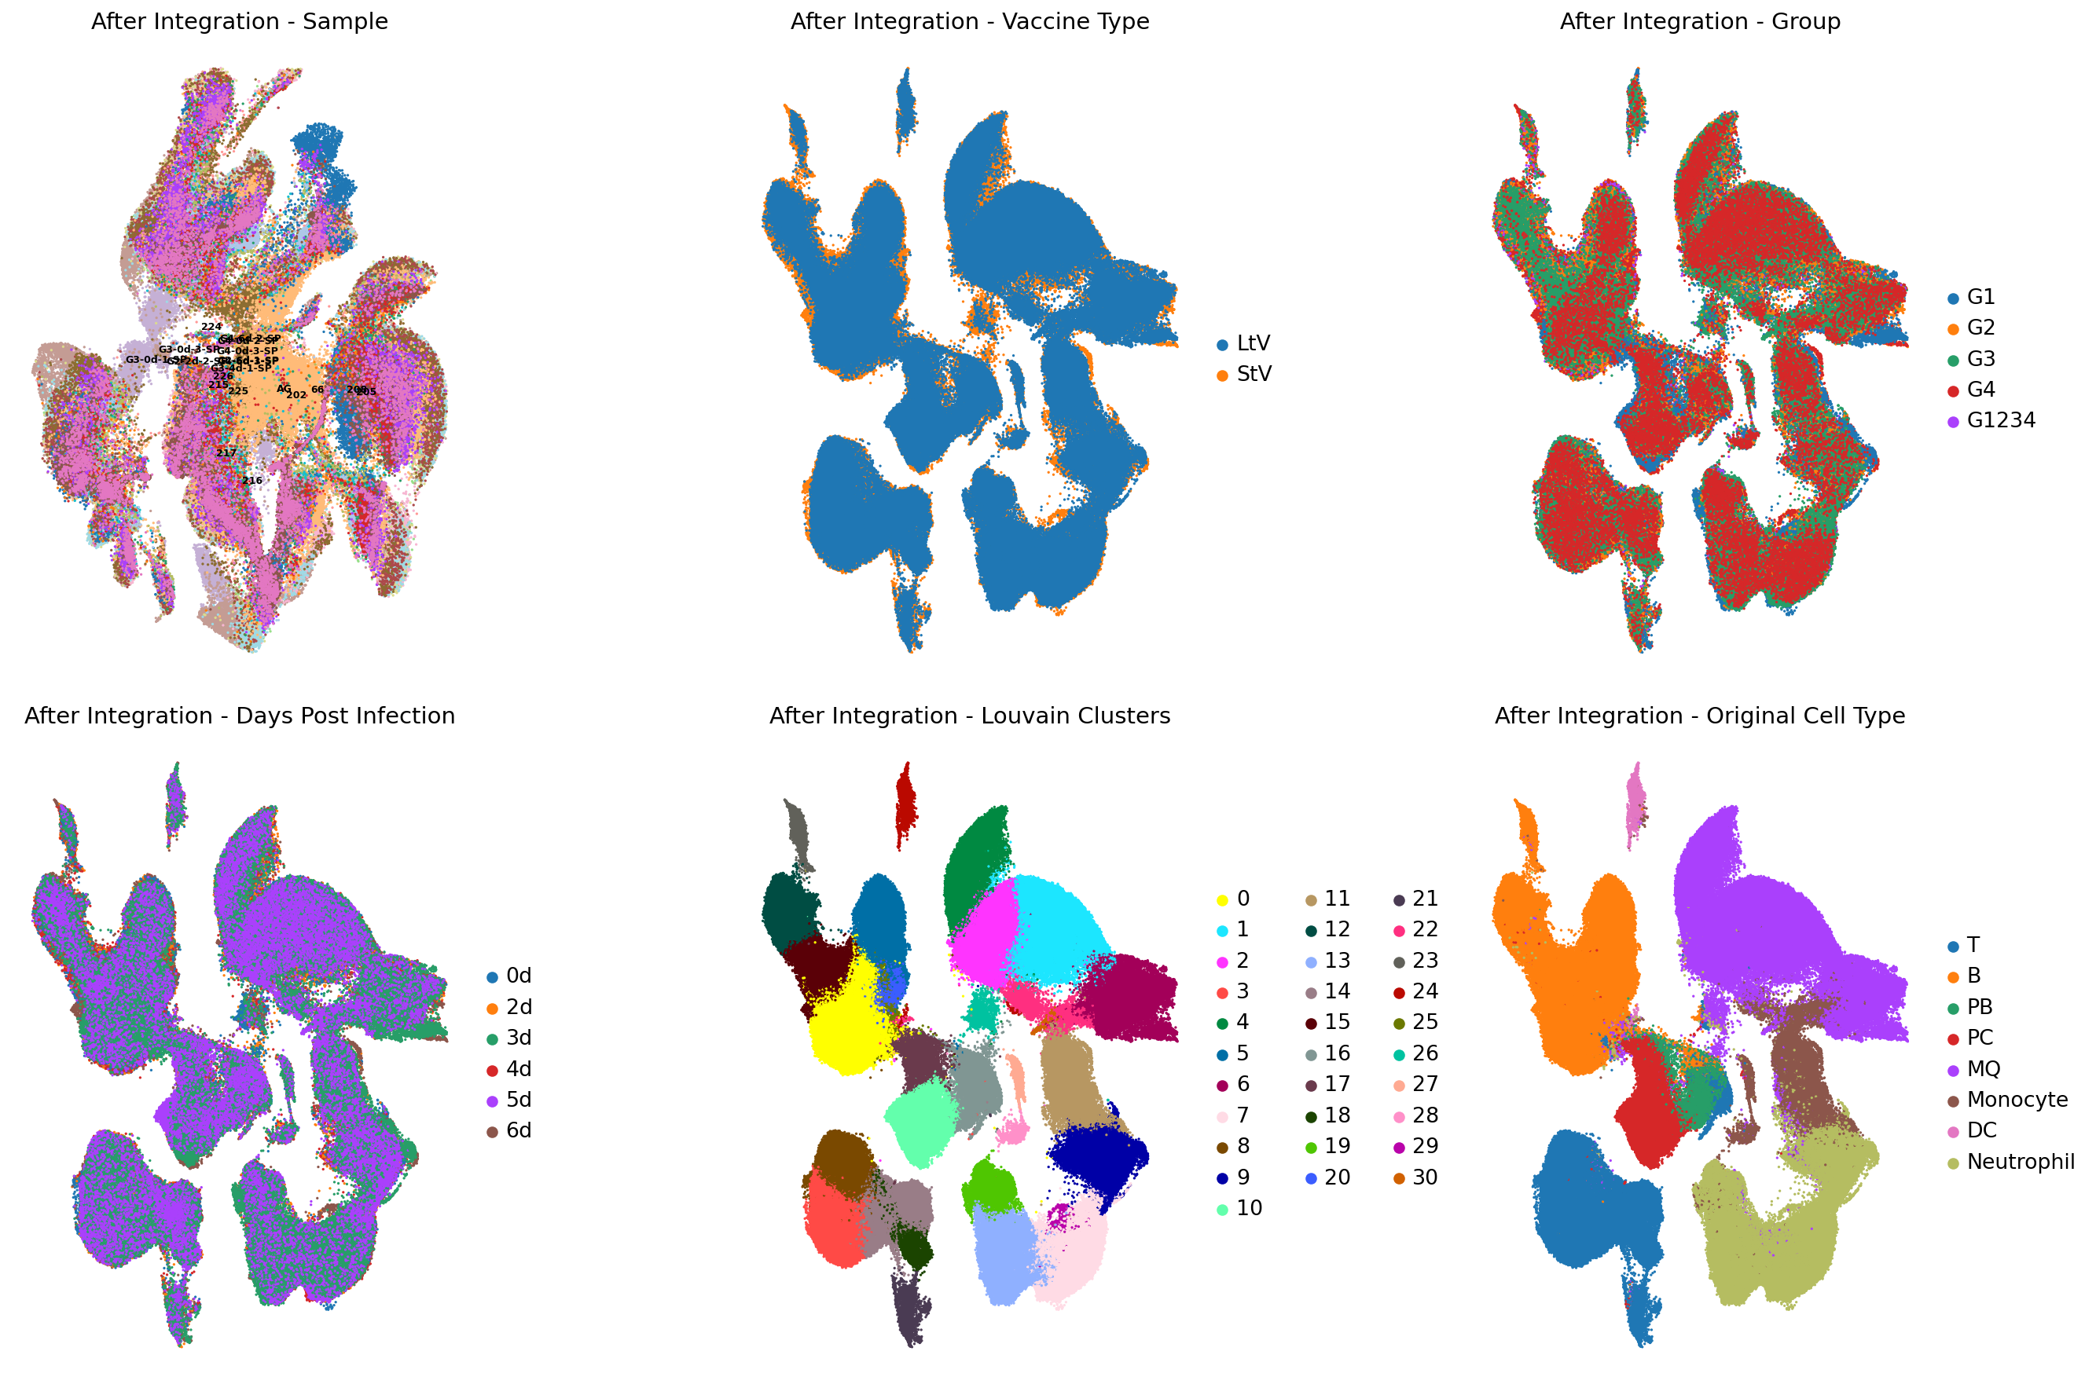
After Harmony Integration

Slide 8
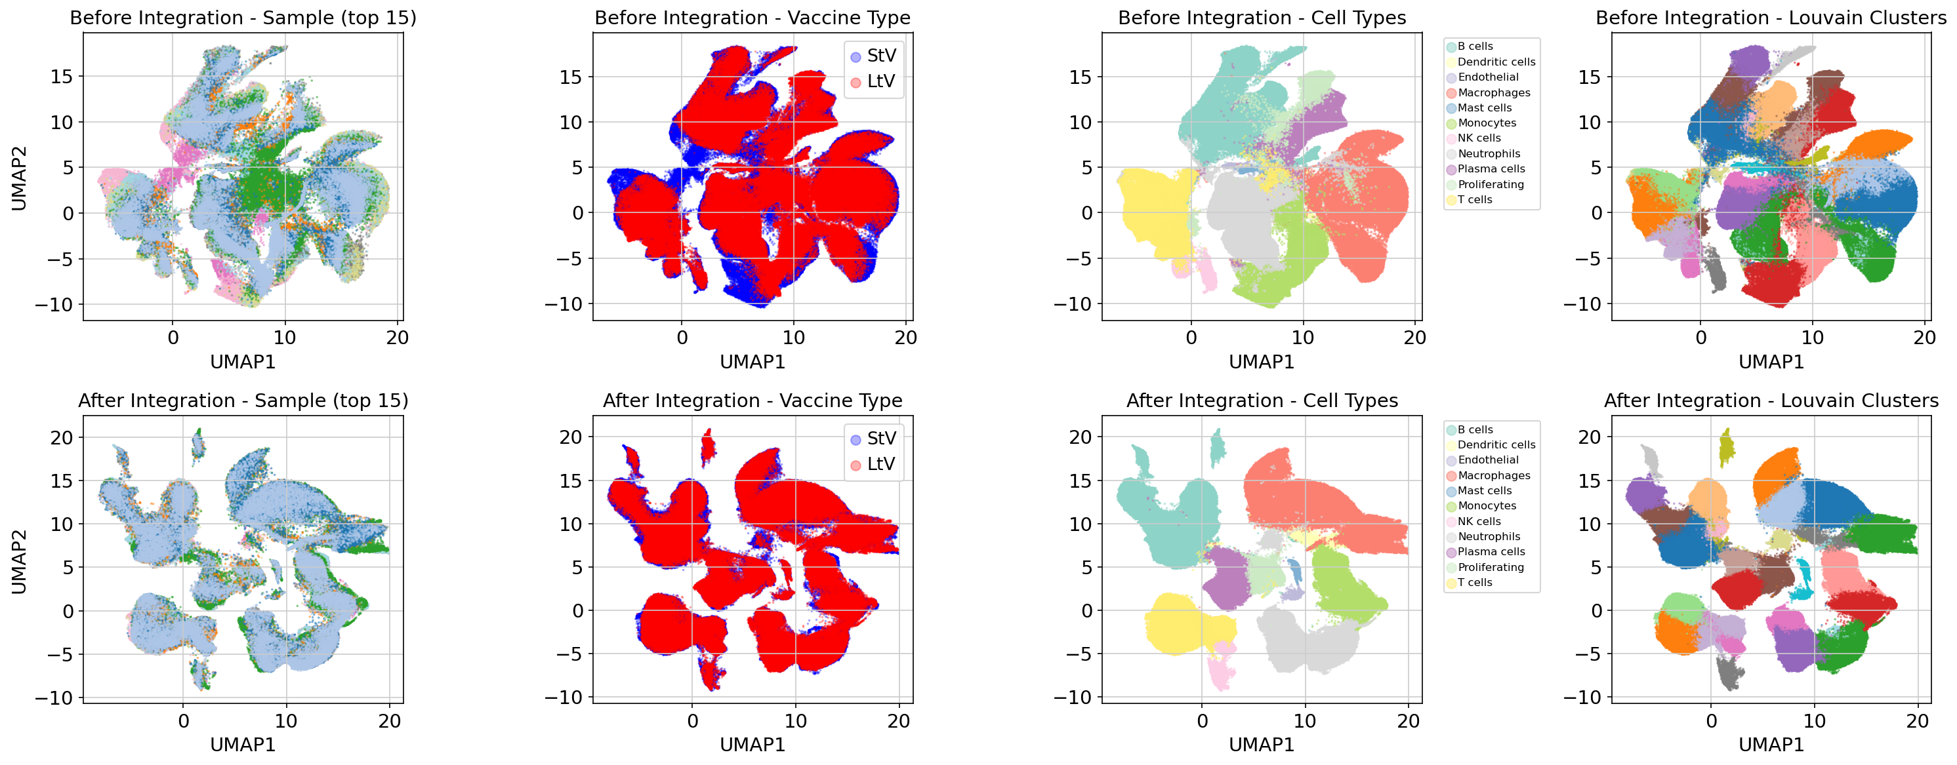
Integration Quality Assessment

Slide 9
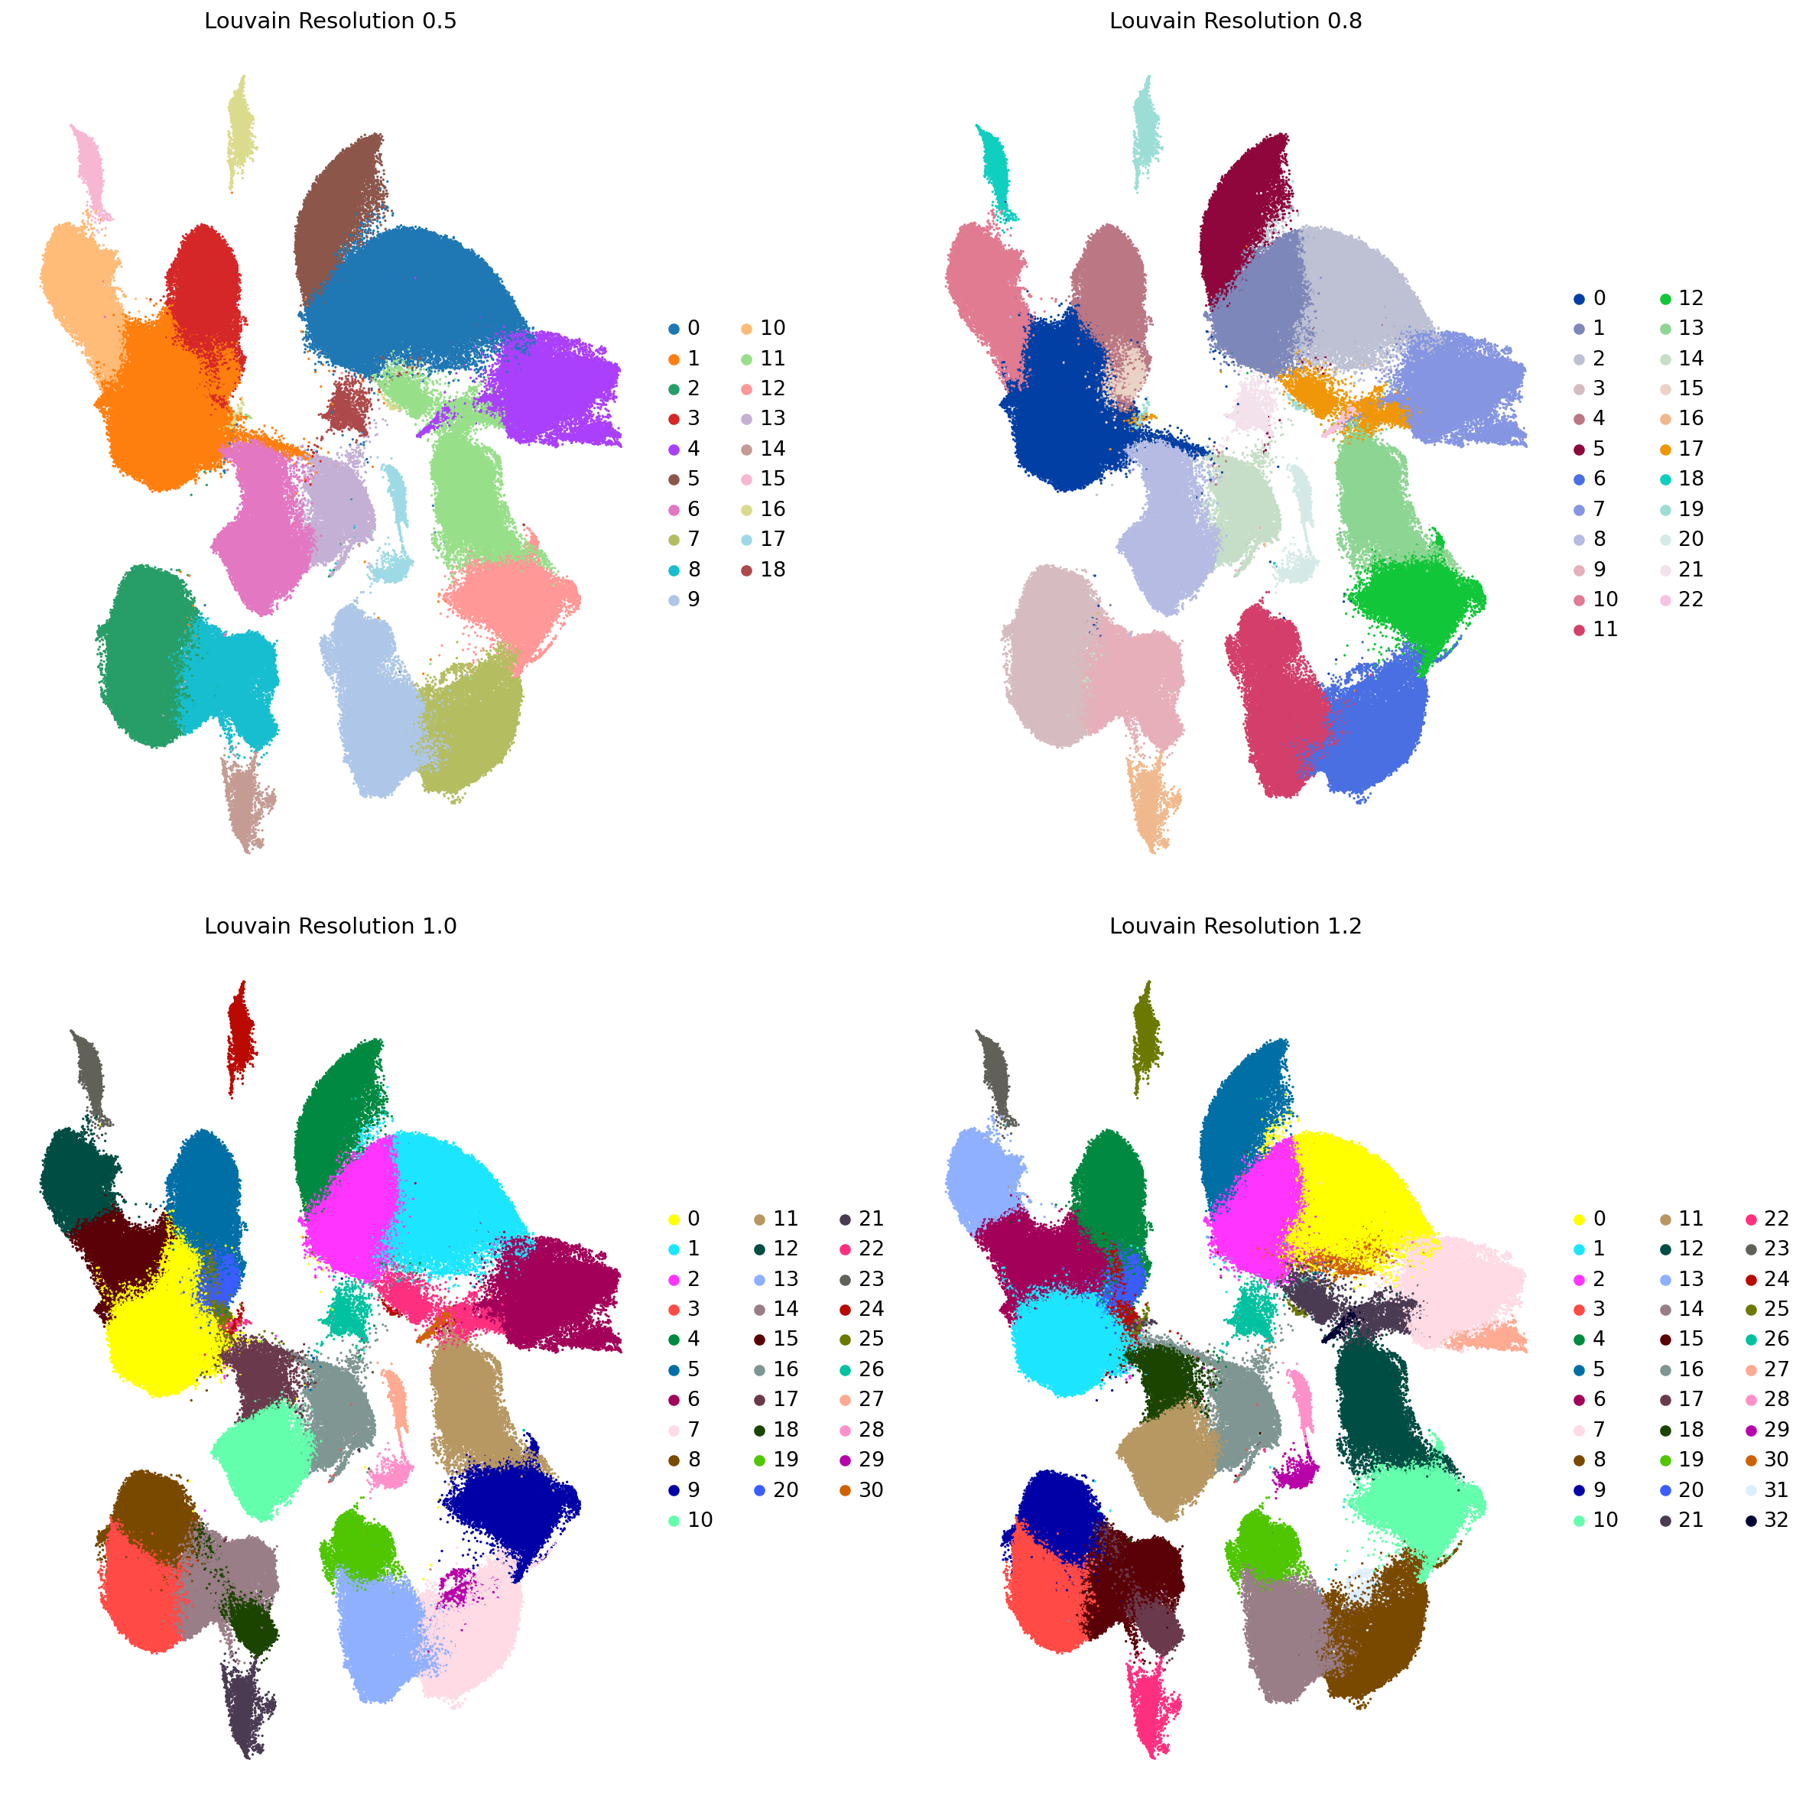
Louvain Clustering Results
Resolution 1.0 selected: 31 clusters

Slide 10
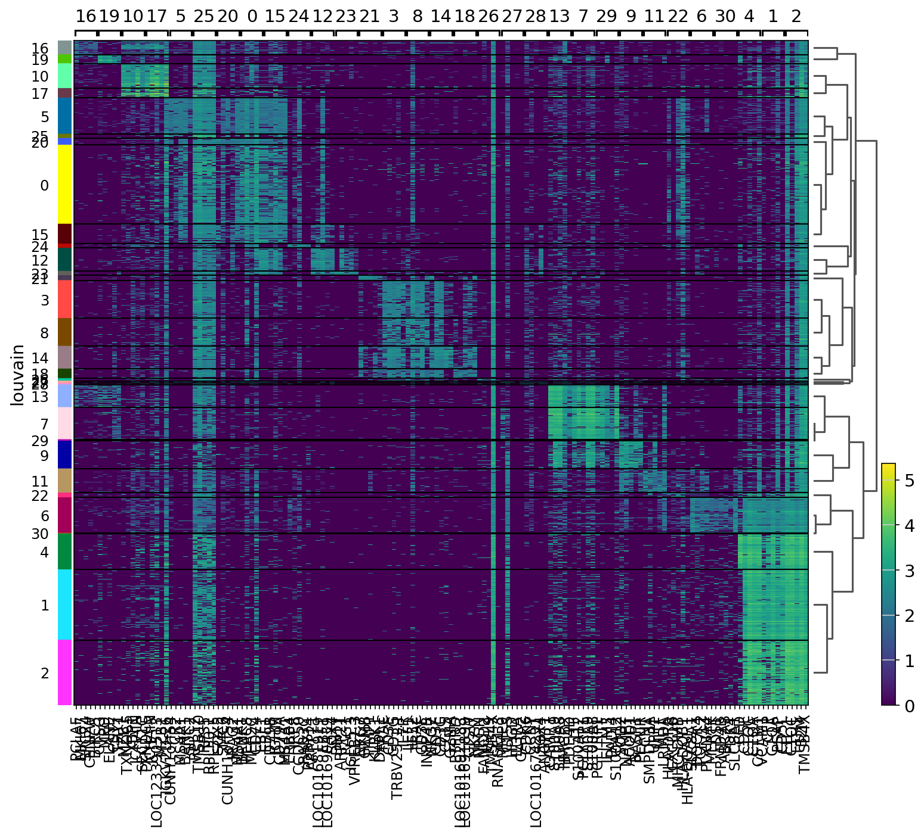
Marker Genes per Cluster

Slide 11
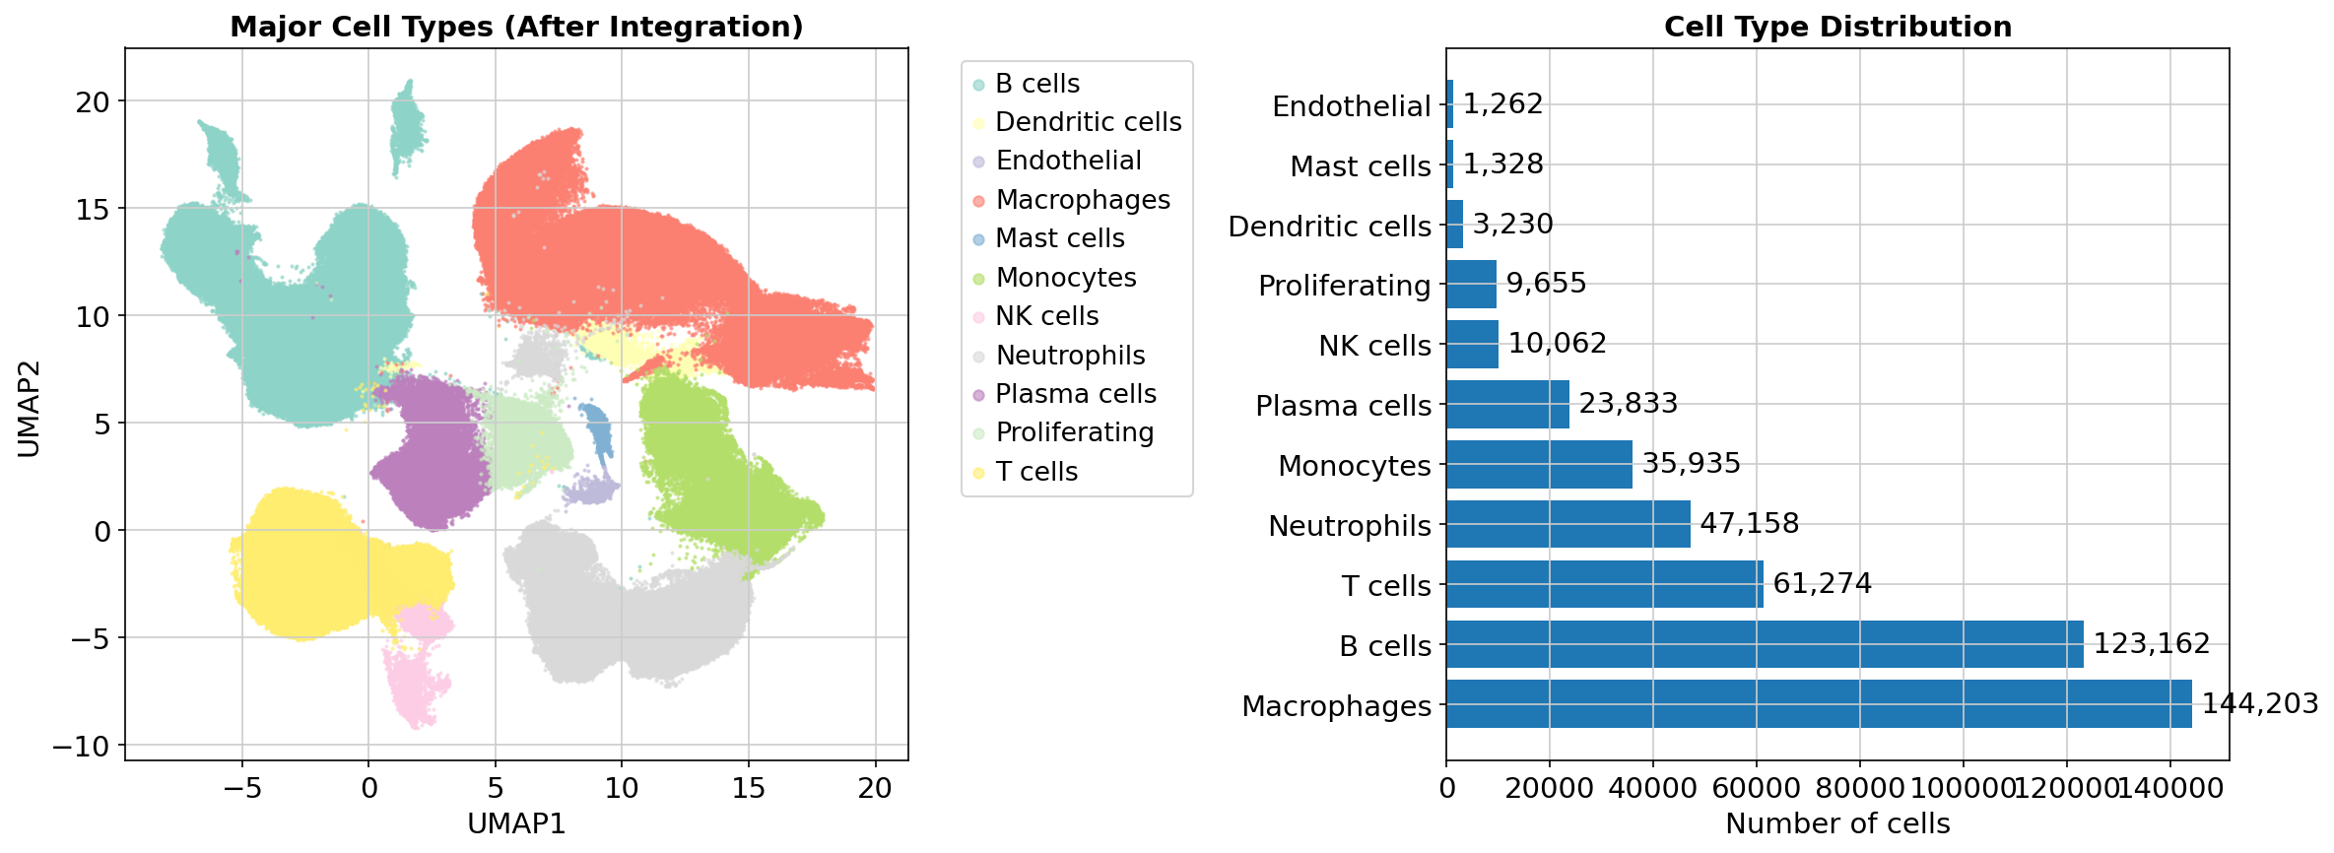
Major Cell Type Distribution

Slide 12
Major Cell Types - Summary
Cell Type | Count | Percentage
Macrophages | 144,203 | 31.27%
B cells | 123,162 | 26.71%
T cells | 61,274 | 13.29%
Neutrophils | 47,158 | 10.23%
Monocytes | 35,935 | 7.79%
Plasma cells | 23,833 | 5.17%
NK cells | 10,062 | 2.18%
Proliferating | 9,655 | 2.09%
Dendritic cells | 3,230 | 0.70%
Mast cells | 1,328 | 0.29%
Endothelial | 1,262 | 0.27%

Slide 13
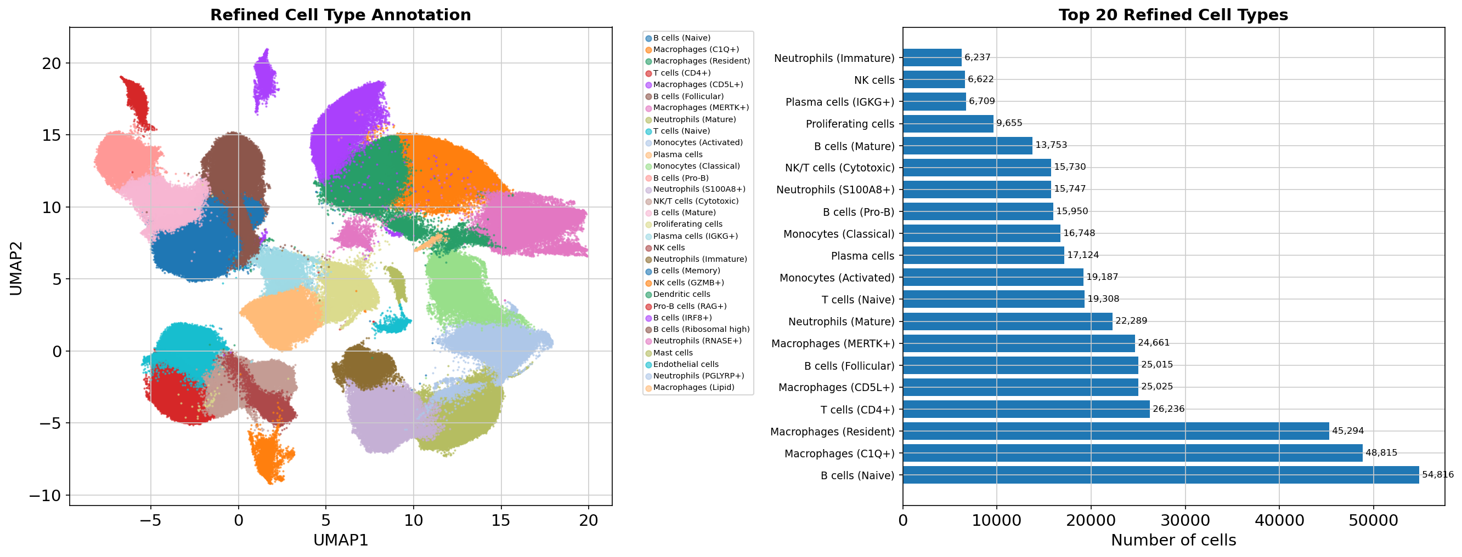
Refined Cell Type Annotation

Slide 14
Top 10 Refined Cell Types
Cluster | Cell Type | Count | Percentage
0 | B cells (Naive) | 54,816 | 11.89%
1 | Macrophages (C1Q+) | 48,815 | 10.59%
2 | Macrophages (Resident) | 45,294 | 9.82%
3 | T cells (CD4+) | 26,236 | 5.69%
4 | Macrophages (CD5L+) | 25,025 | 5.43%
5 | B cells (Follicular) | 25,015 | 5.43%
6 | Macrophages (MERTK+) | 24,661 | 5.35%
7 | Neutrophils (Mature) | 22,289 | 4.83%
8 | T cells (Naive) | 19,308 | 4.19%
9 | Monocytes (Activated) | 19,187 | 4.16%

Slide 15
Key Marker Genes by Cell Type
B cells: CD79A, CD79B, MS4A1, BANK1, PAX5
T cells: CD3E, CD3D, CD3G, TRAC, IL7R
Macrophages: C1QA, C1QC, CD68, CD163, APOE
Monocytes: FCN1, S100A8, S100A9, VCAN, CD14
Neutrophils: LTF, CAMP, S100A12, MPO, ELANE
NK cells: NKG7, KLRD1, GZMB, KLRK1
Plasma cells: MZB1, XBP1, JCHAIN, TNFRSF17
Dendritic cells: HLA-DRA, HLA-DQA1, HLA-DRB1

Slide 16
Key Findings
✓ Successful batch correction across 73 samples using Harmony
✓ Macrophages dominate (31.3%) - consistent with spleen function
✓ Diverse B cell populations (26.7%) - multiple developmental stages
✓ Active immune response: substantial neutrophils (10.2%) & plasma cells (5.2%)
✓ High-resolution annotation: 31 refined cell type subtypes identified
✓ Clear marker gene signatures for all major cell populations
✓ Integration preserved biological variation while removing batch effects

Slide 17
Biological Interpretation
Macrophage diversity reflects red pulp function:
• C1Q+ macrophages: debris clearance & complement
• MERTK+ macrophages: M2-like anti-inflammatory phenotype
• Resident macrophages: tissue-resident population
B cell heterogeneity indicates active germinal center:
• Naive → Follicular → Memory B cell differentiation
• Pro-B cells: ongoing B lymphopoiesis
• Plasma cells: active antibody production
Neutrophil infiltration suggests immune activation
NK & T cells provide cellular immunity

Slide 18
Analysis Quality Metrics
Data Quality:
• High cell count: 461,102 cells analyzed
• Good gene detection: median 1,505 genes/cell
• Low MT contamination: median 3.3%
Integration Quality:
• Harmony converged in 11 iterations
• Batch effects successfully removed
• Biological variation preserved
Annotation Quality:
• Clear marker gene signatures
• Biologically consistent populations
• Well-separated clusters in UMAP space

Slide 19
Generated Output Files
Figures (9 PNG files):
• QC metrics, PCA variance, UMAP before/after integration
• Clustering comparisons, marker heatmaps, cell type UMAPs
Data Files:
• Spleen_harmony_processed.h5ad (processed data)
• Spleen_harmony_annotated.h5ad (with annotations)
• cell_type_annotations.csv (per-cell annotations)
• marker_genes_per_cluster.csv (top markers)
Reports:
• ANALYSIS_REPORT.md (comprehensive report)
• annotation_summary.txt (statistics)

Slide 20
Conclusions
Successfully analyzed 461,102 spleen cells with high quality
Harmony integration effectively corrected batch effects across 73 samples
Identified 11 major cell types and 31 refined subtypes with clear marker signatures
Cell type composition consistent with spleen immunology and function
Dataset shows active immune response with diverse lymphoid and myeloid populations
Results ready for downstream analysis and biological interpretation

Slide 21
Summary
Analysis Complete
✓ 461,102 cells analyzed
✓ 40 PCs, Harmony integration, Louvain clustering
✓ 31 clusters → 11 major cell types
✓ Comprehensive annotation with marker genes
✓ All results saved with detailed reports

