Slide 1

Predicting MLB batter’s Batting Average
Wooyoung Jeong,
Baseball Reference.com

Slide 2
Design
Objective: Explore relationship between batting average of 1998-2021 MLB players compare to other batting statistics.
Goal: Produce semi-automated application to predict the batting averages of MLB players by using Streamlit with deploying the application via Github.

Slide 3



Tools Used
BeautifulSoup
Numpy & Pandas
Scikit-learn & Statsmodels
Matplotlib
Pickle
Streamlit

Slide 4
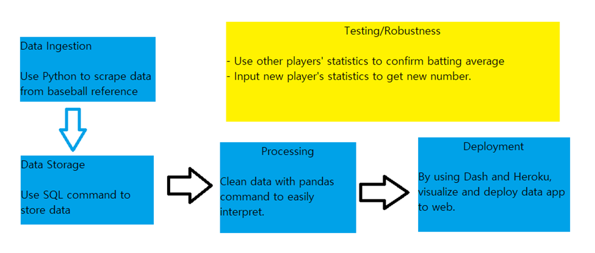
Pipeline of the Project

Slide 5

Data
All batting data was scraped from Baseball Reference
Each row represents statistics of one batter in 1998-2021 Major League Baseball
Features
Age, Game played, Plate appearance, At bat, Run, Hit, Double, Homerun, Strikeout, Based on balls, Runs batted in

Slide 6
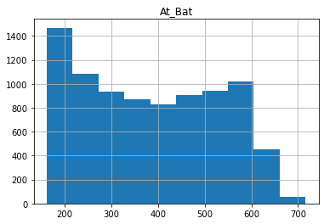
Data Cleaning
Delete all rows that have empty data
There are total 33831 players who were on the plate in 1998-2021 MLB.
There are 162 games in 1 year.
Only collect data from players who had more than 162 at bat.
Total 8562 players
R_squared value = 0.867

Slide 7
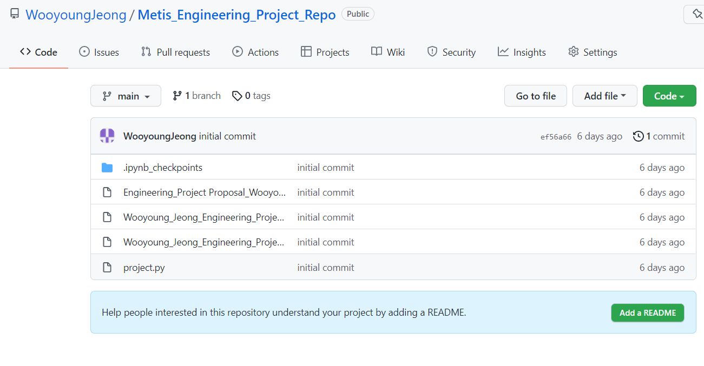
Deploying Streamlit via Github

Slide 8
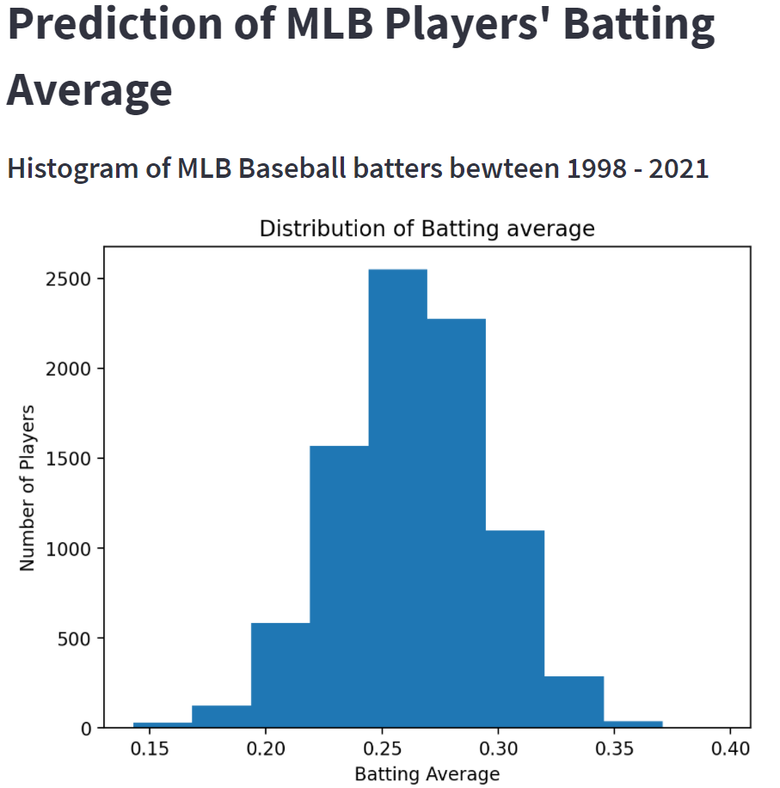
Streamlit App
Used Streamlit to create an app that users can input the statistics to predict the batting averages of batters.

Slide 9
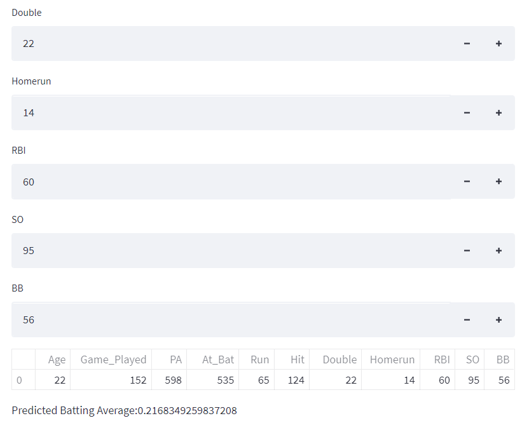
Testing Prediction
Input data of first batter.
Original batting average = 0.232
Predicted batting average = 0.217
7% difference.

Slide 10
Future Work
Adding more features to make model more accurate
Opponent pitchers’ stats
Main hand of the hitters
Position of the hitters
Collect more data
Collecting all years’ statistics before 1998
Having more examples will be helpful

