Slide 1
Exploratory Data Analysis Project
Wooyoung Jeong

Slide 2
Introduction
The goal of project is to find the best place to open deli-business.
This project is designed for auy kind of business company and small business restaurant owners.
Main objective of this project is finding the most crowded station during certain time period.

Slide 3
Methodology
7/3/21 - 10/30/21 data were used.
1. Limited time range between 3 am to 4 pm to include all daily workers.
2. Found the daily entries and exits.
3. Grouped all entries and exits data by stations.
4. Added all daily exits and entries per station.

Slide 4
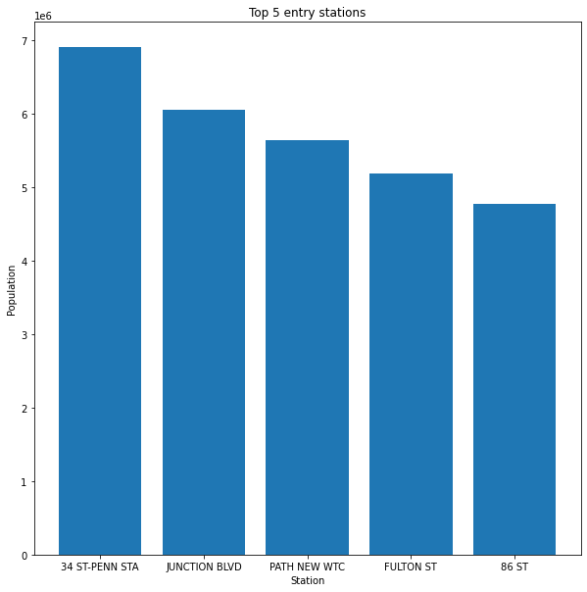
Results - Entry
station | daily_entries
61 | 34 ST-PENN STA | 6904849.0
259 | JUNCTION BLVD | 6056614.0
315 | PATH NEW WTC | 5645263.0
226 | FULTON ST | 5184331.0
110 | 86 ST | 4770242.0

Slide 5
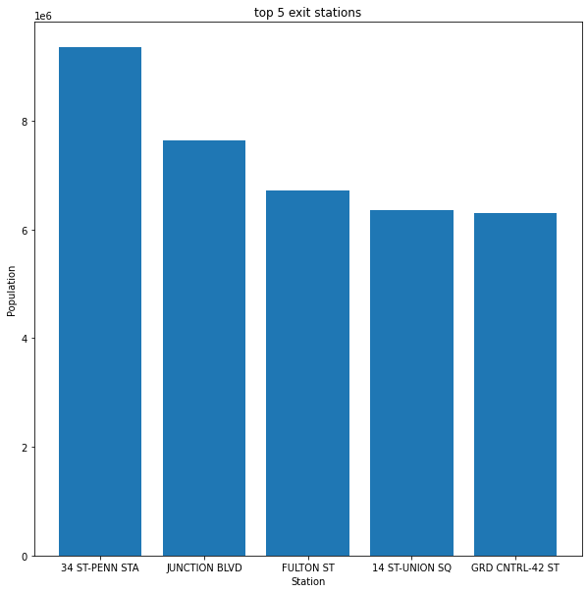
Results - Exits
 | station | daily_exits
61 | 34 ST-PENN STA | 9357674.0
259 | JUNCTION BLVD | 7645097.0
226 | FULTON ST | 6718823.0
14 | 14 ST-UNION SQ | 6363556.0
233 | GRD CNTRL-42 ST | 6304887.0

Slide 6
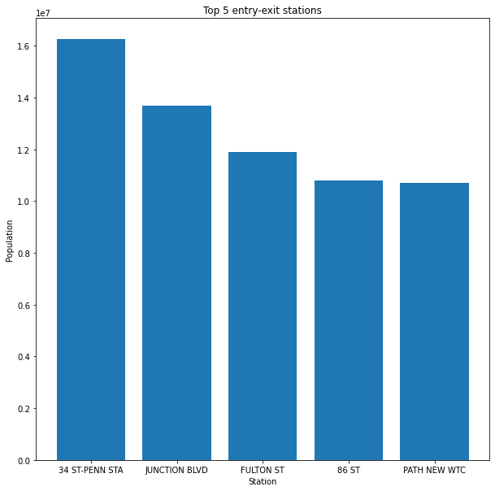
Results - Final
 | station | sum_entry_exit
61 | 34 ST-PENN STA | 16262523.0
259 | JUNCTION BLVD | 13701711.0
226 | FULTON ST | 11903154.0
110 | 86 ST | 10811795.0
315 | PATH NEW WTC | 10695411.0

Slide 7
Conclusion
Top 5 entries and exits stations are not same.
34th Street-Penn station has the most entries and exits during 3 am to 4 pm.
It could be best location to open deli-restaurant.

Slide 8
Future Work
Finding most crowded station might be not the only option.
Number of similar business restaurants, monthly lease payment could affect the location.

Slide 9
Question

