Slide 1
VPN Design, implementation and analysis
----exp 6

Slide 2
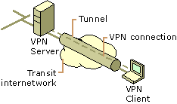
What is virtual private network (VPN)
connect remote sites or users together. Instead of using a dedicated connection such as leased line, a VPN uses “virtual” connections routed though the internet.

Slide 3
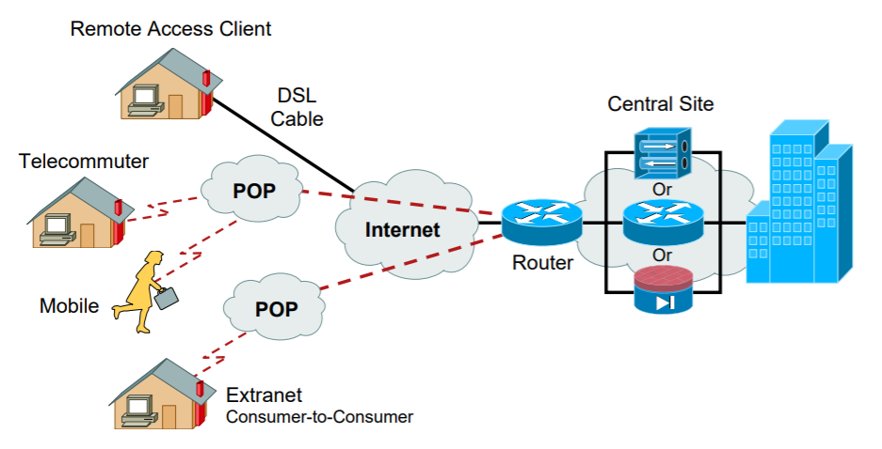
VPN Types (1)
Remote-access
single remote network device to intranet

Slide 4
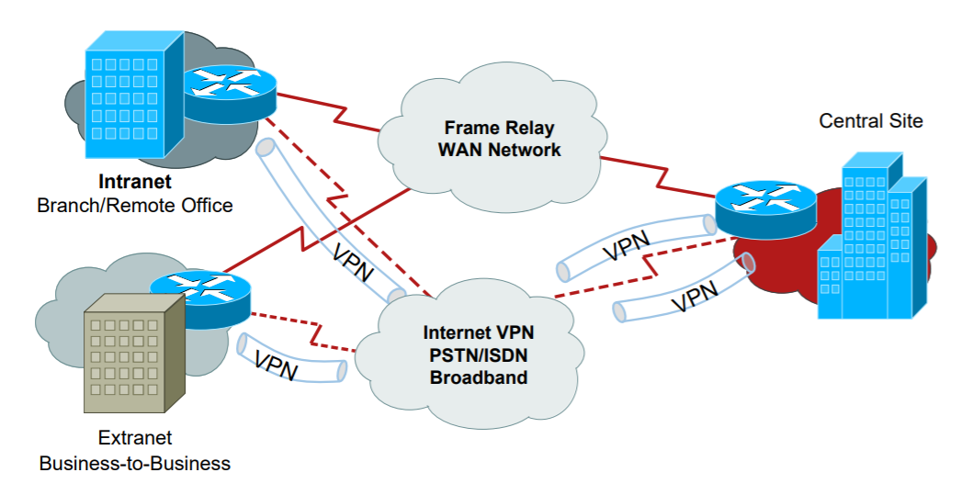
VPN Types (2)
Site-to-site
connect multiple fixed sites over a public network

Slide 5
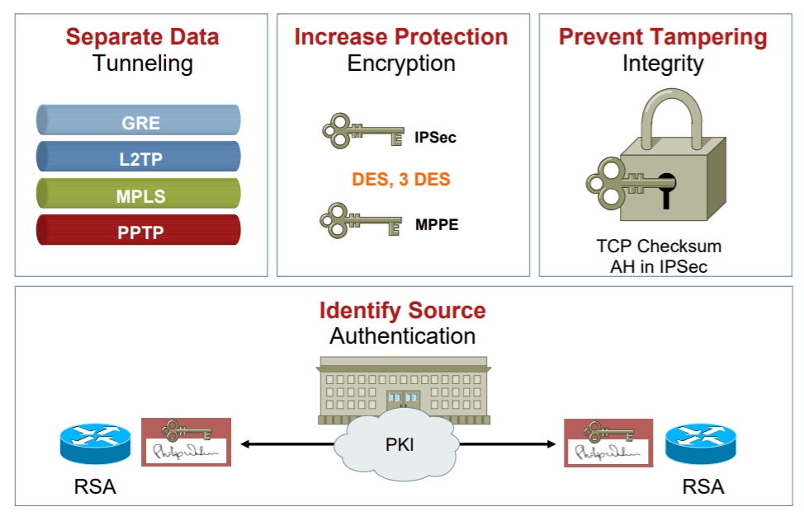
VPN Components
We focus

Slide 6
Tunneling
Tunneling is the transmission of data intended for use only within a private, usually corporate network through a public network in such a way that the routing nodes in the public network are unaware that the transmission is part of a private network.
C
E
G
A
B
H
I
D
F
Tunnel

Slide 7
VPN Tunneling Protocols
Layer 2 tunneling protocols
PPTP, L2F, L2TP
Layer 3 tunneling protocols
Ipsec
Label switching protocol
MPLS
Original IP
Header
Payload
New IP
Header
Original IP
Header
Payload

Slide 8
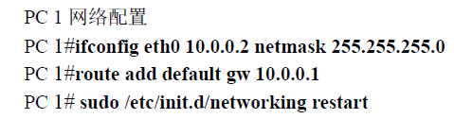
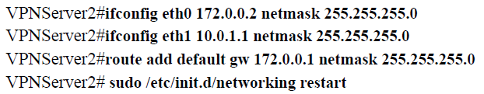
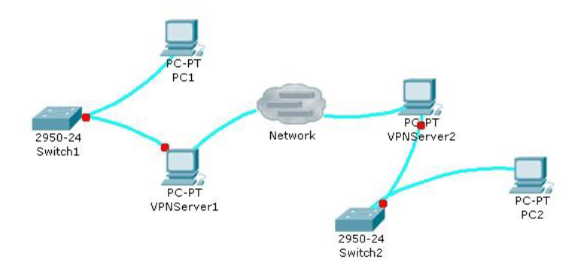
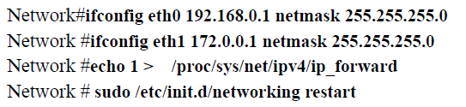
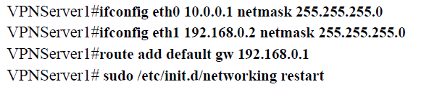
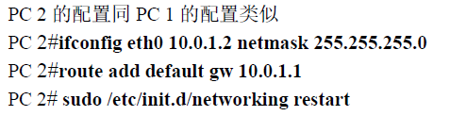
Experimental requirements

Slide 9
1. 搭建如图所示拓扑，路由，ARP可以由实验四中程序实现，不允许手工配置
2. 实现简单的VPN接入程序，使得PC1可以Ping通PC2 (ping程序可以使用系统自带ping程序，或者实验2中实现的ping程序)
3. 将你的实现与已有的标准实现（如PPTP）进行比较

Slide 10
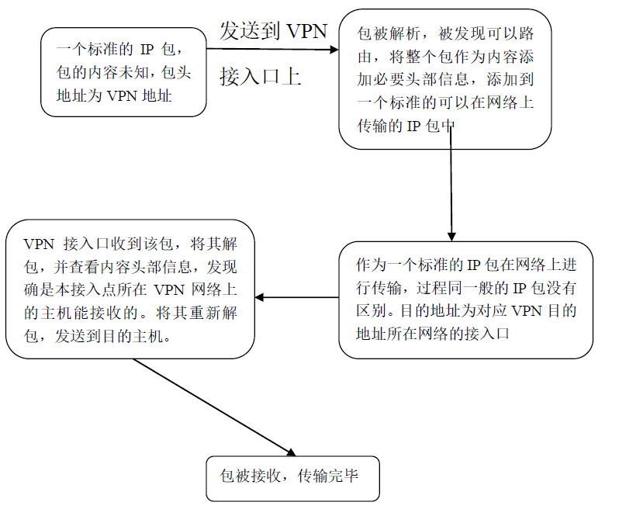

IP In IP VPN 实现
Original IP
Header
Payload
New IP
Header
Original IP
Header
Payload

Slide 11
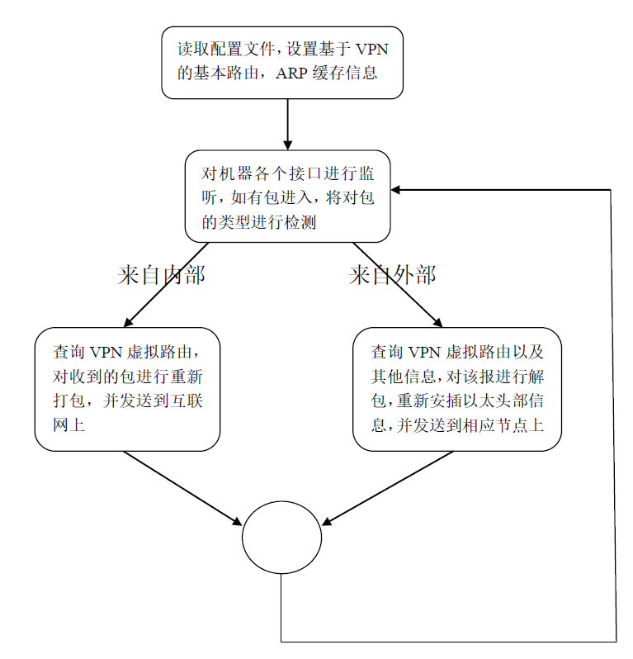

Slide 12
Q&A

Slide 13
3Q

