Slide 1
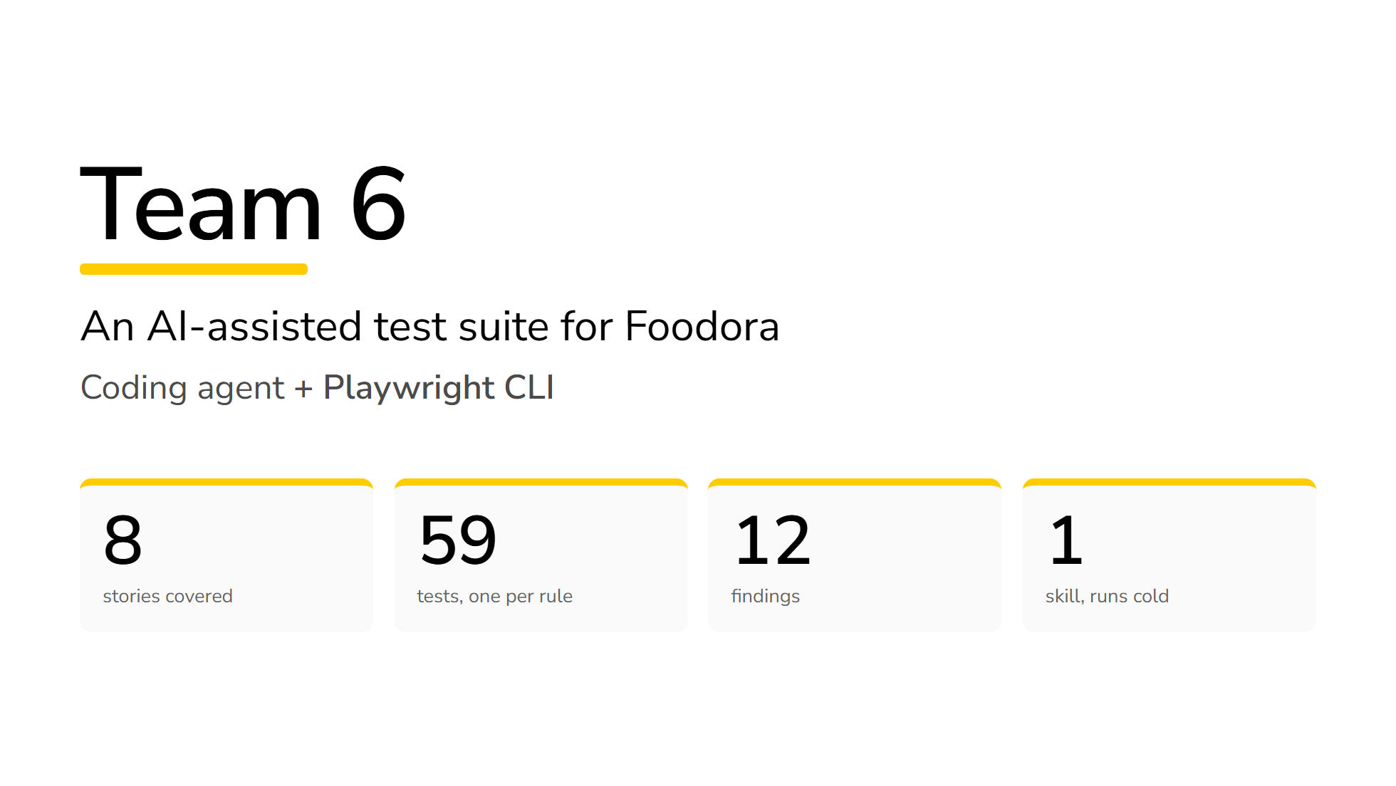
Notes:
0:00 — Say the four numbers. Nothing else. Then move on.

Slide 2
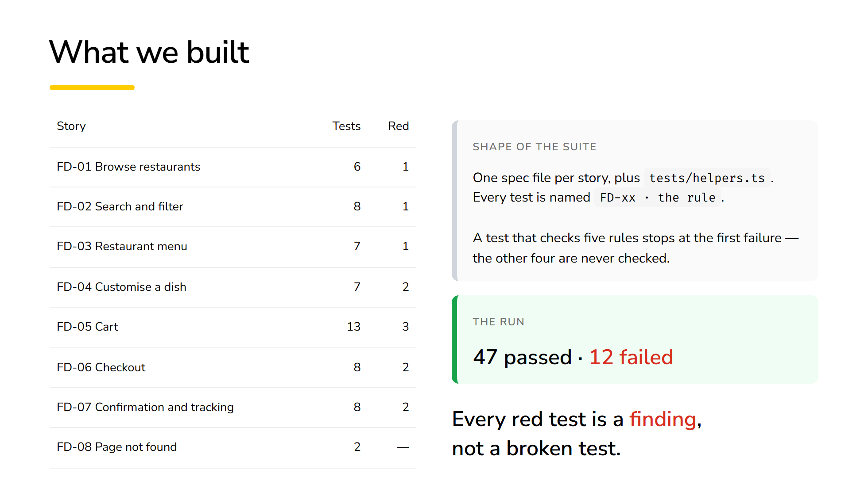
Notes:
0:20 — The last line is the whole deck. Pause after it.

Slide 3
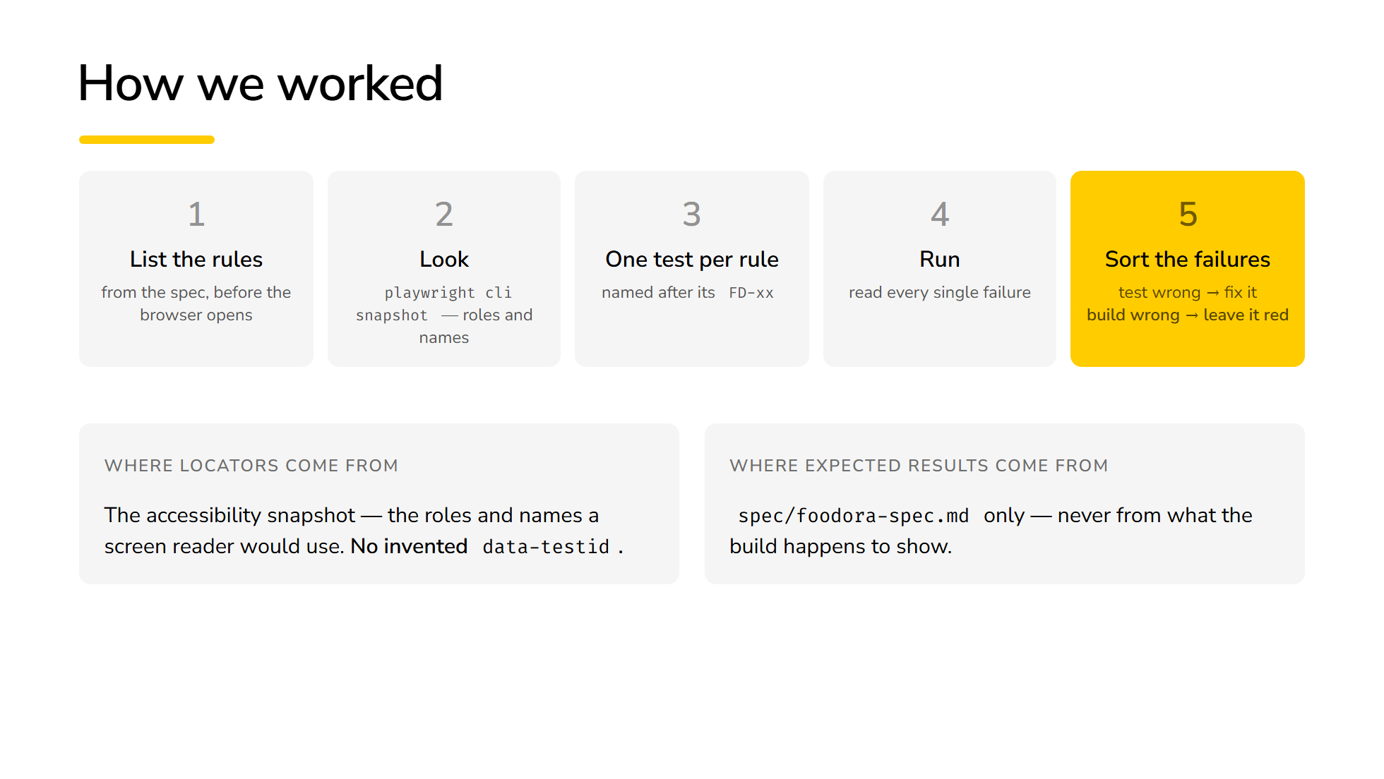
Notes:
0:45 — Step 5 is the one nobody else will say out loud. Lean on it.

Slide 4
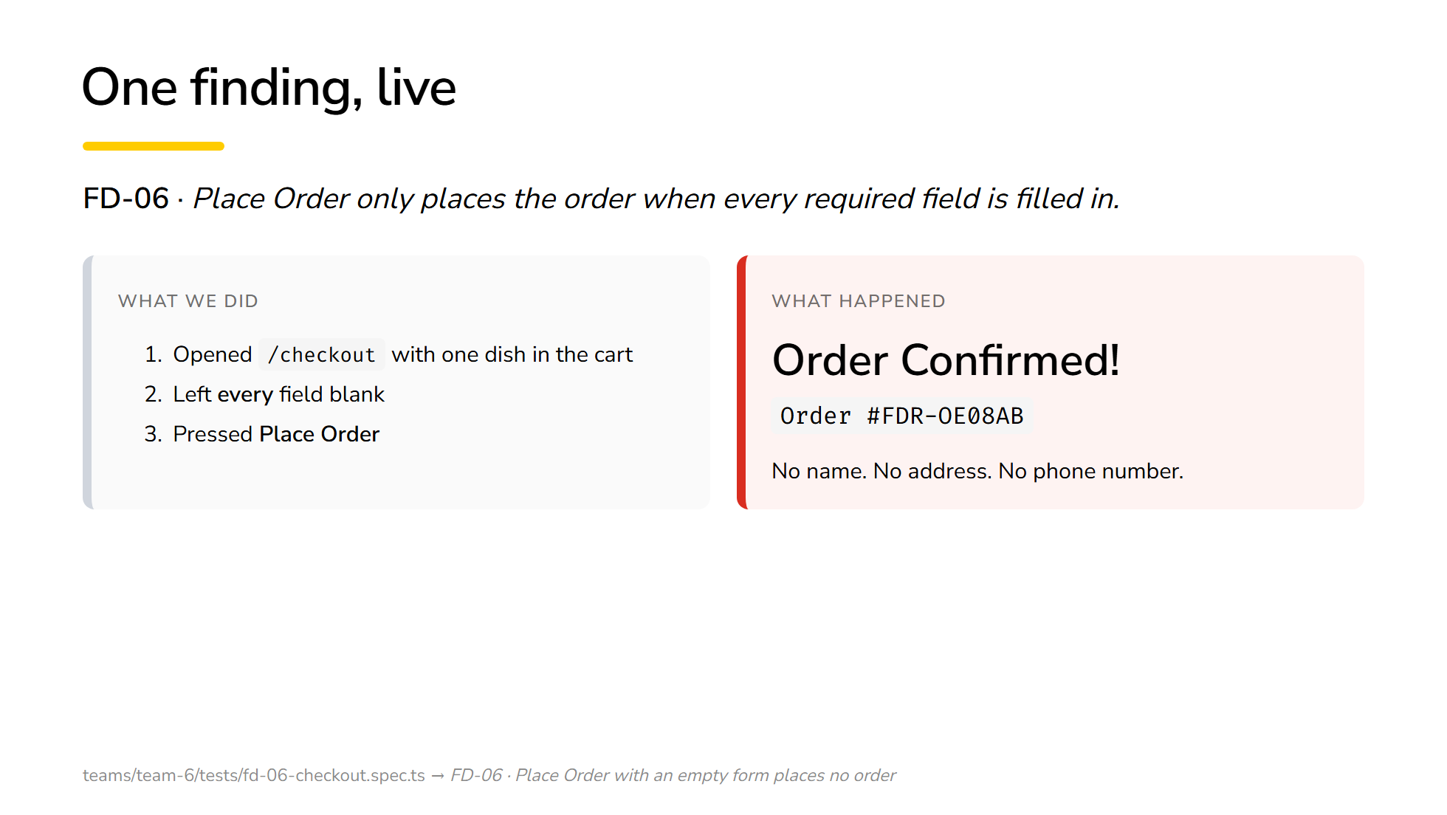
Notes:
1:00 — Do it in the browser if the wifi holds, on the slide if it does not.

Slide 5
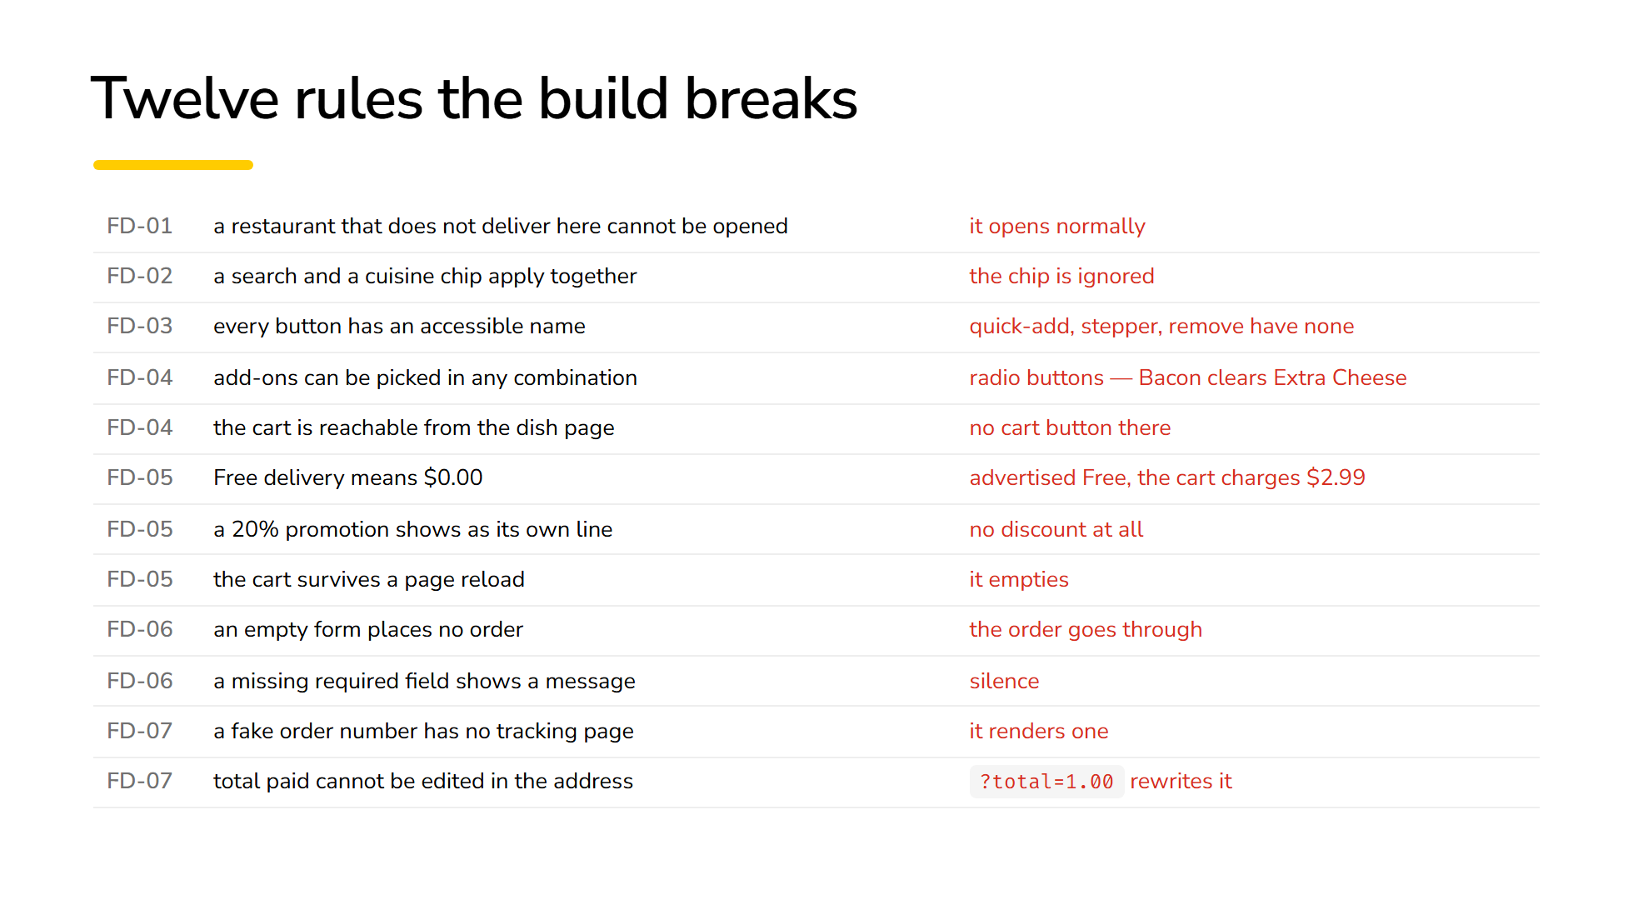
Notes:
1:30 — Do not read this. Point at the last four rows, then move on.

Slide 6
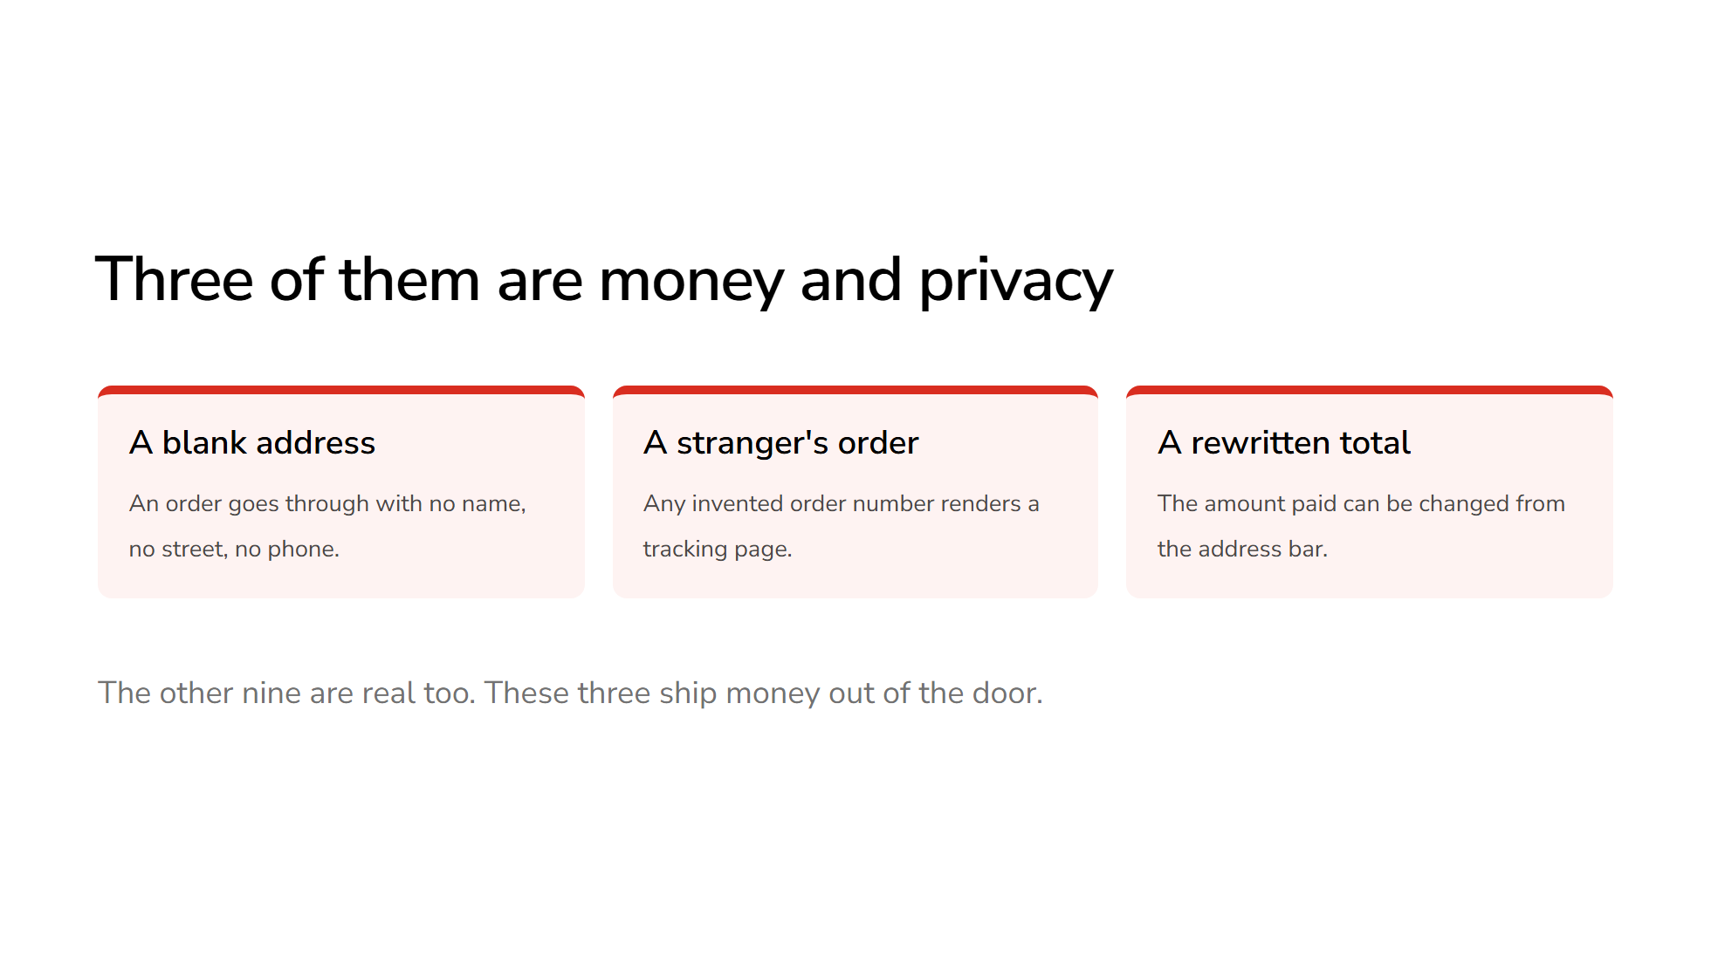
Notes:
1:50 — Slow down. This is the Accuracy vote.

Slide 7
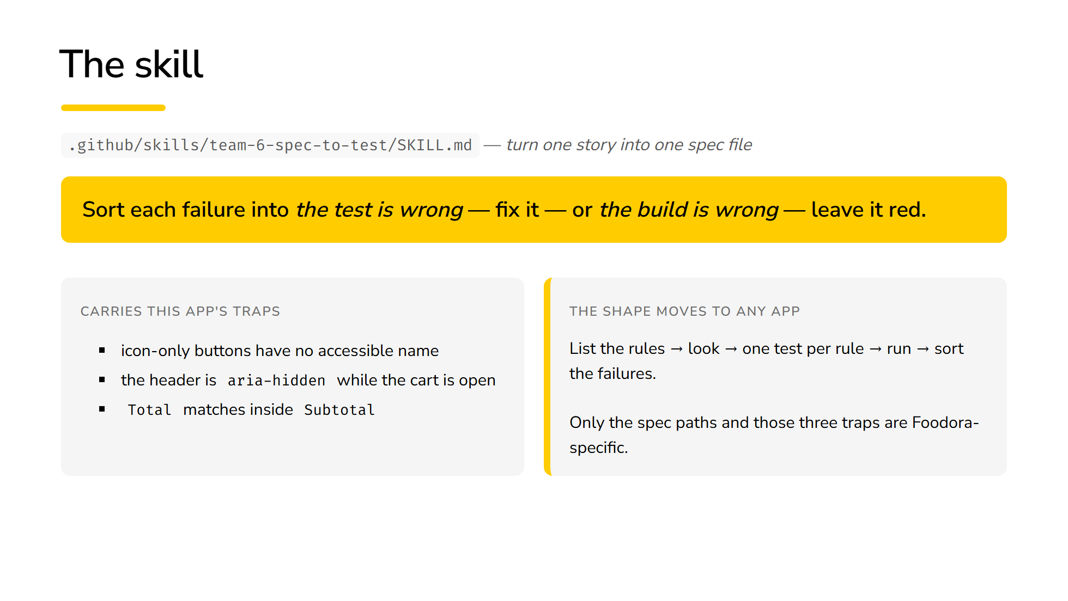
Notes:
2:10 — Reusability vote. Show a cold run only if there is time left.

Slide 8
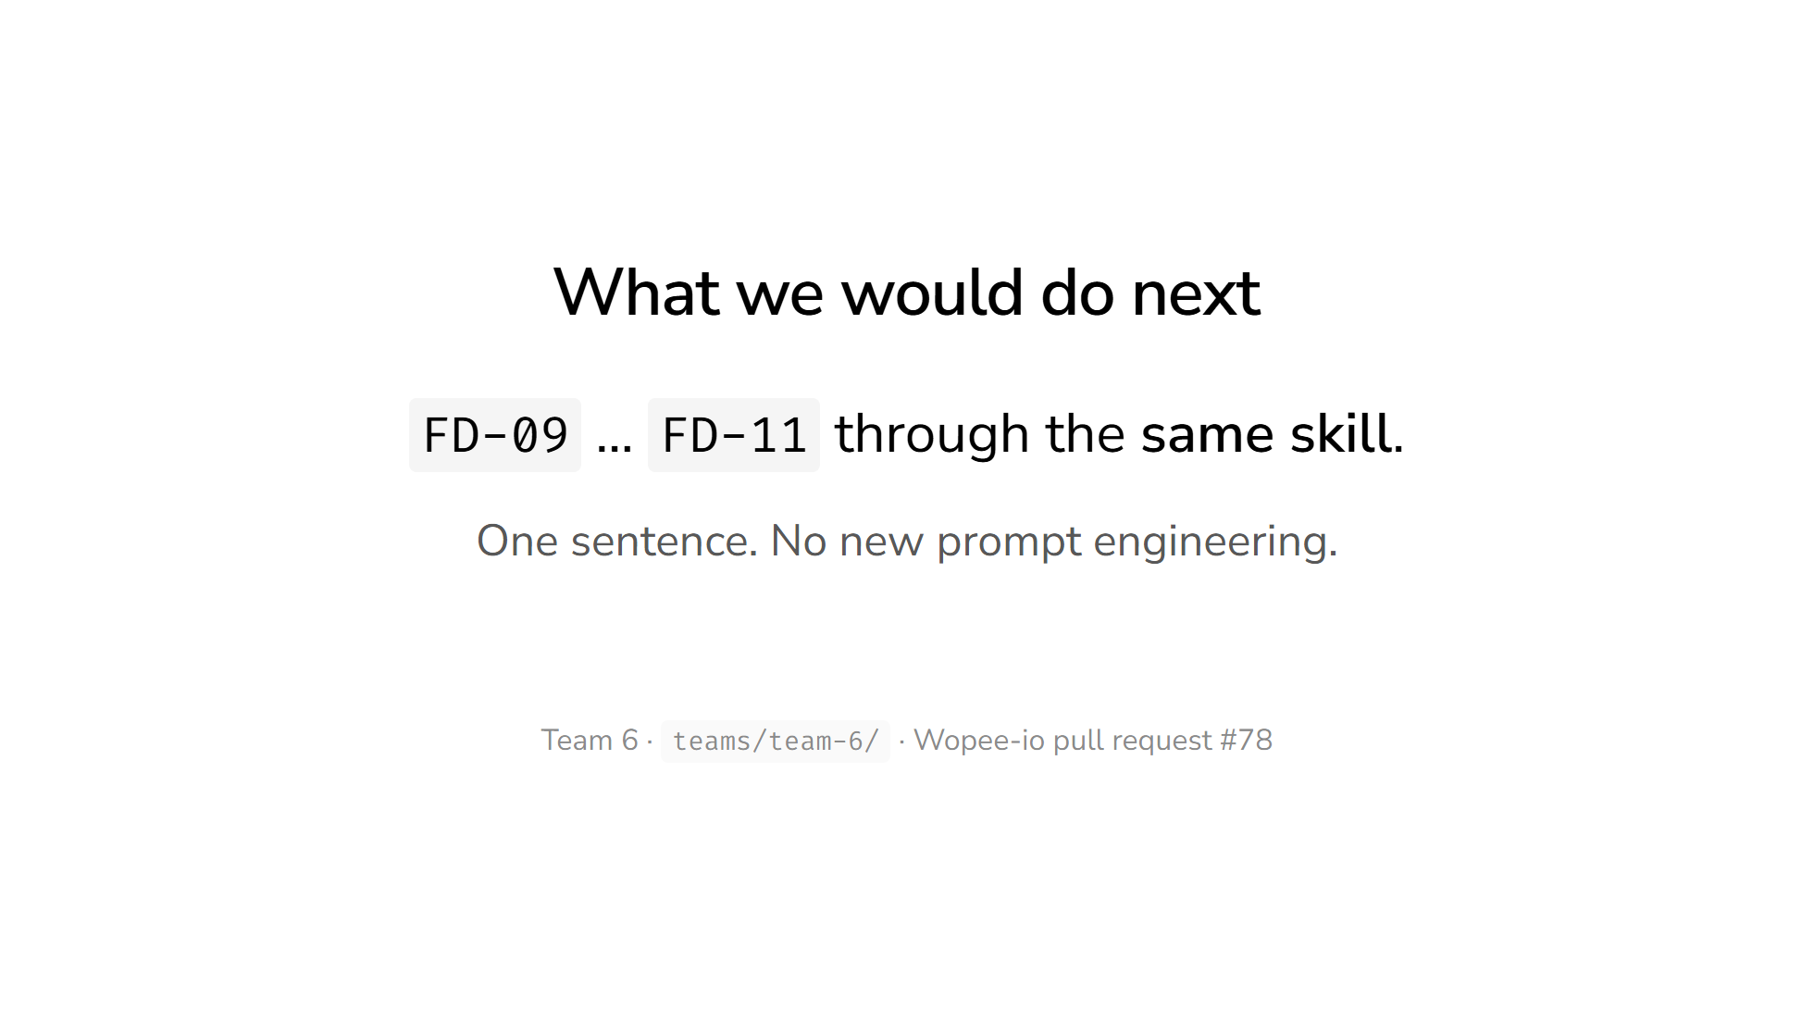
Notes:
2:40 — Stop here. Leave 20 seconds for the room to raise hands.

