Slide 1

VIDEO #001 · REVIEW
The $499/month home robot: what they don't tell you
I read the spec sheets, the demos, and the fine print.
The Robot Desk

Slide 2
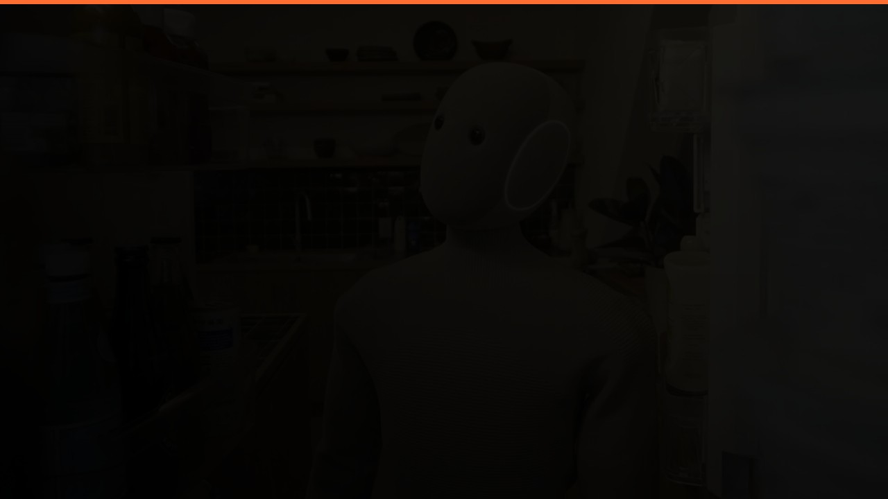
THE SUBSCRIPTION MATH
$499
$6,000
$42,000
→
→
per month
per year
over 7 years
Buying it outright: $20,000
You could buy the robot twice.

Slide 3

THE VERDICT
Trying to save money on chores?
DON'T BUY
Mobility or accessibility needs?
WORTH A SERIOUS LOOK
Want to be early — and can afford it?
SUBSCRIBE, DON'T BUY
Everyone else
WAIT

Slide 4

SOURCES
01
1x.tech/neo — pricing & spec pages
2026-07-09
02
Goldman Sachs — humanoid robotics outlook
2026-06
03
1X press briefing — teleoperation disclosure
2026-06
04
FCC filing — NEO radio module
2026-05
Every claim primary-sourced or hedged. Facts verified within two weeks of upload.

