Slide 1
Indigenous AI Compute Engine
Indigenous AI Accelerator
Design & Development
8 × 32
SYSTOLIC COMPUTE FABRIC
A programmable FPGA compute platform
with a roadmap for more models and operators.
INT8 / INT16 · MICROCODE CONTROL
ARCHITECTURE
BUILD RESULTS
CURRENT STATUS
• Compute Architecture • Memory Hierarchy • FPGA Integration
01 / 11
Notes:
PRESENTER SPEECH
This presentation introduces the design and development of our Unified C-Engine AI accelerator on the AMD ZCU106. The aim is to build a programmable compute platform that can grow over time. Four model integrations are available today: MNIST LeNet-5, ResNet-50, MobileNetV2 and EfficientNet-B0. More models and operators will follow as the compiler and RTL evolve. I will explain the system and engine architecture, the memory hierarchy, and the software flow, then show the implementation evidence and the remaining development milestones. The results are drawn from saved repository artifacts, so each performance claim is tied to its recorded scope.
TECHNICAL REFERENCES AND QUALIFICATIONS
Scope: a concise project overview based on files in E:/unified, reviewed 2026-10-19. No new FPGA build, simulation, or board execution was performed for this presentation. Raw routed reports and saved execution logs take precedence over summary prose when numbers disagree. Some logs reference source snapshots outside the current checkout; they are recorded results, not a fresh verification of the present files.

Slide 2
COMPILER + RUNTIME: The software makes the hardware reusable
Compilation generates the data and instruction stream for each model; deployment launches the same engine.
Import
Transform
Schedule
Emit
Load PyTorch parameters
and model structure
Fold BatchNorm; quantize
weights and activations
Tile tensors; assign SRAM
rows and layer controls
Weights, 128-bit microcode,
stimulus and metadata
01
02
03
04
JTAG / XSDB preload
weights in DDR
ARM + AXI-Lite launch
DDR logits → UART
Indigenous AI Compute Engine
02 / 11
Notes:
PRESENTER SPEECH
At the system level, the ARM processor manages the inference job. It prepares configuration, launches transfers and presents the returned predictions. The FPGA programmable logic executes the scheduled neural compute. Images and weights begin in DDR, move through the DMA read path into banked SRAM, and feed the compute array. Post-processing transforms the accumulated results before they return to SRAM. The write DMA then returns the final logits to DDR. Microcode coordinates the layer sequence. This separation provides a reusable accelerator architecture while keeping control and result handling in a familiar baremetal software environment.
TECHNICAL REFERENCES AND QUALIFICATIONS
Sources: rtl/c_engine_dma_top.v, rtl/c_engine_top.v, rtl/axi_lite_slave.v, rtl/axi4_master_rd.v, rtl/axi4_master_wr.v, rtl/dma_sram_bridge.v, baremetal/src/c_engine_driver.c and main.c. Diagram is a functional overview; controller signals and SRAM return paths are summarized in the data-path caption. PPU means post-processing unit. Main CPU also performs softmax and top-k result presentation, so the broad README phrase "zero neural network math" is not repeated.

Slide 3
SYSTEM ARCHITECTURE
From Python Model assets to FPGA inference
The processing system controls the overall inference run; the programmable logic performs the scheduled compute involved in four models
PROCESSING SYSTEM
PROGRAMMABLE LOGIC
ARM Cortex-A53
AXI-Lite
Microcode sequencer
Baremetal driver + AXI-Lite
Registers + status
Layer control, address generation and DMA triggers
PS DDR4
128-bit DMA
Banked SRAM
256 PEs + PPU
Images, weights, microcode
Using JTAG
Read + write masters
Activations + weights
MAC, activation, pooling
Data path: DDR → SRAM → compute / post-processing → SRAM → DDR
Indigenous AI Compute Engine
03 / 11
Notes:
PRESENTER SPEECH
At the system level, the ARM processor manages the inference job. It prepares configuration, launches transfers and presents the returned predictions. The FPGA programmable logic executes the scheduled neural compute. Images and weights begin in DDR, move through the DMA read path into banked SRAM, and feed the compute array. Post-processing transforms the accumulated results before they return to SRAM. The write DMA then returns the final logits to DDR. Microcode coordinates the layer sequence. This separation provides a reusable accelerator architecture while keeping control and result handling in a familiar baremetal software environment.
TECHNICAL REFERENCES AND QUALIFICATIONS
Sources: rtl/c_engine_dma_top.v, rtl/c_engine_top.v, rtl/axi_lite_slave.v, rtl/axi4_master_rd.v, rtl/axi4_master_wr.v, rtl/dma_sram_bridge.v, baremetal/src/c_engine_driver.c and main.c. Diagram is a functional overview; controller signals and SRAM return paths are summarized in the data-path caption. PPU means post-processing unit. Main CPU also performs softmax and top-k result presentation, so the broad README phrase "zero neural network math" is not repeated.

Slide 4
RTL MODULE ARCHITECTURE
RTL engine architecture: modules and data paths
The DMA wrapper handles transfers; the compute core contains instruction memory, SRAM, control and the PE array.
PL Implementation Architecture
axi_lite_slave
Control / status / config
config_mem
c_engine_controller
256 × 128 bits
FSM + GAP
Requantization PPU
axi4_master_rd / wr
128-bit read / write AXI
Requantized writeback
dma_sram_bridge
multibank_dualport_mem
compute_engine
128-bit beat → SRAM bank
Port A: DMA / controller mux; Port B: compute
8 × 32 processing_element
Solid: data / instructions · Dashed: array control · PPU is instantiated inside the controller
Indigenous AI Compute Engine
05 / 11
Notes:
PRESENTER SPEECH
Here we move inside the RTL hierarchy. The outer DMA wrapper contains the AXI-Lite register interface, the read and write masters, and the bridge that maps transfer beats into SRAM banks. Inside the compute core, configuration memory feeds the sequencer. The controller selects operands and controls the processing-element array. Array results pass through the requantization and post-processing unit, which is instantiated inside the controller, before returning to SRAM. Port A is shared through a DMA-versus-controller multiplexer, while Port B serves the compute path. This modular boundary helps us identify what changes when adding an operator: its scheduling, operand steering, arithmetic or post-processing requirements.
TECHNICAL REFERENCES AND QUALIFICATIONS
Sources: rtl/c_engine_dma_top.v instantiates u_axi_lite, u_master_rd, u_master_wr, u_bridge and u_engine. rtl/c_engine_top.v instantiates u_memory, u_config_mem, u_controller and u_c_engine. Port A is selected by ext_mem_override between bridge/host and controller; Port B is controller-driven. c_engine_controller.v assigns engdata_in from mem_dout_b; GEMV weights come from mem_dout_a, convolution uses its staged weight table; PPU requantization_block instance u_requant belongs to the controller. The diagram summarizes operand paths through controller steering rather than drawing every mux and bus. PPU receives PE results plus residual data and writes back under controller control. GAP reduction is also inside the controller. The dashed arrow shows PE enable and steering controls; additional controller SRAM and DMA handshakes are omitted for legibility. Config words are 128 bits according to active headers despite legacy comments saying 96 bits.

Slide 5
COMPUTE DESIGN
Inside the compute engine
One parameterized grid supports convolution, depthwise execution and dense matrix-vector stages.
01
Accumulate (CONV, GEMV, GAP)
256 signed MAC units
INT8 → INT32; INT16 → INT48
02
Requantize
Arithmetic shift and saturation
03
Fuse
Residual add + ReLU / Leaky ReLU / LUT
04
Write back
Horizontal / vertical forwarding
Local accumulation + bias injection
Stride, pooling and registered SRAM output
38.4 GOP/s theoretical INT8 peak at 75 MHz
Indigenous AI Compute Engine
06 / 11
Notes:
PRESENTER SPEECH
Here we move inside the RTL hierarchy. The outer DMA wrapper contains the AXI-Lite register interface, the read and write masters, and the bridge that maps transfer beats into SRAM banks. Inside the compute core, configuration memory feeds the sequencer. The controller selects operands and controls the processing-element array. Array results pass through the requantization and post-processing unit, which is instantiated inside the controller, before returning to SRAM. Port A is shared through a DMA-versus-controller multiplexer, while Port B serves the compute path. This modular boundary helps us identify what changes when adding an operator: its scheduling, operand steering, arithmetic or post-processing requirements.
TECHNICAL REFERENCES AND QUALIFICATIONS
Sources: rtl/c_engine_dma_top.v instantiates u_axi_lite, u_master_rd, u_master_wr, u_bridge and u_engine. rtl/c_engine_top.v instantiates u_memory, u_config_mem, u_controller and u_c_engine. Port A is selected by ext_mem_override between bridge/host and controller; Port B is controller-driven. c_engine_controller.v assigns engdata_in from mem_dout_b; GEMV weights come from mem_dout_a, convolution uses its staged weight table; PPU requantization_block instance u_requant belongs to the controller. The diagram summarizes operand paths through controller steering rather than drawing every mux and bus. PPU receives PE results plus residual data and writes back under controller control. GAP reduction is also inside the controller. The dashed arrow shows PE enable and steering controls; additional controller SRAM and DMA handshakes are omitted for legibility. Config words are 128 bits according to active headers despite legacy comments saying 96 bits.

Slide 6
Overall MEMORY HIERARCHY
Memory hierarchy: DDR capacity to PE-local reuse
Explicitly managed storage keeps bulk model data off chip and active compute data close to the array.
PS DDR4 — images, weights and output logits
CONTROL STORAGE
Large external store; DMA sees the mapped 2 GiB DDR-low aperture
128-bit AXI bursts / 16 bytes per beat
config_mem: 4 KiB
256 instructions × 128 bits
AXI-Lite programming → sequencer
Banked on-chip SRAM — active tensors and weights
INT8: 3.93 MB, 256 B/row | INT16: 2.10 MB, 512 B/row
DDR ADDRESS EXAMPLE
Controller selects rows, banks and operands
0x20100000 ImageNet input
Weight staging + GAP / output registers
0x21000000 Microcode assets
0x31000000 ResNet-50 weights
0x38000000 Output logits
PE registers: HOR / VERT / ENG / Outf_map
Read path shown; results return through SRAM and write DMA to DDR.
Indigenous AI Compute Engine
07 / 11
Notes:
PRESENTER SPEECH
Here we move inside the RTL hierarchy. The outer DMA wrapper contains the AXI-Lite register interface, the read and write masters, and the bridge that maps transfer beats into SRAM banks. Inside the compute core, configuration memory feeds the sequencer. The controller selects operands and controls the processing-element array. Array results pass through the requantization and post-processing unit, which is instantiated inside the controller, before returning to SRAM. Port A is shared through a DMA-versus-controller multiplexer, while Port B serves the compute path. This modular boundary helps us identify what changes when adding an operator: its scheduling, operand steering, arithmetic or post-processing requirements.
TECHNICAL REFERENCES AND QUALIFICATIONS
Sources: rtl/c_engine_dma_top.v instantiates u_axi_lite, u_master_rd, u_master_wr, u_bridge and u_engine. rtl/c_engine_top.v instantiates u_memory, u_config_mem, u_controller and u_c_engine. Port A is selected by ext_mem_override between bridge/host and controller; Port B is controller-driven. c_engine_controller.v assigns engdata_in from mem_dout_b; GEMV weights come from mem_dout_a, convolution uses its staged weight table; PPU requantization_block instance u_requant belongs to the controller. The diagram summarizes operand paths through controller steering rather than drawing every mux and bus. PPU receives PE results plus residual data and writes back under controller control. GAP reduction is also inside the controller. The dashed arrow shows PE enable and steering controls; additional controller SRAM and DMA handshakes are omitted for legibility. Config words are 128 bits according to active headers despite legacy comments saying 96 bits.

Slide 7
MEMORY + PRECISION
SRAM Memory planning is central to scaling
DDR stores large model assets; banked SRAM stages the active tensors and weight tiles.
CONFIGURATION
INT8 BUILD
INT16 BUILD
Arithmetic
8-bit inputs / weights; 32-bit sums
16-bit inputs / weights; 48-bit sums
SRAM geometry
16 banks × 128 bits × 15,360 rows
32 banks × 128 bits × 4,096 rows
Logical capacity
3.93 MB (3.75 MiB)
2.10 MB (2.00 MiB)
Instruction store
256 × 128-bit words
256 × 128-bit words
Example: current ResNet-50 INT8 compiler allocation of SRAM rows
Input +
stage 0
Ping
Pong
Residual
Weights
Indigenous AI Compute Engine
08 / 11
Notes:
PRESENTER SPEECH
Here we move inside the RTL hierarchy. The outer DMA wrapper contains the AXI-Lite register interface, the read and write masters, and the bridge that maps transfer beats into SRAM banks. Inside the compute core, configuration memory feeds the sequencer. The controller selects operands and controls the processing-element array. Array results pass through the requantization and post-processing unit, which is instantiated inside the controller, before returning to SRAM. Port A is shared through a DMA-versus-controller multiplexer, while Port B serves the compute path. This modular boundary helps us identify what changes when adding an operator: its scheduling, operand steering, arithmetic or post-processing requirements.
TECHNICAL REFERENCES AND QUALIFICATIONS
Sources: rtl/c_engine_dma_top.v instantiates u_axi_lite, u_master_rd, u_master_wr, u_bridge and u_engine. rtl/c_engine_top.v instantiates u_memory, u_config_mem, u_controller and u_c_engine. Port A is selected by ext_mem_override between bridge/host and controller; Port B is controller-driven. c_engine_controller.v assigns engdata_in from mem_dout_b; GEMV weights come from mem_dout_a, convolution uses its staged weight table; PPU requantization_block instance u_requant belongs to the controller. The diagram summarizes operand paths through controller steering rather than drawing every mux and bus. PPU receives PE results plus residual data and writes back under controller control. GAP reduction is also inside the controller. The dashed arrow shows PE enable and steering controls; additional controller SRAM and DMA handshakes are omitted for legibility. Config words are 128 bits according to active headers despite legacy comments saying 96 bits.

Slide 8
An AI accelerator platform with four model integrations
Current model support spans digit recognition and ImageNet vision workloads; validation maturity varies by model.
256
4
2
1,000
processing elements
model compiler flows
precision builds
ImageNet output classes
MNIST / LeNet-5
ResNet-50
MobileNetV2
EfficientNet-B0
Digit recognition
10 classes
5 microcode words
Residual network
1,000 classes
57 microcode words
Depthwise convolution
1,000 classes
56 microcode words
MBConv + Swish LUT
1,000 classes
53 microcode words
Platform direction: The model and operator coverage can be expanded using python compiler, reusable RTL and systematic validation.
Indigenous AI Compute Engine
09 / 11
Notes:
PRESENTER SPEECH
At the system level, the ARM processor manages the inference job. It prepares configuration, launches transfers and presents the returned predictions. The FPGA programmable logic executes the scheduled neural compute. Images and weights begin in DDR, move through the DMA read path into banked SRAM, and feed the compute array. Post-processing transforms the accumulated results before they return to SRAM. The write DMA then returns the final logits to DDR. Microcode coordinates the layer sequence. This separation provides a reusable accelerator architecture while keeping control and result handling in a familiar baremetal software environment.
TECHNICAL REFERENCES AND QUALIFICATIONS
Sources: rtl/c_engine_dma_top.v, rtl/c_engine_top.v, rtl/axi_lite_slave.v, rtl/axi4_master_rd.v, rtl/axi4_master_wr.v, rtl/dma_sram_bridge.v, baremetal/src/c_engine_driver.c and main.c. Diagram is a functional overview; controller signals and SRAM return paths are summarized in the data-path caption. PPU means post-processing unit. Main CPU also performs softmax and top-k result presentation, so the broad README phrase "zero neural network math" is not repeated.

Slide 9
RECORDED RESULTS
Recorded Results (Full end to end): Int8
Saved INT8 logs show functional completion; elapsed hardware time below is calculated from cycles at 75 MHz.
MODEL / Input Image
CYCLES
TIME AT 75 MHz
RECORDED OUTCOME
MNIST / raw 8 × 32 MNIST input
350
4.66 µs
PASS (0/10 mismatches)
MobileNetV2 / full RGB 224x224x3
3,047,626
40.63 msec
PASS (0 / 1,000 mismatches)
EfficientNet-B0 / full RGB 224x224x3
3,795,311
50.6 msec
PASS (0 / 1,000 mismatches)
ResNet-50 / full RGB 224x224x3
76,275,902
1017 msec
PASS (0/1,000 mismatches) –In progress
24.6 FPS / MobileNetV2
19.7 FPS / EfficientNet-B0
Indigenous AI Compute Engine
10 / 11
Notes:
PRESENTER SPEECH
Here we move inside the RTL hierarchy. The outer DMA wrapper contains the AXI-Lite register interface, the read and write masters, and the bridge that maps transfer beats into SRAM banks. Inside the compute core, configuration memory feeds the sequencer. The controller selects operands and controls the processing-element array. Array results pass through the requantization and post-processing unit, which is instantiated inside the controller, before returning to SRAM. Port A is shared through a DMA-versus-controller multiplexer, while Port B serves the compute path. This modular boundary helps us identify what changes when adding an operator: its scheduling, operand steering, arithmetic or post-processing requirements.
TECHNICAL REFERENCES AND QUALIFICATIONS
Sources: rtl/c_engine_dma_top.v instantiates u_axi_lite, u_master_rd, u_master_wr, u_bridge and u_engine. rtl/c_engine_top.v instantiates u_memory, u_config_mem, u_controller and u_c_engine. Port A is selected by ext_mem_override between bridge/host and controller; Port B is controller-driven. c_engine_controller.v assigns engdata_in from mem_dout_b; GEMV weights come from mem_dout_a, convolution uses its staged weight table; PPU requantization_block instance u_requant belongs to the controller. The diagram summarizes operand paths through controller steering rather than drawing every mux and bus. PPU receives PE results plus residual data and writes back under controller control. GAP reduction is also inside the controller. The dashed arrow shows PE enable and steering controls; additional controller SRAM and DMA handshakes are omitted for legibility. Config words are 128 bits according to active headers despite legacy comments saying 96 bits.

Slide 10
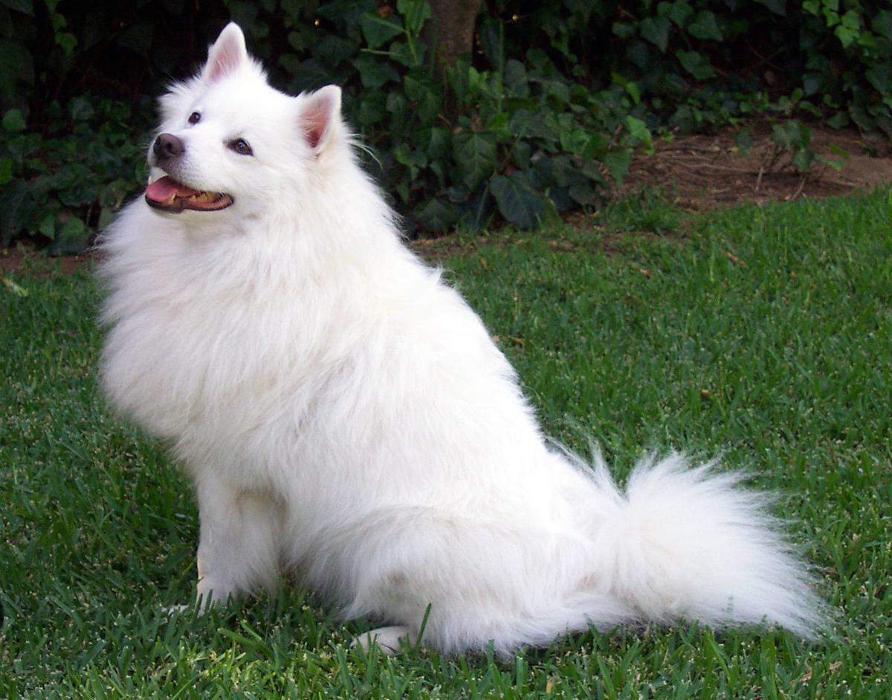
RESULT INTERPRETATION
A correct top-1 example is only part of accuracy
The saved dog-image runs identify Samoyed, while the full distributions reveal quantization limits.
MobileNetV2: Samoyed #258
Logit 90; next recorded class is thunder snake (72).
EfficientNet-B0: three-way top tie
Samoyed, ibex and analog clock all saturate at 127.
What the evidence supports
Exact agreement with the logged quantized reference.
A limited sample; held-out dataset accuracy remains open.
TEST IMAGE: DOG.JPG
Indigenous AI Compute Engine
11 / 11
Notes:
PRESENTER SPEECH
This example helps explain why we look beyond the pass marker. The dog-image runs report Samoyed as top one. MobileNetV2 has a clear highest logit in this capture. EfficientNet-B0, however, gives three classes the maximum INT8 value of 127, so its top result includes a saturation tie. Agreement with a quantized reference is valuable evidence about execution, but it does not establish general classification accuracy. We need to examine output distributions, fix saturation where appropriate, and evaluate on images that were not used for calibration. That becomes more important as we bring additional models onto the accelerator.
TECHNICAL REFERENCES AND QUALIFICATIONS
Sources: data/test_images/dog.jpg; sim/logs/mobilenetv2_8bit.log, efficientnetb0_8bit.log. MobileNet Top-5 = [258:90,52:72,904:56,0:53,61:53]. EfficientNet Top-5 = [258:127,350:127,409:127,128:117,146:116]; the tie at INT8 maximum limits interpretation of a top1=258 marker. Zero mismatches means agreement with the logged fixed-point reference, not proof of equivalence to floating-point PyTorch on all images. The current compiler explicitly calibrates a projected head using test-image features. No held-out benchmark accuracy result was located in the reviewed project evidence. This slide intentionally avoids the V4 prose claim of 100% PyTorch bit-exact accuracy.

