Slide 1
Introduction to
Quality Management System
ISO 9001:2008
Nabil Manzoor
Workplains (Pvt) Ltd

Slide 2
Outlines
What is Certification/ Accreditation?
Introduction to Quality
The Importance of QMS
Introduction to 9001:2008 Standard
Quality Management principles of ISO 9001
Clauses of ISO 9001:2008 Standard
Benefits of ISO 9001:2008
Q/A

Slide 3
What is Certification?
Certification refers to the confirmation of certain characteristics of an object, person, or organization.
This confirmation is normally provided by:
External review
Education
Assessment or
Audit

Slide 4
What is Accreditation?
Assessment of the company’s or organization’s ability to conduct an independent assessment in a competent and efficient manner.
The act of granting credit or recognition that maintains suitable standards.
It is a process in which certification of competency, authority, or credibility is presented.

Slide 5
What is UKAS?
United Kingdom Accreditation Service
In UK, accreditation is offered by UKAS only. In Pakistan, by PNAC (Pakistan National Accreditation Council).
Organizations that issue credentials or certify third parties against official standards are themselves formally accredited by UKAS; hence they are sometimes known as “accredited certification bodies” e.g. DAS Pakistan.

Slide 6
What is IRCA?
International Register of Certificated Auditors – UK based
IRCA provides two main services:
Certification of auditors of management systems
Approval of training organizations and certification of their auditor training courses e.g. IQMS in UK providing auditor training courses etc.

Slide 7

ISO – Language of Quality
Conformance to
Specification
“Zero Defect”
Build Right
Characteristics
Meet implied/Market
Needs

Slide 8
Quality
Ability of a set of inherent characteristics of a
product, system or process to fulfill requirements
of customers and other interested parties
(ISO 9000:2008)

Slide 9
Quality Management
Coordinated activities to direct and control an organization with regard to quality.
An ongoing effort to provide services that meet or exceed customer expectations through a structured, systematic process for creating organizational participation in planning and implementing quality improvements.
Quality Management incorporates all activities conducted to improve the efficiency.

Slide 10
Quality Management System (QMS)
The complete set of quality standards, procedures and responsibilities for an organization.
The formalized system that documents the structure, responsibilities and procedures required to achieve effective quality management
A quality management system is a web of interconnected processes.

Slide 11
Quality Management System (QMS)
QMS consists of :
Policies
Manuals
Roles & Responsibilities
Procedures
Work Instructions
Forms/Templates

Slide 12
Why QMS ?
To achieve Quality
Consistency
Traceability
Resource Independence
Continual Improvement

Slide 13
ISO 9001:2008

Slide 14
Introduction to ISO
ISO: The official title for the ‘International Organization for Standardization’.
ISO 9001:2008 is an international standard for implementing a quality management system

Slide 15
ISO - General
International Organization for Standardization
Founded on February 23, 1947. Headquarters in Geneva, Switzerland.
ISO is not an acronym or initialism.
Organization adopted ISO based on the Greek word isos (ἴσος), meaning equal - to equalize and standardize across cultures.
21,595 companies in Pakistan are ISO 9001 certified up to the end of 2012. First company registered in 1994.
At the end of Dec 2013, ISO had 19977 international standards and standards-type documents.
http://www.iso.org/iso/home/standards/certification/iso-survey.htm?certificate=ISO%209001&countrycode=PK#countrypick
http://www.iso.org/iso/home/standards/management-standards/iso_9000.htm
http://www.iso.org/iso/home/about/iso-in-figures.htm

Slide 16
ISO 9000 Standards
ISO 9000: Quality management systems – Fundamentals and vocabulary
ISO 9001: Quality management systems – Requirements
ISO 9004: Quality management systems – Guidance for improvements
ISO 10011: Guidelines for Auditing Quality

Slide 17
Introduction to ISO 9001:2008
9001 is series
2008 is version
ISO 9000 provides a framework and systematic approach to managing business processes to produce a product/service that conforms to customer expectations.

Slide 18
Quality Management Principles
Customer focused organization
  Organization should understand current and future customer needs
Leadership
  Leaders establish purpose & direction of the organization
Involvement of people
  People at all levels are the essence of an organization
Process approach
  A desired result is achieved more efficiently when activities and related resources are managed as a process (interrelated activities which transforms inputs into outputs)
System approach to management
  Identifying, understanding and managing interrelated processes as a system contributes to the organization's effectiveness and efficiency in achieving its objectives
Continual improvement
  Ongoing effort to improve products, services or processes (should be a permanent objective of the organization)
Factual approach to decision making
  Effective decisions are based on the analysis of data and information
Mutually beneficial supplier relationship
  An organization and its suppliers are interdependent and a mutually beneficial relationship enhances the ability of both to create value

Slide 19
Clauses of ISO 9001:2008 Standard
1. Scope - Requirements for a QMS
2. Normative reference - ISO 9000:2005, QMS - Fundamentals and vocabulary
3. Terms and definitions
4. Quality Management System
5. Management Responsibility
6. Resource Management
7. Product Realization
8. Measurement, Analysis and Improvement
Major Clauses

Slide 20
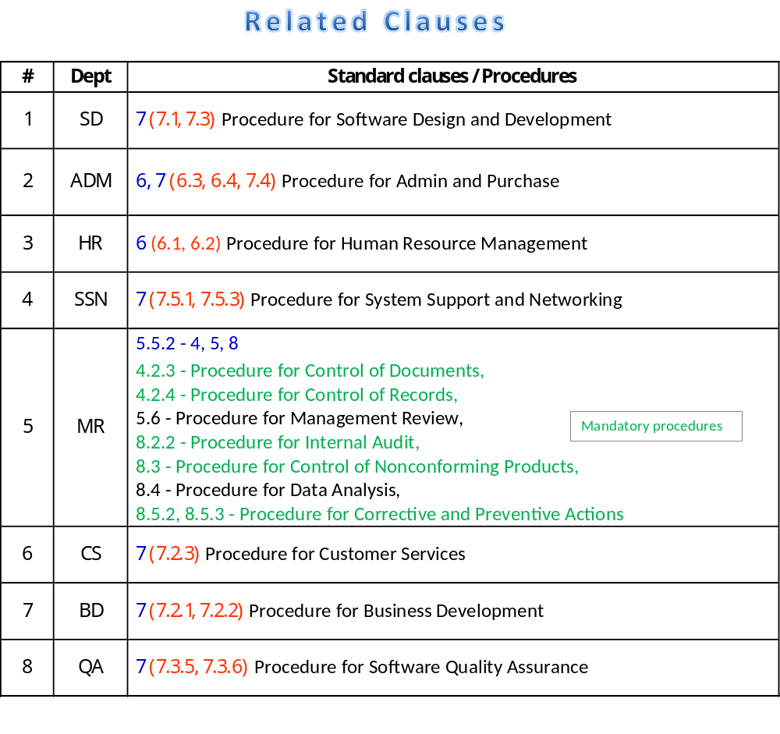

Slide 21
Quality Policy
<<Company>> is committed to providing high quality software, web development and data management services which exceed each of our customer’s expectations. We aim to maintain the highest quality of standards and seek continual improvement in our overall quality and performance by complying with the requirements of our Quality Management System.

Slide 22
Quality Objectives
  Top management shall define SMART Objectives. The quality objectives shall be measurable and consistent with the quality policy.
  Specific
  Measurable
  Achievable
  Realistic
  Time-Bound

Slide 23

ISO 9001:2008
CONTINUAL IMPROVEMENT OF THE QUALITY MANAGEMENT SYSTEM
Management responsibility
Customers
Customers
Clause 5
Measurement, analysis and improvement
Resource
Management
Satisfaction
Clause 6
Clause 8
Clause 7
Requirements
Input
Service/Product
realization
Output
Service
Product
Value adding activities
Information flow

Slide 24
Benefits of ISO 9001-2008
Improved customer relations-satisfied customers, fewer complaints
Improved company name image and credibility
Continued or improved access to foreign markets
Improved marketing position domestically
More consistent, improved products and services
Adds value to the product
Meeting requirements of regulatory, international market exports

Slide 25
Non-Conformity
This relates to customer complaints, audit findings, product non-conformity, development processes and the quality system.
If you see any non-conformity then inform MR/PM/CEO and fill the CPA form and submit to MR:
Corrective and Preventive Actions Form
VSS path: …
Refer to the following procedure:
Procedure for Corrective and Preventive Actions
Section …
VSS path: …

Slide 26
Documents update/storage
Only MR has the authority to apply changes in documents after taking approval from PM/CEO and these can only be placed in VSS, SVN, TFS.
Refer to the following documents:
Procedure for Control of Documents
Section …
VSS path: …
Procedure for Control of Records
Section …
VSS path: …

Slide 27
Related documents
Policy
VSS path → …
Manuals
VSS path → …
Procedure
VSS path → …
Forms/Templates
VSS path → …
ISO 9001:2008 standard
VSS path → …
QMS Training
VSS path → …

Slide 28
Road Map to ISO 9001 Certification
Step 9
Step 8
Registration
Step 7
Final Assessment
Step 6
Pre-Assessment
Step 5
Internal Quality Audit
Step 4
Implementation & Progress Monitoring
Step 3
Process Definition
Step 2
Review of current system
Setup/Appointment of
Consultant
MR
Task Team
Step 1
Management Decision &
Commitment

Slide 29
Questions & Answers

Slide 30
Thank You

