Slide 1
AIMS Workshop
July 2012

Slide 2
Summary
Registration and Introduction
About AIMS
Assessment Methodology
Assessments with AIMS
Essential Features
Scenario Running
Way Forward

Slide 3
Registration
AIMS User Accounts
AIMS Registration Form
Validity of Registration

Slide 4
About AIMS
AIMS is an easy-to-use assessment tool builder geared towards the specific needs of the humanitarian sector.
A simple drag-and-drop process to create assessments and collaborate on your draft assessments
Assists you in gathering data through traditional paper as well as mobile phones and PCs.
The gathered data can then be cleaned and validated to ensure data integrity and validity
Once the gathered data is cleaned and validated, AIMS uses it to provide program managers with actionable insights and decision-making support
AIMS thus helps you manage the assessment process from start to finish – greatly reducing the time and cost involved in traditional, manually assessment approaches.

Slide 5




Humanitarian Projects and Services
2005
2009
2010
2011
2012
Earthquake 2005 Housing Monitoring ERRA & NESPAK- Successfully implemented
IVAP Project (KPK)– IRC– IDP’s Vulnerability Assessment and Profiling project – Successfully implemented and further modules are being developed by Workplains as an enhancement to the project. Other partners in the project OCHA, WFP and UNHCR . Project was highlighted as best practice in Inter Agency Real Time Evaluation report of Conflict in KPK and FATA 2010.
CCCM (Flood 2010) – Camp Coordination and Camp Management, Village Profiling System – successfully implemented
IOM Call Centre and SMS software – successfully implemented
IOM Watan Card and Mass Com Project – successfully implemented
AIMS – Assessment Information Management System Service

Slide 6
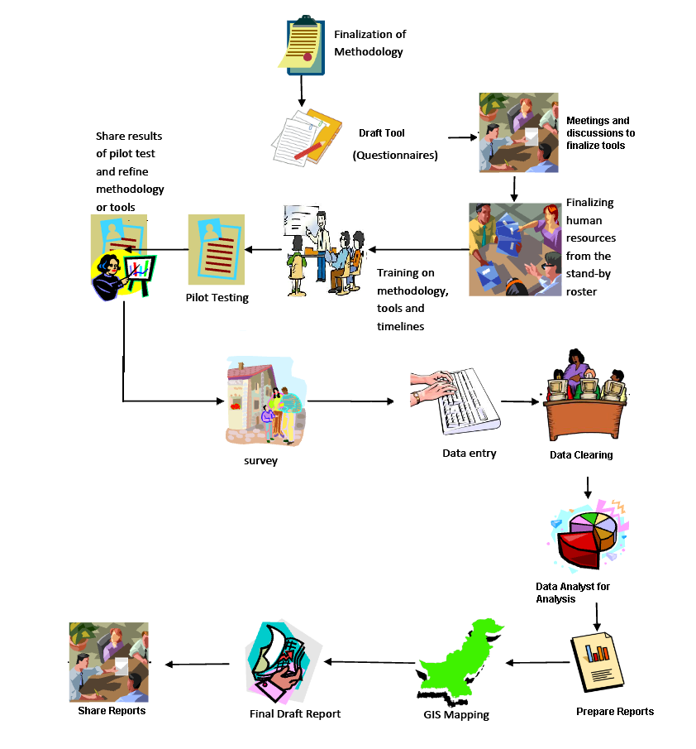
A Typical Assessment Methodology

Slide 7
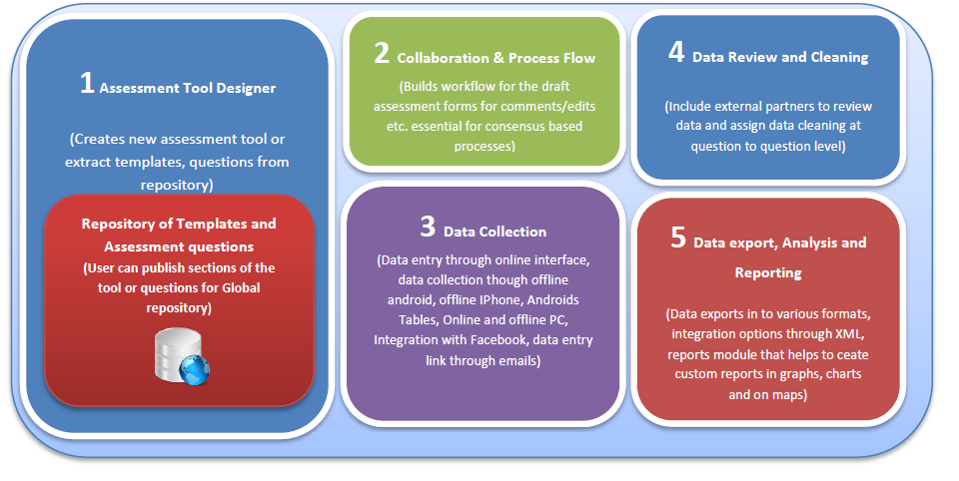
AIMS Overview

Slide 8
Features Matrix
Create Assessments
Simply drag-and-drop questions to create assessments
WYSIWYG support for creating assessments
Include images in your questions and answers
Re-use past assessments and questions from past assessments
Collaborate on Assessment Drafts
Collaborate and discuss with partners on each question in the draft assessment
Set limits for how long a draft assessment is open for feedback from partners
Send collaboration requests through email
Request Approvals for Assessments
Assessment approval dashboard for program managers
Approval request notifications through email
Collect Assessment Data
Collect assessment data through mobile phones
Collect assessment data using paper-based assessments
Collect assessment data through PC and web browser
Clean and Validate Assessment Data
AIMS automatically cleans assessment data using its rules engine
Validate assessment data through on-site agents
Validate data through call centers
Report Assessment Data
Dashboard to report assessment data
Email notifications for the release of assessment report
Analyze and Decision Support
Visualize assessment data through graphs and charts
Visualize assessment data imposed on geographical and political maps
Export Assessment Data
Data in IBM SPSS format
Export assessment data to Spreadsheet programs (such as MS Office and OpenOffice)

Slide 9
Essential Features and OVERVIEW

Slide 10
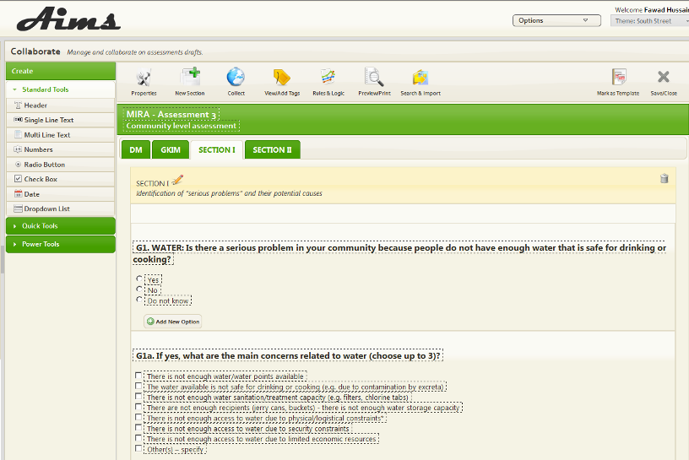
Create Assessments with Simple Drag and Drop
Drag-and-drop interface
New assessments in quick time
No specialist help needed
Divide related sets of questions in sections for improved readability
Tag Questions, Sections and Forms for quick search

Slide 11
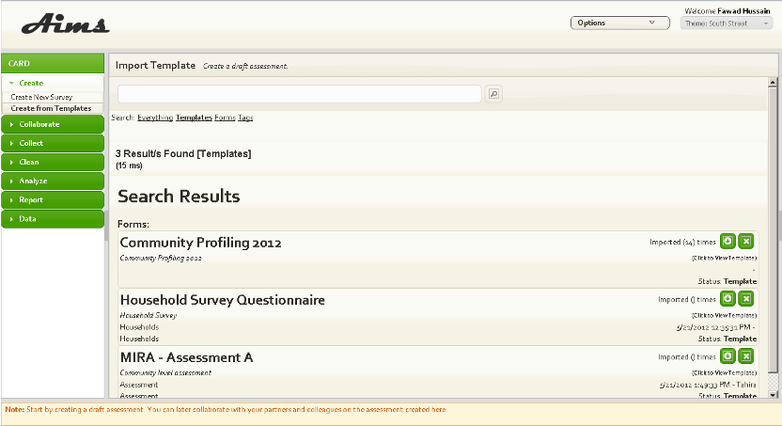
Templates and Reuse Questions from Past Assessments
Intuitive user interface for finding relevant questions
Use questions from templates and past assessments
Quickly build a relevant and effective assessment
Use templates from your own organization as well as other NGOs

Slide 12
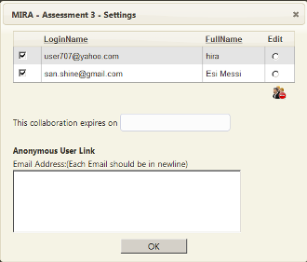
Invite Contributors to Give Feedback
Invite partners and collaborators to any assessment created in AIMS
Use collaboration feature to gather feedback and changes
Simply send a web link to your assessment to partners
Partners can then view and comments the draft assessment
Allows you to quickly finalize an assessment draft without having to manually gather feedback

Slide 13
Time-barred Collaboration
Collaboration on assessment drafts can be time-limited
Simply decide how long you want a given assessment to be open for discussion
Your assessment partners are automatically notified about the time-barred nature of the assessment

Slide 14
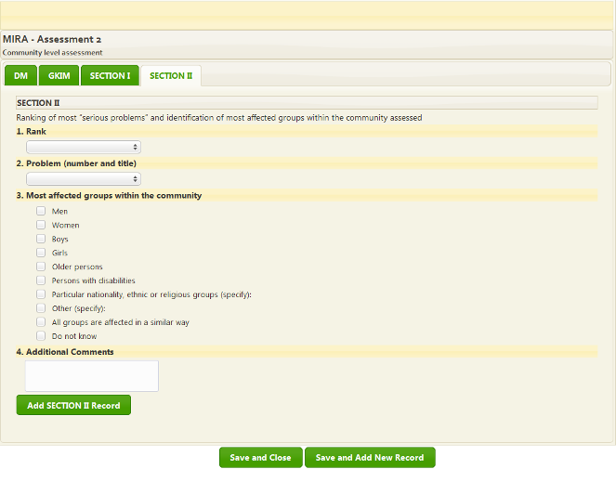
Publish Assessment and Collect Data
After an assessment draft has been finalized, coordinator/administrator can publish assessment for data collection
Start gathering on an assessment using mobile phones, paper-based forms and PCs.

Slide 15
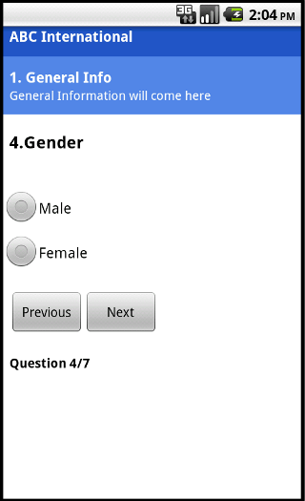
Use Mobile Phones to Collect Data
Agents in the field can use mobile phones to gather assessment data
Using mobile phones to gather is both faster and less error-prone
Data gathered in the field can then be imported into the AIMS system
Mobile phone application allows to collect GPS coordinates and Photos along with responses.

Slide 16
Support for Manual Data Entry
AIMS supports gathering assessment data using traditional paper-based assessments.
Subsequently enter the data into the AIMS by using convenient browser-based pages for inputting data.

Slide 17
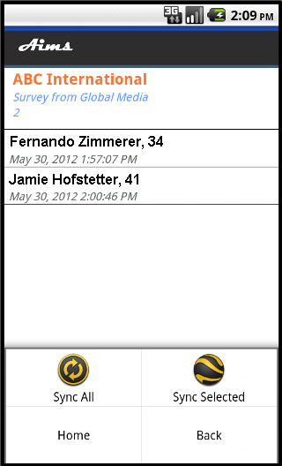
Clean and Validate Your Assessment Data
AIMS allows you to efficiently manage data cleaning and validation processes
Using AIMS workflows for running data integrity checks through call-centers and on-site agents and managers
Quickly run a smooth data validation to ensure high data integrity.

Slide 18
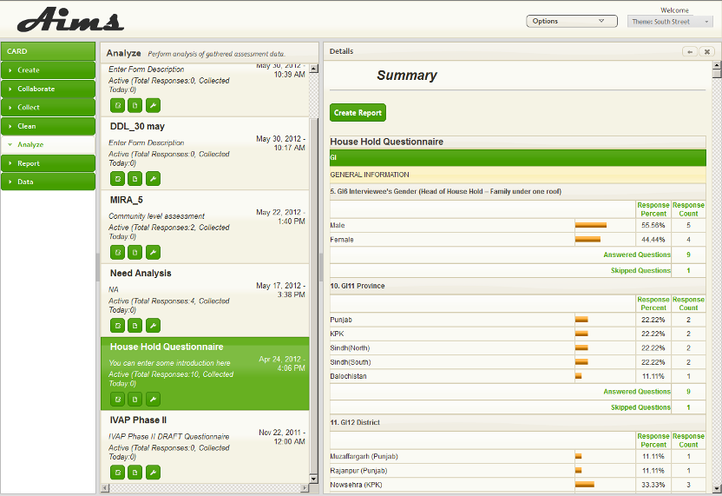
Assessment Data Analysis
Analyze the assessment data on a per question basis to identify immediate and current needs as well as weigh tactical priorities.
Help to formulate intelligent work plans for the target areas where the assessment was conducted.
View data in the backdrop of geographical and political maps of the area

Slide 19
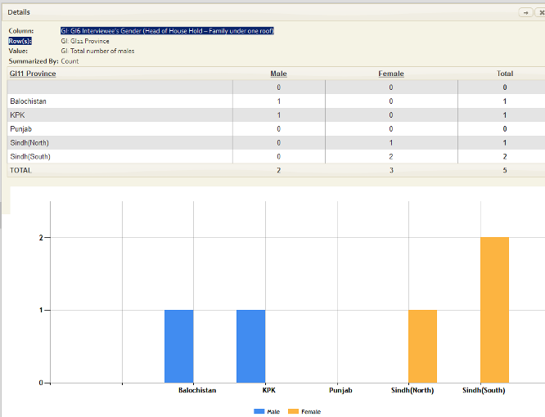
Rich Reports
AIMS offers rich reporting capabilities to visualize the data and make informed decisions based on the data
Drill down information
Format Analysis Reports for sharing

Slide 20
Export Your Data
Export your assessment data to external systems for further analysis.
AIMS supports exporting assessment data to Microsoft Excel and OpenOffice.

Slide 21
AIMS DEMO

Slide 22
Scenario
Rapid Assessment Flood 2012
Create
Collaborate
Collect through phones
Collect through PC ‘s Web Browsers
Data Cleaning
Analyze
Report
Export

