Slide 1
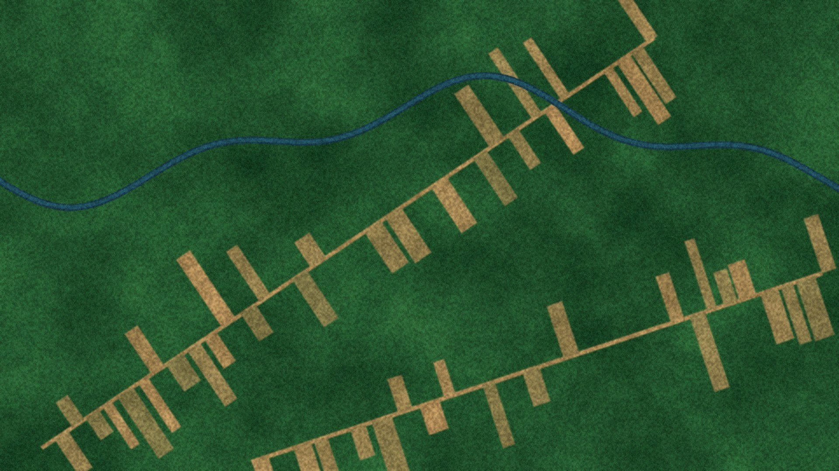
VELLORE INSTITUTE OF TECHNOLOGY, CHENNAI · BACSE202 DATABASE MANAGEMENT SYSTEMS
TREE COVERAGE · −17.7 %
Satellite Imagery Knowledge Graph
GraphRAG for Earth Observation Data
Joshwa D Y
25BCE5176
Nallazhahu M
25BCE5203
Akshay V
25BCE5116
Faculty
Dr. S. Geetha
Notes:
Introduce the team and the project title.

Slide 2




01 · PROBLEM
Why connect satellite data?
Link the data
15-table Oracle schema, normalised to BCNF
THE ANALYST’S QUESTION
“Find images showing rapid deforestation near river basins in Q3, and how trustworthy is that evidence?”
Track change over time
the same forest patch across images: loss % and rate
Rank the evidence
meaning + distance to a river + date, with tunable weights
Metadata, AI detections and change history live in separate files, so what, where, when, how it changed and how reliable it is never meet in one query.
Trust every answer
detection confidence × clear sky → alerts and a score

Slide 3
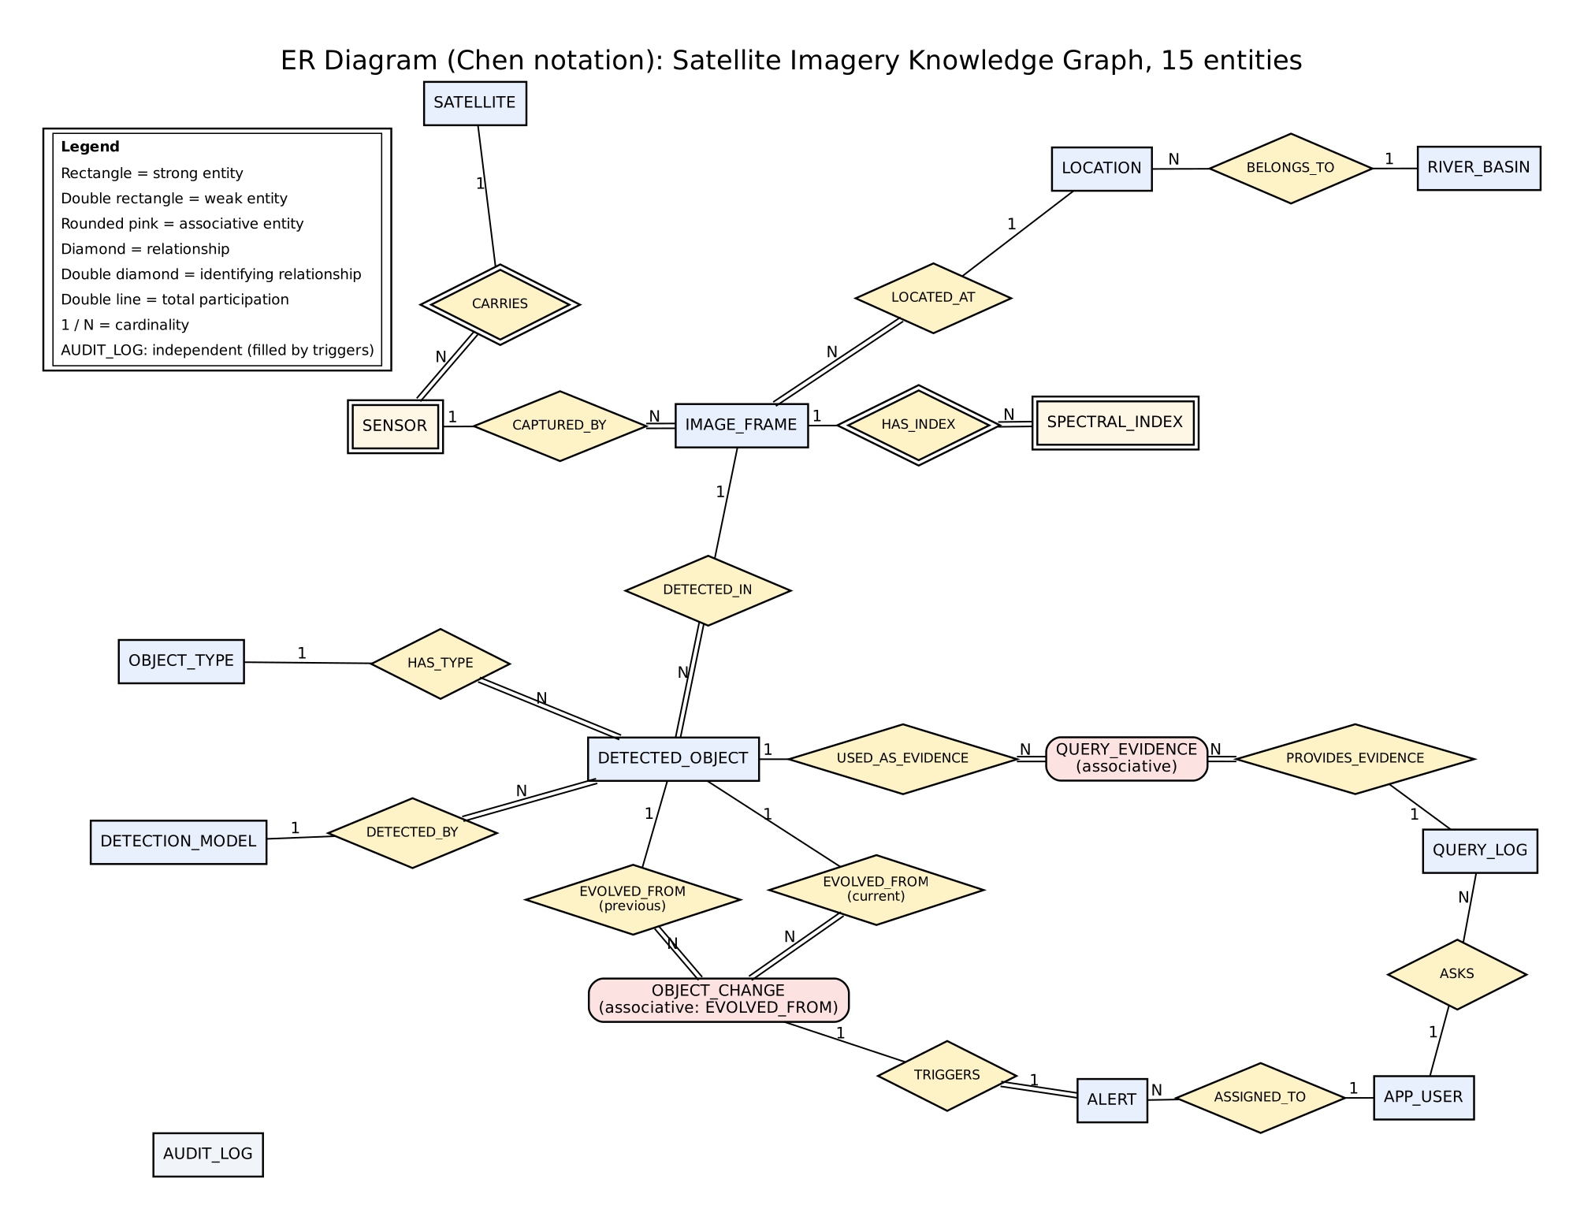
02 · DESIGN
Architecture and ER model
Browser
HTML · Leaflet maps · Chart.js
HTTP
Flask application
validation · scoring · SQL with bind variables
python-oracledb pool
Oracle 21c XE
15 tables · 2 views · pkg_eo · 5 triggers
same data as CSV
Neo4j 2026.10
graph · point + vector indexes
15 entities weak: SENSOR, SPECTRAL_INDEX · associative: OBJECT_CHANGE (recursive EVOLVED_FROM), QUERY_EVIDENCE (M:N)

Slide 4
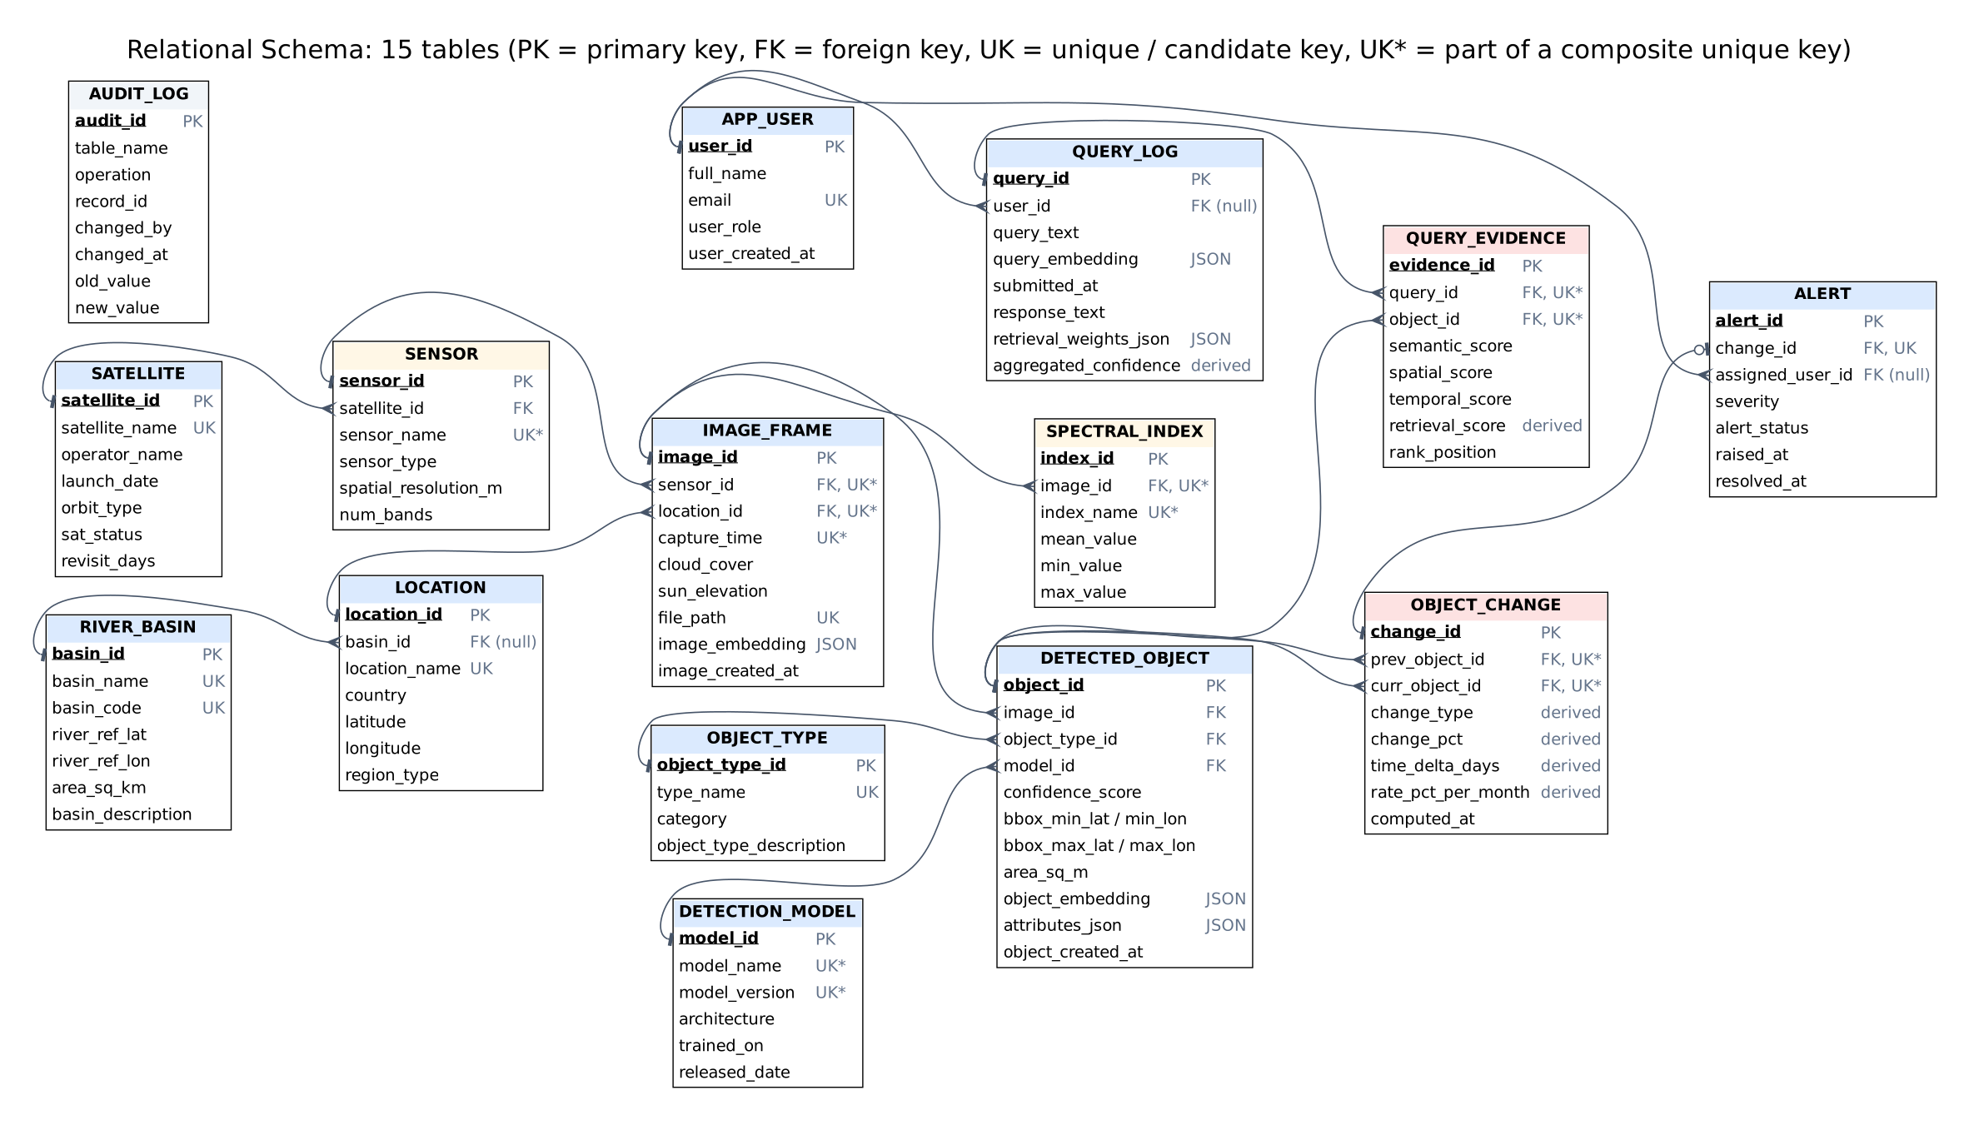
03 · SCHEMA
Relational schema and normalization
UNF
one flat record per image, two repeating groups
1NF
atomic bbox; one row per object and per index
2NF
image columns depend only on file_path
3NF
split satellite, sensor, location, basin, type, model
BCNF
every determinant is a candidate key
Keys surrogate PKs; natural keys kept UNIQUE
Constraints CHECK, IS JSON, FK CASCADE / SET NULL / RESTRICT, triggers
Result 10 FDs · lossless · dependency-preserving

Slide 5
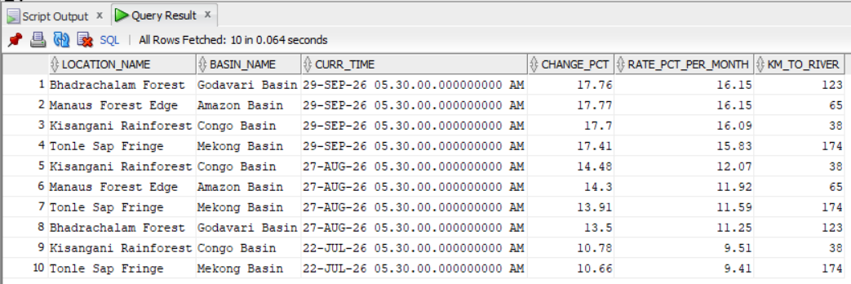
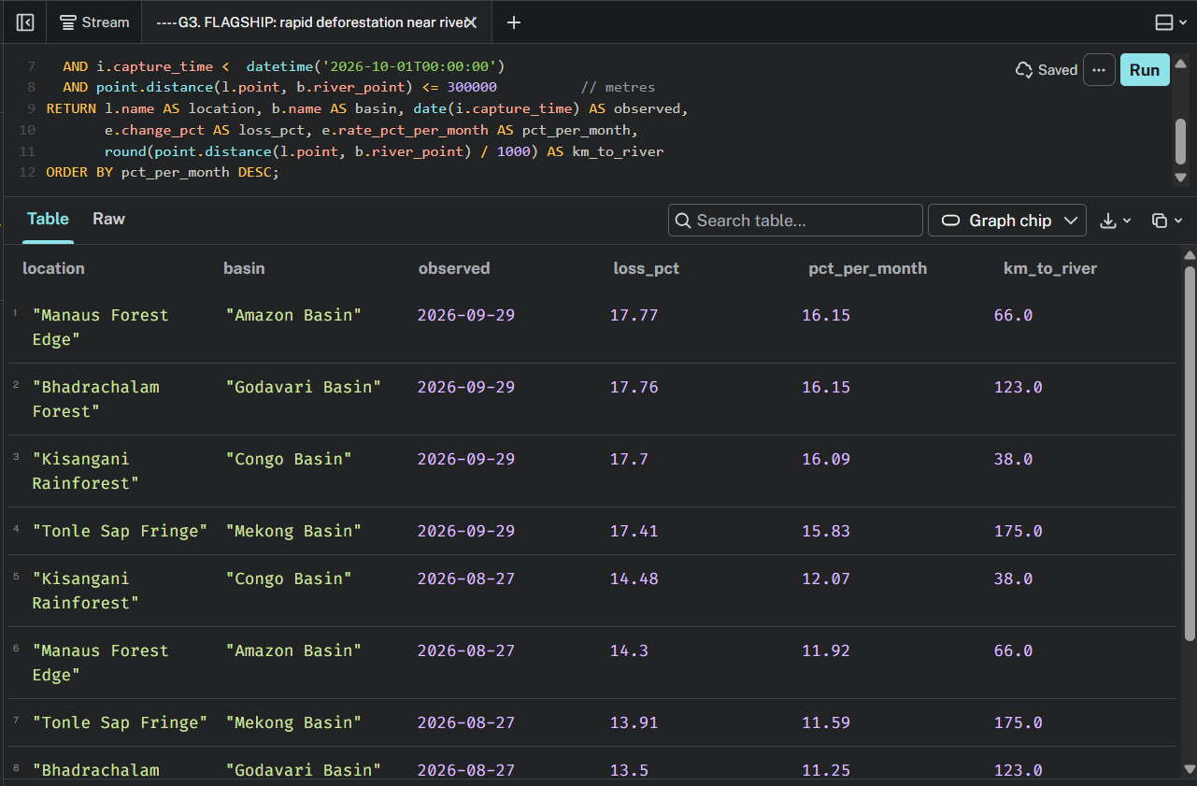
04 · IMPLEMENTATION
PL/SQL, SQL and the flagship query
compute_changes
LAG() + MERGE build 36 EVOLVED_FROM links
raise_alerts
loss ≥ 10 %, conf ≥ 0.7, cloud ≤ 40 % → 4 of 10 alerted
Q10 · rapid deforestation ≤ 300 km from a river in Q3
fn_query_confidence
Σ(retrieval × conf × clear sky) ÷ Σ retrieval
5 triggers
audit, no future captures, resolved_at, lineage checks
Neo4j G3 returns the same 10 rows with one path pattern
19 SQL queries joins, GROUP BY / HAVING, correlated subqueries, MINUS, window functions, CONNECT BY, CORR, JSON_VALUE, SAVEPOINT / ROLLBACK
Connectivity python-oracledb pool, bind variables, callproc with OUT id, one-transaction evidence insert

Slide 6
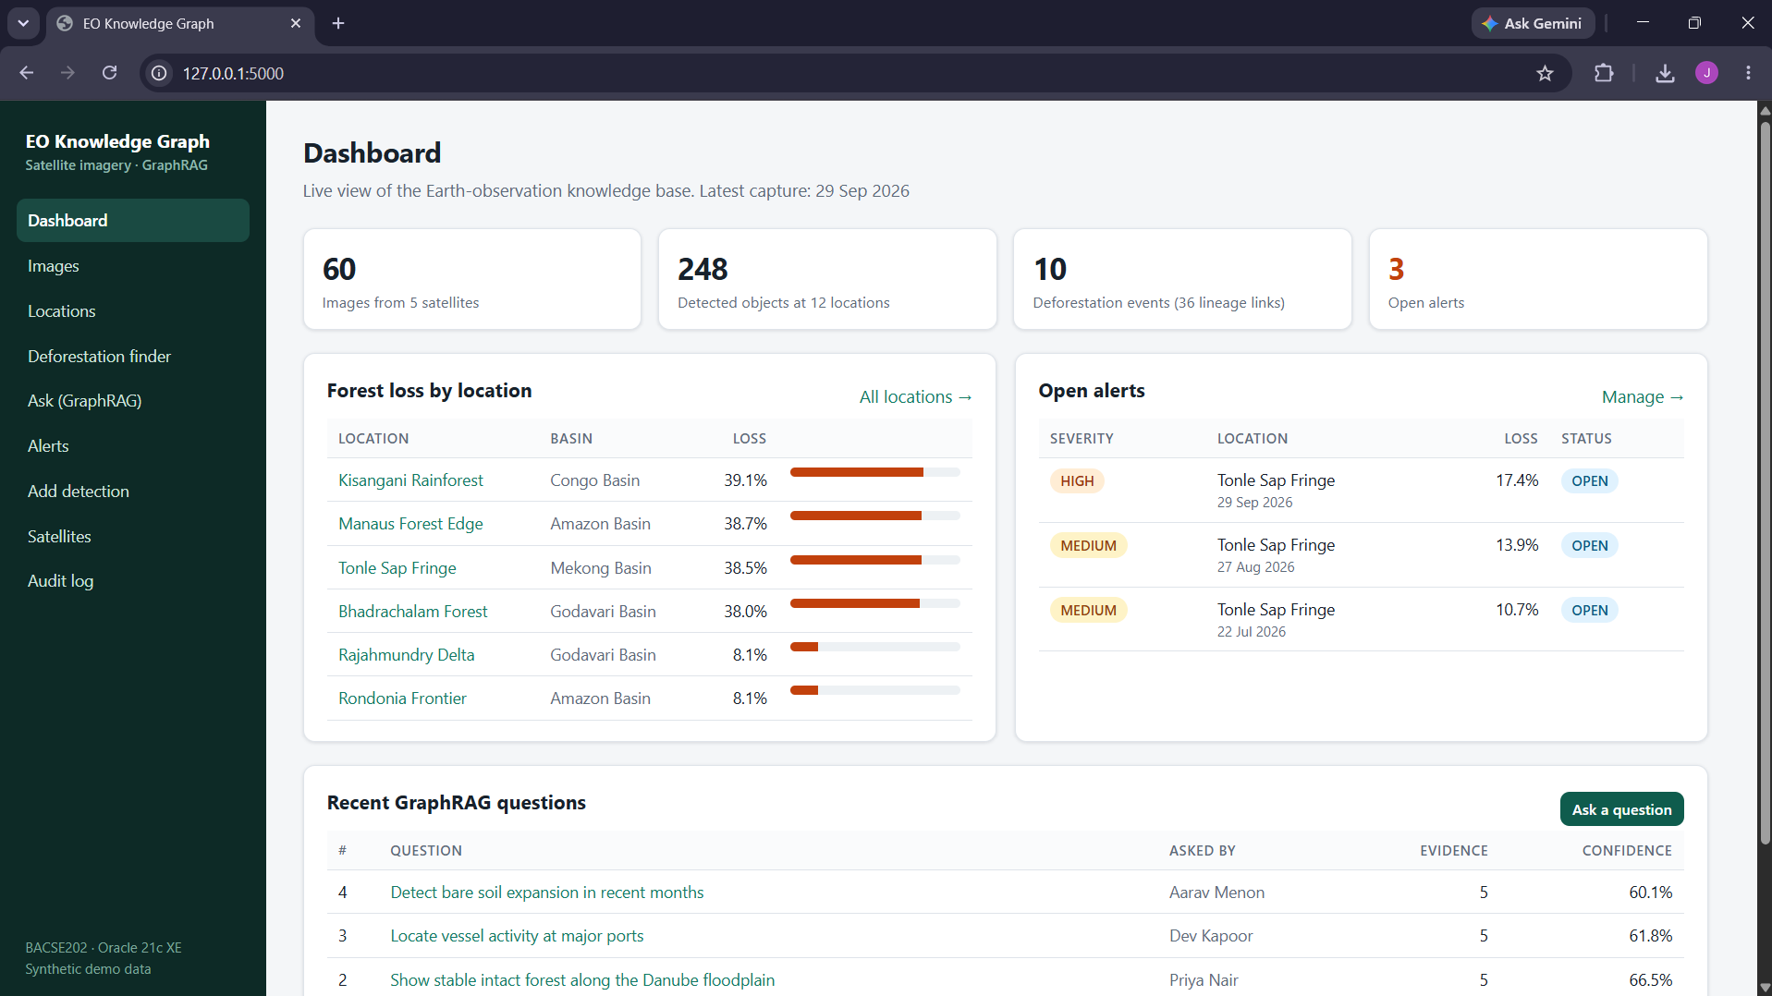
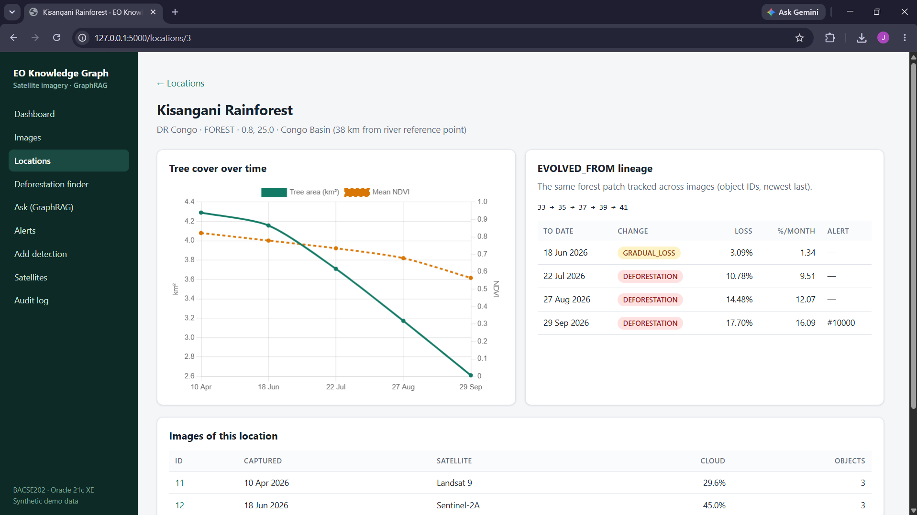
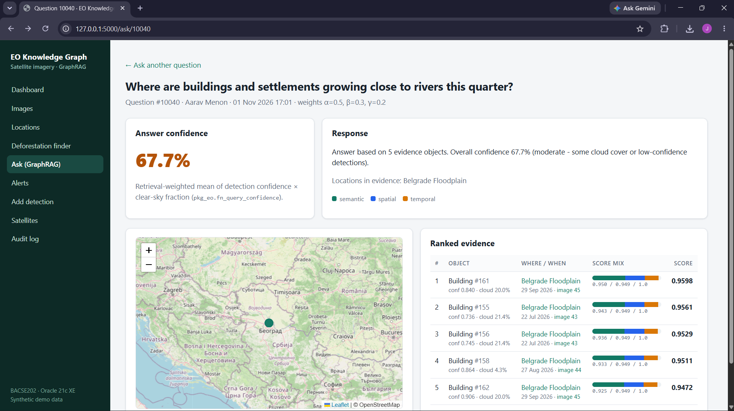
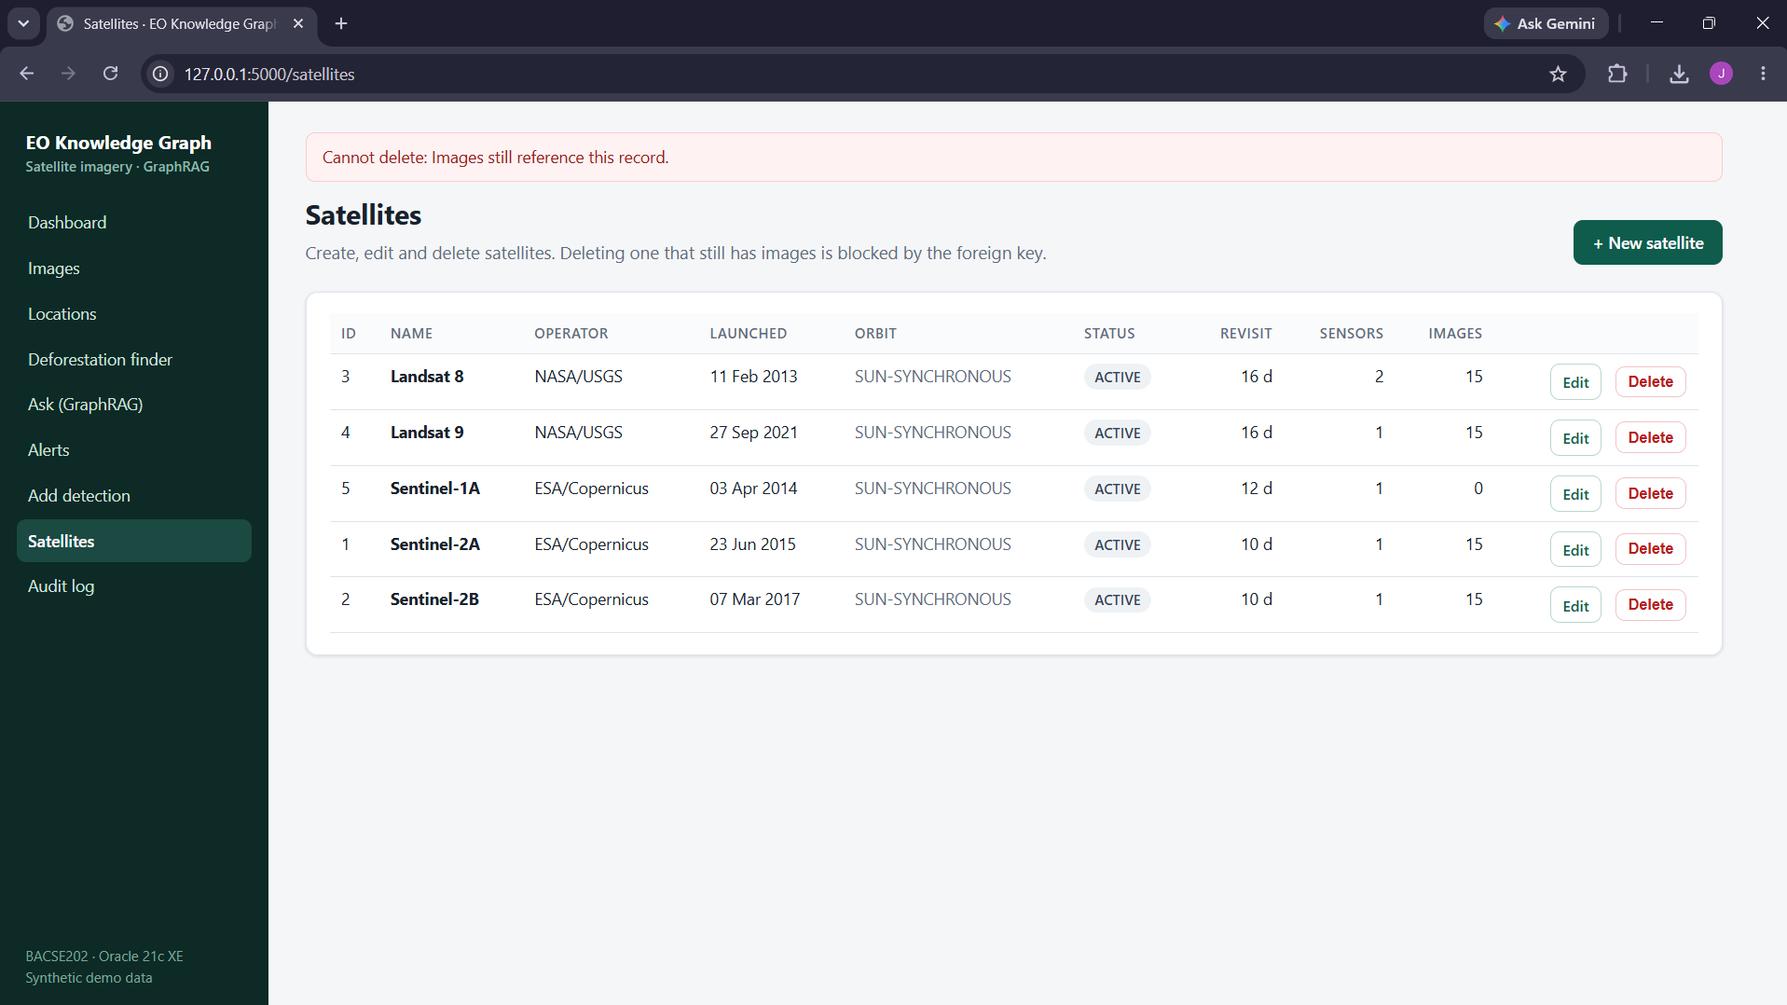
05 · APPLICATION
The working application
Dashboard: live KPIs, forest loss by location, open alerts
Kisangani: tree area 4.29 → 2.61 km², lineage 33 → 41
Ask (GraphRAG): ranked evidence, 67.7 % answer confidence
Constraint handled: delete blocked while images exist

Slide 7
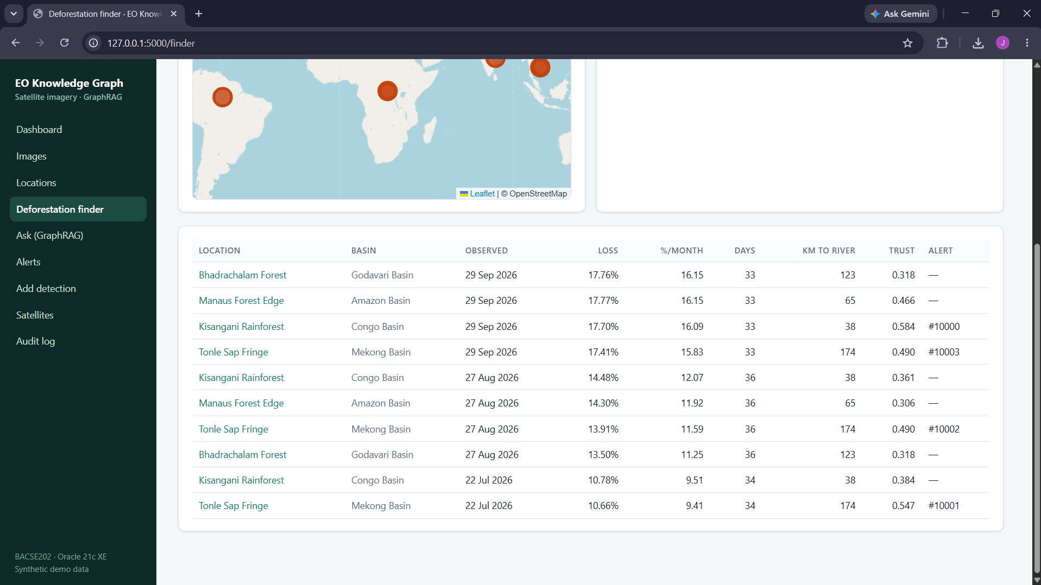
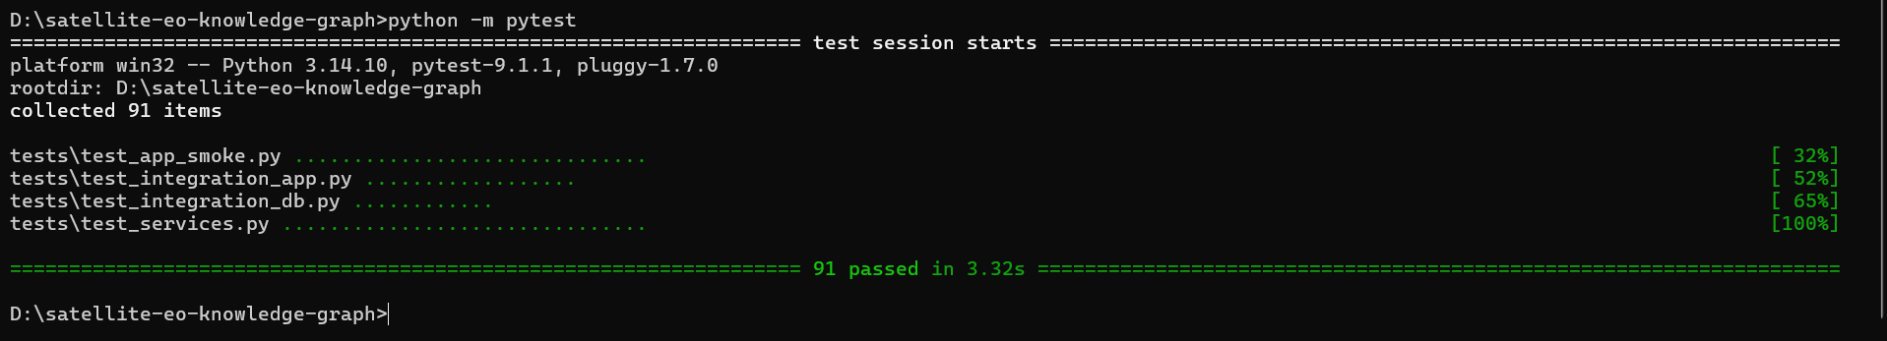
06 · RESULTS
Testing and key findings
91
30
automated tests passed: unit, UI and live Oracle
documented test cases with expected vs actual, all Pass
4 / 10
10 = 10
deforestation events trusted enough to raise an alert
flagship rows: Oracle Q10 matches Neo4j G3
Finder: 10 events with trust score and linked alerts
Findings rapid sites lost 38–39 % of forest in six months; NDVI tracks tree area (r = 0.442); answer confidences match the independent prediction to 4 decimals.
python -m pytest: 91 passed in 3.32 s

Slide 8
07 · OUTLOOK
Limitations and future enhancements
Limitations
Next steps
Synthetic data and 8-dimensional demo embeddings
Concept search, not free-text understanding
One river point per basin (no spatial option in XE)
One tree patch per image; no login; CDN maps
Real Sentinel-2 imagery and detection models
Basin polygons and river lines in a spatial DB
Multi-patch matching across dates
LLM-written answers (full GraphRAG); Oracle → Neo4j sync
Thank you
Joshwa D Y · Nallazhahu M · Akshay V

