Slide 1
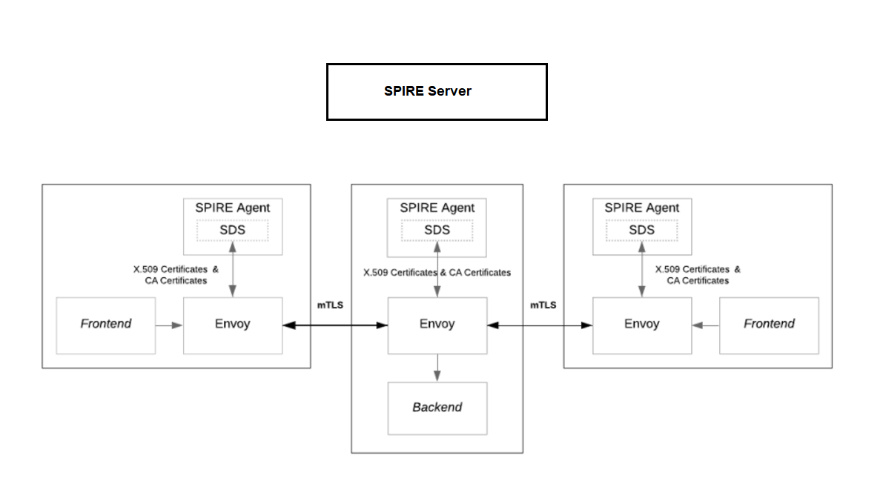
Workload Registration entries
K8s worker node
K8s worker node
K8s worker node
Wkl API
Wkl API
Wkl API
Port: 3000
Port: 3001
Port: 9001
Port: 3003
Port: 3002
Port: 80

