Slide 1
How I entered a $5000 design challenge by accident
By Andy Clark

Slide 2
What is a design challenge?
Free Stuff
Company promotion
Proposal
Build
Write up / Video
Prizes

Slide 3
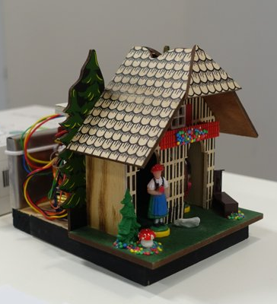
2015 Enchanted Objects Design Challenge
Add enchantment to an every day object
16 weeks of soldering, 3D printing, coding and writing
Won the grand prize Trip to New York Makers Faire
No More Design Challenges!

Slide 4
March 2016
Tell us what you would make with a DragonBoard 410c for a chance to win your own
Qualcomm
I am entering this contest and wish your vote when polls open
Clem Martins
Mark B
Some ideas are so far west they are another planet
I'm really tempted to put in a completely ridiculous entry
Nico teWinkel

Slide 5
My Entry

Slide 6
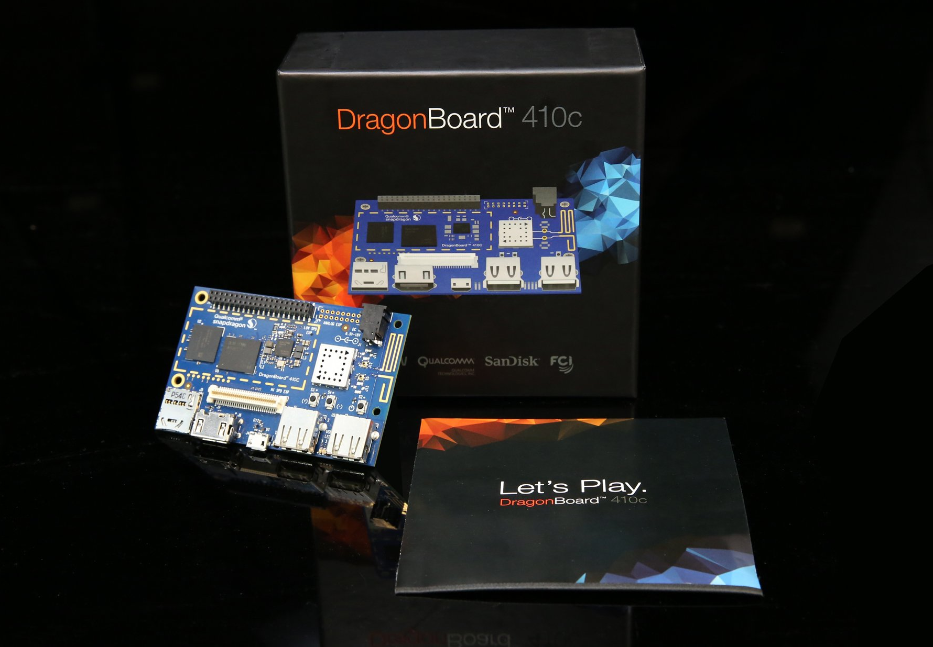
Photo thanks to Arrow.Com

Slide 7
Setting up the DragonBoard
Preinstalled Android image
Community support at 96boards.org
Reflashed with Debian image provided by Linaro

Slide 8
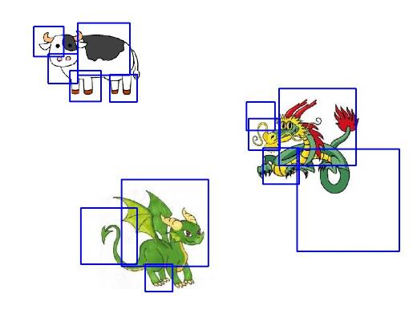

OpenCV
“(Open Source Computer Vision) is a library of programming functions mainly aimed at real-time computer vision.”

Slide 9
GPIO General Purpose Input / Output
Install drivers such as LibSoc
No PWM
1.8v
Ref: https://github.com/jackmitch/libsoc/blob/master/static-docs/docs/index.md

Slide 10
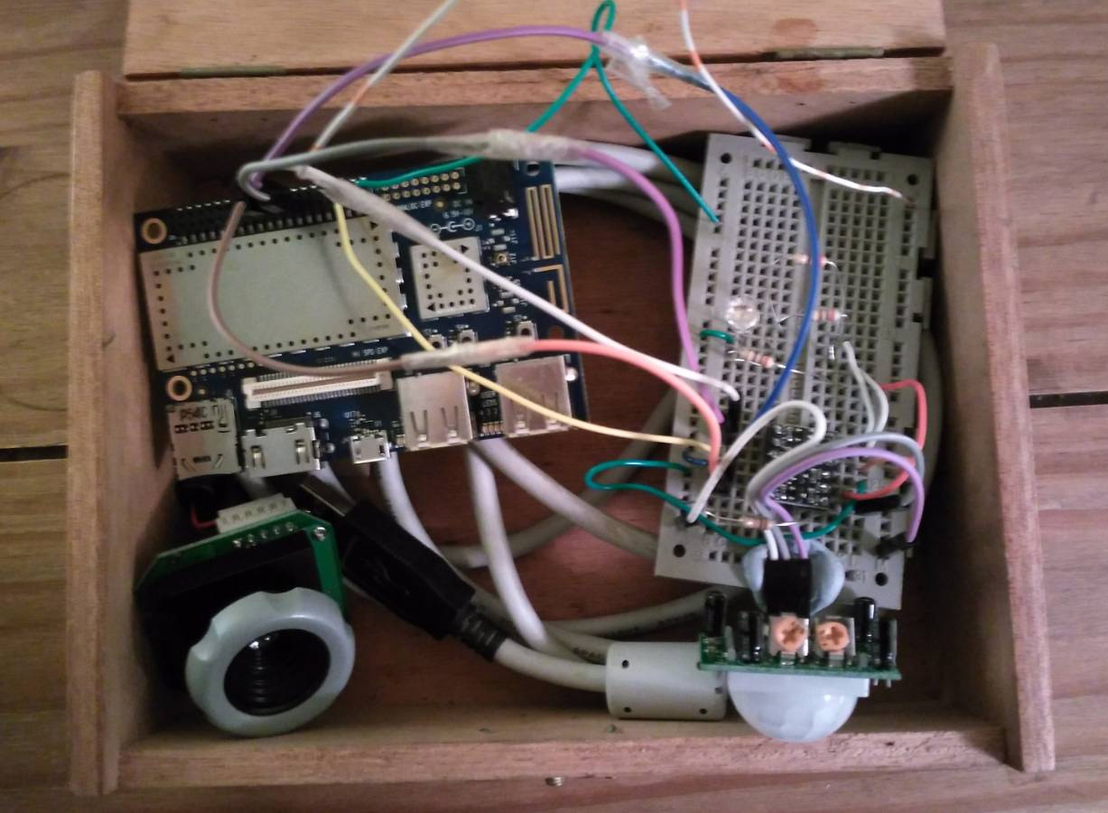
Electronics
Level Shifters
Passive IR module
USB Camera
LEDs

Slide 11
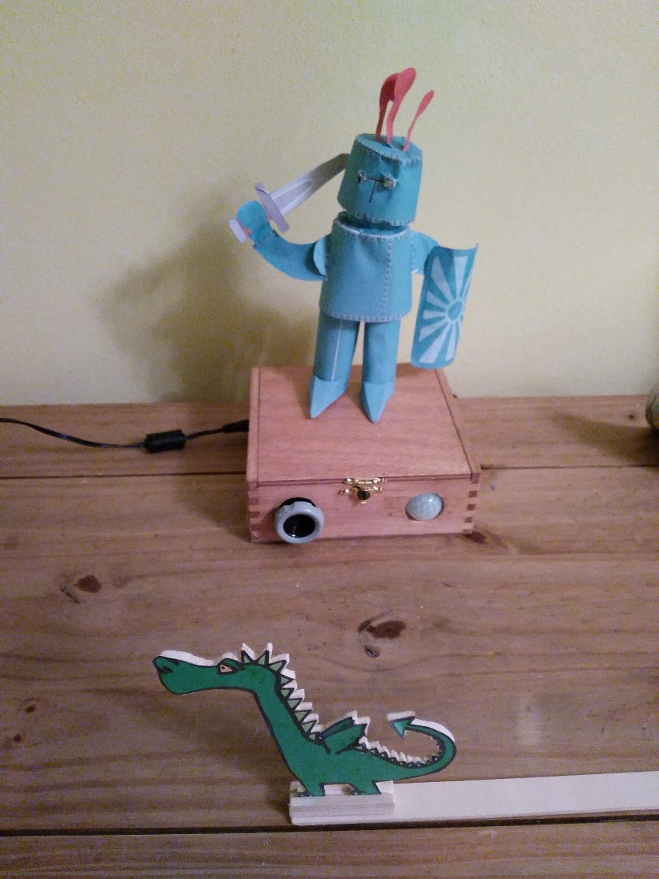
So did I win $5000?
Qualcomm Developer of the Month
Arrow.com sponsoring

Slide 12
Dragon Detector V2
3D Printed model
PiConZero module for PWM
Demo

Slide 13
Questions?
https://wsshd.com/DragonDectector

Slide 14


