Slide 1
GRaD-Nav Real4Real audit
Native rendering and dynamics coupled
Policy and fidelity remain blocked
One existing A6000 host. No training. Instance remains running.
Decision: study native rendering and dynamics. Defer calibrated Real4Real and policy claims.
AirLab / 8 October 2026
1
Notes:
Evidence: https://github.com/WorldExplored/R4R-Sims/tree/audit/grad-nav/results/grad-nav/. Exact source refs: docs/grad-nav/sources.md. All source/runtime failures are retained.

Slide 2
Real4Real evidence still needed
Outdoor residential, suburban and campus scenes below 100 m
Held-out horizontal and vertical camera trajectories
Capture at 15 m and rendering at 50 m remains a research question
Sparse capture coverage and sparse physical content need separate tests
AirLab / 8 October 2026
2
Notes:
Evidence: https://github.com/WorldExplored/R4R-Sims/tree/audit/grad-nav/results/grad-nav/. Exact source refs: docs/grad-nav/sources.md. All source/runtime failures are retained.
Project context: docs/r4r-audit-context.md. No AirLab calibrated held-out assets were supplied.

Slide 3
Action, state and observation path
Requested
action
Dynamics
Achieved
state
Camera
mount
Gaussian
renderer
RGB and
depth
B: measured
Mounted pose checked
A/D: rendered
C needs the original actor, normalization, VAE and trained visual observation components.
AirLab / 8 October 2026
3
Notes:
Evidence: https://github.com/WorldExplored/R4R-Sims/tree/audit/grad-nav/results/grad-nav/. Exact source refs: docs/grad-nav/sources.md. All source/runtime failures are retained.
B executes direct dynamics. Transform checks execute exact baseline helpers. A renders with unresolved capture registration. D renders achieved-state mounted cameras. Native actor/CENet omitted, never replaced with random outputs.

Slide 4
Released scene assets recovered
README file IDs returned 404. The author folder supplied replacement IDs.
Gaussian archive 5.049 GB. Full expanded size 5.827 GB.
Point-cloud archive 0.294 GB. Selected cloud 65.9 MB.
Selected gate_mid inputs: 1.140 GB across 1,213 locally verified files.
AirLab / 8 October 2026
4
Notes:
Evidence: https://github.com/WorldExplored/R4R-Sims/tree/audit/grad-nav/results/grad-nav/. Exact source refs: docs/grad-nav/sources.md. All source/runtime failures are retained.
Author Drive replacement IDs and archive SHA256 are in asset-inventory.csv and results/grad-nav/preflight/download-hashes.json. Scene terms remain unverified.

Slide 5
B feedback response
Final error
0.0356 m
Overshoot
0.1030 m
First 0.02 m band entry
1.25 s
The error band is an authored diagnostic. First entry does not establish settling or stable hover.
AirLab / 8 October 2026
5
Notes:
Evidence: https://github.com/WorldExplored/R4R-Sims/tree/audit/grad-nav/results/grad-nav/. Exact source refs: docs/grad-nav/sources.md. All source/runtime failures are retained.
20261009T012429Z-recovery-e58f8a state.jsonl. kp=2 N/m, kd=0.8 N/(m/s), target1.25m, initial1.0m. Direct normalized thrust and zero rates, noise0. Timing/geometry are simulation diagnostics.

Slide 6
B scope and measured behavior
Force balance: 20 × 0.05 s. Height 1.25 m, drift 0.0 at float32 precision.
Feedback: kp 2, kd 0.8. Initial perturbation −0.25 m.
One second: drift +0.1706 m, remaining error 0.0794 m, no overshoot.
Five seconds: drift +0.2144 m, error 0.0356 m, overshoot 0.1030 m.
No saturation. Dynamics median about 14.2 ms, with GPU synchronization. Rendering timing is reported separately; policy latency remains blocked.
AirLab / 8 October 2026
6
Notes:
Evidence: https://github.com/WorldExplored/R4R-Sims/tree/audit/grad-nav/results/grad-nav/. Exact source refs: docs/grad-nav/sources.md. All source/runtime failures are retained.
Force/smoke/recovery metrics.json, config.json and action/state records. No visual policy or native delay/filter/contact logic.

Slide 7
Numerical camera checks
Camera helper uses xyzw. Dynamics uses wxyz. Conflicting comments are recorded.
Identity, 90° yaw and translation composition checks passed.
Active helper applies no dataparser normalization. Scale/alignment needs scene validation.
Rounded mount orthonormality residual: 0.00042425.
These are algebraic checks. Direct/author pixel parity is exact. Native D view is upright. Capture calibration remains unresolved.
AirLab / 8 October 2026
7
Notes:
Evidence: https://github.com/WorldExplored/R4R-Sims/tree/audit/grad-nav/results/grad-nav/. Exact source refs: docs/grad-nav/sources.md. All source/runtime failures are retained.
20261009T012433Z-conversion-04f90b/conversion.json and pinned gs_local.py. Loaded camera metadata recorded in failed A attempts.

Slide 8
Compiler selection repaired
Default GCC 12 cannot resolve cc1plus.
The minimal CUDA control reproduces the exact failure.
GCC 11 C++ and CUDA tests compile and run successfully.
Emitted gsplat command: -ccbin /usr/bin/gcc-11.
CXX: /usr/bin/g++-11. Binary linked and rendered.
One repair attempt. No package, driver or alternative changes.
Debugging stopped after 12.12 minutes; second attempt unused.
AirLab / 8 October 2026
8
Notes:
Evidence: https://github.com/WorldExplored/R4R-Sims/tree/audit/grad-nav/results/grad-nav/. Exact source refs: docs/grad-nav/sources.md. All source/runtime failures are retained.
repair-history.json continuation and20261009T020316Z-compiler-preflight. Earlier failures retained. New bounded repair explicitly authorized.

Slide 9
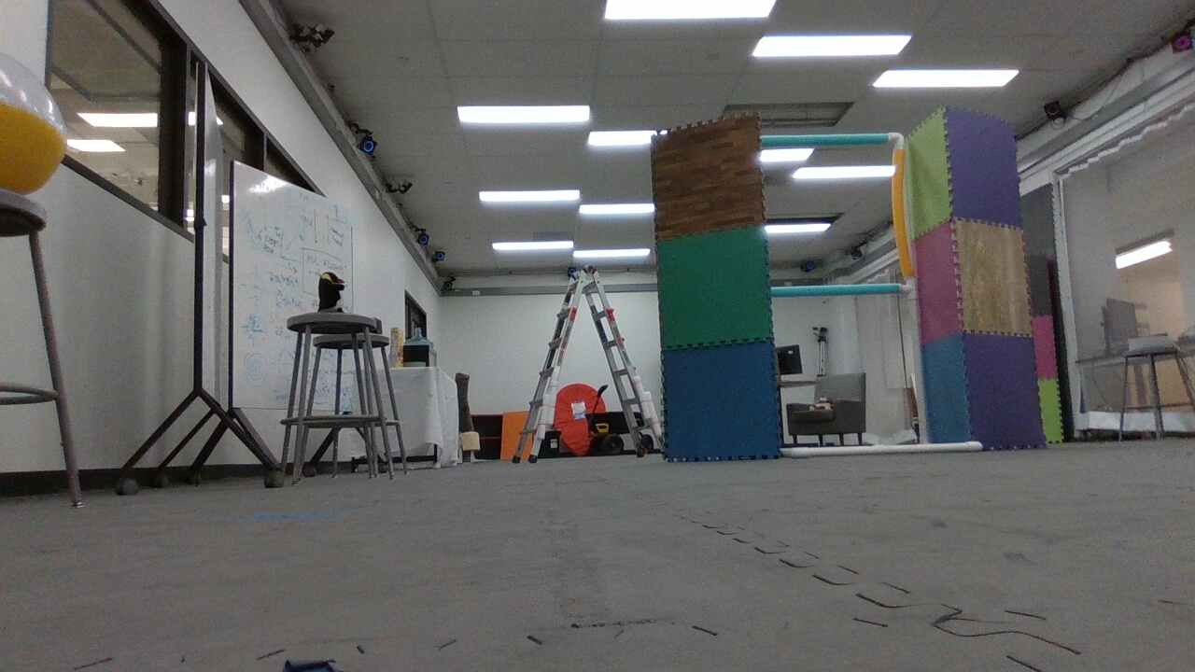
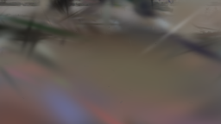
A: equal pixels, unresolved capture view
Associated author capture
Frozen A output
All five direct/author RGB, depth and camera differences: 0.
COLMAP/source poses agree exactly. Capture-to-checkpoint alignment remains unresolved.
AirLab / 8 October 2026
9
Notes:
Evidence: https://github.com/WorldExplored/R4R-Sims/tree/audit/grad-nav/results/grad-nav/. Exact source refs: docs/grad-nav/sources.md. All source/runtime failures are retained.
20261009T020714Z-a-1004f1: same model/K/camera, RGB and depth max difference0 across5 poses. Left source frame00010, right frozen A render. This is qualitative registration evidence, not held-out fidelity. NS source-pose/original-K diagnostic stays blurred. No scene or mount transforms changed.

Slide 10
A rendering latency and depth
Direct render: median 2.765 ms; p95 2.802 ms.
Author render and pose/stack: median 3.426 ms; p95 3.490 ms.
Raw RGB/depth + CPU transfer: median 3.500 ms; p95 3.595 ms.
Peak Torch allocated 174.2 MB; driver/context totals sampled separately.
RGB+ED is expected camera-axis depth. No-hit diagnostic yields alpha 0 and depth 0. Learned-feature/policy timing remains blocked.
AirLab / 8 October 2026
10
Notes:
Evidence: https://github.com/WorldExplored/R4R-Sims/tree/audit/grad-nav/results/grad-nav/. Exact source refs: docs/grad-nav/sources.md. All source/runtime failures are retained.
20261009T022120Z-a-e1d652 metrics.json; camera matrix resident on GPU before interval:5warmups/50calls per path, GPU sync before/after. Diagnostic reference pose256x144 and265631Gaussians; capture registration unresolved. Peak reserved190840832bytes. Scene diagnostic no-hit view is not part of frozen route.

Slide 11
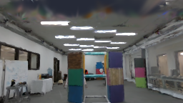
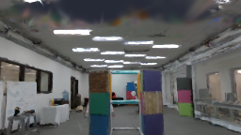
D: achieved state determines the image
First frame: upright native gate view
Final frame: follows achieved height
Height 1.15 → 1.21829; controller kp 2, kd 0.8.
Coordinate coupling works. Metric flight, task success and outdoor fidelity remain blocked.
AirLab / 8 October 2026
11
Notes:
Evidence: https://github.com/WorldExplored/R4R-Sims/tree/audit/grad-nav/results/grad-nav/. Exact source refs: docs/grad-nav/sources.md. All source/runtime failures are retained.
20261009T020926Z-d-748818. Existing kp2,kd0.8 controller, initial1.15,target1.25,20ticks x.05s.21states/20actions/20cameras/20RGB-depth outputs,1s H26420FPS. wxyz→xyzw, origin[-6,0,0],YZflip and mount unchanged. Physical scale/registration unverified. Images shown are observed outputs, not generated illustrations.

Slide 12
Native policy and collision limits
C blocked: scene checkpoints do not supply the original six learned components.
The native body-rate termination check reads quaternion fields 10:13.
Obstacle handling uses forward-FOV nearest-point distance and reward.
Rear and coincident synthetic points returned infinity. No body-volume contact test.
AirLab / 8 October 2026
12
Notes:
Evidence: https://github.com/WorldExplored/R4R-Sims/tree/audit/grad-nav/results/grad-nav/. Exact source refs: docs/grad-nav/sources.md. All source/runtime failures are retained.
Pinned drone_long_traj.py:777 reads privileged10:13. Quaternions9:13, rates13:16. point_cloud_util.py FOV diagnostics. GradNav.load six-object schema.

Slide 13
Outdoor fidelity remains untested
No PSNR, SSIM or LPIPS result. No validated held-out reconstruction split.
No altitude-change, sparse-capture, vegetation or moving-object experiment.
Indoor/gate paper results motivate study. Outdoor and racing were not executed.
Other candidate scenes, controllers and hardware differ. No matched ranking.
AirLab / 8 October 2026
13
Notes:
Evidence: https://github.com/WorldExplored/R4R-Sims/tree/audit/grad-nav/results/grad-nav/. Exact source refs: docs/grad-nav/sources.md. All source/runtime failures are retained.
Dataset transforms/config are preserved, but prior reconstruction/fitting exclusion is not attested. Comparisons read from recorded Project AirSim, Unreal and TravelUAV branch SHAs.

Slide 14
Decision, preservation and next evidence
Native rendering and dynamics work as research components. Defer calibrated Real4Real and policy reproduction.
All 16 run directories and 1,213 scientific files verified locally.
Logs, configs, route records and compiler failures are preserved.
Next evidence: author-confirmed scene/capture registration, metric scale, original learned components and trusted held-out real capture.
AirLab / 8 October 2026
14
Notes:
Evidence: https://github.com/WorldExplored/R4R-Sims/tree/audit/grad-nav/results/grad-nav/. Exact source refs: docs/grad-nav/sources.md. All source/runtime failures are retained.
artifact-index.md, preservation.json, sources.md and handoff.md. Original phase1 retained with hashes. No unrelated files/environments/drivers/processes changed. Instance remains running.

Slide 15
Provenance appendix
Upstream baseline: d9b00e16107338e49071c65f44582c013e522633
Current source inspected: 95218abe9a5d355519cdaab78d915365303066fe
Host: Ubuntu 22.04.5, RTX A6000, 6 vCPU, 47 GiB RAM
Rendering stack: Torch 2.1.2/cu118, NS 1.1.3, gsplat 1.0.0.
Full-instance charges unknown. $0.54/hour is an unconfirmed GPU-only quote. No termination or cleanup occurred.
AirLab / 8 October 2026
15
Notes:
Evidence: https://github.com/WorldExplored/R4R-Sims/tree/audit/grad-nav/results/grad-nav/. Exact source refs: docs/grad-nav/sources.md. All source/runtime failures are retained.
Full upstream lines and asset digests in sources.md, asset-inventory.csv and repair-history.json. See repository artifact index for each run.

