Slide 1
Unreal Engine in the Real4Real audit
Camera checks pass. Flight acceptance and splat appearance remain unresolved.
8 October 2026 · Focused validation included · Complete R4R workflow unproven
Notes:
Updated from preserved v2. Sources: original runs, focused-validation.md and closeout recovery/dependency records. No additional GPU experiment was started for this update.

Slide 2
Real4Real question and experiment scope
Small real outdoor capture
Reconstruct one site, then render trustworthy observations for NEW drone camera routes in residential, suburban and campus scenes below 100 m.
Capture at 15 m → render at 50 m
Open research goal. Blocks cannot answer it.
A: pose replay B: scripted closed loop C: released learned policy S: UE Gaussian splat
Notes:
Internal project context: docs/r4r-audit-context.md, 2026-10-08. No approved AirLab dataset was supplied.

Slide 3
Native Blocks system path
A Target poses → ComputerVision pose RPC → UE scene → RGB + planar depth
B Estimated position → P velocity script → SimpleFlight → FastPhysicsEngine
UE supplies rendered camera views and scene collision; AirSim logs state.
C No compatible released policy weights or task interface in Blocks.
Scene: stock FlyingExampleMap. No real capture, common splat scene or held-out split.
Notes:
Microsoft AirSim source commit 96235148a332fe7cb3d3525a0720e26faaca99e0; Linux Blocks v1.8.1 release ZIP SHA-256 563e1da1b5d7303b9405c8736243ea92ab0a011b96a561f26f17563d105a404f. See docs/unreal/sources.md.

Slide 4
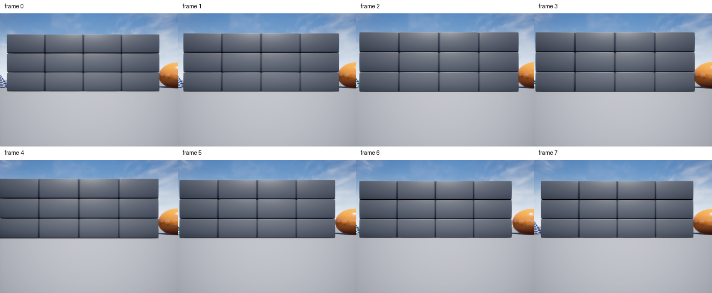
A: eight camera poses produced eight RGB images
NED route: 0–1 m horizontal at z = −2 m; 0.25 s pose settling
Notes:
Run ue-20261008T215319Z-a-5fe9b7c3; source-manifested local artifacts. 640x480; requested/actual rig and response camera centers matched to recorded precision. Image contact: figures/rgb-contact.png. A is not flight.

Slide 5
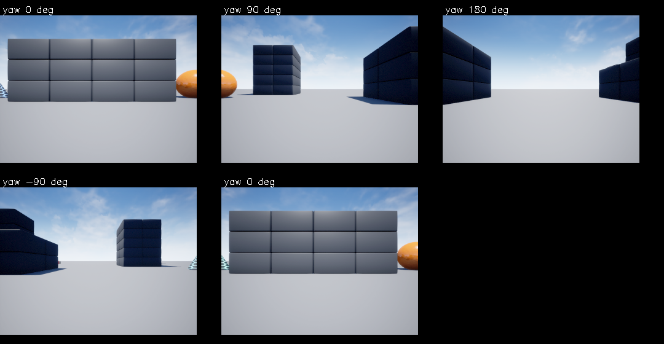
Camera sanity passed across four yaw directions
Scene directions visibly change. Recorded centers match. RGB/depth times differ by 5–8 ms.
Notes:
Run ue-20261008T232215Z-yaw-6b9a9962. NED fixed center (0,0,-2) m. Five actual RGB/depth pairs. Max orientation error 0.0000136604 degrees, zero position error. Adjacent distinct-yaw RGB mean absolute differences 31.29–43.08/255. Repeat-zero mean difference 0.968/255. RGB/depth timestamps differ 5.249–8.051 ms. Original eight-frame replay retained.

Slide 6
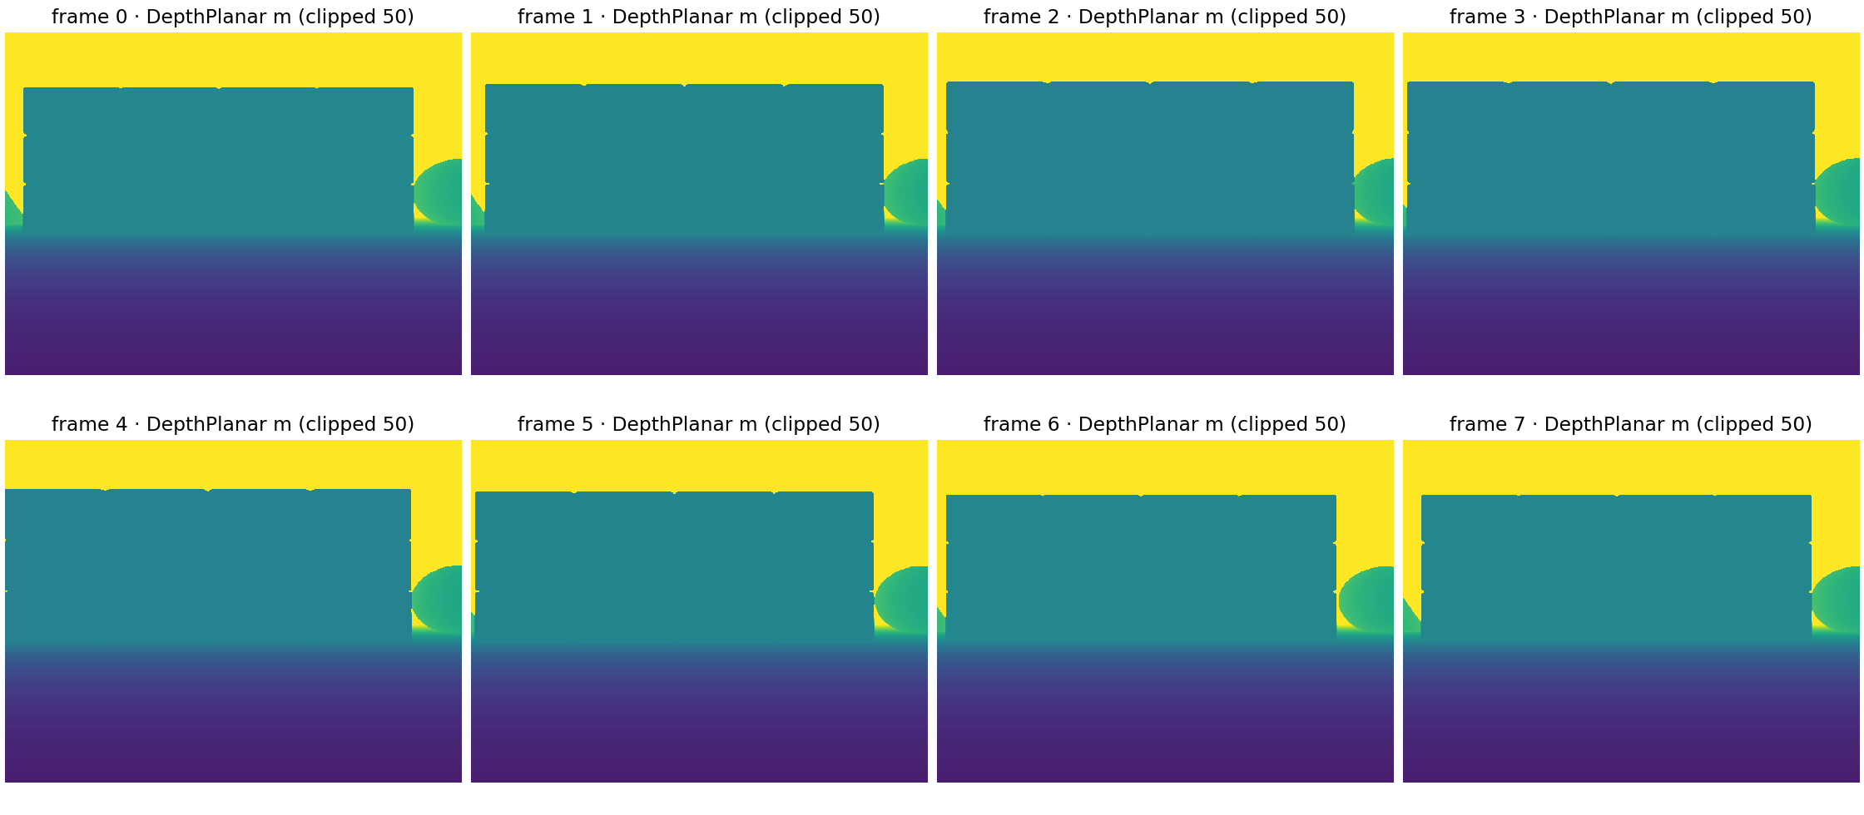
A: planar depth is present for all eight views
First-frame wall edge matched at five tested columns; depth timestamp remains unmeasured.
Notes:
Run ue-20261008T215319Z-a-5fe9b7c3; all 8 float32 480x640 arrays opened. DepthPlanar is optical-axis distance in metres. Display clipped at 50 m. First frame wall 23.09375 m; ground 6.0195 m; far/sky 13456 m. RGB timestamp only, depth timestamp not recorded.

Slide 7
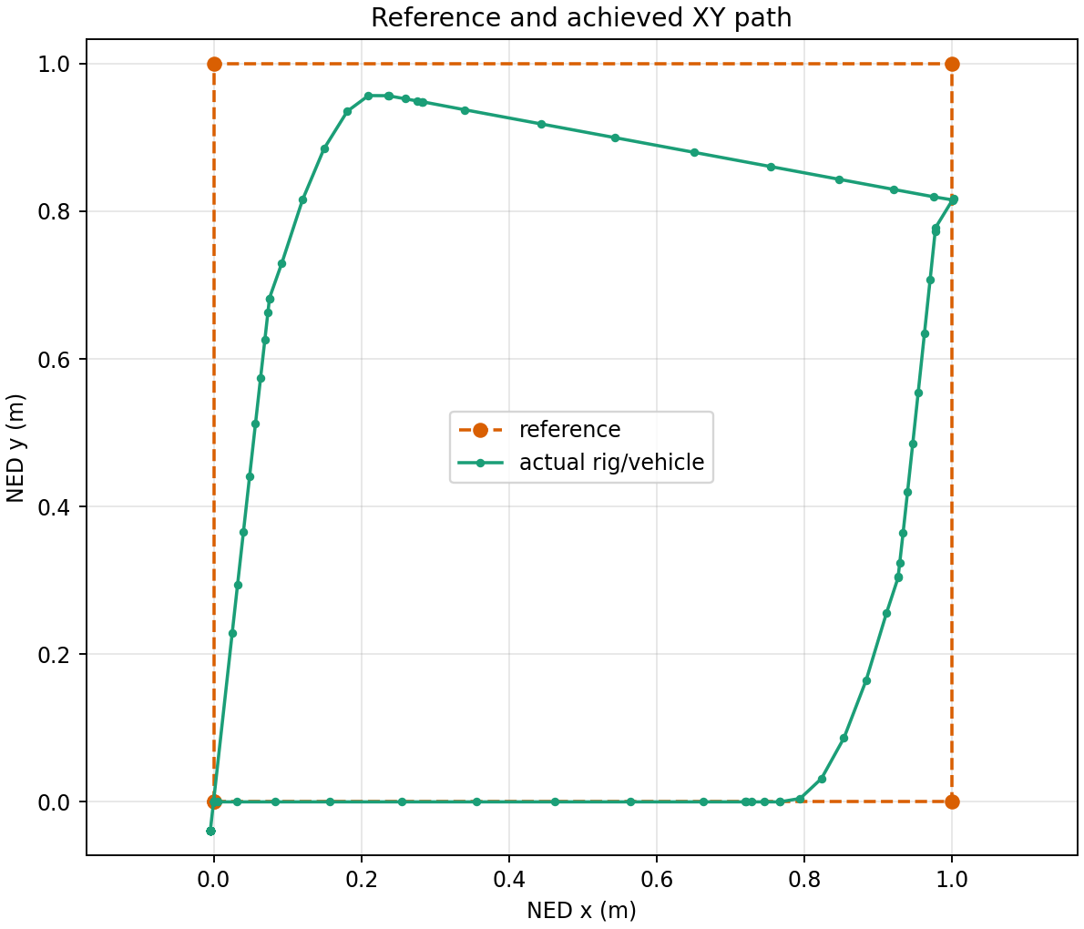
B: scripted flight reached the five square waypoints
Reference
1 m square; NED z = −2 m
Controller
P gain 0.7; velocity clip ±0.7 m/s; 0.2 s commands; SimpleFlight inner loop
Five waypoint events met 0.25 m tolerance. Landing state did not confirm.
Notes:
Run ue-20261008T220451Z-b-a3d4be49, five waypoint_reached events at 0.228–0.248 m error; full run failed the final landing-state check. Actual track from vehicle_trajectory.jsonl. Baseline Ground_6 collision is recorded separately.

Slide 8
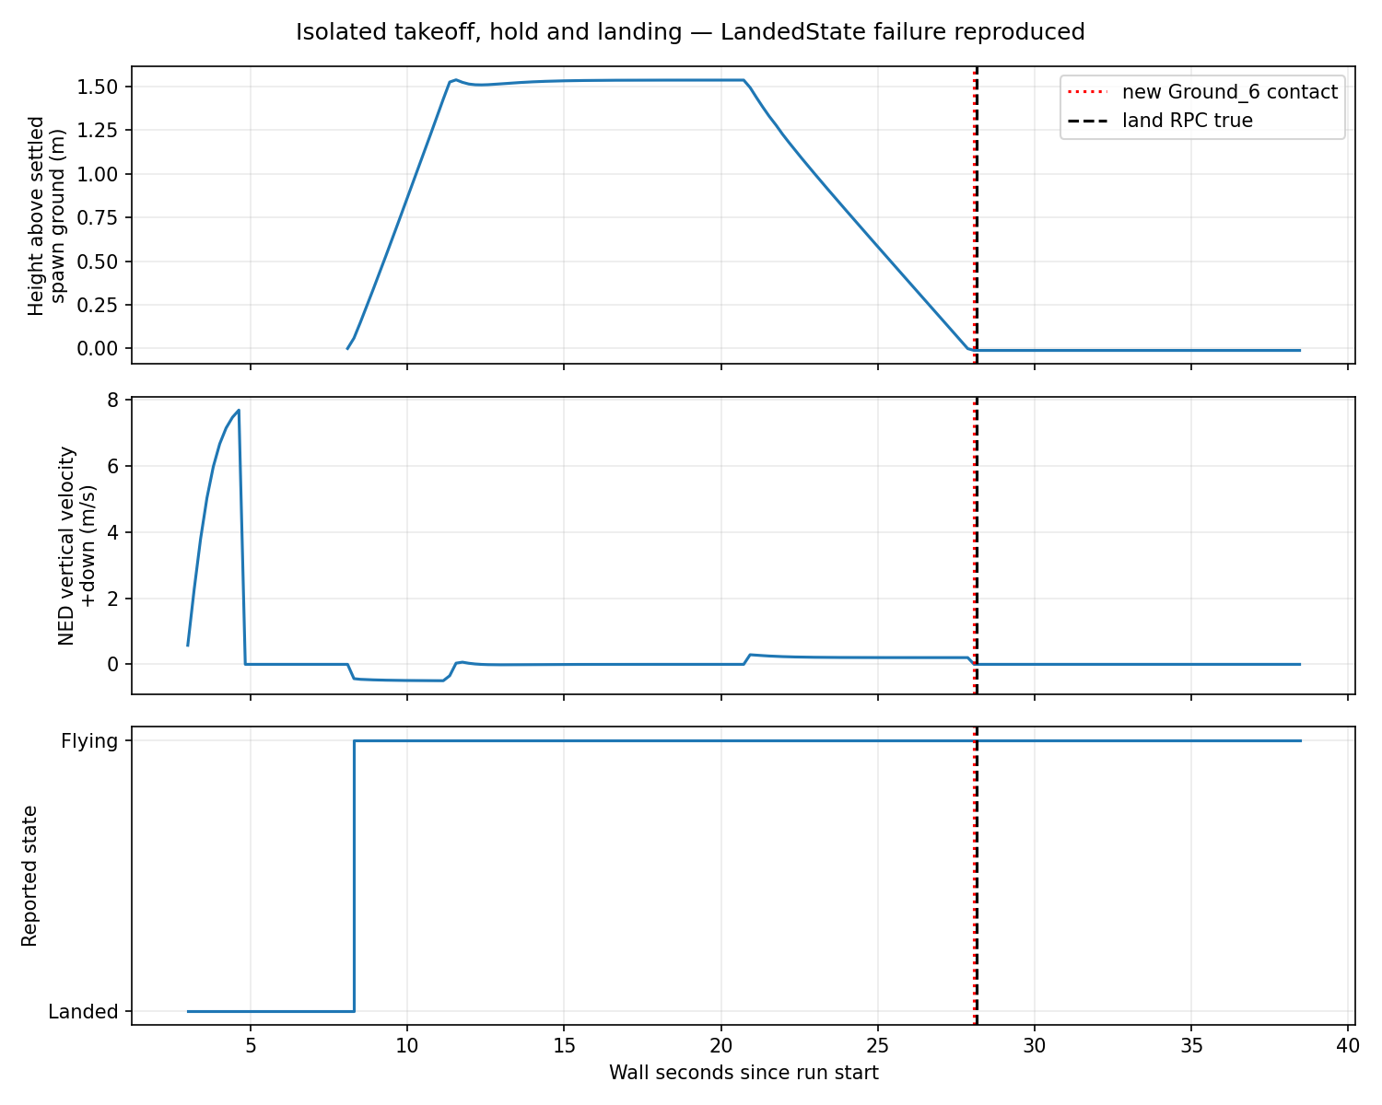
B still fails acceptance without route or image waits
Airborne hover observed
Takeoff returned False despite achieved height.
Landing returned True after floor contact.
LandedState stayed Flying for 10 s at zero velocity.
Notes:
Run ue-20261008T232723Z-land-observed-c1f84706. 177 state samples, descent median polling 4.912 Hz. Ground-relative hover 1.51–1.54 m, downward speed up to 0.290 m/s. New Ground_6 contact at 28.068 s. land RPC true at 28.152 s. Flying persisted through 38.446 s with zero velocity. takeoff RPC false despite observed airborne movement. First isolated apparent pass was rejected because no flight occurred.

Slide 9
Measured rates and resource use
Native B landing-check run
Image RPC median
3.210 s (acquisition, transport, encoding)
Image interval median
5.355 s ≈ 0.187 captured images/s
Velocity command rate
4.696 Hz median interval; 2.007 Hz over action span
GPU memory
769 MiB sampled whole-GPU peak
Wall / simulation time
64.75 s run / 48.83 s first-to-last state
Video
2 FPS encoded playback; renderer throughput unmeasured
Notes:
Analysis from ue-20261008T220451Z-b-a3d4be49/analysis.json, camera.jsonl, actions.jsonl, run.json and GPU JSONL. Sampled GPU usage is whole-GPU nvidia-smi, not process peak. Renderer GPU timing and policy latency were not measured.

Slide 10
Failures retained under separate run IDs
A startup RPC race
first attempt failed; next A run completed
B occupied RPC port
supervisor output retained; process ownership fixed
B spawn Ground_6 baseline
subsequent route checks compare collision timestamps
Landing-state failure reproduced
Isolated airborne descent ended at contact with LandedState still Flying.
Notes:
All IDs and error details are in results/unreal/ and local source-manifested artifacts. Preflight-only failure has a local supervisor log but no remote run directory/source manifest. The landing-check run had new Ground_6 contact after the spawn baseline, so landing cannot be called successful.

Slide 11
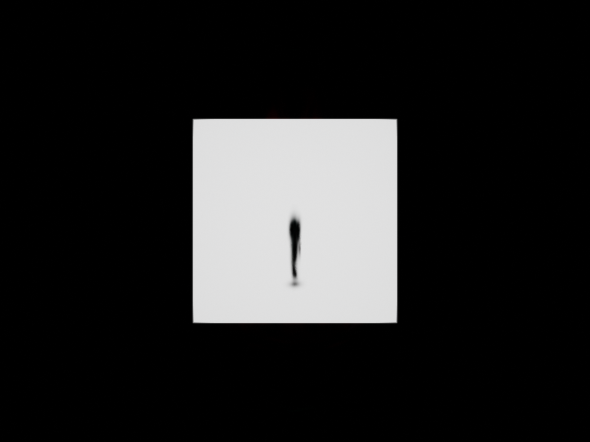
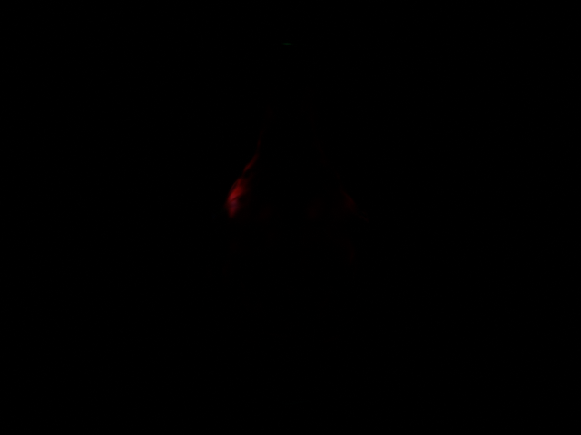
Final-color capture works. Splat appearance is unvalidated
Corrected light direction and saturation
Usable mesh control, RGB max 226
Visible splat detail, RGB max 113
Dark appearance remains unexplained. Useful fidelity, depth and collision remain unproven.
Notes:
Focused control ue-20261008T232833Z-s-light-573e44a0, same author PLY/imported project. Corrected directional light yaw 180, intensity 10. SCS_FINAL_COLOR_LDR, RTF_RGBA8, actual camera (900,0,0) cm yaw180, HFOV60, 640x480. Mesh RGB max226, no saturation. Single splat frame max113, 0.322% pixels above10. These raw PNGs have no brightness enhancement. Initial black and saturated attempts retained. This is one-frame integration evidence, no fidelity metric.

Slide 12
The selected importer drops higher-order SH
PLY includes higher-order appearance coefficients
The importer checks their fields, but stores only DC-derived color. Its point structure has no place for the higher-order coefficients.
Viewing-direction appearance is lost on this path
This limits a faithful R4R baseline when the input model uses those coefficients. It does not explain the dark red frame by itself.
Next comparison: the same PLY and matched cameras, with color conversion and exposure checked.
Notes:
Pinned Italink commit 411f879985719ce69eaaf15d58152c551e2719b1. GaussianSplattingPointCloud.cpp lines204–216 collects/validates f_rest indices. Lines263–271 stores DC-derived color after sRGB-to-linear conversion. GaussianSplattingPointCloud.h lines18–55 has one Color field and no higher-order SH storage. Source URLs: https://github.com/Italink/GaussianSplattingForUnrealEngine/blob/411f879985719ce69eaaf15d58152c551e2719b1/Source/GaussianSplattingRuntime/Private/GaussianSplattingPointCloud.cpp#L204-L271 and Public/GaussianSplattingPointCloud.h#L18-L55. This is static inspection of the selected import path, not a diagnosis of the dark frame.

Slide 13
Three ways to replace UE visuals
1 Splats inside UE
Replace chosen object appearance. UE keeps world time, rendering/compositing and collision. UE5 drone layer and accurate collision geometry remain to build.
2 External splat observations
Retain AirSim/UE dynamics, SimpleFlight, collisions and other sensors. Build a synchronized pose/intrinsics, axes/scale and image-return adapter.
3 UE removed
Another simulator must own dynamics, controller, sensors, clocks, collision, logging and task evaluation. A splat renderer supplies appearance only.
Notes:
Architecture assessment based on source inspection and current native run. No external sensor adapter or complete UE replacement was built. UE4.27 Blocks is a packaged binary and cannot be edited as the UE5.5 splat project.

Slide 14
Applicability to R4R tasks
Indoor navigation
API and collision plumbing demonstrated; realistic obstacles and task thresholds absent.
Outdoor navigation, sparse scenes
No real reconstruction, vegetation, capture coverage or altitude extrapolation evidence.
Racing
No gates, racing policy or high-rate vision benchmark; captured images averaged about 0.19 Hz in flight.
Complete R4R workflow remains unproven. Native integration and one splat frame leave the real-scene questions open.
Notes:
User scope and docs/r4r-audit-context.md. Blocks supports integration only. Outdoor scene coverage, novel views, moving objects, depth and collision are separate tests. No policy score or real drone transfer was measured.

Slide 15
A5000 host, storage and practical limits
GPU experiments are paused
The supplied Ubuntu 22.04 A5000 proved Vulkan and offscreen rendering. Its 24 GB VRAM is headroom. Future experiments need a specific hypothesis before provisioning.
Space and installation
UE 5.5.4 archive 27.09 GB; ZIP entry sum 65.30 GB expanded. Blocks ZIP 142.5 MB / 281.3 MB expanded. Preserve about 30 GB project/cache headroom after editor extraction.
Cheaper option and limits
An 8 GB VRAM NVIDIA Vulkan VM may run packaged Blocks, consistent with Epic editor guidance, but is untested here. Original 3DGS training VRAM does not size rendering.
Notes:
Host: user-supplied RunPod Ubuntu 22.04.5, RTX A5000 24 GB, driver 580.178.04, 50 GB cgroup RAM, 120 GB root disk. Epic Linux requirements: https://dev.epicgames.com/documentation/en-us/unreal-engine/linux-development-requirements-for-unreal-engine. Source ZIP and editor sizes are in docs/unreal/assets.md. $0.30/hour was displayed by provider UI, not independently billed.

Slide 16
Next scientific gate and evidence handoff
Same-PLY rendering comparison first
Reference splat renderer and UE at matched poses, intrinsics and resolution. Check retained attributes, color conversion and exposure before another scene.
Calibrated outdoor holdout afterward
Approved real training capture and separate held-out views, including sparse regions and new altitude. Capture at 15 m and render at 50 m remains unresolved.
Flight-stack diagnosis is separate
Landing RPC and SimpleFlight LandedState use different predicates. Instrument their inputs if this control stack is retained. No condition failure is identified yet.
Notes:
Internal R4R context; see docs/unreal/handoff.md and sources.md. Source-manifested A/B files reside under ~/Downloads/AL/R4R-Sims/artifacts/unreal/. Public source URLs and commits are in sources.md.

Slide 17
Local recovery verified. No other audit uses this host
18 run folders matched VM-created manifests
Blocks and sample ZIPs, full UE 5.5.4 archive, compiled plugin, imported map and point-cloud asset are recoverable locally.
TRAVELUAV uses a separate A6000 instance
Other listed audits are idle preparation tasks. This A5000 has no simulator or GPU process running. No dependency on it was found.
v2 and earlier evidence remain preserved. The instance has not been terminated.
Notes:
Closeout recovery.json rechecks VM-source manifests, archive hashes, compiled plugin and imported project assets. Instance-dependencies.json records a read-only host process/GPU snapshot and inspected task records. TRAVELUAV is active on separate A6000 host 209.137.198.205. RFLY SIM, GRADNAV and AIRSIM are idle phase-1 work. No simulator or GPU consumer was observed on 63.141.33.148:22134. This is an observed dependency check, not a provider-wide guarantee. Instance remains running.

