Slide 1
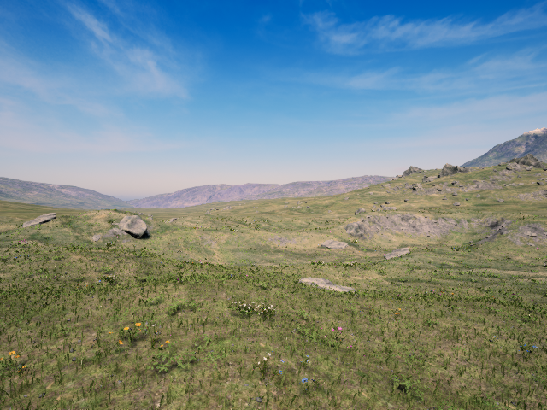
RflySim components for R4R
Reuse PX4/CopterSim for stock motion and control integration.
Keep native RGB as a visual baseline. Two waypoint flights passed and B2 recorded RGB concurrently.
External motion replay is proposed. Native calibration and real-scene fidelity remain unverified.
Stock integration evidence · offline handoff 11 October 2026 1 / 16
Notes:
B1/B2 run.json, metrics, installed-execution.md. No real capture, reconstruction or learned policy used. Source: measured eval-20261010T215531Z, offline handoff-20261011T220420Z. Measurements remain 10 October 2026.

Slide 2
Actual assets and versions
Software: Free v5.01-20260831. CopterSim 5.0.1, RflySim3D 5.01 / UE4.27.2, PX4 1.12.3dev.
Scene and vehicle: stock Grasslands, CopterSim model 0, Iris airframe 10016. Full physical model inventory is missing.
No real reconstruction, dataset or learned weights. “Checkpoint” ZIPs back up evidence. They are not learned models.
Stock integration evidence · offline handoff 11 October 2026 2 / 16
Notes:
assets.json. ISO 23,151,480,832 bytes SHA ed5f41add2e97469c900f4ccff87f615eae4e7cfbedcc7d99211afd4d5dc7973. SDK hashes identify installed sources separately from repository HEAD. B1 ULog ver_sw a301969dc209c166b9fbbb524bd51ca1ece76b04. Source: measured eval-20261010T215531Z, offline handoff-20261011T220420Z. Measurements remain 10 October 2026.

Slide 3
Native control and observation path
Supervisor
PX4
CopterSim
RflySim3D
Recorder
NED targets
10 Hz
Estimation
and control
Actuators
to motion
Body motion
to RGB
PNG frames
and metadata
PX4 estimates, ACKs, modes and arming return to the supervisor.
Body truth, native camera metadata and image timestamps export separately.
Control UDP 20100/20101, SITL TCP 4560, truth UDP 30101, camera UDP 20006, RGB shared memory.
Stock integration evidence · offline handoff 11 October 2026 3 / 16
Notes:
Installed SDK file/line references in docs/rflysim/installed-execution.md. Scripted targets and estimate feedback close the loop. Pixels never enter controller. Source: measured eval-20261010T215531Z, offline handoff-20261011T220420Z. Measurements remain 10 October 2026.

Slide 4
Algorithms and responsibilities
Our script advances a target only after fresh estimated position stays inside the tolerance for 2 seconds.
PX4 estimates motion and uses position, velocity, attitude and rate feedback to generate actuators. CopterSim integrates the stock dynamics.
UE renders scene pixels. A separate process copies frames and writes files. No image-based controller ran.
Stock integration evidence · offline handoff 11 October 2026 4 / 16
Notes:
https://docs.px4.io/v1.12/en/flight_stack/controller_diagrams and tuning_the_ecl_ekf accessed 2026-10-11. B1 ULog SYS_MC_EST_GROUP=2 and estimator topics support EKF2 configuration. Conceptual cascaded P/PID structure is documented, internal loop signals not independently validated. No dynamics calibration. Source: measured eval-20261010T215531Z, offline handoff-20261011T220420Z. Measurements remain 10 October 2026.

Slide 5
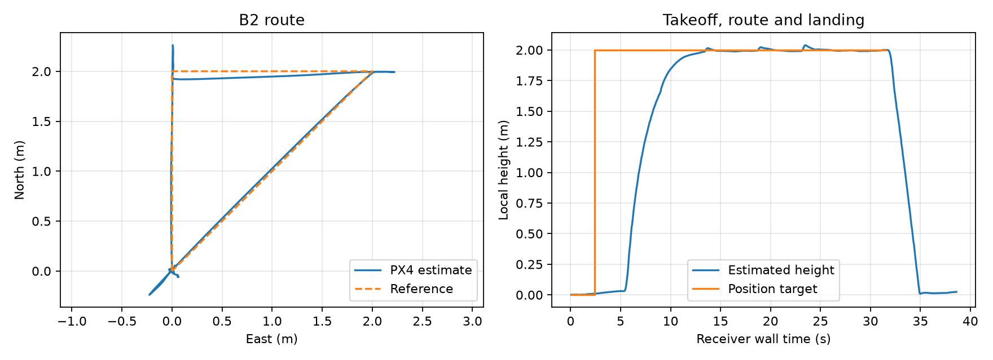
Both flights completed the route
B1 without capture: 38.750 s. B2 with RGB: 39.219 s. Both minimum integration and full-route outcomes passed.
NED metres: (0,0,-2), (2,0,-2), (2,2,-2), (0,0,-2), land. Each leg required error ≤0.25 m for 2 s.
Fresh PX4 estimates provide the measurement basis. Landing and disarming are retained in the raw flight records.
Stock integration evidence · offline handoff 11 October 2026 5 / 16
Notes:
B1/B2 freeze.json, dwell-corroboration.json. 75s flight +15s cleanup,10Hz,12s/leg,0.5s freshness. Takeoff armed>=1m1s; ON_GROUND/speed<=0.2m/s2s plus fresh disarm. Independent truth criterion blocked. Source: measured eval-20261010T215531Z, offline handoff-20261011T220420Z. Measurements remain 10 October 2026.

Slide 6
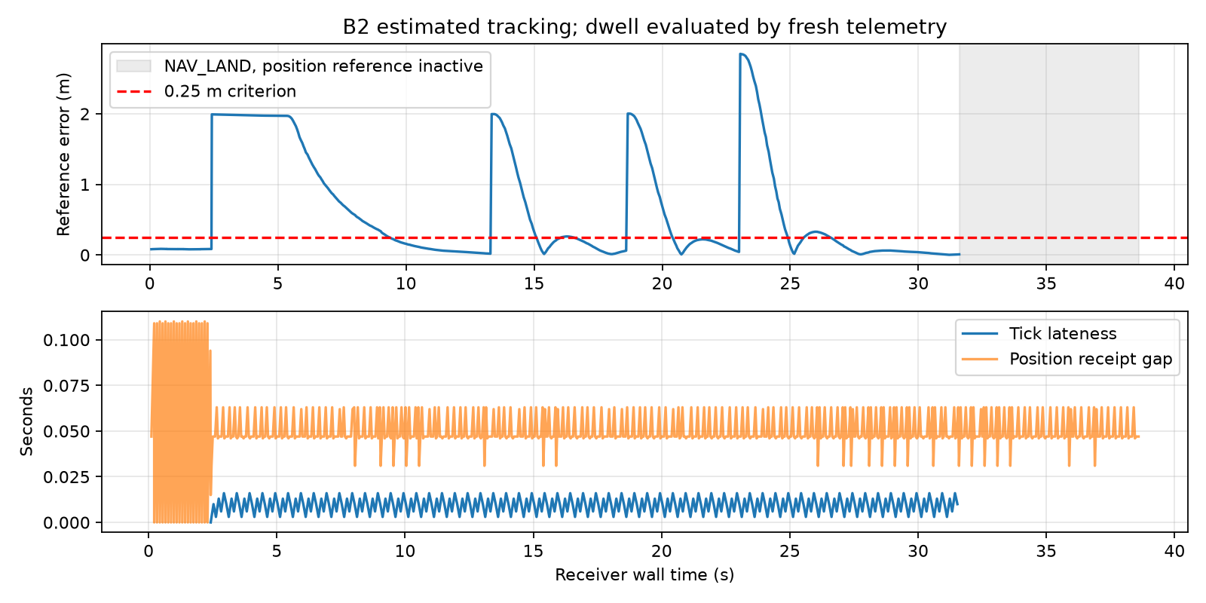
Control timing with concurrent RGB
Mean target intervals: B1 100.022 ms, B2 100.034 ms. Maximum intervals: 109 ms and 110 ms.
Maximum tick lateness: 12 ms and 16 ms. Neither run exceeded 100 ms. Position gaps peaked at 125 ms and 110 ms.
These two sequential flights do not isolate capture overhead. Reset state, leg durations and scheduler timing also differ.
Stock integration evidence · offline handoff 11 October 2026 6 / 16
Notes:
Tick lateness>10ms 56/280 vs116/292. Pixel copying, file I/O and resource sampling outside control. Preserve raw clocks. Cleanup limitation separate. Source: measured eval-20261010T215531Z, offline handoff-20261011T220420Z. Measurements remain 10 October 2026.

Slide 7
Playable native RGB recordings
A1: 260 frames, 26.0 s playback. Capture was short at 25.797 s and rotations were invalid.
A2: 261 frames, 26.1 s playback. Rotations were invalid. B2: 365 frames, 36.5 s playback during its route.
Rate test: 300 post-warmup frames, 10.013 Hz. Videos use fixed 10 FPS playback including warmup. Acquisition time is unknown.
A1 video
A2 video
B2 video
Stock integration evidence · offline handoff 11 October 2026 7 / 16
Notes:
videos.json records source/frame/video hashes, encode/decode commands. Native images640x480; videos640x520 with40px caption, H264, noaudio. Full decode260/261/365. Receipt spans25.766/25.984/36.359s. All Drive videos roundtriphashverified. Source: measured eval-20261010T215531Z, offline handoff-20261011T220420Z. Measurements remain 10 October 2026.

Slide 8
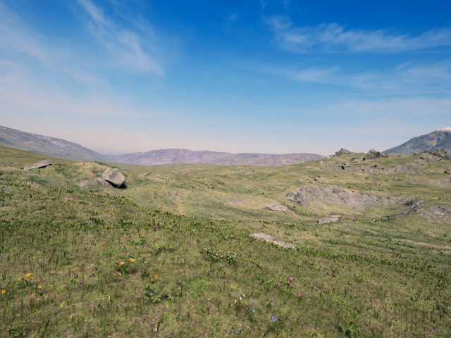
Worked record trace: B2 frame 182
Target (2,2,-2) at UTC 1791674187.681857. Nearby PX4 estimate: (1.985,1.743,-1.999) m. OFFBOARD and armed.
Native body: (2.035,1.695,-10.042). Camera: (2.335,1.684,-10.193). Their map origin differs from PX4 local NED.
Frame clock 239.352. Camera clock 239.392. Body clock 239.405. Receiver-near illustration only. Acquisition pose is unknown.
Concurrent records demonstrated · acquisition-time association unverified 8 / 16
Notes:
worked-example.json. Latest preceding command UTC1791674187.6818573. Native estimate boot233896ms. Mode176 andarm400 ACKresult0. Position targets have no per-targetCOMMAND_ACK. Original trace512ACK is telemetry request, not waypoint acceptance. FrameSHA be45e6ef227cf1dd4967568796e25c484c920cbcbb1c3536b20e930d79983e5b. Source: measured eval-20261010T215531Z, offline handoff-20261011T220420Z. Measurements remain 10 October 2026.

Slide 9
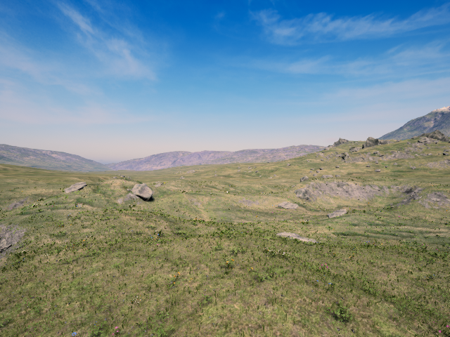
Camera results and authored defects
The degree field received radians. Intended yaw 15° and pitch 10° became about 0.262° and 0.172°.
Our local angle and duration fixes have not run on Windows. The unexported duration-only retest still used wrong angles.
Repeatability and projected-feature criteria remain incomplete. Native pose metadata does not establish calibrated acquisition pose.
Stock integration evidence · offline handoff 11 October 2026 9 / 16
Notes:
camera-angle-diagnostics.json; official vis-cfg.html SensorAngEular degrees. A criteria0.02m/1deg,feature2%dimension.5swarmup/3sperpose/1ssettle/40swatch. Rotation defect belongs to authored helper, not simulator. Source: measured eval-20261010T215531Z, offline handoff-20261011T220420Z. Measurements remain 10 October 2026.

Slide 10
Native calibration and clock limits
Initial camera minus body was (0.3,0,-0.15) m despite the requested (0.3,0,0) mount. Actor-origin explanation is unresolved.
FOV axis, projection, optical axes, color/orientation and achieved extrinsics need independent checks for native calibrated images.
Acquisition UTC is unknown. A2 began with an old-looking image clock. No latency or geometric pass follows from receiver timestamps.
Stock integration evidence · offline handoff 11 October 2026 10 / 16
Notes:
mount-diagnostic.json,camera-clock-diagnostics.json. A2firstimage257.636,camera425.638,nextimage426.759. No rootcause claimed. Desired interpolation linear/SLERP,bracketgap<=0.1s,residual<=0.02s,noextrapolation. These are nativecamera concerns, not universal externalrenderer prerequisites. Source: measured eval-20261010T215531Z, offline handoff-20261011T220420Z. Measurements remain 10 October 2026.

Slide 11
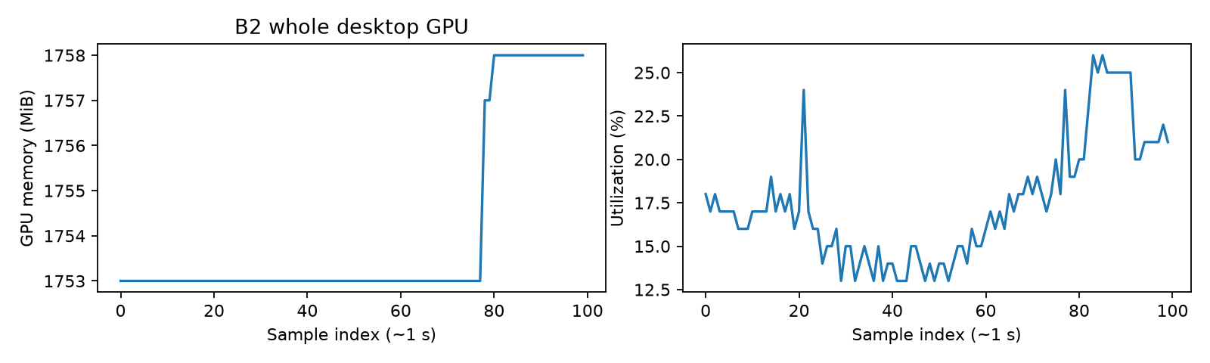
Hardware and measurement coverage
L4 / Windows Server 2025 / WSL1 worked on this host. 8 logical CPUs, 32 GB RAM, 400 GB SSD.
Whole-window GPU peaks: B1 1,761 MiB, B2 1,758 MiB. Mean utilization: 16.93% and 17.47%.
Desktop and Moonlight share the samples. B2 coverage ends mid-flight. Minimum VRAM, total RAM and renderer-only throughput are unknown.
Stock integration evidence · offline handoff 11 October 2026 11 / 16
Notes:
resource-coverage.json,process-resources.json. Driver596.86,L423034MiB. VendorWindows10/11documented; Server2025empirical.100samplesperrun~1.05s. B2apparent21.65soverlap underinferredUTC-04. CompleteISO23.15GB expandedsize/currentdiskmissing, compute$1.95/hr excludesunknownstorage/tax. No A6000 need/noLinuxcheapestclaim. Source: measured eval-20261010T215531Z, offline handoff-20261011T220420Z. Measurements remain 10 October 2026.

Slide 12
Cleanup lifecycle and evidence boundaries
Flight records confirm landing and disarming in both B runs. Separate cleanup evaluators also returned confirmation summaries.
Our cleanup workers stayed alive until the 15 s deadline, exit -15. Raw cleanup logs are empty. The queue/finalizer cause remains unresolved.
Local lifecycle fixes need a Windows retest only if the unattended helper will be reused. This issue does not invalidate the retained flight passes.
Stock integration evidence · offline handoff 11 October 2026 12 / 16
Notes:
B1/B2 run.json and empty cleanup.jsonl. Authored lifecycle/preservation issue, not established upstream simulator failure. Fresh-queue/exit-status correction passed synthetic tests, not on-host validation. Offline B1 ULog additionally recovers660initialparams/11changes and firmware identity, see handoff/native-log-summary.json.

Slide 13
R4R reuse options
Native visual baseline
Demonstrated
Stock RGB and control integration. Native calibration needed for geometric comparison.
Motion to external Gaussian renderer
Proposed small adapter
Verify chosen body frame/origin/scale. External renderer can supply its own camera and time.
Reconstructed mesh through UE
Documented, eligibility unresolved
Cooked UE assets plus XML. Verify installed loader and Free custom-scene permission.
Future visual controller loop
Substantial integration
Deliver external images to a controller, then commands to PX4. Scheduling/reset and task interfaces remain.
Native calibration is architecture-specific · depth/contact only when the task needs them 13 / 16
Notes:
Official mesh route https://rflysim.com/doc/en/4.DevRef/3d-import.html accessed2026-10-11. VisionCaptureApi.sendImgBuffer forwarding not proved nativeinjection. Freeonecamera/vehicletested. NoGaussianloaderorrealphoto+posedirectpathverified. Existing externalrenderer no implementation here. Source: measured eval-20261010T215531Z, offline handoff-20261011T220420Z. Measurements remain 10 October 2026.

Slide 14
Applicability and research inputs
Residential, suburban and campus views below 100 m remain fidelity research questions. No real reconstruction entered this audit.
Sparse capture means missing view coverage. Sparse scene content means limited physical/perceptual structure. They need different evaluations.
Indoor navigation and racing are untested tasks. C lacks a compatible released policy path. That does not erase component usefulness.
Stock integration evidence · offline handoff 11 October 2026 14 / 16
Notes:
docs/r4r-audit-context.md. Missingrealimagery/poses/calibration/reconstruction/split/heldouthorizontalverticalviews/downstreammodel/approvedthresholds. NoPSNRSSIMLPIPS,policybenchmark,realtransfer. No simulatorrankingusingunmatchedworlds/hardware. Source: measured eval-20261010T215531Z, offline handoff-20261011T220420Z. Measurements remain 10 October 2026.

Slide 15
Preservation and reviewer navigation
Mac copies verify all three evidence ZIPs and their internal manifests. Main records include 1,237 native PNGs and B1 ULog.
Standalone videos, the revised deck/PDF and an explanatory index publish to the existing private Drive folder. Sharing stays unchanged.
Final transcript, B2 ULog, strict-duration A1 retest and final scene/model/launcher inventory remain missing from durable delivery.
Stock integration evidence · offline handoff 11 October 2026 15 / 16
Notes:
local-source-verification.json,source-before.json,outputs.json,drive-publication.json. Originalreport/deckpreservedGit9749a40andbefore snapshot. Executedsource raw/code-v2 immutable. CompleteISOWindows-only withofficialURL/hash; truncatedMacoriginal preserved. Source: measured eval-20261010T215531Z, offline handoff-20261011T220420Z. Measurements remain 10 October 2026.

Slide 16
Minimal follow-up and interface learning
No restart is needed for the control/native-baseline decision. Optional recovery of missing files would take about 15–20 minutes.
Only measure the selected role next: external motion mapping, native calibrated replay, or our cleanup helper. Do not repeat every passed flight.
Understand NED/FRD versus camera axes, estimate versus truth, ACK versus achieved state, distinct clocks, and SITL versus physical HITL.
Offline handoff complete · AirGPU stays Off · no new simulator measurements 16 / 16
Notes:
docs/rflysim/minimal-followup.md estimates. Externalmotionmapping10–15min;correctedA10–15afterstartup;nativecalibration15–25;clock10–20;cleanup5–10onlyifreuse. Original numericalcriteriaunchanged. Humanfilesinstalled_adapter/runtime_core,capture_adapter,canonicalSDKandstocklauncher. No newauthorization/hoststartup. No HITL/training/customrenderer. Source: measured eval-20261010T215531Z, offline handoff-20261011T220420Z. Measurements remain 10 October 2026.

