Slide 1
Unreal Engine in the Real4Real audit
Native camera and flight evidence on the supplied A5000
8 October 2026 · Gaussian sensor RGB failed; real-scene fidelity pending
Notes:
Source: locally preserved A/B run directories and docs/unreal/handoff.md. This deck does not report any AirLab real-scene image or learned-policy result.

Slide 2
Real4Real question and experiment scope
Small real outdoor capture
Reconstruct one site, then render trustworthy observations for NEW drone camera routes in residential, suburban and campus scenes below 100 m.
Capture at 15 m → render at 50 m
Open research goal. Blocks cannot answer it.
A: pose replay B: scripted closed loop C: released learned policy S: UE Gaussian splat
Notes:
Internal project context: docs/r4r-audit-context.md, 2026-10-08. No approved AirLab dataset was supplied.

Slide 3
Native Blocks system path
A Target poses → ComputerVision pose RPC → UE scene → RGB + planar depth
B Estimated position → P velocity script → SimpleFlight → FastPhysicsEngine
UE supplies rendered camera views and scene collision; AirSim logs state.
C No compatible released policy weights or task interface in Blocks.
Scene: stock FlyingExampleMap. No real capture, common splat scene or held-out split.
Notes:
Microsoft AirSim source commit 96235148a332fe7cb3d3525a0720e26faaca99e0; Linux Blocks v1.8.1 release ZIP SHA-256 563e1da1b5d7303b9405c8736243ea92ab0a011b96a561f26f17563d105a404f. See docs/unreal/sources.md.

Slide 4
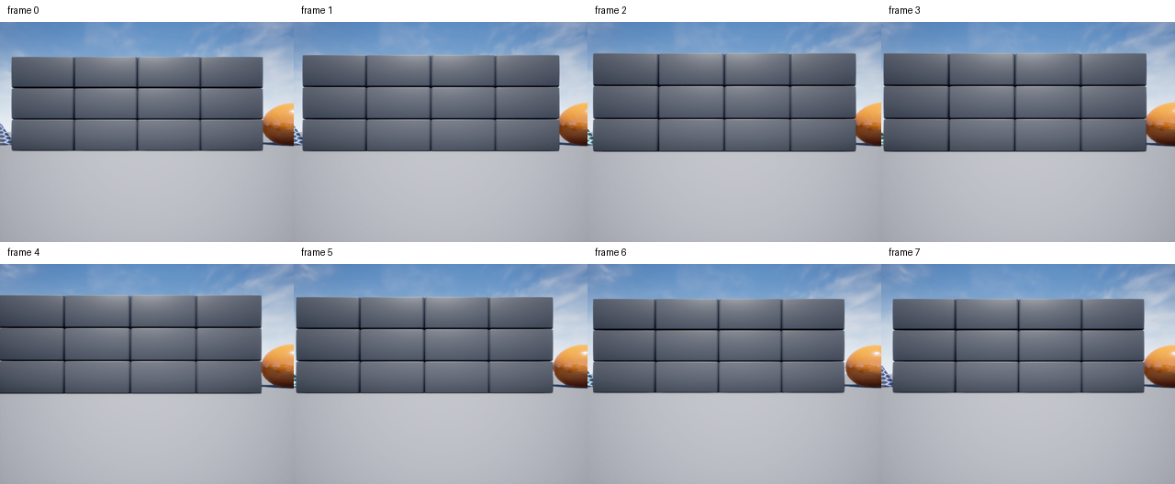
A: eight camera poses produced eight RGB images
NED route: 0–1 m horizontal at z = −2 m; 0.25 s pose settling
Notes:
Run ue-20261008T215319Z-a-5fe9b7c3; source-manifested local artifacts. 640x480; requested/actual rig and response camera centers matched to recorded precision. Image contact: figures/rgb-contact.png. A is not flight.

Slide 5
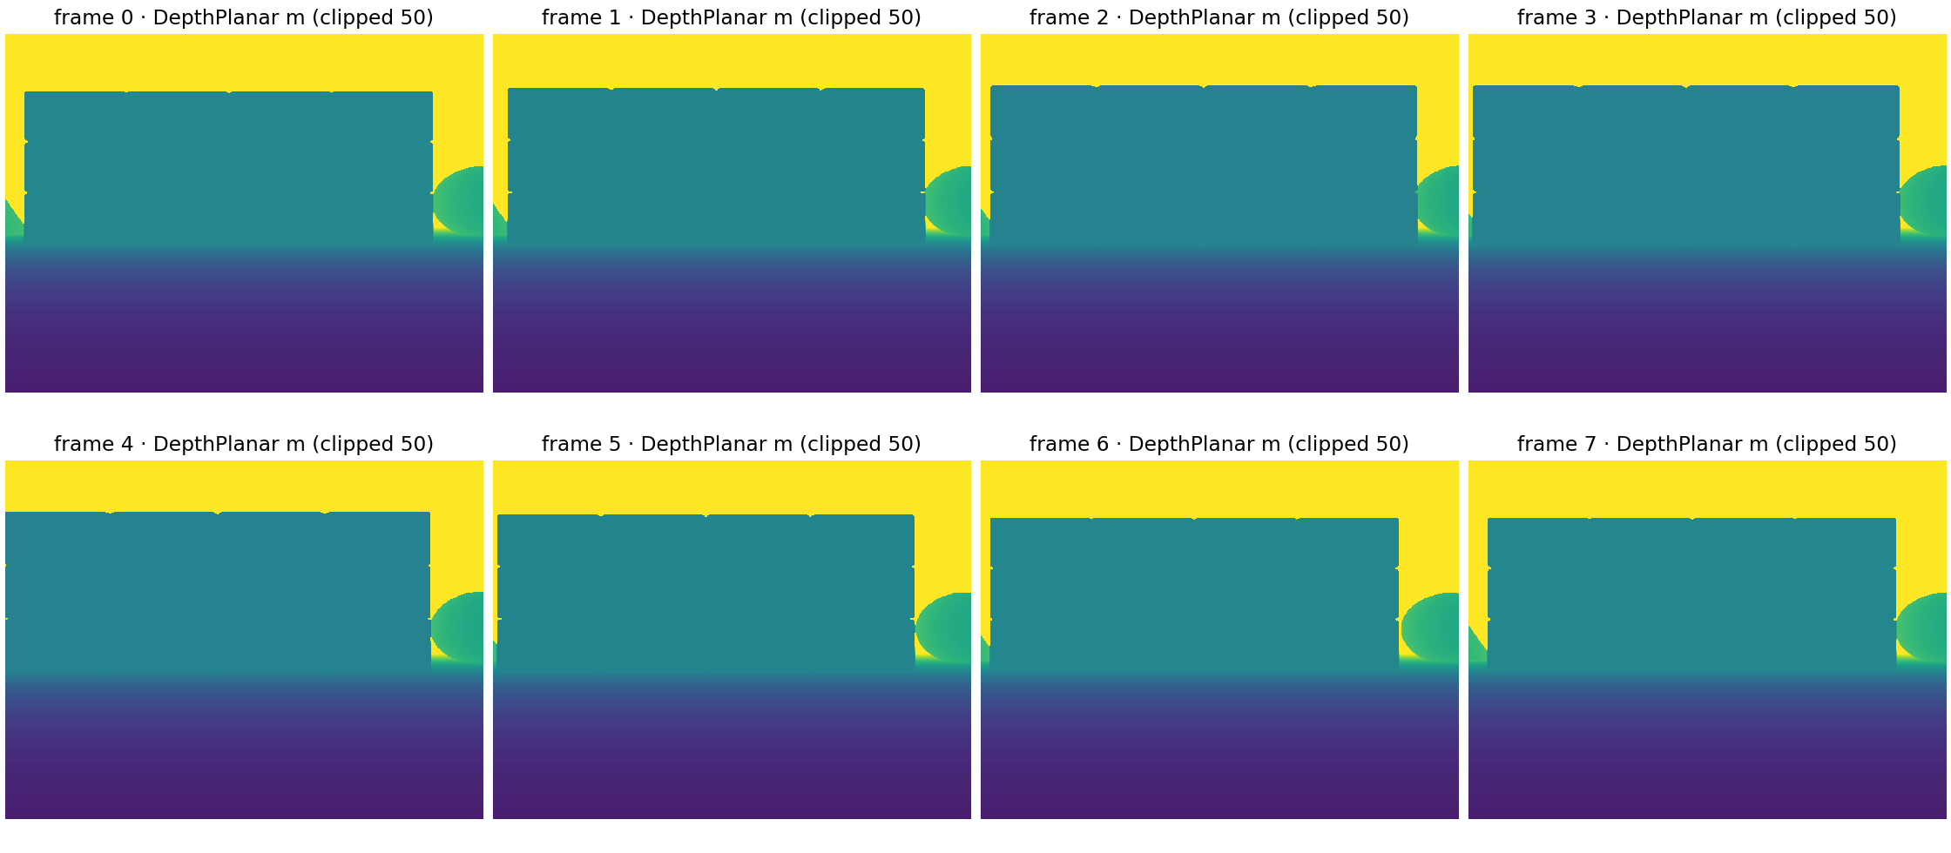
A: planar depth is present for all eight views
First-frame wall edge matched at five tested columns; depth timestamp remains unmeasured.
Notes:
Run ue-20261008T215319Z-a-5fe9b7c3; all 8 float32 480x640 arrays opened. DepthPlanar is optical-axis distance in metres. Display clipped at 50 m. First frame wall 23.09375 m; ground 6.0195 m; far/sky 13456 m. RGB timestamp only, depth timestamp not recorded.

Slide 6
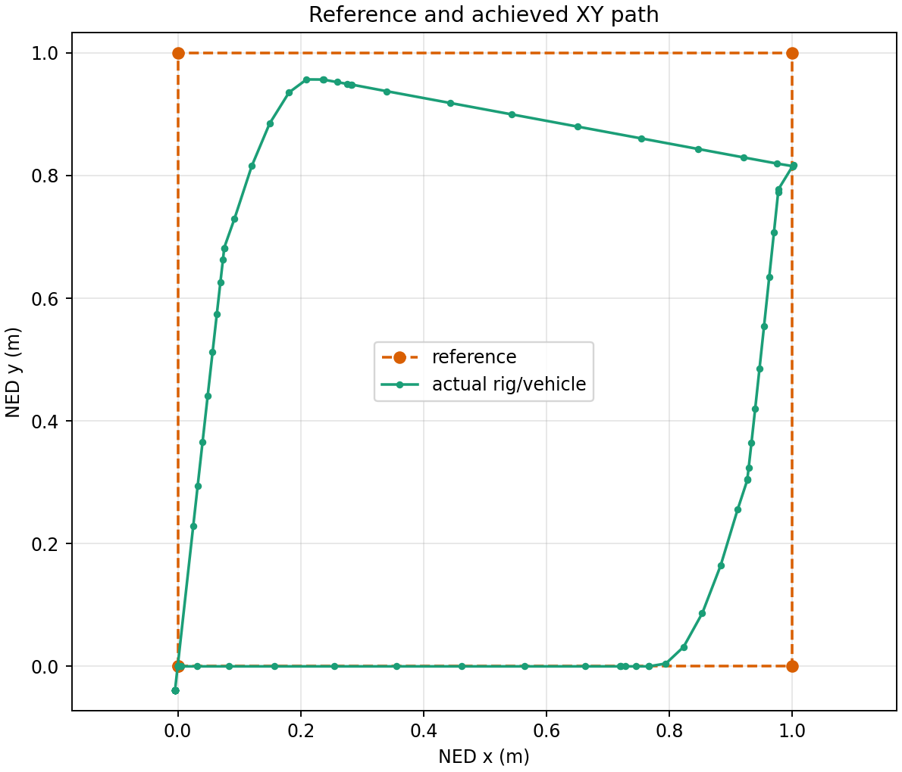
B: scripted flight reached the five square waypoints
Reference
1 m square; NED z = −2 m
Controller
P gain 0.7; velocity clip ±0.7 m/s; 0.2 s commands; SimpleFlight inner loop
Five waypoint events met 0.25 m tolerance. Landing state did not confirm.
Notes:
Run ue-20261008T220451Z-b-a3d4be49, five waypoint_reached events at 0.228–0.248 m error; full run failed the final landing-state check. Actual track from vehicle_trajectory.jsonl. Baseline Ground_6 collision is recorded separately.

Slide 7
Measured rates and resource use
Native B landing-check run
Image RPC median
3.210 s (acquisition, transport, encoding)
Image interval median
5.355 s ≈ 0.187 captured images/s
Velocity command rate
4.696 Hz median interval; 2.007 Hz over action span
GPU memory
769 MiB sampled whole-GPU peak
Wall / simulation time
64.75 s run / 48.83 s first-to-last state
Video
2 FPS encoded playback; renderer throughput unmeasured
Notes:
Analysis from ue-20261008T220451Z-b-a3d4be49/analysis.json, camera.jsonl, actions.jsonl, run.json and GPU JSONL. Sampled GPU usage is whole-GPU nvidia-smi, not process peak. Renderer GPU timing and policy latency were not measured.

Slide 8
Failures retained under separate run IDs
A startup RPC race
first attempt failed; next A run completed
B occupied RPC port
supervisor output retained; process ownership fixed
B spawn Ground_6 baseline
subsequent route checks compare collision timestamps
Landing remains unverified
landAsync returned; floor contact occurred; LandedState stayed Flying
Notes:
All IDs and error details are in results/unreal/ and local source-manifested artifacts. Preflight-only failure has a local supervisor log but no remote run directory/source manifest. The landing-check run had new Ground_6 contact after the spawn baseline, so landing cannot be called successful.

Slide 9


S: Linux build/import passed; sensor RGB failed
UE 5.5.4 Linux plugin build + PLY import succeeded
Control cube: base-color RGB visible, max 228
Imported vase: final color near black, RGB max 1
Scene-color cube also black. Fix the camera render channel before claiming Gaussian observations.
Notes:
UE5.5.4 Linux installed ZIP SHA-256 e20acd77e6caad42ee1bf0df1cb4c5077ceb1350817cfdacb554f4a594710383. Italink plugin commit 411f879985719ce69eaaf15d58152c551e2719b1, BuildPlugin exit 0. Imported author's chinese_vase.ply to /Game/Gaussians. Ticked control ue-20261008T225105Z-s-control-e488bef0, source-manifested: cube base-color RGB max 228; splat final-color RGB max 1. The raw base-color PNG has alpha 0; its RGB channels are displayed opaque in this slide without changing their values. Even lit cube scene-color was zero, so failure is not isolated to plugin alone. No outdoor or real-scene claim.

Slide 10
Three ways to replace UE visuals
1 Splats inside UE
Replace chosen object appearance. UE keeps world time, rendering/compositing and collision. UE5 drone layer and accurate collision geometry remain to build.
2 External splat observations
Retain AirSim/UE dynamics, SimpleFlight, collisions and other sensors. Build a synchronized pose/intrinsics, axes/scale and image-return adapter.
3 UE removed
Another simulator must own dynamics, controller, sensors, clocks, collision, logging and task evaluation. A splat renderer supplies appearance only.
Notes:
Architecture assessment based on source inspection and current native run. No external sensor adapter or complete UE replacement was built. UE4.27 Blocks is a packaged binary and cannot be edited as the UE5.5 splat project.

Slide 11
Applicability to R4R tasks
Indoor navigation
API and collision plumbing demonstrated; realistic obstacles and task thresholds absent.
Outdoor navigation, sparse scenes
No real reconstruction, vegetation, capture coverage or altitude extrapolation evidence.
Racing
No gates, racing policy or high-rate vision benchmark; captured images averaged about 0.19 Hz in flight.
R4R role: useful conventional visual/control baseline and possible UE dynamics host; splat camera fit remains open.
Notes:
User scope and docs/r4r-audit-context.md. Blocks supports integration only. Outdoor scene coverage, novel views, moving objects, depth and collision are separate tests. No policy score or real drone transfer was measured.

Slide 12
A5000 host, storage and practical limits
Recommended for the next UE splat test
Keep the supplied Ubuntu 22.04 A5000 graphics VM. Vulkan and offscreen Blocks RGB are demonstrated; 24 GB VRAM is headroom, not a measured minimum.
Space and installation
UE 5.5.4 archive 27.09 GB; ZIP entry sum 65.30 GB expanded. Blocks ZIP 142.5 MB / 281.3 MB expanded. Preserve about 30 GB project/cache headroom after editor extraction.
Cheaper option and limits
An 8 GB VRAM NVIDIA Vulkan VM may run packaged Blocks, consistent with Epic editor guidance, but is untested here. Original 3DGS training VRAM does not size rendering.
Notes:
Host: user-supplied RunPod Ubuntu 22.04.5, RTX A5000 24 GB, driver 580.178.04, 50 GB cgroup RAM, 120 GB root disk. Epic Linux requirements: https://dev.epicgames.com/documentation/en-us/unreal-engine/linux-development-requirements-for-unreal-engine. Source ZIP and editor sizes are in docs/unreal/assets.md. $0.30/hour was displayed by provider UI, not independently billed.

Slide 13
Next scientific gate and evidence handoff
Held-out real camera test
Approved AirLab training capture plus calibrated, separate held-out poses; keep sparse vegetation, unseen angles and 15→50 m altitude routes explicit.
Matched comparisons
Same scene, scale, camera poses, intrinsics, resolution and exposure assumptions; report PSNR/SSIM/LPIPS with masks and failure close-ups.
Preserved today
Six native and six S source manifests matched local copies. RGB/depth and control PNGs opened; editor ZIP and compiled plugin hashes matched. Landing and usable splat RGB remain gates.
Notes:
Internal R4R context; see docs/unreal/handoff.md and sources.md. Source-manifested A/B files reside under ~/Downloads/AL/R4R-Sims/artifacts/unreal/. Public source URLs and commits are in sources.md.

