Slide 1
GRaD-Nav usability decision
NO-GO for calibrated R4R camera replay
with this released gate_mid package
Native rendering and dynamics work as research components.
Capture/checkpoint correspondence remains unresolved.
One controlled version comparison. Original weights unchanged.
AirLab / 8 October 2026 / training-view diagnostic
1
Notes:
https://github.com/WorldExplored/R4R-Sims/tree/audit/grad-nav/docs/grad-nav/camera-correspondence.md; runs20261009T033353Z-correspondence-23ce26 and20261009T033735Z-correspondence-6bf320. Source and full hashes retained. No new model/scene training.

Slide 2
Inputs, outputs and E2E scope
Scene config + Gaussian checkpoint + camera pose/K → RGB, depth, alpha
Body rates + normalized thrust + state → next simulated state
PD controller → dynamics → achieved camera → native images/video
Original learned visual policy → actions/outcomes: blocked by weights
The demonstrated controller consumes height/velocity, not rendered images. Calibrated replay, visual autonomy and outdoor fidelity are separate gates.
AirLab / 8 October 2026 / training-view diagnostic
2
Notes:
https://github.com/WorldExplored/R4R-Sims/tree/audit/grad-nav/docs/grad-nav/camera-correspondence.md; runs20261009T033353Z-correspondence-23ce26 and20261009T033735Z-correspondence-6bf320. Source and full hashes retained. No new model/scene training.

Slide 3
Checkpoint restoration and camera corrections
Strict loading: no missing keys and no unexpected keys in either version
All six Gaussian arrays and all saved model tensors restored exactly
270 saved pose corrections; median translation 0.01597 scene units
Maximum correction: 0.04156 scene units; rotation tangent 0.01827 rad
Every learned parameter hash is unchanged after rendering. Zero training steps and optimizer updates. The checkpoint does not embed the original filename order.
AirLab / 8 October 2026 / training-view diagnostic
3
Notes:
https://github.com/WorldExplored/R4R-Sims/tree/audit/grad-nav/docs/grad-nav/camera-correspondence.md; runs20261009T033353Z-correspondence-23ce26 and20261009T033735Z-correspondence-6bf320. Source and full hashes retained. No new model/scene training. Strict load hooks record missing/unexpected keys. All saved tensors and named parameters checked. SO3xR3 apply_to_camera called only for corresponding training index; model always evaluation-mode.

Slide 4
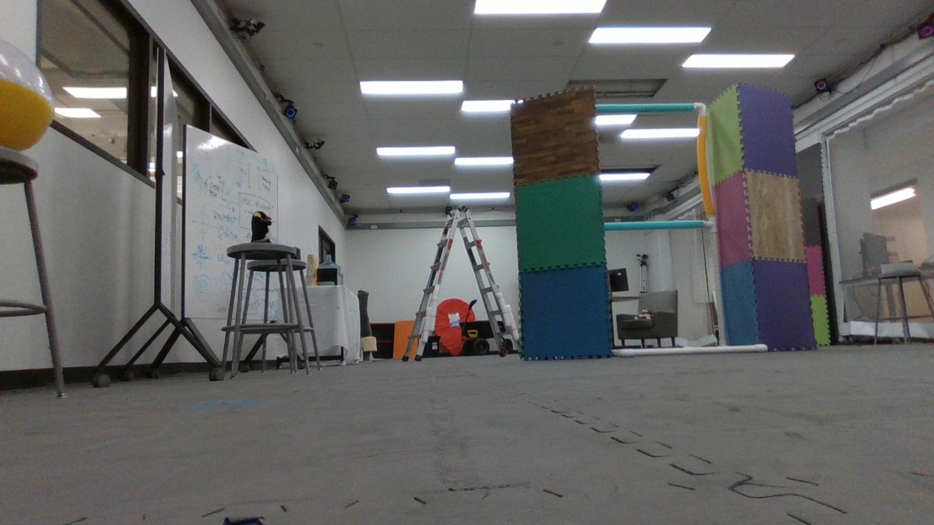
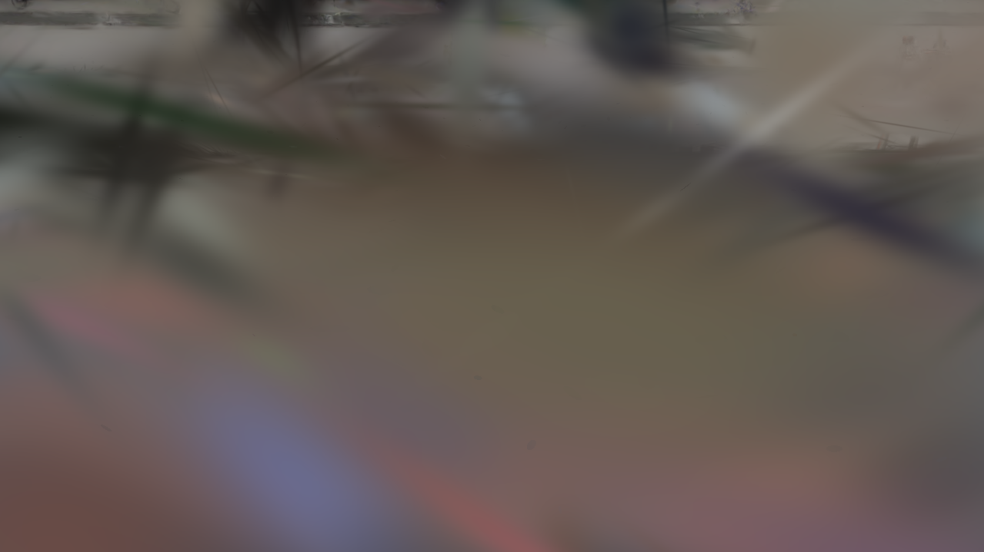
Training camera 0: frame_00001.png
Preprocessed source
Render with saved pose correction
PSNR: canonical 14.7467 dB; corrected 14.8001 dB.
Saved corrections do not recover the source scene structure.
AirLab / 8 October 2026 / training-view diagnostic
4
Notes:
https://github.com/WorldExplored/R4R-Sims/tree/audit/grad-nav/docs/grad-nav/camera-correspondence.md; runs20261009T033353Z-correspondence-23ce26 and20261009T033735Z-correspondence-6bf320. Source and full hashes retained. No new model/scene training. Deterministic selection[0,floor((Ntrain-1)/2),Ntrain-1] ->0,134,269. Source is canonical OpenCV-undistorted ROI-cropped1279x719, uint8/255. Right saved-correction render uses upstream CameraOptimizer.apply_to_camera for this exact training index. No color/exposure fit. Figures are observed outputs; not held-out fidelity.

Slide 5
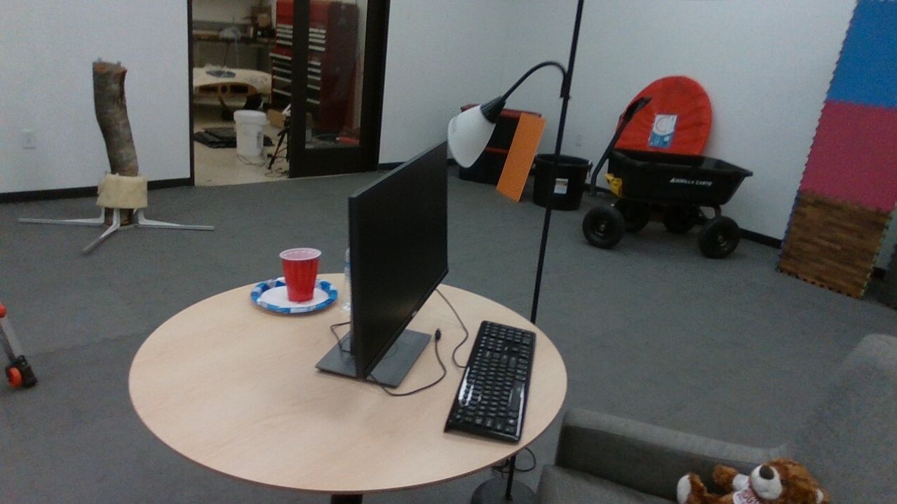

Training camera 134: frame_00149.png
Preprocessed source
Render with saved pose correction
PSNR: canonical 13.1784 dB; corrected 13.0754 dB.
Saved corrections do not recover the source scene structure.
AirLab / 8 October 2026 / training-view diagnostic
5
Notes:
https://github.com/WorldExplored/R4R-Sims/tree/audit/grad-nav/docs/grad-nav/camera-correspondence.md; runs20261009T033353Z-correspondence-23ce26 and20261009T033735Z-correspondence-6bf320. Source and full hashes retained. No new model/scene training. Deterministic selection[0,floor((Ntrain-1)/2),Ntrain-1] ->0,134,269. Source is canonical OpenCV-undistorted ROI-cropped1279x719, uint8/255. Right saved-correction render uses upstream CameraOptimizer.apply_to_camera for this exact training index. No color/exposure fit. Figures are observed outputs; not held-out fidelity.

Slide 6
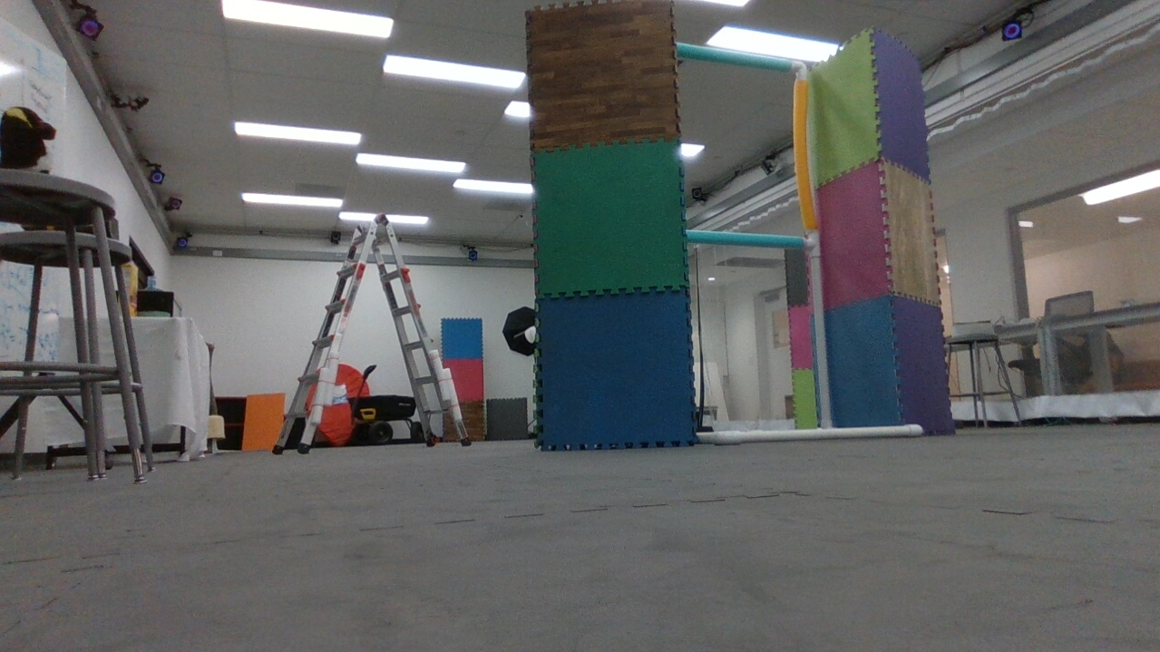

Training camera 269: frame_00300.png
Preprocessed source
Render with saved pose correction
PSNR: canonical 15.5847 dB; corrected 15.5810 dB.
Saved corrections do not recover the source scene structure.
AirLab / 8 October 2026 / training-view diagnostic
6
Notes:
https://github.com/WorldExplored/R4R-Sims/tree/audit/grad-nav/docs/grad-nav/camera-correspondence.md; runs20261009T033353Z-correspondence-23ce26 and20261009T033735Z-correspondence-6bf320. Source and full hashes retained. No new model/scene training. Deterministic selection[0,floor((Ntrain-1)/2),Ntrain-1] ->0,134,269. Source is canonical OpenCV-undistorted ROI-cropped1279x719, uint8/255. Right saved-correction render uses upstream CameraOptimizer.apply_to_camera for this exact training index. No color/exposure fit. Figures are observed outputs; not held-out fidelity.

Slide 7
Controlled Nerfstudio version comparison
1.1.3 baseline retained; 1.1.4 installed in a separate environment
Torch 2.1.2/cu118 and gsplat 1.0.0 retained exactly
Required changes only: OpenCV 4.10.0.84, viser 0.2.3, tensorly 0.9.0
Dependency check passes; all 18 RGB/depth/alpha arrays are identical
This version change did not resolve correspondence. No Gaussian restoration or optimizer-update failure was found.
AirLab / 8 October 2026 / training-view diagnostic
7
Notes:
https://github.com/WorldExplored/R4R-Sims/tree/audit/grad-nav/docs/grad-nav/camera-correspondence.md; runs20261009T033353Z-correspondence-23ce26 and20261009T033735Z-correspondence-6bf320. Source and full hashes retained. No new model/scene training. Actual module paths/hashes and pip-check recorded. NS1.1.4 overlay shares baseline dependencies read-only. Runtime OpenCV changed from4.8 to4.10; baseline has duplicate distributions. Every RGB/depth/alpha array is bit-identical across versions. No broad search or guessed scene transform.

Slide 8
Direct usefulness for Real4Real
Use case | Decision | Evidence or missing gate
Dynamics API / native integration | Usable component | B state feedback and D camera/video
Calibrated camera replay | NO-GO now | Training captures not reproduced
Original visual-policy E2E | Blocked | Compatible learned package absent
Outdoor sparse views / racing fidelity | Not established | Calibration, held-out inputs and task tests missing
Splats can supply appearance; collision geometry, calibrated physics and verified camera registration remain separate requirements.
AirLab / 8 October 2026 / training-view diagnostic
8
Notes:
https://github.com/WorldExplored/R4R-Sims/tree/audit/grad-nav/docs/grad-nav/camera-correspondence.md; runs20261009T033353Z-correspondence-23ce26 and20261009T033735Z-correspondence-6bf320. Source and full hashes retained. No new model/scene training.

Slide 9
Information needed from the authors
Matching checkpoint/config/captures bundle with hashes and reference renders
Every world transform and scale baked into the Gaussians or camera poses
Original 270-image training order, split and preprocessing steps
Exact training environment; original compatible navigation checkpoint
Until that provenance is supplied, do not use this bundle as a calibrated R4R baseline. No outdoor fidelity or real-transfer claim follows from these diagnostics.
AirLab / 8 October 2026 / training-view diagnostic
9
Notes:
https://github.com/WorldExplored/R4R-Sims/tree/audit/grad-nav/docs/grad-nav/camera-correspondence.md; runs20261009T033353Z-correspondence-23ce26 and20261009T033735Z-correspondence-6bf320. Source and full hashes retained. No new model/scene training. Surviving hypotheses are explicitly hypotheses: post-training scene transform, mixed asset revision or historical preprocessing/order. Do not infer original experiment failure. Four older shared-host logs were transferred and checksum-verified; no termination.

