Slide 1
COVID-19 Contact Tracing Report

Slide 2
VALUE BOX SUMMARIES

Slide 3
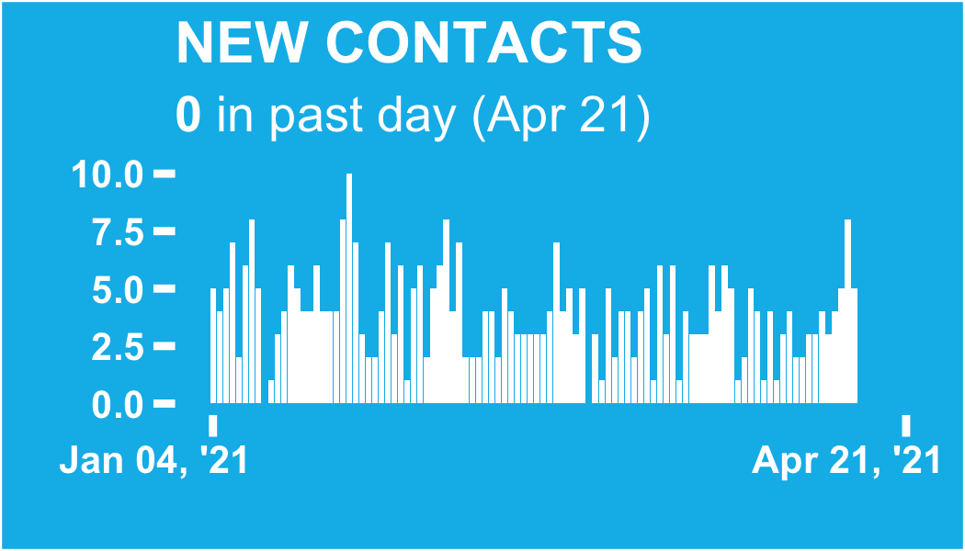

Slide 4
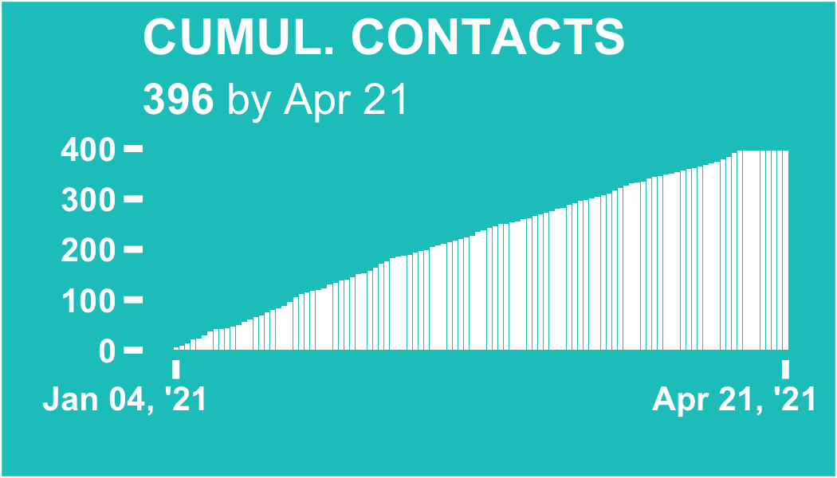

Slide 5
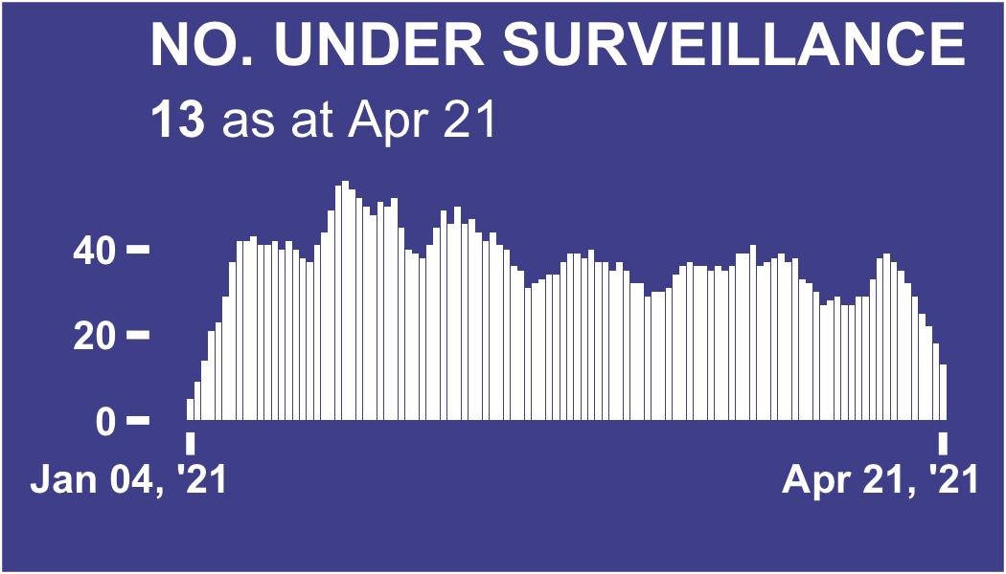

Slide 6
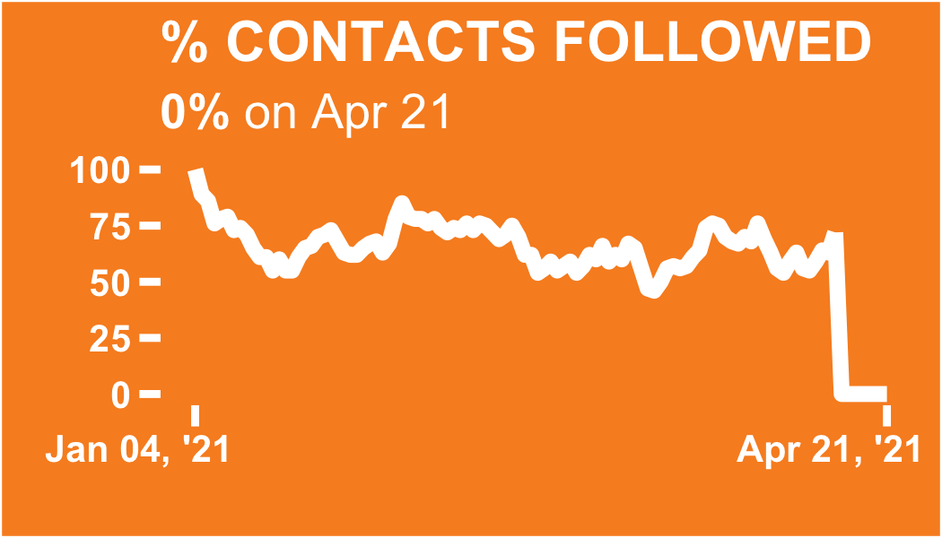

Slide 7
ALL CONTACTS

Slide 8
Regional breakdown

Slide 9
ℹ: The table and plots show the count of all contacts recorded in each region since database inception.
The region with the most total contacts since database inception is Abidjan 2, with 193 contacts (48.7% of the total)
NULL

Slide 10
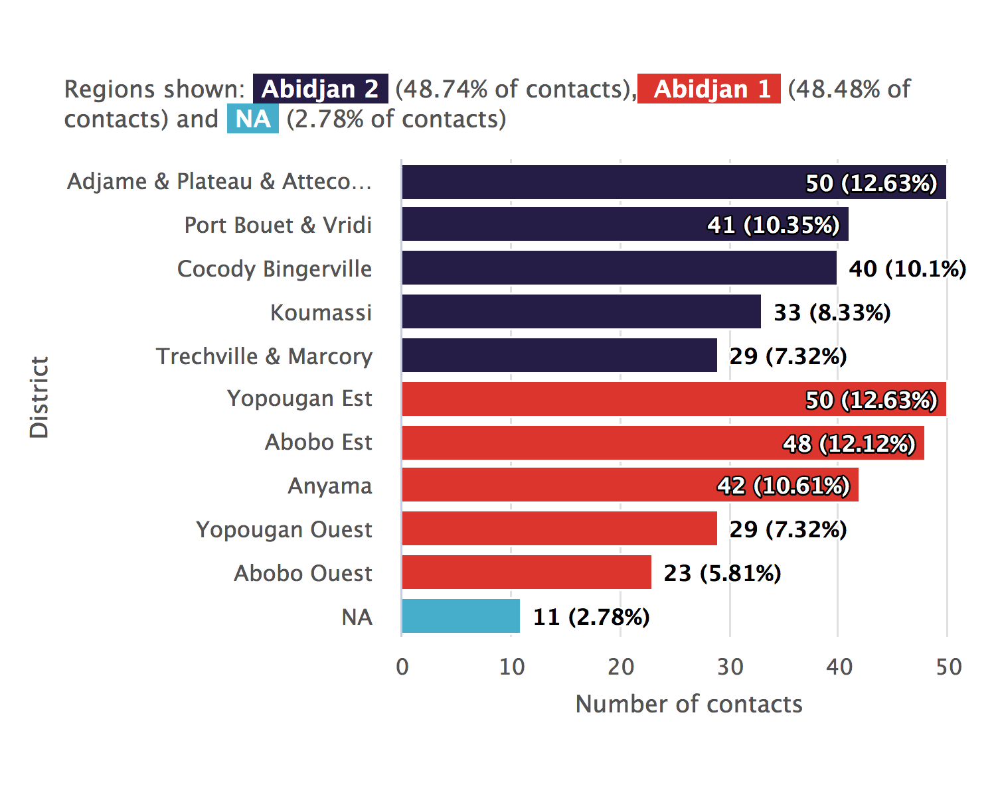
Regional breakdown bar chart

Slide 11
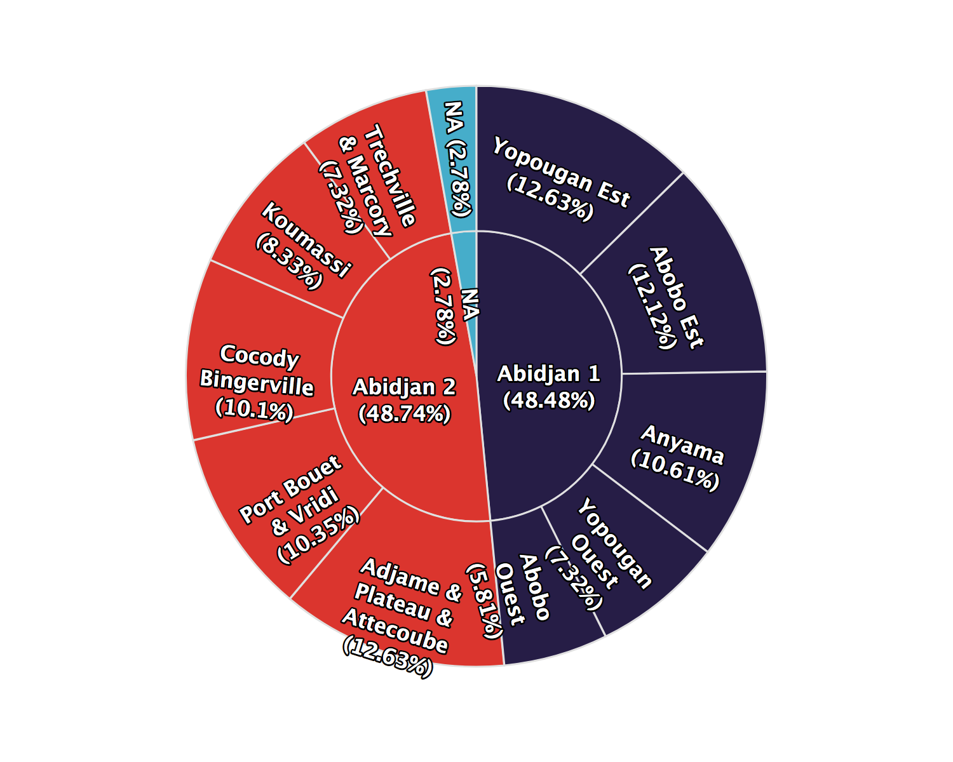
Regional breakdown sunburst plot

Slide 12
NULL

Slide 13
Regional breakdown table

Slide 14
Regional trends

Slide 15
ℹ: The plots show the number of contacts under surveillance on each day, whether or not they were successfully contacted.
The day on which the highest number contacts were under surveillance was Jan 26, 2021, with 56 contacts under surveillance.
NULL

Slide 16
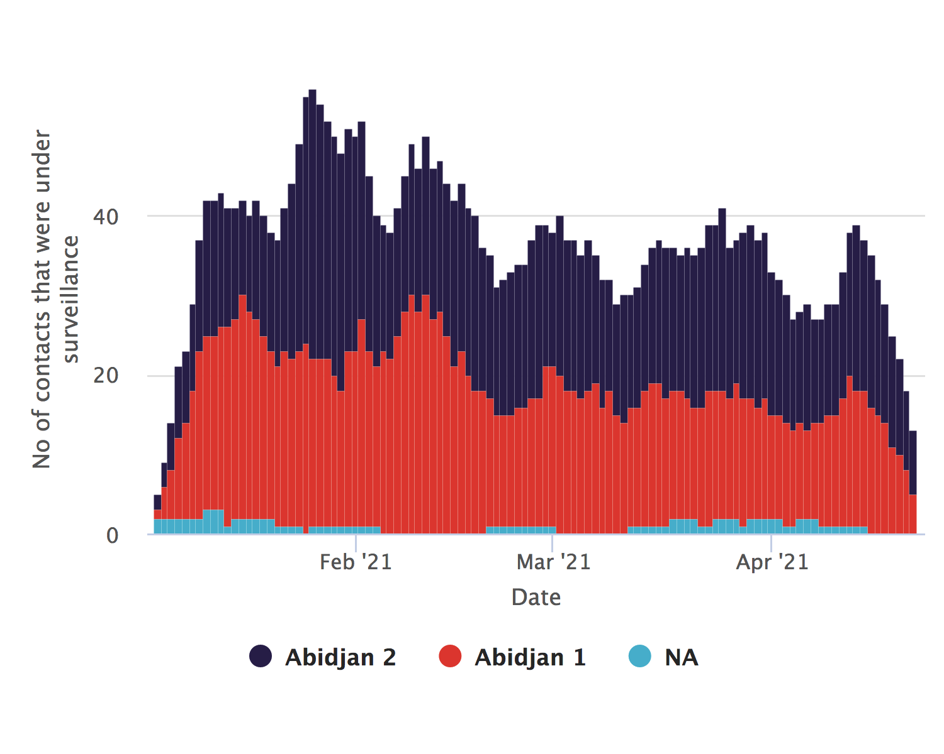
Regional trends absolute counts

Slide 17
## NULL

Slide 18
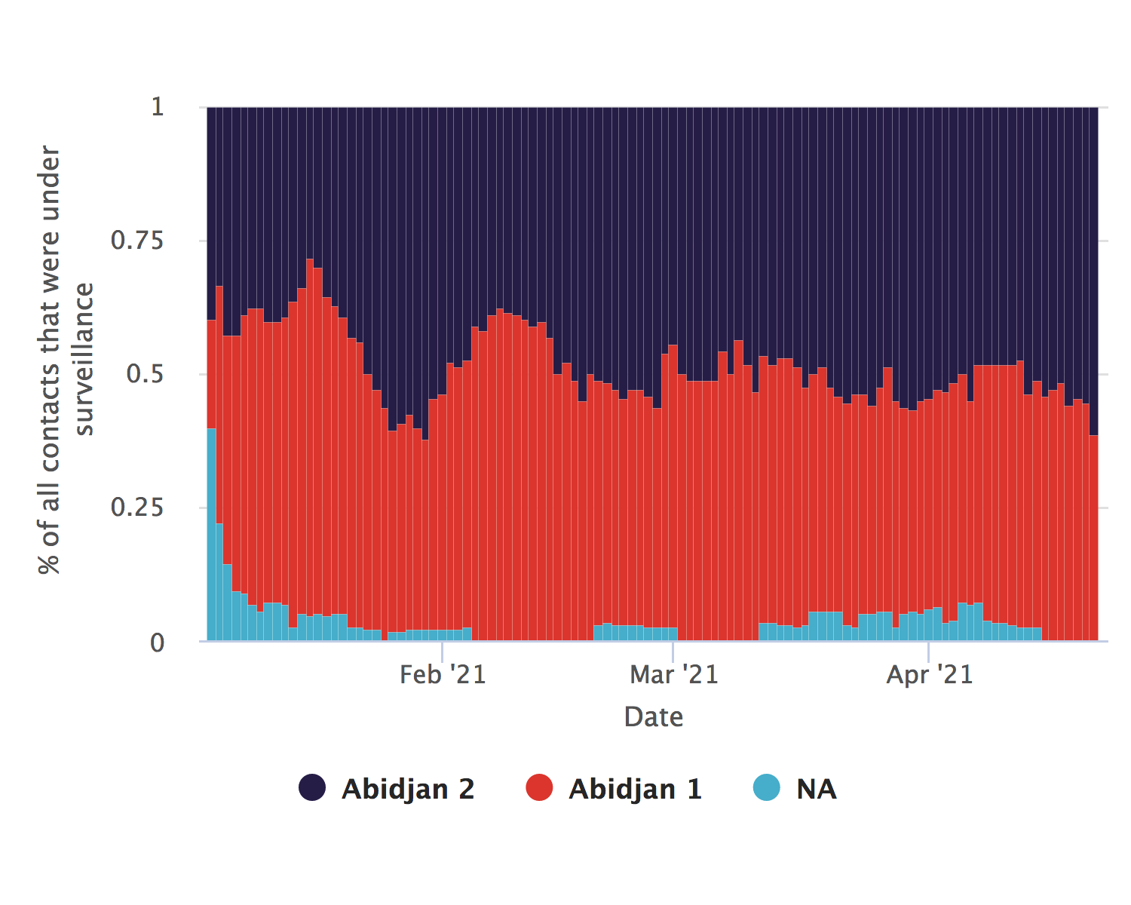
Regional trends relative proportions

Slide 19
## NULL

Slide 20
Contacts per case

Slide 21
ℹ: The plots show the number of contacts linked to each case.
The mean number of contacts per case is 12.8, (SD:5.3) with a minimum of 2 and a maximum of 24
NULL

Slide 22
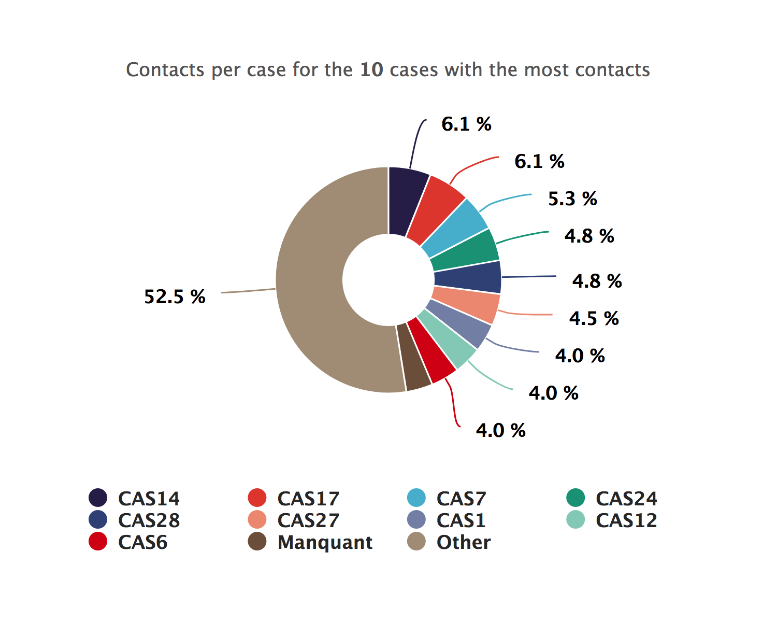
Contacts per case donut plot

Slide 23
## NULL

Slide 24
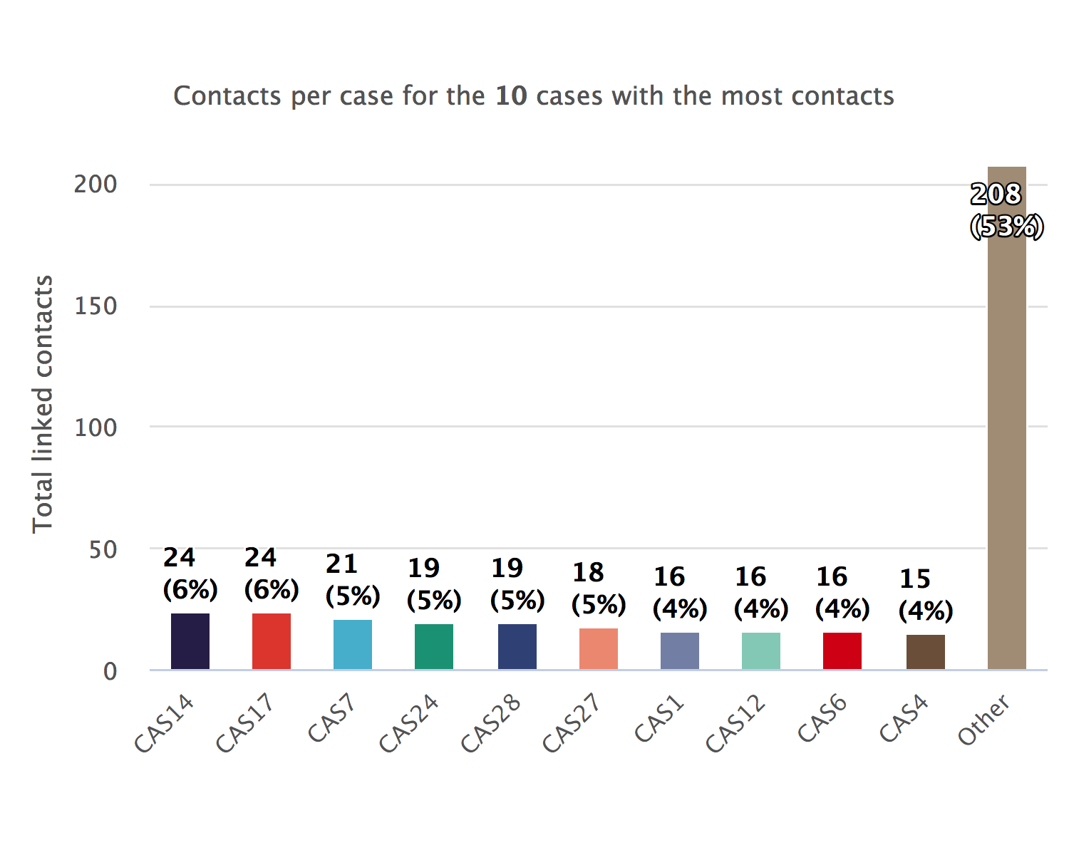
Contacts per case bar chart

Slide 25
## NULL

Slide 26
Link type between contacts and cases

Slide 27
ℹ: The plots show the number of contacts per type of type of link. The categories have been cleaned and condensed. Access the data in tabular form by clicking on the top-right button.
The most common link category is ‘parent proche’, with 66 contacts (16.67%).
NULL

Slide 28
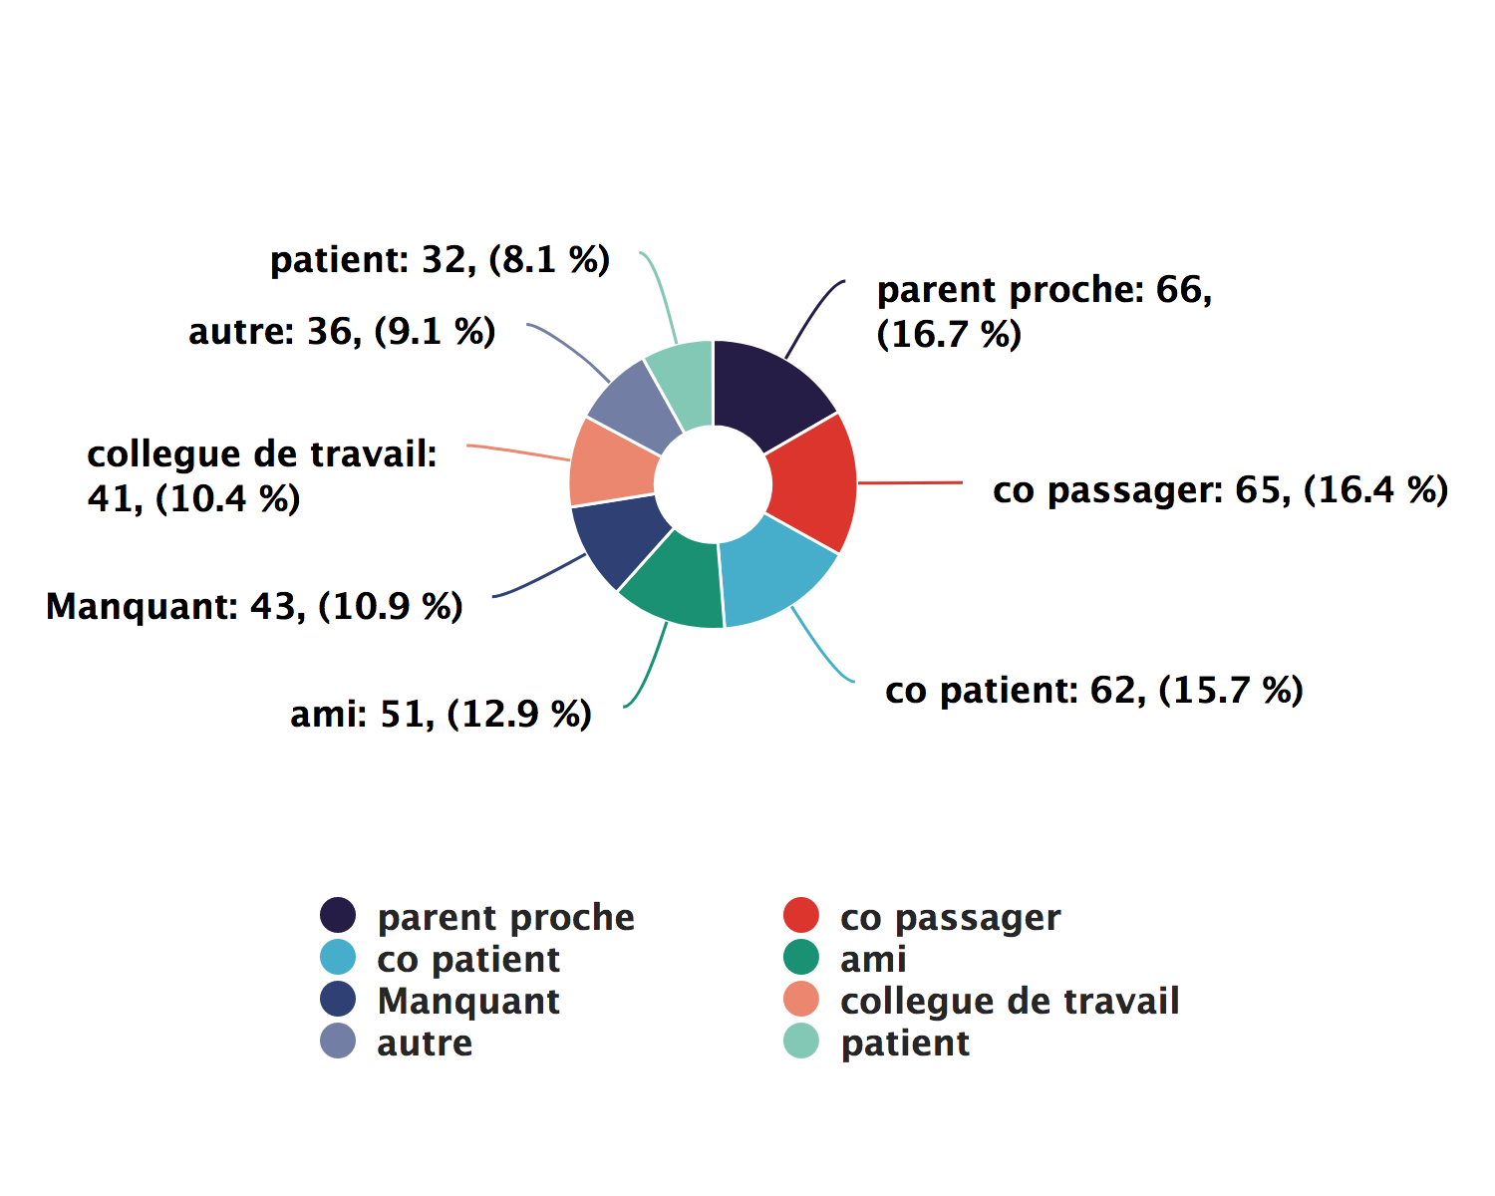
Link type donut plot

Slide 29
## NULL

Slide 30
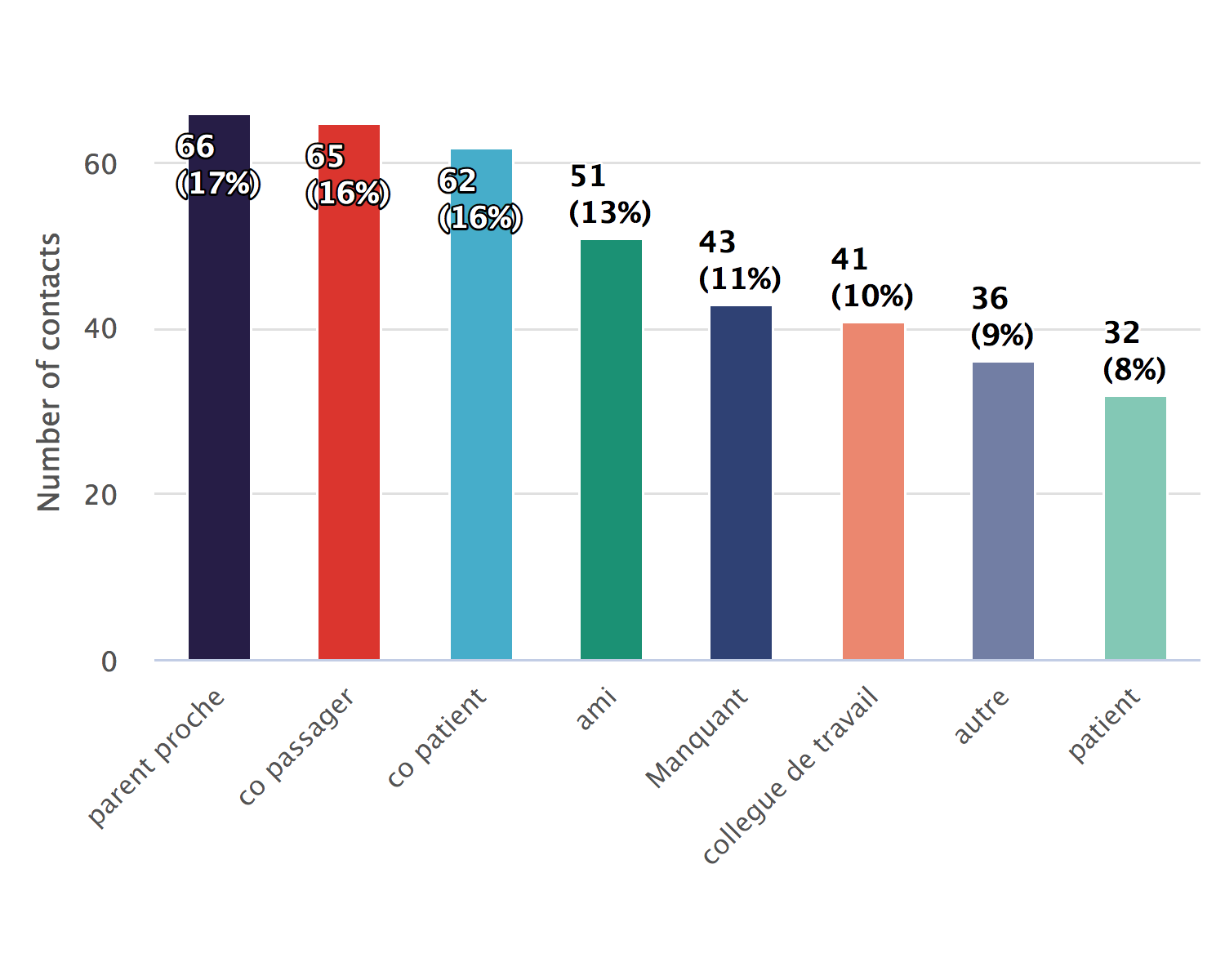
Link type bar chart

Slide 31
## NULL

Slide 32
ACTIVE CONTACTS

Slide 33
Follow-up timelines

Slide 34
There are 13 active contacts
NULL

Slide 35
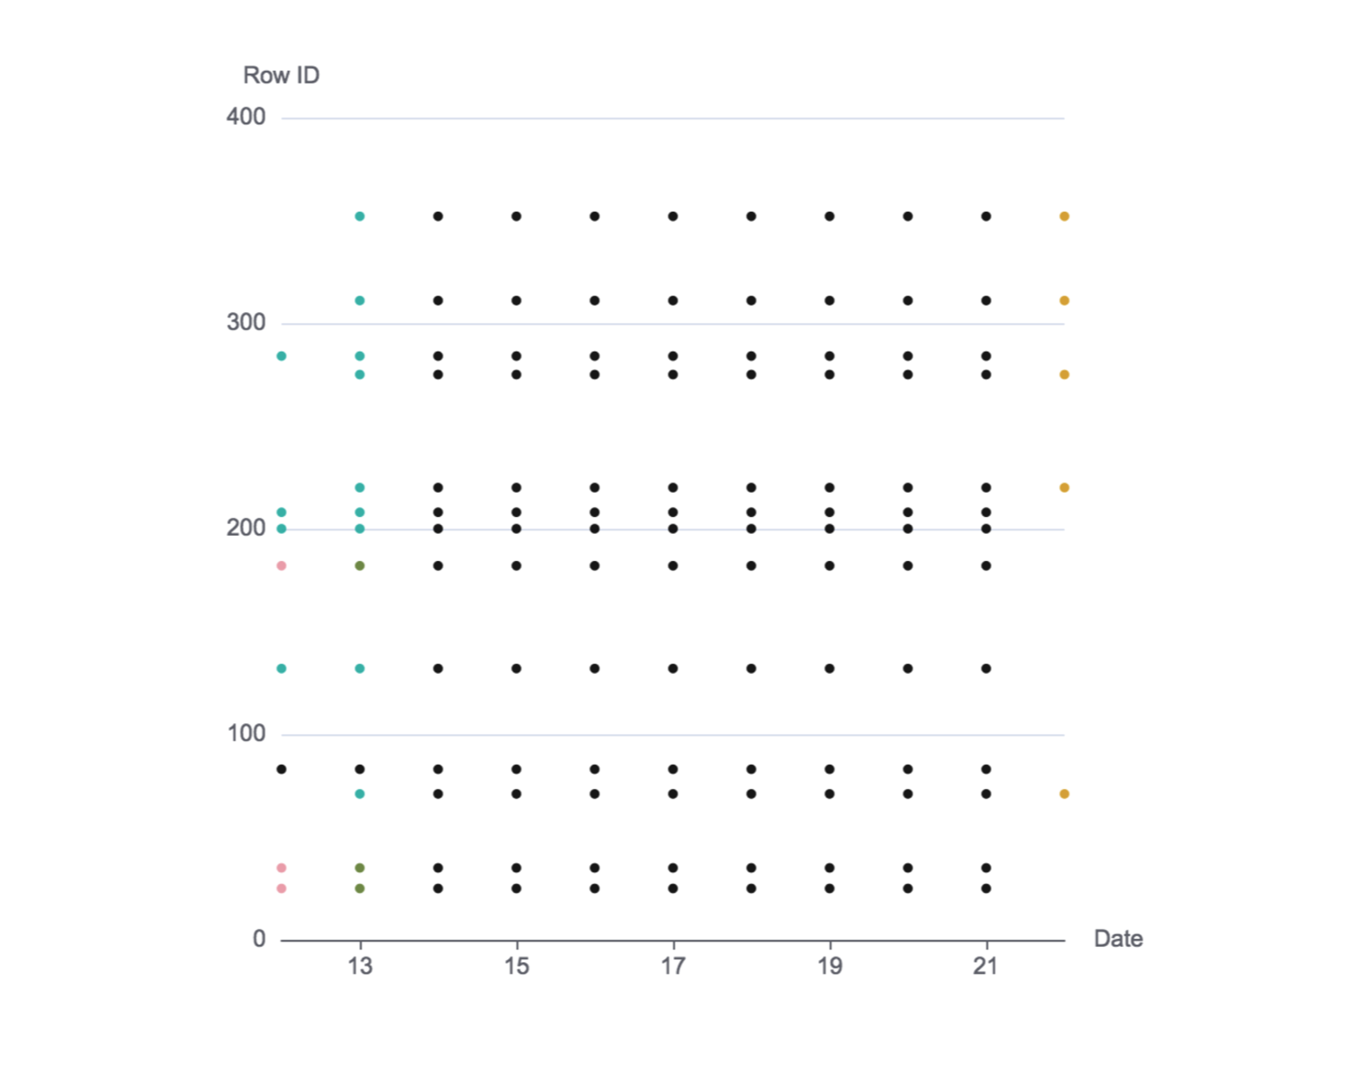
Follow-up timeline snake plot

Slide 36
## NULL

Slide 37
Follow-up timeline summary bar chart

