Slide 2
VALUE BOX SUMMARIES

Slide 3
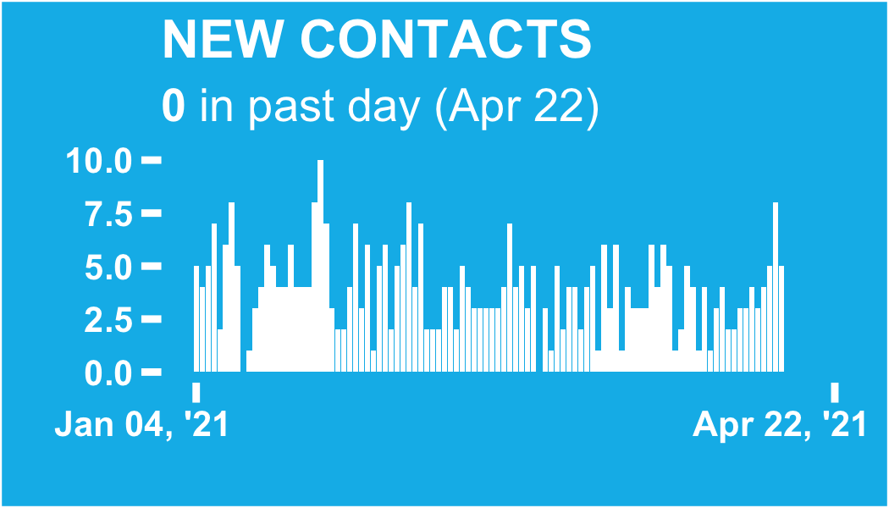

Slide 4
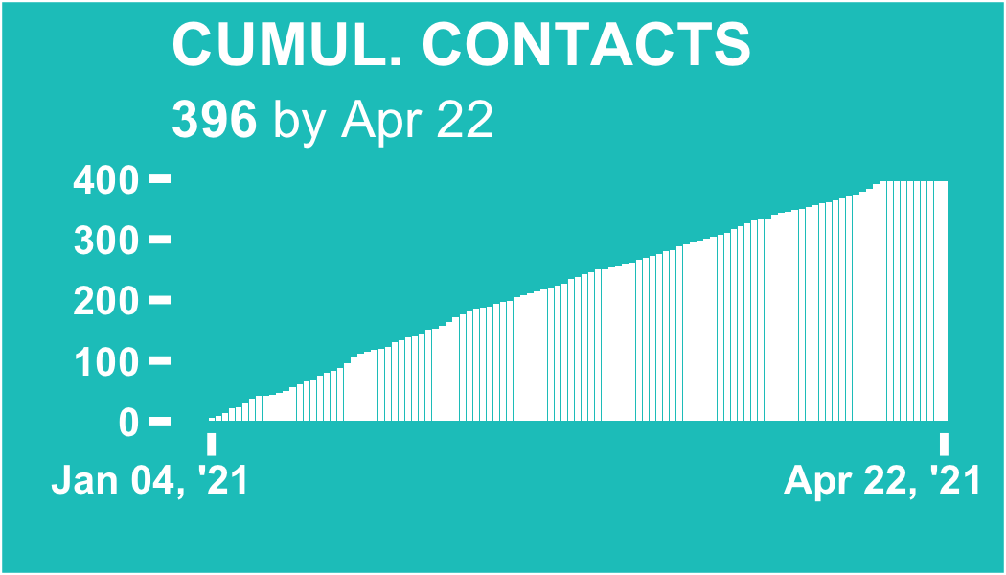

Slide 5
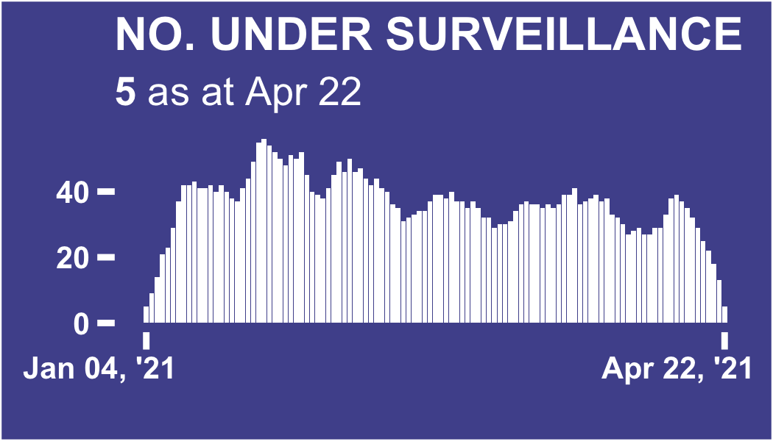

Slide 6
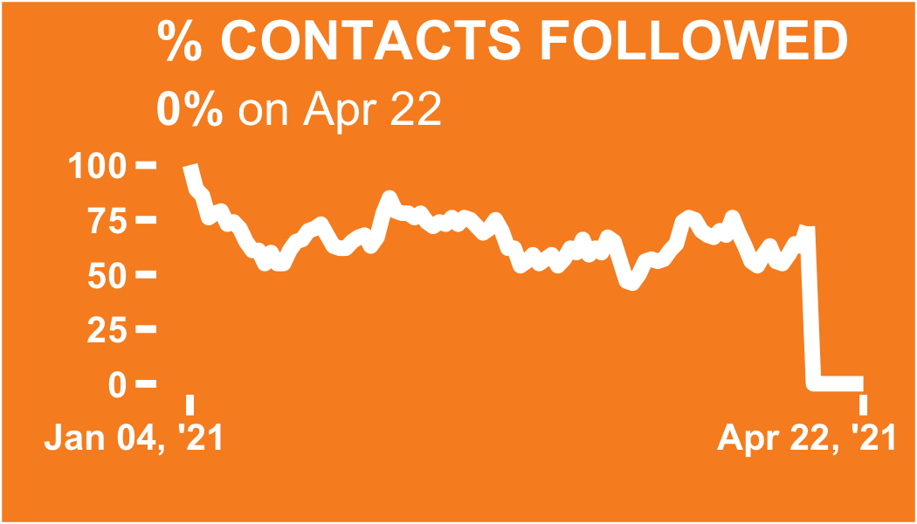

Slide 7
DATA PERTAINING TO ALL CONTACTS

Slide 8
Regional breakdown

Slide 9
ℹ: The table and plots show the count of all contacts recorded in each region since database inception.
The region with the most total contacts since database inception is Abidjan 2, with 193 contacts (48.7% of the total)

Slide 10
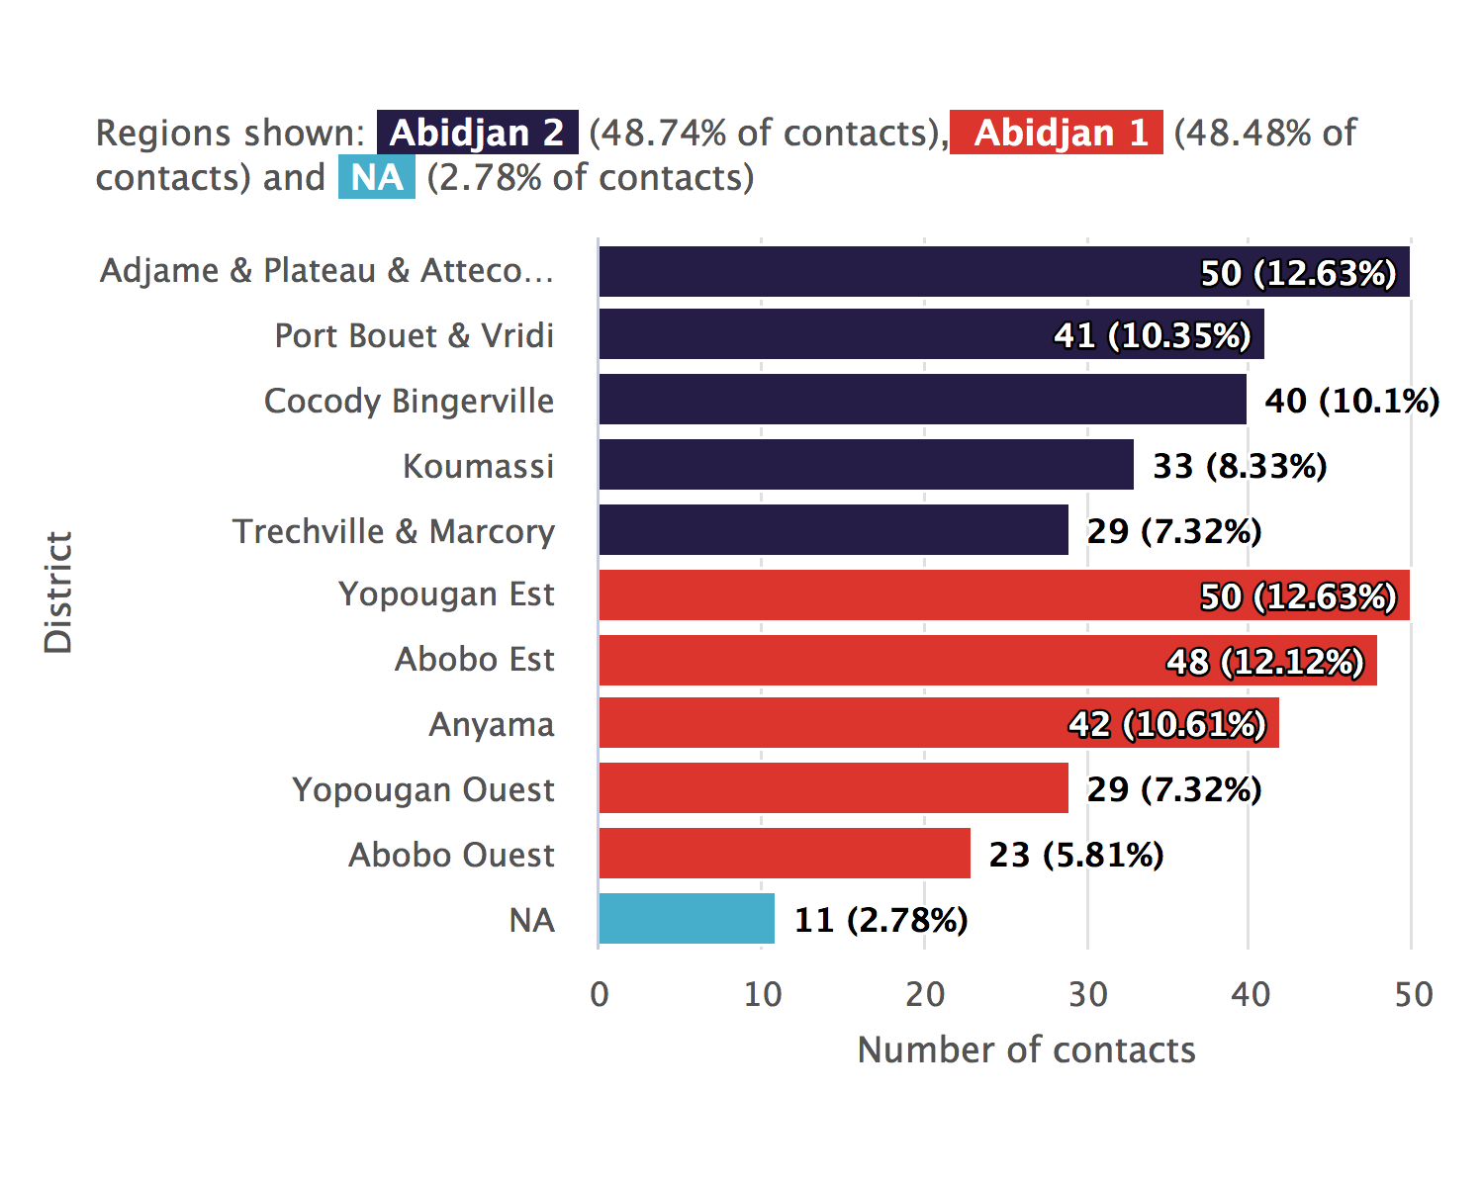
Regional breakdown bar chart

Slide 11
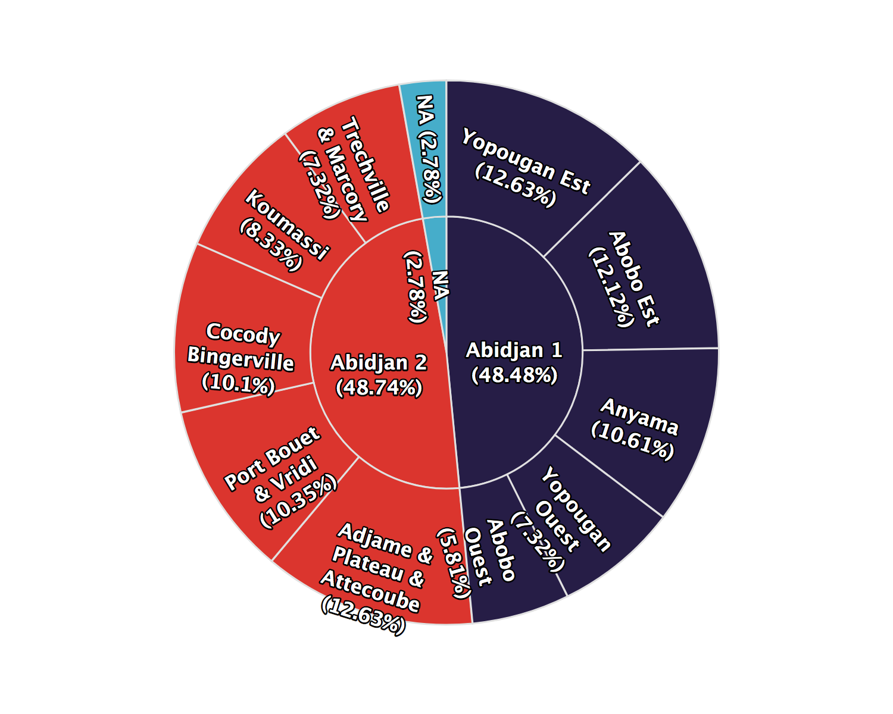
Regional breakdown sunburst plot

Slide 12
Regional breakdown table
Region | District | Total contacts | %
Abidjan 2 | Adjame & Plateau & Attecoube | 50 | 12.6
Abidjan 2 | Port Bouet & Vridi | 41 | 10.3
Abidjan 2 | Cocody Bingerville | 40 | 10.1
Abidjan 2 | Koumassi | 33 | 8.33
Abidjan 2 | Trechville & Marcory | 29 | 7.32
Abidjan 1 | Yopougan Est | 50 | 12.6
Abidjan 1 | Abobo Est | 48 | 12.1
Abidjan 1 | Anyama | 42 | 10.6
Abidjan 1 | Yopougan Ouest | 29 | 7.32
Abidjan 1 | Abobo Ouest | 23 | 5.81
NA | NA | 11 | 2.78
Total | - | 396 | 100

Slide 13
Regional trends

Slide 14
ℹ: The plots show the number of contacts under surveillance on each day, whether or not they were successfully contacted.
The day on which the highest number contacts were under surveillance was Jan 26, 2021, with 56 contacts under surveillance.

Slide 15
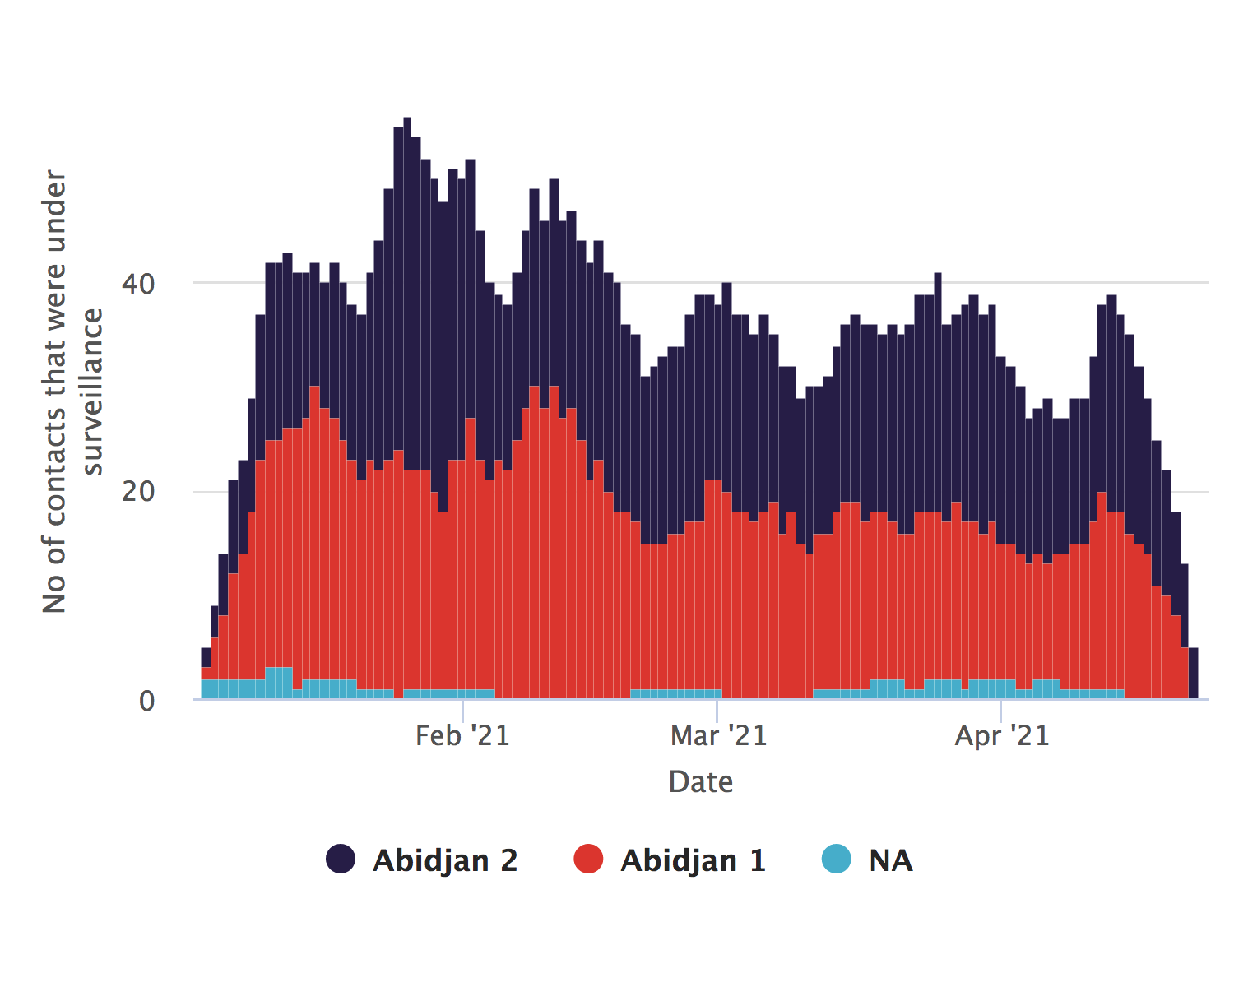
Regional trends absolute counts

Slide 16
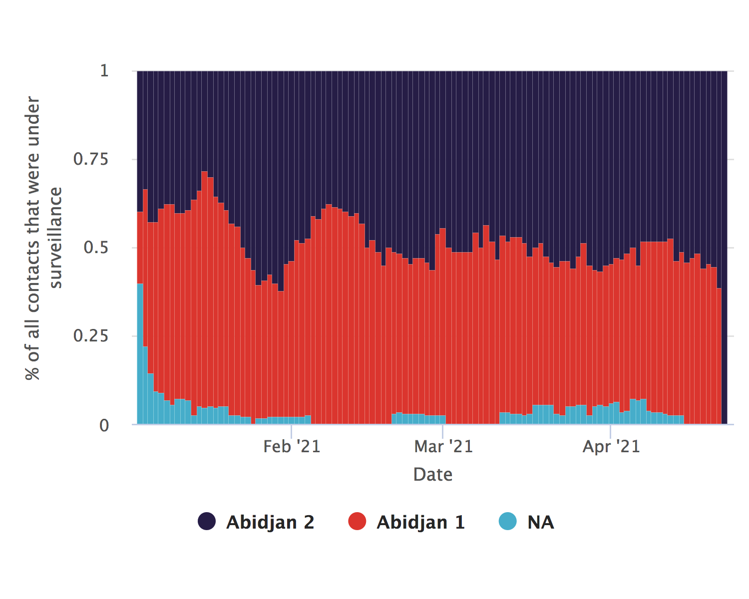
Regional trends relative proportions

Slide 17
Contacts per case

Slide 18
ℹ: The plots show the number of contacts linked to each case.
The mean number of contacts per case is 12.8, (SD:5.3) with a minimum of 2 and a maximum of 24

Slide 19
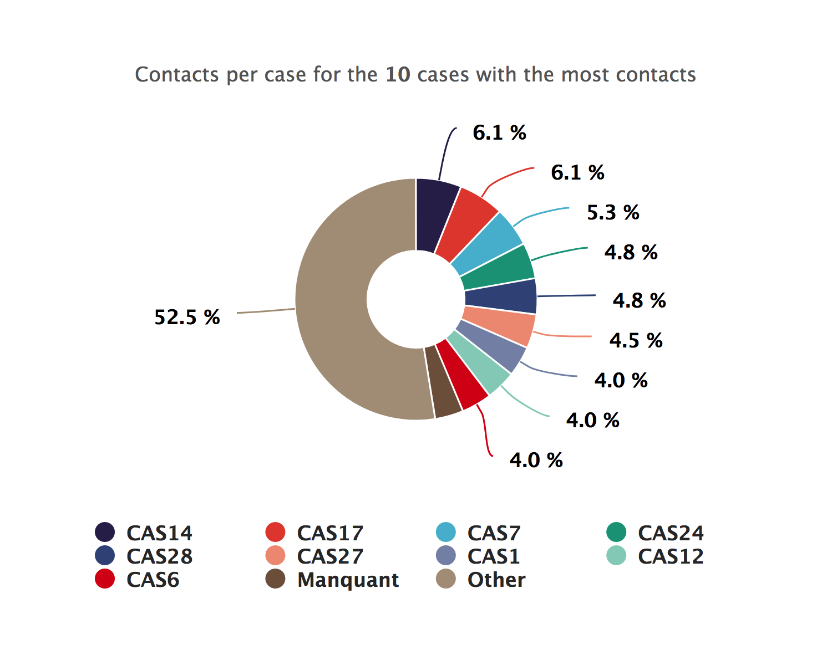
Contacts per case donut plot

Slide 20
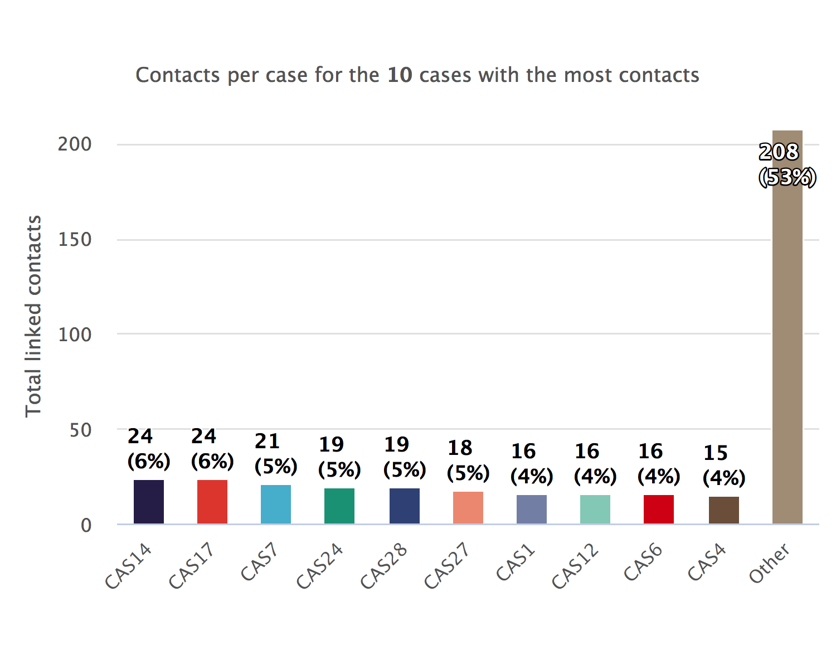
Contacts per case bar chart

Slide 21
Case-contact relationships

Slide 22
ℹ: The plots show the number of contacts per type of type of link. The categories have been cleaned and condensed. Access the data in tabular form by clicking on the top-right button.
The most common link category is ‘parent proche’, with 66 contacts (16.67%).

Slide 23
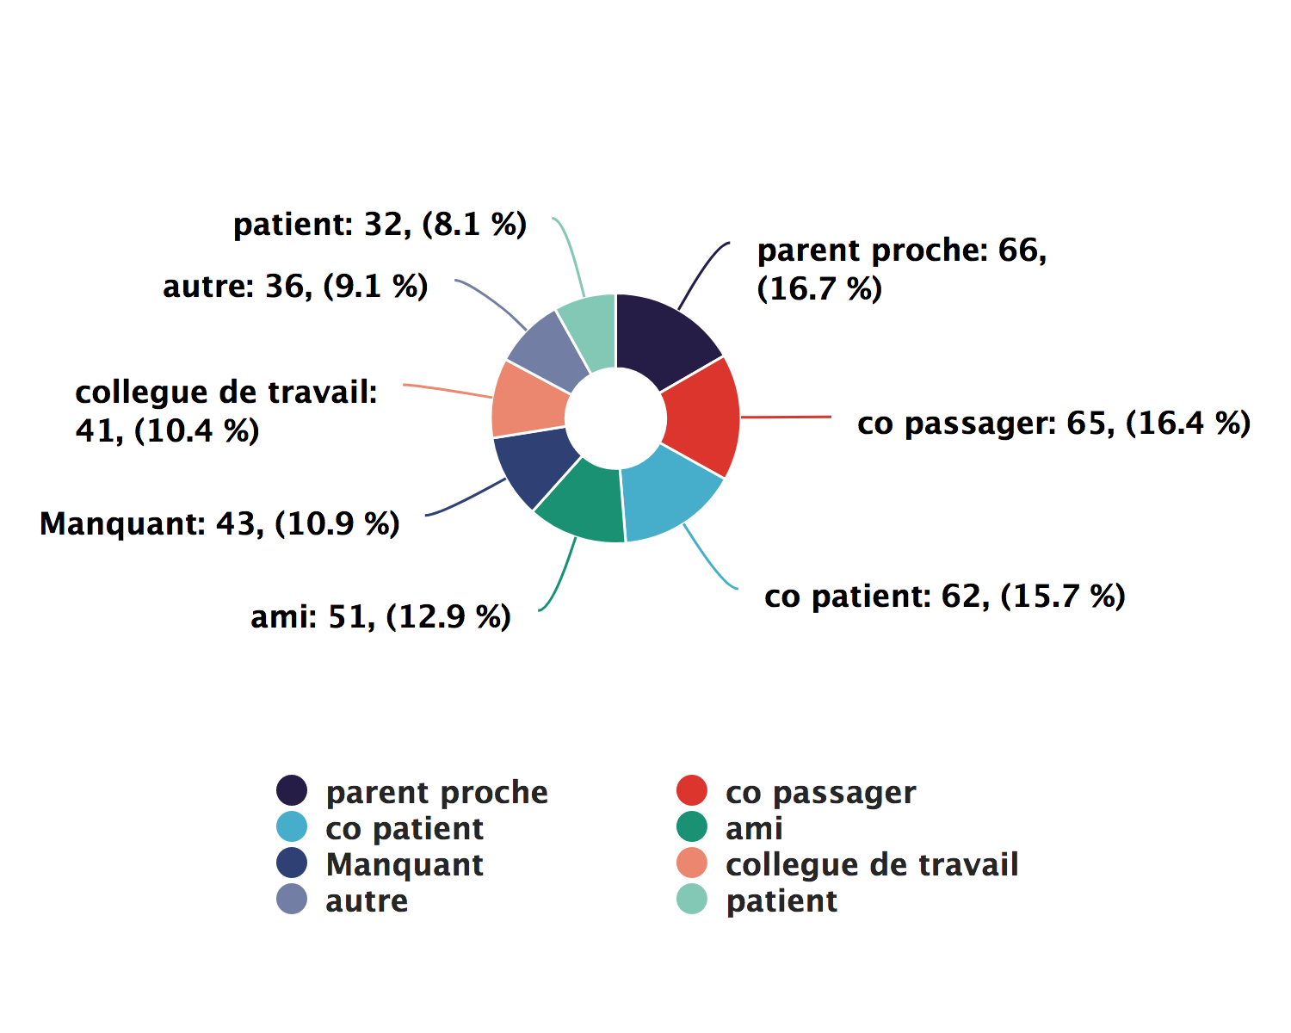
Case-contact relationships donut plot

Slide 24
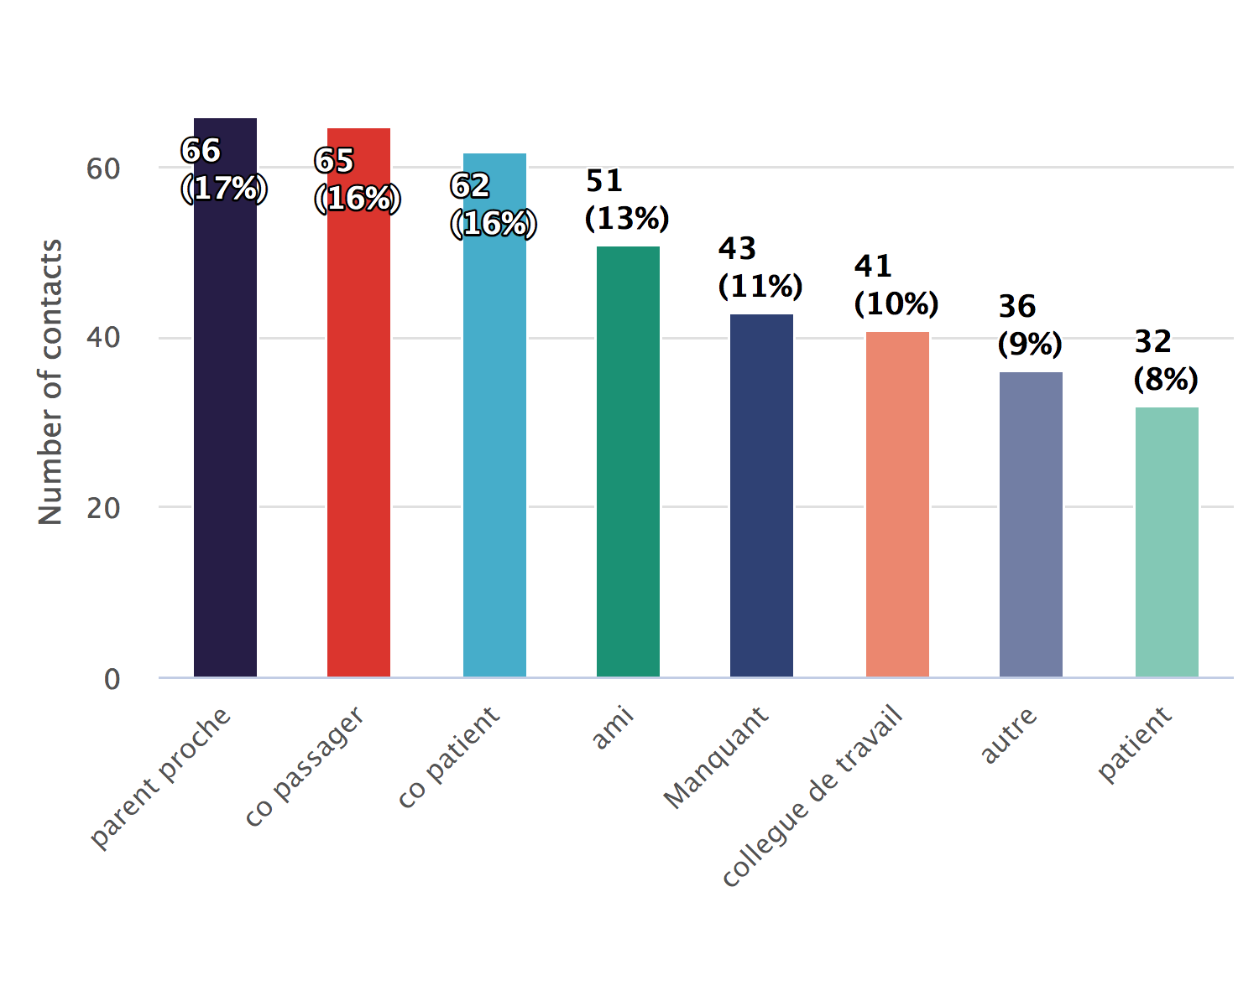
Case-contact relationships bar chart

Slide 25
DATA PERTAINING TO ACTIVE CONTACTS

Slide 26
Follow-up timelines

Slide 27
ℹ: The plots track the status of each active contact over all 10 days of follow-up.
There are 5 active contacts

Slide 28
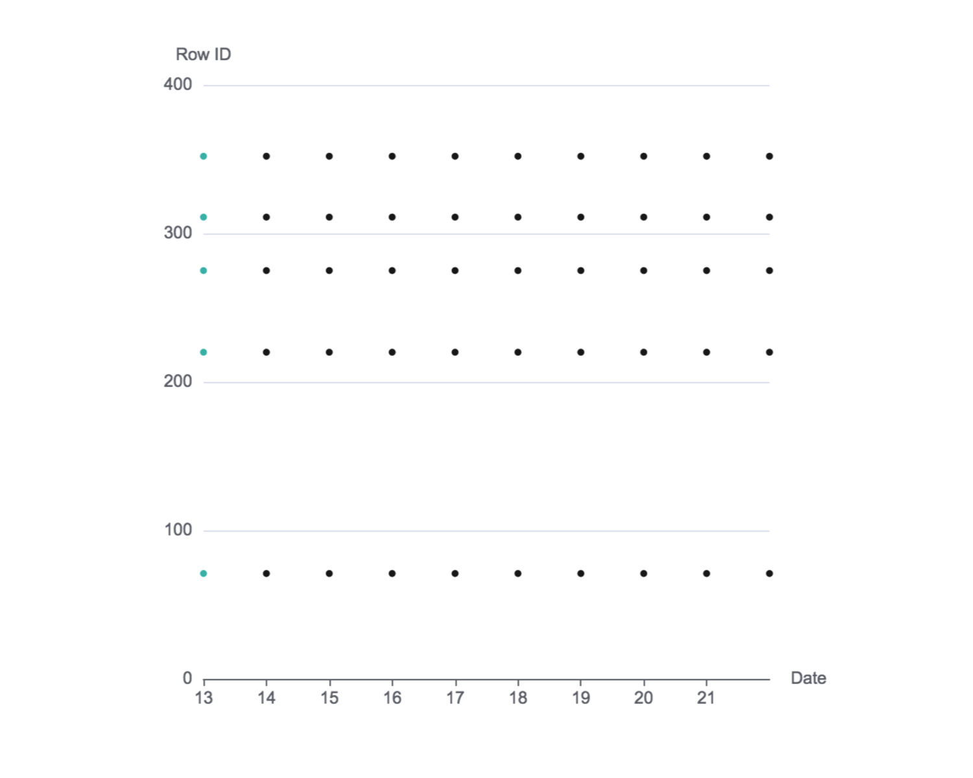
Follow-up timeline snake plot

Slide 29
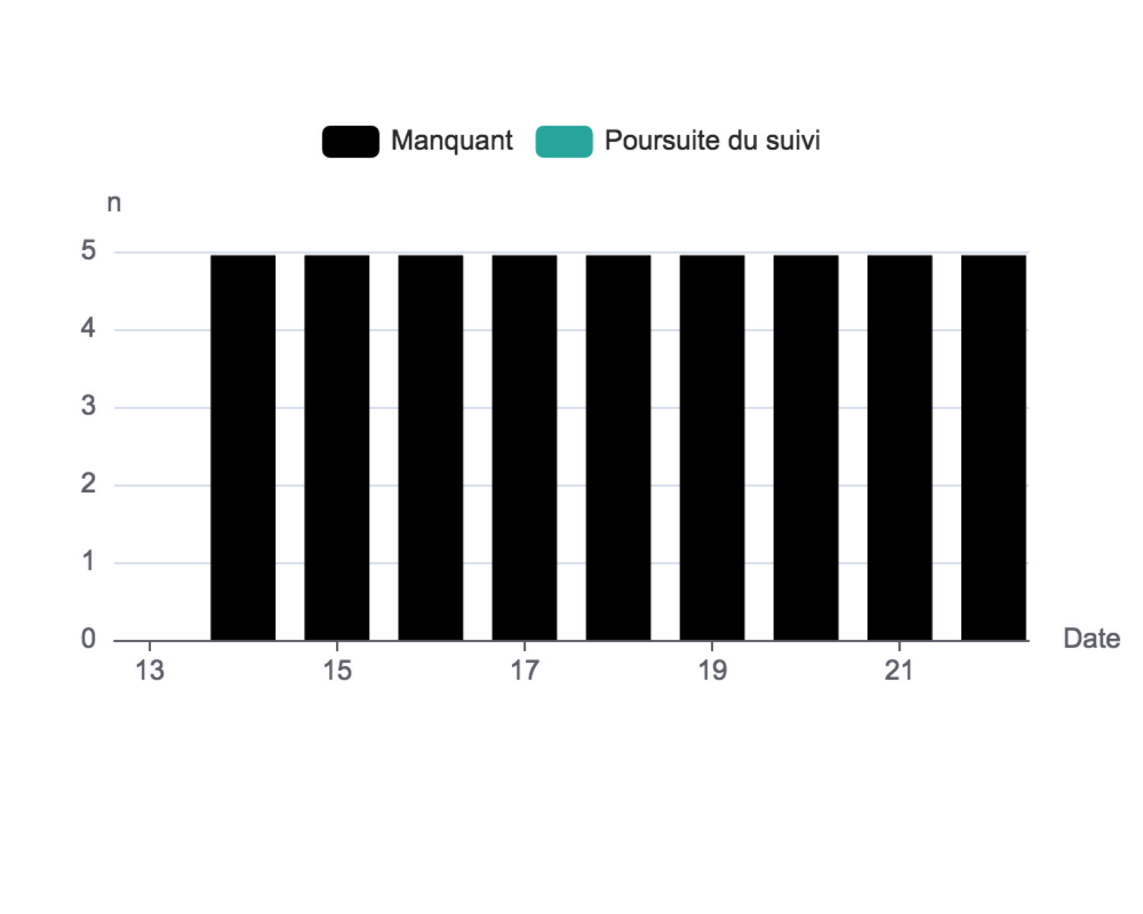
Follow-up summary bar chart

Slide 30
Contacts not seen recently

Slide 31
ℹ: The tables track the contacts who should be under surveillance but have not been followed for an extended period.
No lost to follow-up (LTFU) contacts to show. (An LTFU contact is a contact that has been seen for more than two days.)
[1] " "

Slide 32
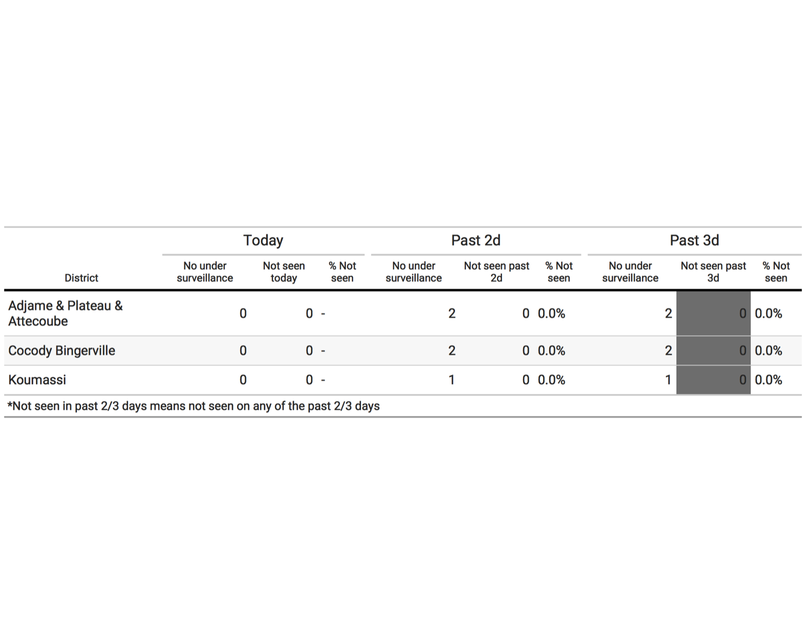
Loss to follow-up, past 3 days

Slide 33
List of contacts not seen
NULL

