Slide 1
RI vs SIA

Slide 2
Antigens with campaigns
HPV
JE
Measles
MenA
Rubella
YF

Slide 3
HPV
We are getting these from Paul and can ignore the distinction?
VIMC Assumptions:
2023 at 90% coverage for women 10-14 in most locations.
Exceptions:
Not included: AGO, AZE, BLZ, BOL, BTN, CUB, GUY, HND, KIR, LKA, LSO, NIC, RWA, UGA
2020 1% in ARM, MDA, and MNG
2023 74.3% in MHL
2023 82.8% in TUV

Slide 4
JE
VIMC Assumptions:
2023 at 90% coverage for both sexes 9-14.
Locations: BGD, BTN, PAK, PHL, PNG, PRK, THA, TLS

Slide 5
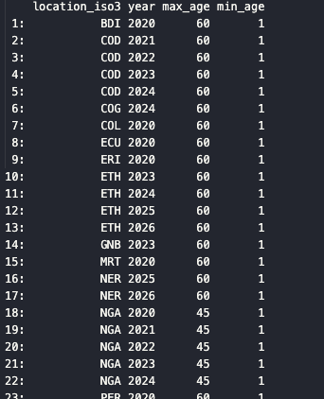
YF
VIMC Assumptions:
At 10% in 2020 (outside NGA, SDN, and UGA which are 90%) and 90% after that for both sexes 1-60 (1-45 for NGA)

Slide 6
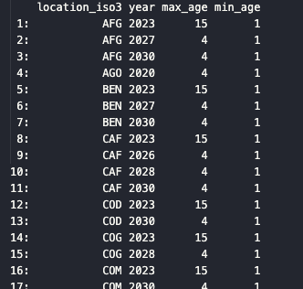
Rubella
VIMC Assumptions:
Every few years at 90% coverage for both sexes 1-15 first then 1-4

Slide 7
Discussion
Do we keep the VIMC campaigns?
This doesn’t affect incremental
Likely, yes keep them
Do we need to do imputation for the past?
Don’t model any new campaigns
Keep the campaigns in but no additions
What locations would not be in VIMC that would be likely to have campaigns?
Which locations have data and aren’t LMIC

