Slide 1


e-SMP
A Web infrastructure to support international nutritional studies
Notes:
- Template du CIRC
Full name e-SMP

Slide 2
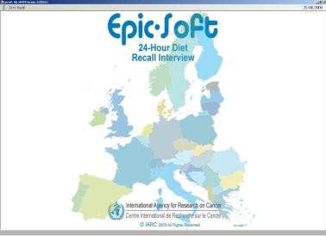

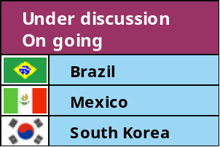
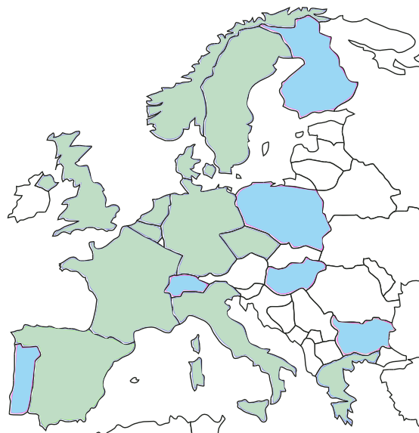
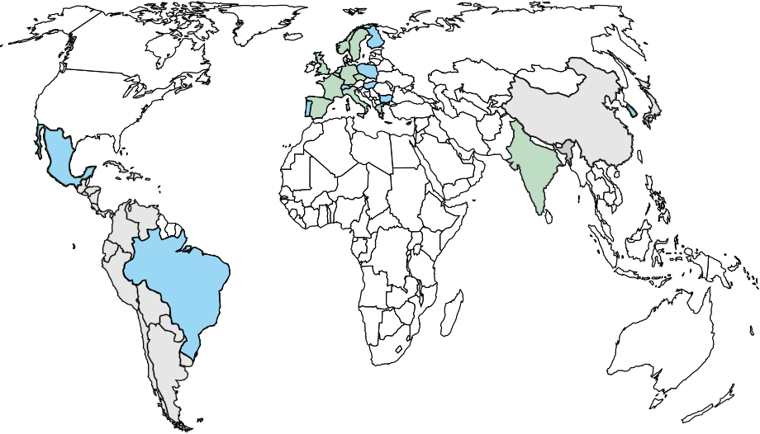
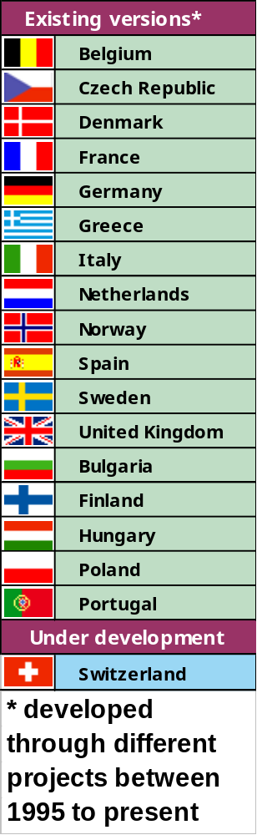
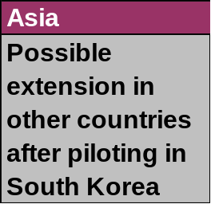
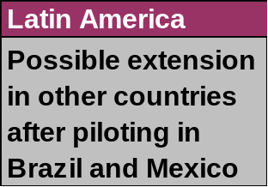
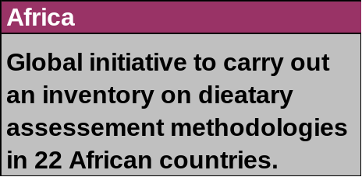
…to Other Global Regions/Countries
From Europe…
Notes:
Through different EU projects and international collaborations, this software was/ is or will be used in 18 EU countries. Initially used as reference calibration study in the 10 countries participating in EPIC, this software has also be adopted in National monitoring surveys, in Germany (20,000 24-HDR), NL, Germany and has been proposed as the reference method in future pan-European monitoring surveys.
More recently we have initiated some discussions to extend this methodology out EU, in Brazil and Mexico as a possible feasibility phase to develop a common Latin America dietary methodology. An attempt to adapt the method to asian countries was also initiated and should start early next year.

Slide 3
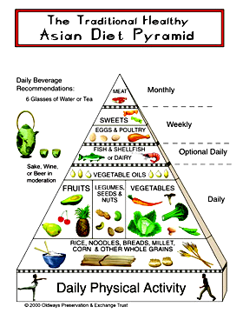
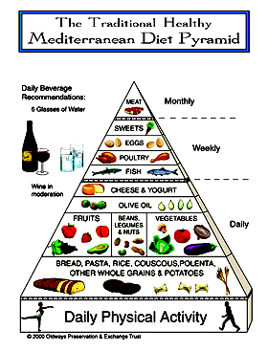
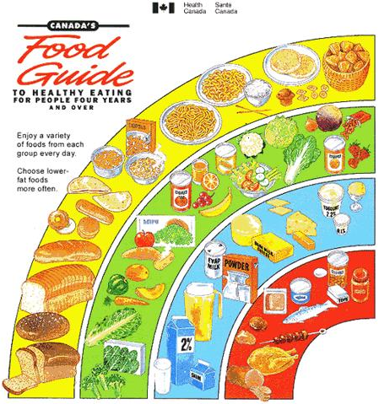
Perspectives….. Towards a cross-discipline standardised dietary methodology bridge
Clinical Nutrition
Nutritional
Epidemiology
Pan-monitoring
Surveys
[EFSA]
Direct institutional
Collaborations
Nutritional
Recommendations,
Guidelines and
Policies
Standardised Reference
Dietary Methodology
Food safety
Risk Assessments
Development of new
Country-versions
(Eastern Europe, Latin America, Asia)
Notes:
To conclude we might be at a unique time where the conjunction of advanced dietary methodologies, political interests by the EU authorities particularly and the dev. of web-based facilities might offer the possibility to move towards a common cross-discipline dietary methodology which could bridge different domains of nutritional activities and research (such as nutritional epidemiology, European monitoring surveys and clinical setting) and strengthen and re-enforce the complementary expertises to better collect, understand, study diet-disease association and derive relevant individual and public recommendations.
- Involving several partners and international collaborations, raising complex methodological as well as legal and political issues, but which also offer unique opportunities

Slide 4
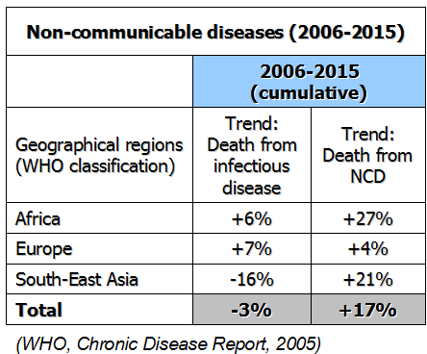

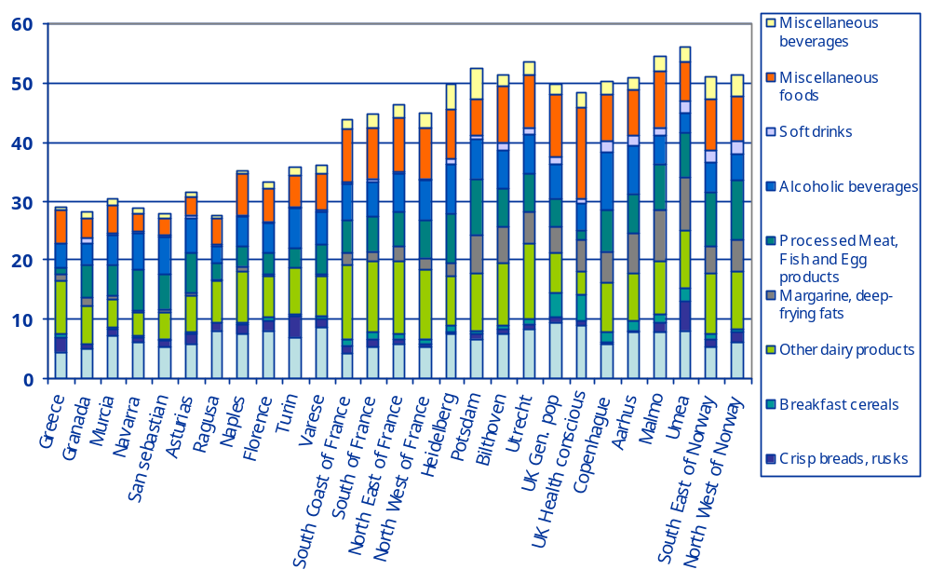

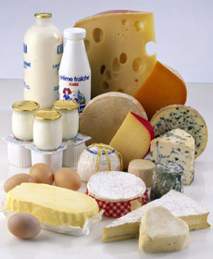

Introduction - Rationale
Current double disease and dietary burden
Need for a standardized European dietary methodology for monitoring and research purposes
The 24-hour dietary recall is recommended for both dietary monitoring and nutritional research
Through different EU projects (EPIC, EFCOSUM, EFCOVAL, IDAMES, PANCAKE, PANEU), EPIC-Soft® has been developed, adapted and validated for monitoring and research purposes
Highly processed foods in European population (% energy)
Worldwide massive introduction of
industrually processed foods in diet
Slimani et al., EJCN 2009
Notes:
As repeatly said during this conference, Europe and the rest of the world are faced to an unprecedent global double disease and dietary burden, with alarming projections on increasing NCD-incidence or mortality rates, touching particularly low and middle incomes countries (with rates betweeen 20% to 27% over the coming years depending on the region).
At the same time, we are also faced to a dietary burden observed with the global and accelerated phenoma over the last 30-40 years relates to a massive introduction of highly processed industrial foods in the woldwide populations’ diet (rich in fats, sugars, salt, energy), touching as well low-middle income countries and vulnerable population groups like children, adolescents and low SE classes. First comparable data used to estimate the contribution of these products suggest that highly industrially processed foods represent more than 50% in certain diets, with a still observed large geographical gradien across populations still depicting traditional diets (such as Mediterrean diet) as compared to more Western diet in the other countries.
As a result, this double burden also generated a major methodological challenge and raised the need to for a standardised European methodology for both monitoring and research purposes, to measure, follow-up and better understand the rapid changes in the dietary habits occuring in Europe and set concerted and cost-effective policies and public health actions.
Among the different existing methods, the 24-HDR is recommended The 24-hour dietary recall is recommended for both dietary monitoring and nutritional research
Through different EU projects (EPIC, EFCOSUM, EFCOVAL, IDAMES, PANCAKE, PANEU), EPIC-Soft® has been developed, adapted and validated for monitoring and research purposes

Slide 5
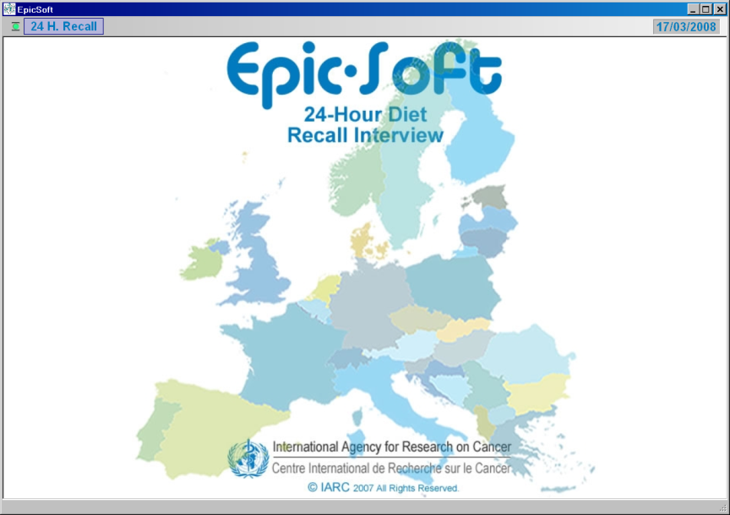

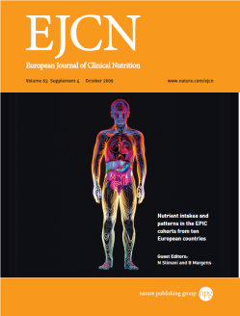
A common methodological for measuring
& monitoring accurately diet across Europe
Highly standardised and detailed 24-HDR method across EU countries (18 versions)
Same general concept and user’s interface
Adapted version for children and potentially elderly people (Data entry system)
Comprehensive quality controls (before, during and after interview collection)
Validated for face-to-face and telephone interview alternatives
Tested in different study designs & populations
Standardised e-training facilities (ongoing)
Methodological papers (concept, validation)
Descriptive EPIC papers on food & nutrient intakes/patterns
(First set of EU comparable data at food and nutrient level)
Other papers outside EPIC (e.g. EFCOVAL special issue)
EPIC diet-disease association papers
(EPIC-soft as reference calibration method)
Notes:
In its broad definition, EPIC-Soft is a Highly standardised and detailed 24-HDR method across EU countries
Same general concept and user’s interface
Adapted version for children and potentially elderly people (Data entry system)
Comprehensive quality controls (before, during and after interview collection)
Validated for face-to-face and telephone interview alternatives
Tested in different study designs & populations
Standardised e-training facilities (ongoing)
Several douzens of papers on the concept, validation, first set of comparable data available in Europe.

Slide 6
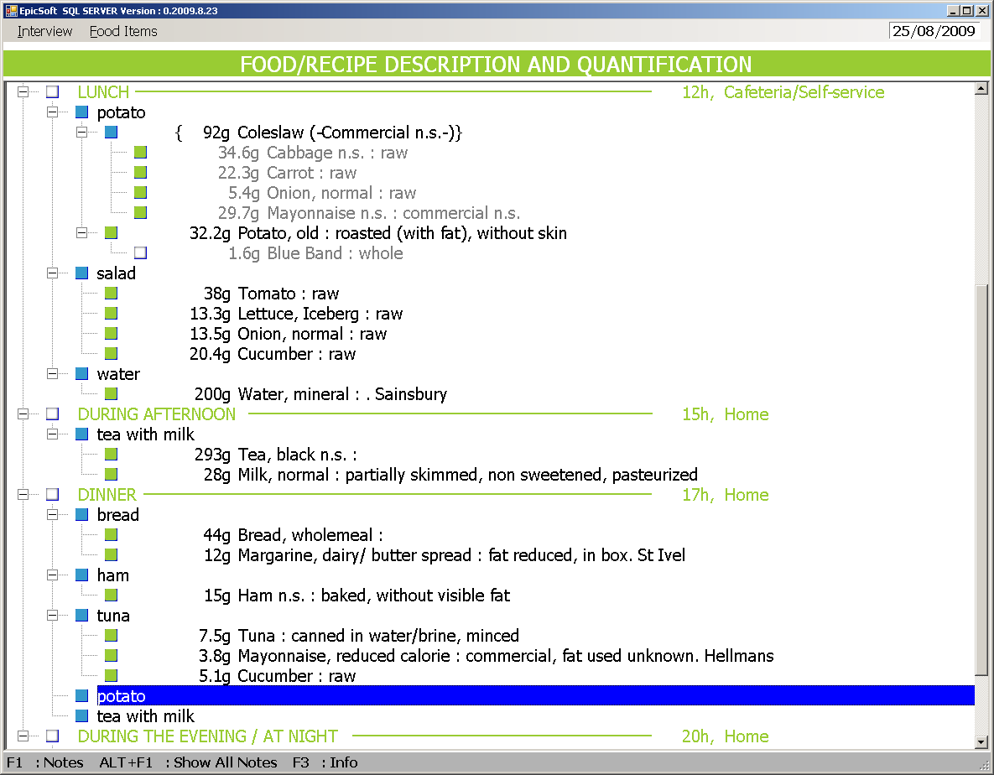
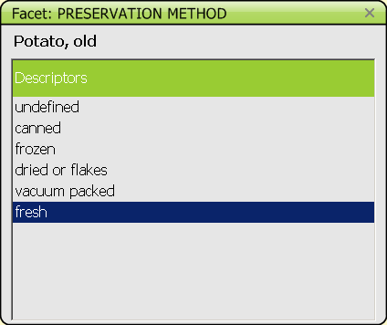
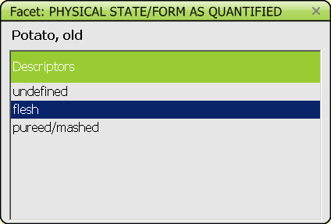
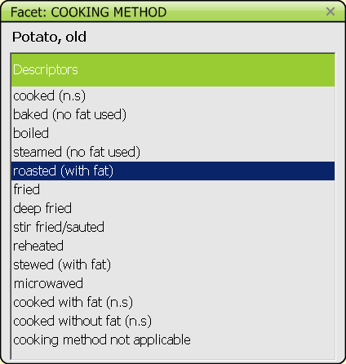
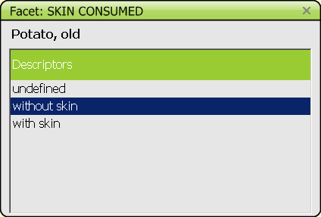
EPIC-Soft: A standardised and flexible system
Possibility to add:
New food
New recipe
New facet
New descriptor
Notes:
ES is a standardised tool which
- share the same interface and general concept across country-versions and standardised procedures to collect, search, describe, quantify, probe, calculate, export and maintain 24-Hdr recalls within and between countries.
- all the detailed information is systematically collected, stored and entirely retrievable
- As an example, the identification, search and level of description of the foods consumed by the study subjects is controlled by using the same sets of questions (facets such as preservation method, physical state, cooking method, skin consumed) and their related precoded answers of descriptors (e.g. different baked, fried, etc…) specific to each facet

Slide 7
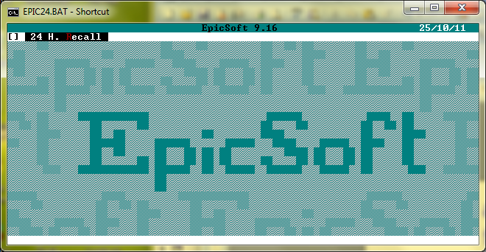
Main adaptations & other improvements for monitoring and other surveys (1/2)
EPIC-Soft application
MS-DOS → Windows
DBase → SQL server
International characters
(e.g. Greek, cyrilic)
Reprogramme the internal architecture
New Graphical User Interface
EPIC-Soft as a Data entry application (children, elderly)
EPIC-Soft Databases
Adapt food and recipe classifications
Add new facets & descriptors for risk safety (e.g. packaging format and material, characterising ingredient and flavouring agent, extend of cooking)
New quantification methods
Back calculation from “as consumed” to raw commodities
Old version
New version
Notes:
Through different project, and particularly the the FP6 EU EFCOVAL project,
The software developed in the early 90s has been further improved and adapted to specific needs of monitoring/risk assessment purposes.
This includes for the application itself:
MS-DOS → Windows
DBase → SQL server
International characters
(e.g. Greek, cyrilic)
Reprogramme the internal architecture
New Graphical User Interface
EPIC-Soft as a Data entry application (children, elderly)
EPIC-Soft Databases
Adapt food and recipe classifications
Add new facets & descriptors for risk safety (e.g. packaging format and material, characterising ingredient and flavouring agent, extend of cooking)
New quatification methods
Back calculation to raw commodities

Slide 8
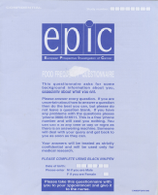
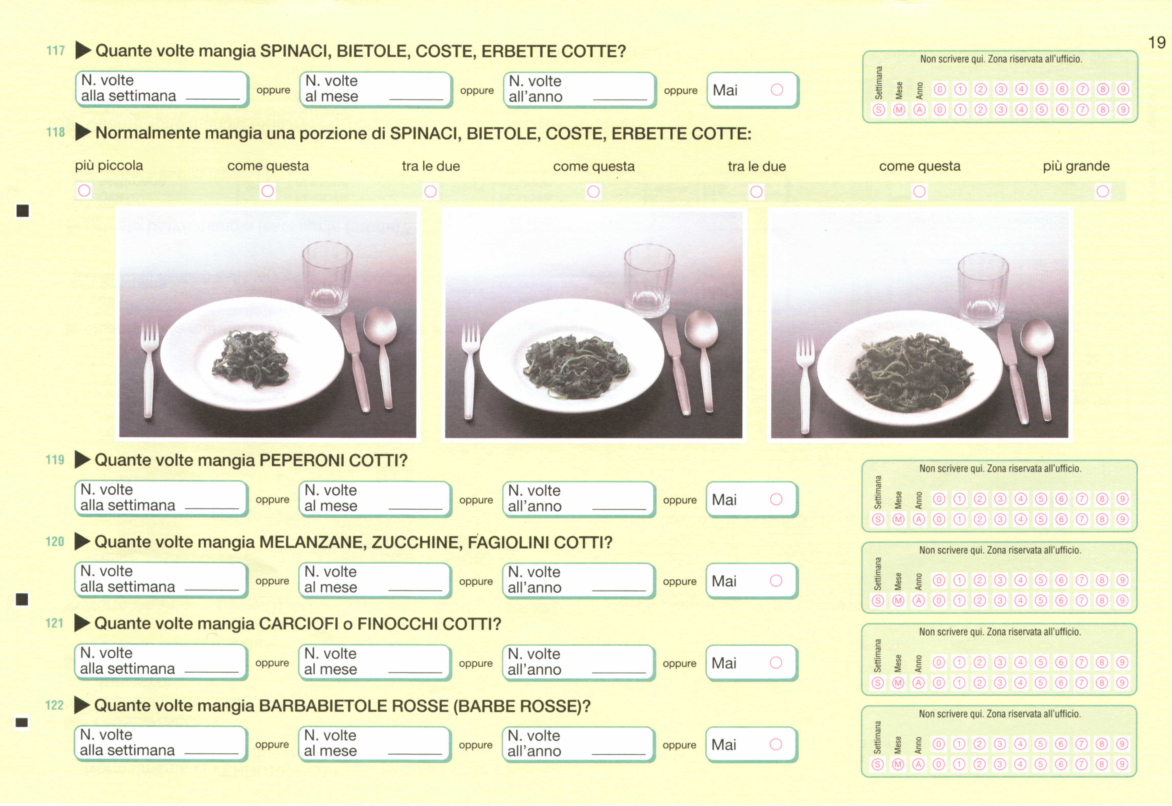



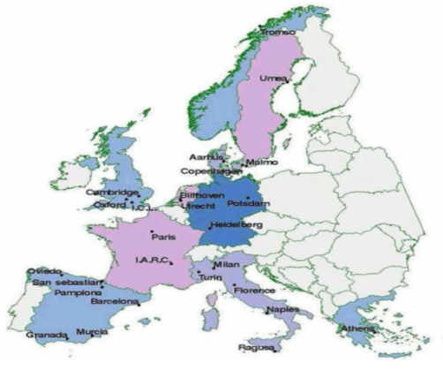









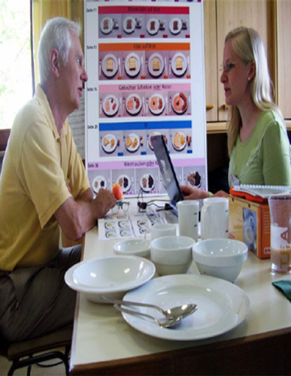
EPIC-Soft: Used in European epidemiological studies (reference calibration)
EPIC cohort
(N=~520,000)
  Country-specific baseline FFQ to rank individual intakes
1. to increase comparability of FFQ across the 23 EPIC centres
2. to de-attenuate RR estimates for the effect of measurement errors
Calibration
24-DHR (R)
R = T + ε_{R}
E(λ) = ρ²_{QT} / β_{Q}
λ = attenuation coefficient
Q = α_{Q} + β_{Q}T + ε_{Q}
Questionnaire (Q)
Cohort sub-sample
(N=~37,000)
  A standardised single interview-based 24-HDR to estimate mean population intakes
Notes:
From the cummulated experiences over the last more than 15 years, the EPIC-Soft application has been used or tests in different European study setting in nutritional research or monitoring surveys.
First of all as the reference calibration in the largest cohort on diet and cancer and other chronic diseases worldwide (the EPIC project), with the main objective to increase the comparability of dietary measurements across participating countries vand de-attenuate the RR estimates for the effect of measurement errors. This was performed by combining two sets of dietary methodologies a) the country-specific FFQ used at baseline to estimate usual individual intakes and rank individual (applied on the whole cohort of more than half million subjects) and a single standardised interview-based 24-hour dietary recall using ES and applied on a representative sub-sample of (37,000 subjects) to have an accurate population mean estimates. Regression of 24-HDR measurements on questionnaire one, enable to derive the calibration coefficient used both to correct for within and between calibrations.
The validation of ES as reference method to discriminate population mean intakes across EU give very promising results with ecological correlation between diet and corresponding concentration and recovery biomarkers between correlations between 0.7 to 0.9 (urinary nitrogen/potassium)

Slide 9
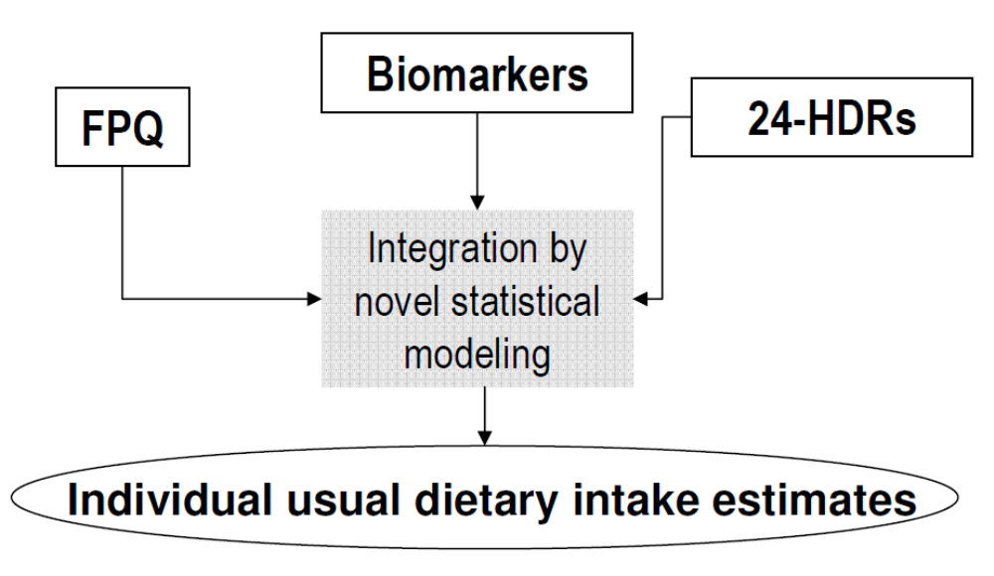
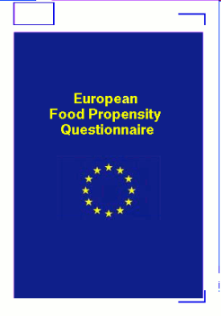
EPIC-Soft: used in European epidemiological study (usual individual intakes)
  2-3 x 24-HDRs as main instrument + Food Propensity Questionnaire (FPQ) as complementary tool
+
Estimating individual usual dietary intakes¹
https://www.nugo.dife.de/efbo/portal
Feasibility study in 5 European countries, n=261 (IDAMES)²
  ¹Illner,....Slimani (2011), IJE, sub.
  ²Illner et al. (2011), Public Health Nutr.
Notes:
Beside the use of calibration reference measurements, ES has also been tested as main baseline method to estimate usual individual intakes (not population means), within the framework of the EU-IDAMES project involving 5 EU countries.
In a study design more and more recommended and currently tested by other research groups (NCI) in cohort studies, the approach consists in using 2-3 non consecutive 24-HDRs complemented by so-called Food Propensity questionnaire which has as main purpose to reduce the individual random errors by distinguishing the real from occasional non consumers.

Slide 10
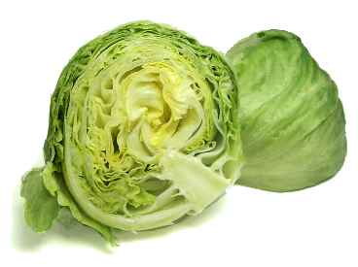
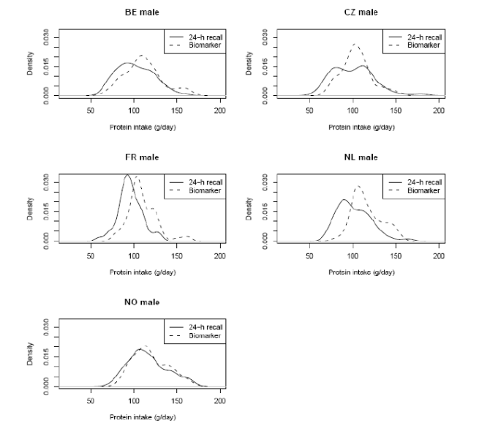

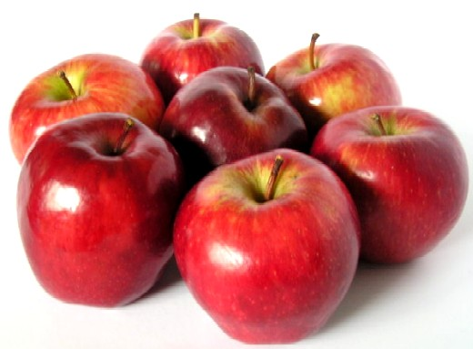
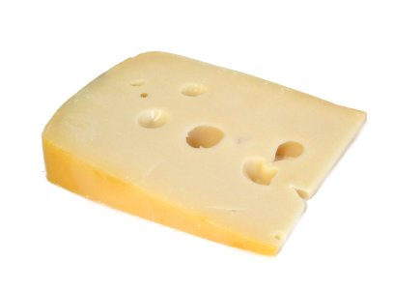
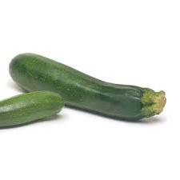

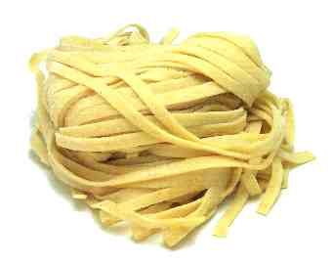

EPIC-Soft: used for European Monitory monitoring surveys (and beyond)
Tested in 12 European countries (EFCOVAL, PANCAKE, PANEU):
  At least 2 interview-based 24-HDRs to estimate standardized population intakes and distribution
Assessing means and distribution of intakes
Latin America, Asia
Crispim et al. 2011. Br J Nutrition
Future
(To be) Implemented in 5 countries Netherlands, Belgium, Germany, Switzerland and the France,
EU-Menu
http://www.efsa.europa.eu/en/datexfoodcdb/datexeumenu.htm
Notes:
The third current application of ES is to use of it as reference method in national and international monitoring surveys, with the main purpose to be population means and distributions.
These has been or is tested in 12 EU countries through different projects and strong support from EFSA mandated to set up the first and future pan-European monitoring survey (so-called EU-Menu), where ES has been recommended as the reference method. ES has already been used in national surveys in NL, Belgium and Germany and versions are under preparation for a formal use in France and Switzerland as well. First contact with other countries interested to use ES for monitoring and research has also been established outside Europe (far advanced collaboration).
Validation of population means and distributions against biomarkers has also given relatively well results as depicted, suggesting that despite inherent measurement errors, dietary data can be used for monitoring surveys, particularly when all data will be pooled together.

Slide 11
e-SMP: Rationale
24-HDR method is a detailed and dynamic open-ended method requiring regular and rigorous maintenance;
Although still functional, the old maintenance procedures are out of date for large dissemination;
There is a need to preserve concept of standardisation and integrity of the EPIC-soft dietary methodology over time;
It is crucial to maintain a centralised control on the use and changes on existing database versions of EPIC-soft;
Standardization by federation of the experiences
IARC, as an International non-profit WHO-UNU organisation and owner of the EPIC-soft methodology, has as main mission to disseminate knowledge.

Slide 12










e-SMP: General Aims
Security, users & projects management, data protection
Administration
Administration
Maintenance & Setting
Interview Management
Create, edit & export EPIC-Soft database
Communication
Centralize, organize, edit (notes, status) & export EPIC-Soft interviews
International
International
National
Project
National
Project
National
National
Local
Admin
Project
Local
Admin
Admin
Admin
Admin
Admin
Admin
Admin
Admin
Admin
Admin
Interview collection
EPIC-Soft and its data-entry application
End
End-user
-
A platform to conduct and support international studies,
Standardise dietary methodology between countries and projects,
Preserve the concept of standardisation and integrity over time,
Cost-effective for countries with limited local technical resources and dietary skills;
Independence and flexibility for individual projects;
Facilitate communication and data synchronisation/exchange.

Slide 13
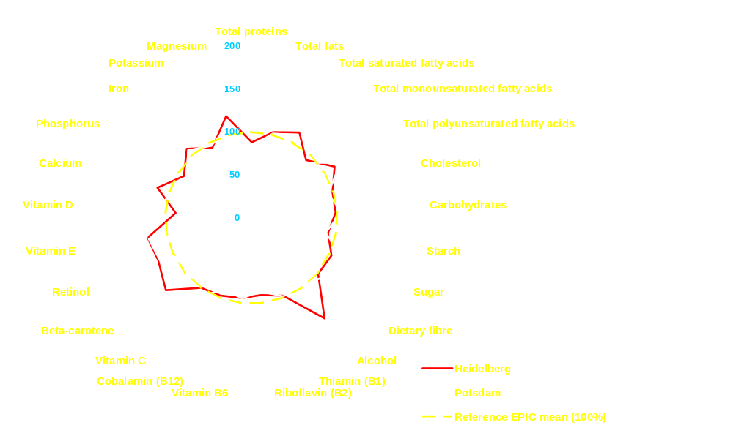










Dietary patterns : Germany (Women)
Foods
Nutrients
Vegetables
Juices
250
Fruits
Alcohol
Potatoes
200
Soft drinks
Legumes
150
Coffee
100
Cereal Products
Tea
50
Cakes
0
Sauces
Sugar Products
Fish products
Vegetable oils
Freisling et al. JN 2010
Processed Meat
Margarines
Fresh Meat
Butter
The EPIC Nutrient DataBase (ENDB)
Eggs
Milk
Potsdam
Dairy Products
Heidelberg
Reference EPIC mean (100%)
27 first priority nutrients
Slimani et al. PHN 2002
Slimani et al. EJCN 2007
Notes:
- Before presenting a selected number of dietary patterns observed in EPIC. I would like to give you some guidance on how to interpret these multi-graphic representations, if you are not already familiar with them.
- As indicate before, the circle of radius of 100%, indicated by a yellow dotted line, corresponds to the reference EPIC mean between food groups. For each individual food group, the centre and gender-specific mean was re-expressed in percentage of deviation relative to the EPIC mean (in grams) indicated in red into parentheses. These numbers will not be repeated in the following graphs. The Higher is the deviation of the spikes over the circle, the more the food group is a dietary characteristic of the centre compared to others and vise versa when the spikes are lower down in the circle.
- In order to facilitate the interpretation and comparisons of dietary patterns across countries/centres, the food groups were ordered according to their plant or animal origin and their degree of food processing.
The Greek diet
1) Strongly characterized by plant foods such as vegetable oils, legumes and vegetables and is among the EPIC countries.
- In contrast to the other Mediterranean countries (Italy and Spain), vegetables consumption is much higher than fruit consumption, with the latter below the EPIC mean.
2) Consumption of animal products, fish, dairy products, meat, egg and milk are below the EPIC mean whereas the consumption of cereal products is around the mean.
3) Alcohol, meat, juices, sugar products, cakes, soft drinks, potatoes, sauces, et to a greater extent, butter, coffee, margarine, processed meats, tea (<30%) are not important components of the Greek diet when compared to the other EPIC centres

Slide 14
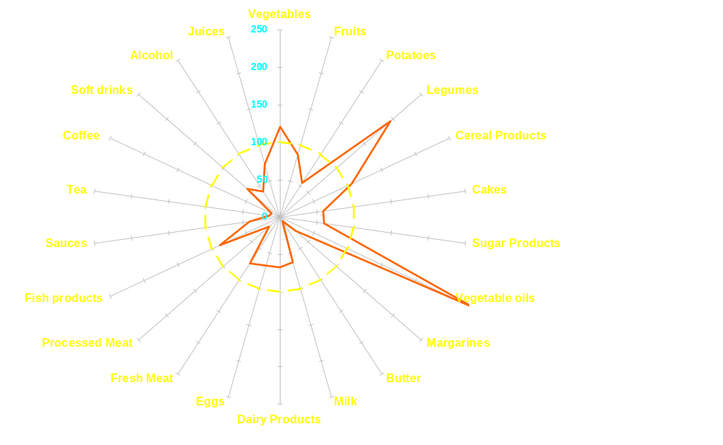
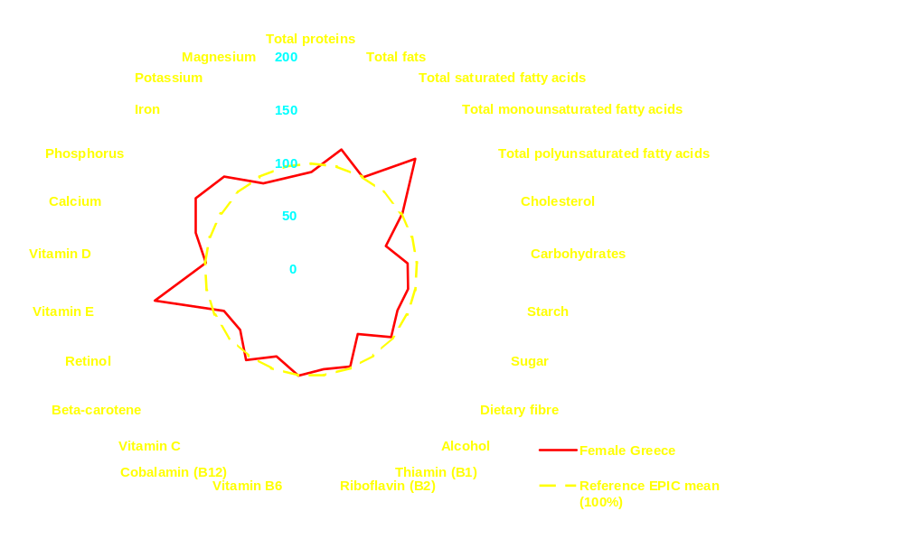
Dietary patterns : Greece (Women)
Foods
Nutrients
Greece
Reference EPIC mean (100%)
Freisling et al. JN 2010
The EPIC Nutrient DataBase (ENDB)
27 first priority nutrients
Slimani et al. PHN 2002
Slimani et al. EJCN 2007
Notes:
- Before presenting a selected number of dietary patterns observed in EPIC. I would like to give you some guidance on how to interpret these multi-graphic representations, if you are not already familiar with them.
- As indicate before, the circle of radius of 100%, indicated by a yellow dotted line, corresponds to the reference EPIC mean between food groups. For each individual food group, the centre and gender-specific mean was re-expressed in percentage of deviation relative to the EPIC mean (in grams) indicated in red into parentheses. These numbers will not be repeated in the following graphs. The Higher is the deviation of the spikes over the circle, the more the food group is a dietary characteristic of the centre compared to others and vise versa when the spikes are lower down in the circle.
- In order to facilitate the interpretation and comparisons of dietary patterns across countries/centres, the food groups were ordered according to their plant or animal origin and their degree of food processing.
The Greek diet
1) Strongly characterized by plant foods such as vegetable oils, legumes and vegetables and is among the EPIC countries.
- In contrast to the other Mediterranean countries (Italy and Spain), vegetables consumption is much higher than fruit consumption, with the latter below the EPIC mean.
2) Consumption of animal products, fish, dairy products, meat, egg and milk are below the EPIC mean whereas the consumption of cereal products is around the mean.
3) Alcohol, meat, juices, sugar products, cakes, soft drinks, potatoes, sauces, et to a greater extent, butter, coffee, margarine, processed meats, tea (<30%) are not important components of the Greek diet when compared to the other EPIC centres

Slide 15
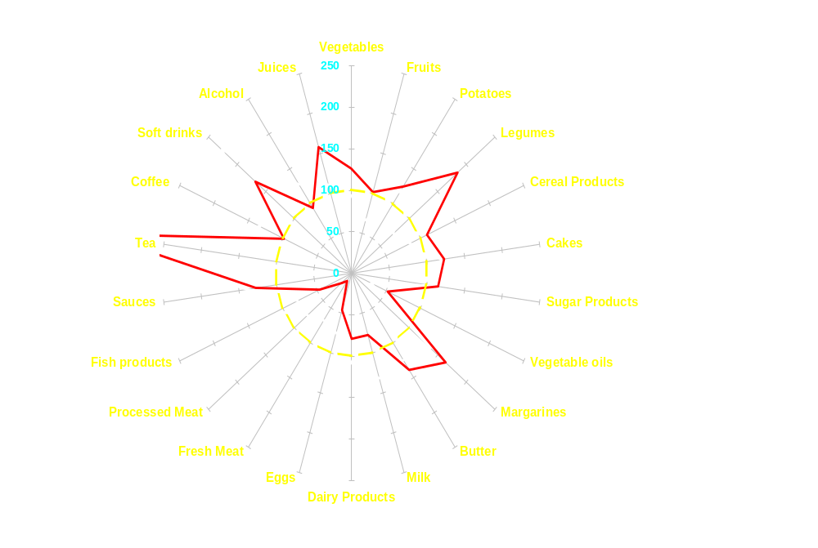
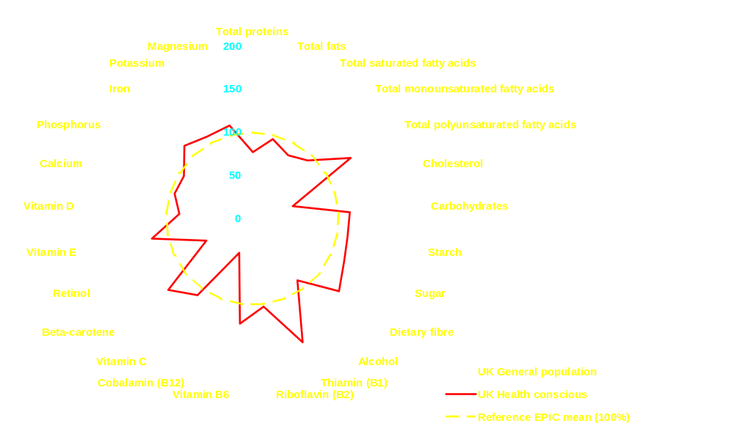
Dietary patterns : UK (Women)
Foods
Nutrients
UK General population
UK Health Conscious
Reference EPIC mean (100%)
Slimani et al. PHN 2002
Freisling et al. JN 2010
The EPIC Nutrient DataBase (ENDB)
27 first priority nutrients
Slimani et al. EJCN 2007
Notes:
- Before presenting a selected number of dietary patterns observed in EPIC. I would like to give you some guidance on how to interpret these multi-graphic representations, if you are not already familiar with them.
- As indicate before, the circle of radius of 100%, indicated by a yellow dotted line, corresponds to the reference EPIC mean between food groups. For each individual food group, the centre and gender-specific mean was re-expressed in percentage of deviation relative to the EPIC mean (in grams) indicated in red into parentheses. These numbers will not be repeated in the following graphs. The Higher is the deviation of the spikes over the circle, the more the food group is a dietary characteristic of the centre compared to others and vise versa when the spikes are lower down in the circle.
- In order to facilitate the interpretation and comparisons of dietary patterns across countries/centres, the food groups were ordered according to their plant or animal origin and their degree of food processing.
The Greek diet
1) Strongly characterized by plant foods such as vegetable oils, legumes and vegetables and is among the EPIC countries.
- In contrast to the other Mediterranean countries (Italy and Spain), vegetables consumption is much higher than fruit consumption, with the latter below the EPIC mean.
2) Consumption of animal products, fish, dairy products, meat, egg and milk are below the EPIC mean whereas the consumption of cereal products is around the mean.
3) Alcohol, meat, juices, sugar products, cakes, soft drinks, potatoes, sauces, et to a greater extent, butter, coffee, margarine, processed meats, tea (<30%) are not important components of the Greek diet when compared to the other EPIC centres

Slide 16
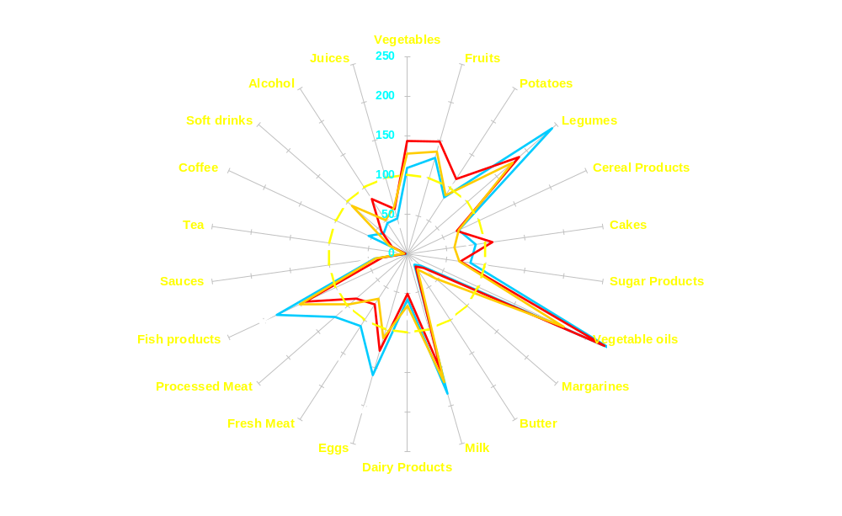
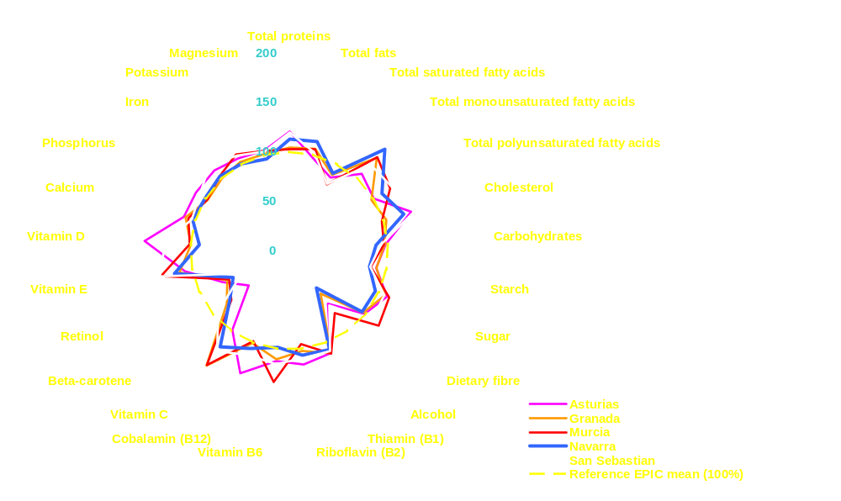
Dietary patterns : Spain (Women)
Foods
Nutrients
Freisling et al. JN 2010
Granada
The EPIC Nutrient DataBase (ENDB)
Murcia
Navarra
San Sebastian
Asturia
Reference EPIC mean (100%)
27 first priority nutrients
Slimani et al. PHN 2002
Slimani et al. EJCN 2007

Slide 17
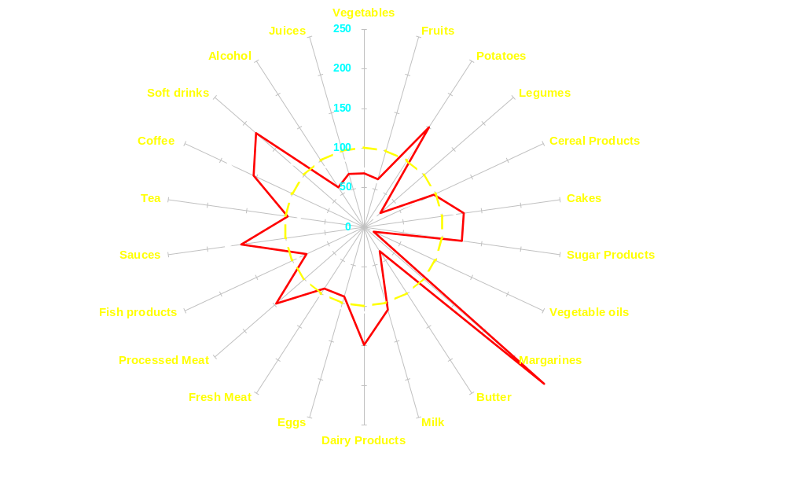
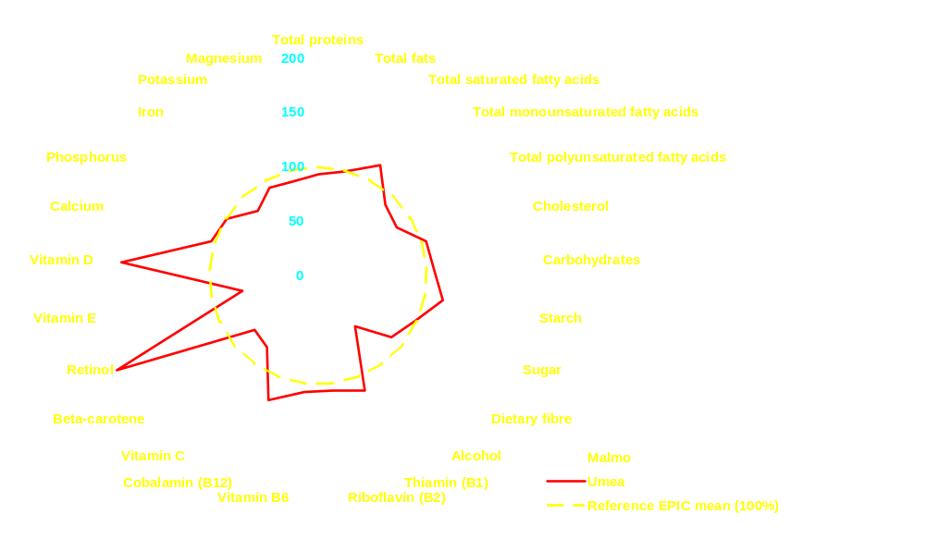
Dietary patterns : Sweden (Women)
Foods
Nutrients
Slimani et al. PHN 2002
Freisling et al. JN 2010
The EPIC Nutrient DataBase (ENDB)
27 first priority nutrients
Slimani et al. EJCN 2007
Notes:
- Before presenting a selected number of dietary patterns observed in EPIC. I would like to give you some guidance on how to interpret these multi-graphic representations, if you are not already familiar with them.
- As indicate before, the circle of radius of 100%, indicated by a yellow dotted line, corresponds to the reference EPIC mean between food groups. For each individual food group, the centre and gender-specific mean was re-expressed in percentage of deviation relative to the EPIC mean (in grams) indicated in red into parentheses. These numbers will not be repeated in the following graphs. The Higher is the deviation of the spikes over the circle, the more the food group is a dietary characteristic of the centre compared to others and vise versa when the spikes are lower down in the circle.
- In order to facilitate the interpretation and comparisons of dietary patterns across countries/centres, the food groups were ordered according to their plant or animal origin and their degree of food processing.
The Greek diet
1) Strongly characterized by plant foods such as vegetable oils, legumes and vegetables and is among the EPIC countries.
- In contrast to the other Mediterranean countries (Italy and Spain), vegetables consumption is much higher than fruit consumption, with the latter below the EPIC mean.
2) Consumption of animal products, fish, dairy products, meat, egg and milk are below the EPIC mean whereas the consumption of cereal products is around the mean.
3) Alcohol, meat, juices, sugar products, cakes, soft drinks, potatoes, sauces, et to a greater extent, butter, coffee, margarine, processed meats, tea (<30%) are not important components of the Greek diet when compared to the other EPIC centres

Slide 18
Dietary patterns : Spain (Women)
Foods
Nutrients
Slimani et al. PHN 2002
Freisling et al. JN 2010
The EPIC Nutrient DataBase (ENDB)
27 first priority nutrients
Slimani et al. EJCN 2007
Notes:
- Before presenting a selected number of dietary patterns observed in EPIC. I would like to give you some guidance on how to interpret these multi-graphic representations, if you are not already familiar with them.
- As indicate before, the circle of radius of 100%, indicated by a yellow dotted line, corresponds to the reference EPIC mean between food groups. For each individual food group, the centre and gender-specific mean was re-expressed in percentage of deviation relative to the EPIC mean (in grams) indicated in red into parentheses. These numbers will not be repeated in the following graphs. The Higher is the deviation of the spikes over the circle, the more the food group is a dietary characteristic of the centre compared to others and vise versa when the spikes are lower down in the circle.
- In order to facilitate the interpretation and comparisons of dietary patterns across countries/centres, the food groups were ordered according to their plant or animal origin and their degree of food processing.
The Greek diet
1) Strongly characterized by plant foods such as vegetable oils, legumes and vegetables and is among the EPIC countries.
- In contrast to the other Mediterranean countries (Italy and Spain), vegetables consumption is much higher than fruit consumption, with the latter below the EPIC mean.
2) Consumption of animal products, fish, dairy products, meat, egg and milk are below the EPIC mean whereas the consumption of cereal products is around the mean.
3) Alcohol, meat, juices, sugar products, cakes, soft drinks, potatoes, sauces, et to a greater extent, butter, coffee, margarine, processed meats, tea (<30%) are not important components of the Greek diet when compared to the other EPIC centres

Slide 19
Application of new combined approaches to improve individual usual dietary intakes
  2-3 x 24-HDRs as main instrument + Food Propensity Questionnaire (FPQ) as complementary tool
https://www.nugo.dife.de/efbo/portal
IARC (DEX group)
  ¹Illner,....Slimani (2011), IJE, sub.
  ²Illner et al. (2011), Public Health Nutr.
Notes:
Based on accumulated experience in new dietary assessment methodologies at IARC and elsewhere to develop new concepts combining different approaches making use of the DEX’s outcomes (repeated 24-HDR recalls using ES) and other projects (Food propensity questionnaires and Multiple Sources statistical Models, DEX intends further dev. This approach and apply it in different ongoing/planned projects in epidemiological as well as monitoring surveys.

Slide 20
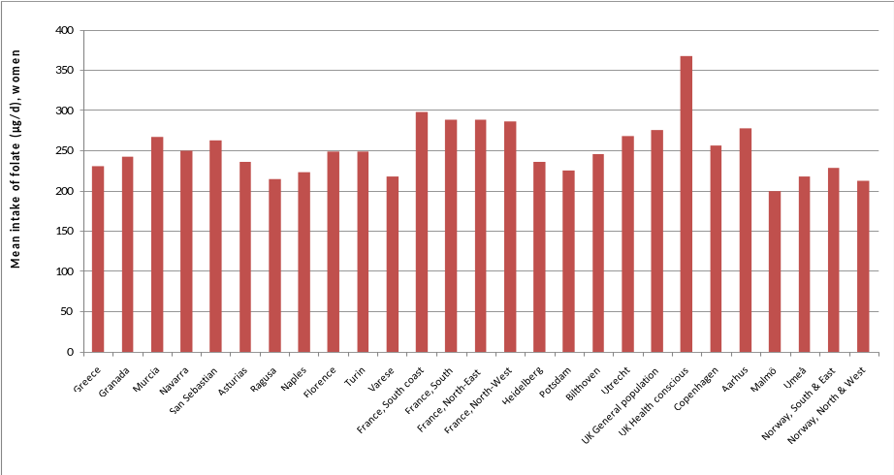
Stepwise model to study specific dietary exposures in
international study settings (e.g. folate)
Inventory of folate databases in 18 countries
Critical evaluation of folate data in European and international databases.
K Bouckaert et al. Mol Nutr Food Res 2011;55: 66-180
Methodological work
Harmonisation and compilation of the nutrient databases
Standardization of folate database for international nutritional research: report of the experience from the EPIC study. G Nicolas et al. (in preparation)
Inventory of validation studies on dietary folate intake against biomarkers
Dietary intake and biological measurement of folate: A review of validation studies. JY Park et al. (In preparation)
Exposure assessment (including biomarkers) in collaboration with BMA
First comparison of standardised dietary folate intake in Europe
Relationships between dietary and corresponding serum B vitamins involved in one-carbon metabolism in the EPIC study
Application of epidemiological studies in collaboration with NEP
Nutrients patterns and pancreatic cancer risk in EPIC
Park et al. 2011
To be integrated in a broader ongoing EPIC project entitled “Dietary patterns in EPIC and their application in studies on disease risk: concepts and work plans” in collaboration Dife (Germany) (Nutritional Working Group, N Slimani et al.)
Nutrient patterns and Colorectal and breast cancer (Moskal et al.)
Nutrient patterns and pancreatic cancer (JY Park et al.)
Patterns of dietary & serum one-carbon metabolism-related nutrients and pancreatic cancer risk in EPIC
Notes:
Different stepwise models were developed in the group to study dietary exposure in-depth taking into account specific features international settings, particularly on nutrients/components where less available evidences and data at the international level, such as folate (in my example), but also acrylamide, industrial foods, patterns analyses.
The work has been divided in three main steps, associated with parallel published already made or planned of methodological or research scientific papers
Methodological work, starting for examples
Exposure intakes combining dietary and biological data (in collaboration with BMA)
Diet-disease association studies, (with NEP and other external collaboration) →
This work is/will always accompagnied with related publication of scientific
Papers, such as the first comparable data on folates (paper in press).

Slide 21
Perspectives….. Towards a cross-discipline standardised dietary methodology bridge
Clinical Nutrition
Nutritional
Epidemiology
(EPIC)
Pan-monitoring
Surveys
[EFSA]
Second
measurements
(ongoing)
Direct institutional
Collaborations
Nutritional
Recommendations,
Guidelines and
Policies
Standardised Reference
Dietary Methodology
Food safety
Risk Assessments
Development of new
Country-versions
(Eastern Europe, Latin America, Asia)
Notes:
To conclude we might be at a unique time where the conjunction of advanced dietary methodologies, political interests by the EU authorities particularly and the dev. of web-based facilities might offer the possibility to move towards a common cross-discipline dietary methodology which could bridge different domains of nutritional activities and research (such as nutritional epidemiology, European monitoring surveys and clinical setting) and strengthen and re-enforce the complementary expertises to better collect, understand, study diet-disease association and derive relevant individual and public recommendations.
- Involving several partners and international collaborations, raising complex methodological as well as legal and political issues, but which also offer unique opportunities

Slide 22

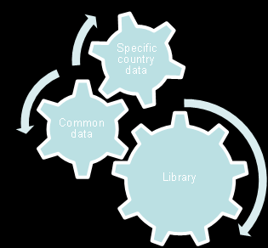
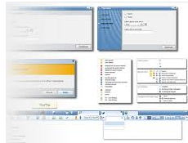
e-SMP: General Concept
PROVIDING A DYNAMIC PLAFORM THAT ALLOWS TO
AUTOMATIC PROCESS
WORKFLOW &
COLLABORATIVE SYSTEM
Project
Standardized
Methodology
Common Project
Data
Country Specific
Data
STANDARDISATION METHODOLOGY
Use & Manage
The System with Standardized
Methodology
& Data
Define
New Project &
Project Partners
Use Workflow
& Ergonomic
Interface
Manage Common
Project Data &
Country-Specific
Data
Notes:
Version plus à jour? Animée? Présentation de Porto? (clef usb)

Slide 23
e-SMP
Future opportunities ?
EuroFIR
Facilitate the access, dissemination and maintenance of EPIC-Soft and related facilities
Need to implement the “missing link”:
Effective management, updating and extending food composition data
Laboratory and data analysis best practices
Food Data Handling
(search, re-order, classify, export…)
-Food Data Linkage
(link, algorithm compilation)
Multiple interests for collecting the maximum of details on food consumption data:
-monitoring surveys
-risk assessment studies
Access more than 25 authoritative European web sites with food data and documentation through a virtual platform of inter-connected national and specialised databases
EPIC-Soft Data Collection Common Library: Standardised and detailed consumption data
EuroFIR Data Collection Common Library: Standardised and documented composition data
Provide a full integrated dietary methodology in Europe for data collection (food consumption) and data handling (nutrient and other compounds)
http://www.eurofir.net/eurofir_aisbl/projects/eurofir_nexus

Slide 24
e-SMP: General Design
IARC INFRASTRUCTURE FOR DISSEMINATION
TECHNICAL AND APPLICATIVE DESIGN
Profile, Users & Privileges
Maintenance & Setting (EPIC-soft tables, Maintenance forms (FUF, RUF,…), Versioning. Optional: Nutrient management)
EPIC-Soft Application and its Data entry version
Interview Manager (Management of data sets & related Notes, Re-compute program, Data export)

Slide 25
e-SMP: General Design
Profile, Users & Privileges: This module allows the administrators and coordinators to create and define different user profiles, specific attributes and (access) rights to the EMP modules;
Maintenance & Setting [MSapp]: This module allows to manage the EPIC-soft data and to maintain the software integrity and concept of standardisation; This module include the Recipe Manager application that allows to manage the recipes ingredients [Application outside but link to EMP]
EPIC-Soft [ESapp] and its data entry: This module allows the collection of 24-HDR interviews;
Interview management [IMapp]: This module allows to manage the interview workflow (e.g. data management, data re-compute, exports)
Communication, Collaborative system, Online Help and Guidelines

Slide 26
e-SMP: Workflow, a mixed infrastructure model
Managed by IARC
Decentralized data collection and storage modules.
Maintenance & Settings
Create and manage EPIC-Soft versions.
MSapp
EPIC-Soft /
Data-entry
Interview Manager
IMapp
Collected
data
Recipe
Manager
Managed by the institutes owner of the data,
or hosted at IARC facilities
Storage and processing application
Autonomy and independence from IARC
Confidentiality, safety and integrity of the collected data.
Centralized at IARC
IARC acts as guarantor and maintainer of the methodology
Capitalize on the experience of all versions
Build a solid common base
Notes:
Title: a mixed infrastructure model
Centralized (standardization, …) / Decentralized-federated (collection, management, stockage des données)
Bénéfice de chaque mode
Liens, fonctions, outcomes

Slide 27
e-SMP: Workflow
Managed by IARC
Decentralized data collection and storage modules.
Maintenance & Settings
Create and manage EPIC-Soft versions.
MSapp
MSapp
EPIC-Soft /
Data-entry
Interview Manager
IMapp
Collected
data
Recipe
Manager
Load and import interviews
Processing
  View interviews and notes
  Subjects management
  Notes management
  Use EPIC-Soft to correct interview data
  Feedback to Maintenance & Settings to update project and country data
Export of interviews data for statistics analysis
Load EPIC-Soft database
Training of interviewers
Field work
Export interviews
Library: methodology data managed and provided by IARC
Project data
  Strong link with library data
  Common data to all countries
  Done by project’s coordinators in collaboration with country’s coordinators and IARC
Country data
  Done by country coordinators
  Strong link with project data
  Collaboration with other country data from different project/country
Export of EPIC-Soft database
Implementation of feedback from field-work

Slide 28




Dataflow between components
STANDARDIZED LIBRARY DATA
PROJECT & COUNTRIES DATA
MSapp
IMapp
Admin
Admin
Interviews (raw/modified)
Interviews (raw/modified)
EPIC-Soft
Database
(~70 tables)
Interviews
(to be corrected)
Recipe manager
Data Export
for statistical analyses
EPIC-Soft Application
Data Entry Application
Notes:
Abbréviations et cohérence

Slide 29














e-SMP: Organizational infrastructure
International principal
Administrator/Coordinator
(IARC)
IARC library data
International project Administrators/Coordinators
(e.g. EFSA)
Interviews data
Project data
National Administrators/
Coordinators
Country data
Interviews data
Intermediate
Local
Coordinators
Country data
Interviews data
End-Users
Country data
Interviews data

Slide 30
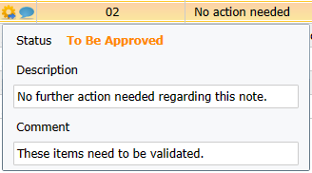
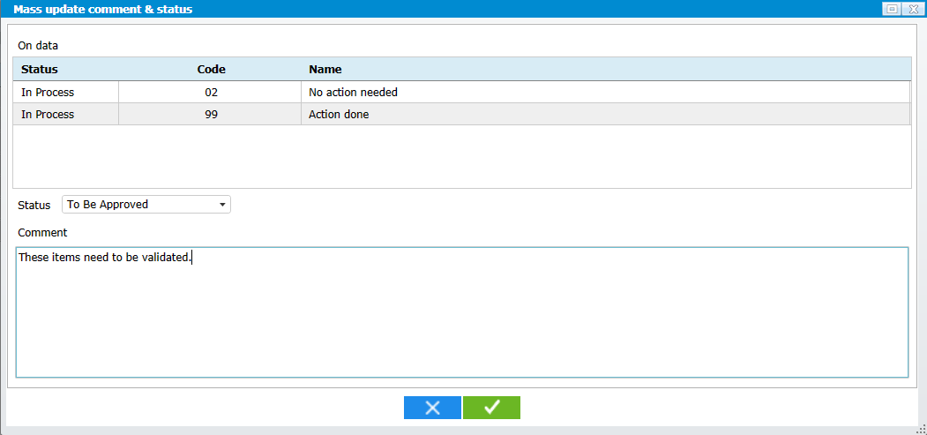
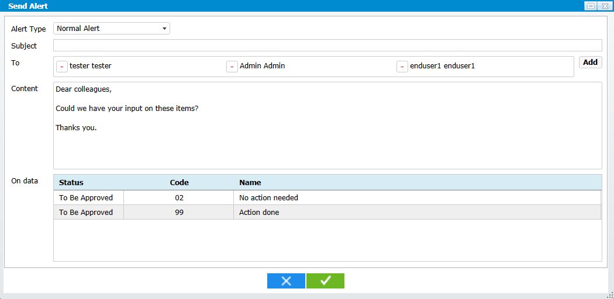
e-SMP: Collaborative
Different levels of users, from interviewer to project coordinator and IARC
Status of each specific data
  ‘In Process’: work on the data is on-going
  ‘To Be Approved’: data ready for validation
  ‘To be reviewed’: data requiring further work and not yet ready for validation
  ‘Validated’: data validated ready for field work
State:
  New: data not yet used in the field
  In Use: data already disseminated
  Archived: data disseminated but no longer proposed in the field
elaborate tracing of the data:
  Who
  When
  Previous validated data as backup before modification
Visual indicators
Inline comments and communication facilities leveraging on proven email infrastructure

Slide 31






e-SMP: Communication
IARC
Send
alerts
Mail client
Receive
Send
Send
alerts
Project
Send
alerts
Send
alerts
Country
Country

Slide 32
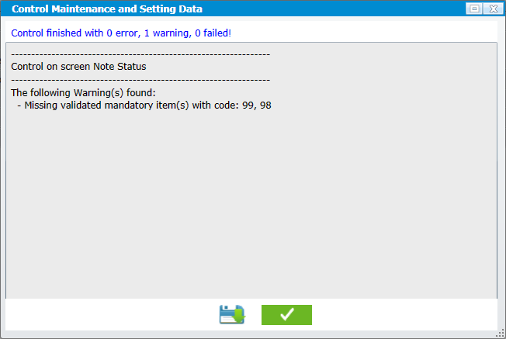
Guidance
implementation of meaningful business-rules to speed up work and prevent common errors
communication between collaborators and with supervisors

Slide 33
Training and guidelines
e-documentation, e-learning, Webinar, online help (tooltip, fixed comments)
EPIC-Soft & Data-Entry
  IARC’s Train the trainers (English, IARC)
  Local training, specific for dietician (local language, local coordinator)
e-SMP web platform

Slide 34


e-SMP, a Web based platform
accessible from anywhere, not tied to a specific workstation,
Ubiquitous technology,
minimal IT investment.
e-SMP

Slide 35


Security
Administration / gestion des utilisateurs
Notes:
Expliciter sur 1 ou 2 slide supplémentaires

Slide 36

User-friendly interface
Uses Microsoft Silverlight 5 to bring a rich and familiar application experience through the Web

Slide 37


Multilingual / International

Slide 38


e-SMP: International

Slide 39
General concepts

Slide 40

e-SMP Screen organisation (1)
1
2
3
4

Slide 41
e-SMP Screen organisation (2)
The screen is divided in 4 areas (highlighted in red on the previous slide)
Header
  General information about the platform and its state (user connected and perimeter selected).
Menu
  Gives access to every accessible screen of the different applications.
Navigation
  Shows the screens currently open.
Content
  The working area of the active screen.

Slide 42


Search
The “Search” facility allows to select specific data to be displayed in the screen according to the defined criteria.
e.g.: here specific criteria on region, first name, birth date, gender and wether the subject has a temporary cade has been set and the resulting dataset is shown in the list below after clicking the button.
Notes:
Search, filter and sorting are general principles that you want to show for e-SMP? Because now it is not clear how to get the search screen that you are showing or how to come to the filters … so I presume that you are only showing the general principles?

Slide 43

Filter
The “Filter” facility allows to focus the data displayed in the list to a subset. These filters can then be saved and re-used.
e.g.: here the user filter the data to display only the records with a note type ‘New food’ or ‘New recipe’.

Slide 44



Sorting
In every list in the application it is possible to sort the data by clicking on the desired header. It follows the cycle: default (as it was originally), ascending order, descending order.
e.g.:

Slide 45

Columns selection
In the lists it is possible to select the columns to be displayed by right clicking anywhere in the header of the list:
e.g.: here the user
displays only 7
of the 17 columns
possible.

Slide 46
Where do we stand now?
In final stage of development, imminent deployment for real use
  Interview Manager
Currently in developpement
  Administration
  Maintenance & Settings, Foods management
Future development
  Maintenance & Settings, Recipes management
  Development of an e-SMP website
  Further development of new functionalities for the Maintenance & Settings application
  Further development of new functionalities for the Interview Manager application
  Further development of new functionalities for EPIC-Soft and Data entry applications
  Further development of the EPIC-Soft as data entry system as an integrated component of the e-SMP
  Implementation of the module e-SMP/EuroFIR-NEXUS

Slide 47
benefit from years of experience and field-work
Epidemiological studies
Monitoring surveys
Whole population covered, from infants to seniors
Collaboration with twenty countries using EPIC-Soft methodology
Refined Library data offering a high-level of standardization
Notes:
Voir Slides résumant l’utilisation d’ES dans différents contextes (monitoring, epidemio, …)

Slide 48
Store collected data
Safe storage, on IARC's infrastructure or on your own
In either case Interview Manager guarantees the confidentiality of your data
the raw collected remain stored as reference while you work on refining the data
Notes:
Voir slide 2 options central/decentral, à simplifier
Voir general conditions, couts, persons & profils

Slide 49
Protection of data
Separation of roles
  Dietician: collect and upload interviews
  Coordinator work on the collected interviews
Strict control of access and actions
Notes:
Voir general conditions pour definition
+ propriété des données intervews par utilisateurs

Slide 50
Post-collection treatments
Work centered on the notes collected during the field work
With the status and the content of the notes you can efficiently refine the data.
Notes:
Remettre avec data-flow

Slide 51
Post-collection treatments (2)
correct collection errors either directly in the Interview Manager or in EPIC-Soft
  Updates of interviews are performed in EPIC-Soft to benefit from the business logic implemented in EPIC-Soft
  Updates of subjects are performed directly in Interview Manager

Slide 52
Prepare analysis
export the data in the universal CSV and XML formats for scientific analysis in
  SAS, SPSS, R, Stata, ...
Data highly detailled
High quality data, clean and ready for analysis

Slide 53
IARC current position/conditions
IARC maintains the ownership and copyright on the whole EPIC-soft (E.S) methodology and related tools and versions [Research methodologies]. This will ensure a formal international institutional commitment and control on the standardisation, maintenance and integrity of the E.S methodology over time;
IARC, as a neutral WHO-UNU organisation, may help in international acceptance of the common international methodology and has as main mission to disseminate knowledge, on the best possible conditions;
IARC can provide the infrastructure for dissemination (ongoing conceptual development of a EPIC-soft e-Standardize Methodologies Platform e-SMP -) but this should be fully funded [Ongoing discussions];
For IARC, E.S. 24-HDR method remains the reference tested and validated method in international study contexts;
Direct or indirect use of E.S. should not compromise the scientific quality of E.S. and its related data (e.g. when used as a data entry for food records).
Ongoing preparation of the general conditions to make EPIC-Soft available in future pan-European monitoring surveys and other projects

