Slide 1


GloboDiet Data Flow between interviewer(s) & Collaborator(s)
International agency for research on cancer lyon - france
e-SMP

Slide 2
Outline
Introduction
Workflow for the Interviewers
Workflow for the Coordinators
Reminders

Slide 3

Outline
During the data collection phase, we have identified 2 main contributors:
The Interviewers in charge of data collection
The Coordinators in charge of data cleaning including note management & interview update
The following figure represents the usual steps of a field work stressing on the:
Two contributors’ tasks
Data Flow
Introduction
Interviewer workflow
Coordinator workflow
Reminders

Slide 4




INTERVIEWER
1. Data Collection
2. Export
Backup
Using GloboDiet
or Data entry application
Export(*) has to be done regularly.
The generated XML & CSV-files have to be sent to the Coordinator
Backup(*) has to be done regularly
(BAK & CSV-files)
6. Import
GloboDiet Database
COORDINATOR
5.
Update
6. Import
4. Update Notes
7. Update interviews
8. CSV-file Export
3. Import
The received XML-file has to be imported in GloboDiet or Data entry application
Preparation of
Note file in Excel
Update of:
+ Note files
+ Interviews
Export of CSV-files for statistical analyses using the backup(*) function
Backup
Backup(*) has to be done regularly
(BAK & CSV-files)
(*) Data Recompute is automatically running during Backup & Export

Slide 5
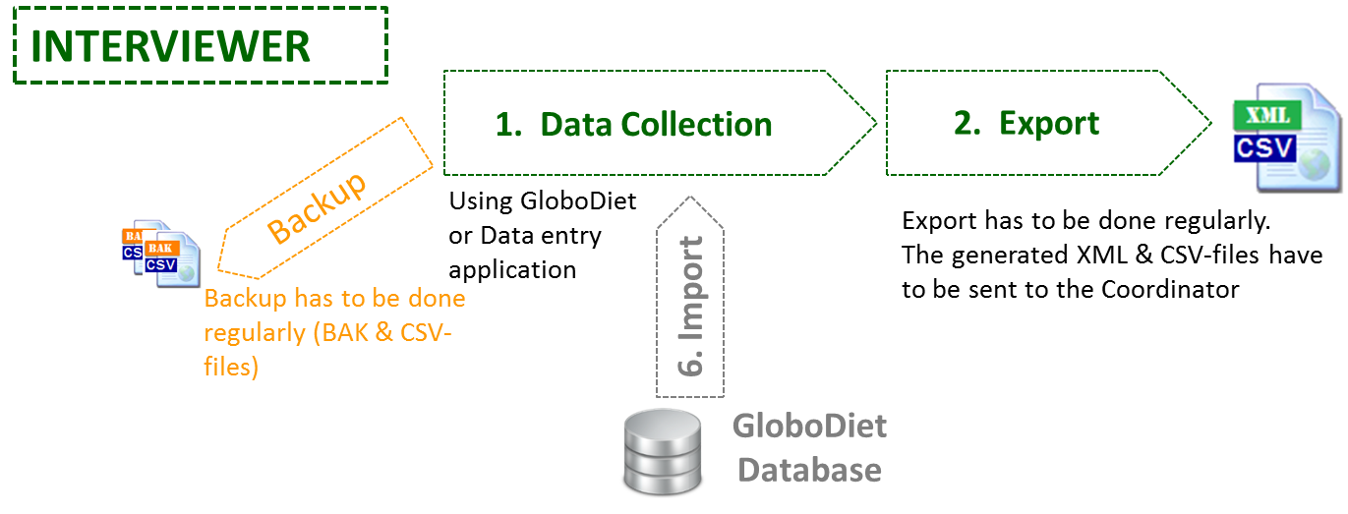
Outline
The Interviewer workflow
The data Collection (1)
Interview collection using GloboDiet or Data Entry application
The interview Backup
Interview Backup has to be done regularly (one or twice a day) using GloboDiet functionalities.
The generated BAK & CSV-files are to be saved in, at least, 2 different supports (e.g. PC + central server…)
During the backup, the data re-compute is running
Introduction
Interviewer workflow
Coordinator workflow
Reminders

Slide 6
The Interview Export (2)
Interview Export has to be done regularly (e.g. once a week, monthly…) using GloboDiet functionalities
XML & CSV-files are generated and the exported interviews will be suppressed on the Interviewer’s PC
The generated XML & CSV-files have to be saved and sent to the Coordinator
Then the Interviewer will continue with a new empty interview database automatically generated
During the export, the data re-compute is running

Slide 7
The GloboDiet database Import (6)
An updated GloboDiet parameter database is periodically prepared by the Coordinator and IARC, together.
The Coordinator has to send this updated GloboDiet parameter database to Interviewer(s)
The received GloboDiet database has to be RESTORED on the Interviewer’s PC using the GloboDiet/Data Entry functionalities

Slide 8
Outline
The Coordinator workflow
The interview Import (3)
The received interview XML-files have to be imported on the Coordinator’s PC using GloboDiet functionalities.
The new generated interview database has to be saved using the GloboDiet backup interview function
Remark: a new function allowing to import several XML-files in one GloboDiet Interview database is under development.
Introduction
Interviewer workflow
Coordinator workflow
Reminders

Slide 9
The Note update (4)
The received NOTE.CSV files can be imported into ONE Excel file.
Depending on the Note type, content, comment and depending on the project rules, each Note Status has to be reviewed (e.g. changed from “New” to “Nothing to do”) and comments can be added.
➔ see guideline on Data Cleaning protocol

Slide 10
Update of GloboDiet parameter database (5)
Based on the information in the notes, some items have to be reviewed/added (e.g. add new foods, change maximum values, etc…)
With the IARC help, a new GloboDiet database has to be generated (e.g. using FUF, RUF, doc-files…)
➔ see guideline on Maintenance

Slide 11
Import of GloboDiet parameter database (6)
The new GloboDiet database, received from IARC, has to be imported in the coordinator’s PC using GloboDiet functionalities
This new GloboDiet database has also to be sent to the Interviewers to be imported in each interviewer’s PC.
After this import, it is important to re-compute the available interviews by backing-up all of them

Slide 12
Update of Interviews (7)
Based on the information in the Excel Notes, attached Type and Status, the Coordinator can open and update (edit) interviews that need it using GloboDiet functionalities.
Backup has to be run regurlarly on the updated interview databases.

Slide 13
Final Export (8)
The Coordinator can export the interview database when needed (e.g. when a database is completely updated).
Using the backup function, 5 CSV-files are generated and can be read with statistical programs (e.g. SAS, Stata…) for analyses.
➔ see Appendix 6 Export guideline
➔ see Appendix 7 Example of SAS programs

Slide 14
Outline
Recompute
Interview Recompute
The Recompute programme runs during Backup and Export of Interview databases.
When a new GloboDiet database is available, the Recompute programme allows to re-calculate:
The reported consumed quantities of each item taking into account the new/updated coefficients and percentages.
The energy and macro-nutrients are also re-calculated based on updated quantities and/or new sets of nutrients.
Using:
The information included in the current GloboDiet database.
The information reported by the subjects, for example, the selected standard unit, photo, the item description (Facet string) for which reported codes are not changed.
Introduction
Interviewer workflow
Coordinator workflow
Recompute
Reminders

Slide 15
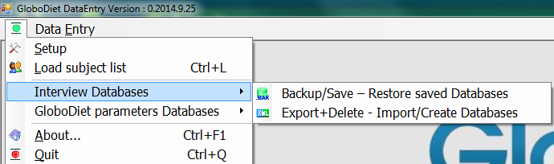
Outline
Reminders
Interview Backup function
Backup has to be done regularly (BAK & CSV-files)
The interviews remain available on PC using GloboDiet
Both Interviewers and Coordinators have to run Backups
The BAK-files are only restored in case of PC crash.
The generated CSV-files can be used for statistical analyses.
Interview Export function
Export has to be done regularly by the Interviewers (XML & CSV-files)
The interviews are suppressed from the interviewer’s PC
The Generated XML-files are used for communication between the Interviewer and the Coordinator
Introduction
Interviewer workflow
Coordinator workflow
Recompute
Reminders

Slide 16
INTERVIEWER
1. Data Collection
2. Export
Backup
Using GloboDiet
or Data entry application
Export(*) has to be done regularly.
The generated XML & CSV-files have to be sent to the Coordinator
Backup(*) has to be done regularly
(BAK & CSV-files)
6. Import
GloboDiet Database
COORDINATOR
5.
Update
6. Import
4. Update Notes
7. Update interviews
8. CSV-file Export
3. Import
The received XML-file has to be imported in GloboDiet or Data entry application
Preparation of
Note file in Excel
Update of:
+ Note files
+ Interviews
Export of CSV-files for statistical analyses using the backup(*) function
Backup
Backup(*) has to be done regularly
(BAK & CSV-files)
(*) Data Recompute is automatically running during Backup & Export

Slide 17
GloboDiet Data Flow between interviewer(s) & Collaborator(s)
International agency for research on cancer lyon - france
e-SMP

