Slide 1


Quality control and data handling of the GloboDiet 24-HDR interviews Part I – Data collection & Note management
International agency for research on cancer lyon - france
e-SMP
Notes:
&&M: Advice: Pagenumber on the same spot every slide.

Slide 2
Outline
Quality control Before the data collection
Quality control During the data collection
Quality control After the data collection: cleaning phase
Quality control After the data collection: after update
Final output of Data Handing: csv-files
Data on General information - INTI
Data on Reported items - INTERV & INTERV_QT
Data on Energy & Nutrient intakes - INTNUT
Data on Reported notes - NOTE
Some Final Highlights
Quality control and data handling of the GloboDiet 24-HDR interviews

Slide 3

Outline
Quality controls before the data collection
Based on principles of standardization in GloboDiet
Database controls
Control consistency/harmonization of rules within a project
Control the level of detail
Quality control Before
Quality control During
Quality control After: cleaning phase
Quality control After: on updated data
Final output of data handling (csv-files)
Data on general information – INTGI
Data on reported items – INTERV & INTERV_QT
Data on energy & nutrient intakes – INTNUT
Data on reported notes - NOTE
Some final highlights
Aiming at fully operational and standardized GloboDiet versions
Quality control and data handling of the GloboDiet 24-HDR interviews

Slide 4
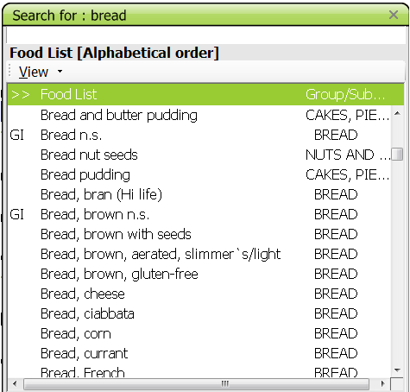
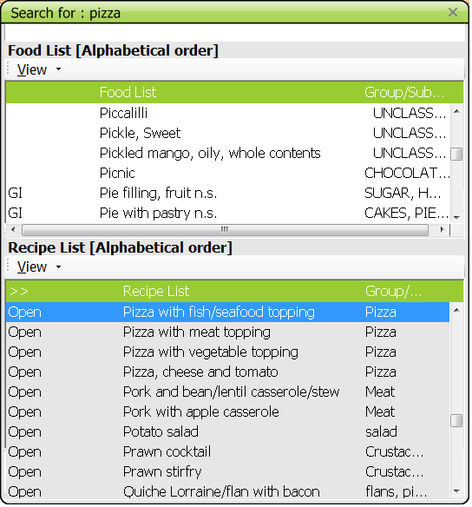
Quality control before the data collection: Example 1
Pre-defined lists of foods and recipes available in the system
Quality control and data handling of the GloboDiet 24-HDR interviews

Slide 5
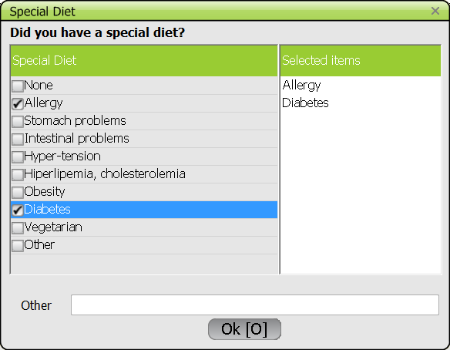
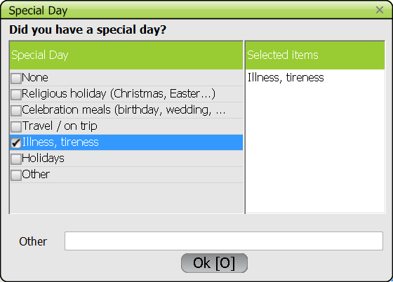
Quality control before the data collection: Example 2
Information about the recalled day (Special Day, Special diet)
Useful information to explain distinct food intake (incl. outliers during data analysis)
Quality control and data handling of the GloboDiet 24-HDR interviews

Slide 6
Quality control before the data collection: Example 3
Foods/recipes are estimated as consumed
Standard & common algorithms are used to:
adjust raw to cooked foods
edible parts
density (from volume to weight)
Quality control and data handling of the GloboDiet 24-HDR interviews

Slide 7
Outline
Quality controls during the data collection
Based on principles of standardization in GloboDiet
Use of cognitive approach (Quick list →Detailed information)
Control for consistency of GloboDiet use
Control for completeness of collected data
Use of note files (automatic & manual)
Who benefits?
→ Interviewee and interviewer
Quality control Before
Quality control During
Quality control After: cleaning phase
Quality control After: on updated data
Final output of data handling (csv-files)
Data on general information – INTGI
Data on reported items – INTERV & INTERV_QT
Data on energy & nutrient intakes – INTNUT
Data on reported notes - NOTE
Some final highlights
Aiming at collecting the most complete and accurate information for comparisons between countries, regions, interviewers
Quality control and data handling of the GloboDiet 24-HDR interviews

Slide 8
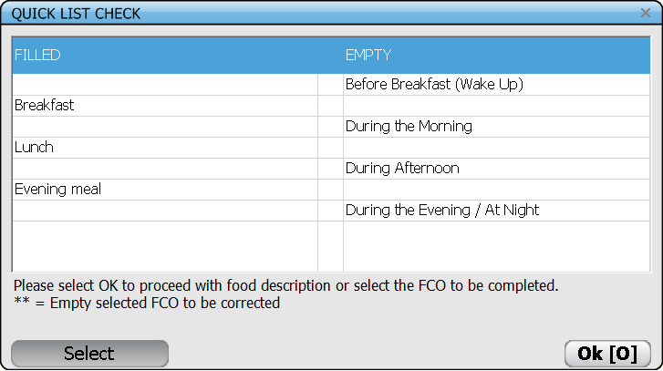
Quality control during the data collection: Example 1
Any forgotten occasions are shown for check at the end of the Quick List screen.
4 occasions are empty: Correct?
Quality control and data handling of the GloboDiet 24-HDR interview

Slide 9
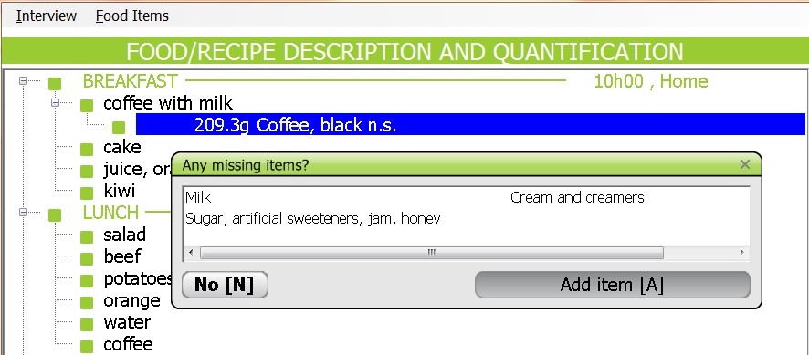
Quality control during the data collection: Example 2
Use of automatic probing questions during the interview. For instance, at each food/recipe description & quantification
Quality control and data handling of the GloboDiet 24-HDR interviews

Slide 10
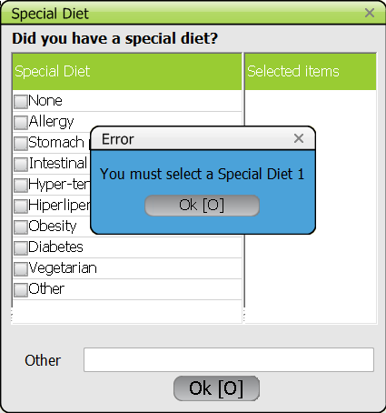
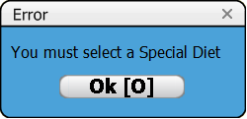
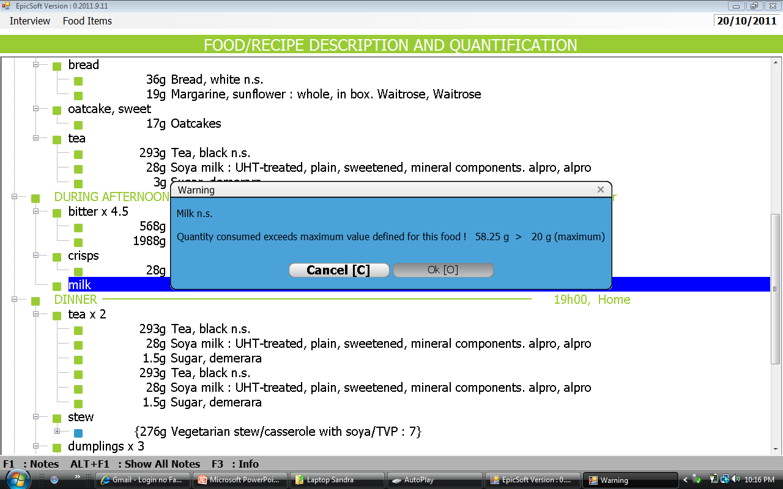
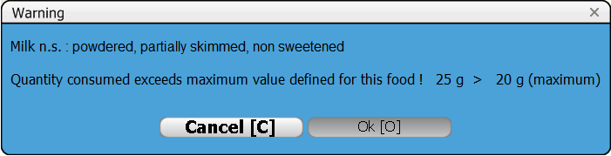
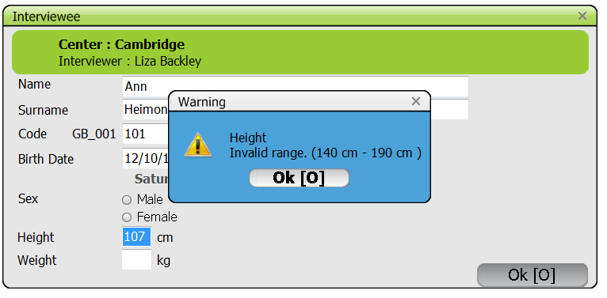
Quality control during the data collection: Example 3
Empty fields or extreme entered values are automatically highlighted
Quality control and data handling of the GloboDiet 24-HDR interviews

Slide 11
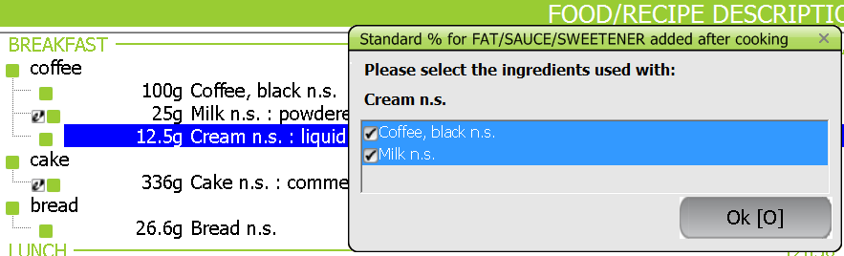
Quality control during the data collection: Example 4
Unknown amounts of Fats, sauces, sweeteners
Automatic estimation (%) attributed according to the weight of attached foods/recipes
Example: Cream with unknown quantity attached to coffee & milk
Quality control and data handling of the GloboDiet 24-HDR interviews

Slide 12
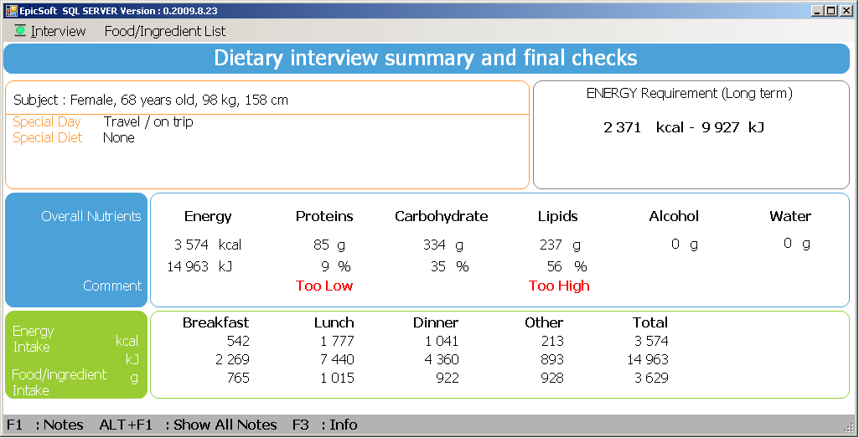
Quality control during the data collection: Example 5
Information on age, sex, height, weight, special day & diet
Comparison of energy requirements with the estimated 24-HDR energy intakes using preliminary data on food composition tables
Quality control and data handling of the GloboDiet 24-HDR interviews

Slide 13
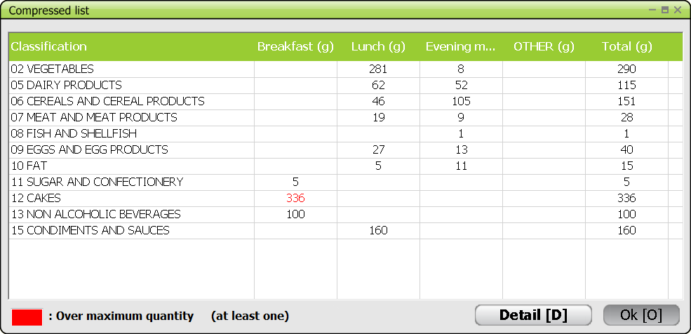
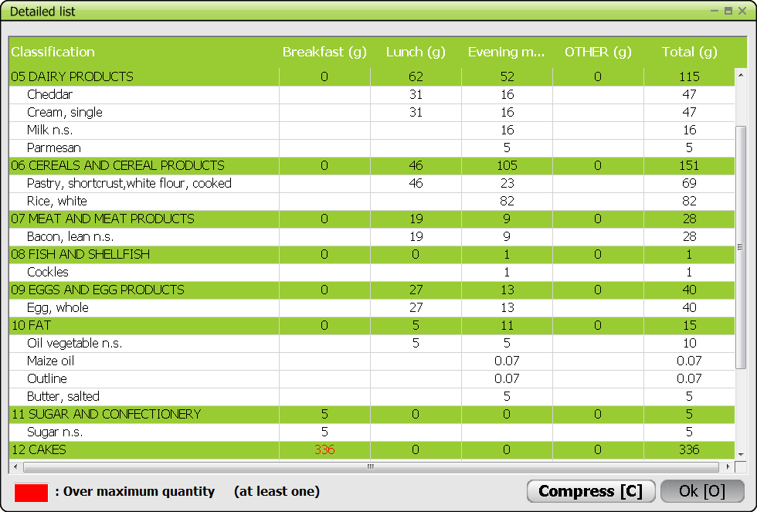
Quality control during the data collection: Example 5
Compressed list
Detailed list
Quality control and data handling of the GloboDiet 24-HDR interviews

Slide 14
Outline
First quality controls After the data collection
Dealing with Note files: control for completeness and correctness of collected data
Guidelines called ‘Data cleaning protocol_GD_xxx.docx’
Quality control Before
Quality control During
Quality control After: cleaning phase
Quality control After: on updated data
Final output of data handling (csv-files)
Data on general information – INTGI
Data on reported items – INTERV & INTERV_QT
Data on energy & nutrient intakes – INTNUT
Data on reported notes - NOTE
Some final highlights
Aiming at collecting the most complete and accurate information for comparisons between countries, regions, interviewers
Quality control and data handling of the GloboDiet 24-HDR interviews

Slide 15
Note Handling
A note is always attached to an item (subject, meal, quick list item, food, fat, recipe, ingredient & supplement)
A note has always a Status attached, ‘New’ by default – code ‘00’.
Status of notes can be subsequently changed in EDIT interview mode or in the exported NOTES file in Excel.
Example of note status (study dependent):
00 New
01 Ongoing
02 No action needed
03 Action approved by coordinator
99 Action done
A note has always a Type attached to identify it. Example:
New food (NEW_F) , recipe (NEW_R), supplement (NEW_S)
Specific note (SPE)
Empty quick list item (coded EMP), etc...
Quality control and data handling of the GloboDiet 24-HDR interviews

Slide 16
Note Handling
Based on Note TYPE, their management can be prioritized:
Priority 1 → Changes required in the interviews
New food, new recipe unknown, new supplement (NEW_F, NEW_R, NEW_S)
Unknown recipe: Addition or delete of ingredient (I_ADD, I_DEL)
Priority 2 → Might require changes in the interviews
Specific and General (SPE, G)
Null and Unknown quantity (NULL, UNK)
Priority 3 → Usually without changes in the interviews but with possible update of GloboDiet database.
Overflow quantity (OVER)
New added special diet, day, descriptor (G_DT, G_DY, F_xx)
Recipe selected as commercial (COM)
Empty quick list item (EMP)
Quality control and data handling of the GloboDiet 24-HDR interviews

Slide 17
Note Handling
Cumulate all the received Notes (Notes.csv files) using the Excel function called “Data” & “From Text” Excel
Check the reported Notes:
Organise them according to their Type, Status and priority
Change the note status
Add comments
Notes may be handled via two different scenarios:
Notes to be handled in GloboDiet edit interview mode
Notes to be handled in GloboDiet edit interview mode after the update of GloboDiet parameter database via maintenance process
→ See guidelines Data cleaning protocol_GD_xxxx.docx
Quality control and data handling of the GloboDiet 24-HDR interviews

Slide 18
Outline
Quality controls After on updated data
To be decided at the project level
Some suggestions from IARC (using csv-files)
→ See guidelines
Appendix 6_Export_guideline_GD_xx.doc
Appendix 7_read_of_export_with_SAS_xx.doc
Quality control Before
Quality control During
Quality control After: cleaning phase
Quality control After: on updated data
Final output of data handling (csv-files)
Data on general information – INTGI
Data on reported items – INTERV & INTERV_QT
Data on energy & nutrient intakes – INTNUT
Data on reported notes - NOTE
Some final highlights
Aiming at ‘understanding’ the quality of the collected data
Quality control and data handling of the GloboDiet 24-HDR interviews

Slide 19
Some suggestions
Checks in data processing: during food linkage/merging (e.g. ID-numbers, sex, birth date)
All New foods have been handled
No New foods anymore in database
All New unknown recipes have been handled
No New Unknown recipes anymore in database
Check distribution of the consumed quantities by GloboDiet food classification at group, subgroup and sub-subgroup levels
mean, SD, min, percentiles, max…
Ten lowest & Ten highest nutrient intakes of the nutrients of interest (e.g. energy & macronutrients) should be evaluated.
Strange values should be checked with original interview files
Quality control and data handling of the GloboDiet 24-HDR interviews

Slide 20
Some more suggestions
Number of interviews (1, 2, etc…)
Distribution of interviews over the week
Duration of the interviews
Subject characteristics (gender, age socioeconomic…)
Number of items per interview
Number of days between the interviews
Number of errors with regard to design/planning (e.g. season, week day…)
Energy ratio (energy intake vs required)
Energy ratio (Goldberg & Black)
See annex on data cleaning protocol guideline
Quality control and data handling of the GloboDiet 24-HDR interviews

Slide 21
Quality control and data handling of the GloboDiet 24-HDR interviews Part II – Management of exported files
International agency for research on cancer lyon - france
e-SMP
Notes:
&&M: Advice: Pagenumber on the same spot every slide.

Slide 22
Outline
Quality control Before the data collection
Quality control During the data collection
Quality control After the data collection: cleaning phase
Quality control After the data collection: after update
Final output of data Handing: csv-files
Data on General information - INTI
Data on Reported items - INTERV & INTERV_QT
Data on Energy & Nutrient intakes - INTNUT
Data on Reported notes - NOTE
Some Final Highlights
Quality control and data handling of the GloboDiet 24-HDR interviews

Slide 23
Outline
Final output of data handling (csv-files)
The Coordinator workflow
Quality control Before
Quality control During
Quality control After: cleaning phase
Quality control After: on updated data
Final output of data handling (csv-files)
Data on general information – INTGI
Data on reported items – INTERV & INTERV_QT
Data on energy & nutrient intakes – INTNUT
Data on reported notes - NOTE
Some final highlights
Quality control and data handling of the GloboDiet 24-HDR interviews

Slide 24
Final output of data handling (csv-files)
5 exported csv-files:
INTGI: general information on subject & recall/record
INTERV: reported foods, recipes, ingredients & supplements including detailed consumption descriptions and quantifications
INTERV_QT: for items quantified with photos or shapes
INTNUT: energy & macronutrient intakes per reported food/ingredients
NOTES: reported notes generated during the interview / data entry
Quality control and data handling of the GloboDiet 24-HDR interviews

Slide 25
Reminder: Recompute program
The Recompute is running during the interview Backup or Export
The Recompute allows to re-calculate:
The reported consumed quantities of each item taking into account the new/updated coefficients & percentages as well as the changes in the quantification methods (e.g. updated quantity of standard unit/portion, photo…)
The energy and macro-nutrients based on updated quantities and/or new sets of nutrients
Remark: the information reported by the subjects are not modified
→ see Appendix 6_Export_guidelines.doc ( in blue ($) re-computed variables )
Quality control and data handling of the GloboDiet 24-HDR interviews

Slide 26
Outline
Data on general information - INTGI
General information on subjects:
Country, Center/Region, ID number,
Sex, Birth date, Weight, Height,
Energy requirement, Energy intake
General information on recalls or records:
Date of recall/record & day (Monday to Sunday)
Interview date & day (Monday to Sunday)
Special Diet codes, Special Day codes
Interviewer code
Date of last recompute (backup/export)
→ 1 record per interview
Quality control Before
Quality control During
Quality control After: cleaning phase
Quality control After: on updated data
Final output of data handling (csv-files)
Data on general information – INTGI
Data on reported items – INTERV & INTERV_QT
Data on energy & nutrient intakes – INTNUT
Data on reported notes - NOTE
Some final highlights
Quality control and data handling of the GloboDiet 24-HDR interviews

Slide 27
Outline
Data on reported items – INTERV/INTERV_QT
Key variables to link the different records & tables:
COUNTRY: Country code
CENTER: Center/Region code
ID_NUM: ID number
DATE_REC: Date of recall/record
FCO_CODE: Food consumption occasion code (FCO)
HOUR: FCO hour
PLACE_CODE: place of consumption code
TOK: Sequential number of the Quick List Item
QLINUM: Sequential number within the quick list item
ING_NUM: Sequential number of ingredient within a mixed recipe
TYPE: type of record
Quality control Before
Quality control During
Quality control After: cleaning phase
Quality control After: on updated data
Final output of data handling (csv-files)
Data on general information – INTGI
Data on reported items – INTERV & INTERV_QT
Data on energy & nutrient intakes – INTNUT
Data on reported notes - NOTE
Some final highlights
Quality control and data handling of the GloboDiet 24-HDR interviews

Slide 28
Data on reported items – INTERV/INTERV_QT
INTERV: Reported Foods, recipes, ingredients, supplements with detailed consumption descriptions & quantification including:
Key-variables: from Country to Type variables
Record information: food or recipe type (F_TYPE/R_TYPE/I_TYPE) and type of modification done on recipe or ingredient (R_MODIF, I_MODIF)
Item identification: code (FOODNUM) + classification (GROUP, SUBGROUP1, SUBGROUP2) + name (NAME)
Item description: sequence of facet/desccriptor codes (FACET_STR) + Label (TEXT) + Brand name (BRANDNAME) (e.g. “0308, 1302” →Food fried & with skin consumed)
Item quantification: quantity as consumed (CONS_QTY) + quantification method code (Q_METHOD, QM_CODE) + other variables used to compute the final consumed quantity (density, raw-to-cooked, inedible coefficients ...)
→ n records per interview
Quality control and data handling of the GloboDiet 24-HDR interviews

Slide 29
Data on reported items – INTERV/INTERV_QT
INTERV_QT – Item quantified with photos & shapes including:
Key-variables: from Country to Type variables
Information on the Selected Shape:
Code (SH_CODE) + Surface in cm² (SH_SURFACE) + Thickness code (TH_CODE) + Thickness in cm (TH_THICK)
Information on the Selected Photo:
Code (PH_CODE) + Quantity (PH_QTY)
For both methods, selected Fraction or Unit (FRACT)
→ n records per interview & item
Quality control and data handling of the GloboDiet 24-HDR interviews

Slide 30
Outline
Data on reported items – INTNUT
Energy & macronutrient intakes per reported food/ingredient including:
Key-variables: from Country to Type variables
FOODNUM: food or ingredient code
NTR_CODE: Nutrient code (1-energy, 2-total proteins, 3-carbohydrate, 4-total fats, 5-Alcohol, 6-water)
VALUE: Nutrient intake for the attached food/ingredient
ITEM_SEQ: internal link number with INTERV file
→ n records per interview & item
Attention: Data not to be used as final nutrient intake!!!
Quality control Before
Quality control During
Quality control After: cleaning phase
Quality control After: on updated data
Final output of data handling (csv-files)
Data on general information – INTGI
Data on reported items – INTERV & INTERV_QT
Data on energy & nutrient intakes – INTNUT
Data on reported notes - NOTE
Some final highlights
Quality control and data handling of the GloboDiet 24-HDR interviews

Slide 31
Outline
Data on reported items – NOTE
Reported notes generated during the data collection, including:
Key-variables: from Country to Type variables
Record information: as food or recipe type (F_TYPE/R_TYPE/I_TYPE) and type of modification done on recipe or ingredient (R_MODIF, I_MODIF)
Item identification: code (FOODNUM) + classification (GROUP, SUBGROUP1, SUBGROUP2) + name (NAME)
Item quantification: consumed quantity (CONS_QTY) + quantification method (Q_METHOD)
Note information: Note Type (NOTE_TYPE) + Note status (NOTE_STATUS) + Date of last update on the note (DATE)
→ n records per interview
→ 1 record per interview & item
Quality control Before
Quality control During
Quality control After: cleaning phase
Quality control After: on updated data
Final output of data handling (csv-files)
Data on general information – INTGI
Data on reported items – INTERV & INTERV_QT
Data on energy & nutrient intakes – INTNUT
Data on reported notes - NOTE
Some final highlights
Quality control and data handling of the GloboDiet 24-HDR interviews

Slide 32
Outline
Some final highlights
Working with exported csv-files
Selection of records/lines
Linkage between records/lines
Final cleaning steps
Some suggestions on final data cleaning (SAS)
Conclusion
Quality control Before
Quality control During
Quality control After: cleaning phase
Quality control After: on updated data
Final output of data handling (csv-files)
Data on general information – INTGI
Data on reported items – INTERV & INTERV_QT
Data on energy & nutrient intakes – INTNUT
Data on reported notes - NOTE
Some final highlights
Quality control and data handling of the GloboDiet 24-HDR interviews

Slide 33
Selection of records/lines
TYPE - Type of records values:
1 : Food consumption occasion
2 & 2S : Quick list item
4 : Food
6 : Fat during cooking for foods
3 : Mixed Recipe
5 : Ingredient of mixed recipe
7 : fat during cooking for ingredient of mixed recipe
A2 : Type of Fat used (facet 15)
A3 : Type of milk/liquid used (facet 16)
8 : Link between Fat/Sauce/Sweetener added & its attached food/recipe → to be excluded for most analysis not to double the reported quantities
9 : Dietary supplement
Quality control and data handling of the GloboDiet 24-HDR interviews

Slide 34
Selection of records/lines
Examples of selection in INTERV table:
Food & Ingredient intakes –> TYPE values: 4-Food, 6-Fat during cooking (FDC) for foods, 5-Ingredient, 7-FDC for ingredients of mixed recipe (Interv table)
Food & Recipe intakes –> TYPE values: 4-Food, 6-FDC for foods, 3-Mixed recipe
Reported list of foods & Ingredients –> TYPE values: 4-Food, 6-FDC for foods, 5-Ingredient, 7-FDC for ingredients, A2-Type of Fat used (facet 15), A3-Type of liquid used (facet 16)
NOTE: Needed Variables = COUNTRY, FOODNUM, FACETS_STR, BRANDNAME, GROUP, SUBGROUP1, SUBGROUP2, NAME, FAT_1, FAT_2, FAT_3, FAT_4,..., FREQ
Reported Dietary supplements –> TYPE value: 9-Dietary supplements
→ see Appendix 6_Export_guidelines.doc (point 7.)
Quality control and data handling of the GloboDiet 24-HDR interviews

Slide 35
Linkages between records/lines
The key variables allowing to link records are:
COUNTRY: Country code
CENTER: Center/Region code
ID_NUM: ID number
DATE_REC: Date of recall/record
FCO_CODE: Food consumption occasion code (FCO)
HOUR: FCO hour
PLACE_CODE: place of consumption code
TOK: Sequential number of the Quick List Item
QLINUM: Sequential number within the quick list item
ING_NUM: Sequential number of ingredient within a mixed recipe
Quality control and data handling of the GloboDiet 24-HDR interviews

Slide 36
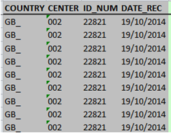
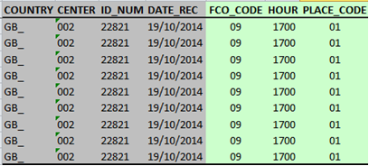
Linkages between records/lines
Variables identifying an interview:
COUNTRY: Country code
CENTER: Center/Region code
ID_NUM: ID number
DATE_REC: Date of recall
Variables identifying a FCO within an interview:
COUNTRY: Country code
CENTER: Center/Region code
ID_NUM: ID number
DATE_REC: Date of recall
FCO_CODE: FCO code
HOUR: FCO hour
PLACE_CODE: place of consumption code
-> As some FCOs can be selected several times, Hour & Place are important
Quality control and data handling of the GloboDiet 24-HDR interviews

Slide 37
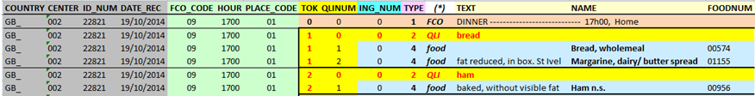
Linkages between records/lines
Variables identifying QLI and its items (within an interview & a FCO):
COUNTRY: Country code
CENTER: Center/Region code
ID_NUM: ID number
DATE_REC: Date of recall
FCO_CODE: FCO code
HOUR: FCO hour
PLACE_CODE: place of consumption code
TOK: Sequential number of the Quick List Item
QLINUM: Sequential number within the quick list item
Example 1: QLI ‘Bread’ (TOK=1) with the 2 following foods attached:
“Bread, wholemeal” with QLINUM=1
“Margarine, dairy/ butter spread” with QLINUM=2
Quality control and data handling of the GloboDiet 24-HDR interviews

Slide 38
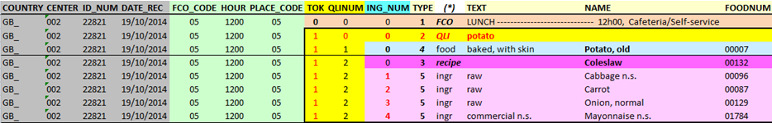
Linkages between records/lines
Variables identifying a recipe and its attached ingredients (within an interview, a FCO & a QLI):
COUNTRY: Country code CENTER: Center/Region code
ID_NUM: ID number DATE_REC: Date of recall
FCO_CODE: FCO code HOUR: FCO hour PLACE_CODE: place of FCO
TOK: Sequential number of QLI
QLINUM: Sequential number within the QLI
ING_NUM: Sequential number of ingredient within a mixed recipe
Example 2: Within QLI ‘potato’ (TOK=1), Recipe ‘Coleslaw’ (QLINUM=2) with 4 attached ingredients (QLINUM=2 & ING_NUM value > 0)
Quality control and data handling of the GloboDiet 24-HDR interviews

Slide 39
Linkages between records/lines
Particular case of fat during cooking – FDC (TYPE=6 or 7):
For foods cooked with fat, e.g. “fried”
For ingredients described as “deep fried”
The link between the cooked item and its fat(s) is kept and described below.
Example 3: A stir fried food with 1 attached fat (TYPE=6).
Under the QLI ‘beef’ (TOK=1), we have:
The fried food “Beef, steak n.s.” (QLINUM=1)
The attached ‘Oil, vegetable’ with the same QLINUM=1
FDC is automatically computed.
Quality control and data handling of the GloboDiet 24-HDR interviews

Slide 40
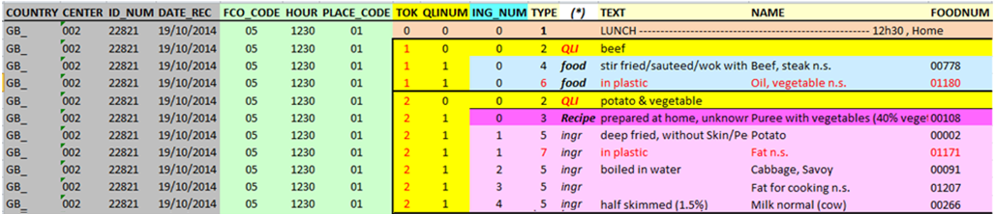
Linkages between records/lines
Particular case of fat during cooking – FDC (TYPE=6 or 7):
For foods cooked with fat, e.g. “fried”
For ingredients described as “deep fried”
The link between the cooked item and its fat(s) is kept and described below.
Example 4: A deep fried ingredient with 1 attached fat (TYPE=7)
Under the QLI ‘potato & vegetable’ (TOK=2), we have:
The recipe “Puree with vegetable” (QLINUM=1)
The deep fried ingredient “Potato” (ING_NUM=1)
The attached fat “Fat n.s.” with the same QLINUM=1 and ING_NUM=1
FDC is automatically computed.
Quality control and data handling of the GloboDiet 24-HDR interviews

Slide 41
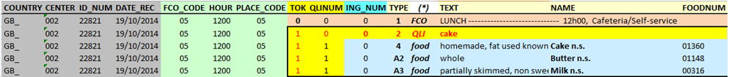
Linkages between records/lines
Particular case of facets 15-‘Type of fat used’ (TYPE=A2) and 16-‘Type of liquid used’ (TYPE=A3)
These records are only qualitative information (no quantity attached) and are used to describe foods/ingredients
The link between the complex food and its qualitative ingredient(s) is kept as:
Example 5: A cake described with butter (TYPE=A2) & milk (TYPE=A3)
Under the QLI ‘cake’ (TOK=1), we have:
The food “Cake n.s.” (QLINUM=1)
The attached type of fat used “Butter n.s.” TYPE=A2 (QLINUM=1)
The attached type liquid used “Milk n.s.” TYPE=A3 (QLINUM=1)
Quality control and data handling of the GloboDiet 24-HDR interviews

Slide 42
Final Cleaning steps: SAS program examples
→ See guideline Appendix 7 read_of_export_with_SAS_program.doc
Examples of transformation of the 5 csv-files to 5 SAS databases including the generation of a SAS Library:
How to read several CSV-files with same topic (INTGI) in 1 SAS database:
Infile ‘d:\database\*intgi*.csv ‘ delimiter='|' missover dsd ;
How to read the Note CSV-files using UTF-8 format
filename extfile ‘d:\database\*Notes*.csv ‘encoding="utf-8";
Data NOTES; filename extfile 'D:\databases\Pilot'\*NOTES*.csv' encoding="utf-8";
How to correct some wrong ID number or Recall date:
IF (ID_NUM='020205') and DATE_REC=MDY(01,21,2014) THEN DO;
ID_NUM='010102'; DATE_REC=MDY(11,20,2014); END;
Quality control and data handling of the GloboDiet 24-HDR interviews

Slide 43
Final Cleaning steps: SAS program examples
Examples of how to compute/manage some data:
How to compute the number of reported foods/recipes/ingredients per interview and to store them in INTGI database
See point 4- Read of INTERV file
How to identify new foods to be updated
See point 4- Read of INTERV file
How to identify the quantification method “Percentage” (e.g. % of fat automatically computed by GloboDiet)
See point 4- Read of INTERV file
How to compute the nutrient intakes per subject and to store them in INTGI database:
See point 5- Read of INTNUT file
How to prepare & export the list of reported foods/ingredients including their description, brand name and type of fat or liquid used (called Raw occurrences)
See point 7- Preparation of the reported occurrence list
How to manage the item description called facet string variable (FACETS_STR)
See point 8- Example on how to manage the facet string
Quality control and data handling of the GloboDiet 24-HDR interviews

Slide 44
Reminder: Final Cleaning steps - Some suggestions
Checks in data processing: during food linkage/merging (e.g. ID-numbers, sex, birth date) with ID correction
All New foods have been handled
No New foods anymore in database
All New unknown recipes have been handled
No New Unknown recipes anymore in database
Check distribution of the consumed quantities by GloboDiet food classification at group, subgroup and sub-subgroup levels
mean, SD, min, percentiles, max…
Ten lowest & Ten highest nutrient intakes of the nutrients of interest (e.g. energy & macronutrients) should be evaluated.
Strange values should be checked with original interview files
Quality control and data handling of the GloboDiet 24-HDR interviews

Slide 45
Reminder: Final Cleaning steps - Some suggestions
Number of interviews (1, 2, etc…)
Distribution of interviews over the week
Duration of the interviews
Subject characteristics (gender, age, socioeconomic status…)
Number of items per interview
Number of days between the interviews
Number of errors with regard to design/planning (e.g. season, week day…)
Energy ratio (energy intake vs. required)
Energy ratio (Goldberg & Black)
→ See annex on data cleaning protocol guideline
Quality control and data handling of the GloboDiet 24-HDR interviews

Slide 46
Outline
Some final highlights
The detailed information collected with GloboDiet allows:
An easy extraction of data with many possibilities such as the use of facets & descriptors (e.g. information on cooking), the use of quantification methods (e.g. photo used)...
To Reclassify foods, ingredients (e.g. To FoodEX2)
To Link the food intakes with food composition table
IARC can provide guidelines for this linkage if needed for the time being
Quality control Before
Quality control During
Quality control After: cleaning phase
Quality control After: on updated data
Final output of data handling (csv-files)
Data on general information – INTGI
Data on reported items – INTERV & INTERV_QT
Data on energy & nutrient intakes – INTNUT
Data on reported notes - NOTE
Some final highlights
Quality control and data handling of the GloboDiet 24-HDR interviews

Slide 47
Quality control and data handling of the GloboDiet 24-HDR interviews
International agency for research on cancer lyon - france
e-SMP
Notes:
&&M: Advice: Pagenumber on the same spot every slide.

Slide 48
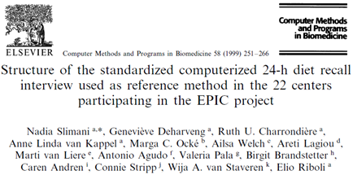
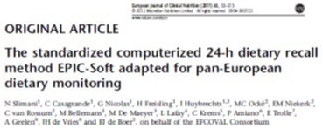
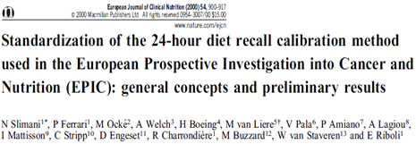
Sources of information
Quality control and data handling of the GloboDiet 24-HDR interviews

Slide 49
Outline
Some final highlights
Good communication practices between IARC team and local Coordinators
No contact between IARC and local interviewers
Communication In English/French
Communication with people in potential sub-contracted institutes to be clarified at the beginning of the project
Gather the questions before contacting IARC
With all people involved in copy (e.g. At IARC: Inge, Geneviève and Corinne)
Quality control Before
Quality control During
Quality control After: cleaning phase
Quality control After: on updated data
Final output of data handling (csv-files)
Data on general information – INTGI
Data on reported items – INTERV & INTERV_QT
Data on energy & nutrient intakes – INTNUT
Data on reported notes - NOTE
Some final highlights
Quality control and data handling of the GloboDiet 24-HDR interviews

