Slide 1


GloboDiet databases maintenance
INTERNATIONAL AGENCY FOR RESEARCH ON CANCER LYON - FRANCE
e-SMP

Slide 2

Introduction
General information
Quick list
Description and quantification
Controls
Preparation steps
Maintenance
IARC, Lyon - France

Slide 3
Facets & Descriptors
Food Classification
Photo Series
Photo Series
Shapes
Shapes
Facets/Descriptors
by Group/Subgroup
Thickness
Thickness
Facet Rules
Probing
HHM
HHM
Probing by
Group/Subgroup
Quantification by
Group/Subgroup
Setting files
% Fats/sauces left over
Foods & Shadows
Quantifications by food
Facets by food
Standard units
Brand name
Standard portions
% Fats during cooking
Probings by food
Maxima
Density
% Fats/Sauces/Sweeteners
Nutritional
values
Edible part
Raw to cooked
Project data in blue
Country data in green
‘FOOD’ DATABASE VERSION
Maintenance

Slide 4
Facets & Descriptors
Recipe Classification
Photo Series
Photo Series
Shapes
Shapes
Facets/Descriptors
by Group/Subgroup
Thickness
Thickness
Facet Rules
Probing
HHM
HHM
Probing by
Group/Subgroup
Quantification by
Group/Subgroup
Recipes & Shadows
Recipe
ingredients
Facets by recipe
FOOD pathway
files
Quantifications by recipe
Brand name
% Fats/Sauces/Sweeteners
Probings by recipe
Maxima
Density
Nutritional
values
Standard units
Project data in blue
Country data in green
Facets & Descriptors
Supplement Classification
Supplements
‘FINAL’ DATABASE VERSION
Facets by Supplements
Maintenance

Slide 5


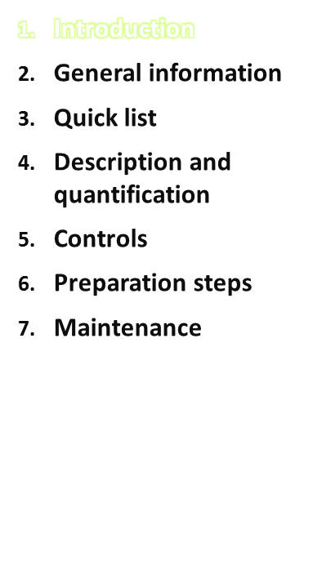
Introduce all GloboDiet files (70)
  Common to all countries
  Country-specific
  For foods/ingredients
  For recipes
  For dietary supplements
Show their format – list all the needed information
Show the links between the files
Show the steps to prepare a GloboDiet version
  Food version → recipe entry → final version
Countries mainly deal with Word files (.end).
Outside e-SMP, IARC handles .xls files.
Maintenance
IARC, Lyon - France

Slide 6
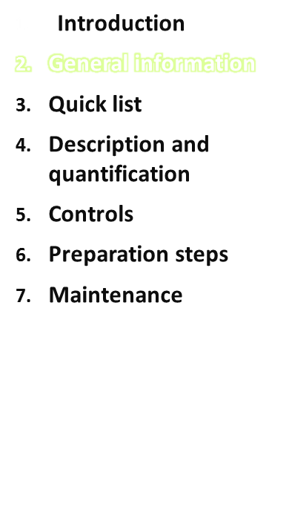
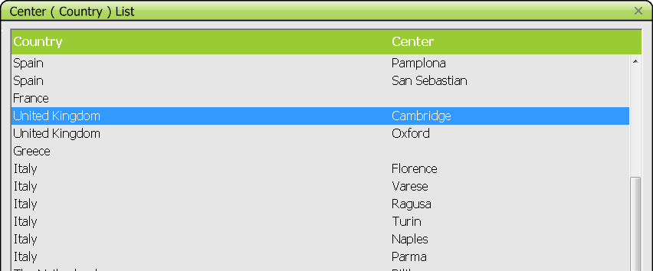
All GloboDiet screens need to be translated into the local language(s):
File GLOBOTEXT.xls
2 files maintained by IARC:
Country.xls
Centers.xls
(codes and names of country and centers)
Maintenance
IARC, Lyon - France

Slide 7
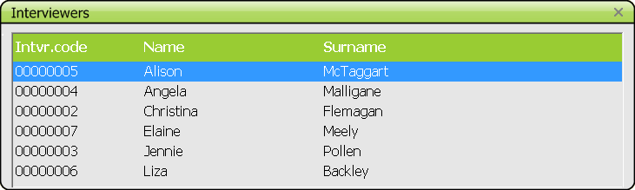
Each coordinator needs to provide the list of interviewers
Code
Name
Family name (surname)
Country to which he/she is attached
Center to which he/she is attached
→ file INTVIEWR.xls
Maintenance
IARC, Lyon - France

Slide 8
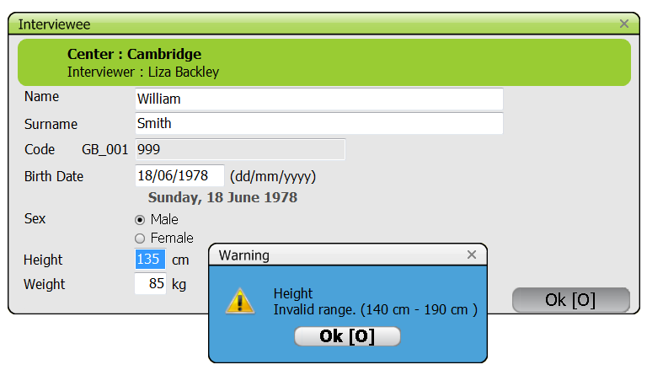
To manage the warning on height and weight:
file ANTHROP.xls maintained by IARC
minima, maxima and default values for height and weight
Per sex
Per age range
Maintenance
IARC, Lyon - France

Slide 9
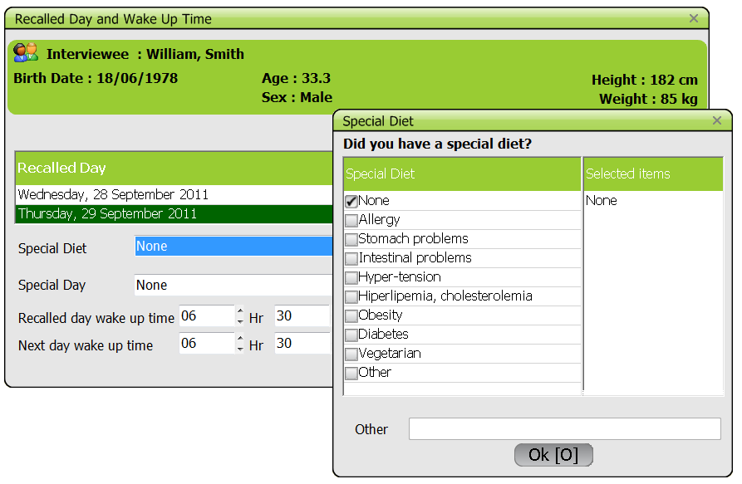
Each coordinator needs to provide a list of special diets, chosen from suggestions from IARC library (code – name).
File SPECDIET.end to be translated into local language(s)
Maintenance
IARC, Lyon - France

Slide 10
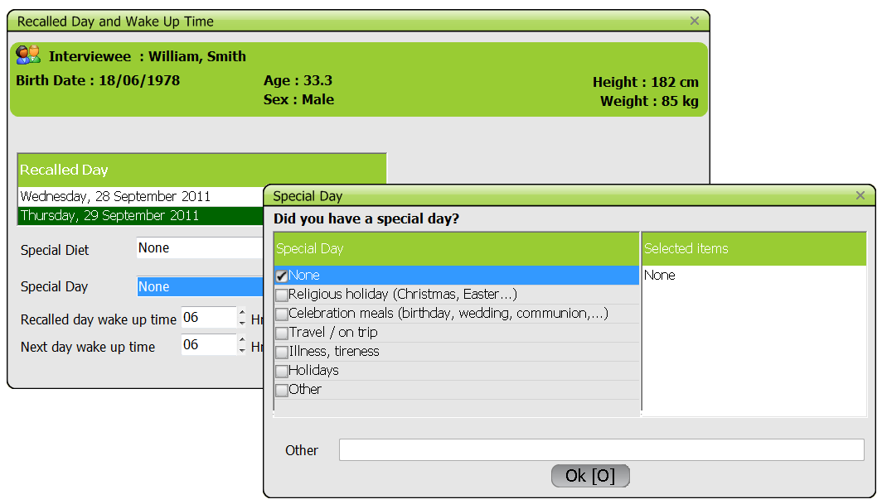
Each coordinator needs to provide a list of special days, chosen from suggestions from IARC library (code – name).
File SPECDAY.end to be translated into local language(s)
Maintenance
IARC, Lyon - France

Slide 11
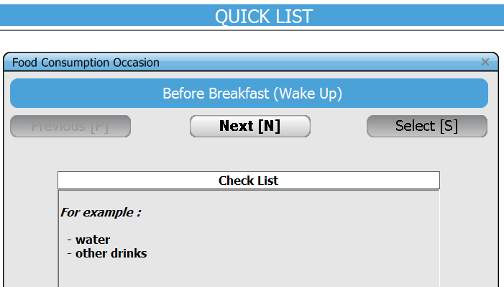
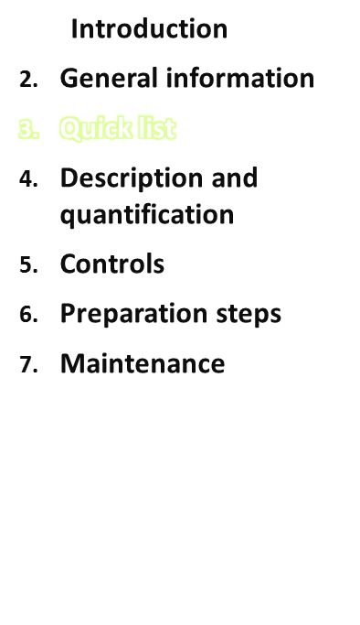
Each coordinator needs to provide a list of food consumption occasions (FCO), chosen from the IARC library (code – name of FCO).
File FCO.end to be translated into local language(s)
Each coordinator needs to provide a list of items linked to each FCO (FCO code – free text).
File CHECKLIST.end
Maintenance
IARC, Lyon - France

Slide 12
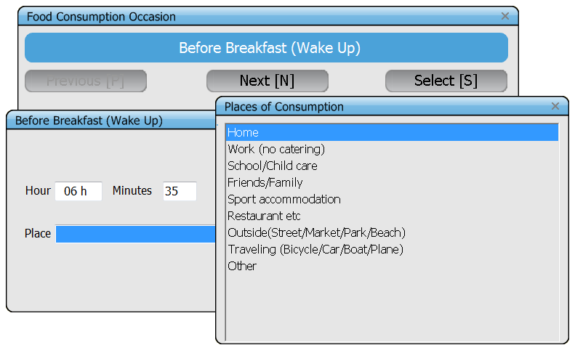
Each coordinator needs to provide a list of places of consumption (POC), chosen from IARC library. (code – name of POC)
File POC.end to be translated into local language(s)
Maintenance
IARC, Lyon - France

Slide 13
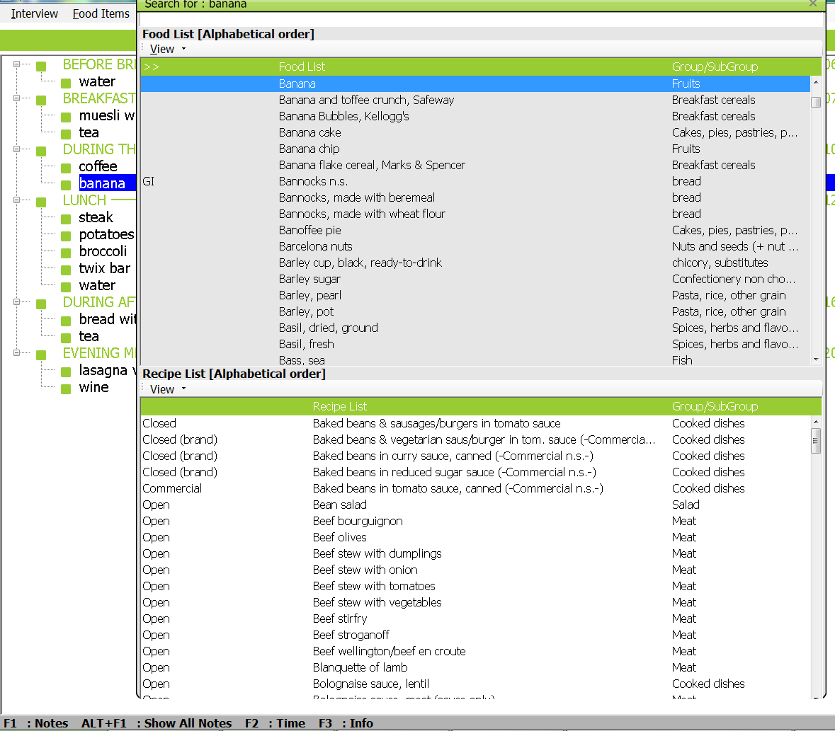
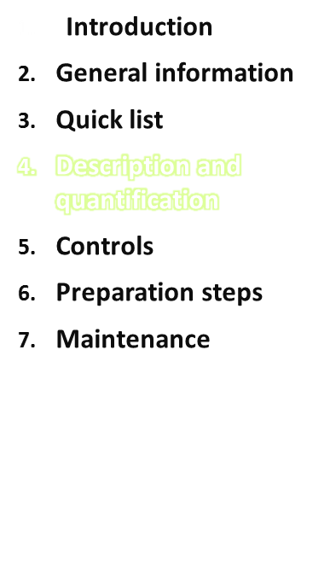
Food list Food classification
Recipe list Recipe classification
Maintenance
IARC, Lyon - France

Slide 14
Each country has to prepare a list of foods (file FDLIST.end) organised following the food classification (file FDCLASS.end).
FDCLASS is provided by IARC – adaptations at the sub-sub-group level are allowed. This has to be translated into local language(s).
- GROUP.xls (code – group name – short name of 20 characters)
- SUBGROUP.xls (3 classification codes – subgroup name – whether involved in the ‘PCTFSS’ calculations - whether involved in the ‘FAT left over’ calculations - whether involved in the ‘PCTFAT’ calculations – short name of 20 characters)
FDLIST is build based on proposals from IARC, from past local field experiences. It must include all the ingredients of the recipes.
Rules for handling complex foods (e.g. cakes) have to be considered at project level: are they considered as foods or recipes? Within a given kind of foods (e.g. soups), all foods should be treated either as foods or as recipes.
Food codes are usually assigned by IARC.
In FDLIST.end, both local and English names are provided.
There is the possibility to enter several synonyms (respect rules to name foods) or alternative food groups in the SHADOWLIST.end file. Both FDLIST and SHADOWLIST are gathered in FOODS.xls (3 classification codes - food code - food name - whether ‘normal food, shadow item (SH) or generic item (GI) - order (internal IARC variable) - whether to be included in the dietary supplement list or not)
Maintenance
IARC, Lyon - France

Slide 15
Each country has to prepare a list of recipes organised following the recipe classification (file RCPCLASS.end).
RCPCLASS is provided by IARC – adaptations at the sub-group level are allowed. This has to be translated into local language(s).
- RGROUPS.xls (code – name – short name of 20 characters)
- RSUBGR.xls (2 classification codes – name – short name of 20 characters)
The list of recipes is built based on proposals from IARC, from past local field experiences.
Recipes are entered via the Recipe Manager, once the food GloboDiet version is ready because ingredients are taken from the food list.
There is the possibility to enter several synonyms or alternative recipe groups.
Two files are exported from the Recipe Manager:
MIXEDREC.xls
MIXEDING.xls
Maintenance
IARC, Lyon - France

Slide 16
Description
by facets and descriptors
Common files
Maintenance
IARC, Lyon - France

Slide 17
Foods are described systematically by a combination of categorized characteristics (i.e. facets & descriptors).
Should ensure that same type of food is described similarily across subjects, interviewers and countries. (Slimani et al. 2000; 2011)
Considerations when defining the level of detail in GloboDiet
Project needs & subsequent use of collected data
Details that the subjects are able
to provide
Duration of the interview
GloboDiet training:
IARC, Lyon - France

Slide 18
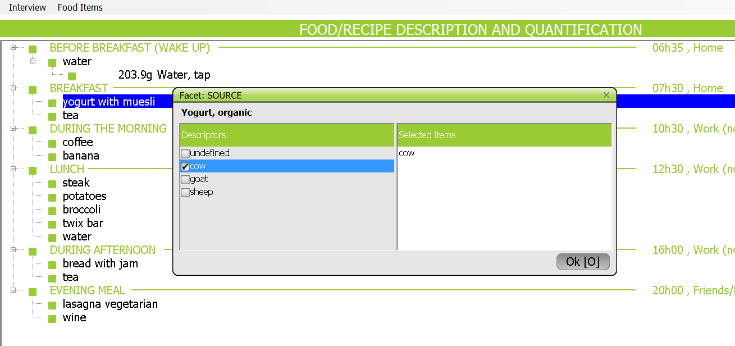
Each coordinator needs to provide the lists of facets (questions) and descriptors (potential answers) which depend on the project’s objectives. They are chosen from the IARC library. Some are mandatory.
The file FADECODE.end (meaning FAcet DEscriptor CODEs) gathers both, facets and descriptors, chosen by the project.
This is then translated into the different country’s language(s). The Thesaurus provides the reference definitions; it will also be translated for the interviewers.
FACETS.xls contains the facet codes - names – type (next slide) – whether multiple choice or not – food (sub-sub-)groups attached when relevant.
DESCFACE.xls contains the descriptor code – descriptor name – handling of cooking method descriptors – whether single or not if multiple choice facet.
Maintenance
IARC, Lyon - France

Slide 19
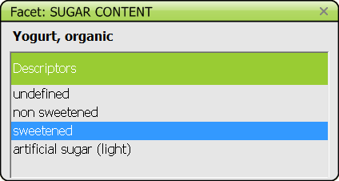
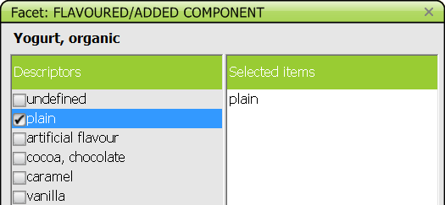
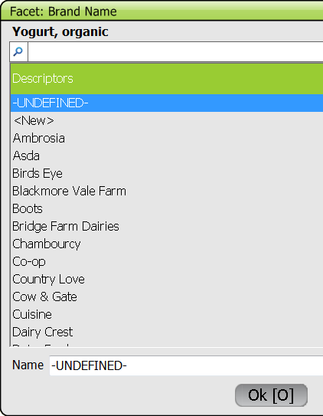
Facet types:
Standard: with list of descriptors attached
If multiple choice, the layout will be different
→
- Brand name: linked to the specific file
BRANDNAME.end. Each country will define the
brand and product names used per food (sub)group.
During the interview, new brand names may be
entered
Linked to a list of foods : for facets 15 Type of fat used and 16 Type of milk/liquid used, the foods are taken from the local food list, so (sub)groups must be defined.
Example: facet 15 Type of fat used will be linked to the group 10 Fats
and sub-group 0507 Dairy and non dairy creams
Maintenance
IARC, Lyon - France

Slide 20
Descriptors:
For the facet Cooking method, one has to define what descriptor is
  Raw
  Cooked with fat (e.g. fried, deep fried, reheated with fat)
  None of these
For facets with multiple choice, one has to define if descriptors are stand-alone or if they may be combined with other descriptors (e.g. ‘plain’ is stand-alone, ‘nuts’ may be combined with ‘chocolate’…).
DESC_IMP.xls, maintained by IARC, lists the improbable combinations of descriptors to avoid proposing ‘stupid’ descriptors.
Example: if reconstituted from powder, do not propose facets Preservation method, Packing method, Skin consumed, nor descriptors ‘homemade’.
Recipes are also described. So it implies to define recipe facets and descriptors
  File R_FACET.xls contains the facet code – facet name – type: identify the facet ‘Brand name’ – whether multiple choice or not – mandatory or not
  File R_DESCFACE.xls contains the descriptor code – descriptor name - descriptor type: identify when the recipe may be known – whether single or not if multiple choice facet
Maintenance
IARC, Lyon - France

Slide 21
Based on the list of facets and descriptors defined globally, each coordinator will define what facets and descriptors are applicable per (sub-) group based on IARC proposal.
For foods: file FADEBYGROUP. end.
For recipes: file RCPFADEBYGROUP.end
The order of facets must remain the same.
But each country will further have to define
the order of descriptors within each set
the default descriptors (the most commonly used) → flagged ‘D’.
IARC sets whether the descriptor name appears on the GloboDiet screen or not (to shorten description on screen)→ flagged ‘N’.
Rules between facets are set to decrease the number of facets asked, depending on the chosen descriptor/answer. They are prepared at IARC.
For example the facet ‘Packing medium’ will be asked only if the preservation method is canned.
For foods: file FACETRUL.end.
For recipes: file RCPFACETRUL.end
See next slide as an example.
GloboDiet training:
IARC, Lyon - France

Slide 22
Example of FADEBYGROUP.end
01 POTATOES AND OTHER TUBERS
01 04 PRESERVATION METHOD
01 04 00 N undefined
01 04 01 N canned
01 04 02 frozen
01 04 03 dried or flakes
01 04 10 vacuum packed
01 04 99 D N fresh
01 05 PACKING MEDIUM
[IF preservation method = canned]
01 05 00 N undefined
01 05 03 D canned in water/brine
01 05 07 canned in sauce (n.s)
01 05 12 canned in tomato sauce
01 05 13 canned in white sauce
01 05 14 canned in cheese sauce
01 05 99 N not applicable…
Food group code
Not in the name
Facet code
Define the facet order
Descriptor code
Default
Maintenance
IARC, Lyon - France

Slide 23
For dietary supplements, the description is less extensive. The coordinator gathers the list of facets and descriptors:
- File DS_FACET.xls contains the facet code – facet name – which is linked to quantification – facet type: multiple choice or not – mandatory or not - order
- File DS_DESCFACE.xls contains the descriptor code - descriptor name – if HHM is needed for its quantification – default – whether ‘other’ or not – whether single or not – order – not in the name
Maintenance
IARC, Lyon - France

Slide 24
Description
by facets and descriptors
Country-specific files
Maintenance
IARC, Lyon - France

Slide 25
Description of foods
IARC will prepare the file FDFACET.end listing all foods of the file FDLIST.end and the facets of the file FADEBYGROUP.end corresponding to the food classification.
In that file, the coordinator has to remove the facets that are not applicable to each food.
The order of facets cannot be changed (or else update the FADEBYGROUP.end)
Facets cannot be added (or else update the FADEBYGROUP.end)
Be aware of the implications:
  Some facets are linked, for example, keep facet Brand name (12) if you have facet Food production (10)
  Some facets are/may be needed for the quantification: facets Physical state (02) and Cooking method (03)
Description of recipes
IARC will prepare the file RCPFACET.end listing all recipes of the file MIXEDREC.xls and the facets of the file RCPFADEBYGROUP.end corresponding to the recipe classification.
In that file, the coordinator has to remove the facets that are not applicable to each recipe.
The order of facets cannot be changed (or else update the RCPFADEBYGROUP.end)
Facets cannot be added (or else update the RCPFADEBYGROUP.end)
Some facets are linked
Maintenance
IARC, Lyon - France

Slide 26
Quantification
Common files
Maintenance
IARC, Lyon - France

Slide 27
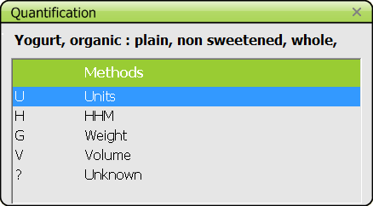
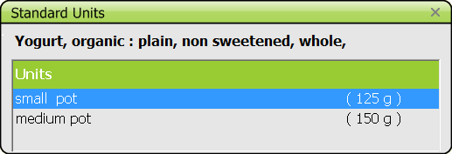
For the quantification step, the interviewer has the choice between several methods:
G: in weight, always proposed by GloboDiet
V: in volume, always proposed by GloboDiet
P: photos. Each country will define a list of photos; these may be taken from the GloboDiet picture book or other sources, validated by IARC
H: household measures (HHM). Each country will define a list of HHM; these may be taken from IARC library or other sources, validated by IARC.
U: standard units. Each country will define a list of units per food or recipe
P: standard portions. Each country will define a list of portions per food
A: shapes. Each country will define a list of shapes, these may be taken from IARC library or other sources, validated by IARC. Related thicknesses will also be defined.
W: part of whole recipe, an additional method is ‘part of the known recipe’ [e.g. ¼ of provided recipe].
Maintenance
IARC, Lyon - France

Slide 28
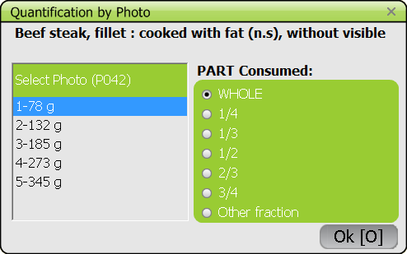
Photos:
Remember that recipes are quantified globally (not one photo for meat, one for side dish).
Photos are often linked to weights [in grams], which means they can be used only for items with similar densities. For new photos we advise to measure the volumes and densities to improve the flexibility of this method, so photos can also be linked to volumes [in ml].
Some photo series are used for spreads on bread (e.g. butter, jam). They are linked to the file THICKNESS.xls.
Fractions are predefined in PARAM.xls (maintained by IARC)
M_PHOTOS.xls: list of quantities/volumes corresponding to photos of all food and recipes in different quantities
Photo code - photo weights (e.g. 1-78,2-132,3-185,4-273,5-345) – whether the weight is raw or cooked – whether the waste is included or not – in g or ml
THICKNESS.xls: list of thicknesses, either linked to spreads or to shapes
Thickness code (e.g. photo 59-1 for butter on bread or T0010 for 1 cm thick) – thickness in cm – comment shown on screen – food (sub)groups for which the thickness is proposed – recipe groups for which the thickness is proposed
Maintenance
IARC, Lyon - France

Slide 29
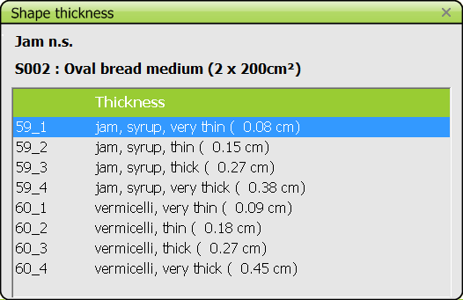
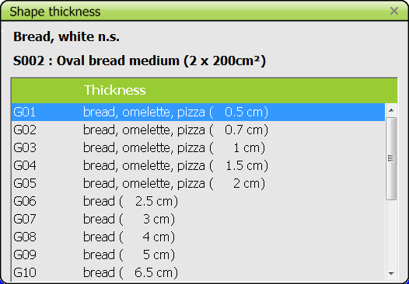
Thickness linked to spreads: during the interview, the steps are the following
Select the shape on which the item is spread
Select the number/fraction of the shape
Select the thickness using a photo
Thickness linked to shapes:
Maintenance
IARC, Lyon - France

Slide 30
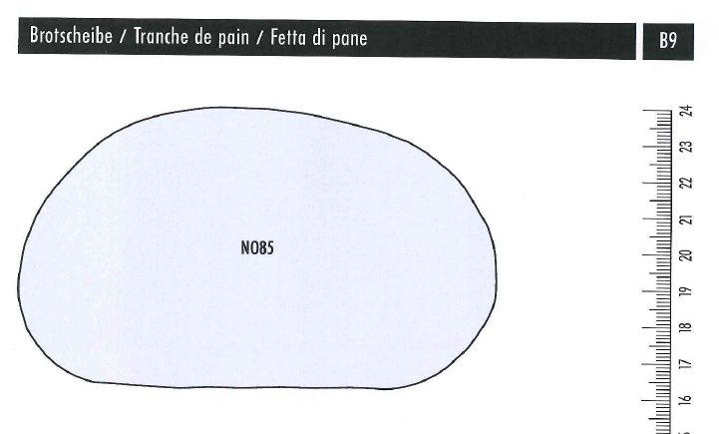
Rationale of this quantification method:
Quantity = Surface x thickness x density
Shapes:
This quantification method can be used for food items having an even thickness or for foods that are commonly sliced to have an even thickness.
Examples:
Rusk
Layer of solid piece of cheese
Slices of bread
Pizza
Shapes cannot be used when the thickness is irregular (e.g. buns, balls, waffle, kugelhopf…) or when the slices contain holes (e.g. melon, sweet pepper, pumpkin, Emmental cheese…).
Maintenance
IARC, Lyon - France

Slide 31
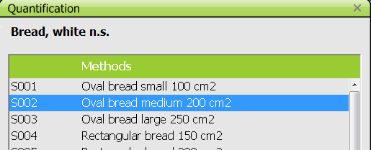
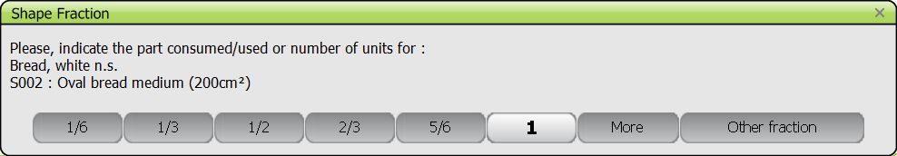
Shapes:
Shapes are most useful to quantify breads, cakes, terrines, pies …(foods and recipes)
Classify them in ‘round’, ‘normal/loaf type’, ‘flat/dense type’, ‘rectangular’, ‘square’ and ‘weird’
Draw them so that they are shown in the picture booklet - Measure their surfaces
Find/measure densities (weight in g/volume in cm3)
File M_SHAPES.xls:
gather the shapes of the picture booklet and of the standard units needed for spreads (e.g. rusk S065)
Shape code – shape surface – shape comment used to select a surface
Maintenance
IARC, Lyon - France

Slide 32
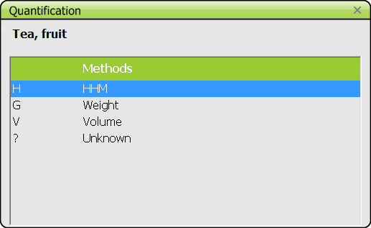
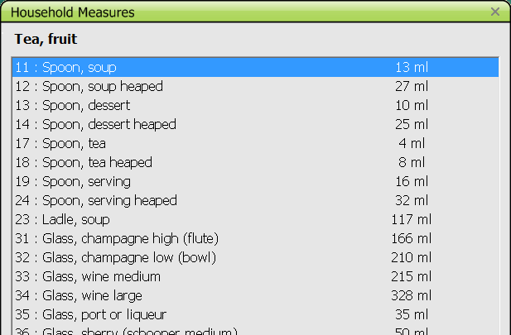
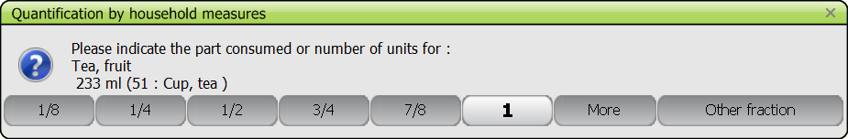
HHM:
For foods and recipes
Most HHM will be shown in the picture booklet with measurements
Spoons and some very standard cups (from vending machines) do not need to be included in the booklet.
M_HHM.xls contains
Household measure code
Volume corresponding to fraction 1
List of fractions, as they appear in the booklet
Comment
Order
Maintenance
IARC, Lyon - France

Slide 33
Based on the list of quantification methods defined globally, the coordinator will define what methods:
photo codes → P1 for example
Standard unit → STDU
Standard portion →STDP
Shapes → A
Household measures → HHM
are applicable per food (sub-sub)group, based on IARC proposal
Cooking method descriptor:
2 = cooked
1 = raw
File FDQMDETAIL. end
Example:
01 01 Potatoes
00 HHM
02 2 P4 mashed
02 STDU potato products
02 HHM
03 HHM
04 2 P1 large pieces
04 2 P2 small pieces
04 2 P3 french fries
04 STDU unit, rosti
04 HHM
06 2 P4 mashed
06 STDU potato products
06 HHM
Physical state as quantified descriptor:
02 reconstituted from powder
03 powdered
04 flesh/default
06 mashed
Maintenance
IARC, Lyon - France

Slide 34
For the recipes, each coordinator will define what methods from the list of quantification methods is to be used globally:
photo codes → P1 for example
Standard unit → STDU
Shapes → A
Household measures → HHM
are applicable per recipe (sub-sub)group, based on IARC proposal.
File RCPQMDETAIL.end
Notes:
No standard portion
No codes for facet Physical state, not for cooking method
The comments of files FDQMDETAIL.end and RCPQMDETAIL.end must be translated to prepare local versions.
Maintenance
IARC, Lyon - France

Slide 35
Quantification
Country-specific files
Maintenance
IARC, Lyon - France

Slide 36
Quantification of foods
IARC will prepare the file FDQUANT.end listing all foods of the file FDLIST.end and using the quantification methods of the file FDQMDETAIL.end corresponding to the food classification:
→ Photo codes, H (HHM), U (STDU), P (STDP), A (shapes).
In that file, the coordinator has to
remove the quantification methods that are not applicable to each food and
specify the shape codes that are applicable to each food
The format of the file cannot be changed
Quantification methods cannot be added (or else update FDQMDETAIL.end)
Description of recipes
IARC will prepare the file RCPQUANT.end listing all foods of the file MIXEDREC.xls and using the quantification methods of the file RCPQMDETAIL.end corresponding to the recipe classification.
→ Photo codes, H (HHM), U (STDU), A (shapes).
In that file, the coordinator has to
remove the quantification methods that are not applicable to each food and
specify the shape codes that are applicable to each recipe
The format of the file cannot be changed
Quantification methods cannot be added (or else update RCPQMDETAIL.end)
Maintenance
IARC, Lyon - France

Slide 37
Standard units have more or less standard weights (e.g. can/tin, package, box, Mars bar, drop) and can be purchased as such.
Each unit has a field ‘comment’ to describe it, to enable a choice during the interview
To distinguish among STDU (e.g. small vs. medium vs. big apple) and to check that the correct unit is chosen, you should indicate some measurements in the comment (e.g. diameter for medium apple)
For e.g. bread buns, rusks, crisp breads, indicate the related surface –which should appear in M_SHAPES.xls - so that the shape can be chosen to spread something on them
Some may be linked to ‘help photos’ (not regular ones), e.g. small flan as on P904-1
For packages containing small units (e.g. can of meatballs, box of chocolates/ sweets), indicate the number of units in each package and/or enter the single unit (meatball, chocolate piece) as a separate standard unit
Note that not all foods/recipes have standard units, only those having ‘U’ in the FDQUANT.end or RCPQUANT.end files.
Maintenance
IARC, Lyon - France

Slide 38
FDSTD.end contains the information on food standard units and portions
food code – food name – unit code
whether the weight/volume refers to raw or cooked/NA food:
  if the item does not have facet Cooking method, then enter ‘cooked/not applicable’
  if the item has the facet Cooking method, then enter ‘raw’ so that raw-to-cooked coefficient can be applied to the provided weight, else choose ‘cooked/not applicable’
whether the waste is included or not in the weight/volume
  If the item does not have an EDIB coefficient, then enter ‘without waste/not applicable’ = 1
  If the item has an EDIB coefficient, then enter ‘with waste’ = 2 so that an edible part coefficient can be applied to the provided weight, else choose ‘without waste/not applicable’ = 1
Standard unit weight/volume (4 digits, but possibility to have decimal figures)
Indication of whether it is a weight or volume
Description field (100 characters) to enable the choice during the interview
RCPSTDU.end contains the information on recipe standard units. Same variables except those on raw/cooked and on waste → enter the final weights as consumed (adapt the weights if baked/cooked after purchase e.g. pizzas, or if hydrated after purchase, e.g. convenient dishes, if needed)
→ M_STDU.xls and M_STDP.xls
Maintenance
IARC, Lyon - France

Slide 39
A standard portion is applied when the food is identified but cannot be quantified (“ I added some…”). This is usually a small quantity. Standard portions do not apply to recipes.
Examples:
    melted/grated cheese on pasta
    nuts on ice cream
Standard portions are gathered with standard units in FDSTD.end so same format.
Notes:
There is often a confusion in the term ‘standard portion’. In GloboDiet, the goal is to capture the actual portion eaten by the subject on that particular day. Therefore we avoid listing ‘regular/mean/average’ portions which are useful for other types of dietary surveys.
We are aware that all required information cannot be collected before starting the field work. FDSTD.end can always be updated- at regular intervals – to enter new standard units.
During the field work, if the item cannot be quantified by means of existing quantification methods, the interviewer should enter an estimate (to avoid missing quantities) and fill the ‘notes’ with as much precision as possible to later allow the coordinators to update the interview with true information.
Maintenance
IARC, Lyon - France

Slide 40
Summary of work on quantification
Common
List of PHOTOS FDCLASS
FDQMDETAIL (quantification methods by group)
Country-specific
List of SHAPES FDLIST
List of HHM
FDQUANT (quantification methods by food)
List of THICKNESSes
FDSTD
Maintenance
IARC, Lyon - France

Slide 41
Coefficients used to calculate the consumed quantities
Maintenance
IARC, Lyon - France

Slide 42
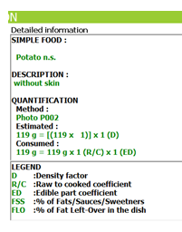
GloboDiet automatically calculates the consumed weights of the food items. This implies using a series of coefficients
Density factor to convert volume in cm³ to weight in g
RAW-to-COOKED coefficient
Edible part coefficient (5% waste gives 0.95)
Standard percentages of fats/sauces/sweeteners (FSS)
Standard percentages of fats/sauces left in the dish
Standard percentages of fat absorbed during cooking
These are applied depending on the context. For example, for photo 2, in M_PHOTOS, the weights are entered
as cooked so no need to use a RAW to COOKED coefficient
As all edible no need to use an EDIBLE PART coefficient
Maintenance
IARC, Lyon - France

Slide 43
Note: IARC proposes coefficient files from other projects/countries.
DENSITY
At least one density coefficient has to be provided per food and recipe as the method Volume is always available to quantify, this is especially relevant when quantifying by household measures and shapes (thickness).
File DENSITY.xls which gather DENSITY.end and RCPDENSITY.end.
For each food, several coefficients may be provided depending on
the food description, e.g. physical state (liquid vs. powder vs. concentrated), preservation method (fresh vs. dried), cooking method (raw vs. cooked)…
the edible part when quantified, e.g. mussels with (‘I:’) and without shells (‘E:’)
the cooking status when quantified, e.g. raw rice (‘R:’) vs. cooked rice (‘C:’)
in a defined order – read carefully the specific guidelines.
For recipes, one coefficient is enough as there is no variation expected.
EDIBLE PART
For foods for which it applies, edible part coefficients have to be provided. They may depend on food description, e.g. preservation method (fresh vs. canned).
File EDIB.end enables to list one coefficient per food.
File EDIBLEP.xls enables to list several coefficients – maintained by IARC.
- apple with skin or not (facet 13)
- meat with visible fat or not (facet 14)
For each case, you have to define a default; for example ‘default = without skin’ vs. ‘1302 with’
Maintenance
IARC, Lyon - France

Slide 44
RAW-to-COOKED coefficients for foods/ingredients, not for recipes.
Only foods having facet Cooking method are listed in the file RAWCOOK.end.
To ease the work, cooking method descriptors are grouped in several sets of similar expected weight loss/gains.
In RAWCOOK.end, there are different columns
Default value
Wet category ‘boiled/BO’
Dry category ‘baked/BA’ and ‘roasted/RO’ (tendency to group them now)
Fry category ‘Fried/FR’: for those cooking methods, the regular raw-to-cooked coefficients cannot be used as such as the absorbed fat is included in those coefficients. Fat update has to be deducted to get the coefficient used in GloboDiet (see specific guidelines for the calculations).
Specific coefficient for 03-98 not applicable: 1.00
Specific coefficient for 04-03 (or 04-18) dried
Maintenance
IARC, Lyon - France

Slide 45
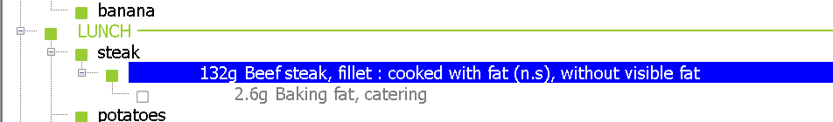
Percentages of fat absorbed during cooking
As subjects are usually unable to quantify absorbed fat, the coordinator needs to provide such percentages to avoid missing quantities.
Only foods having the facet Cooking method are listed in the file PCTFAT.end.
To ease the work, cooking method descriptors are grouped in several sets by similar expected absorption of fat.
In PCTFAT.end, there are different columns
Column 1 corresponds to ‘Very fatty’, such as deep fried
Column 2 corresponds to ‘Fatty’, such as fried in pan
Column 3 corresponds to ‘Very low fat’, such as stewed
Notes:
Some cooking methods do not absorb fat so no coefficient attached;
For recipe ingredients, this calculation does not take place – except if the ingredient is deep fried – and the fat used in the recipe is listed as a separate ingredient.
Maintenance
IARC, Lyon - France

Slide 46
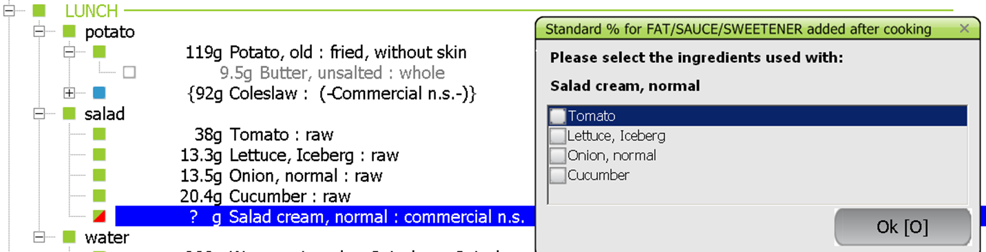
Standard percentages of fats, sauces and sweeteners applied to foods (PCTFSS.end) and to recipes (RCPFSS.end)
Used whenever a fat, sauce or sweetener cannot be quantified during the interview: linked to quantification method ‘?’.
In .end files, coefficients are organised in 3 columns
Fats: group 10 and sub-group 0507
Sauces: sub-group 1501
Sweeteners: some sub-groups of group 11
These food (sub-sub)groups must first be identified in the SUBGROUP.xls file.
The coordinator needs to provide these three percentages, based on experience, analyses… for each food.
Note:
For the moment, percentages are the same for all foods of a given food group, e.g. same percentage applied to potatoes for added butter and for added oil (group 10). More flexibility will be possible with the e-SMP and is already on request.
Link with probing questions: if probing ‘sauce’ is linked to a food, we expect a percentage for ‘sauce’ to be available in case this sauce cannot be quantified.
Maintenance
IARC, Lyon - France

Slide 47
Standard percentages of fat left in the dish
For fats and sauces poured on top of foods/dishes, some may be left in the dish → this left over quantity must be deducted from the initial quantity to get the consumed quantity.
The coordinator must first provide the list of food (sub)group for which this type of calculation is needed.
For each sub(group), a percentage must be provided.
File PCTFATLEFT.end
Maintenance
IARC, Lyon - France

Slide 48
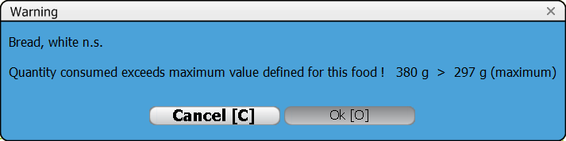
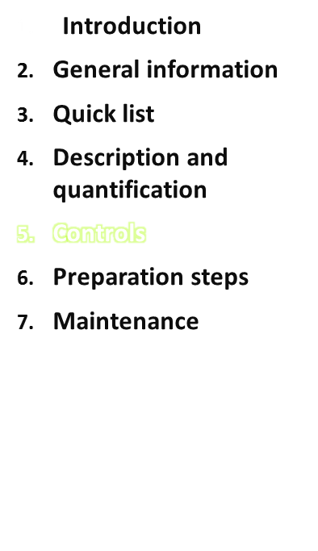
Warnings on ‘exceeding/overflow’ quantities are implemented in GloboDiet, but they do not block the interview.
The file FDMAX.end – and RCPMAX.end – are prefilled at IARC based on
Information on photos used for the given item
Information on standard units of the given item
Past experience
The national coordinator has to check these proposed values and adapt them if needed.
Maxima values may depend on the description, for example the Physical state. These values may be added to the file.
Maintenance
IARC, Lyon - France

Slide 49
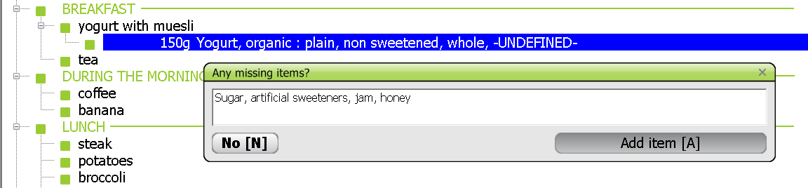
Probing questions are proposed to avoid forgetting items. This is based on local dietary habits.
1st step: Each coordinator needs to provide a list of probing items chosen from the IARC library (code – name).
File PROBING.end to be translated into local language(s).
2nd step: IARC will prepare the file FDPROBING.end based on the file FDLIST.end and proposals from IARC.
IARC will prepare the file RCPPROBING.end based on the file MIXEDREC.xls and proposals from IARC.
In those files, the coordinator has to
remove the probing question codes that are not applicable to each food/recipe
add those relevant to each food/recipe.
Remember that there is a link with the standard percentages of fats, sauces and sweeteners for probing questions 07 cream, 15 fat, 22 savoury sauce and 23 sweet sauce.
Maintenance
IARC, Lyon - France

Slide 50
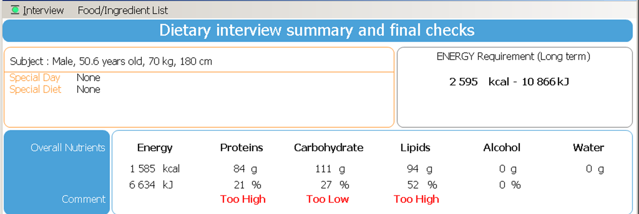
To perform a broad control at the macronutrient level, a simplified food composition table (rounded, no decimal figures) is implemented in GloboDiet: file FDTABLE.end.
At least one set of the following variables must be entered per food, i.e. as usually consumed (e.g. no ‘dried’ rice or legumes):
Energy, expressed in kCal/100g - Proteins, in g/100g
Lipids, in g/100g
Glucids: available carbohydrates (without dietary fibers), in g/100g
Alcohol, in g/100g
When eaten cooked, enter value sets for boiled or baked foods (i.e. without fat used for cooking).
Maintenance
IARC, Lyon - France

Slide 51
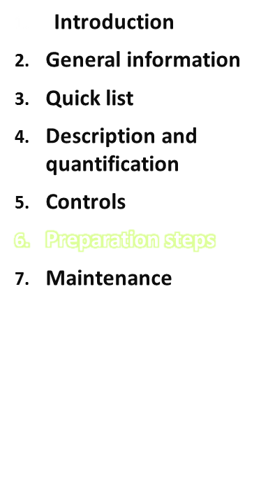
Common files
Country-specific files
Foods
GloboDiet ‘food database version’
and Recipe Manager
Country-specific files
2. Recipes
3. Dietary supplements
GloboDiet ‘final database version’
→ IARC guides throughout the whole preparation
Maintenance
IARC, Lyon - France

Slide 52
IARC maintains a library containing the common files used to control/allow for standardisation across projects/countries. It contains
Food and recipe classifications
List of facets and descriptors for foods, recipes and dietary supplements
Picture books, shapes, household measures photos
Setting files
When starting a project, an agreement among the countries participating in a project has to be found in terms of
Food and recipe classifications – rules on handling of complex foods such as soups, snacks
Level of details for the description
Quantification methods
Setting files (list of food consumption occasions, of places of consumption, of special days, of special diets…)
To come up with the common files of the project.
Based on the common project files, each country will prepare its country-specific files.
N.B. This approach applies also to a national project (one country only).
GloboDiet training:
IARC, Lyon - France

Slide 53
Facets & Descriptors
Food Classification
Photo Series
Photo Series
Shapes
Shapes
Facets/Descriptors
by Group/Subgroup
Thickness
Thickness
Facet Rules
Probing
HHM
HHM
Probing by
Group/Subgroup
Quantification by
Group/Subgroup
Setting files
% Fats/sauces left over
Foods & Shadows
Quantifications by food
Facets by food
Standard units
Brand name
Standard portions
% Fats during cooking
Probings by food
Maxima
Density
% Fats/Sauces/Sweeteners
Nutritional
values
Edible part
Raw to cooked
Project data in blue
Country data in green
‘FOOD’ DATABASE VERSION
Maintenance

Slide 54
Facets & Descriptors
Recipe Classification
Photo Series
Photo Series
Shapes
Shapes
Facets/Descriptors
by Group/Subgroup
Thickness
Thickness
Facet Rules
Probing
HHM
HHM
Probing by
Group/Subgroup
Quantification by
Group/Subgroup
Recipes & Shadows
Recipe
ingredients
Facets by recipe
FOOD pathway
files
Quantifications by recipe
Brand name
% Fats/Sauces/Sweeteners
Probings by recipe
Maxima
Density
Nutritional
values
Standard units
Project data in blue
Country data in green
Facets & Descriptors
Supplement Classification
Supplements
‘FINAL’ DATABASE VERSION
Facets by Supplements
Maintenance

Slide 55
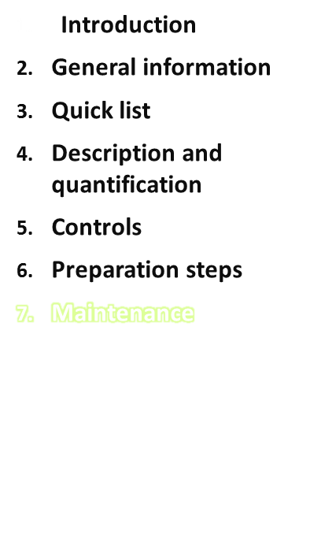
Food update form (FUF) and Recipe update form (RUF)
During the field work, new needs may be identified with regards to foods and recipes which can be incorporated into the GloboDiet files via standard forms: FUF and RUF (.end or Word).
Foods:
The FUF enables to
Update information on an existing food (replace or add)
Add a new food
Recipes:
Updates of recipes and their ingredients are made in the Recipe Manager.
The RUF enables to update the other recipe information
Maintenance
IARC, Lyon - France

Slide 56
Food update form (FUF) and Recipe update form (RUF)
During the field work, new identified needs with regards to foods and recipes can be incorporated into the GloboDiet files via a procedure using dedicated forms: FUF and RUF.
FOOD UPDATE FORM (version 1.2) 12 January 1996
1. Country ..........
2. Code (for new food IARC complets) 0000
( )
3. Food name, 50 caracters max. ( )
- own language ( ) .
- English( ) .
4. Group/subgroup ( ) .. .. ..
5. Shadow ( )
- Synonym, 50 caracters max. .
( )
- Other group ( ) .. .. ..
6. Brandname (if not yet listed) ( )
- 1. Brandname .
- 2. Brandname .
7. Facet ( ) .. .. .. .. .. .. .. .. .. .. ..
Leave 0000 if new food
Otherwise enter the food code
Provide the food name in both languages
If applicable, several shadow items can be specified (copy row)
If applicable, several new brand or product names can be specified (copy row)
Specify the facets you wish to keep from the FADEBYGROUP file
Maintenance
IARC, Lyon - France

Slide 57
Specify the quantification methods you wish to keep from the FDQMDETAIL file –
for units and portions:
be careful with the numbering and with the variables raw/cooked and edible part
new rows may be added
8. Quantification ( )
- photos ( ) ..,..
- HHM ( ) .
- STDU and comment ( ) U.1 C 2 .... ....................
- STDU and comment ( ) U.2 C 1 .... ....................
- STDU and comment ( ) U.3 C 1 .... ....................
- STDP and comment ( ) P.1 C 1 .... ....................
- STDP and comment ( ) P.2 C 1 .... ....................
9. Maxima ( ) .
10. Probings ( ) ..,..
11. Nutrient values ( )
- Energy ( ) . . .
- Protein ( ) . . .
- Fat ( ) . . .
- Carbohydrate ( ) . . .
- Alcohol ( ) . . .
- Priority number 1 2 3
- Facet-string ( ) .... .... .... ....
12. Density/facet-string (if HHM used) ( )
- Raw R:0.__ .... R:0.__ ....
- Cooked C:0.__ .... C:0.__ ....
- Default density 0.__ .... 0.__ ....
13. Edible Part ( )
- Default edib ( ) 0.__
- for fish: whole ( ) 0.__
- for fish: fillet ( ) 0.__
- for fish: steak/slice ( ) 0.__
- for fish: canned ( ) 0.__
Provide a set of nutrients values, if several sets, please specify the description attached (facet-descriptor string)
facet-descriptor string
Other EDIB coefficients may be entered, linked to specific facet-descriptor string(s)
Maintenance
IARC, Lyon - France

Slide 58
14. Rawcook coef. (if facet 03) ( )
- Default R/C ( ) 0.__
- Boiled ( ) 0.__
- Baked ( ) 0.__
- Roasted ( ) 0.__
- Fried ( ) 0.__
- from dried (if facet 0403) 0.__
( )
15. PCTFAT (if facet 03) ( )
- Group1 very fatty ( ) 0.__
- Group2 fatty ( ) 0.__
- Group3 less fatty ( ) 0.__
16. PCTFSS ( )
- %Fat ( ) 0.__
- %Sauce ( ) 0.__
- %Sweetener ( ) 0.__
If you wish to have the shape method, please write so after ‘STDP and comment’ and specify the shape codes attached to the food, e.g. ‘A1 R055, R065’.
For units and portions in volume [ml], enter ‘$’ in the description field.
If you wish to update and/or create several foods, please prepare a single file gathering all the individual FUFs.
Maintenance
IARC, Lyon - France

Slide 59
RECIPE UPDATE FORM (version 1.0) SEPTEMBER 2013
1. Country .
2. Code .
3. Recipe name, 50 caracters max. ( ) .
4. Group/subgroup ( ) .
5. Quantification ( )
- photos ( ) ..,..
- HHM ( ) .
- STDU and comment ( ) U.1 0000 ....................
- STDU and comment ( ) U.2 0000 ....................
- STDU and comment ( ) U.3 .... ....................
- Shape A
6. Maxima ( ) 0000
7. Probings ( ) ..,..
8. PCTFSS ( )
- %Fat ( ) 0.__
- %Sauce ( ) 0.__
- %Sweetener ( ) 0.__
9. Density .
10. Facet .. .. .. .. .. .. .. ..
Provide the recipe code, name and classification as entered in the Recipe Manager
Specify the quantification methods you wish to keep from the RCPQMDETAIL file – for units :
be careful with the numbering,
new rows may be added
For the shape method, specify the shape codes attached to the recipe, e.g. ‘A1 R055, R065’.
For units in volume [ml], enter ‘$’ in the description field.
Specify the facets you wish to keep from the RCPFADEBYGROUP file
Maintenance
IARC, Lyon - France

Slide 60
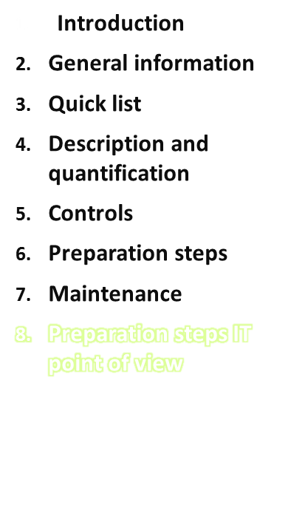
Common files 2.Preparation of common files
Country-specific files 3.Construction of tmp & new-files
Foods
Food database 4.Controls on FOOD end-files
& Recipe Manager
2. Recipes
3. Dietary supplements
GloboDiet ‘final database version’
Guideline 02_Readme_Procedure_ref_GER.docx
Maintenance
IARC, Lyon - France

Slide 61
Common files
Country-specific files
Foods
GloboDiet ‘food database version’
and Recipe Manager
Country-specific files
2. Recipes
3. Dietary supplements
GloboDiet ‘final database version’
→ IARC guides throughout the whole preparation
Maintenance
IARC, Lyon - France

