Slide 1

IARC Guidelines for preparing GloboDiet photos

Slide 2
Outline
Quantification methods used in GloboDiet
Picture book
  Content
  Selection of new pictures
  How to take pictures
  Layout

Slide 3
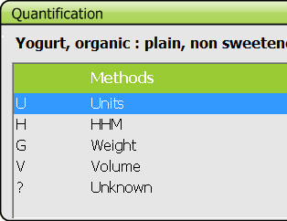
Quantification methods in GloboDiet
G: in weight, always proposed
V: in volume, always proposed
P: photos, selection - picture book
H: household measures (HHM), list of HHM common to foods, recipes and dietary supplements - picture book
U: standard units, per food or recipe
P: standard portions, per food
A: shapes, selection - picture book. Related thicknesses also defined.

Slide 4
Rationale for guidelines
part of the GloboDiet methodology = comparable data across countries and studies
based on
  the literature,
  previously used GloboDiet procedures,
  on the EFSA expert committee opinion and
  on the experience from recent projects, including EFCOVAL and PANCAKE.
PANCAKE developed and tested a protocol to create pictures of food portion sizes for use among children in Europe
Notes:
The picture book is part of the GloboDiet methodology that is why special care on its preparation is required.
→ensure that the development and choice of pictures, food shapes and household measures for use within the GloboDiet methodology is comparable across countries and studies, warranting the best possible collection of food consumption data
→based on the literature, on previously used EPIC-Soft procedures, on the EFSA expert committee opinion and on the experience from recent projects, including EFCOVAL and PANCAKE. The latter developed and tested a protocol to create pictures of food portion sizes for use among children in Europe

Slide 5
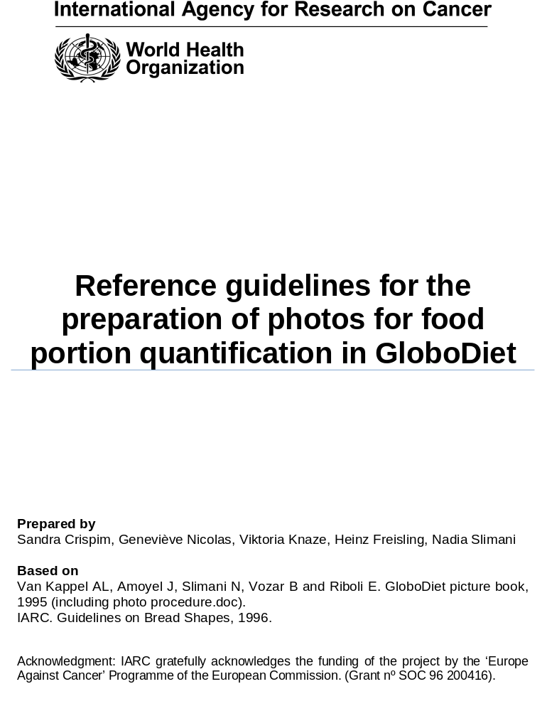
Content of Appendix 5 to the GloboDiet User manual
Guidelines on how to
select foods for including in the picture book
take standardized pictures for dishes, HHM and shapes
Layout the picture book

Slide 6
Standard procedure
Selection of food items that require photos
IARC’s approval on the selection
Proofs of new photos
Final approval of new photos
Coding and inclusion into picture book
Notes:
The workshop today will mainly focus in the selection procedure!

Slide 7
Content of picture books
Table of content
Photos
  Photo series for foods/dishes
  Help photos to choose standard units
  Shapes in real size
  Household measures with dimensions
  Real size serving plate, ruler
Acknowledgments
Front cover with logo of institutes, incl. IARC

Slide 8
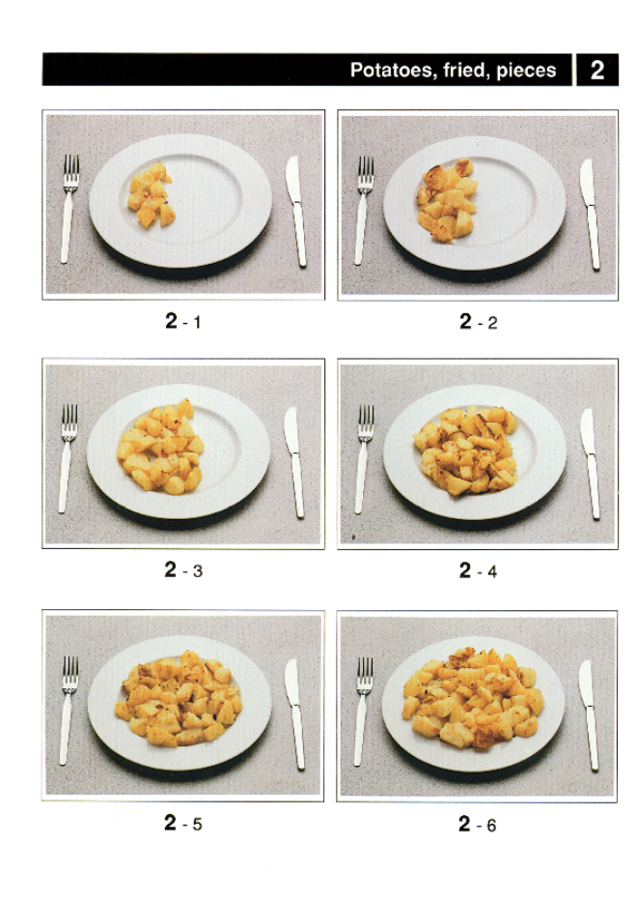
Photos of foods/dishes
Existing pictures from previous projects and studies (EPIC, PANCAKE, INCA3, MenuCH, PILOT-PANEU, Korea)
New photos needed for bulk foods if
  Different weight/portion ranges
  Different preparation methods
  Different foods/dishes (density)
  No other good alternative quantification method
  (relatively) frequently consumed foods
Notes:
Existing pictures = this is the initial criteria Sandra used to select the photos in the work she will present afterwards.

Slide 9
New photos
Determine the weight range using age-specific and population-based data. The maximum may be eaten in several servings.
Difference between two portions = at least 25% in order to be visible, but not more than twice as much. Linear increase
All 4 to 6 portions in one page (9 x 5.7 cm) to be visible enough
→ Crispim’s article in preparation

Slide 10
Preparation of food items
Use reference objects : serving plate d=26 cm, dessert plate d=20cm, stainless steel cutlery
Consider visual quality, cost of products, ease of preparation
Weigh portions on electronic balance and measure their volume, note if the weight/volume is with inedible part or not and if ready-to-eat or to be cooked
→ Willem’s protocol in preparation

Slide 11
Information for IARC
Photo code provided by IARC
Weights (G) or volumes (V) measured during the preparation of photos
#PH_CODE | #PH_QSTR | #RAW_COOKED | #EDIB | #PH_UNIT | local names (if applicable) | English names
P001 | 1-70,2-141,3-228,4-304,5-405,6-507 | 2 | 1 | G |  | Potatoes, boiled
P002 | 1-60,2-119,3-189,4-259,5-343,6-440 | 2 | 1 | G |  | Potatoes, fried, pieces
P003 | 1-62,2-97,3-142,4-184,5-265 | 2 | 1 | G |  | French fries (without 12% fat)
P004 | 1-71,2-141,3-221,4-311,5-399,6-499 | 2 | 1 | G |  | Mashed potatoes
P005 | 1-10,2-20,3-40,4-60,5-80 | 2 | 1 | G |  | Potato crisps
Variable indicating if the weight/volume is ready-to eat (2) or can be further cooked (1)
+ density (g/ml)
Variable indicating if the weight/volume is ready-to eat (1) or contains inedible part (2)

Slide 12
Presentation of portions
Usual local presentation (cut, cooking method)
There may be several presentations per portion – same weight/volume (e.g. whole and sliced – in a plate and in a bowl)
Increase the portions from left side of the plate to the right side (same thickness)
Technical points (see video)
Notes:
angle 45º for adults, distance 174 cm, grey background, professional quality

Slide 13
Some examples of photo series

Slide 14
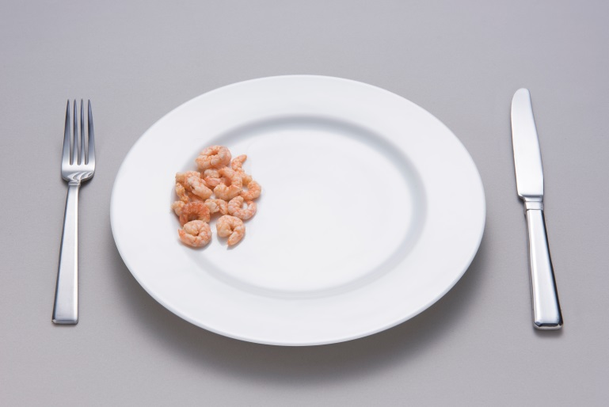
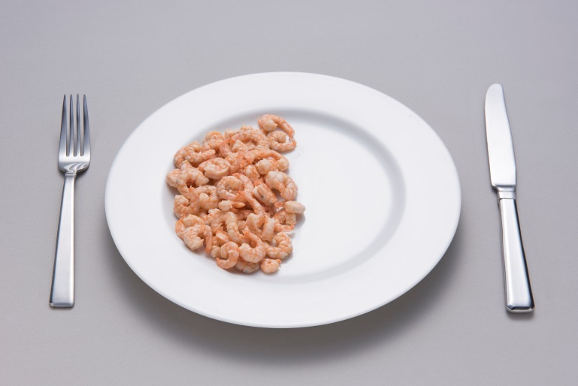

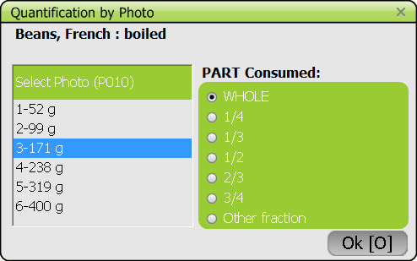
Portion 1 = 25g Portion 2 = 91g
Too big difference
Think that the subject can use fractions.

Slide 15
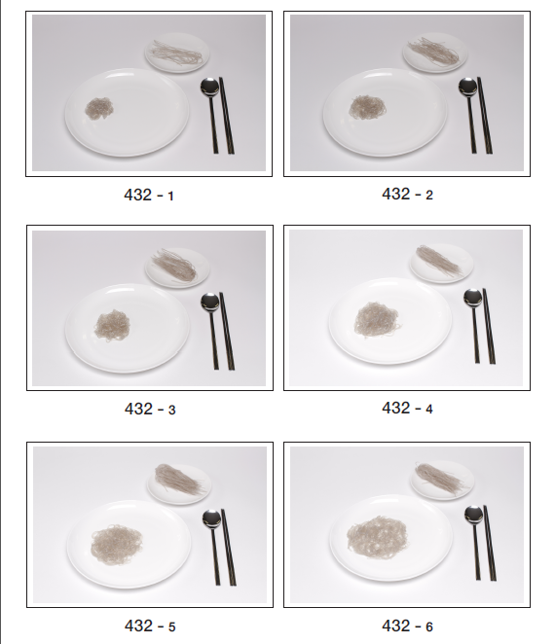

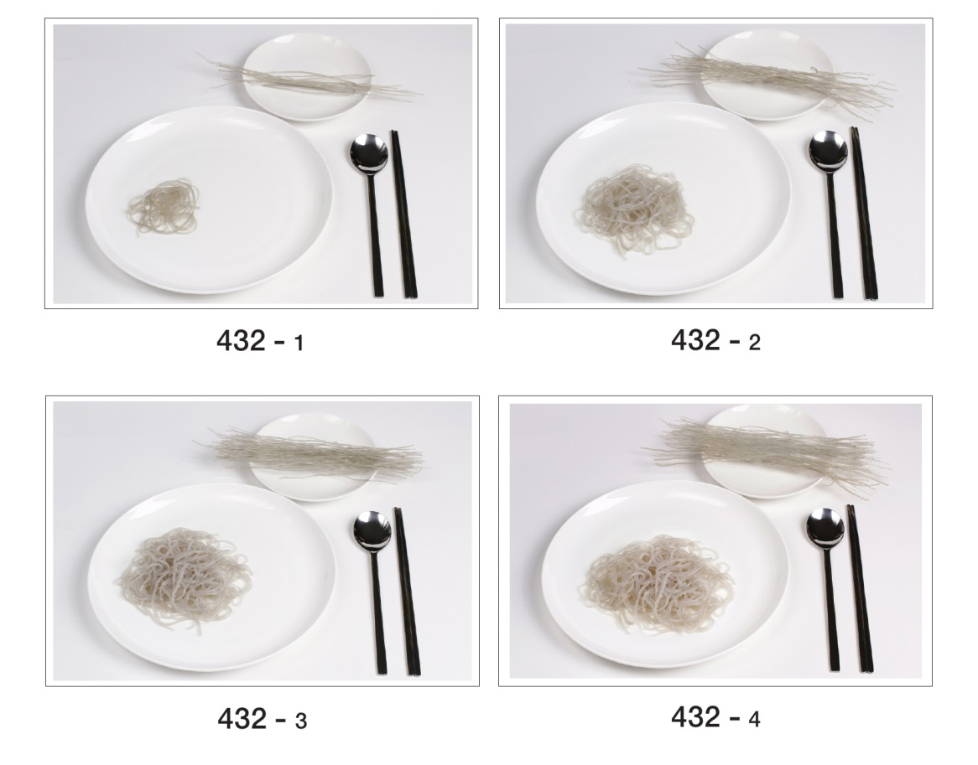
Too little difference between portions

Slide 16
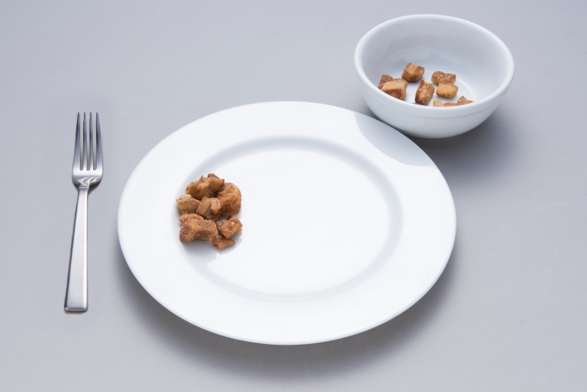
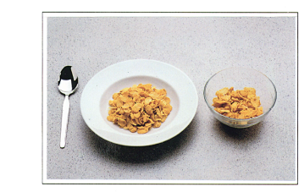
The food in the bowl is not 100% visible
→ Use glass bowl

Slide 17
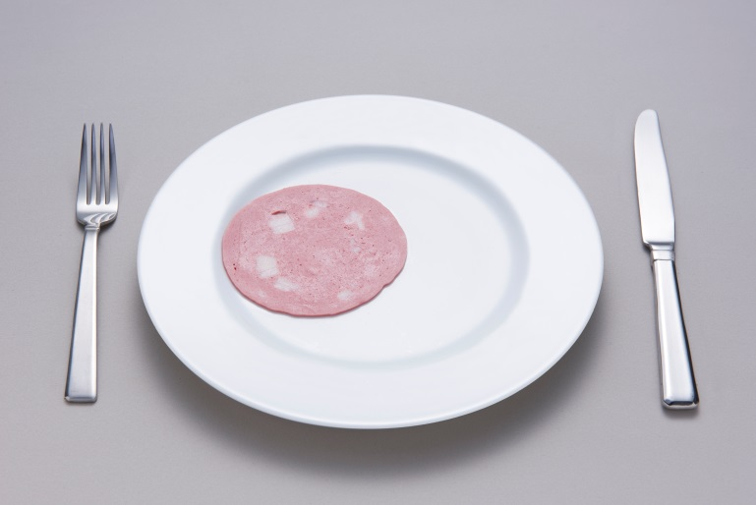
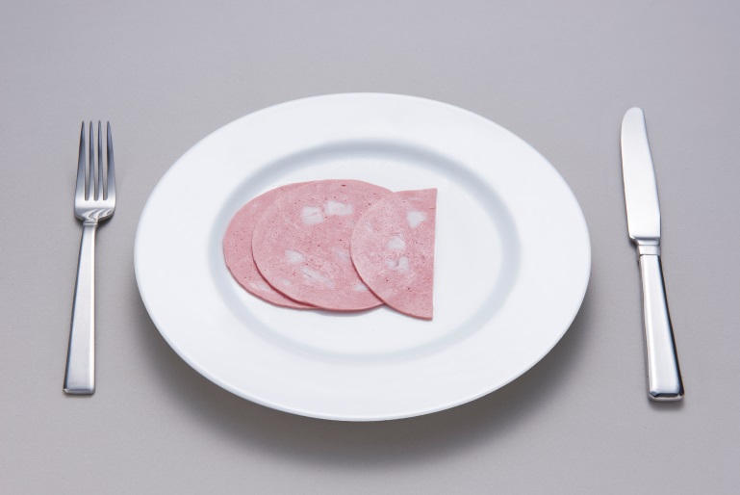
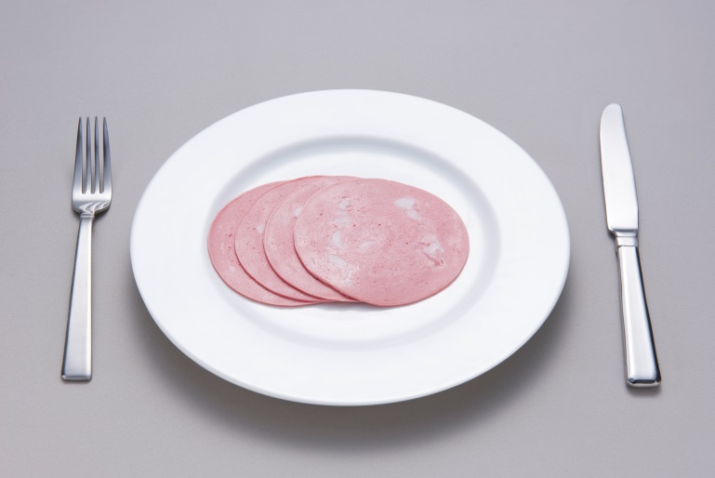
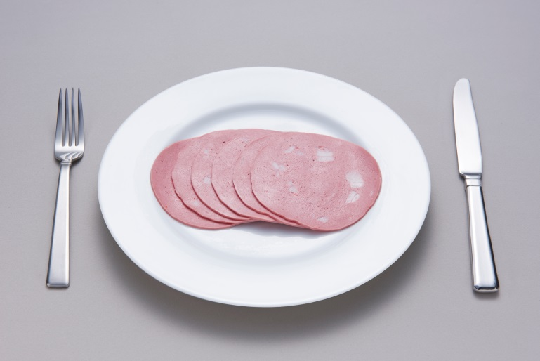
1
2
3
4
Portion 1 is a standard unit. A help photo may not be needed if really standard size.
A photo series is needed only if eaten in large amounts and displayed on a plate.

Slide 18
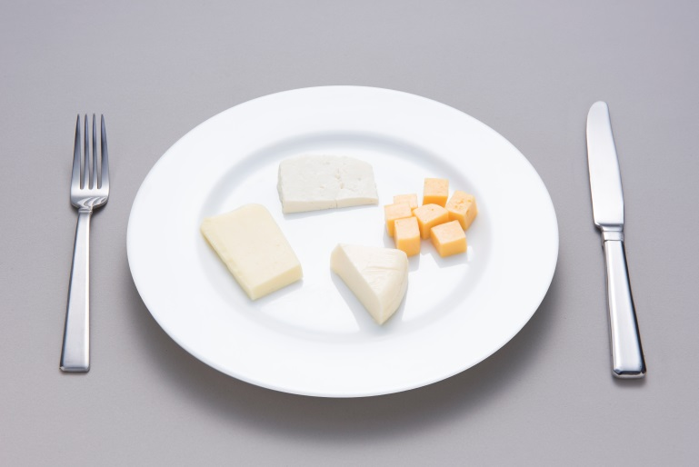
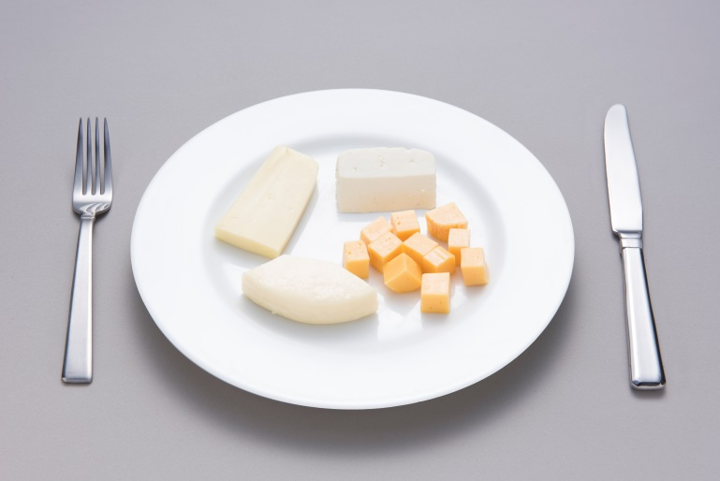
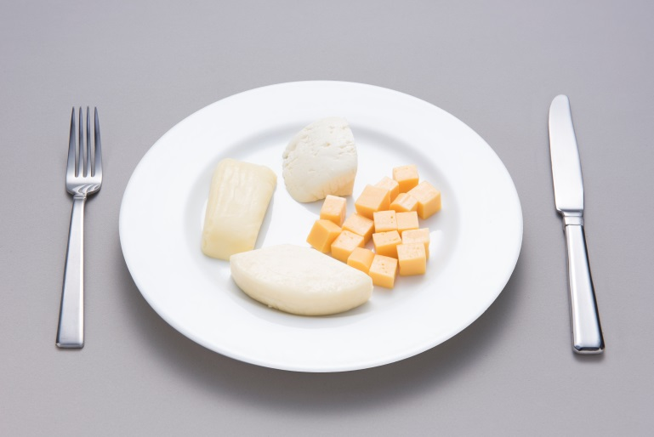
2
3
Changes in
Position/location
Shape of some cheese cuts
White on white (contrast)
4

Slide 19
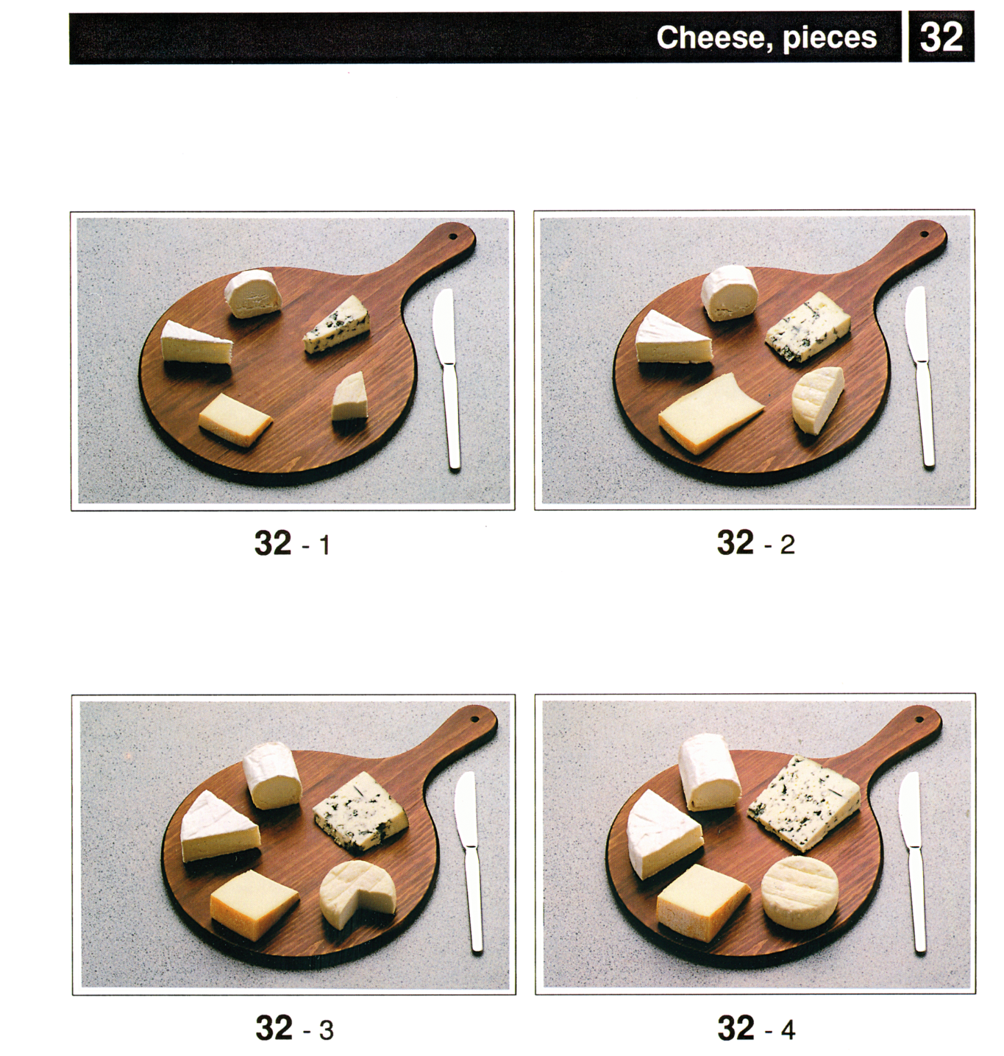

Slide 20
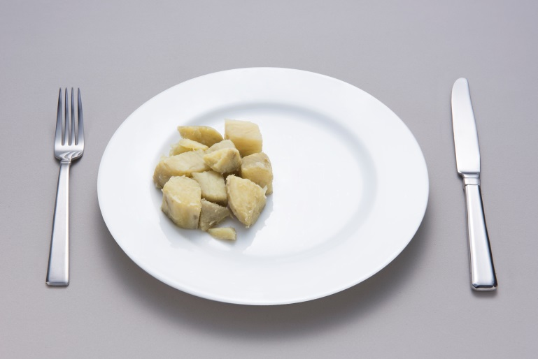
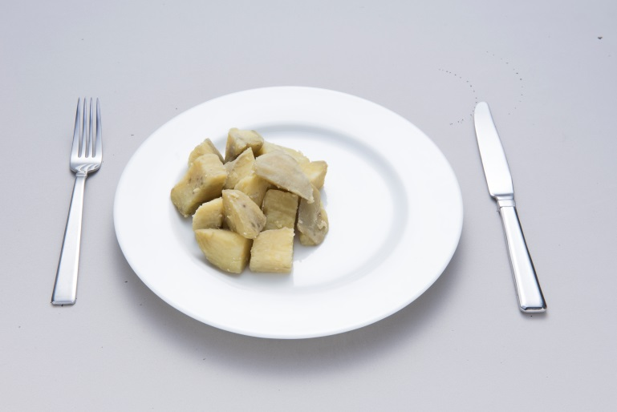
2
3
To increase quantities:
First spread from left to right in a uniform layer
Then pile up

Slide 21
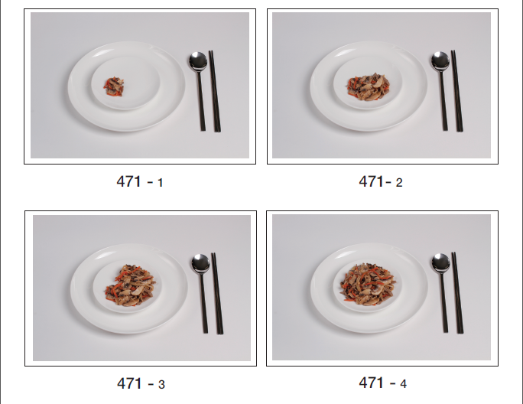
Increase the portion by adding food in an even direction (left to right is recommended)

Slide 22
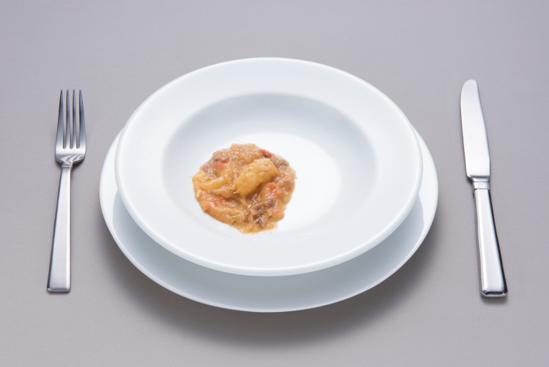
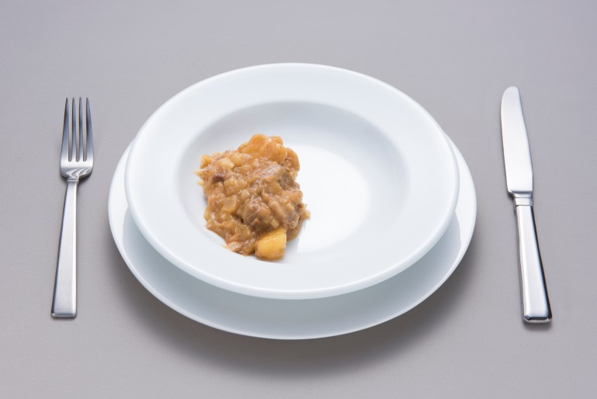
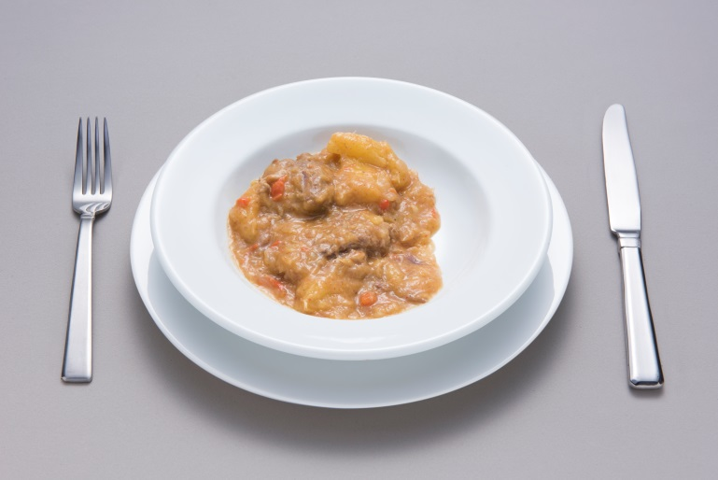
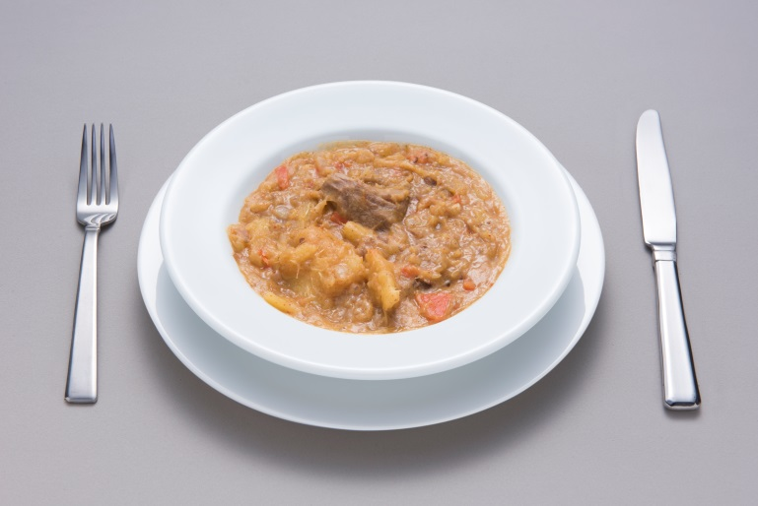
1
2
3
4
Be sure to show a homogeneous recipe

Slide 23
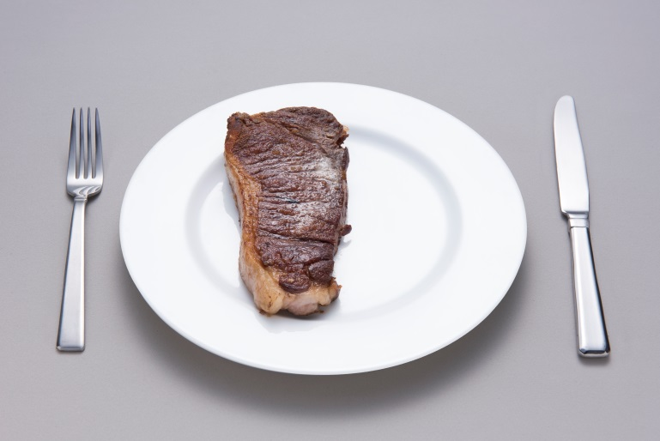
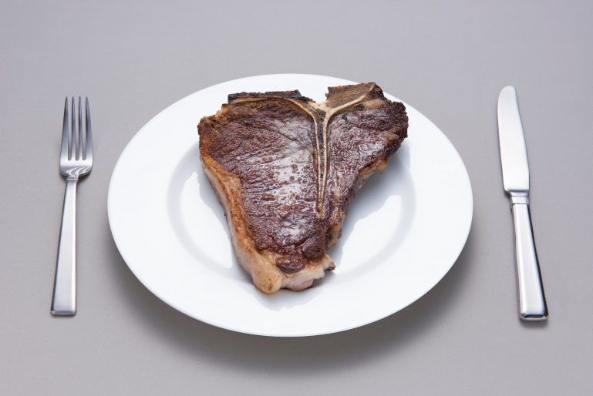
3
4
An edible part coefficient is attached to each food.
For a photo series, weights may include inedible parts. If so, this applies to all pictures of the photo series.

Slide 24
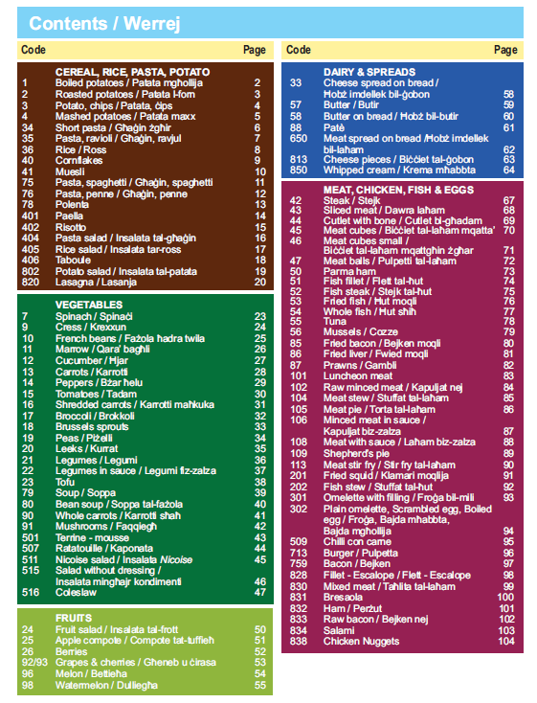
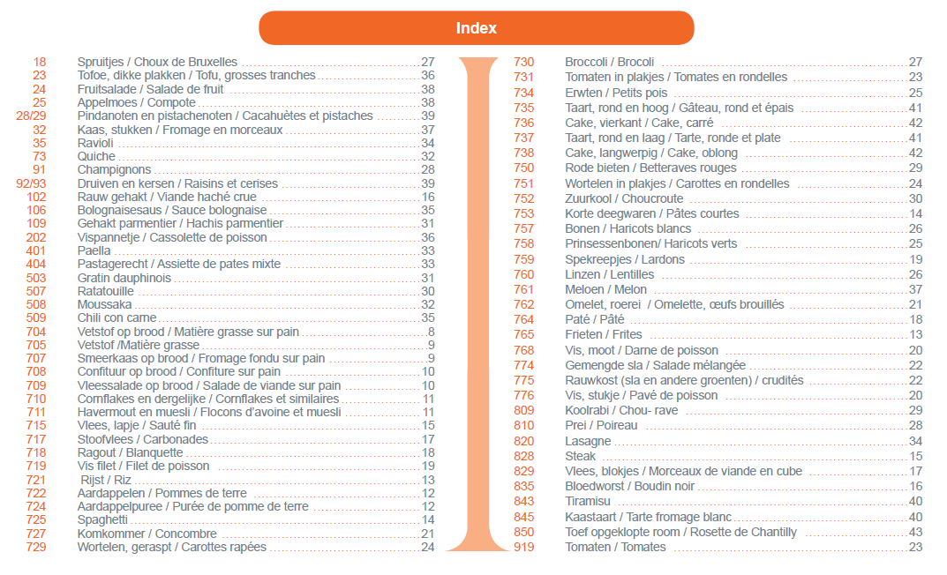
Organisation of photos
Either grouped by food groups (vegetables, cereals, sources of proteins…)
Either by increasing photo code

Slide 25
Household measures (HHM)

Slide 26
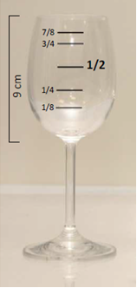
Household measures (HHM)
Existing pictures from previous projects and studies (EPIC, PANCAKE, INCA3, MenuCH, PILOT-PANEU, Korea) → may be adapted to different volumes if same look/aspect
No picture needed for standard HHM (spoons, plastic cups)
Check the dimensions with a ruler
45

Slide 27
Presentation of HHM
On a white table
Coffee spoon as reference (same scale for all pictures)
Max. 4 HHM per picture
Angle close to 90º with visible top rim
Dimensions indicated (height, diameter)
Fractions well visible (1, ½, ¼…)
Coded (local coding)

Slide 28
Information needed on HHM
Total volume, corresponding to fraction 1, at the rim.
Dimensions of each HHM, knowing that for series, only one HHM will be on the picture book
  Total height
  Height of the containing body (if different)
  Diameter for bowls

Slide 29
Information for IARC
Total volume (fraction =1)
Fractions shown on the picture book
HHM code in local GloboDiet | HHM name | HHM volume [ml] | Fractions | Diameter [cm] | Total height [cm] | Height of bowl, if applicable [cm]
31 | verre, coupe champagne | 170 | 1/4,1/2,3/4,1 | 8.6 | 10.4 | 3.9
32 | verre, petit vin | 190 | 1/8,1/4,1/2,3/4,7/8,1 | 6.8 | 13 | 6.5
33 | verre, grand vin | 245 | 1/6,1/3,1/2,2/3,5/6,1 | 6.2 | 16.1 | 9.6
34 | verre, flute champagne | 180 | 1/8,1/4,1/2,3/4,7/8,1 | 4.4 | 17.9 | 11.2
35 | verre, eau de vie | 60 | 1/6,1/3,1/2,2/3,5/6,1 | 4.4 | 8.1 | 5.5
Glasses: height(s) shown on the picture book
Bowls: diameter and height shown on the picture book

Slide 30
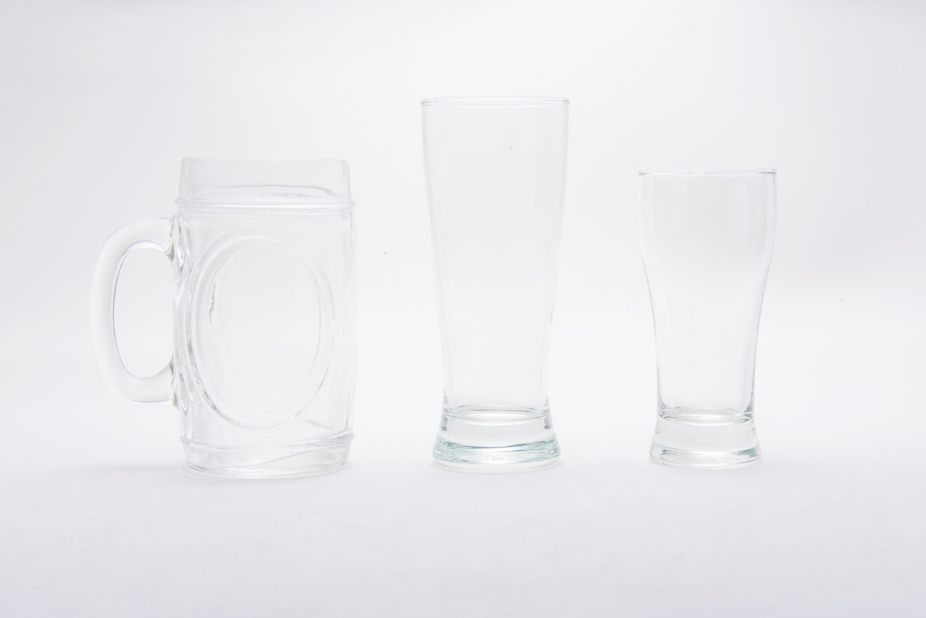
Improve contrast
Top rims should be seen from top

Slide 31
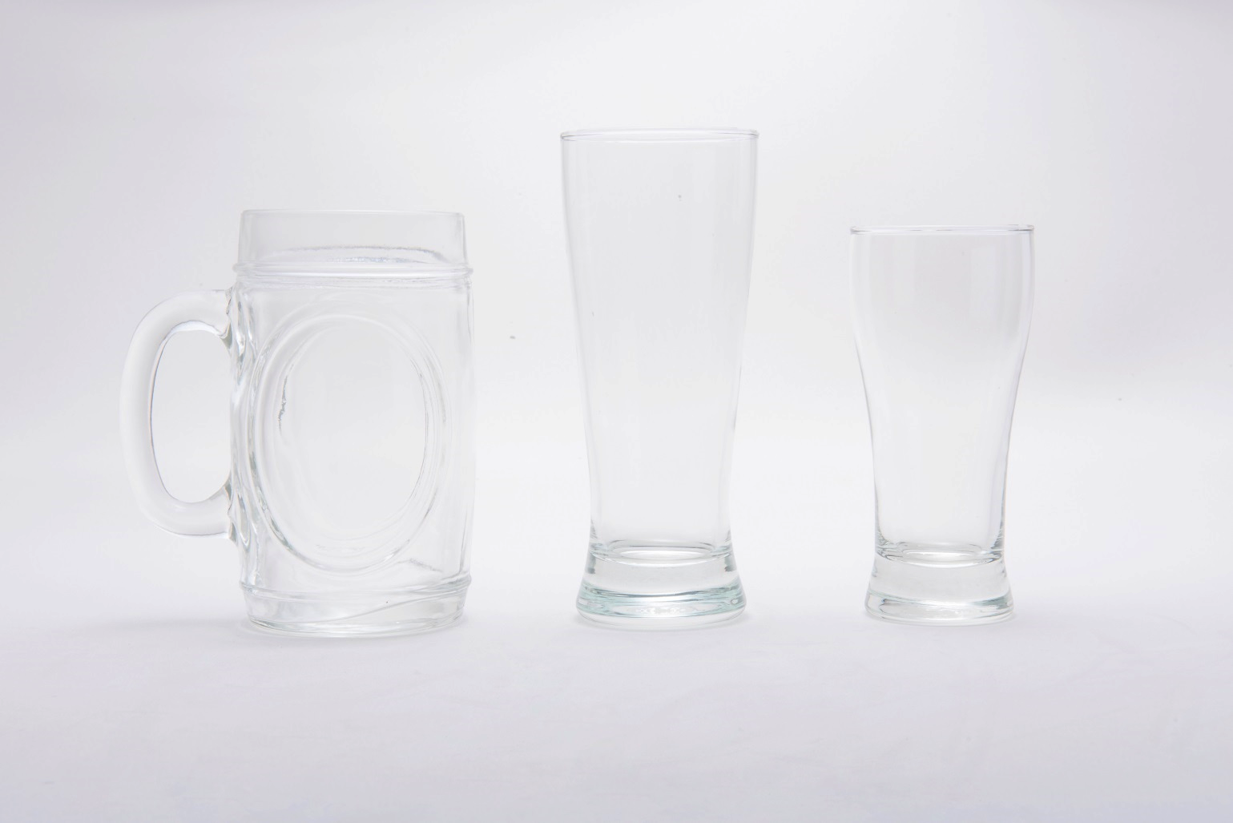
Better contrast… (see with Roland for “photoshoped” pictures)

Slide 32
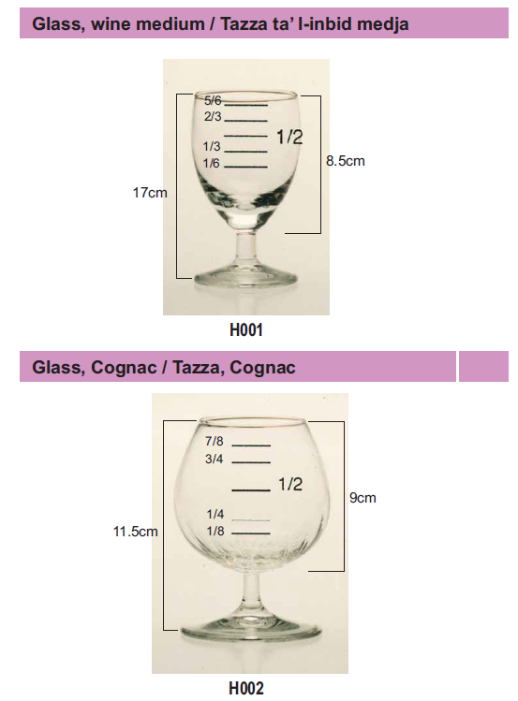
Use a common scale (reference coffee spoon)

Slide 33
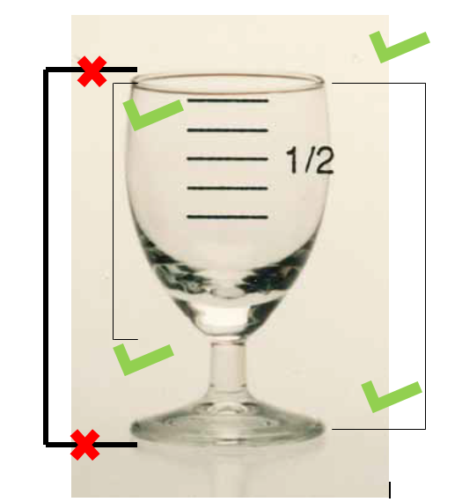
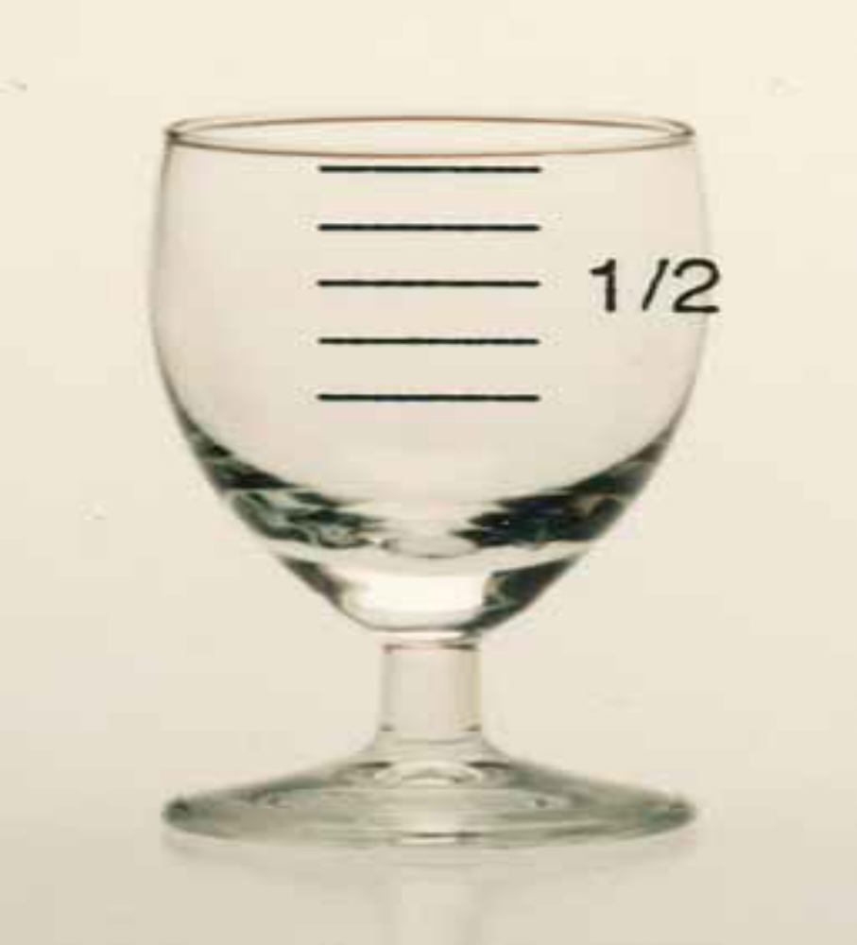
The line showing the dimension reaches the left or right edge of the measure, not the top or bottom.

Slide 34
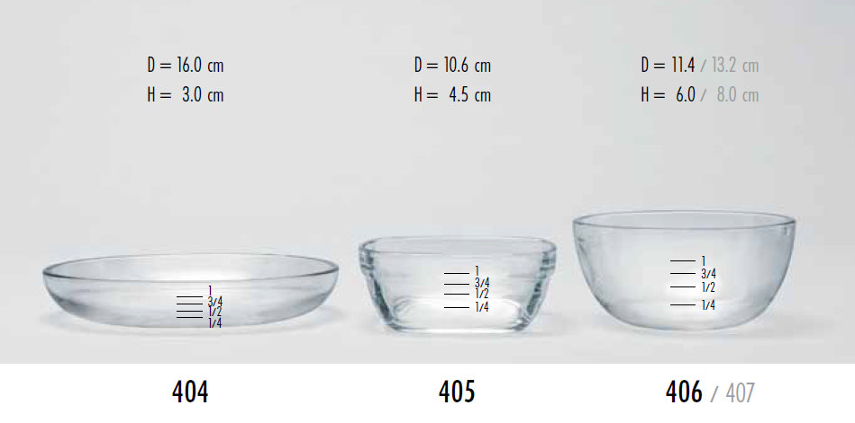
Picture used for several HHM with same look : list all dimensions and related codes

Slide 35
Shapes

Slide 36
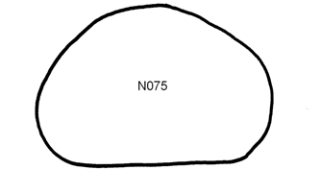
Shapes
Used to quantify
breads, rusks, cakes and similar food items with flat surface and not hollow
toppings (fats, jams, honey, cheese spread, liver pate…)
Volume = surface of the shape X reported thickness
Existing pictures from previous projects and studies (EPIC, INCA3, MenuCH…) in real size

Slide 37
Shapes series
Loaf bread shapes
  Round
  Flat (dense breads)
  Square (toast)
Moulded meat loaves/pates/cakes
Circles (e.g. pies/pizzas)
Irregular shapes (e.g. brioche)

Slide 38
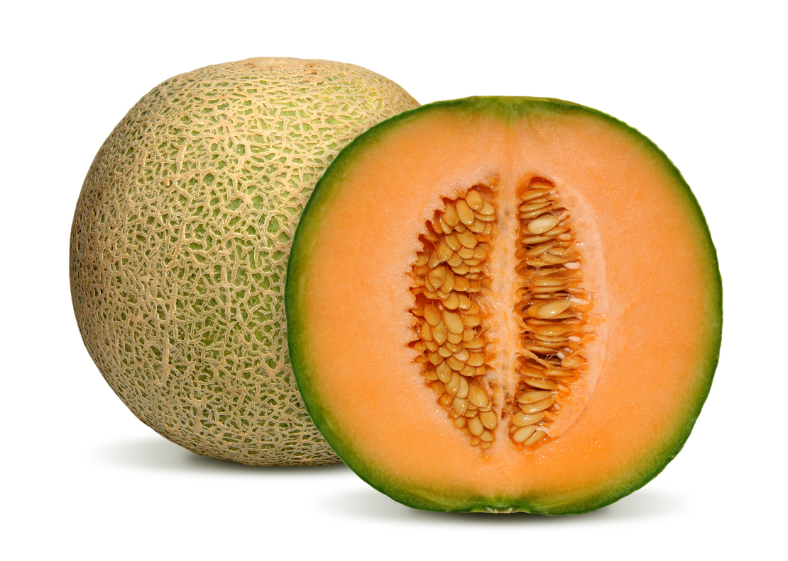
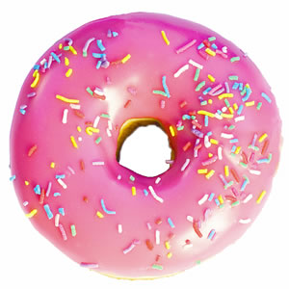
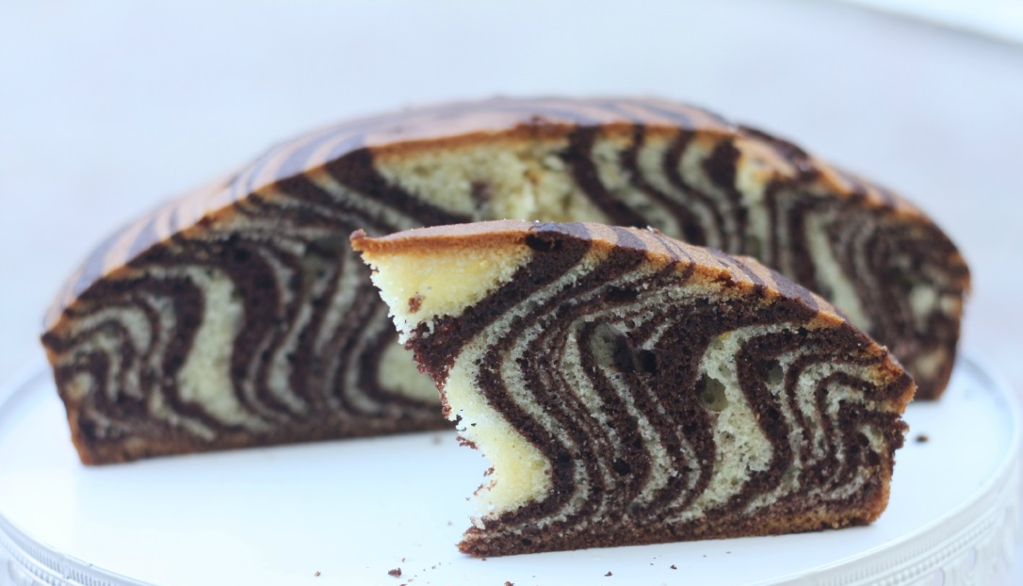
Cannot be used for
Hollow
Not flat

Slide 39
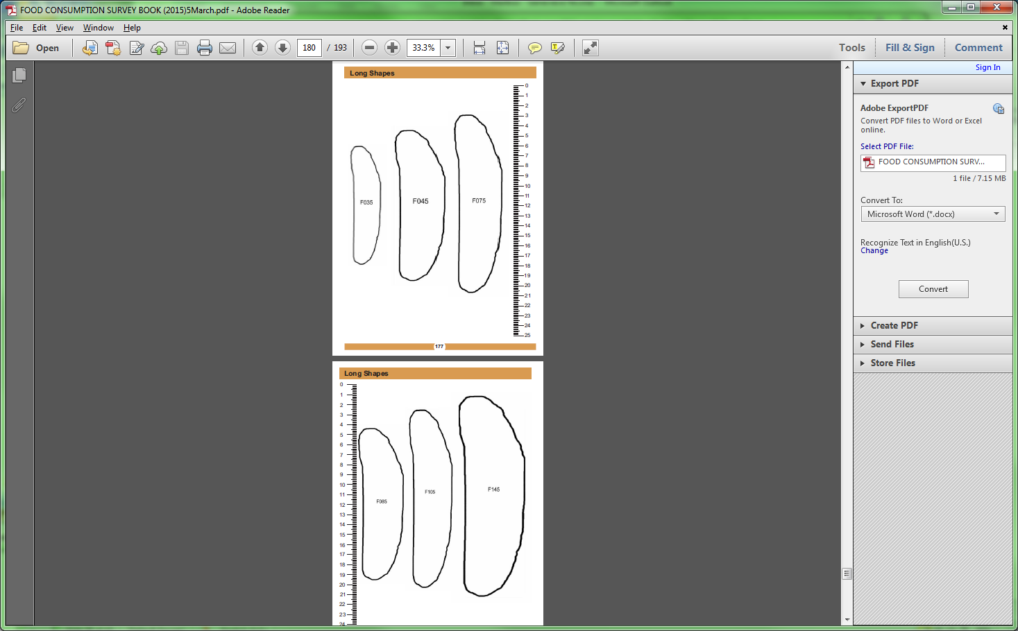
Wrong size (scale): the surface of F045 is bigger than that of F085 (it should be about half)

Slide 40
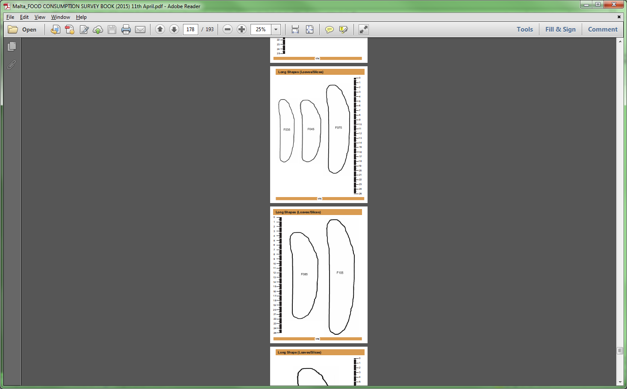

Slide 41
Overall picture book

Slide 42
Standard layout
Front page:
  Name of the project, logo of the institutes involved
Table of content referring to page numbers
Content
Acknowledgements
Back page
  IARC logo only if IARC checked and approved

Slide 43
Content
Photos and help photos series
  Grouped by topic or chronologically
  may include some comments on use
  Be in line with M_PHOTOS.xls
HHM
  Appear on the same scale, with dimensions
  Ruler easily accessible
  Homogeneity with regard to fraction “1” (at the rim or below the rim)
  Be in line with M_HHM.xls

Slide 44
Content (cont’d)
Shapes
  In real size
  Organised by topic, increasing sizes when possible
  Ruler easily accessible
  Be in line with M_SHAPES.xls
Serving plate – reference dishes
  In real size

Slide 45
Acknowledgements
List the sources/institutes
  (1) GloboDiet picture book… 1995
  (2) MenuCH… 2014…
Per section, list the codes and sources
  Part 1 – photos of foods and dishes
    Pictures 1 to 94 are from (1)
    Pictures 802 to 850 are from (2)
    …

Slide 46
Conclusion
Importance of
  Quantification methods
  Content of the picture booklet
Good selection
Standardised picture layout

