Slide 1


Instructions to prepare the simplified FCT
INTERNATIONAL AGENCY FOR RESEARCH ON CANCER LYON - FRANCE

Slide 2

Rationale
Technical details
Conclusion
GloboDiet training: food composition table
IARC, Lyon - France

Slide 3


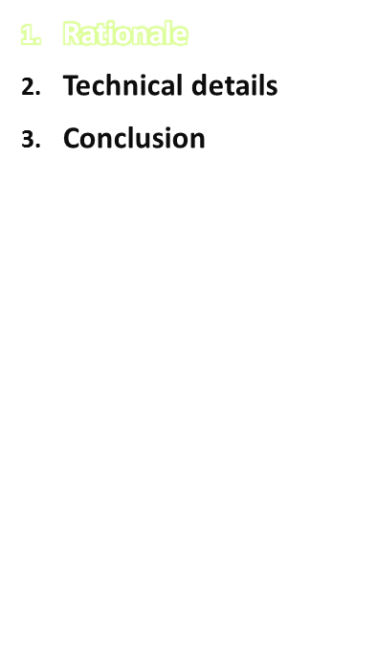
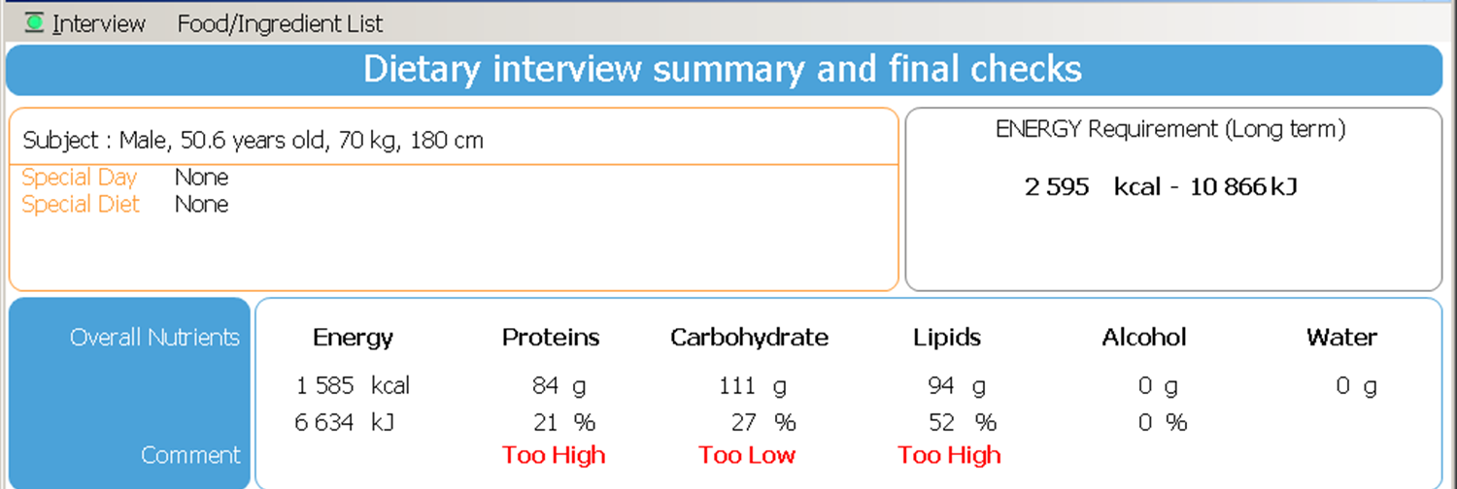
To perform a broad control at the macronutrient level:
- Long term energy requirement is calculated using the subject’s characteristics.
- Pre-set broad ranges of recommended macronutrients intakes (e.g. CHO 35-65% energy)
= Compare the actual intake reported in the 24-HD recall with requirement and ranges.
IARC, Lyon - France
GloboDiet training: food composition table

Slide 4
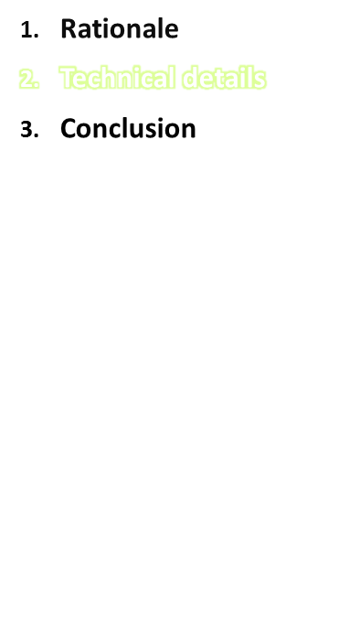
FDTABLE.end.
Prepared at IARC based on the food list
Work to be done: enter at least one set of the following variables per food
  Energy, expressed in kCal/100g
  Proteins, in g/100g
  Lipids, in g/100g
  Glucids: available carbohydrates (without dietary fibers), in g/100g
  Alcohol, in g/100g
Possibility to enter several sets per food using the facet-string (FADECODE)
..\..\Ireland\received-sent\FADECODE_IR_EN.docx
GloboDiet training: food composition table
IARC, Lyon - France

Slide 5
Basic rules
We need the nutrient values for foods as usually consumed (e.g. no ‘dried’ rice or legumes):
Rounded values (no decimals)
Enter a set of values at the heading level
  Calculate an average
  Calculate a weighted average …
    Will be used for new foods
E P L G A priority
03 01 LEGUMES 115 8 1 14 0 1
144 Beans, Flageolet 112 9 1 17 0 1
145 Beans, seeds, n.s. 115 8 1 14 0 1
146 Beans, Adzuki 112 9 1 17 0 1
147 Beans, black-eyed 119 8 0 17 0 1
GloboDiet training: food composition table
IARC, Lyon - France

Slide 6
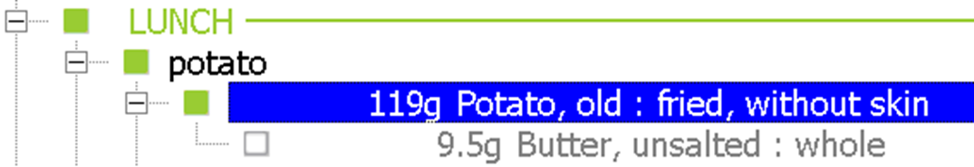
Basic rules
When eaten cooked, enter value sets for boiled or baked foods, i.e. without fat used for cooking.
In GloboDiet the food and its cooking fat(s) are separate items:
Nutrient values (NVs) for pre-fried and fried items present in national food composition tables should not be used as such
  Select nutrient values of a similar item boiled or baked
  If not possible, remove the cooking fat
  Qty of absorbed fat = PCTFAT x Qty of cooked item
  NVs food + NVs fat = NVs fried food so NVs food = NVs fried food - NVs fat
  in food comp. table
GloboDiet training: food composition table
IARC, Lyon - France

Slide 7
Calculations
  Qty of absorbed fat = PCTFAT x Qty of cooked item
  So approximately
  NVs food + NVs fat = NVs fried food so NVs food = NVs fried food - NVs fat
  Example: protein fat cho
  100g fried food 20 15 30
  Qty fat =10g (PCTFAT) 0 10 0
  90g food 20 5 30
  100g food 22 6 33
GloboDiet training: food composition table
IARC, Lyon - France

Slide 8
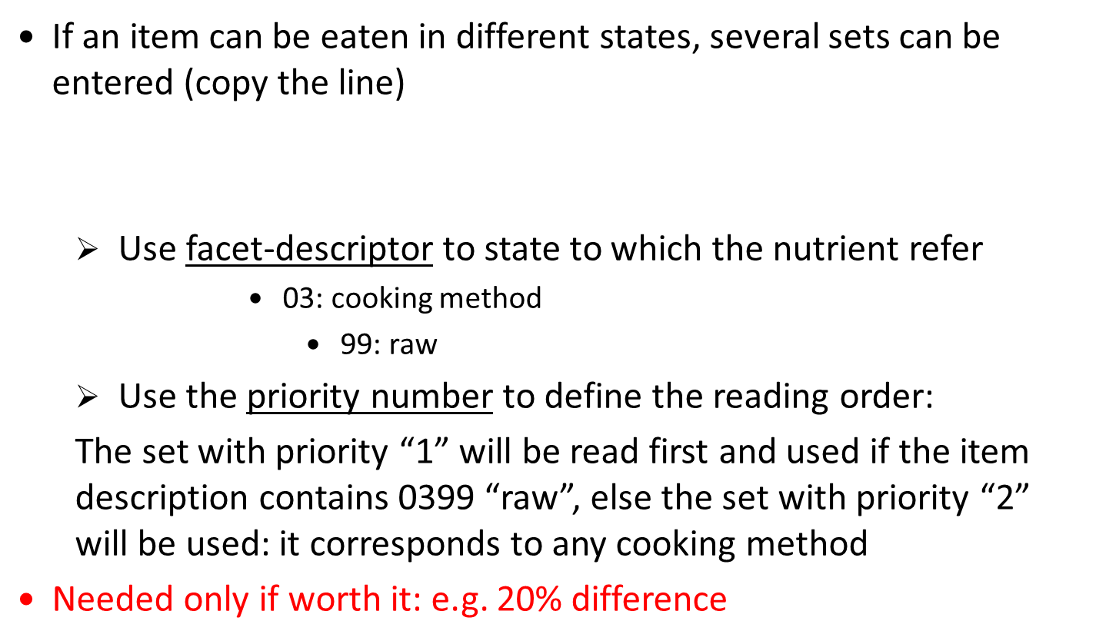
Basic rules
E P L G A priority
99 Cauliflower 21 2 0 2 0 1 0399
99 Cauliflower 28 3 0 2 0 2
GloboDiet training: food composition table
IARC, Lyon - France

Slide 9
Practice
Item “Yoghurt”
- What is the source of nutrient data? Does is comply with GloboDiet requirements? (kcal, g/100g edible food)?
McCance and Widdowson:
monosaccharides (glucose) in MSE → no conversion
disaccharides (sucrose) in MSE → /1.05
polysaccharides (starch) in MSE → /1.10
kcal = kJ/4.18
Present in the food composition table?
  Yes, several or one?
  No,
    Use similar item nutrient values
    Use the (sub)sub-group level nutrient values (basic average of the nutrient values)
GloboDiet training: food composition table
IARC, Lyon - France

Slide 10
Practice
Item “Yoghurt”
    Yogurt, whole milk, plain Yogurt, virtually fat free/diet, fruit
    Yogurt, whole milk, fruit Yogurt, virtually fat free/diet, plain
    Yogurt, low fat, plain
    Yogurt, low fat, fruit Whole milk yogurt, goats
How different are the nutrient and energy values?
What is captured by facets and descriptors?
  See in the FADEBYGROUP, section 0503 Yoghurt
    link
Facet 01 Source Facet 07 Sugar content
Facet 06 Flavoured/added component Facet 08 Fat content
Facet 10 Food production Facet 11 Enriched/fortified
Facet 12 Brand/product name
GloboDiet training: food composition table
IARC, Lyon - France

Slide 11
Practice
 | Energy [kcal] | Protein, total [g] | Fat, total [g] | Carbohydrates [g] | Alcohol [g]
Yogurt, whole milk, fruit | 469 kJ (112) | 4 | 3 | 17.1 | 0
Yogurt, whole milk, plain | 334 kJ (80) | 5.7 | 3 | 7.6 | 0
Whole milk yogurt, goats | 63 | 3.5 | 3.8 | 3.9 MSE | 0
Yogurt, low fat, plain | 239 kJ (57) | 4.8 | 1 | 7.2 | 0
Yogurt, low fat, fruit | 333 kJ (80) | 4.2 | 1.1 | 13.1 | 0
Yogurt, virtually fat free/diet, fruit | 202 kJ (48) | 4.8 | 0.2 | 6.7 | 0
Yogurt, virtually fat free/diet, plain | 232 kJ (55) | 5.4 | 0.2 | 7.9 | 0
Comparison of nutrient values (rule of 20% difference)
  Group some lines
  how will people report “low fat”?
08 01 whole
08 03 skimmed/no fat (<0.5%)
08 02 semi-skimmed/low fat (1.5-1.8%)
08 05 fat reduced/partially skimmed n.s.
  Analyse the difference between cow and goat whole milk → keep both as more than 20 % difference in energy
GloboDiet training: food composition table
IARC, Lyon - France

Slide 12
Practice
Assign facet strings
  See in the FADEBYGROUP, section 0503 Yoghurt
Facet 01 Source “0103 goat” vs. other (cow)
Facet 06 Flavoured/added component “0699 plain” vs. other (all flavours)
Facet 08 Fat content “0801 whole”
“0805-0802 low fat”
“0803 skimmed/no fat”
“0801 whole” vs. “0803 skimmed/no fat” vs. other (low fat)
 | Energy [kcal] | Protein, total [g] | Fat, total [g] | Carbohydrates [g] | Alcohol [g]
Yogurt, whole milk, fruit | 469 kJ (112) | 4 | 3 | 17.1 | 0
Yogurt, whole milk, plain | 334 kJ (80) | 5.7 | 3 | 7.6 | 0
Whole milk yogurt, goats | 63 | 3.5 | 3.8 | 3.9 MSE | 0
Yogurt, low fat, plain | 239 kJ (57) | 4.8 | 1 | 7.2 | 0
Yogurt, low fat, fruit | 333 kJ (80) | 4.2 | 1.1 | 13.1 | 0
Yogurt, virtually fat free/diet, fruit | 202 kJ (48) | 4.8 | 0.2 | 6.7 | 0
Yogurt, virtually fat free/diet, plain | 232 kJ (55) | 5.4 | 0.2 | 7.9 | 0
0801 0605
0801 0699
0103 0801
0805/02 0699
0805/02
0803 0605
0803 0699
GloboDiet training: food composition table
IARC, Lyon - France

Slide 13
Practice
 | Energy [kcal] | Protein, total [g] | Fat, total [g] | Carbohydrates [g] | Alcohol [g]
Yogurt, whole milk, fruit | 469 kJ (112) | 4 | 3 | 17.1 | 0
Yogurt, whole milk, plain | 334 kJ (80) | 5.7 | 3 | 7.6 | 0
Whole milk yogurt, goats | 63 | 3.5 | 3.8 | 3.9 MSE | 0
Yogurt, low fat, plain | 239 kJ (57) | 4.8 | 1 | 7.2 | 0
Yogurt, low fat, fruit | 333 kJ (80) | 4.2 | 1.1 | 13.1 | 0
Yogurt, virtually fat free/diet, fruit | 202 kJ (48) | 4.8 | 0.2 | 6.7 | 0
Yogurt, virtually fat free/diet, plain | 232 kJ (55) | 5.4 | 0.2 | 7.9 | 0
whole
Assign priorities
 | Energy [kcal] | Protein [g] | Fat [g] | CHO [g] | Alcohol [g]
Whole milk yogurt, goats | 63 | 3.5 | 3.8 | 3.9 MSE | 0
Yogurt, whole milk, plain | 334 kJ (80) | 5.7 | 3 | 7.6 | 0
Yogurt, whole milk, fruit | 469 kJ (112) | 4 | 3 | 17.1 | 0
Yogurt, virtually fat free/diet | 202 kJ (48) | 4.8 | 0.2 | 6.7 | 0
Yogurt, low fat, plain | 239 kJ (57) | 4.8 | 1 | 7.2 | 0
Yogurt, low fat, fruit | 333 kJ (80) | 4.2 | 1.1 | 13.1 | 0
0103 1
0801 0699 2
0801 3
0803 4
0699 5
6
GloboDiet training: food composition table
IARC, Lyon - France

Slide 14
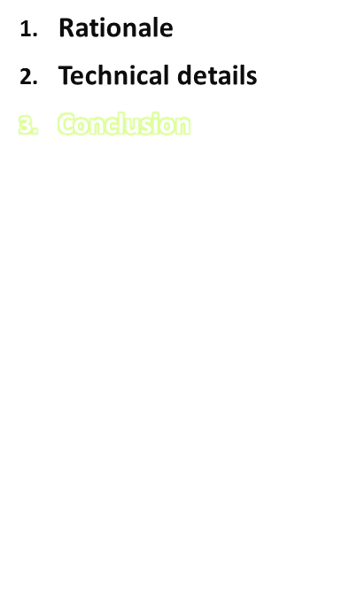
The goal is to have nutrient values for all food items.
Do not hesitate to use
Average values or values from a similar item
Only one set if the difference between two states is below 20% difference
→ Refer to the FDTABLE-guidelines
GloboDiet training: food composition table
IARC, Lyon - France

